Slide 1
From discipline to behaviour management in the early years
DR. SWATI POPAT VATS
GLOBAL EDUCATOR

Slide 2

Behaviour has a cause. When you can get to the root of what is driving the behaviour, you can then begin to teach a child a better way.

Slide 3
All Children have basic emotional needs: to feel loved, secure, wanted and valued.
The purpose of discipline is to ensure the safety of all children and to encourage respect for others and for property.
Insisting on good behaviour shows that you care.

Slide 4
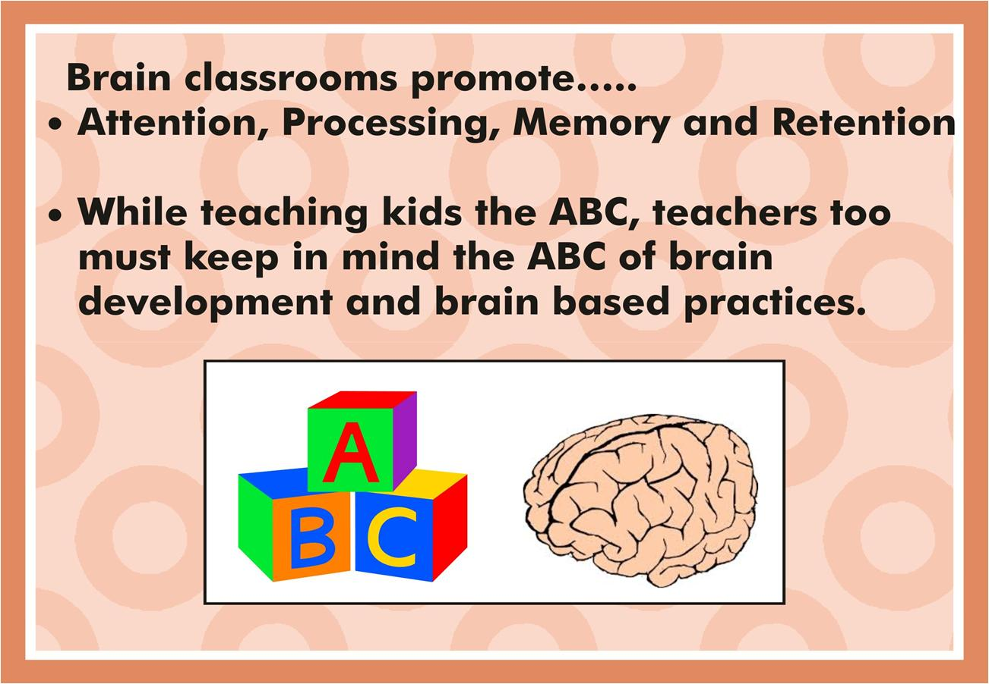

Slide 5


Slide 6
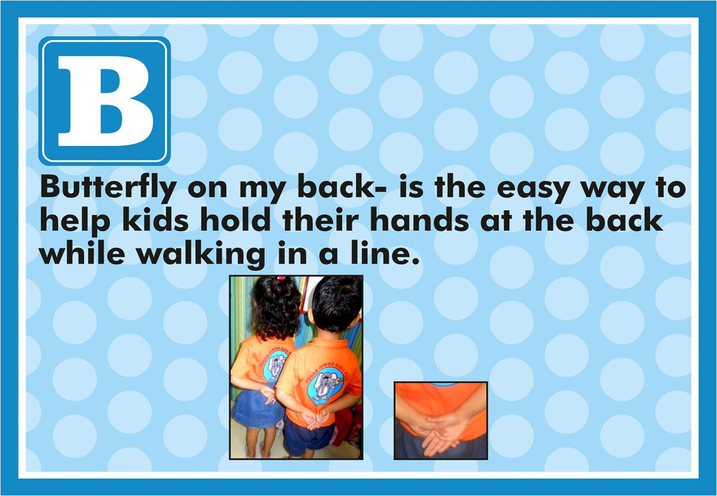

Slide 7


Slide 8
Coping Tips
Count to 10.
Ask someone for a hug.
Take a deep breath (or several).
Assess the situation: how much does this really matter? Will this matter tomorrow or next year?
Use family members as allies with challenging children.
When you feel overly stressed, get help.
Try to see the humor in it all. Someday you may write a best seller about all that you have experienced!

Slide 9


Slide 10
Don’t Say
“Stop hitting!”
“Don’t stand up during circle time.”
“Don’t throw the books!”
“How many times d I have to ask you to clean up?”
“Don’t colour on the table!”
“Don’t yell!”
“Don’t run!”
“Don’t take this toy!”
“Don’t you remember how to line up?”
“Don’t touch.”
“Don’t talk to me that way!”
“You are not playing nicely together.”

Slide 11
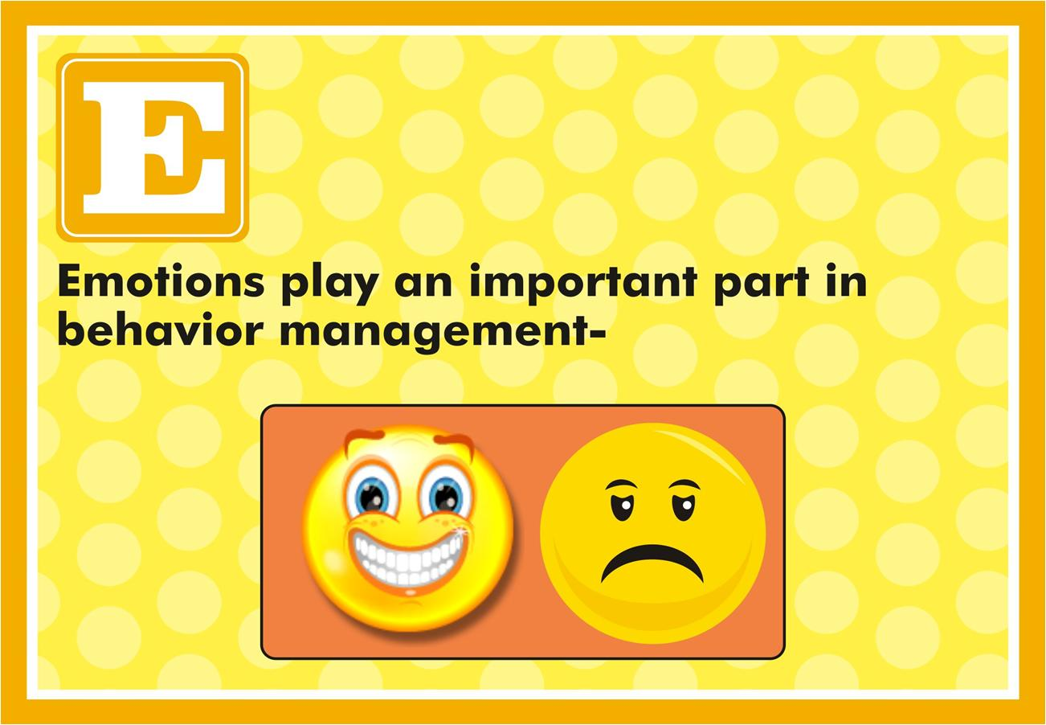

Slide 12
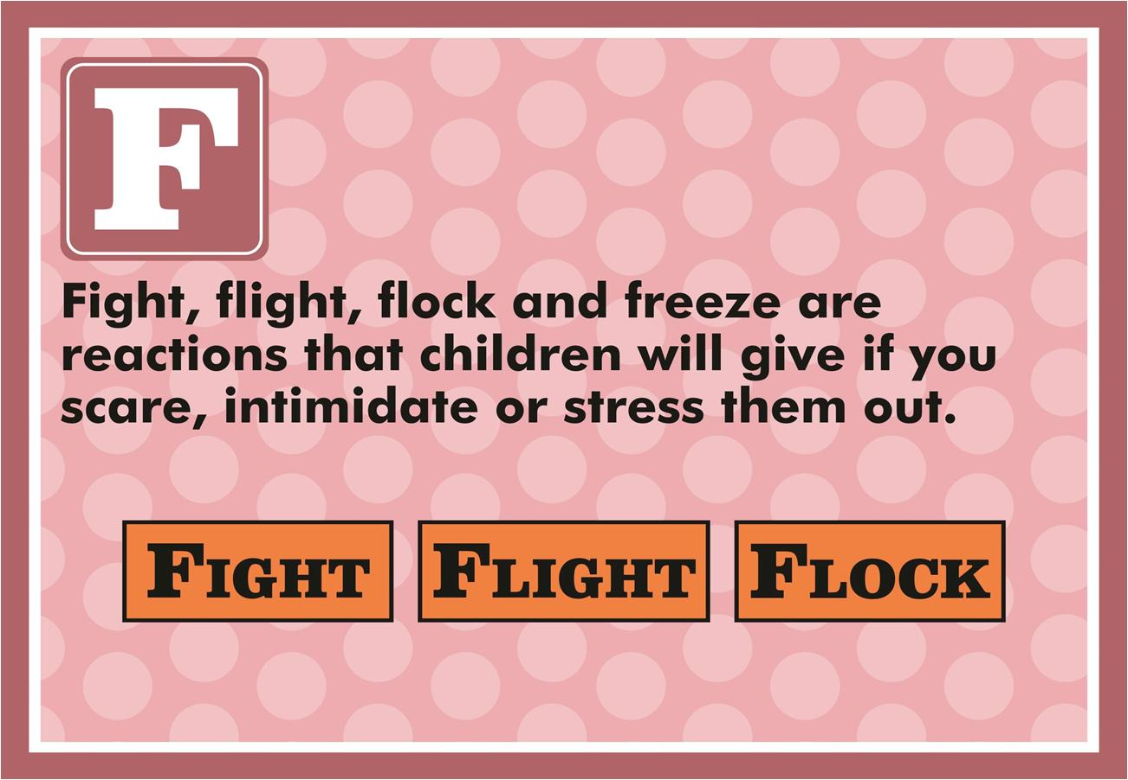

Slide 13
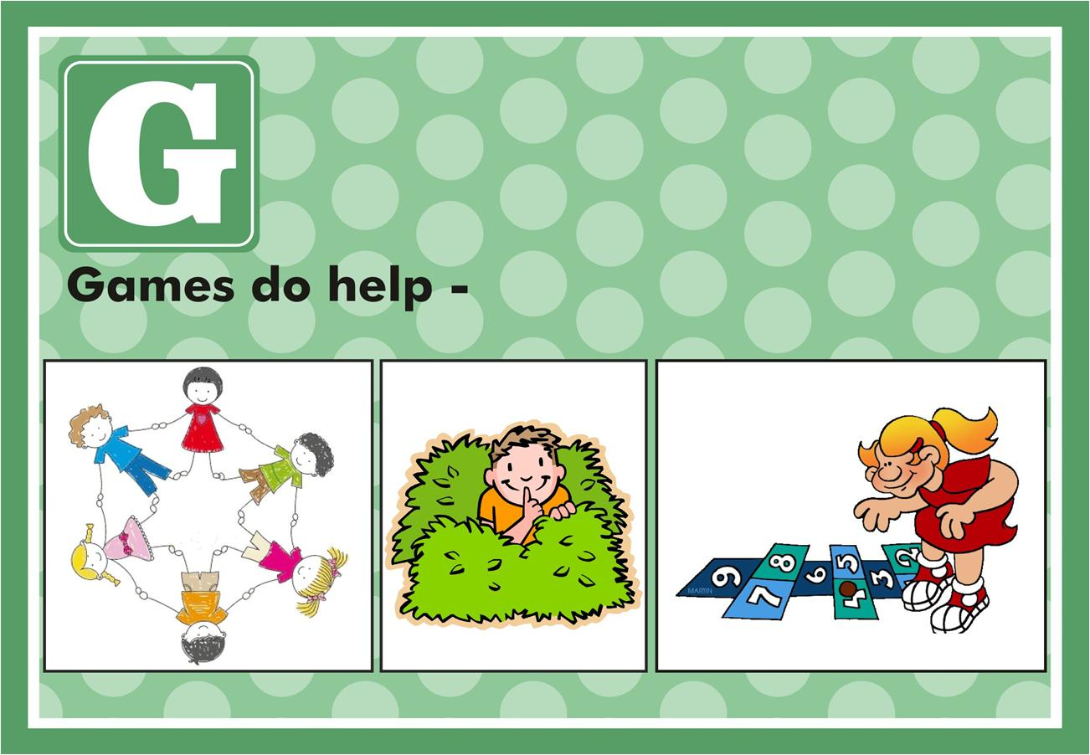

Slide 14
GAMES THAT DEVELOP IMPULSE CONTROL
Traditional games:
Red Light, Green Light
Simon Says
Freeze Tag
Ready, Set, Go! (child must wait for “Go!”)

Slide 15

PLAY GAMES FOR FOCUS- INDIVIDUAL

Slide 16
PLAY GAMES FOR FOCUS- GROUP

Slide 17
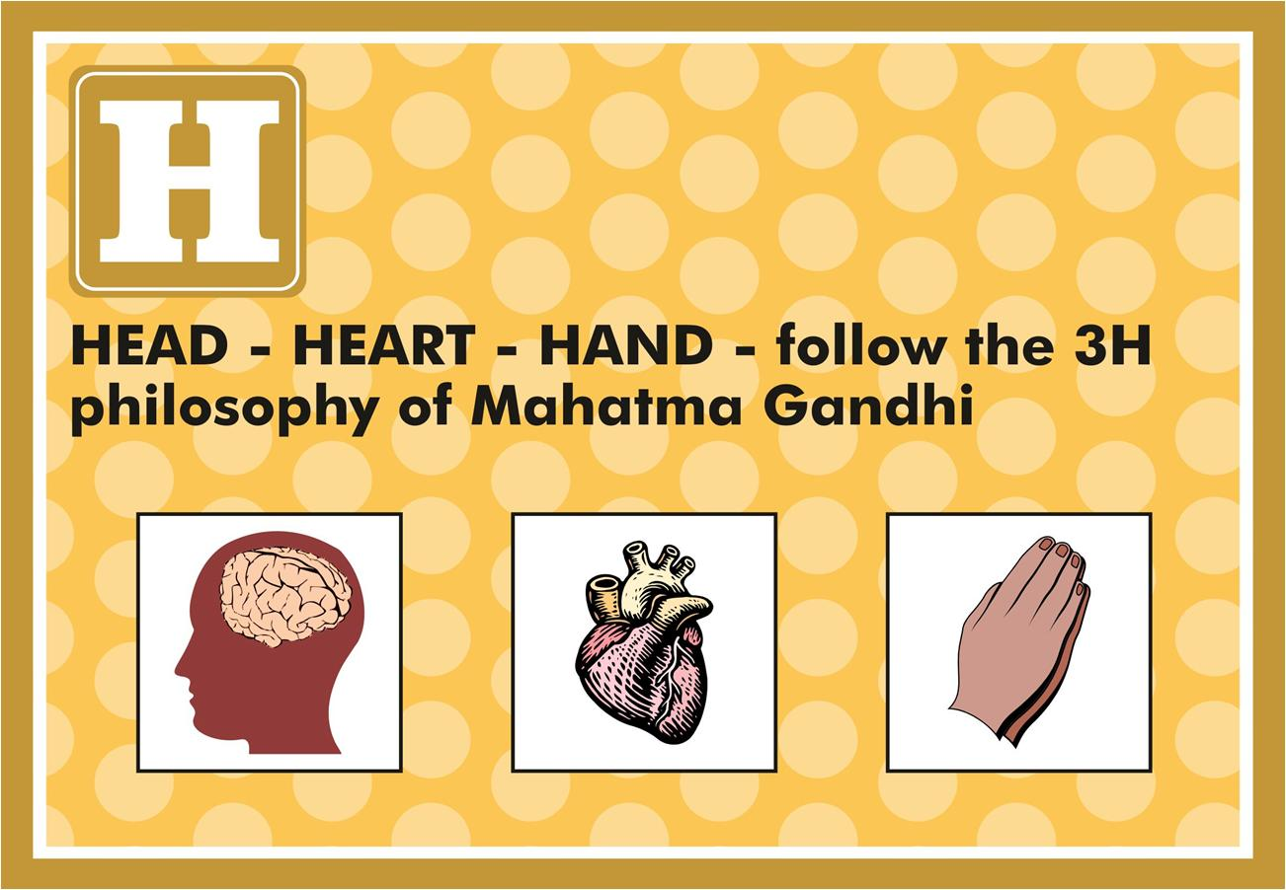

Slide 18
MOVEMENT- THINKING AND CARING

Slide 19
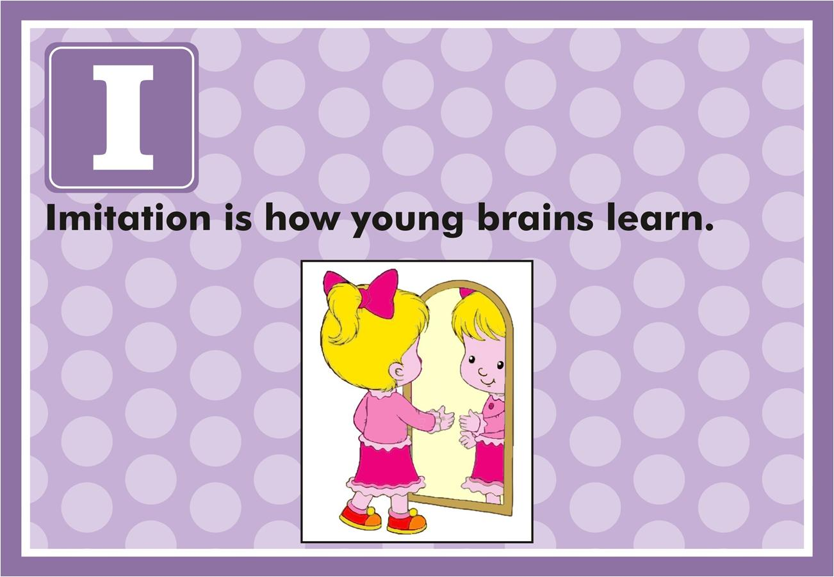

Slide 20
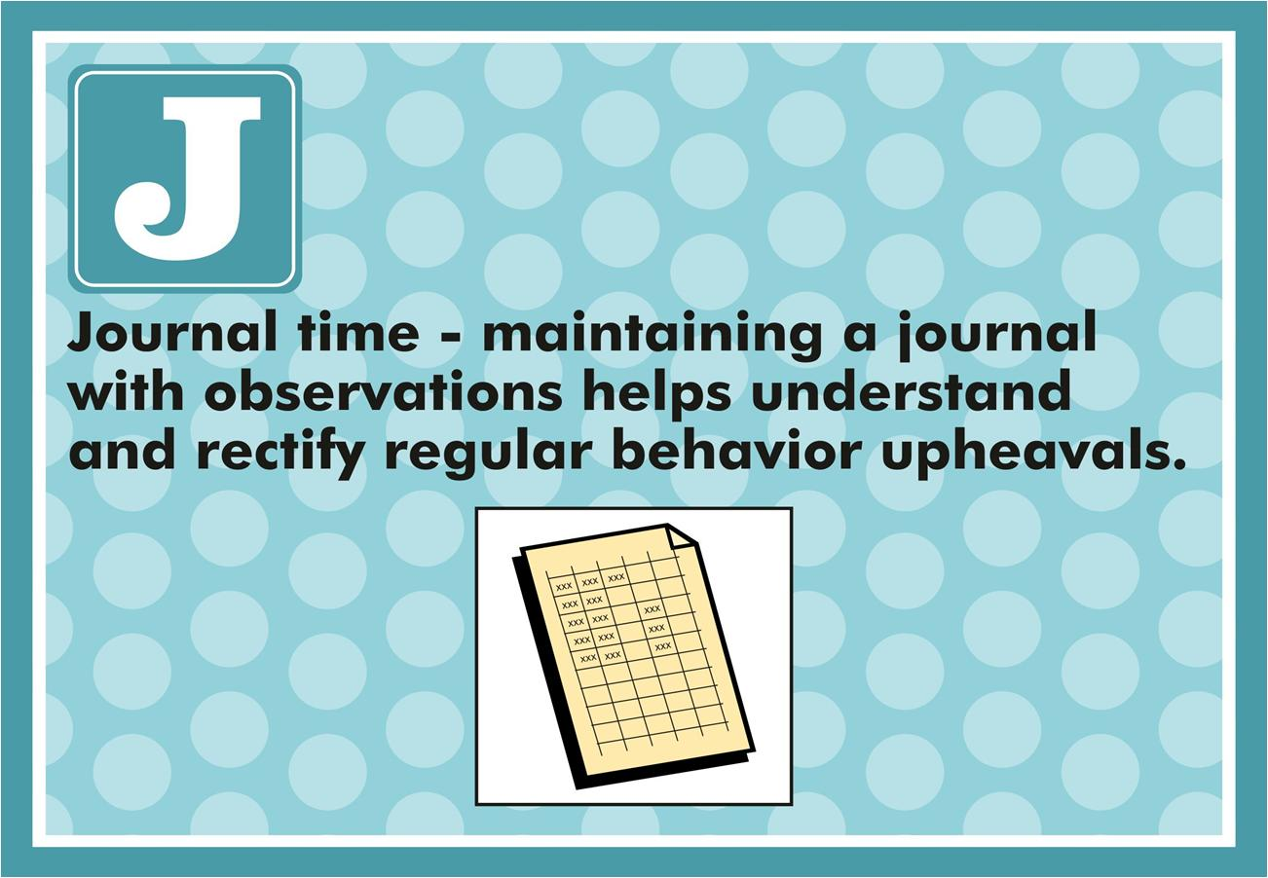

Slide 21
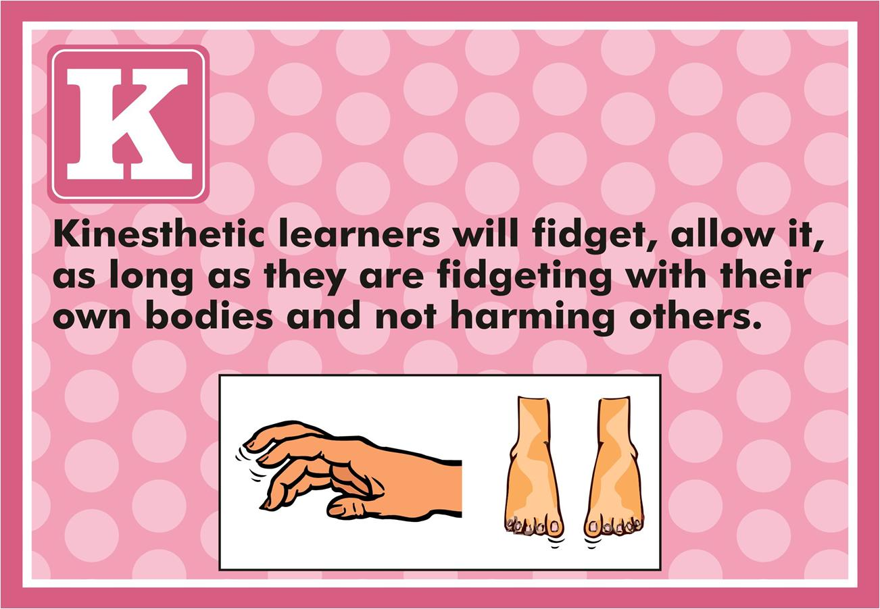

Slide 22
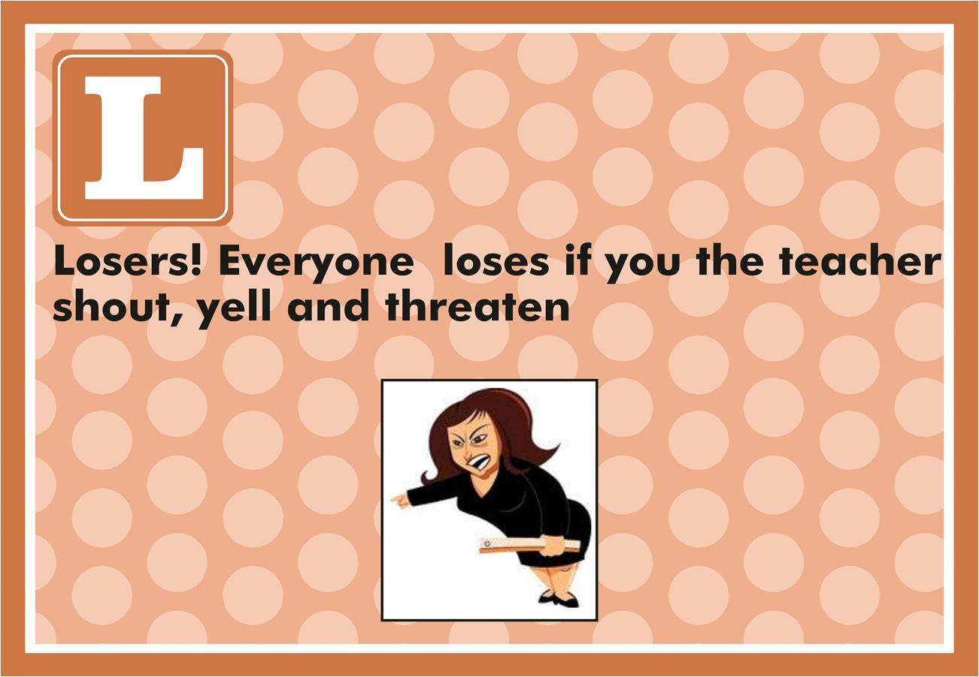

Slide 23
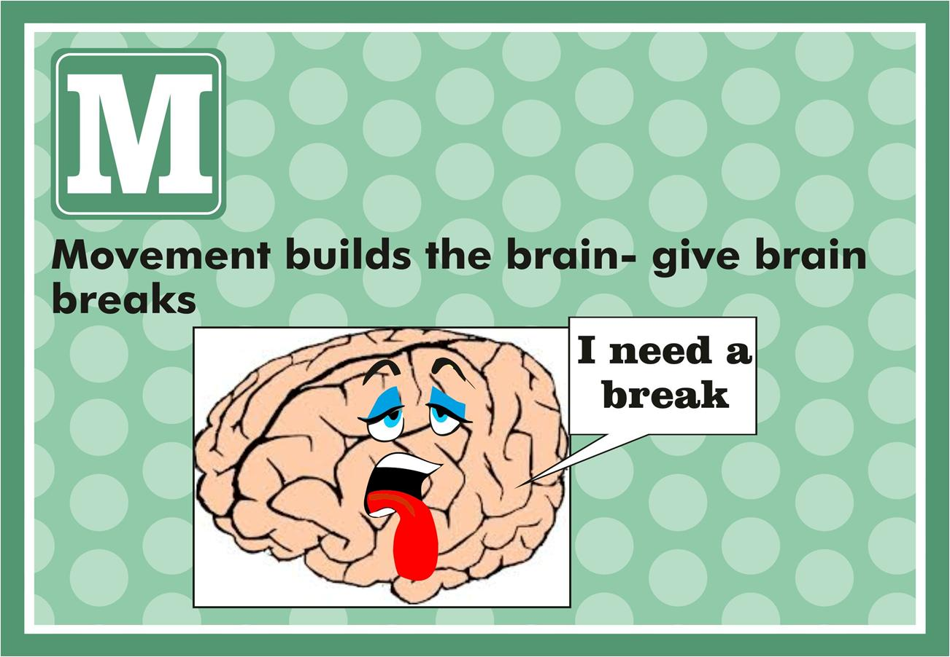

Slide 24
BRAIN BREAKS OR TRANSITIONS

Slide 25
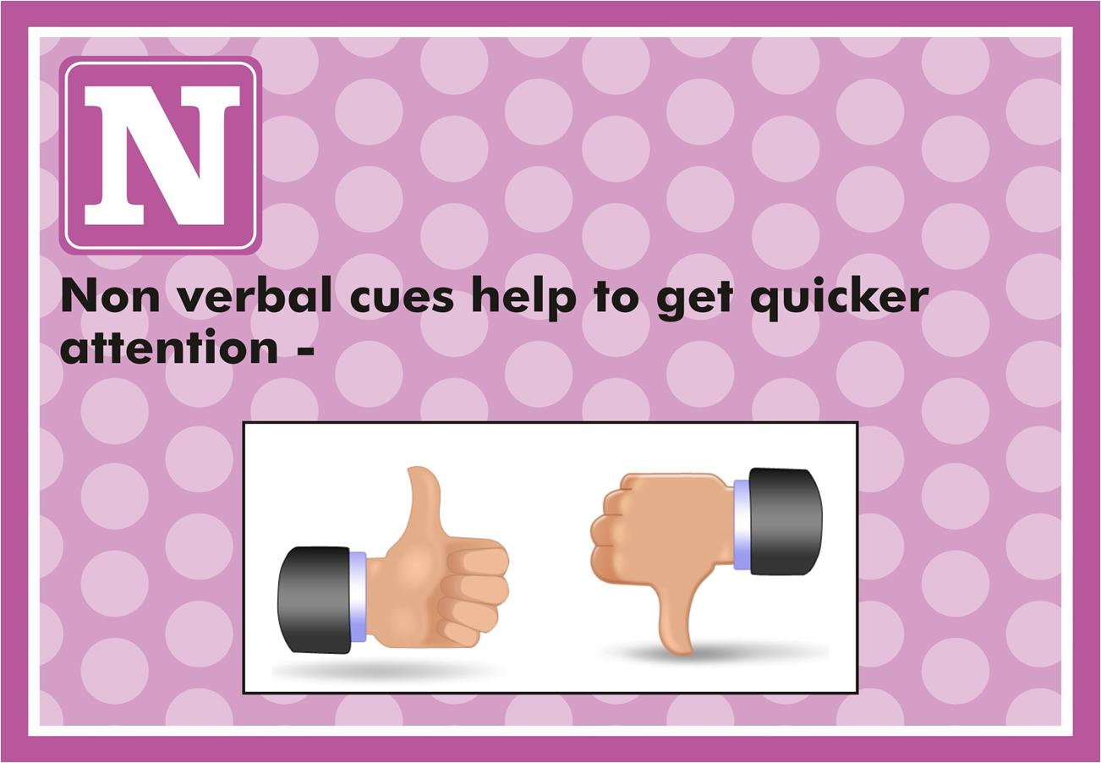

Slide 26
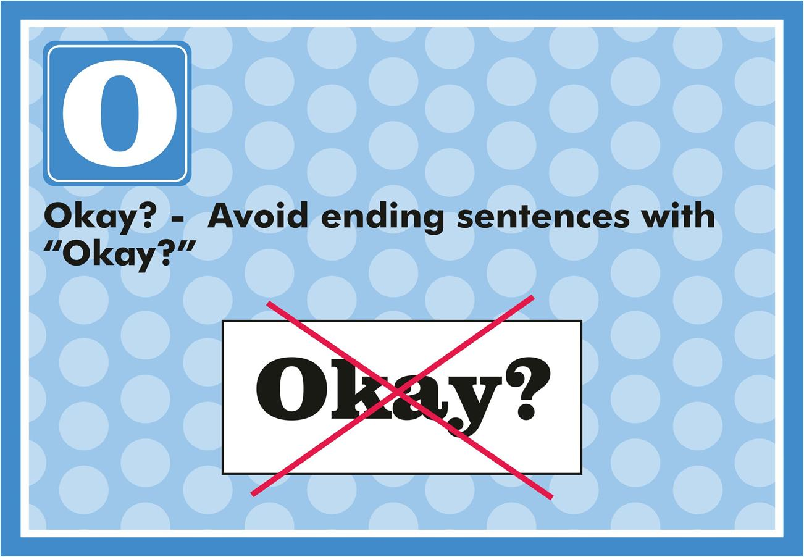

Slide 27
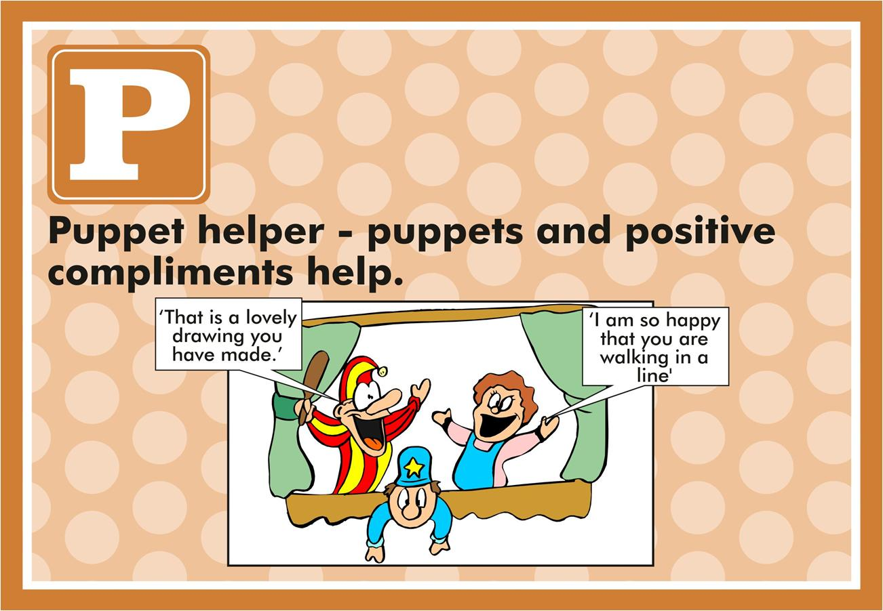

Slide 28
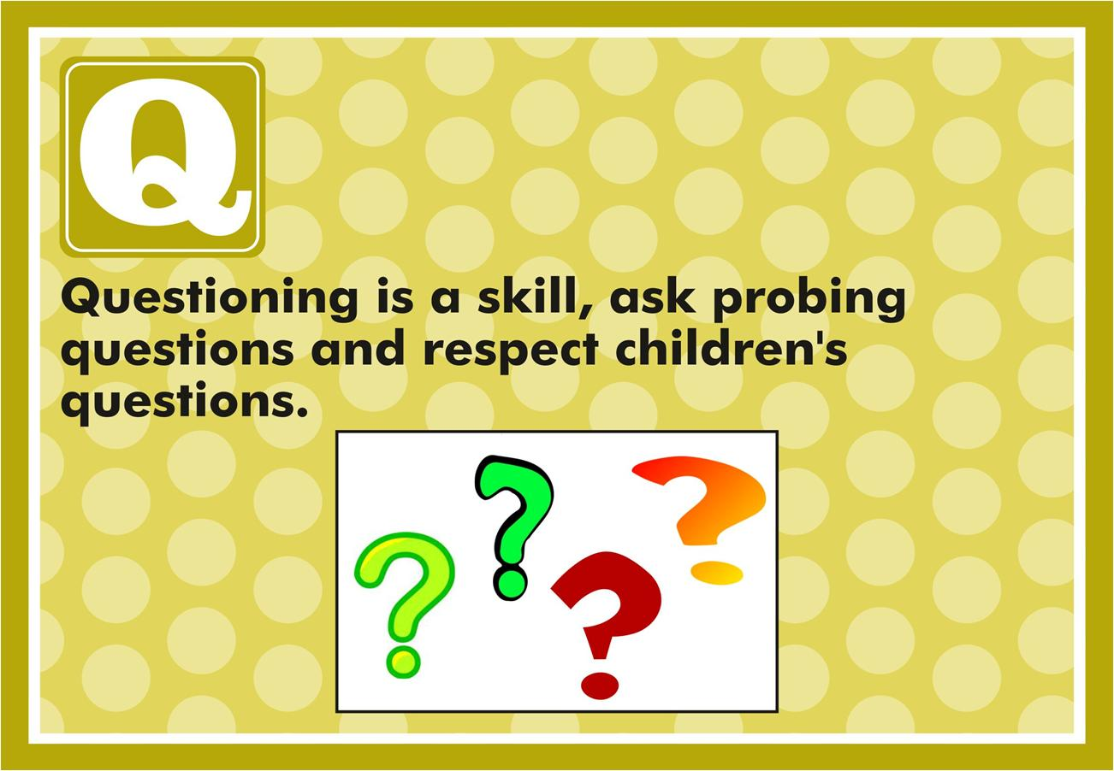

Slide 29
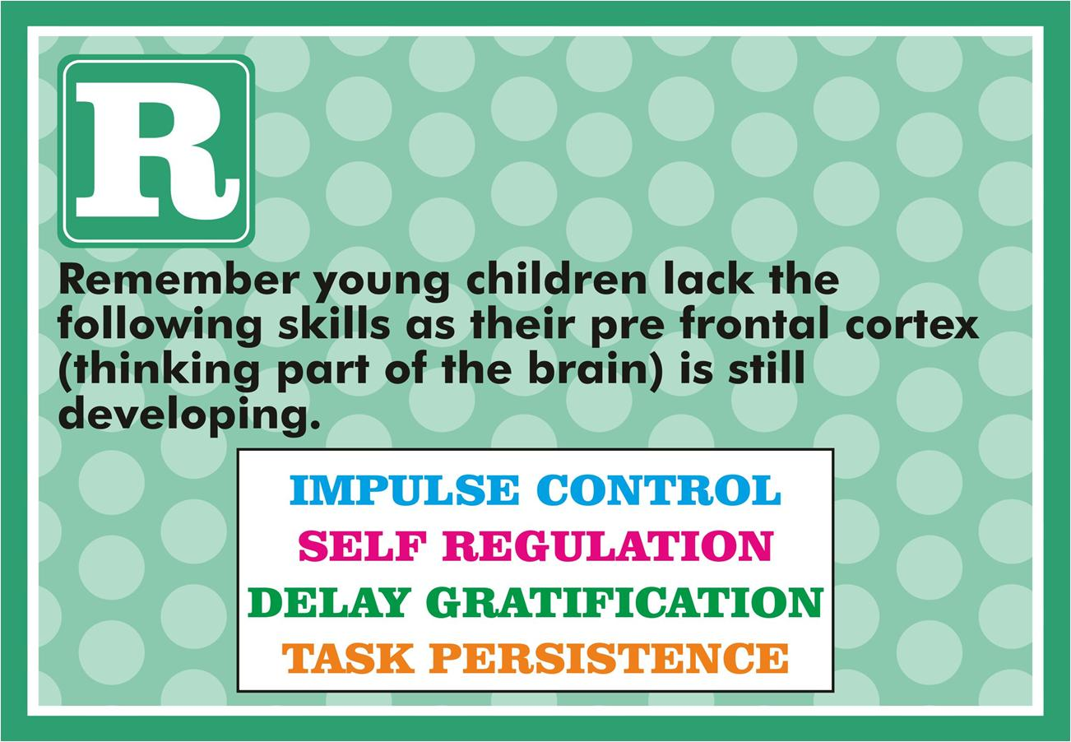

Slide 30
GIVE THEM TASKS THAT INTEREST

Slide 31


Slide 32
This Is How We Learn to Share
(Sing to tune of “Mary had a Little Lamb”)
This is how we learn to share,
Learn to share, learn to share.
This is how we learn to share
Every day at school.
We can share by taking turns,
Taking turns, taking turns.
We can share by taking turns
Every day at school.
We can share our favourite books
Favourite books, favourite books.
We can share our favourite books
Every day at school.
Add more verses with these ideas
Or let children create their own;
We can share our lunch or snack,
We can share our teacher’s time’
We can share our crayons or glue.
We will share with our friends,
With our friends, with our friends.
We will share with our friends
Every day at school.

Slide 33
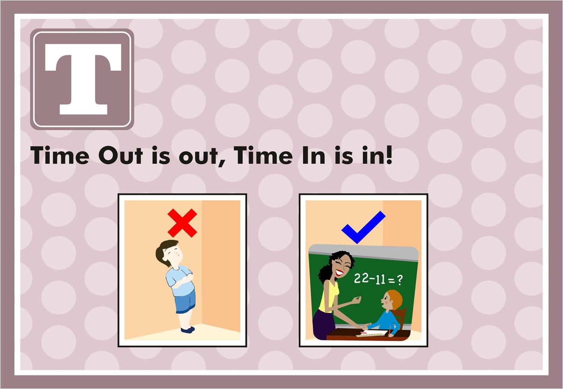

Slide 34
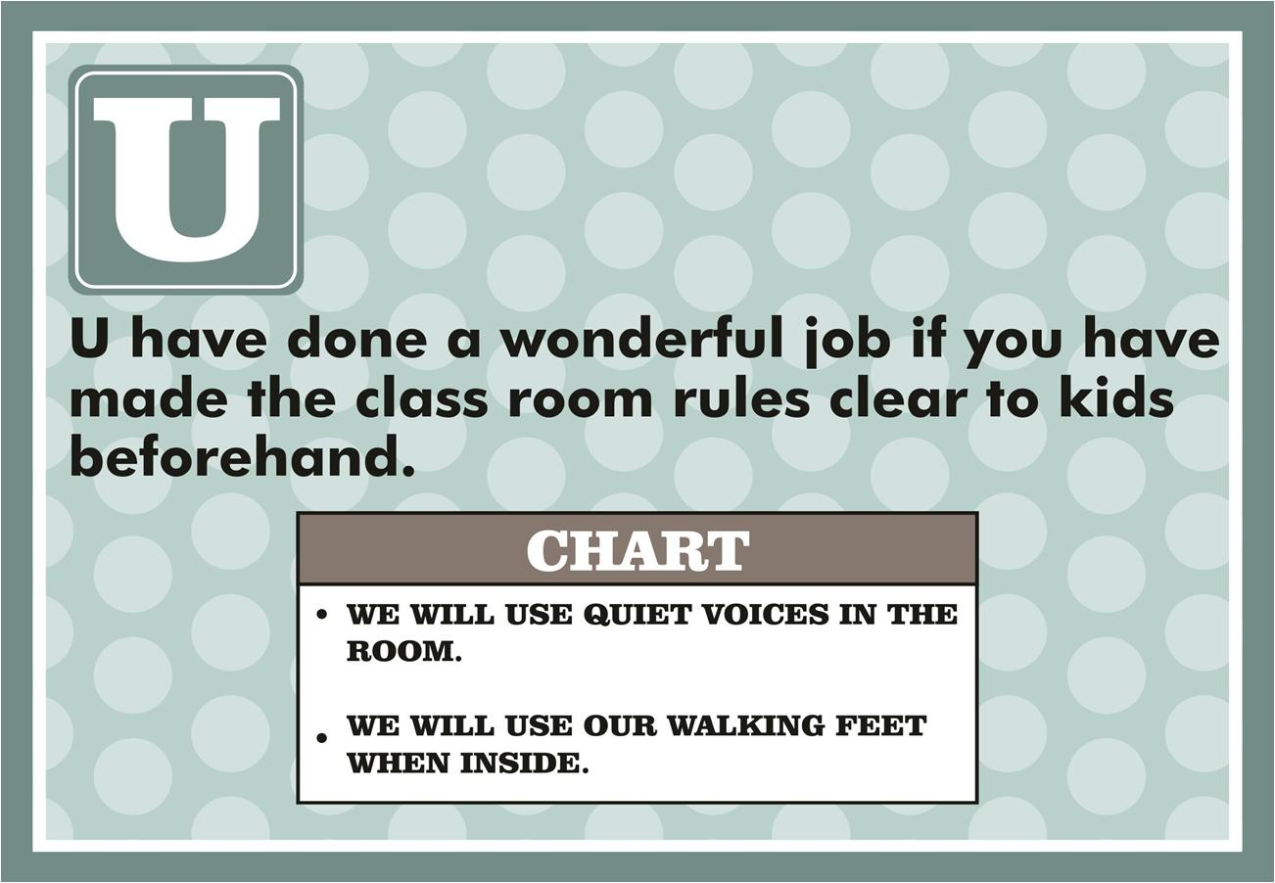

Slide 35
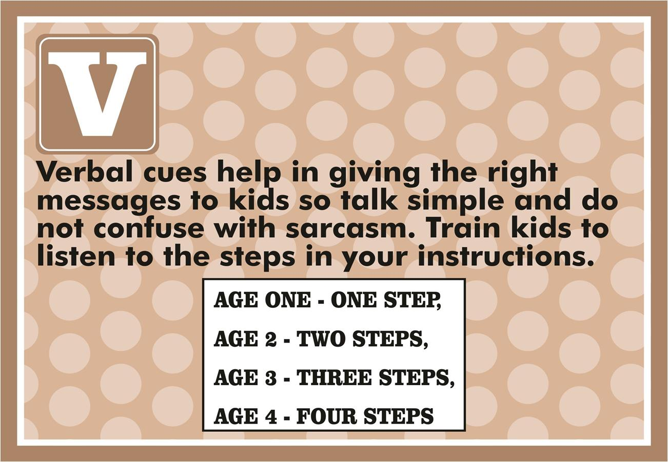

Slide 36
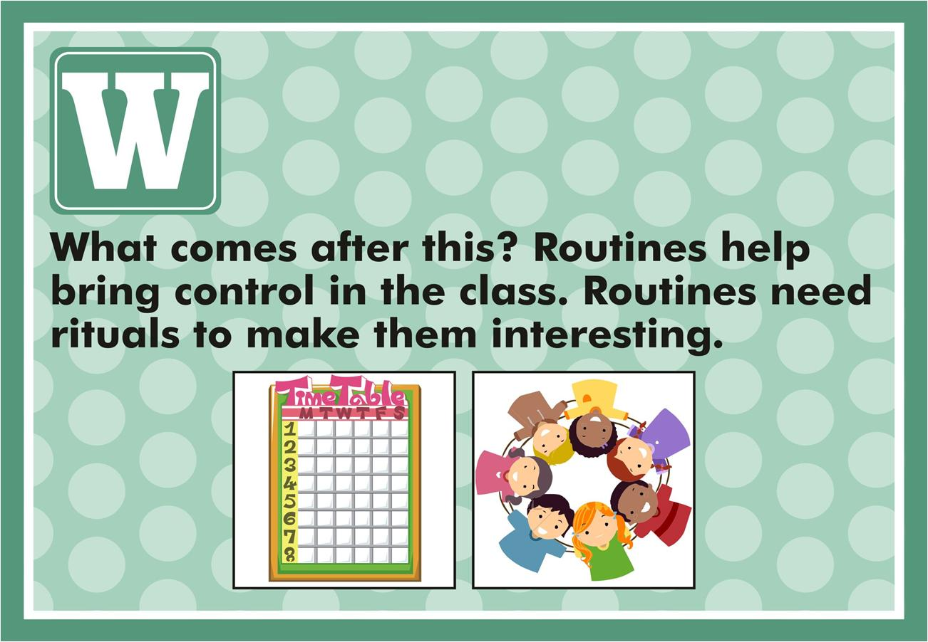

Slide 37
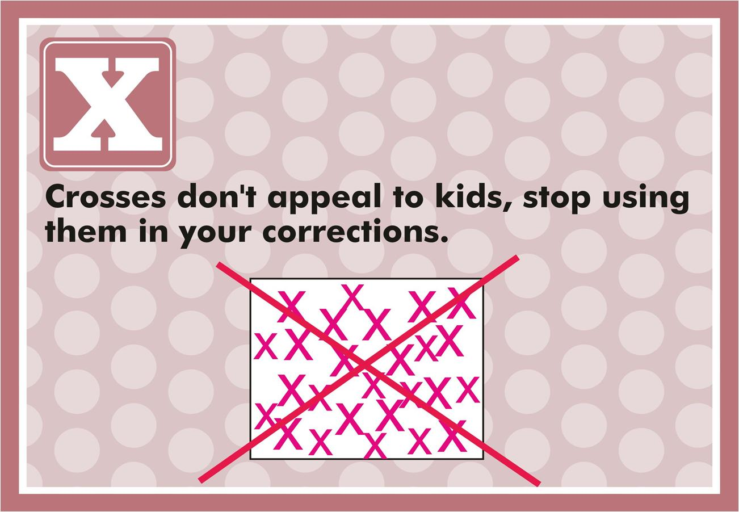

Slide 38
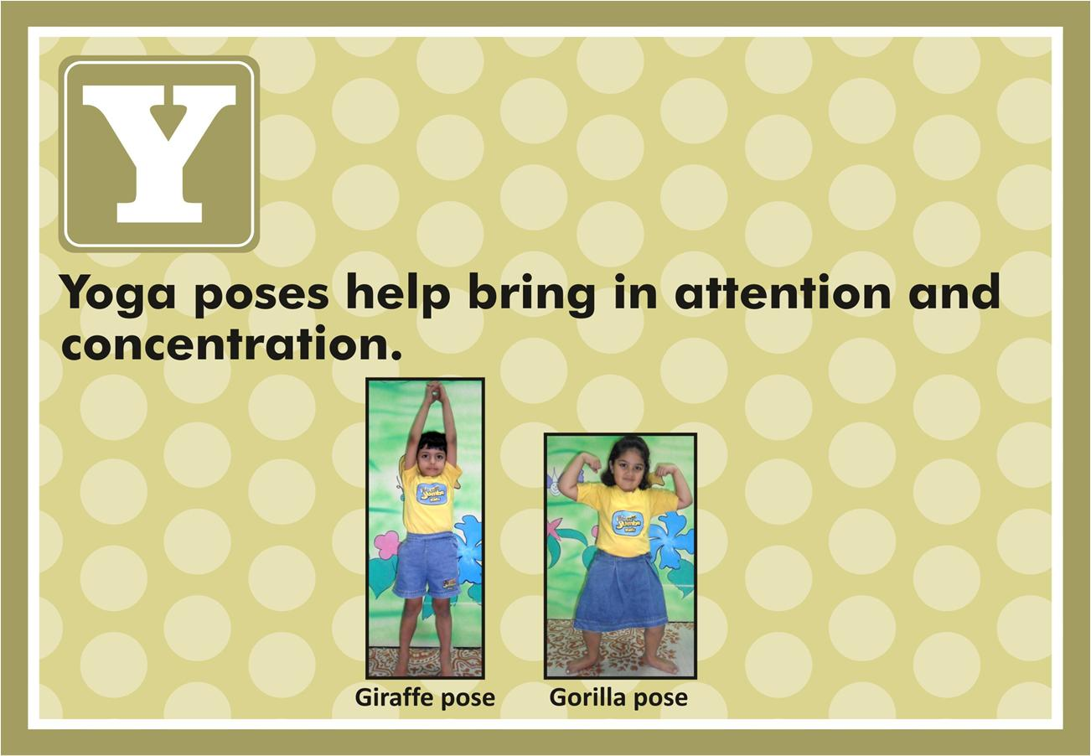

Slide 39
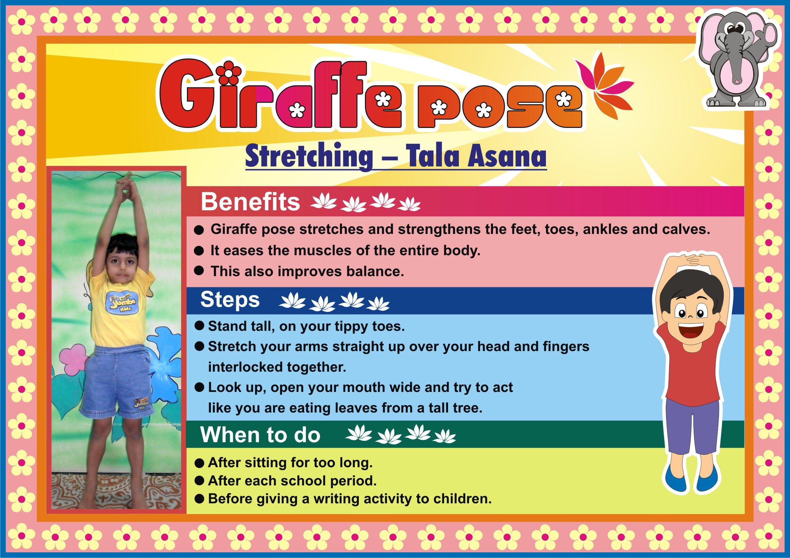

Slide 40
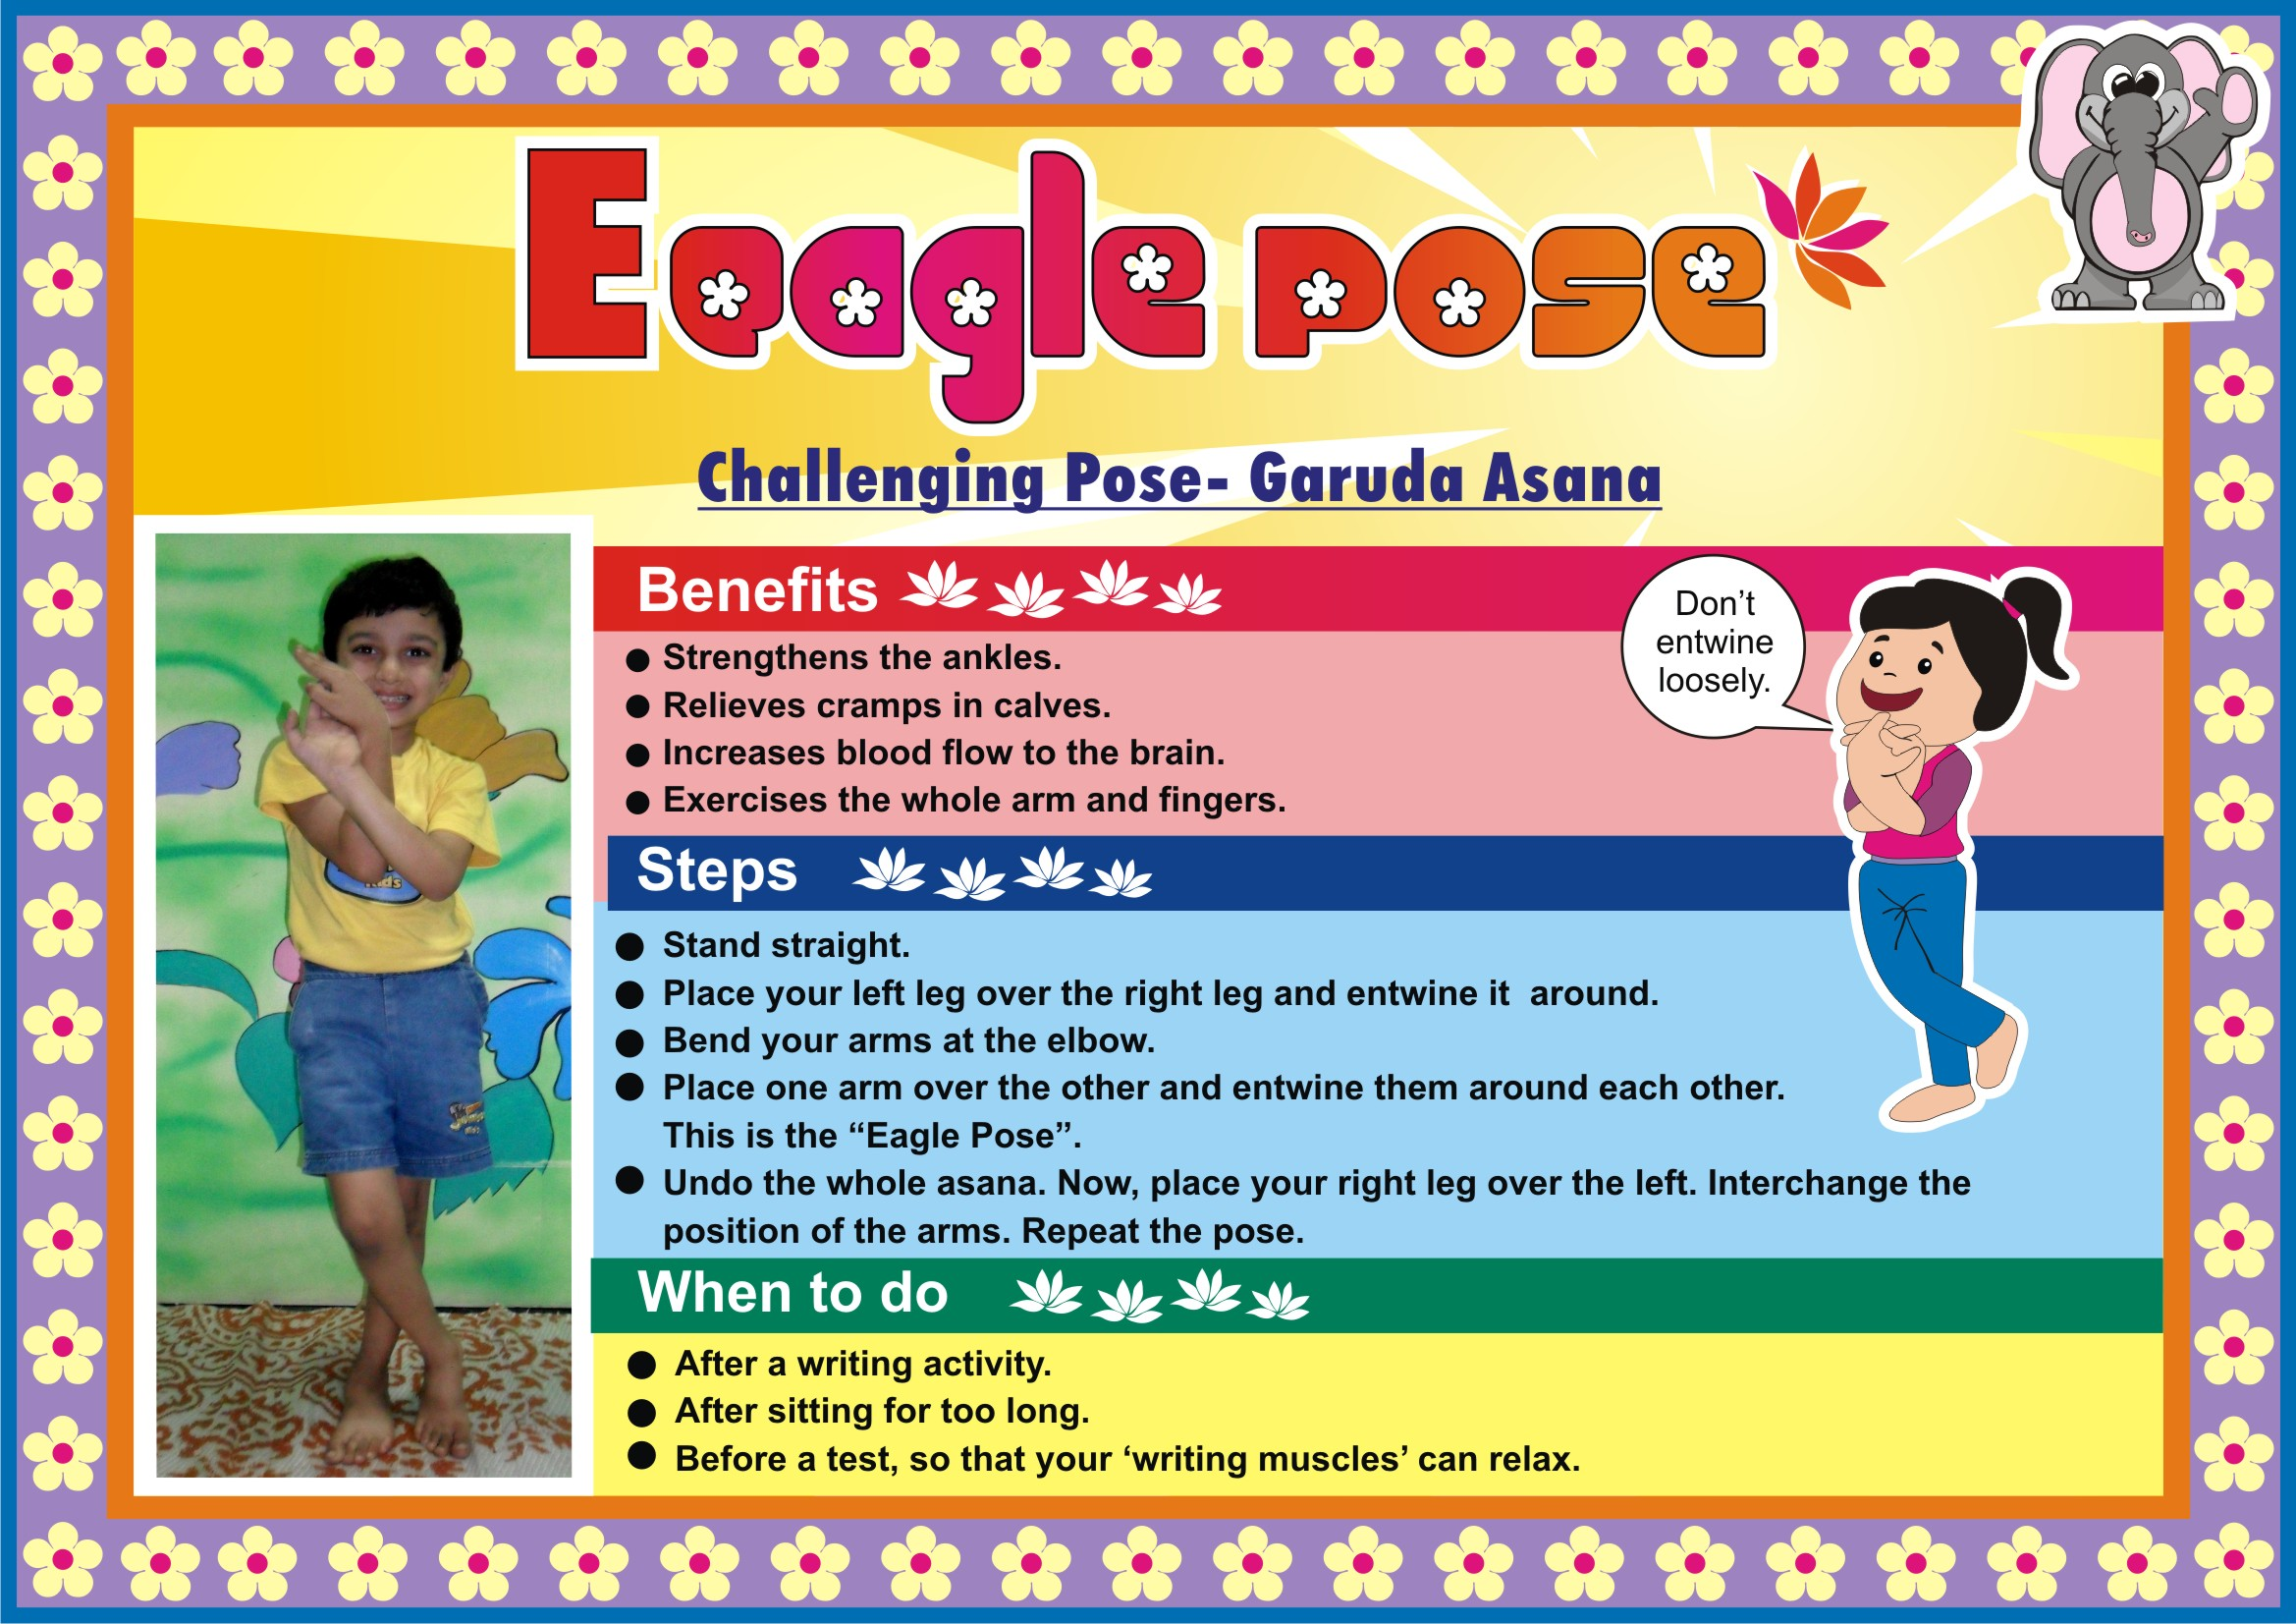

Slide 41
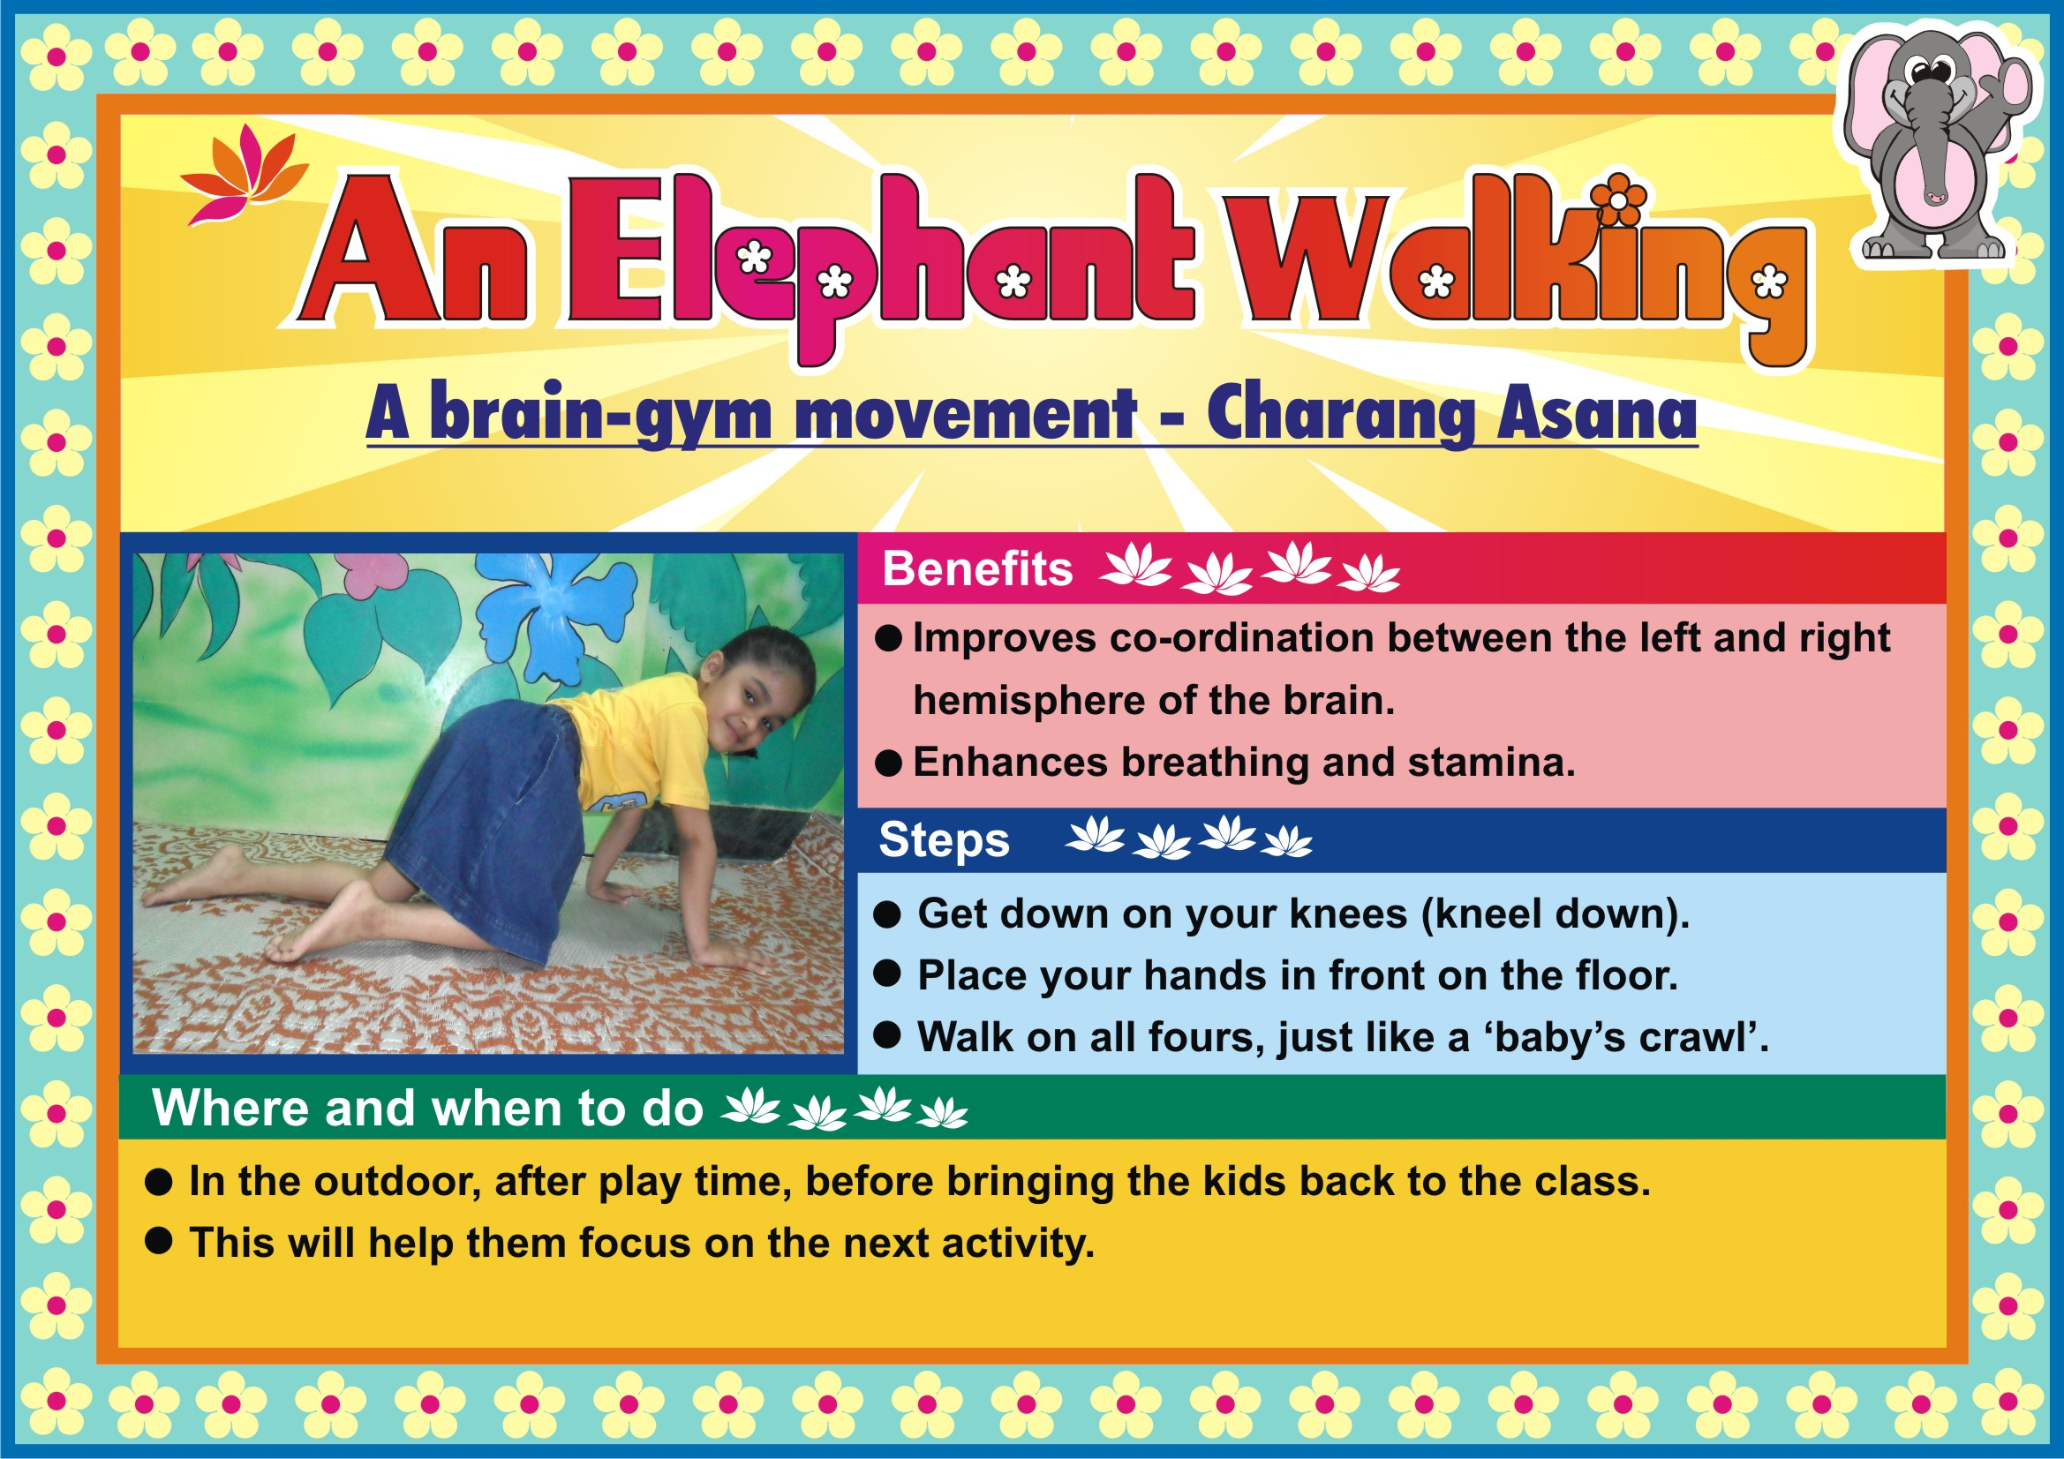

Slide 42
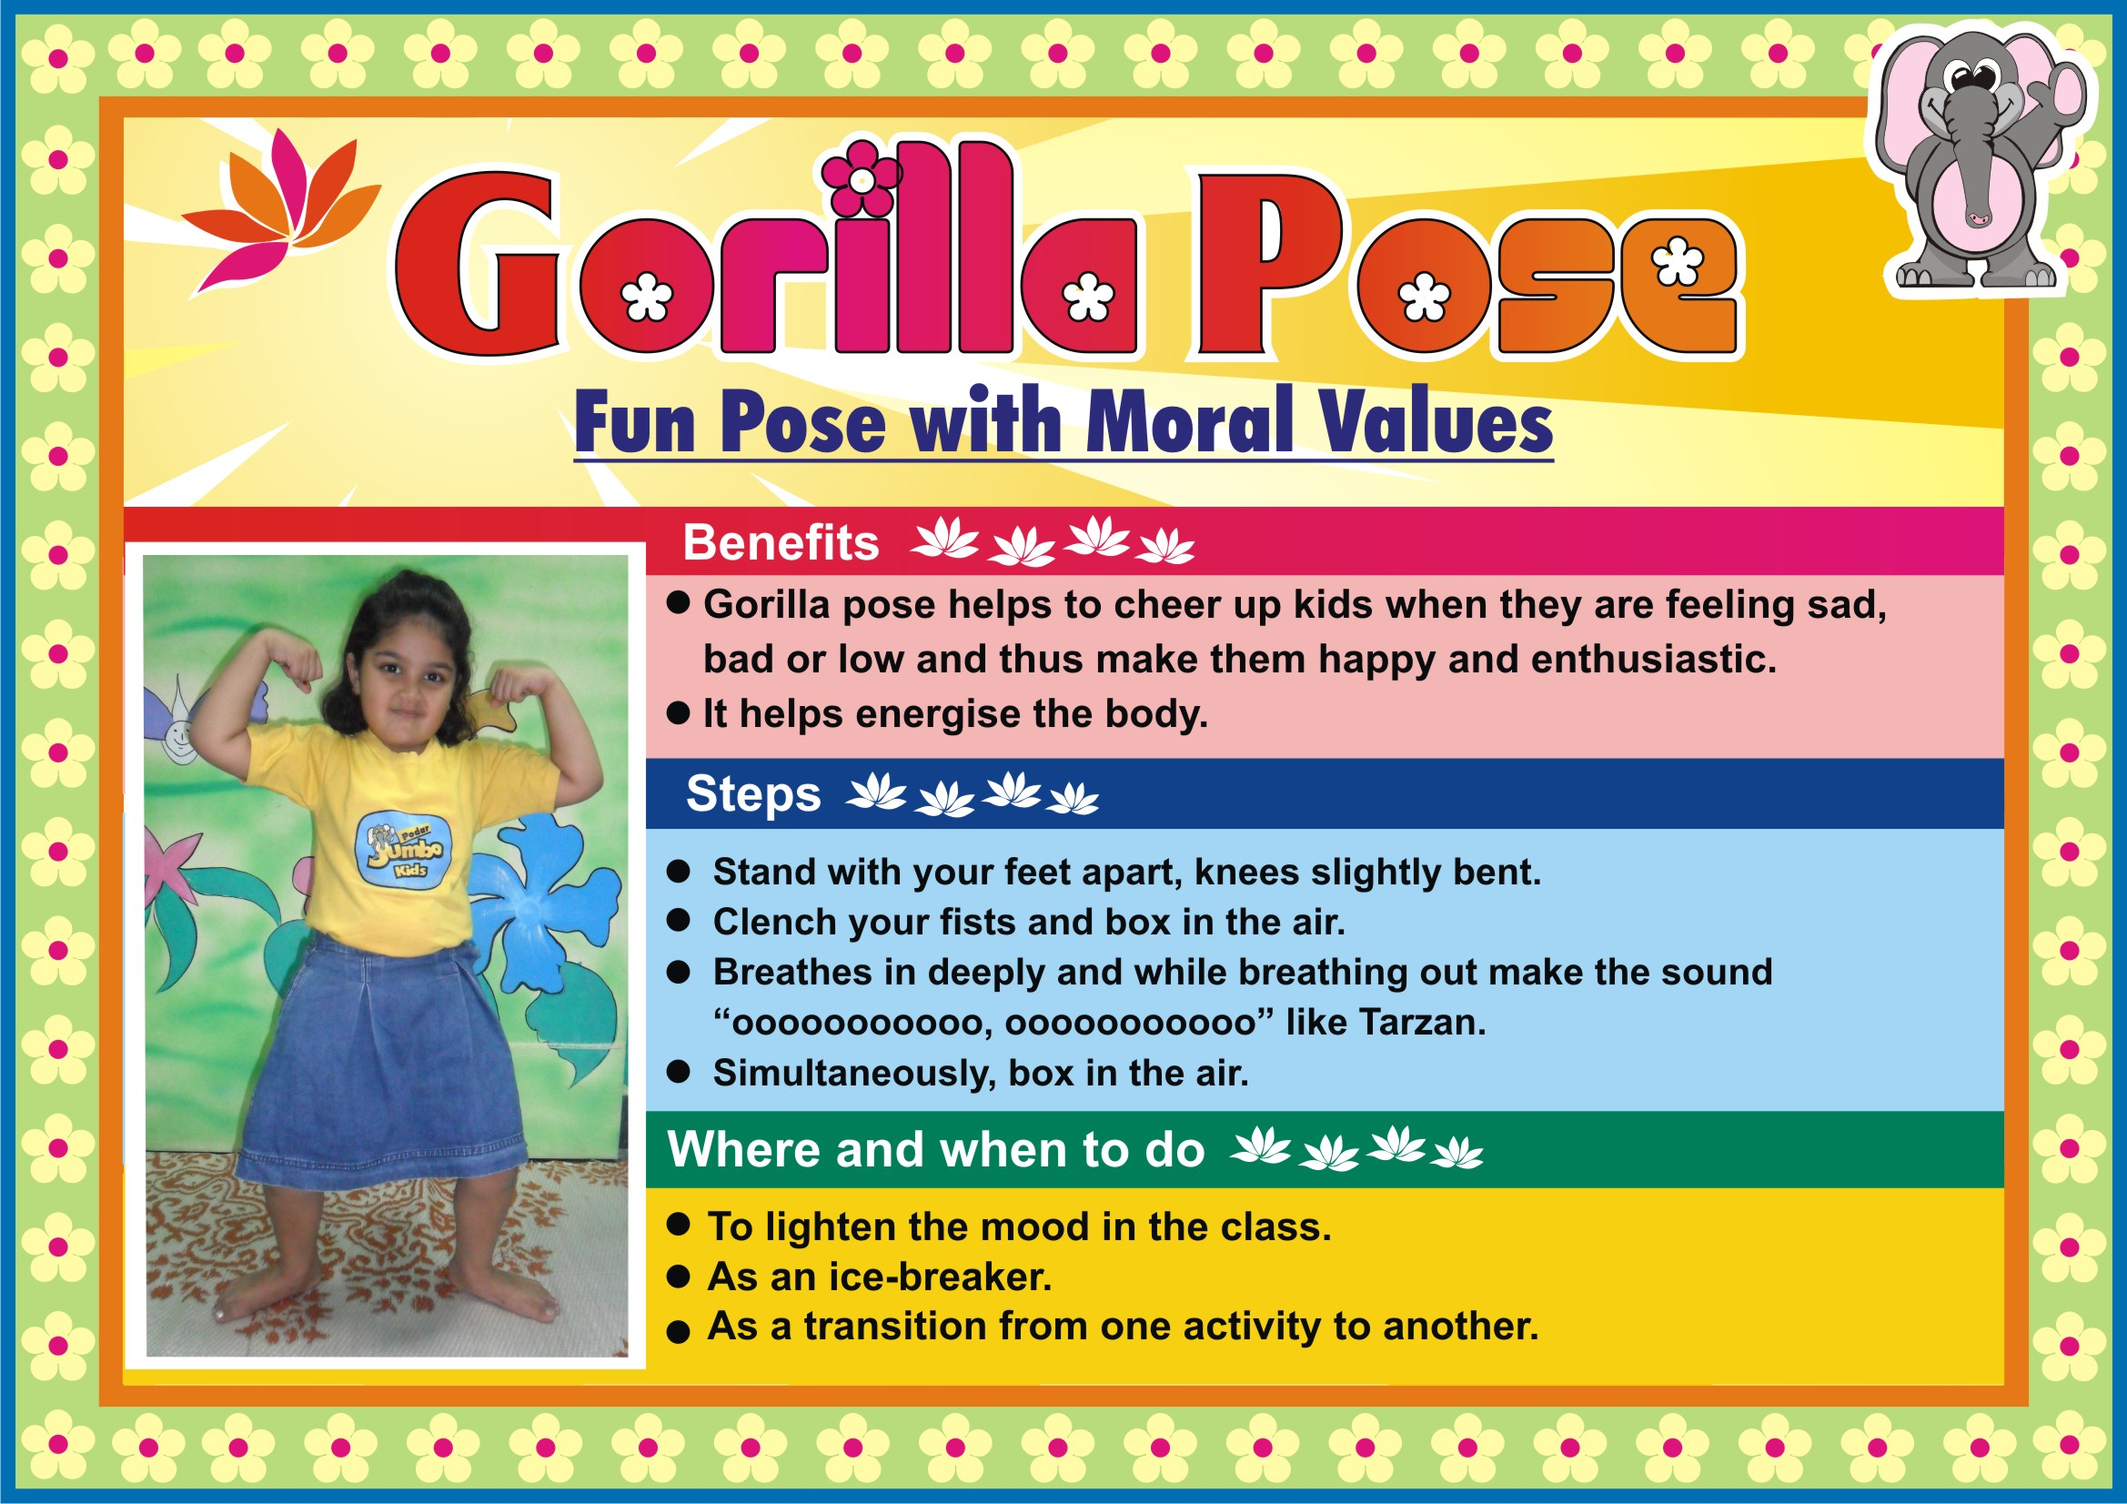

Slide 43
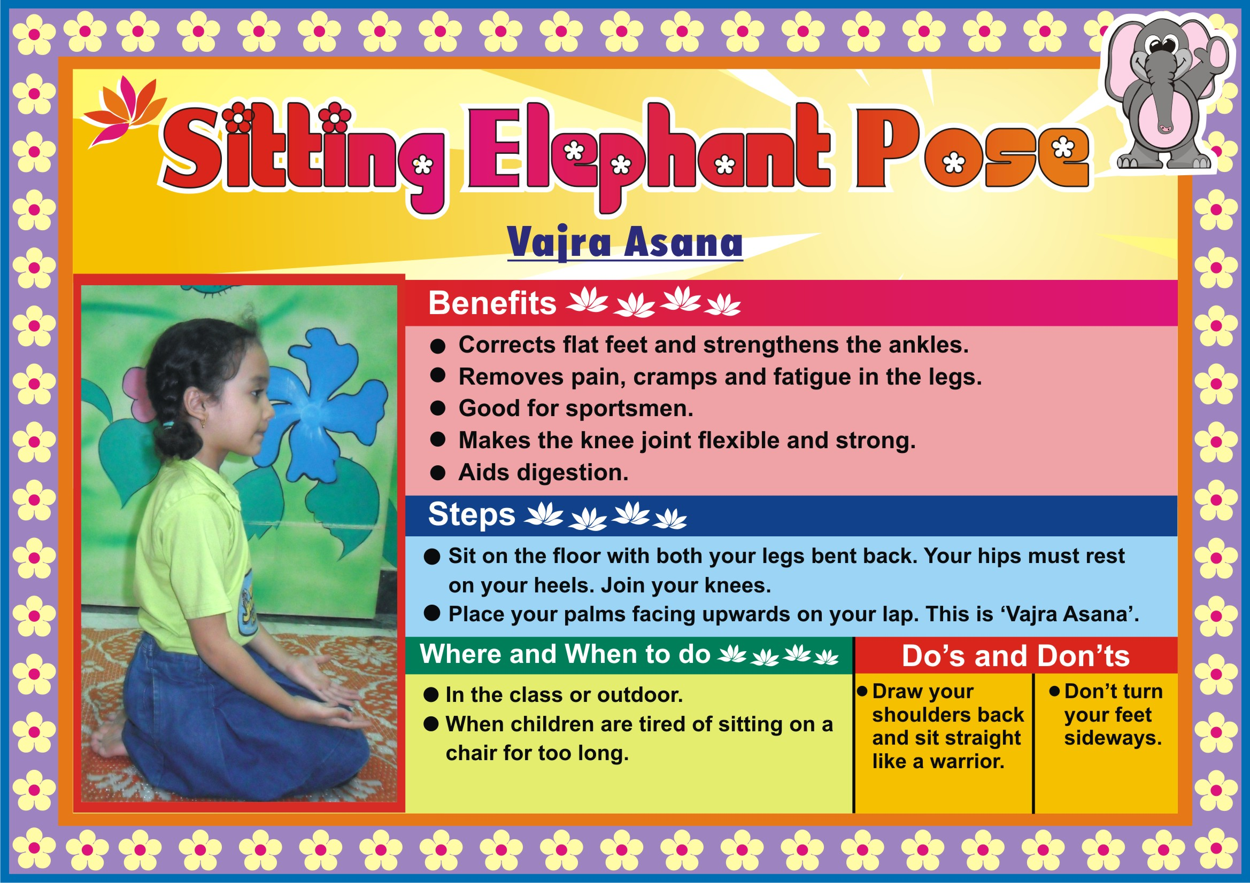

Slide 44
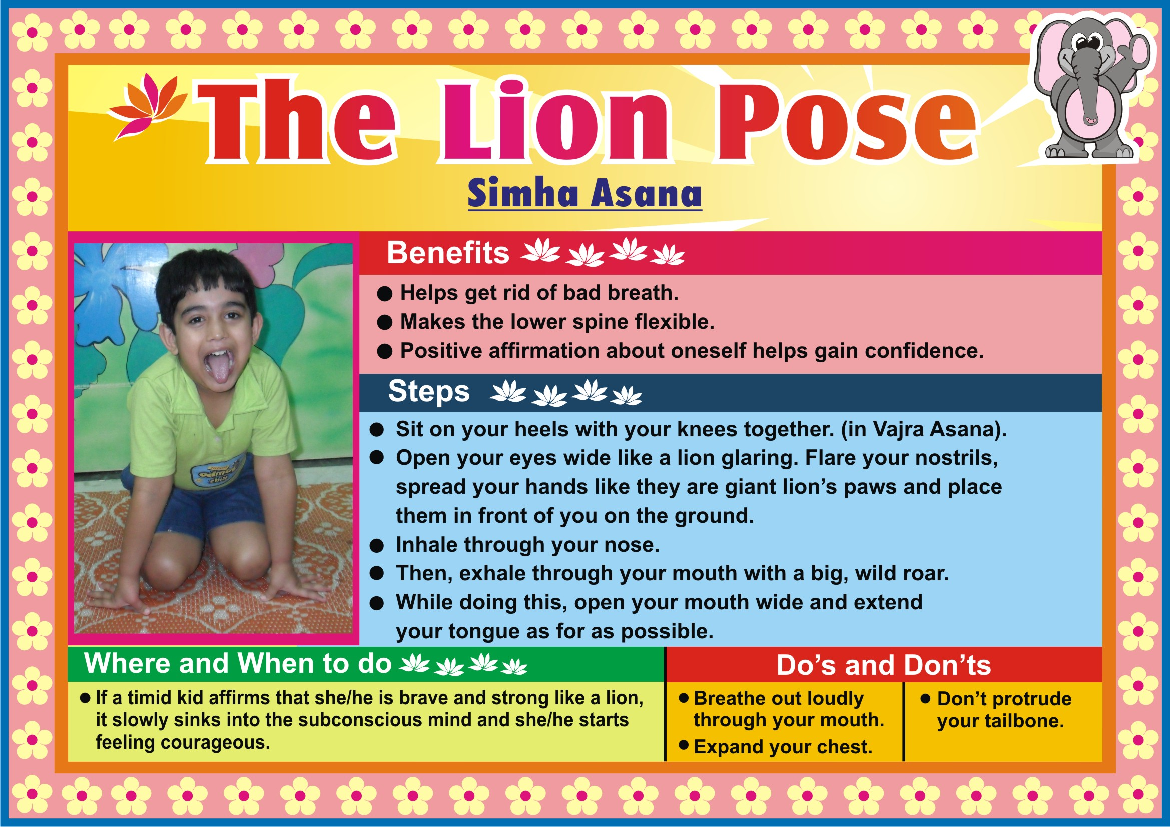

Slide 45
