Slide 1
A to Z of Adult Behaviour Management

Slide 2
What is Behaviour Management
Behaviour is how someone acts. It is what a person does to make something happen, to make something change or to keep things the same. Behaviour is a response to things that are happening:
internally – thoughts and feelings.
externally - the environment, including other people.

Slide 3
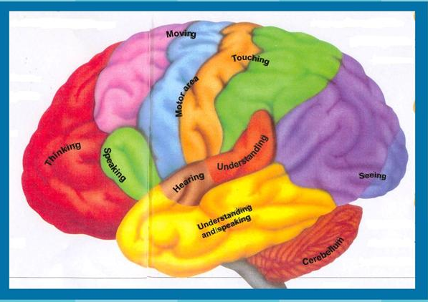
‘We live in a new world where education, neuro science and classroom instruction are joined’.
(Dr Stephen Rushton 2012, Exchange)

Slide 4
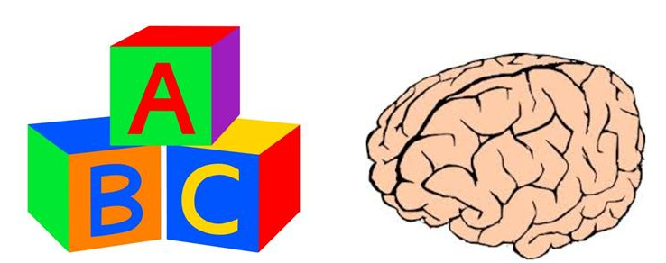
Brain classrooms promote……
Attention, Processing, Memory and Retention
While teaching kids the ABC, teachers too must keep in mind the ABC of brain development and brain based practices.

Slide 5
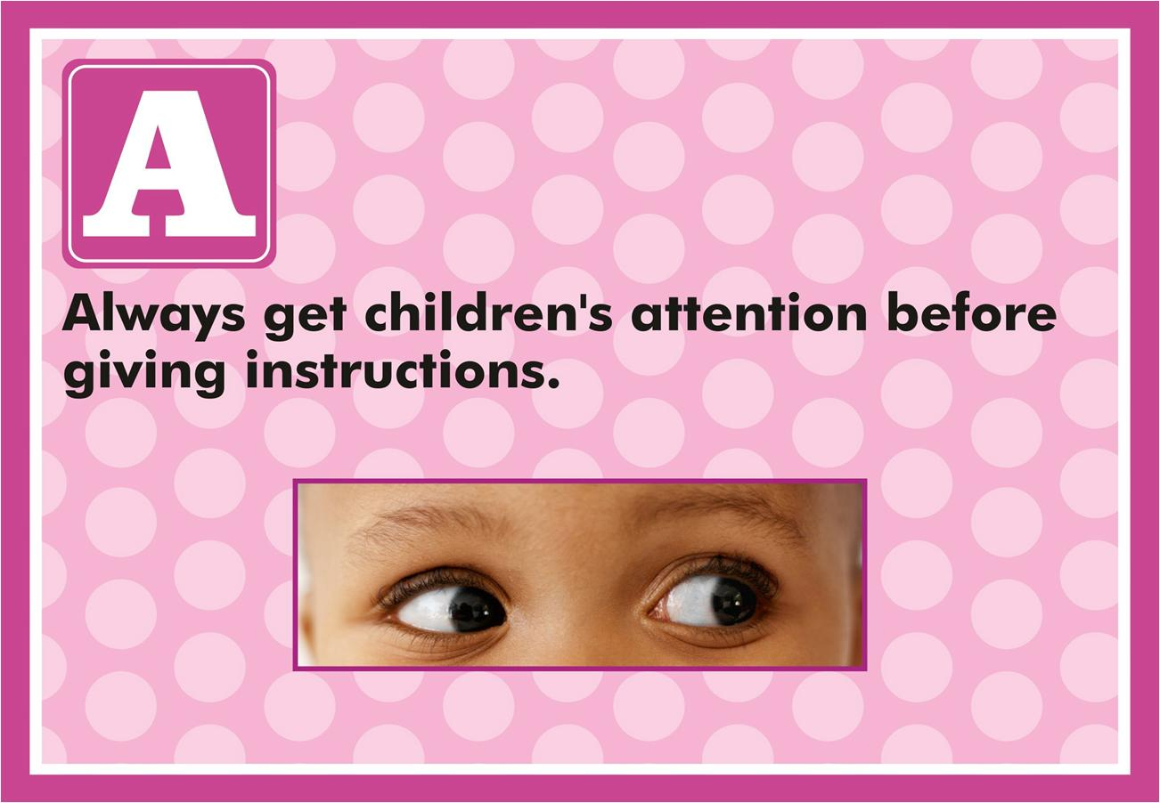

Slide 6
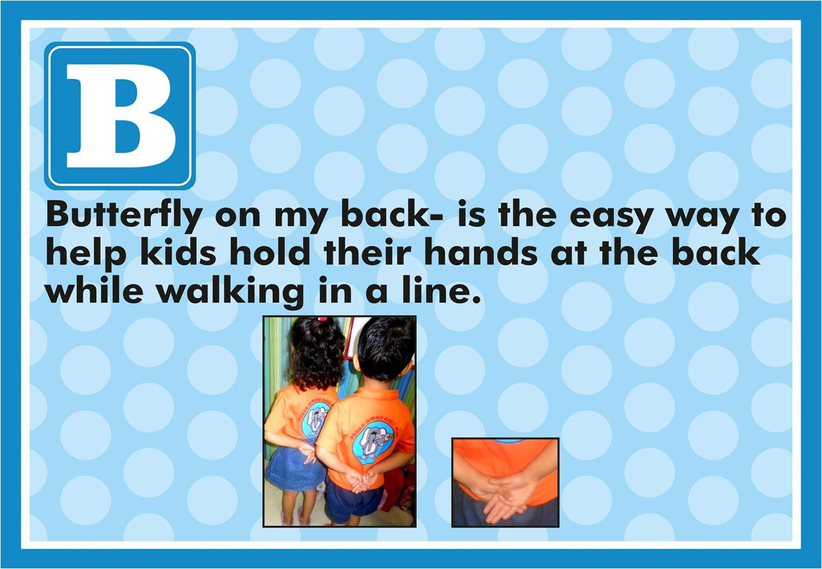

Slide 7


Slide 8


Slide 9
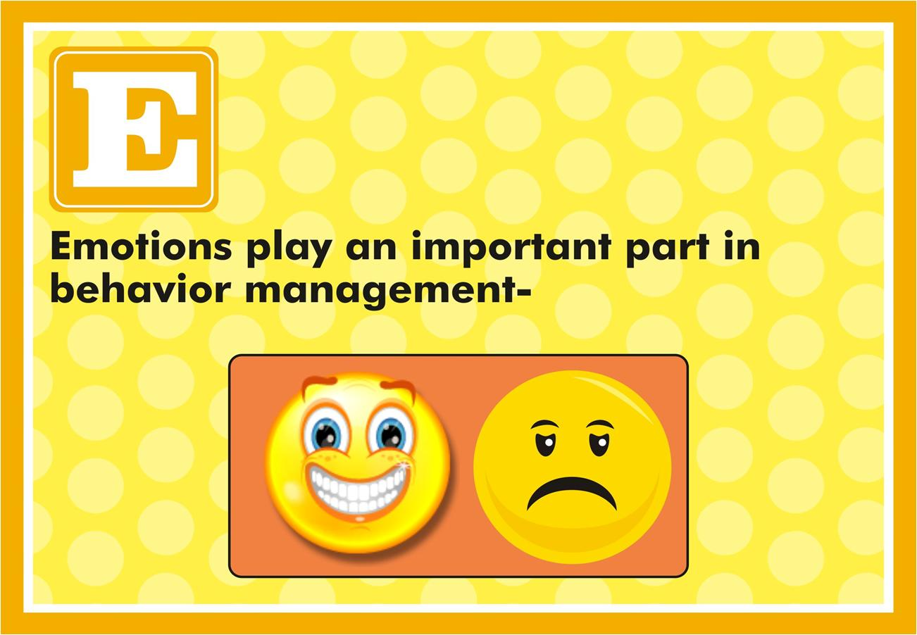

Slide 10
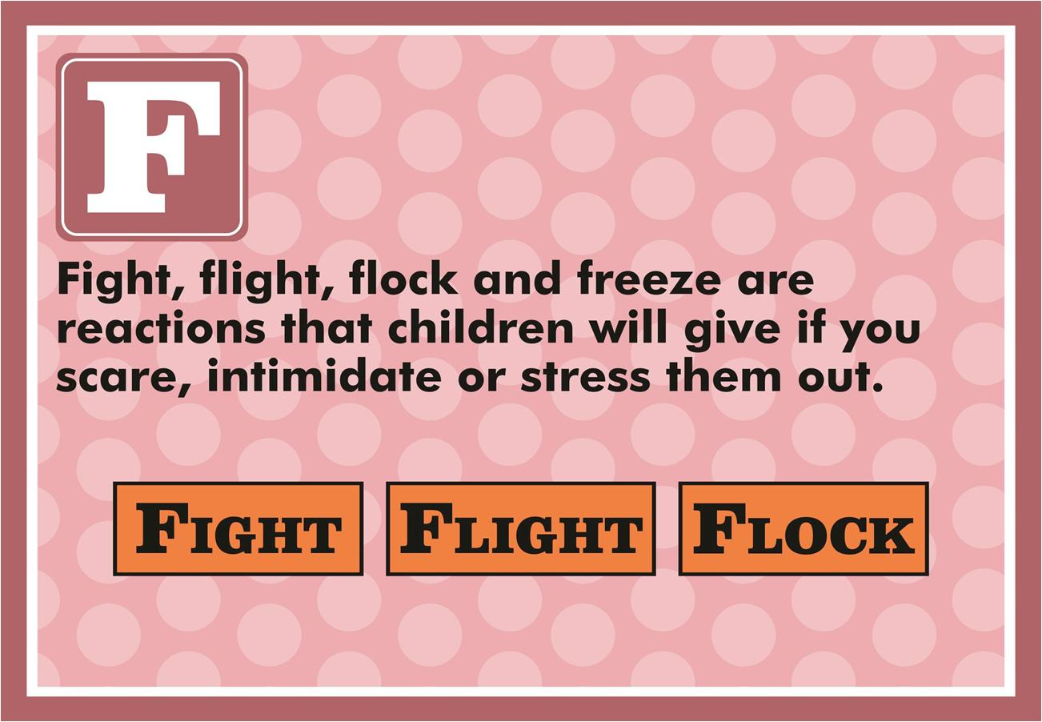

Slide 11
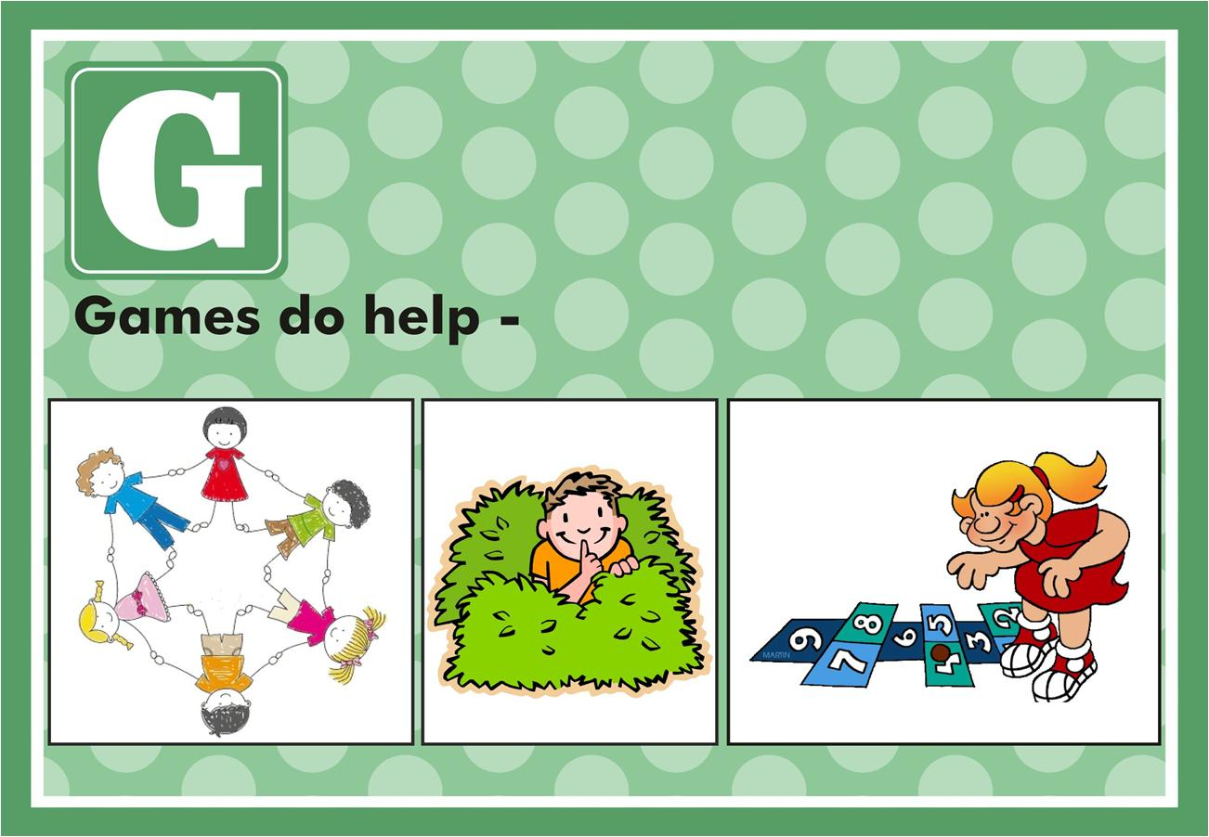

Slide 12
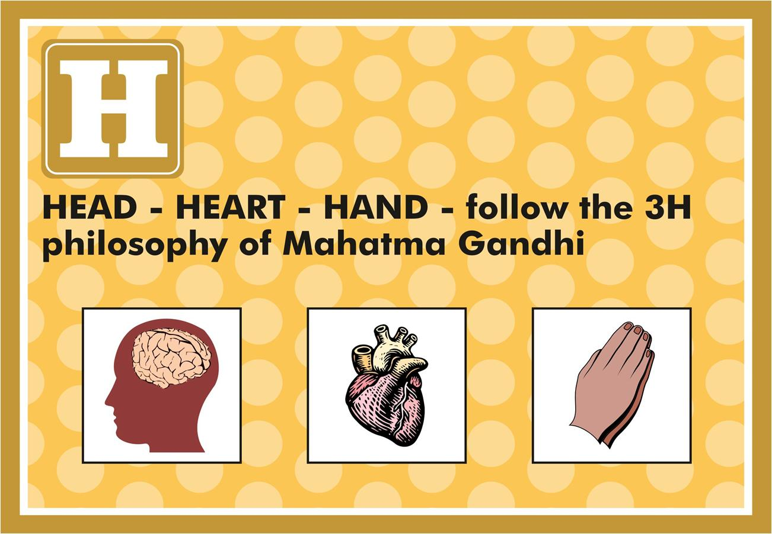

Slide 13
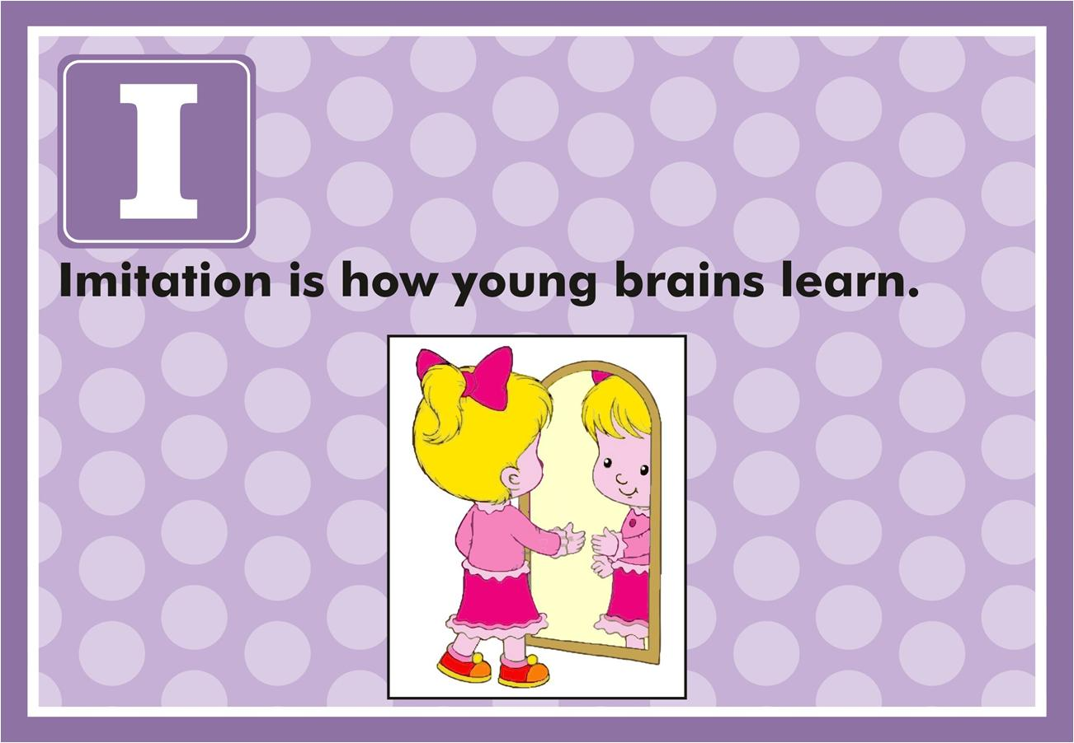

Slide 14
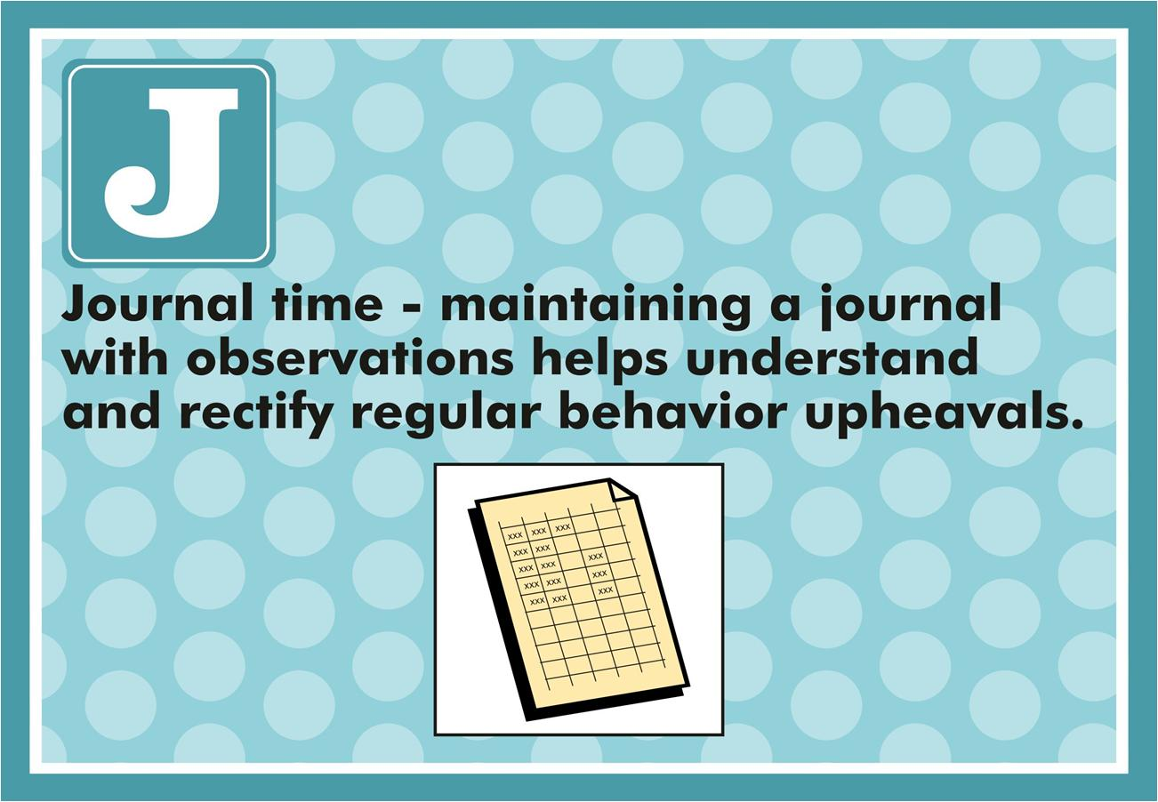

Slide 15
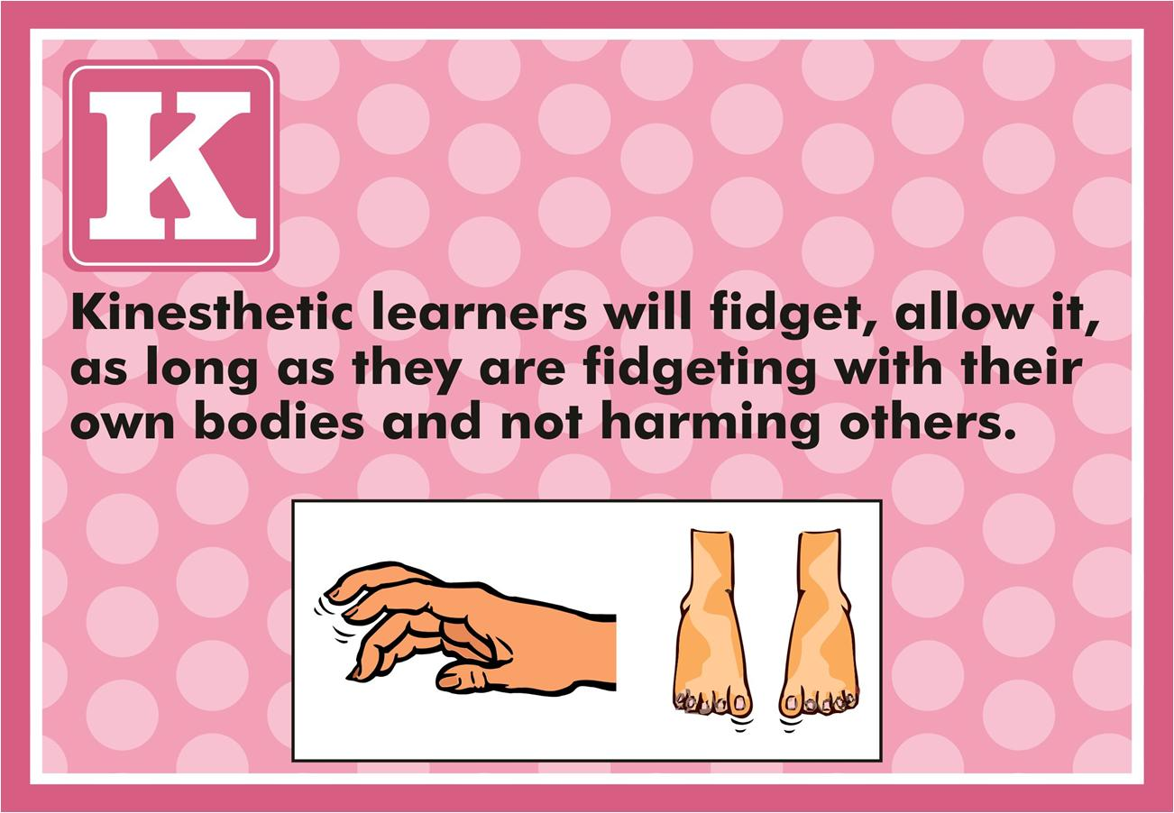

Slide 16
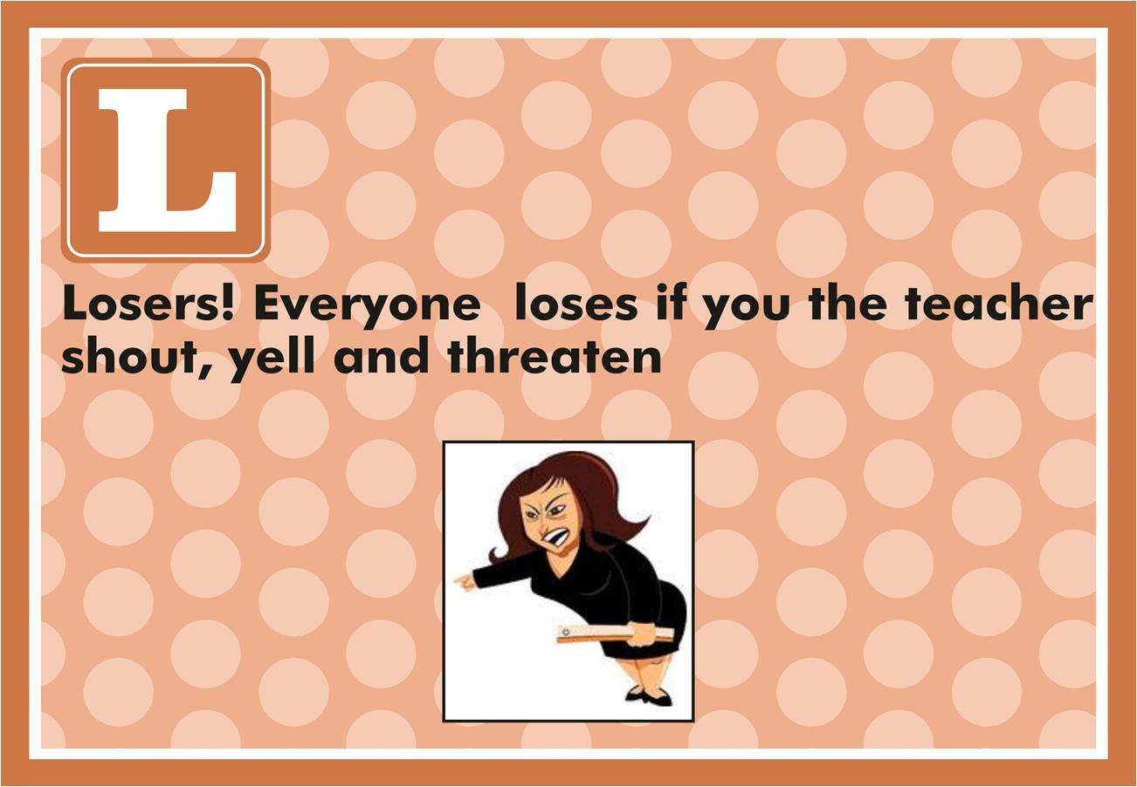

Slide 17
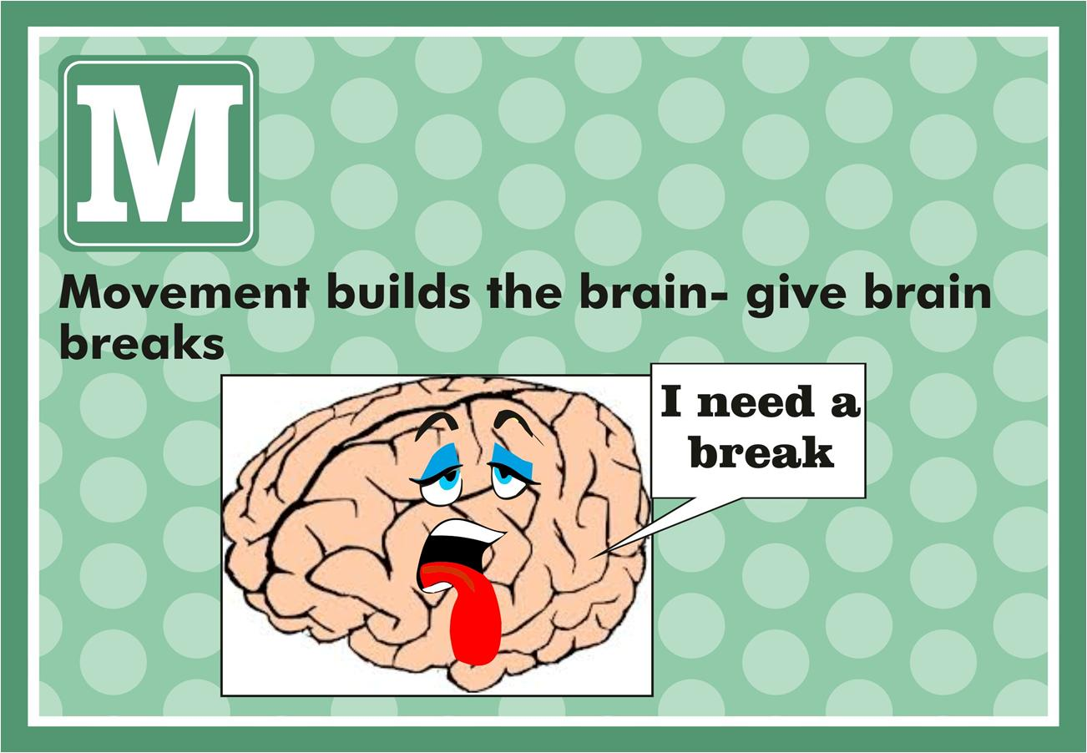

Slide 18
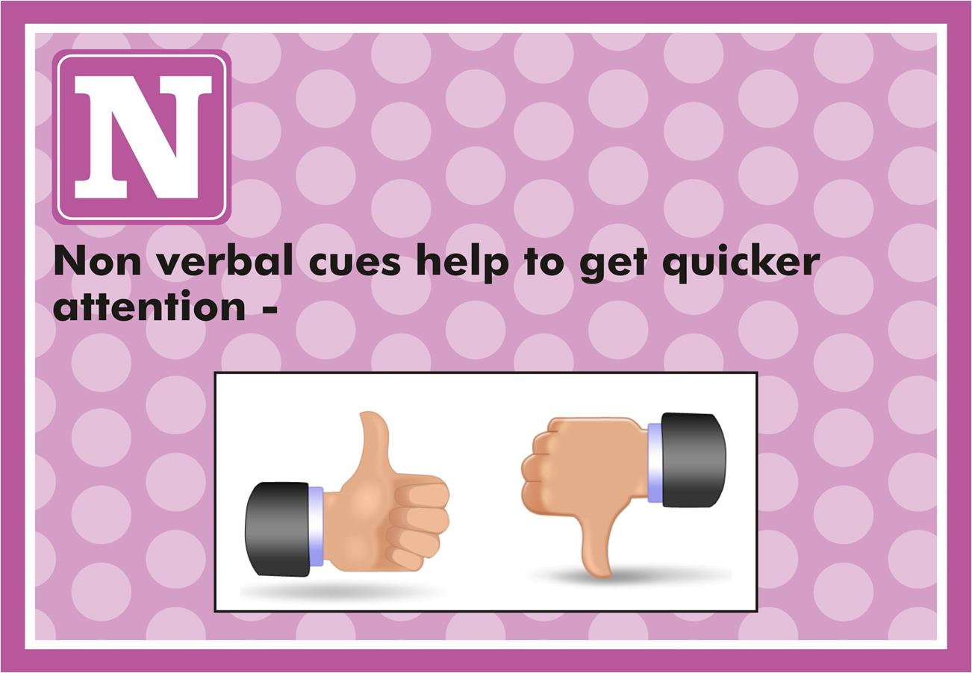

Slide 19
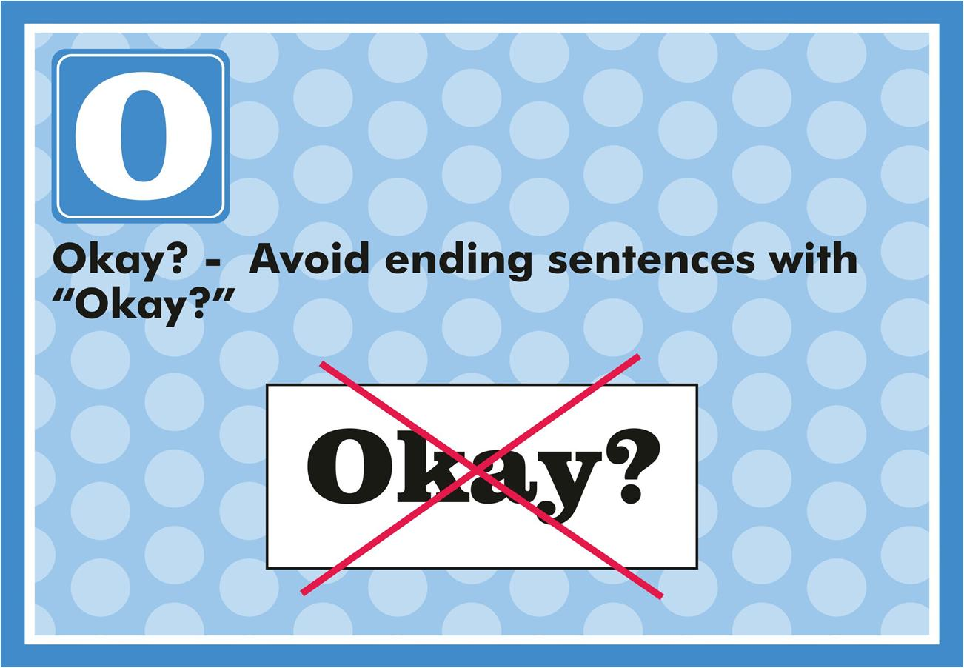

Slide 20
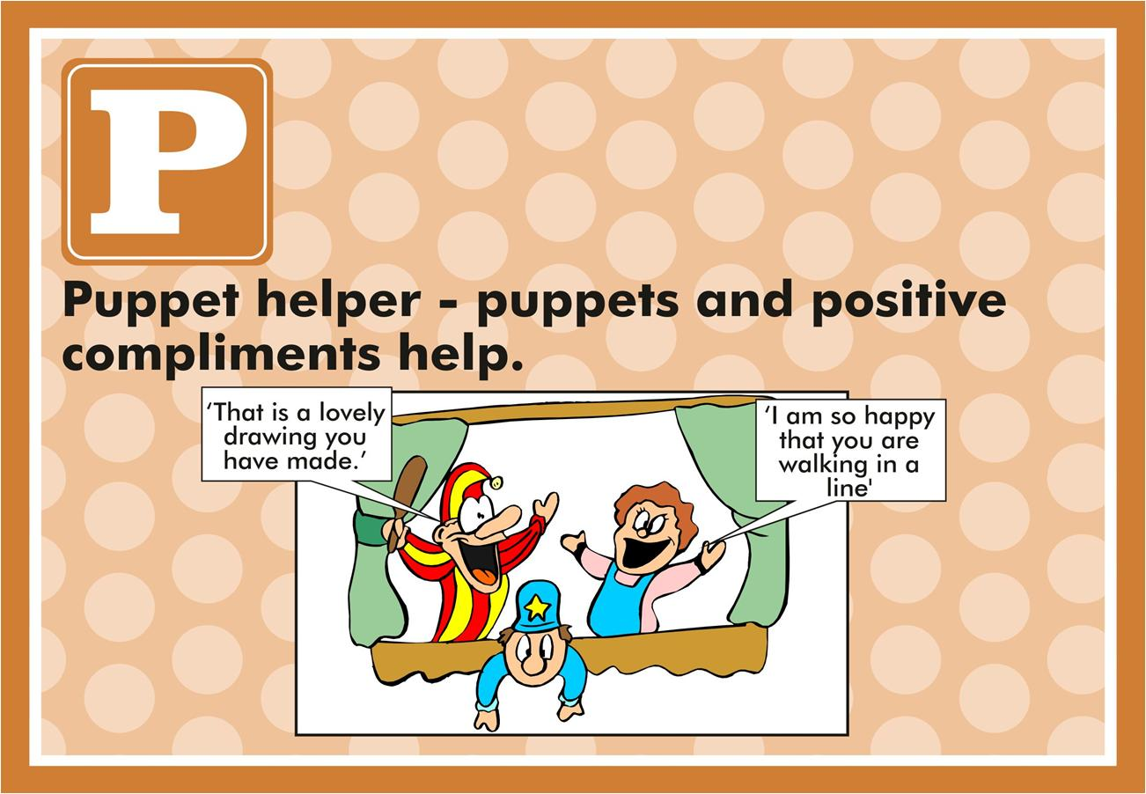

Slide 21
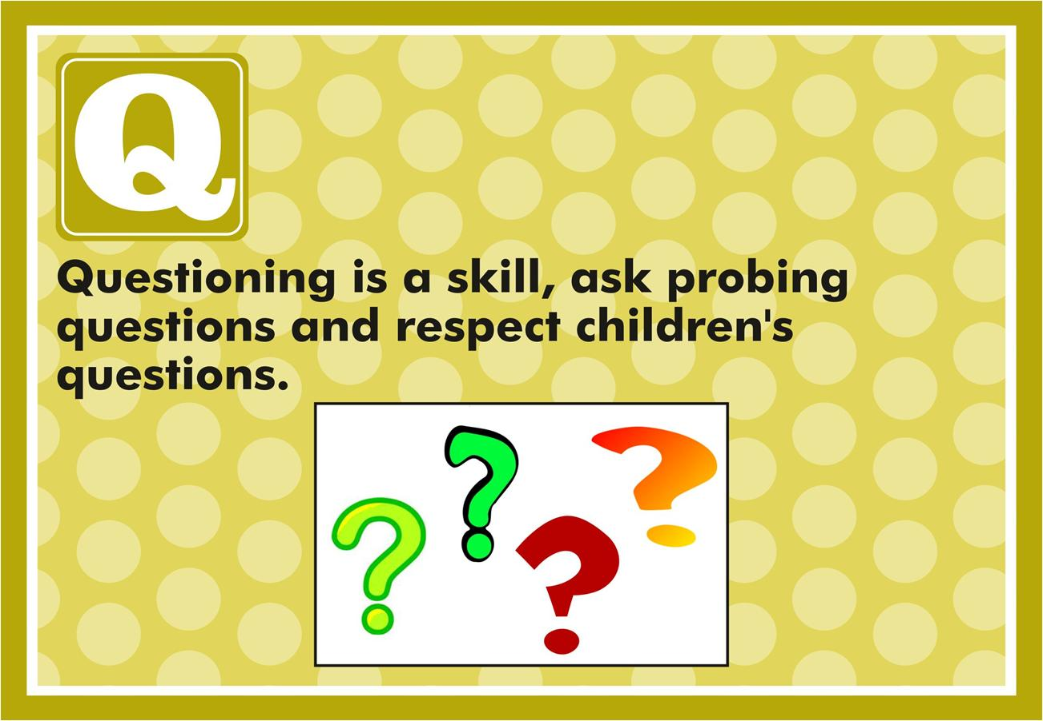

Slide 22
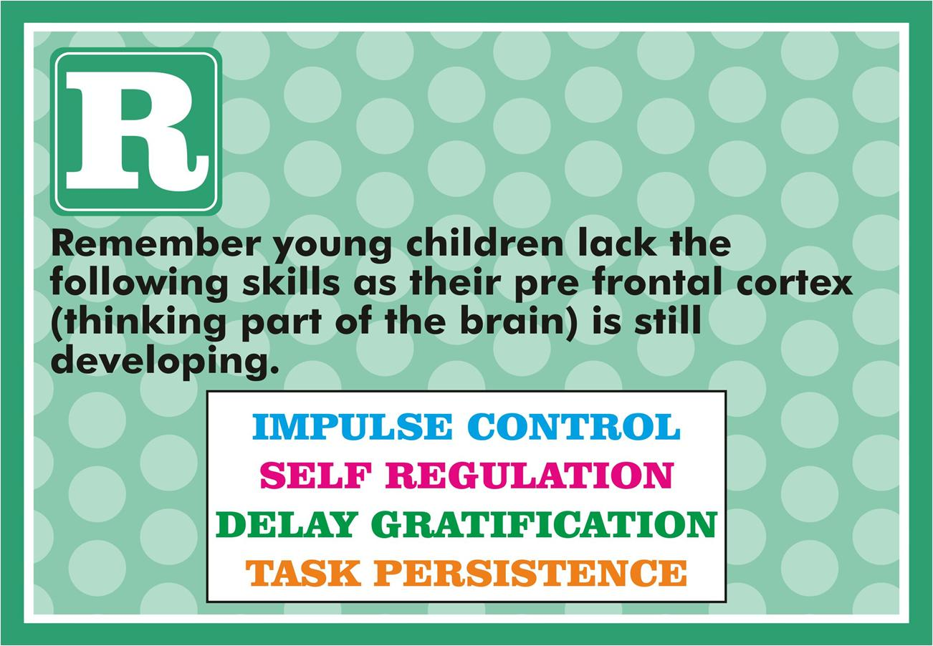

Slide 23
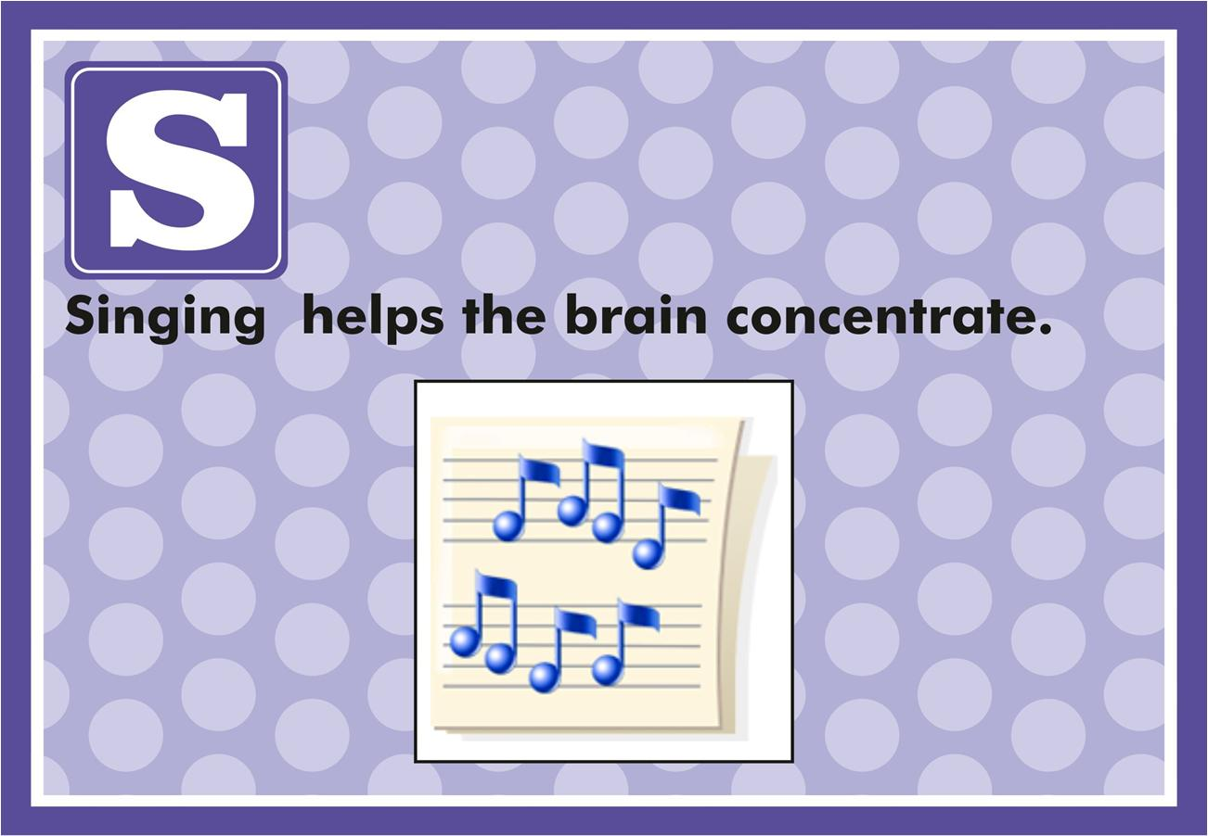

Slide 24
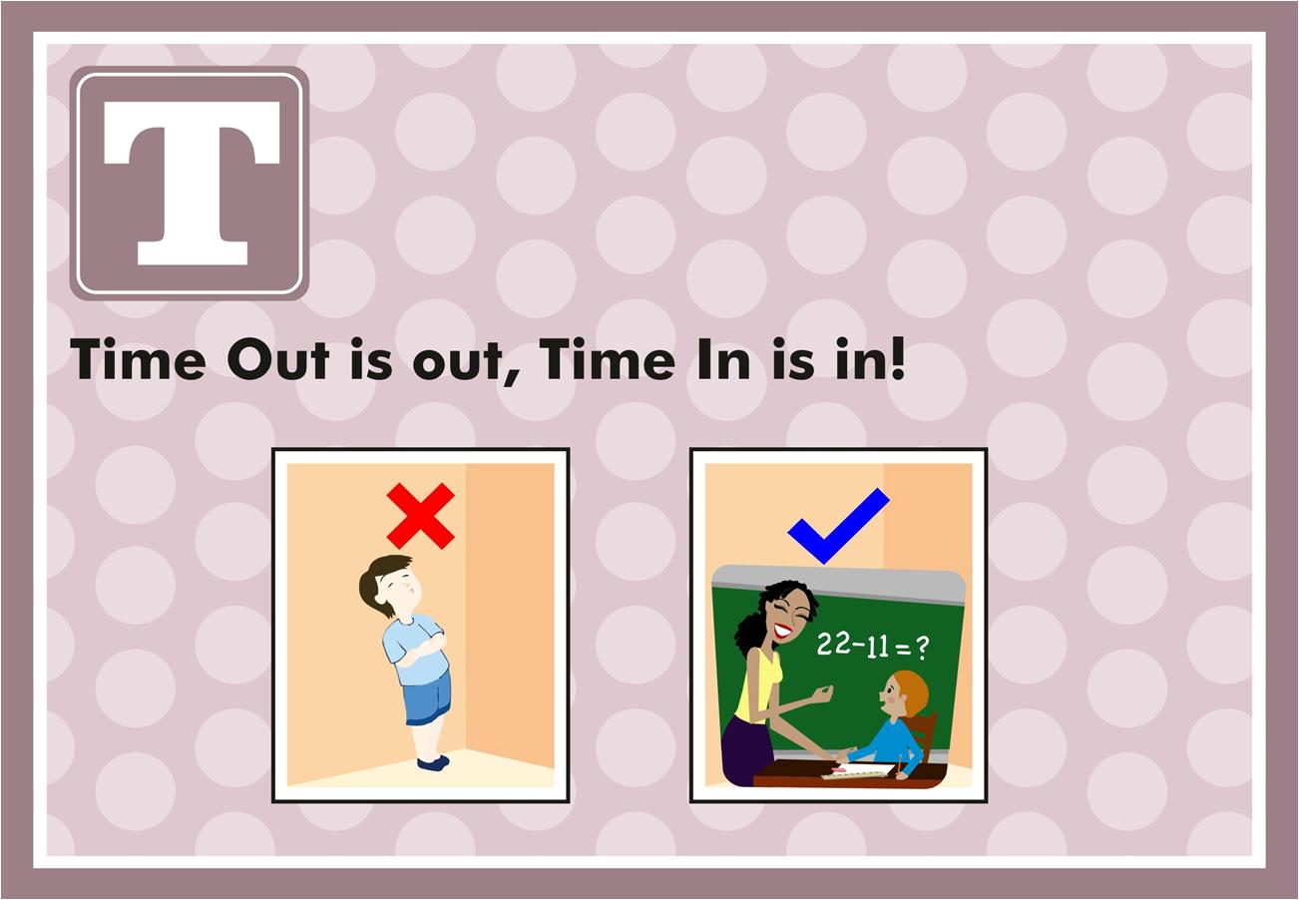

Slide 25
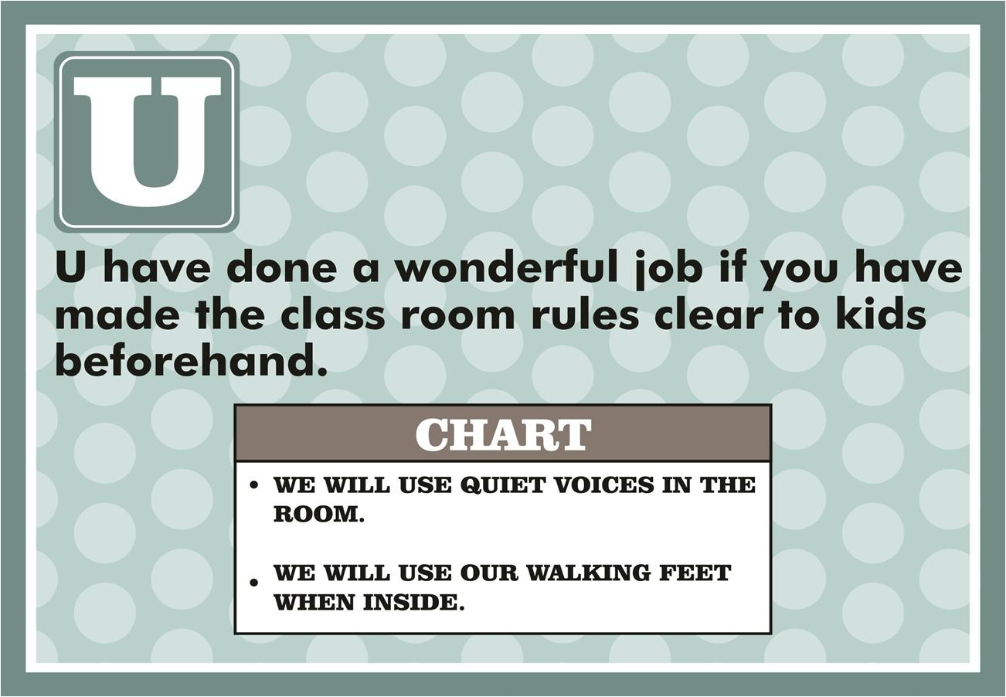

Slide 26
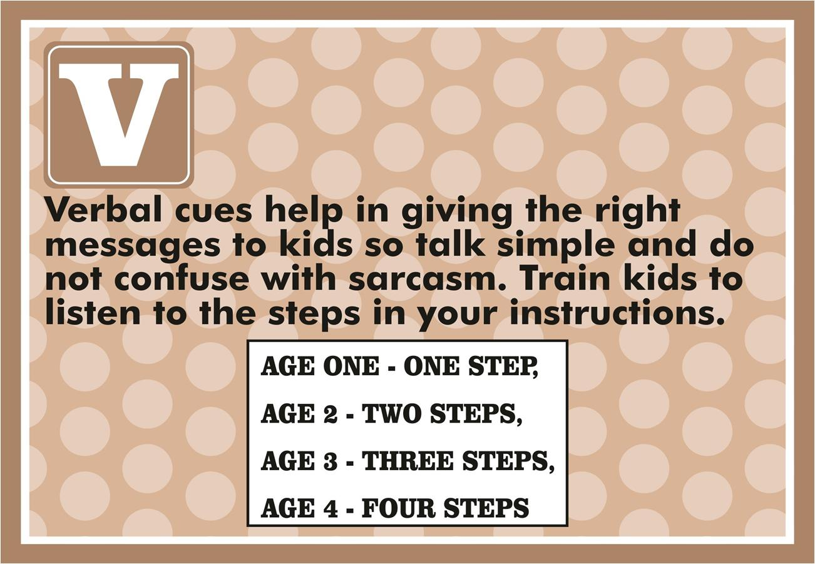

Slide 27
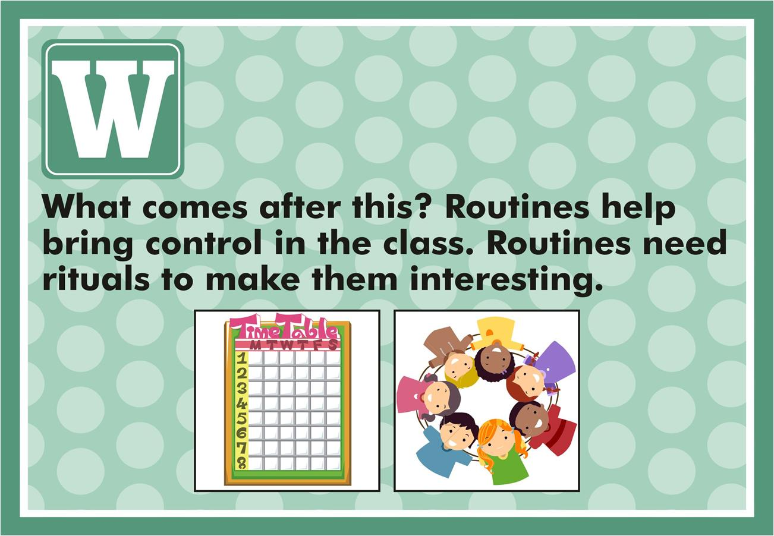

Slide 28
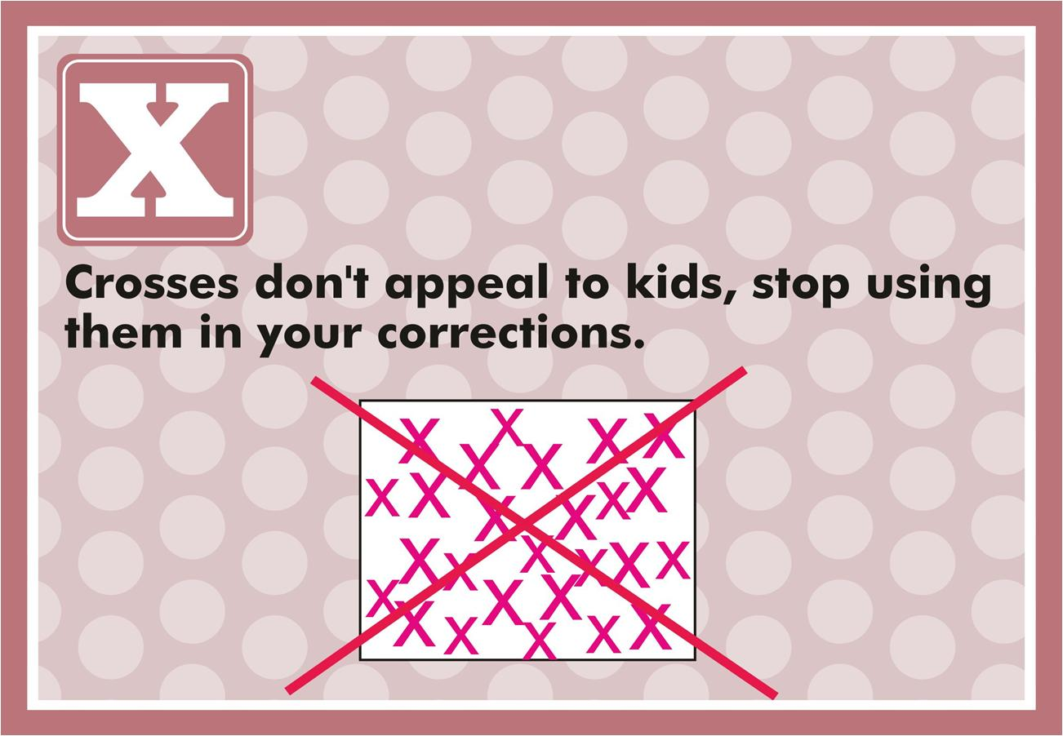

Slide 29
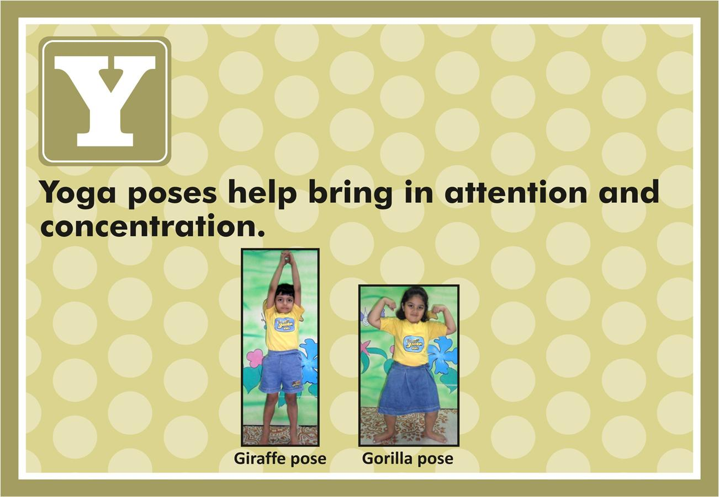

Slide 30
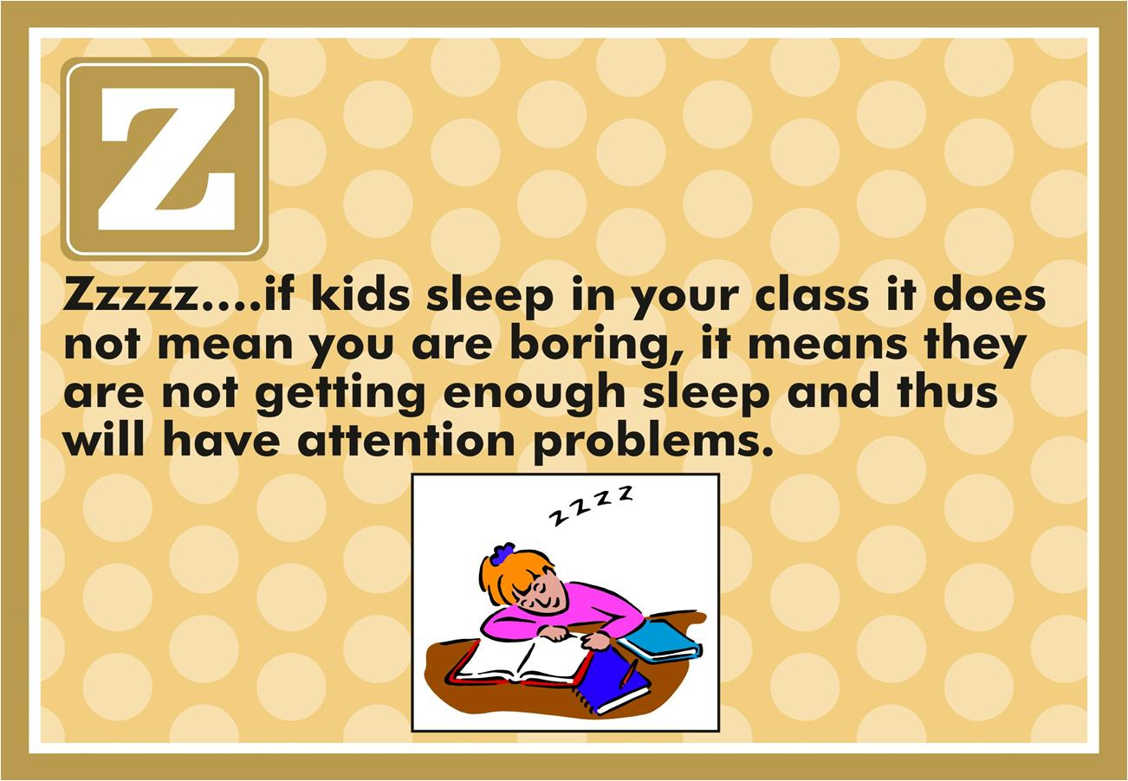

Slide 31
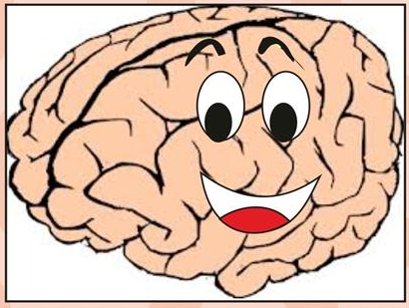
The brain is an organ that is shaped through its interaction with the environment and so if the brain is the organ dedicated to learning and memory then it’s time to reinvent teacher training and make their classroom instructions, techniques and activities brain friendly.
After all positive emotions make happy children.

Slide 32
Managing Difficult Behaviour
Children behave inappropriately for many reasons. Behaviour is often the unspoken language through which children act out feelings and thoughts. It is also because they are unaware of group behaviour norms or alternative ways of behaving and not because they are ‘bad’ or they want to ‘trouble us’.
Sometimes they use behaviour to seek extra attention. They could be angry or helpless and don’t know any other way to express this. Children need to feel secure and in control – when that control is taken away, they may seek to regain it through this kind of behaviour. Sometimes this behaviour could be because of lack of sleep, poor nutrition, health reasons or developmental delay or deficits, family dysfunctionality or stress.

Slide 33
Managing Difficult Behaviour
Some examples of difficult behaviour which harms children or disrupts the classroom are:
a. Aggressive behaviour (example – hurting others – hitting, biting, pinching, throwing objects)
b. Antisocial behaviour (example – using inappropriate language, name calling, refusing to share)
c. Disruptive behaviour (example – disrupting circle time, running around the classroom, shouting in the classroom, dropping objects, tearing books, breaking toys, destroying the work of others)
d. Inappropriate expression (example – excessive crying, pouting, whining)

Slide 34
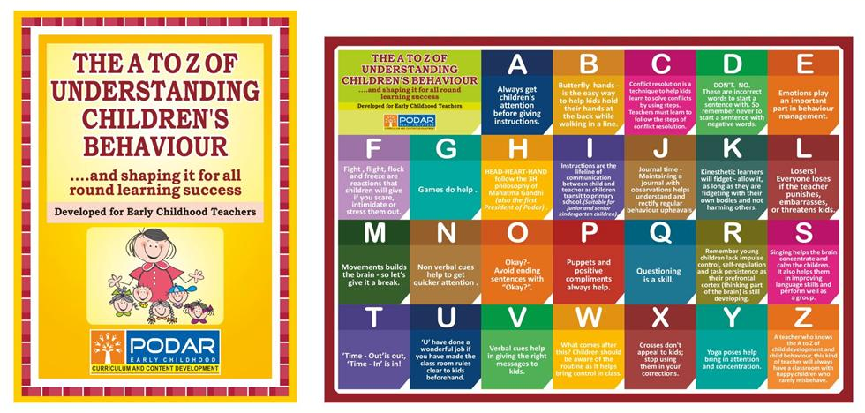
This booklet and poster is available if you would like to have one for your school

