Slide 1


Slide 2
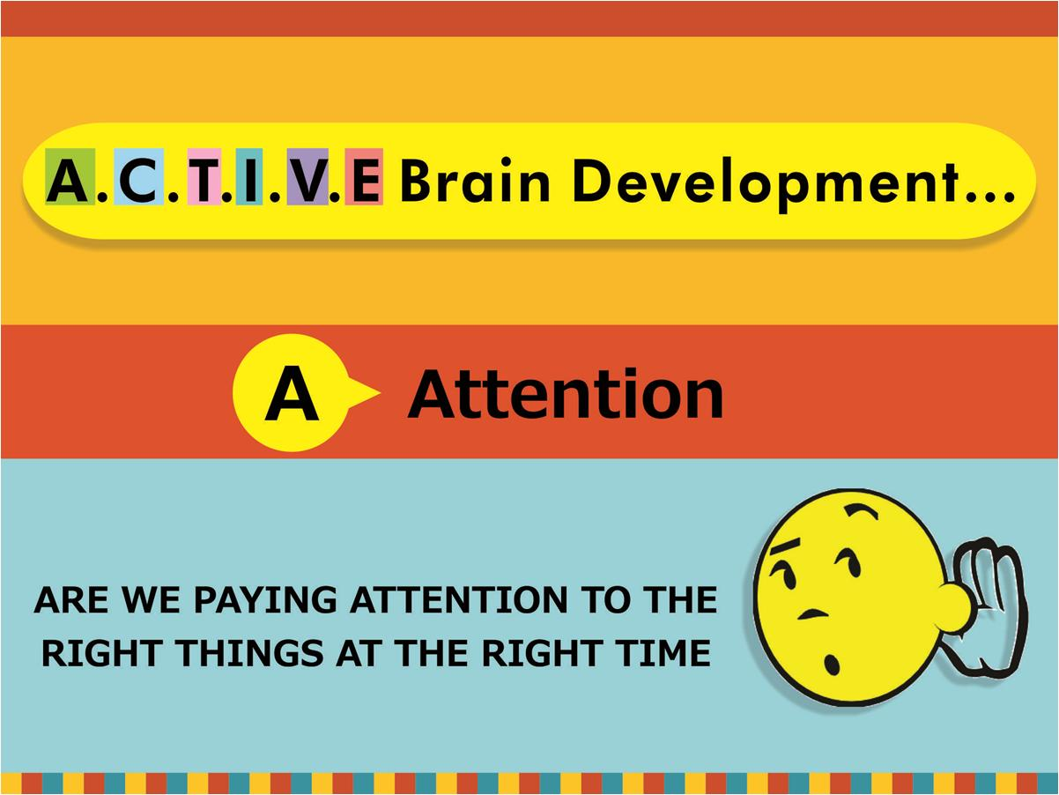

copyright swatipopat@podar.org

Slide 3

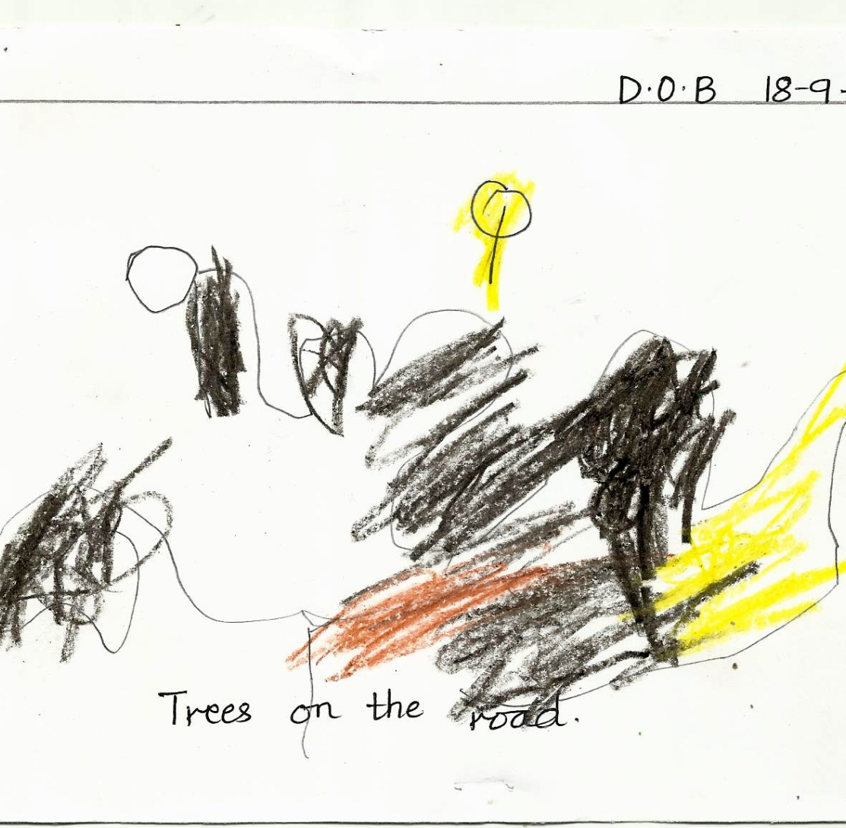
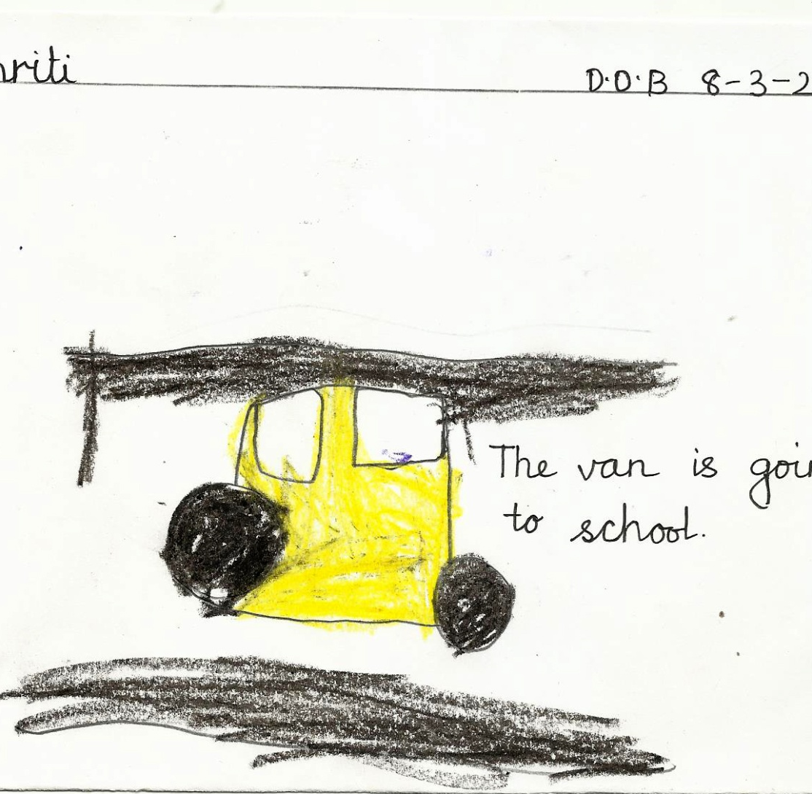
Dob- 18-9-2010
Dob- 8-3-2010

Slide 4
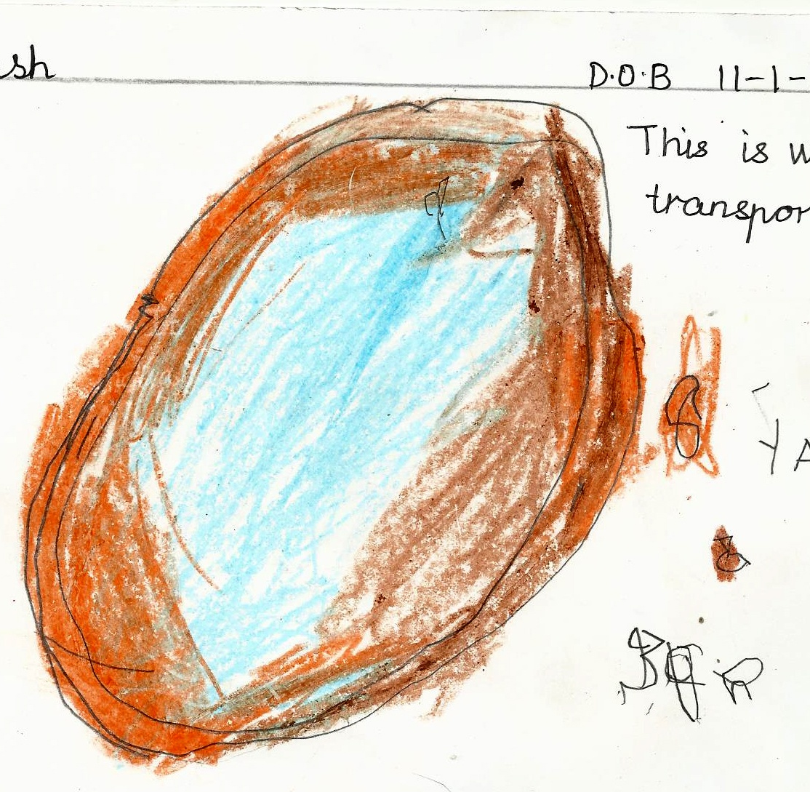
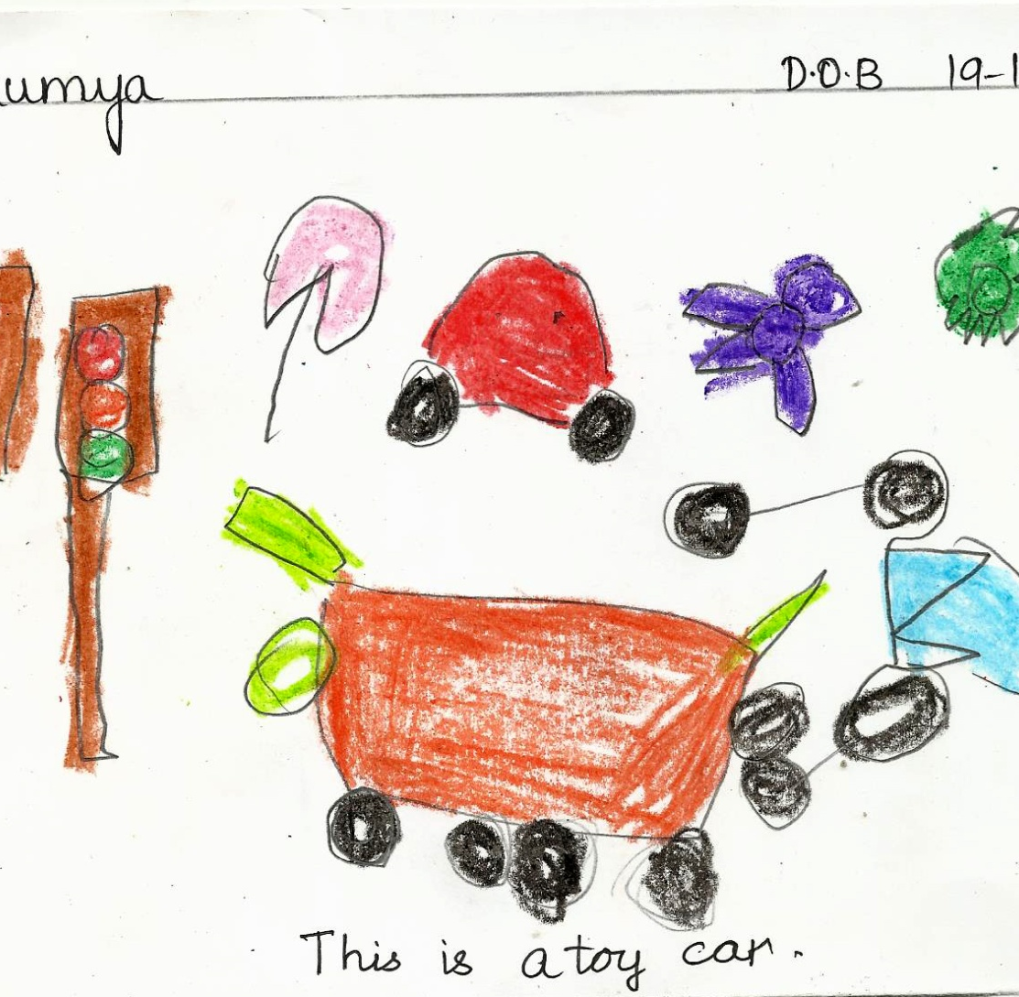
Same age?
Dob- 11-1-2010
Dob- 19-1-2010

Slide 5



Slide 6
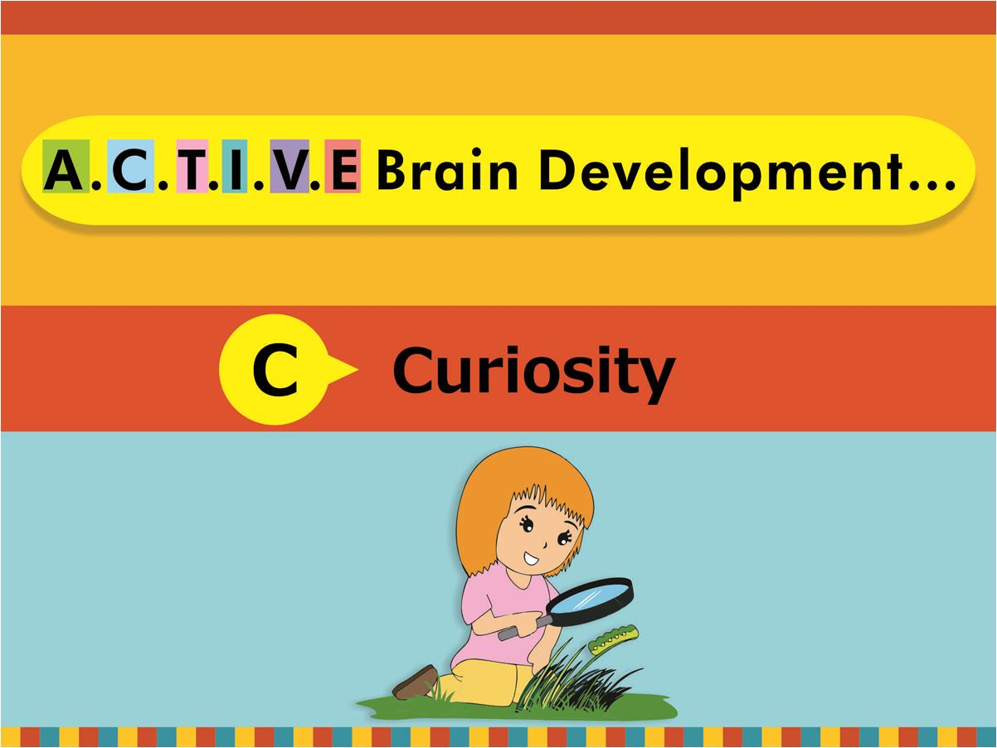
copyright swatipopat@podar.org

Slide 7
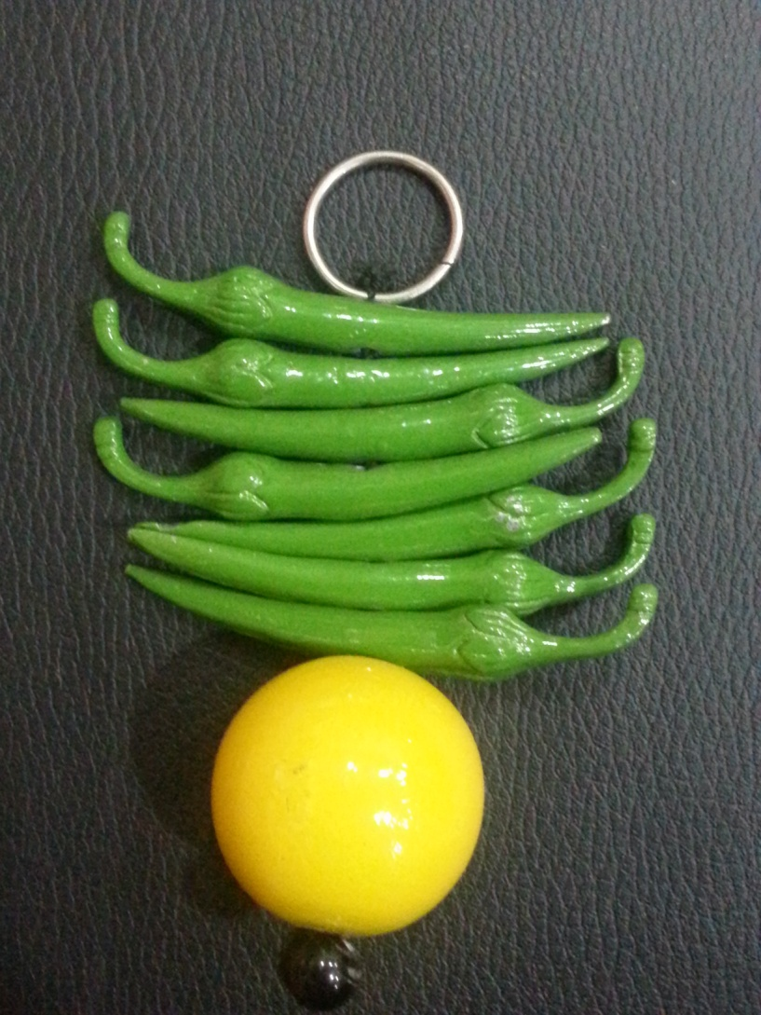

Slide 8
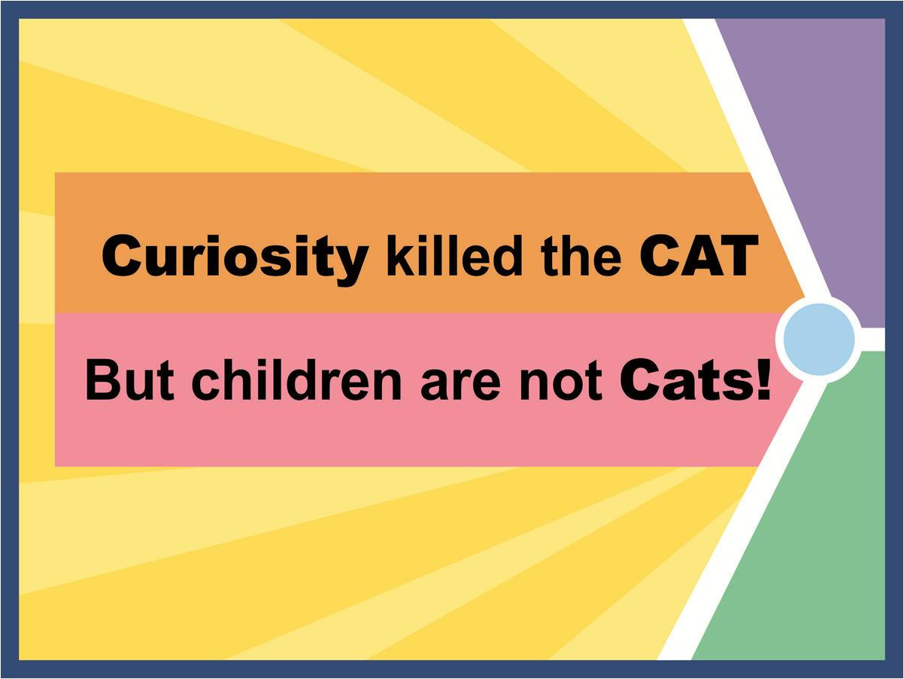
copyright swatipopat@podar.org

Slide 9

copyright swatipopat@podar.org

Slide 10

copyright swatipopat@podar.org

Slide 11
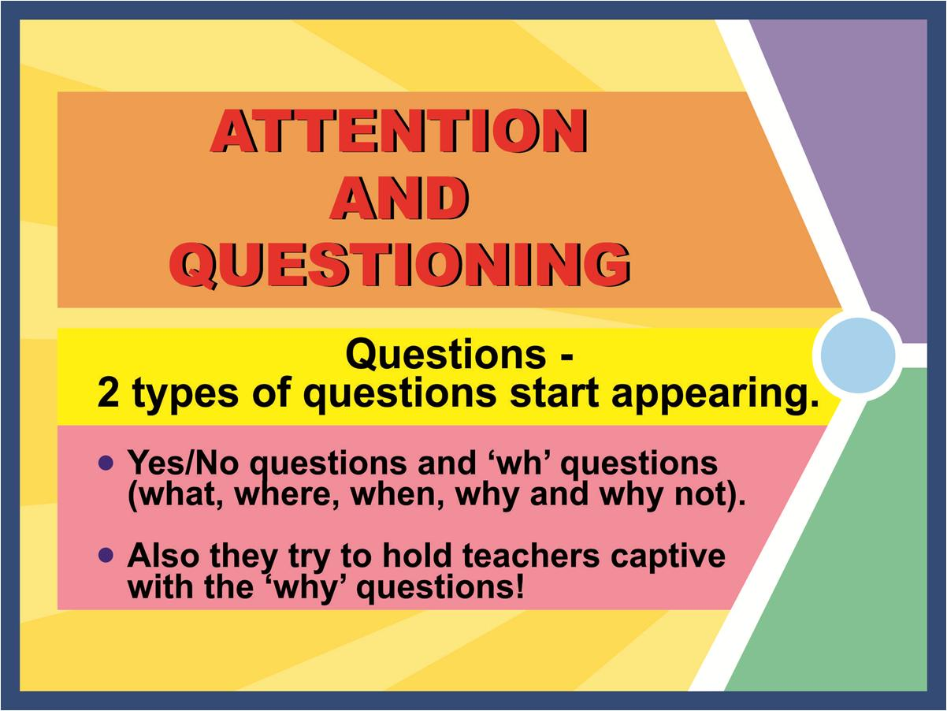
copyright swatipopat@podar.org

Slide 12

copyright swatipopat@podar.org

Slide 13
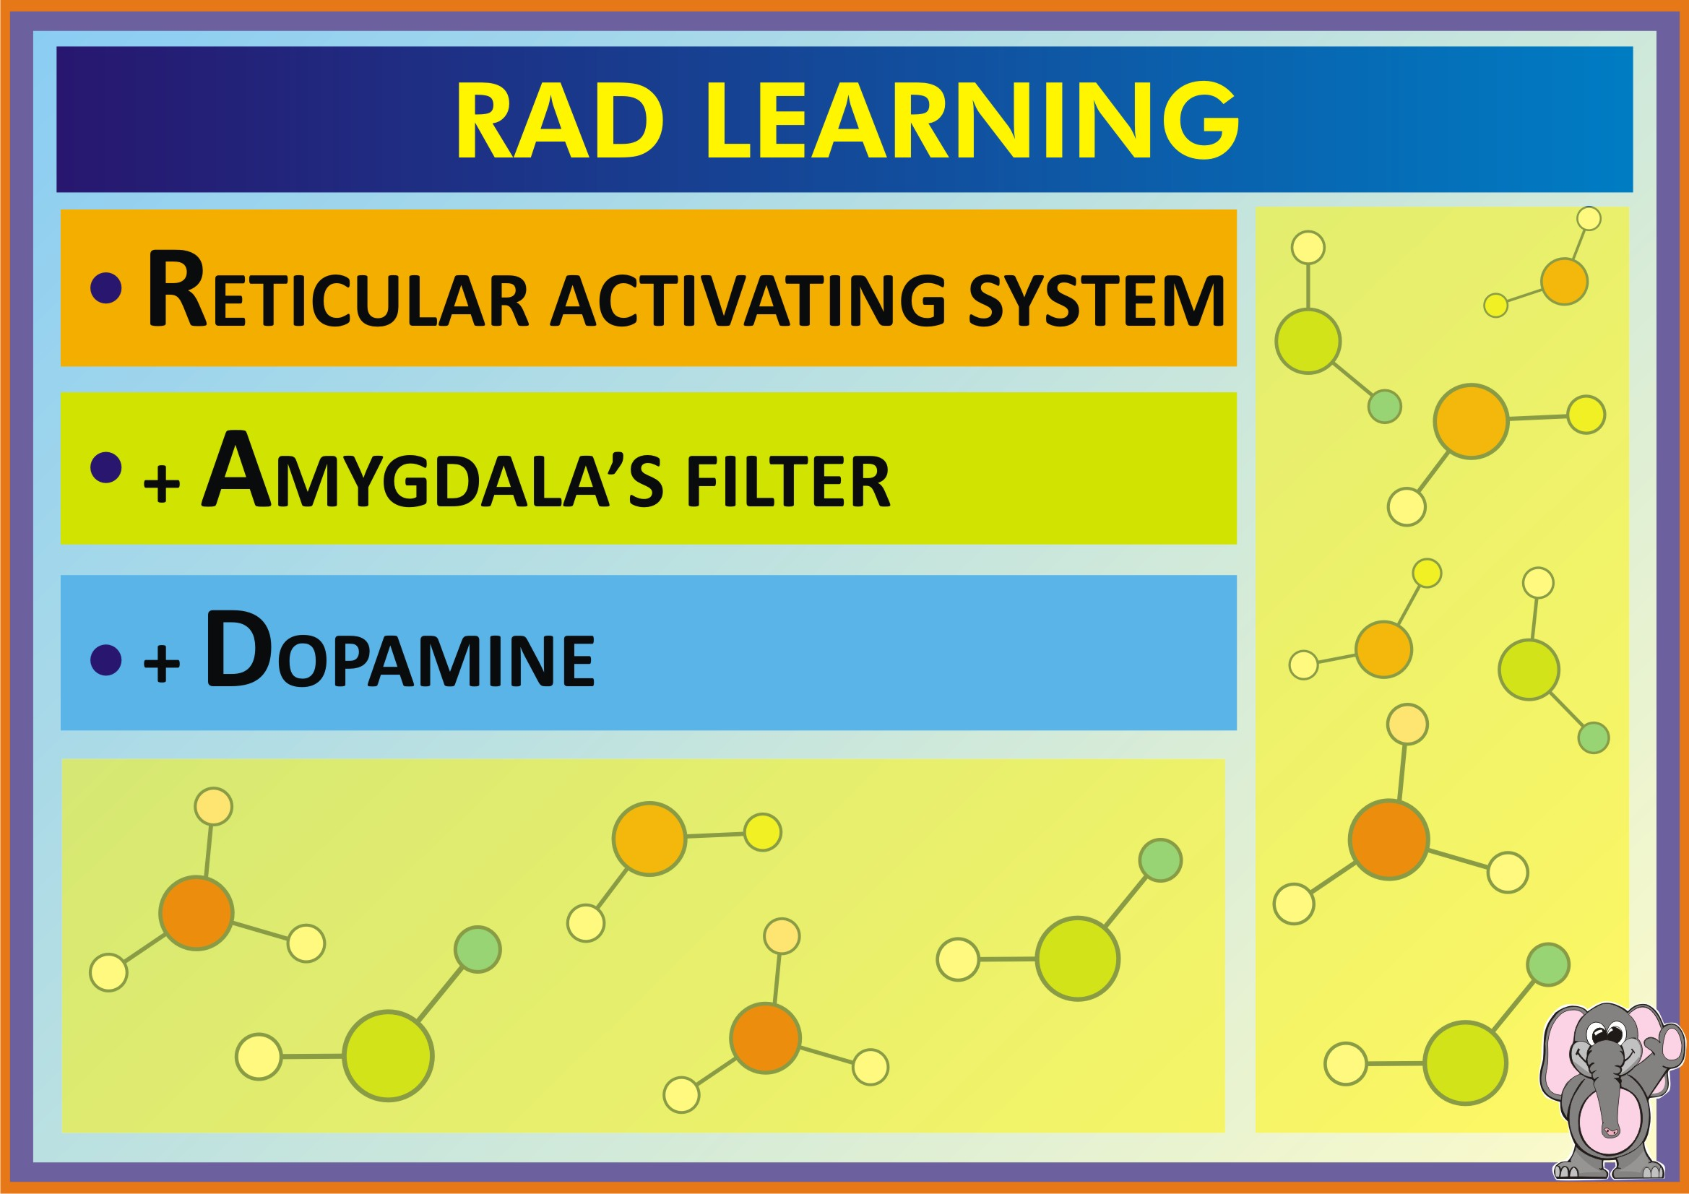

Slide 14
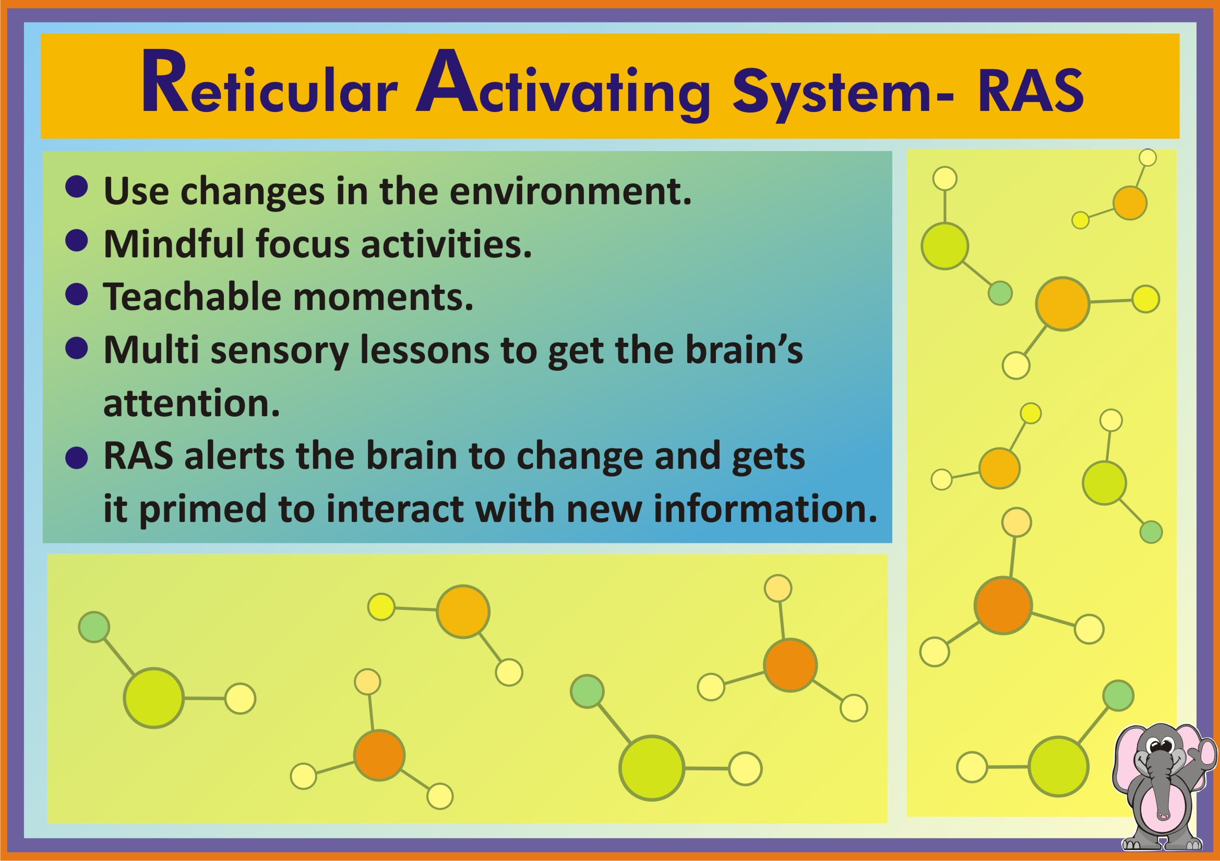

Slide 15
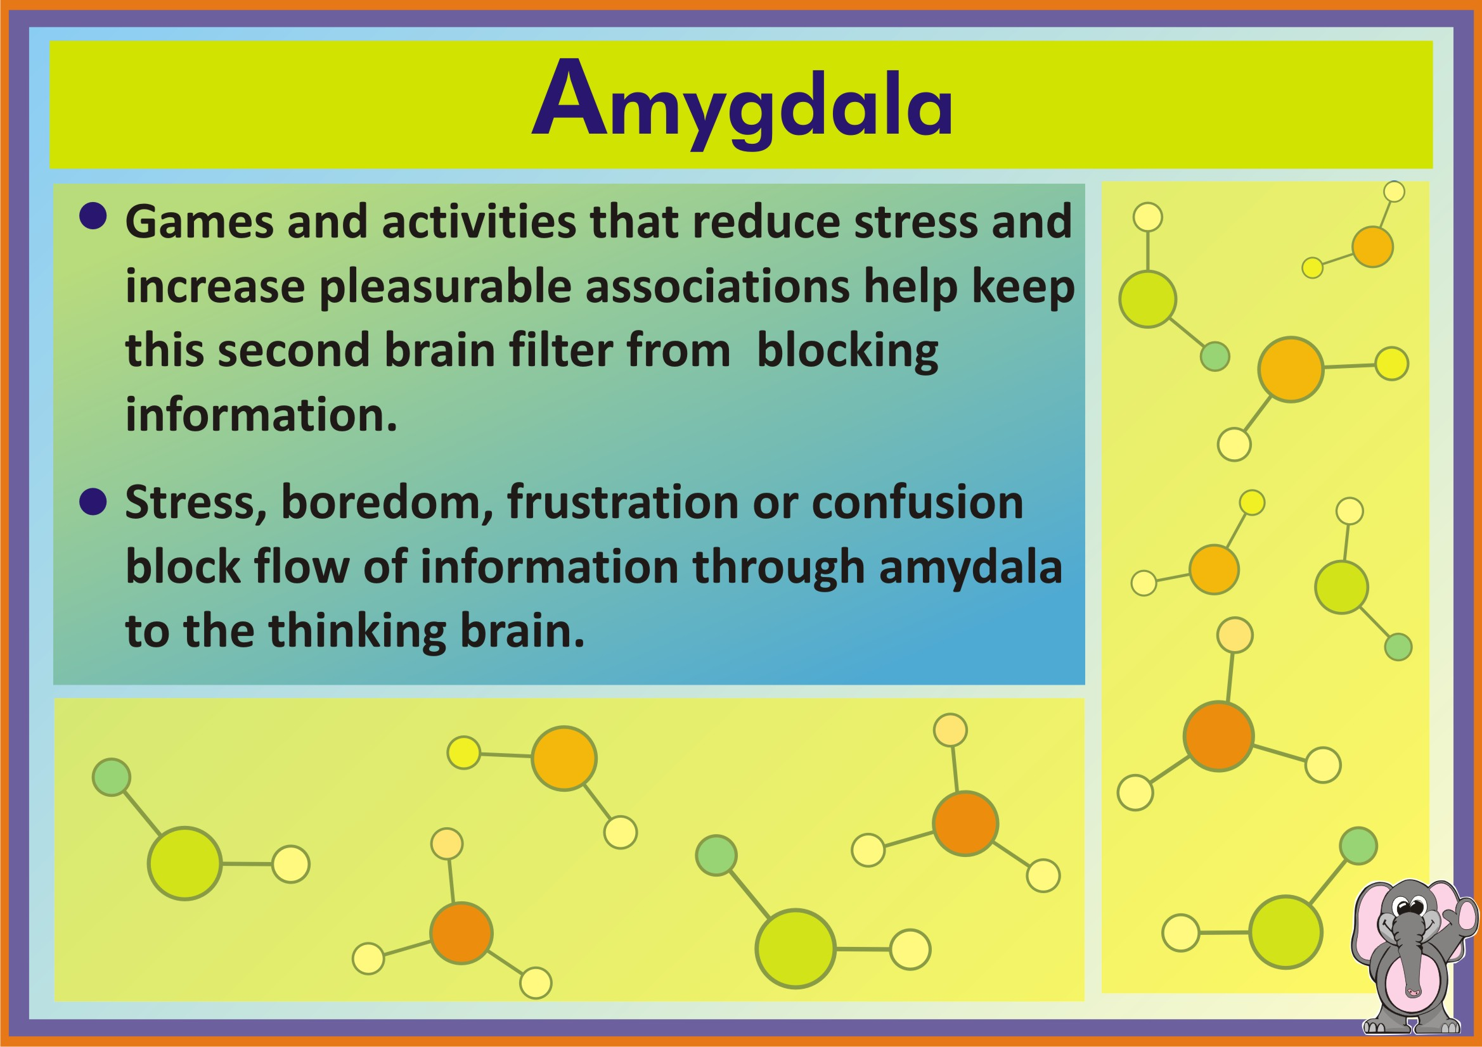

Slide 16
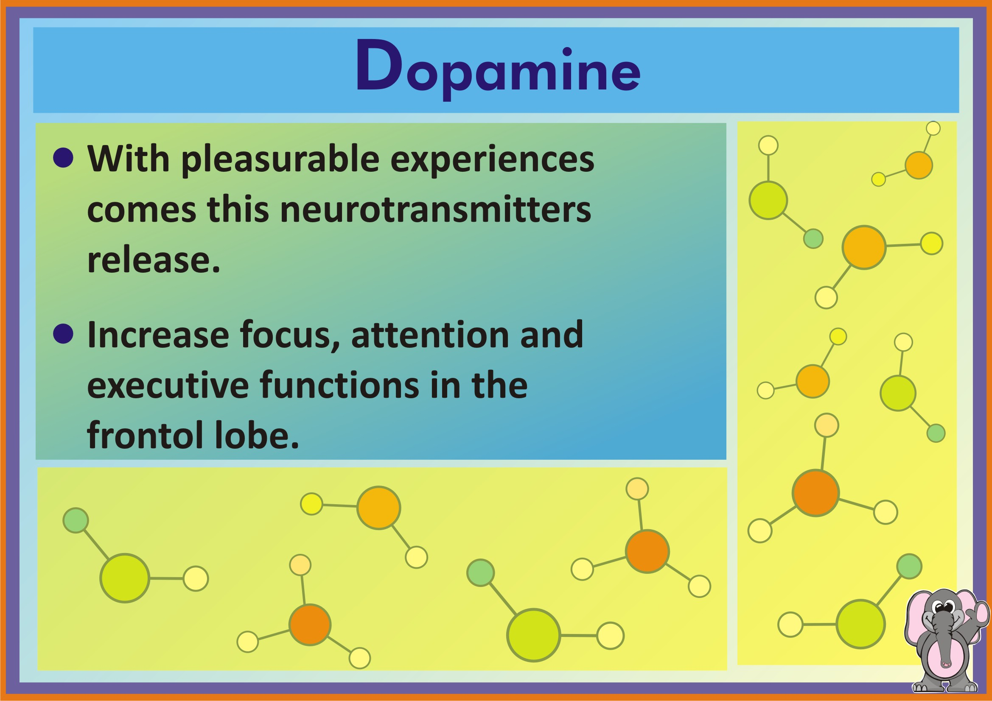

Slide 17

copyright swatipopat@podar.org

Slide 18
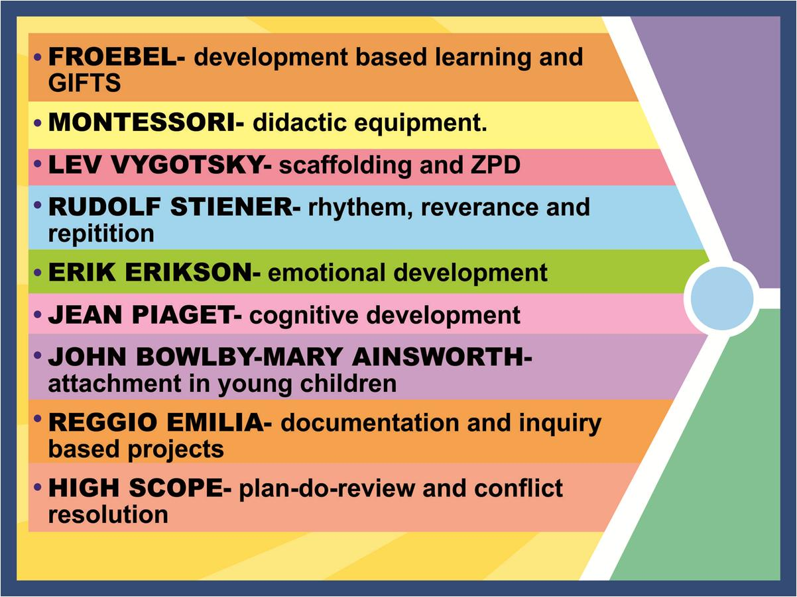
copyright swatipopat@podar.org

Slide 19
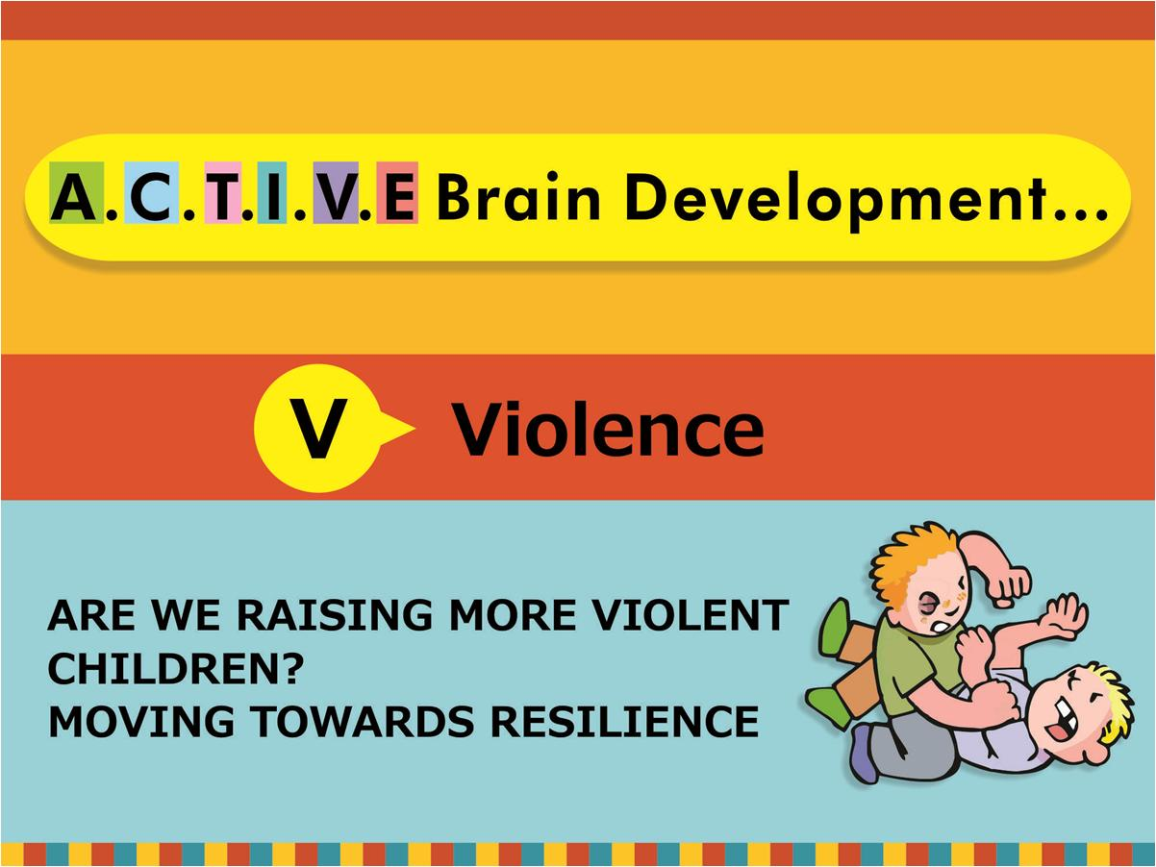
copyright swatipopat@podar.org

Slide 20


Slide 21
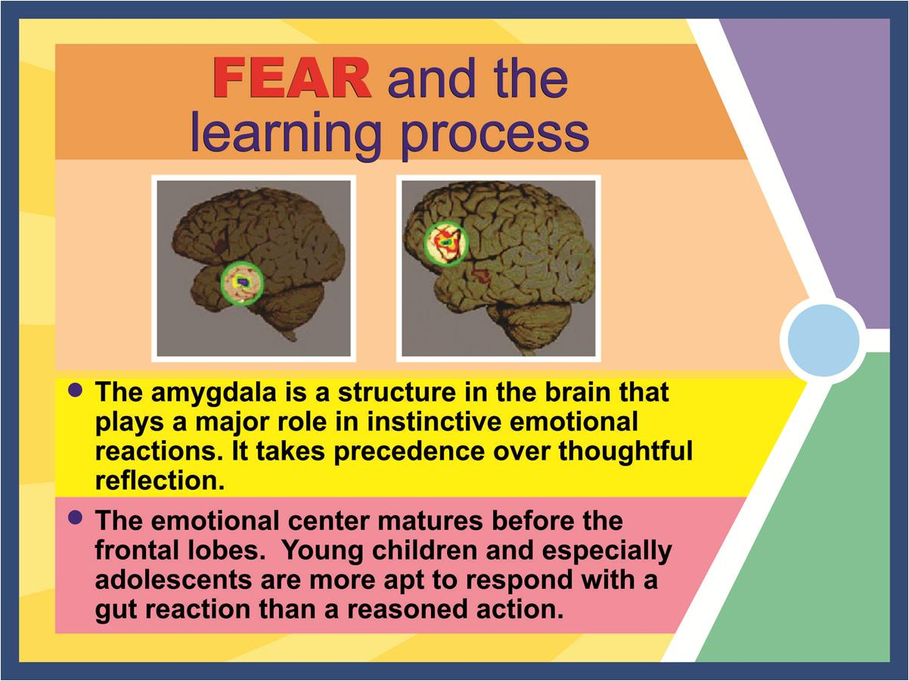
copyright swatipopat@podar.org
Notes:
21

Slide 22
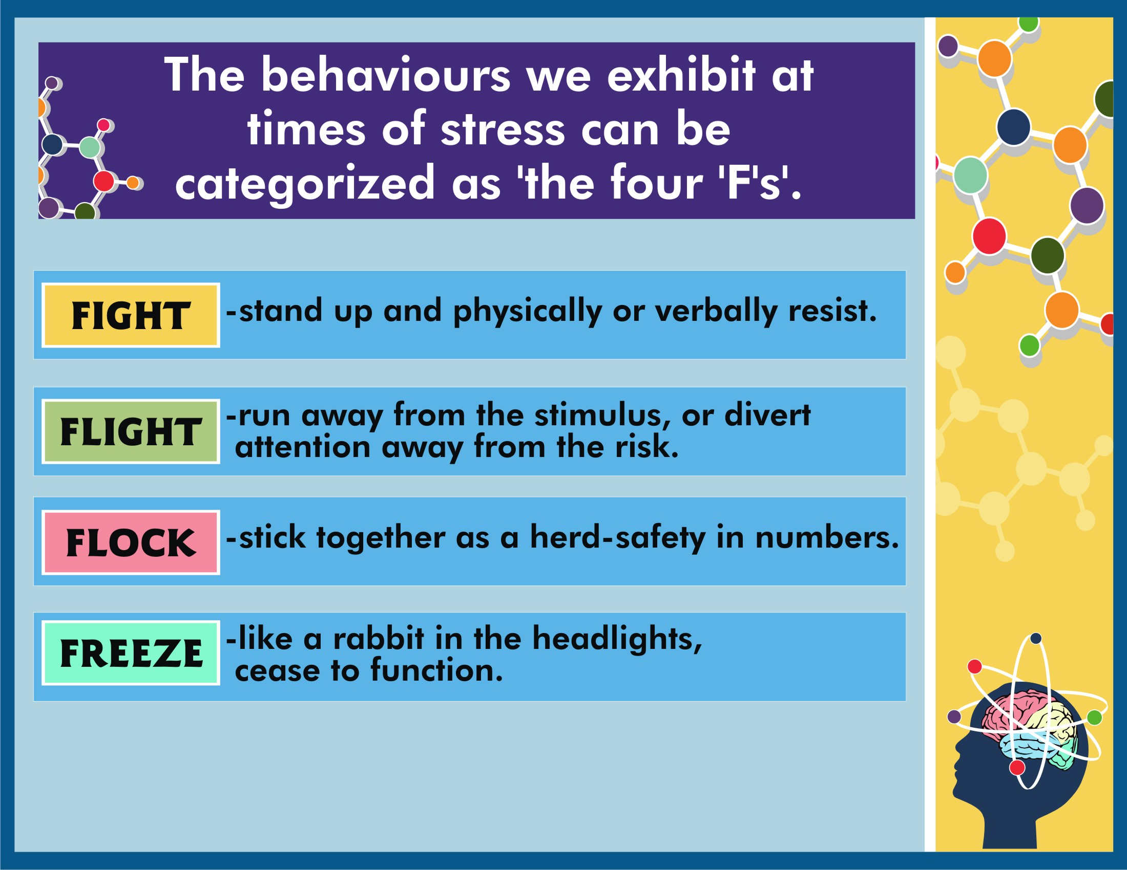

Slide 23
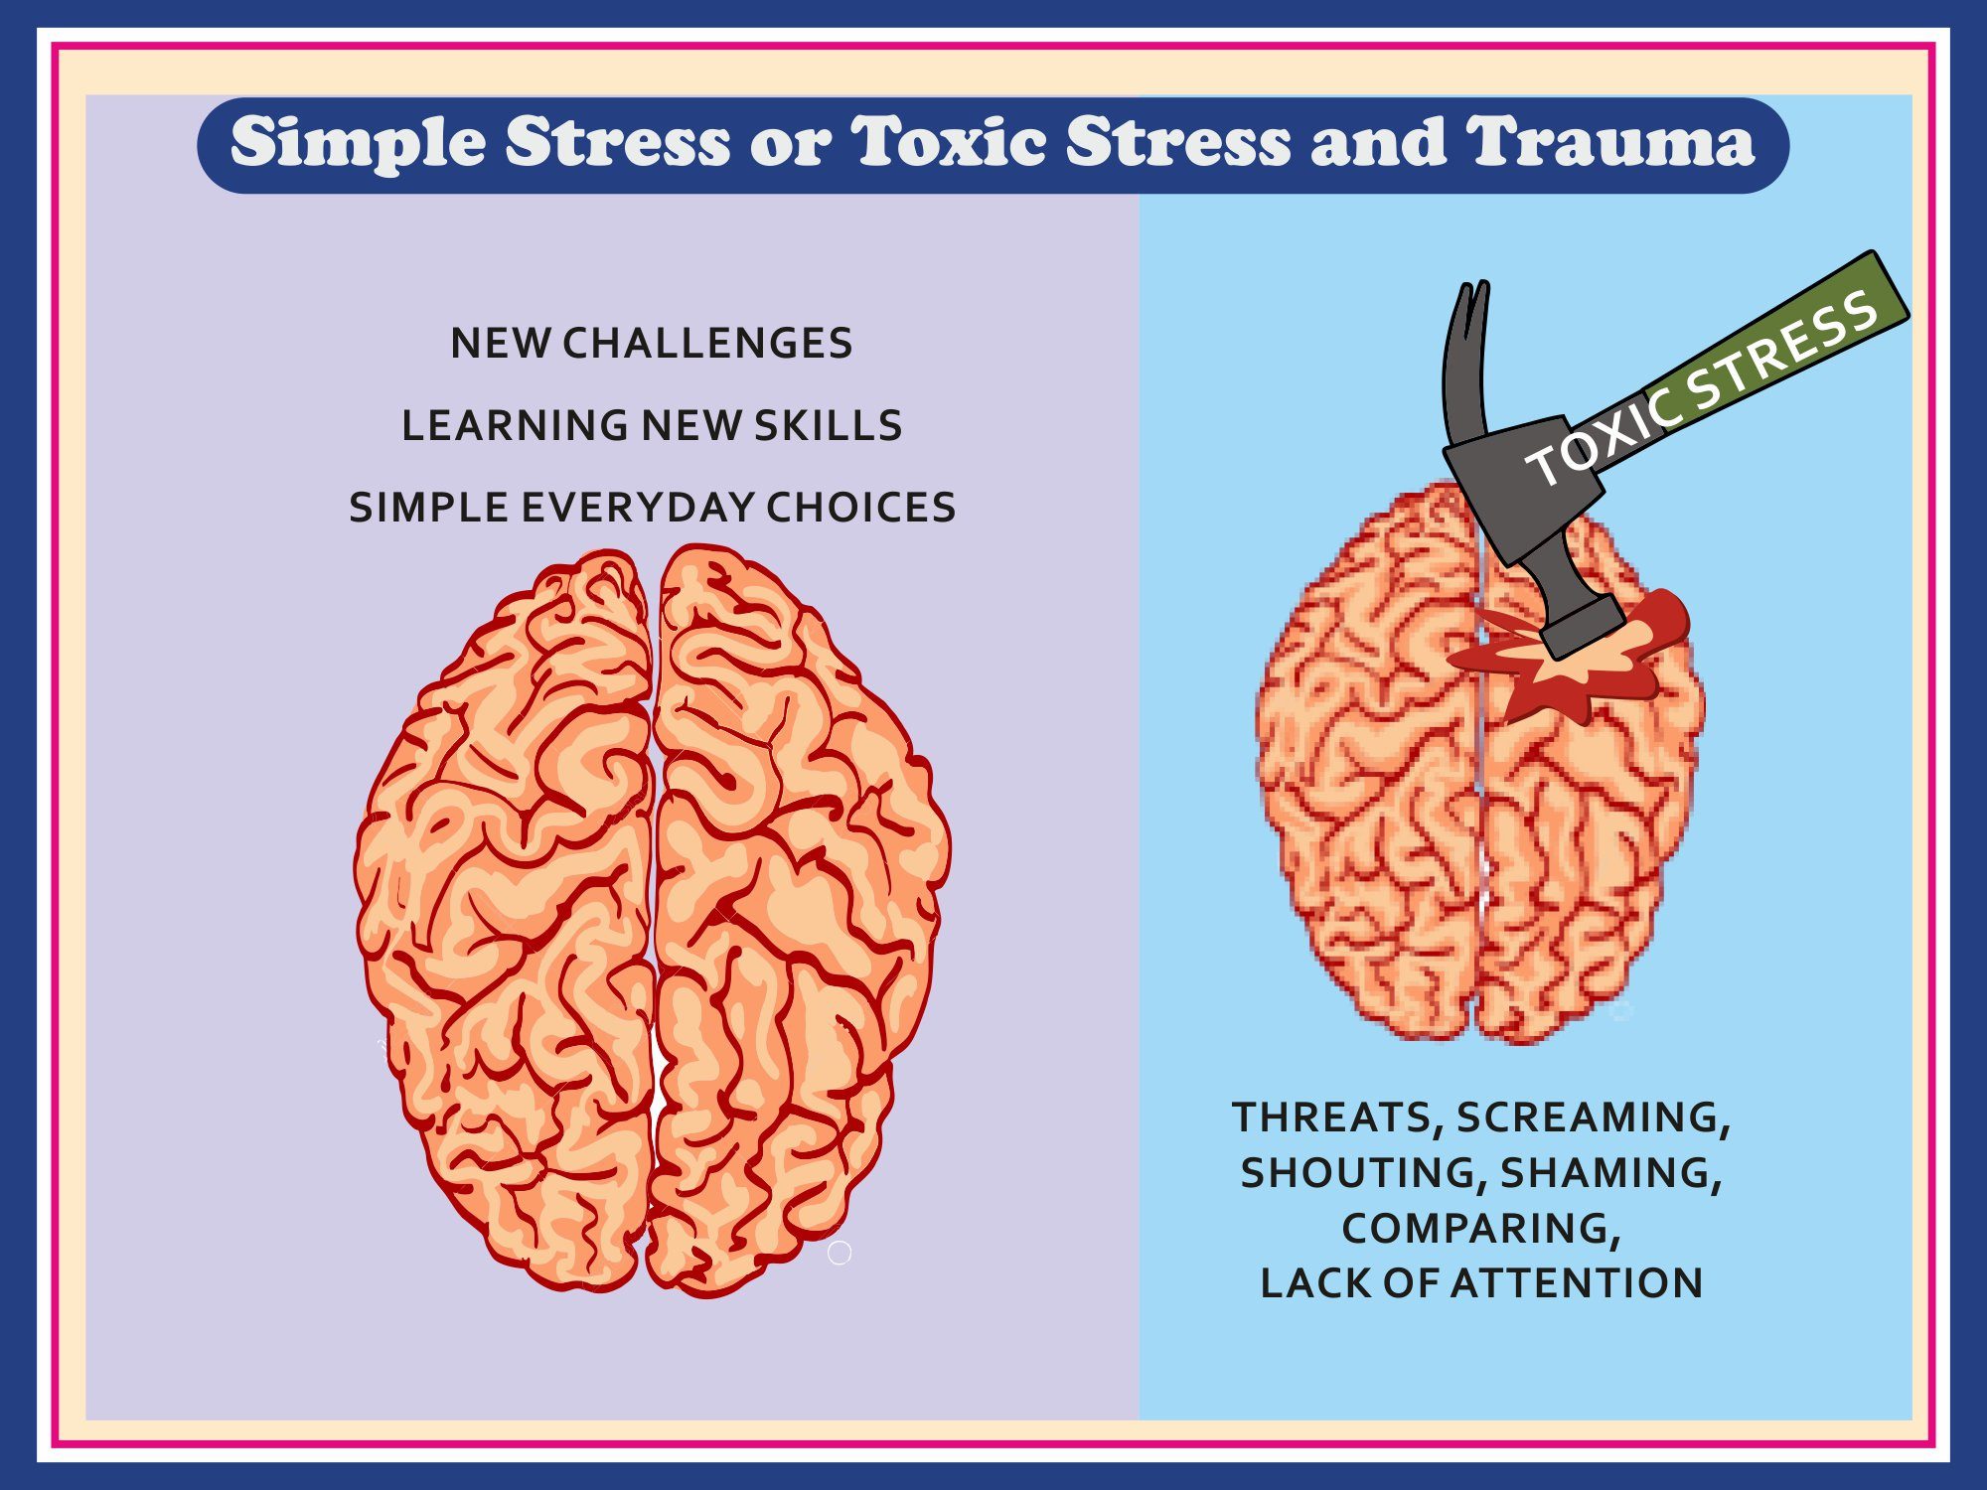
Notes:
Change heading to Simple Stress or Toxic Stress and Trauma
Make the brain better looking, remove watering can, put the headings in such a way it can be read
The brain on the right, make it smaller and wrinkly as if shrivelled and make an impact like a dent where it hits the brain, on the hammer write toxic stress and under the brain wirte- threats, screaming, shouting, shaming, comparing, lack of attention

Slide 24
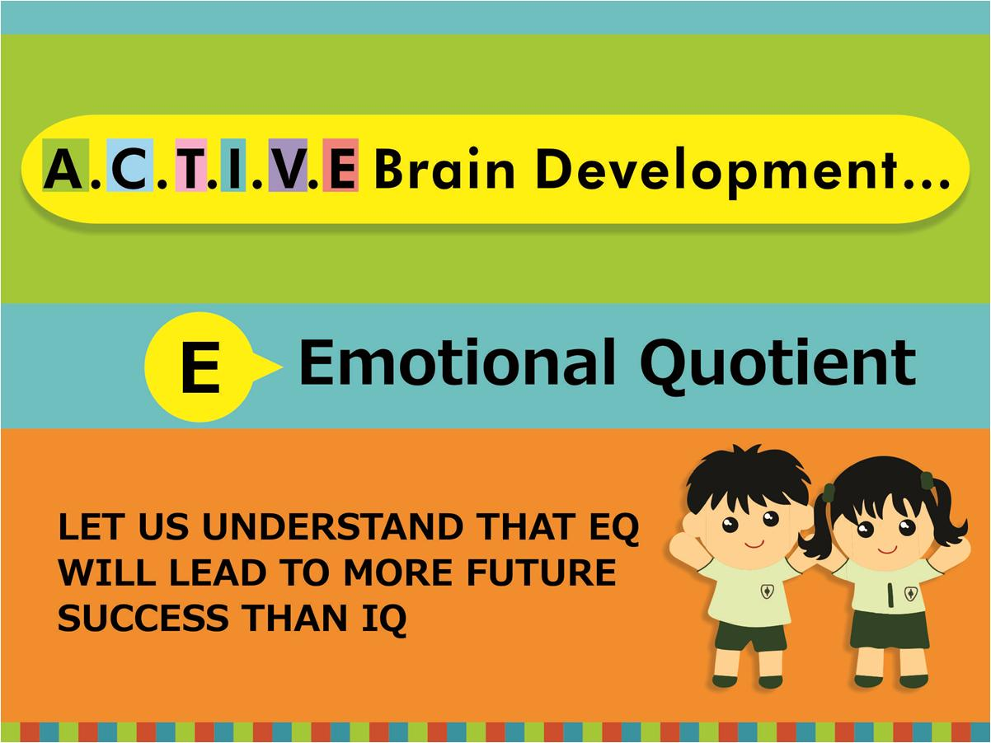
copyright swatipopat@podar.org

Slide 25

copyright swatipopat@podar.org

Slide 26
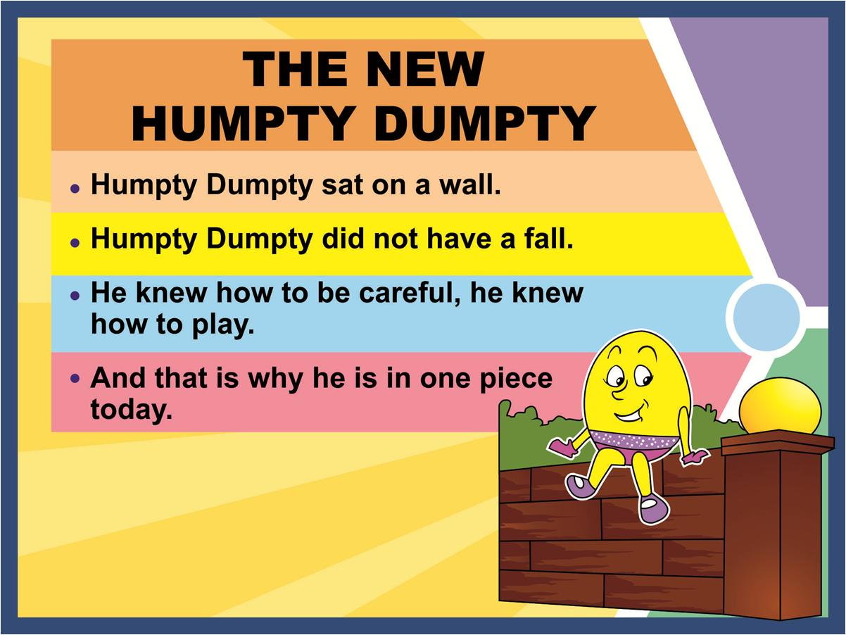
copyright swatipopat@podar.org

Slide 27
Emotions.Fairness.
Behaviour

Slide 28


Slide 29
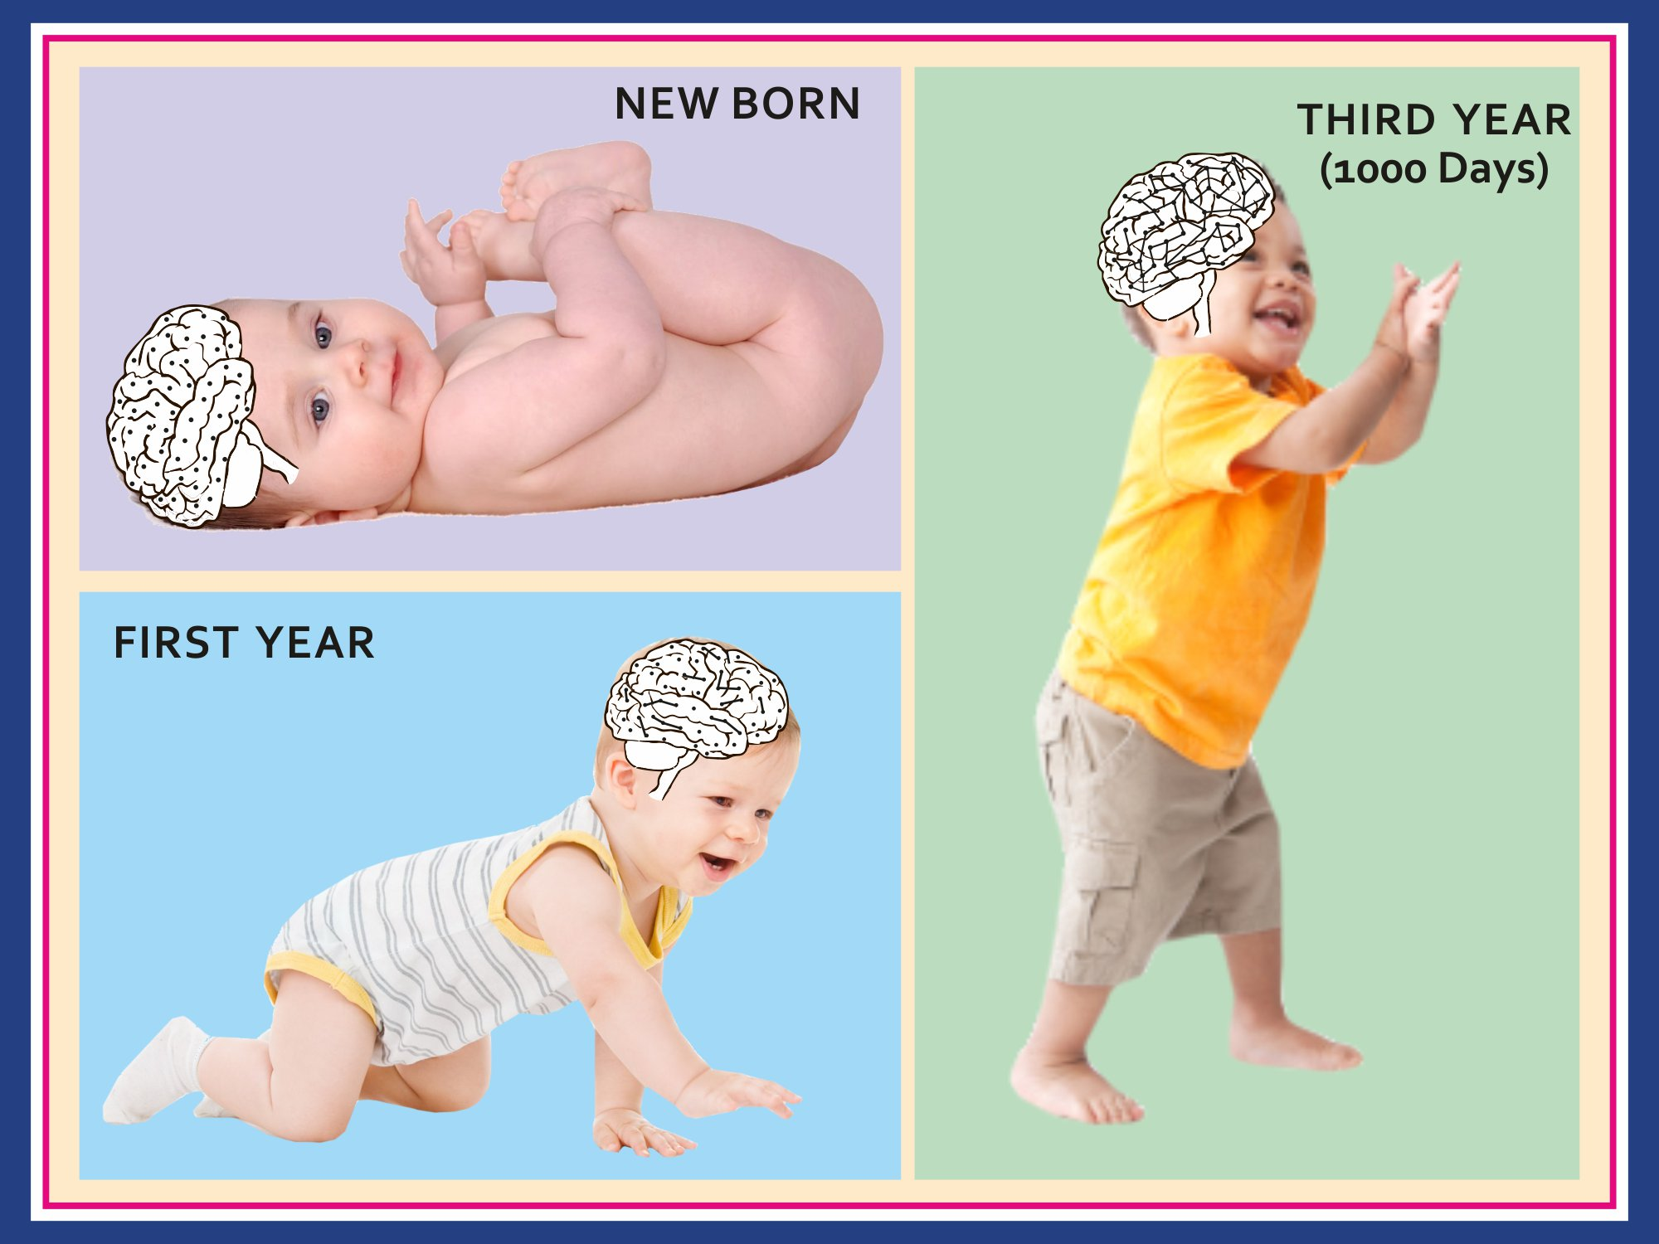
Notes:
Same here, brain should be white so that the connections difference is seen. Babies real, also in new born only dots, in first year show some lines between the dots and the three years how it is complex connections

Slide 30
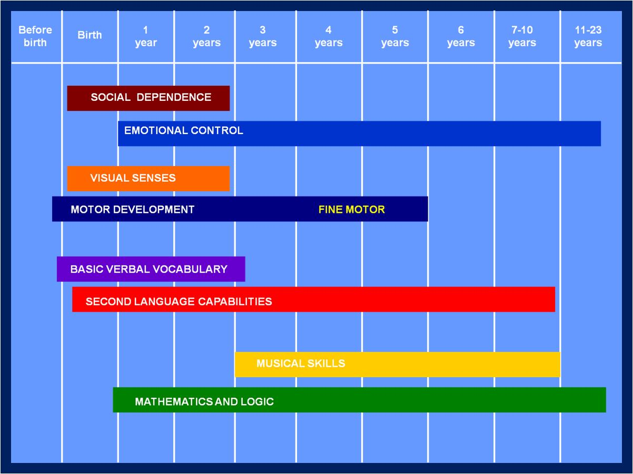
copyright swatipopat@podar.org

Slide 31
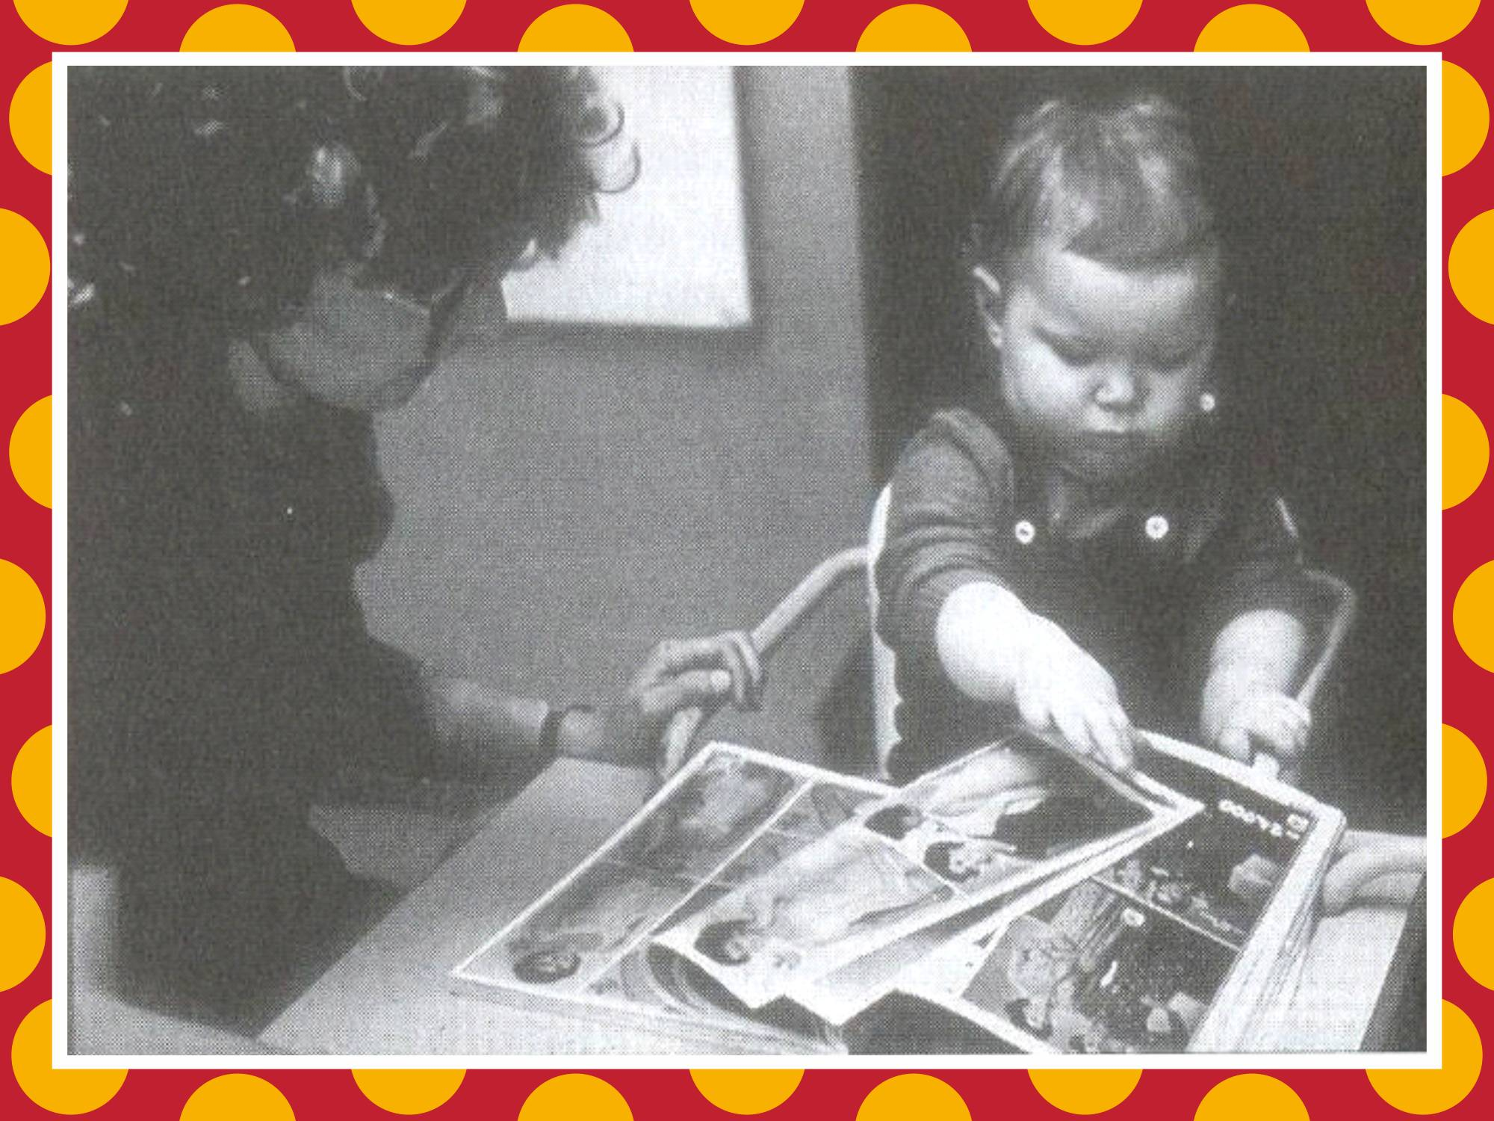

Slide 32
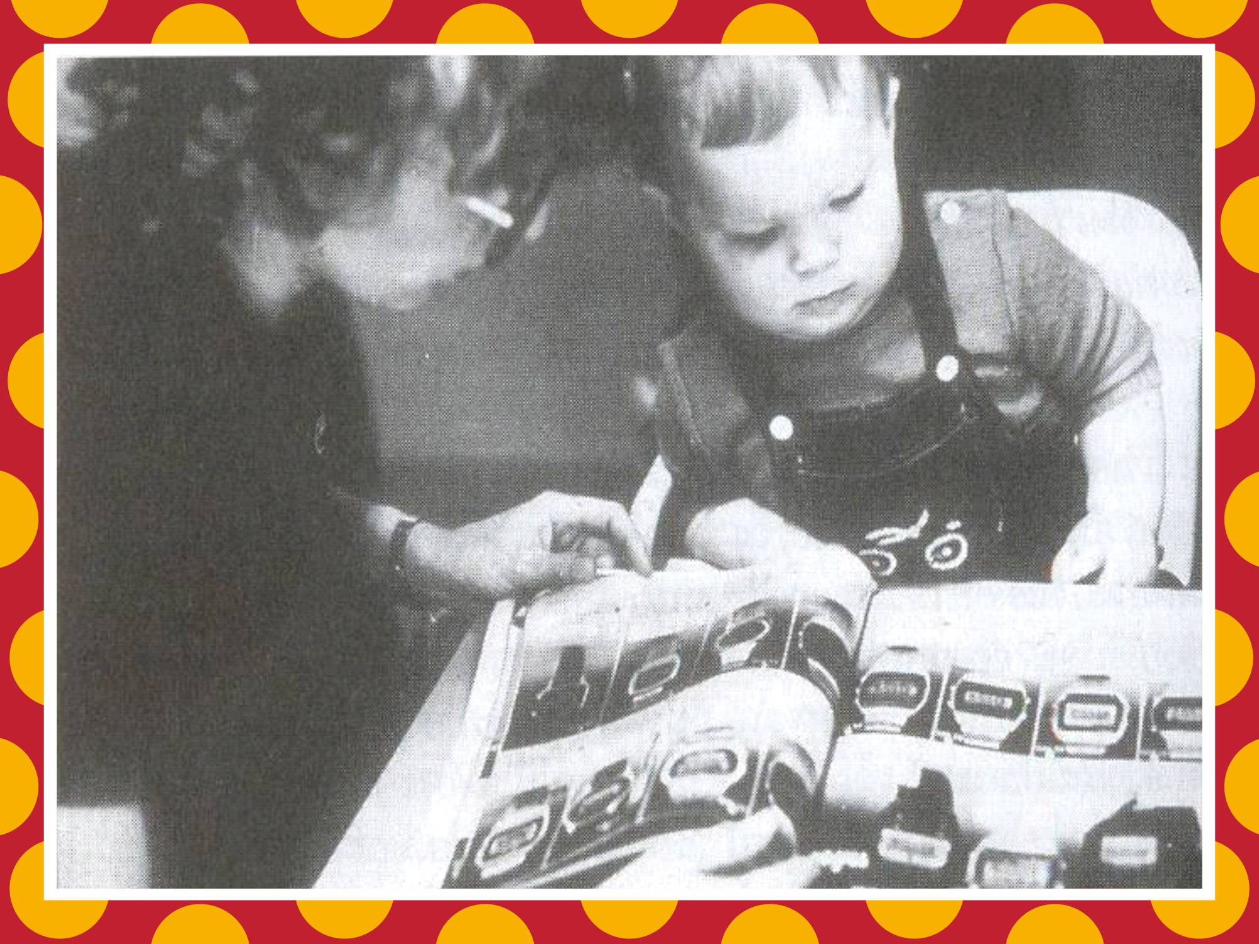

Slide 33
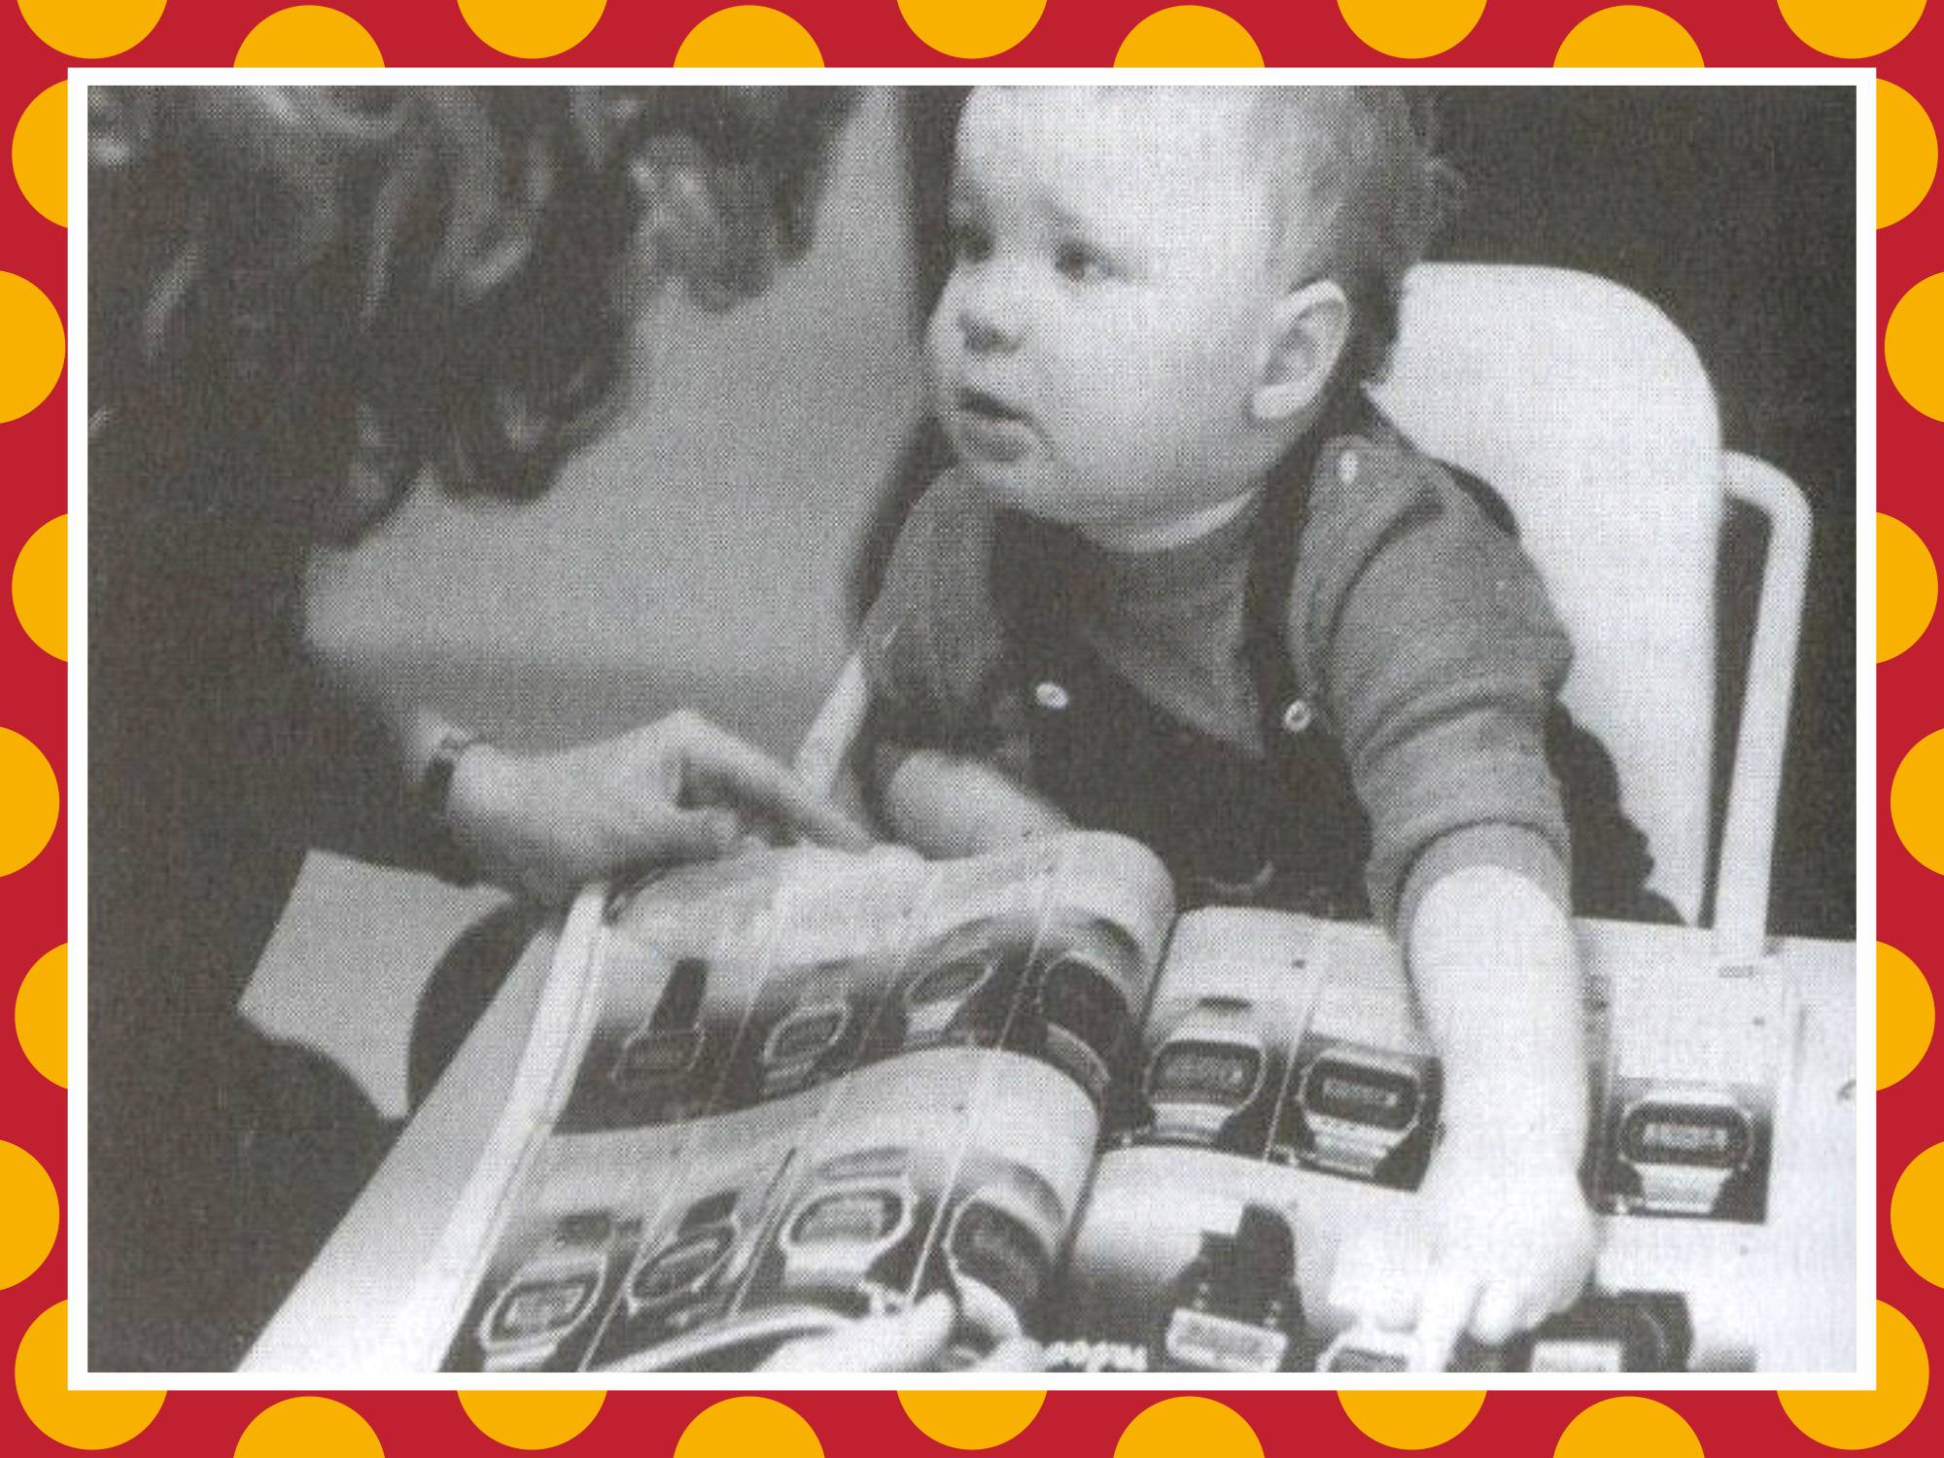

Slide 34
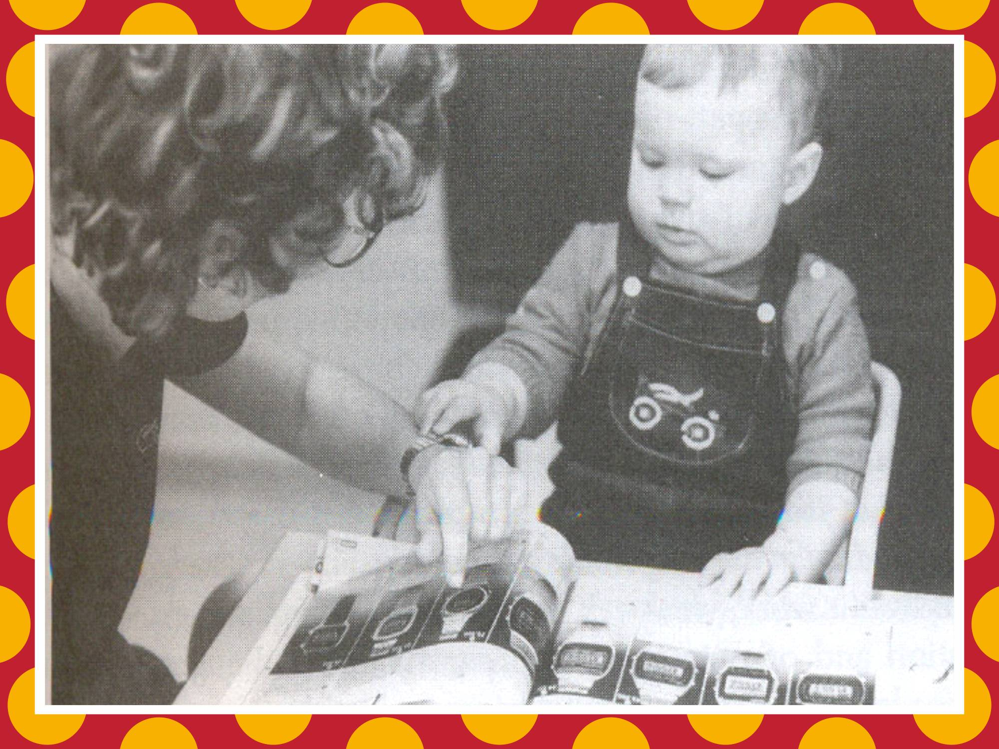

Slide 35
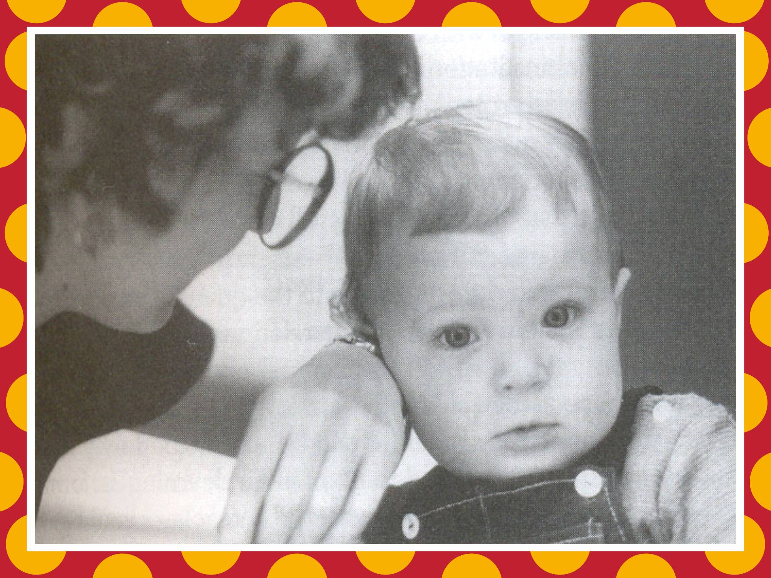

Slide 36
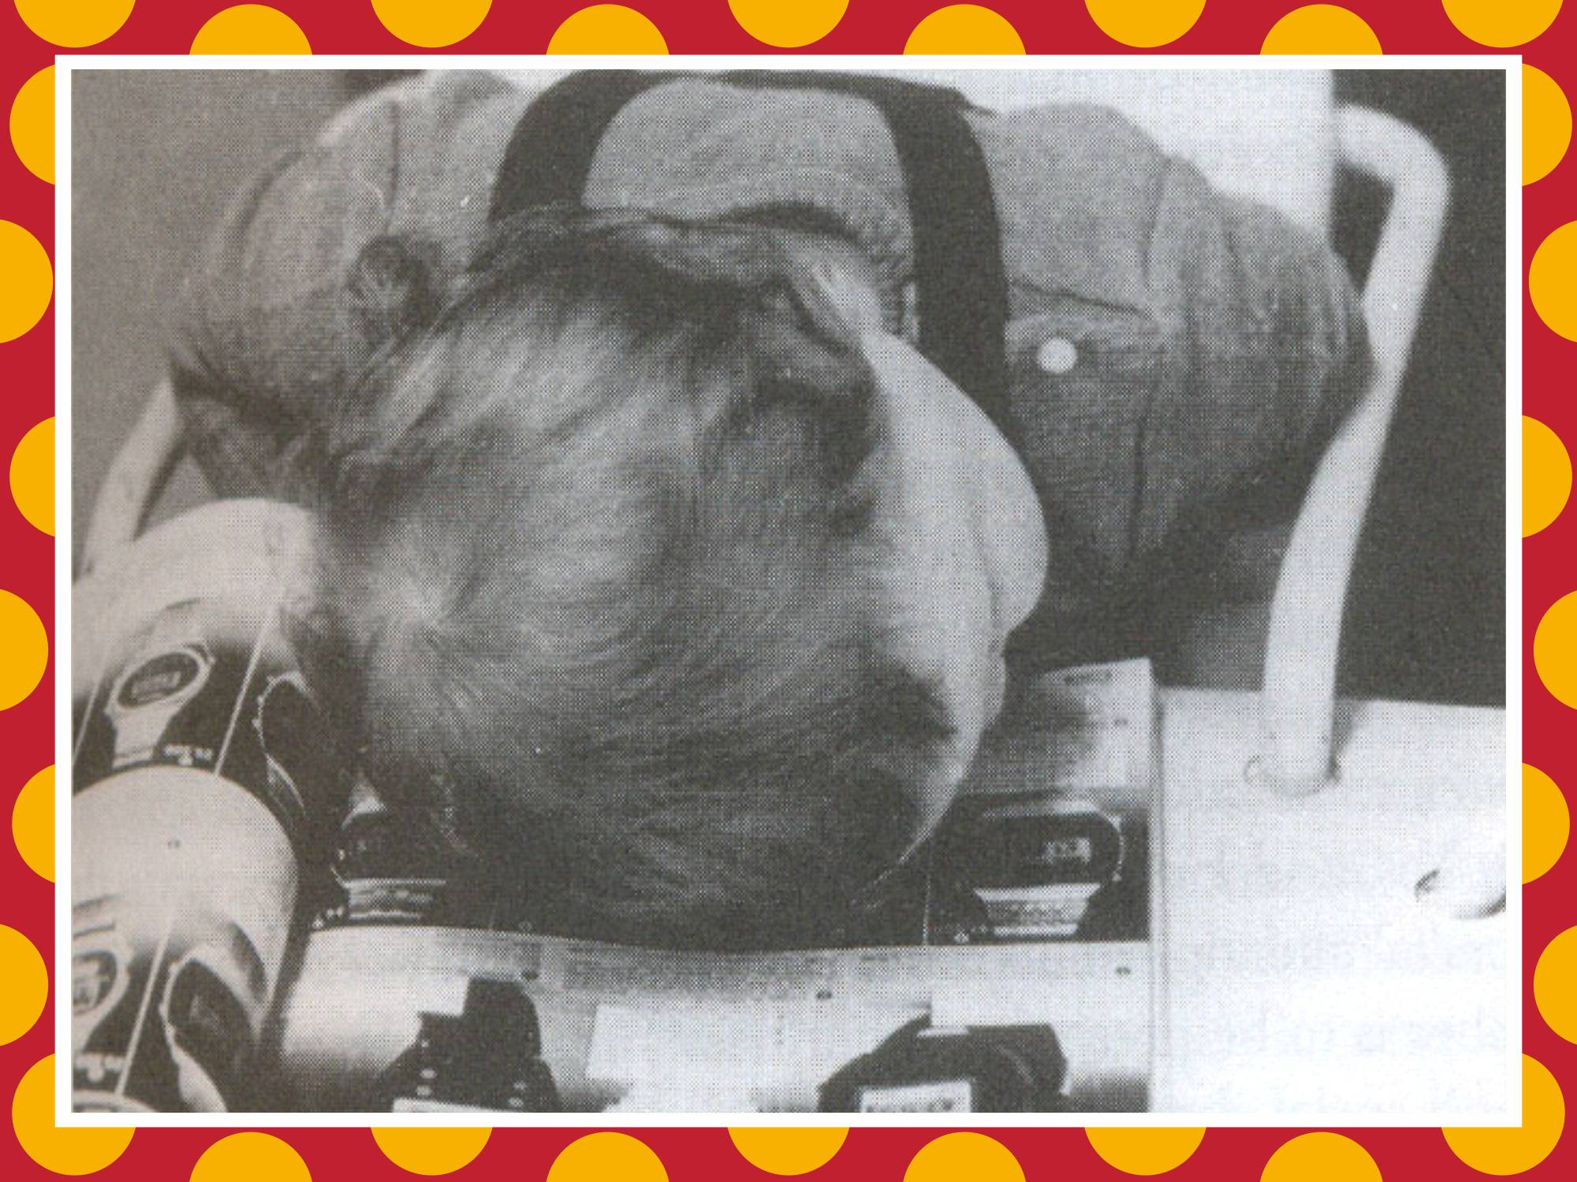

Slide 37

copyright swatipopat@podar.org

