Slide 1
BASIC HISTORY OF ECE IN INDIA
DR. SWATI POPAT VATS
PRESIDENT
PODAR EDUCATION NETWORK
EARLY CHILDHOOD ASSOCIATION
www.eca-india.org

Slide 2
The concept of formal pre-primary schooling in India came from the Western countries in the late 19th century.

Slide 3
Families…
Families had a big part in imparting various kinds of qualities in children.
Large joint families consisted of many children of the same age who would play and learn together under the supervision of parents, grandparents, older children and other relatives.
The need of a formal school system for young children in the age group of 0-5 was not felt.

Slide 4
The beginning of formal education in ECE…
The British Government attached an Infant class to primary schools to prepare 4-5 years old children for entry to Std. I.
Reading, counting up to 100, reciting poems and story-telling constituted the curriculum.
But the formal test at the end of the school year showed that such a formalized education system for pre-school children was not conducive to their development, as large number of children failed and dropped out.

Slide 5
West and ECE
This was the era when a number of child-development theories emerged in the Western countries which had already become aware of the shortcomings of pre-school education.
Philosophers like Froebel, Piaget, Dewey and Maria Montessori revolutionized the education system which still continues to influence the educators throughout the world.

Slide 6
Influencers in India…
Tagore, Gandhi, Aurobindo, Gijubhai Badheka, Tarabai Modak were also inspired by these philosophers and were one of the first few educationists in India who realized the importance of early childhood education

Slide 7
Tagore and Gandhi both were in favour of child education.
Tagore believed that the school environment was an arrangement to give pre-decided lessons whereas nature is the best teacher for children under the age of 7.
Tagore’s theory on education focused on individual differences and demanded that curriculum should address the needs of children.
He claimed that music, art and poetry are essential to the overall development of children and thus they should be facilitated with these in the early years of school (Vittachi, Raghavan & Raj, 2007).

Slide 8
Gandhi’s views about education of children under the age of 7
He also believed that education can be best imparted in the natural surroundings and that it should be contextualized with the child’s background.
He developed the concept of Nai Taleem which was the first major initiative towards early childhood education in India. He was against the textbook culture and exam-oriented approach to education.

Slide 9
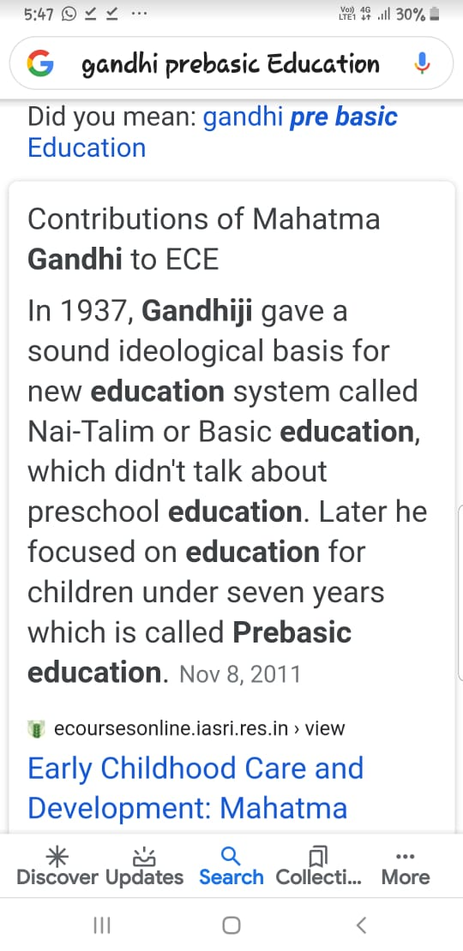

Slide 10
Gandhi and NEP 2020
By making children independent from young age, giving instruction in mother tongue and stressing on the culture of India, feeling of strong nationalism was to be inculcated through basic education.
In a speech given on 17th February, 1946, he said that a child starts learning from the time of conception itself and so he said that pregnant women should be taught as a part of adult education till the child is born (NCTE, 1998).

Slide 11
Gandhi and prebasic education…
Till 2 and half years of age, parents will be responsible for the child’s education. By that time, children are able to use their sensory and motor skills.
Thus, formal pre-basic education will start at 2 and half years where children will learn through play and group activities. The education will teach them to be constructive and creative.

Slide 12
Gandhi and prebasic education…
From 4 to 7 years of age, first knowledge about their region.
Then, arithmetic, multiplication tables and finally reading-writing skills will be taught. Along with craft-work, agriculture, cooking and cleaning related activities were also included in order to make the children self-sufficient.

Slide 13
1915- montessori school- Vaso
By this time, Maria Montessori’s ideas had already influenced few social workers in India. Darbar Gopaldas, king of Dhasa and Motibhai Amin, a teacher from Vaso were very influenced by Montessori’s methods of teaching and thus in 1915, with the financial help of Darbar Gopaldas, he established a Montessori school at Vaso (“About Vaso”, n.d.).

Slide 14
Gijubhai Badheka and Bal Mandir-1920
In 1920, Gijubhai Badheka, a High court lawyer from Bhavnagar, Gujarat opened Bal Mandir, a school in which Montessori methods were Indianized.
There was considerable emphasis on “religion (Hinduism), language (Gujarati) and culture (traditional music, art, dance), along with Montessori materials and activities” (Prochner, 2002, p.441).

Slide 15
Tarabai joins Gijubhai- 1922
In 1922, Tarabai Modak who was the first Indian Principal of the Barten Female College of Education at Rajkot, resigned from the post and joined Badheka as she was also inspired by Montessori’s work in pre-school education.
They together established the Nutan Bal Shikshan Sangh (NBSS) which was responsible for evolution of a preschool system which devised Montessori’s principles suitable to Indian context. They also used Froebel’s methodology with Montessori’s methods and developed innovative techniques of story-telling and handicrafts making (Naik, 1978).

Slide 16
1936- ECE in Bombay
In 1936, at first she conducted a pre-school in a Scheduled-caste locality in Bombay after which she established the Shishu Vihar Mandal in Dadar which conducted pre-school centers and trained pre-school teachers.
Tarabai had realized that the poor and deprived children from rural areas were in need of pre- school education as the practices in the schools mostly reflect the middle class.
Also the materials needed for the Montessori methods were very expensive for the rural setting.

Slide 17
Indianise ECE…
Even Gandhi was not in complete adoption of the Montessori approach as it was not suitable for the Indian socio-cultural milieu.
His letters to Tarabai Modak and Saraladevi Sarabhai (President of NBSS) , written in 1945 show his disagreement by mentioning the above concerns and also that the teachers trained under Montessori were unable to deal with the rural children as they were not aware of the child’s background (NCTE, 1998).

Slide 18
1945- Anutai and Bordi
In 1945, Tarabai moved to Bordi, a small coastal town about 160 kms from Bombay and established the Gram Bal Shiksha Kendra (GBSK) - Center for the Education of Rural Children. Anutai Wagh, a social worker working with the Kasturba Gandhi Trust joined Modak and they started the preschool in Bordi.

Slide 19
The Caste divide…RTE?
But the denial of caste Hindus to send their children to mix with Harijan children in the preschool posed a problem for GBSK (“Tarabai Modak”, n.d.).
The concept of Balwadi developed during this time in 1946. Two types of Balwadi- a central Balwadi which would be open for all children in the regular school hours and the angan Balwadi which was conducted in different courtyards of Bordi by the Gram-sevikas trained by the Kasturba Gandhi Trust, so that children and their parents of any caste can realize the significance of the preschool and do not get deprived of it

Slide 20
1937-1939 Montessori visits…
In 1934, George Arundale, husband of Indian dancer Rukmini Devi, invited Maria Montessori to take charge of the Besant Theosophical High School.
Montessori came to Adyar in 1939 and worked as a teacher at this school for three years.
Rukmini Arundale also helped Montessori setup a teacher- training center at Adyar.
Around the same time in 1937, Dr. V.N.Sharma and his wife Ellen Sharma founded The Children’s Garden School in Mylapore, Chennai. Similar to Bal Mandir, this preschool also integrated Froebel’s and Montessori’s methods and modified them to suit Indian context (Prochner, 2002).

Slide 21
1944- Sargent Plan
In 1944, the Central Advisory Board of Education (CABE) presented a post-war educational development proposal known as the Sargent Plan.
This was the first official document which recommended pre-primary schools for children of the age group 3-6
It even gave an estimate that 32,000 Rs. Per year expenditure will be needed for this (Naik, 1965).!!!!!
But, there is no record after this which shows that this plan was implemented.
The significant contribution of this report was that it recommendation of free and compulsory education for children of 0-14 years of age was included in the Article 45 of the Constitution.

Slide 22
1953- first official recommendation…
After independence, the first government initiative for inclusion of pre-primary school in the existing primary school system as suggested by the Committee on early Childhood Education came in 1953.
The Central Social Welfare board started grant-in-aid scheme for voluntary organizations. The Committee on Child Care (1963-1964) suggested that the various philosophies about child development and preschools from Western countries should be adjusted to suit the Indian society.
This committee also recommended the introduction of midday meals in preschool programs.

Slide 23
1964- Kothari commission…
In 1964, the Kothari Commission of India recommended the establishment of state-level pre-primary education centers.

Slide 24
1974- national policy on children
The National Policy on Children (1974) integrated the aspects of care and education in early childhood education which got reflected in the Fifth Five Year Plan in 1975 (Sood, 2003).
The Integrated Child Development Scheme (ICDS) was launched with 33 pilot projects providing healthcare services to children of 0-6 years of age, pregnant and lactating mothers. The objectives of the ICDS include promotion of child and maternal health, nutrition and preschool education for children aged 3–6 (Department of Women and Child Development, 1995, cited in Prochner, 2002).

Slide 25
National policy on education- 1986
The National Policy on Education (1986) emphasized early childhood care and education (ECCE).
It suggested that programmes of ECCE should be focused around play and takes into account the individual differences of child. It warned against the introduction of 3 R’s at the initial stage of education.
Provision of day care centers to support education of young girls who are otherwise unable to attend schools because of responsibility of siblings was recommended.

Slide 26
1992-2005
Convention on the Rights of the Child (1992) by India prepared a National Charter for Children which again put stress on the nutrition, health care and education of children (NCERT, 2006).
The National Curriculum Framework (2005) says:
Early Childhood Care and Education (ECCE) requires that young children be provided care, opportunities and experiences that lead to their all-round development — physical, mental, social and emotional, and school readiness. A holistic and integrated perspective views the health and nutritional needs of children as integrally related with their psychosocial/educational development. (NCF, 2005, p.65)

Slide 27
Teacher in ECE
Although, all the policies have given emphasis to early childhood education, most of the schools do not take into account the critical role of teacher and employ unqualified teachers to reduce their expenditure.
They should also be prepared to deal with multicultural classrooms so that children who come from diverse backgrounds do not find it difficult to learn because of cultural differences.
The inadequate number of qualified teachers in this field is mainly because of the low salary given to them.
The qualified teachers in the pre-school level should also be paid on the same scale with that of elementary school teachers.

Slide 28
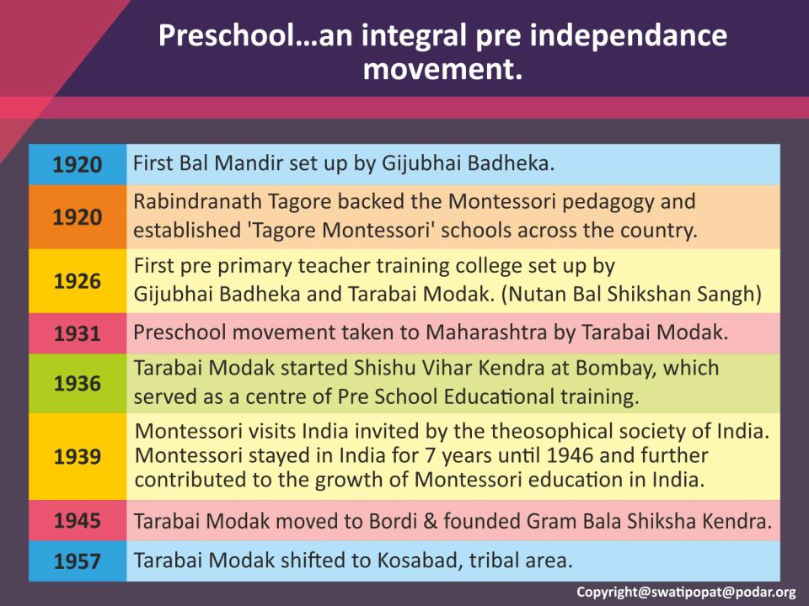

Slide 29
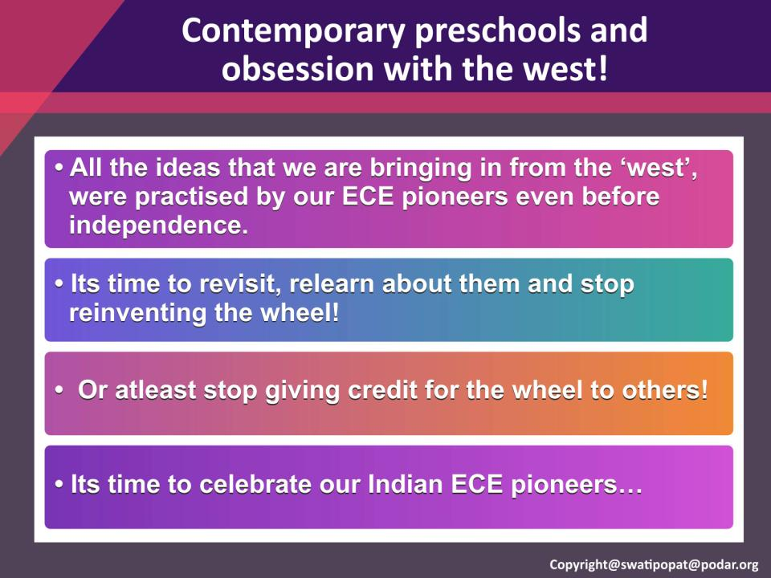

Slide 30
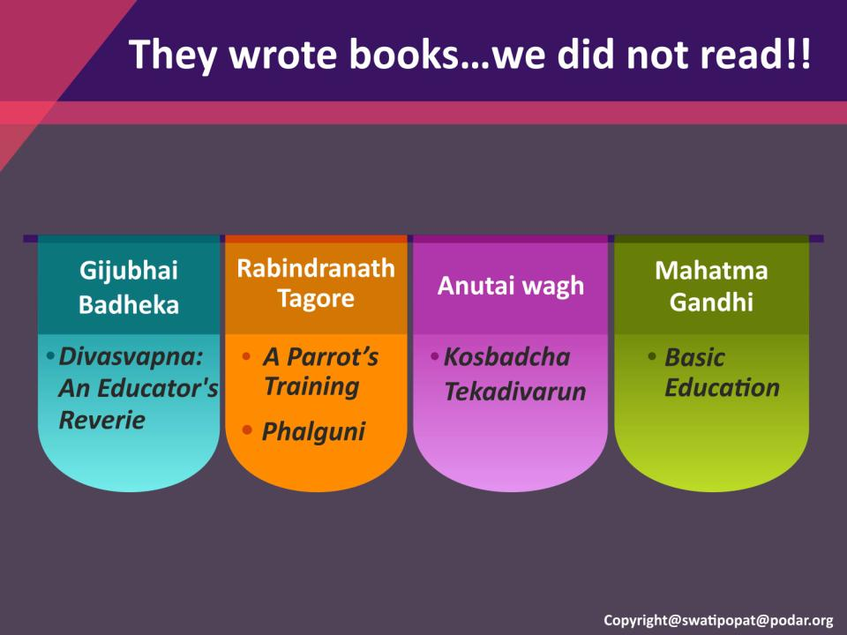

Slide 31
