Slide 1
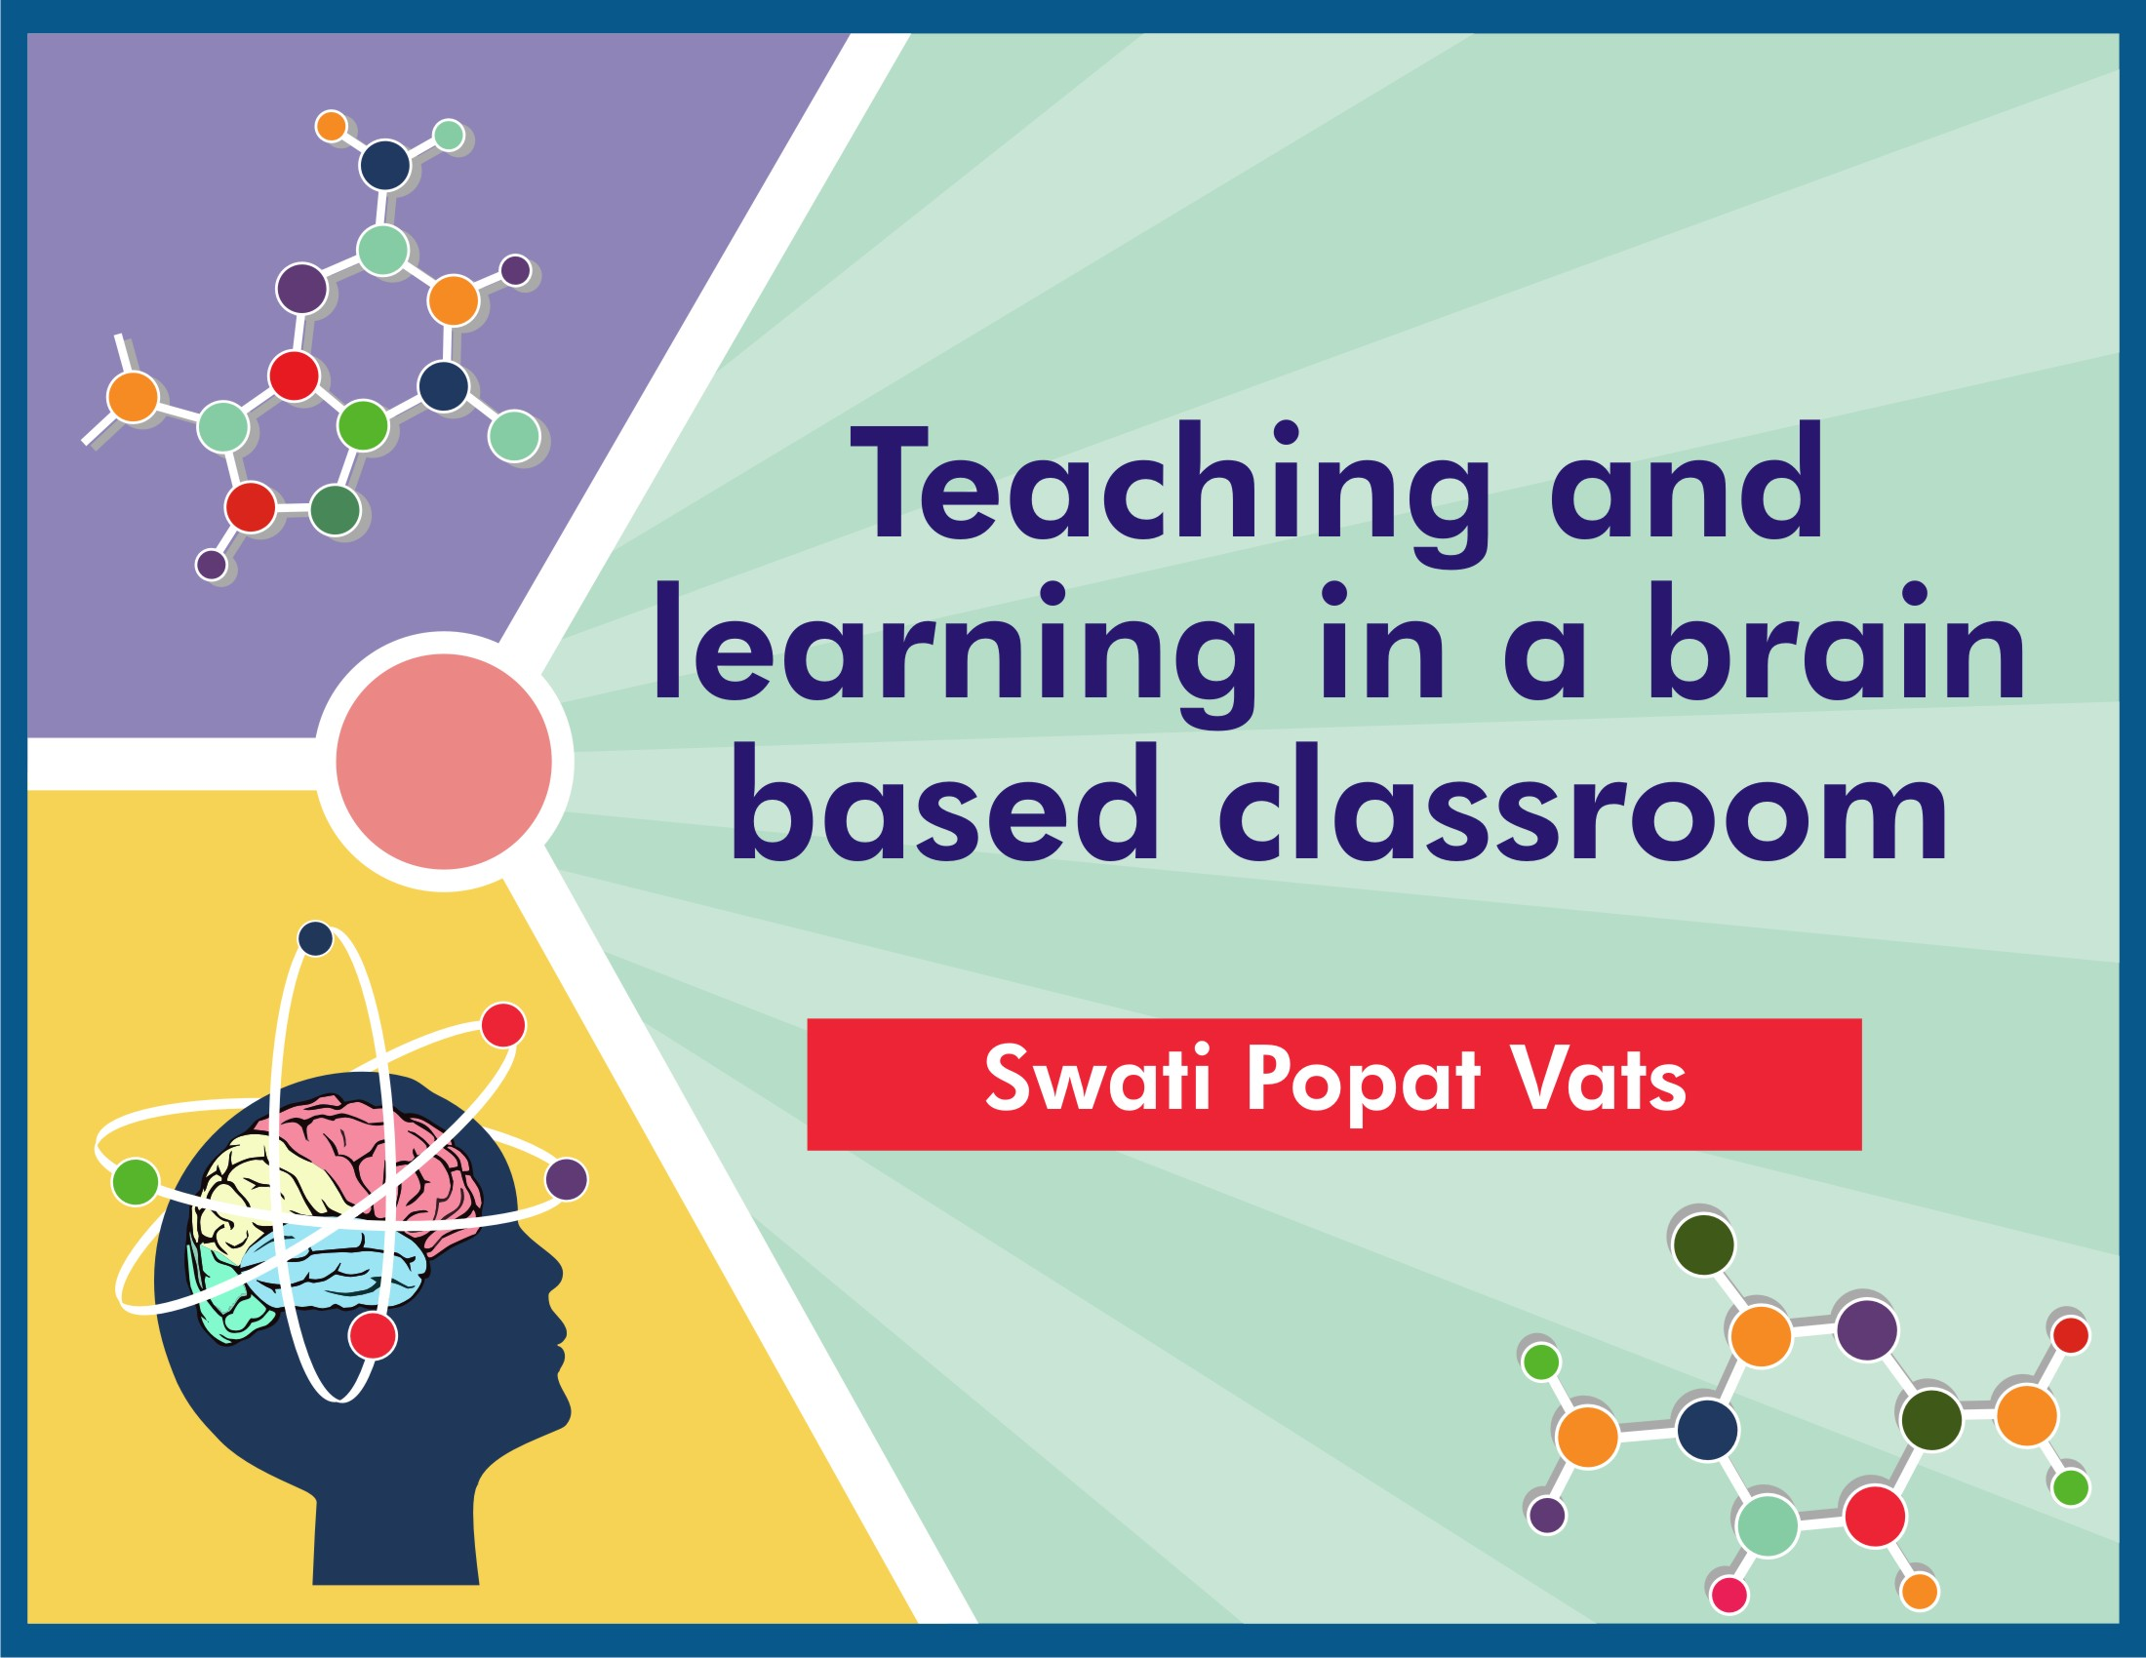

Slide 2

98% of your child’s brain develops in the first 6 years!
What are you doing to help it develop?
LET’S NURTURE BRAINS WITH SMART PARENTING

Slide 3
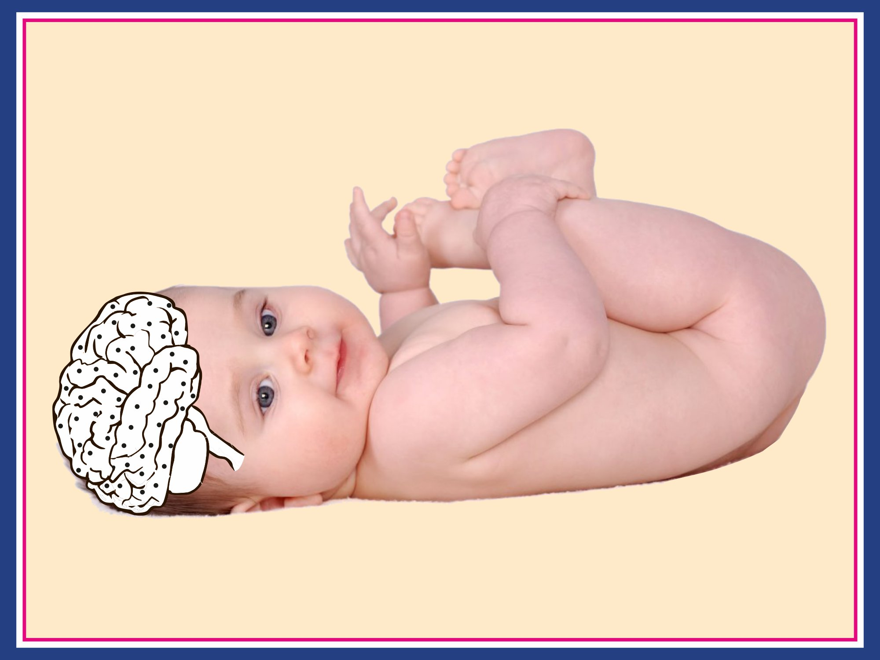
Notes:
Remove colour from the brain, make it white and all the black dots to be seen. Make the baby a cute real baby

Slide 4
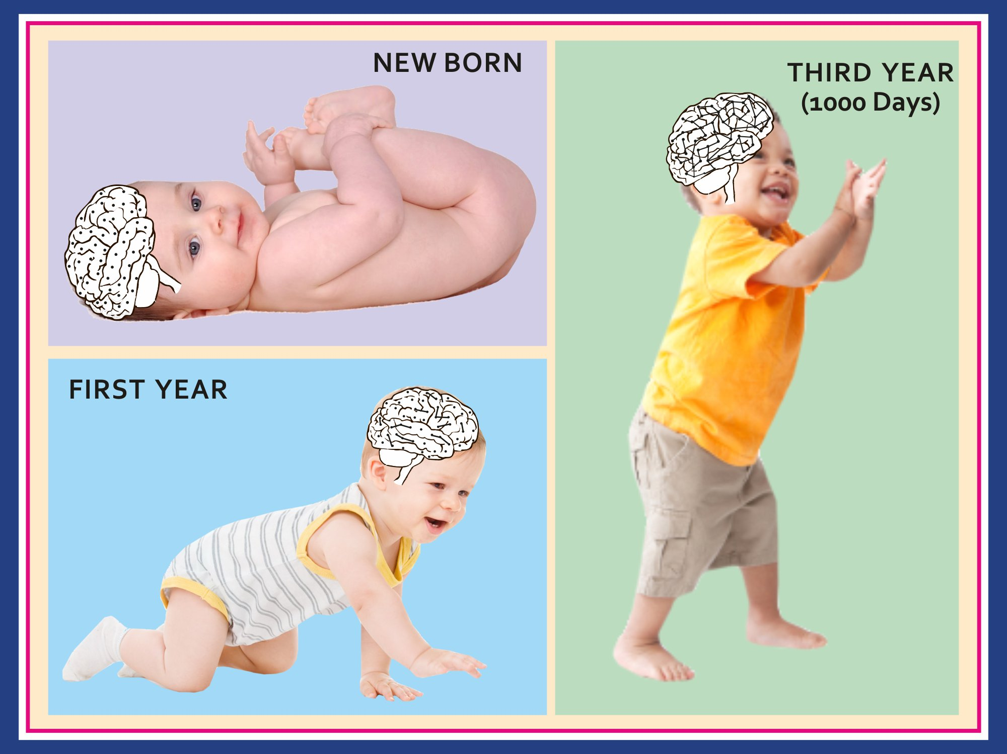
Notes:
Same here, brain should be white so that the connections difference is seen. Babies real, also in new born only dots, in first year show some lines between the dots and the three years how it is complex connections

Slide 5
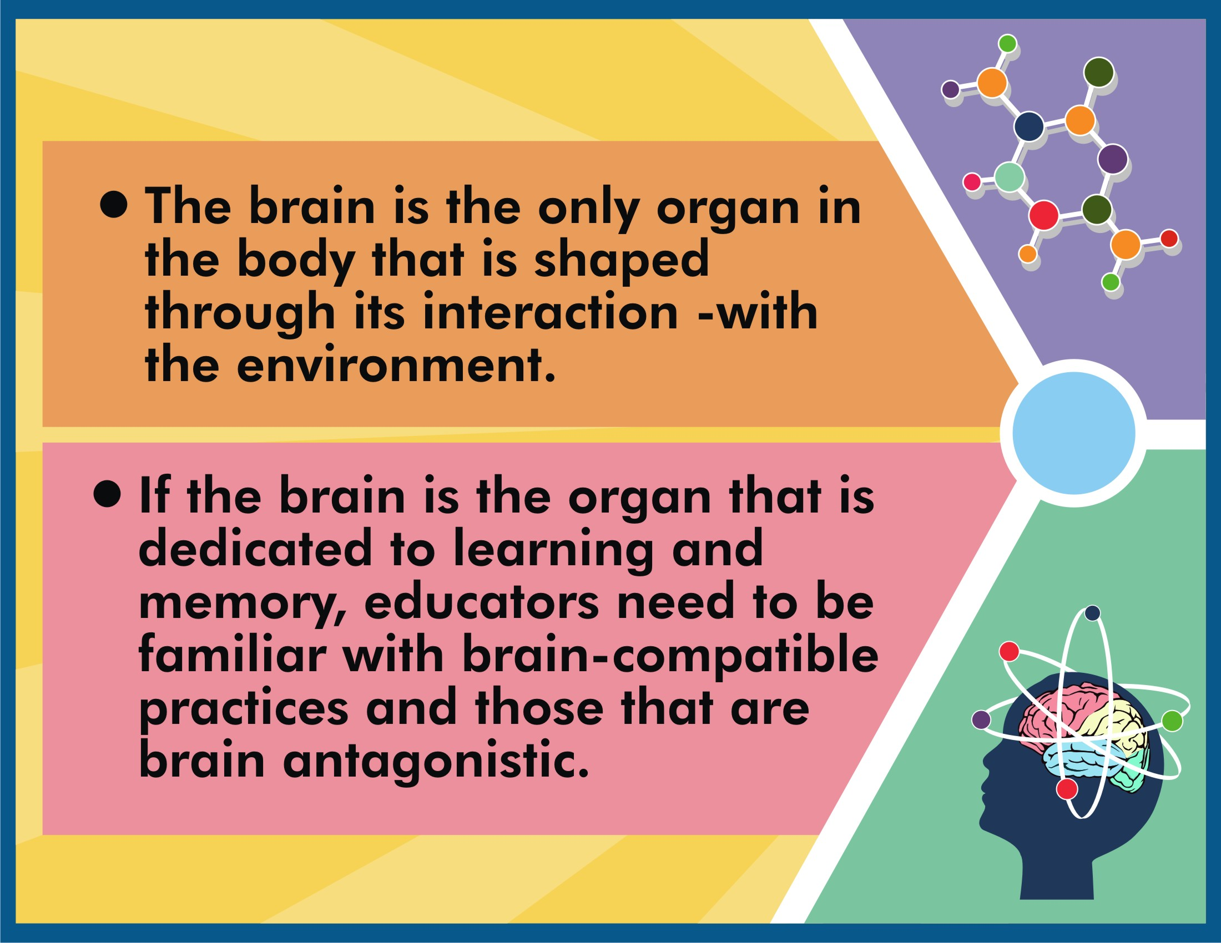

Slide 6
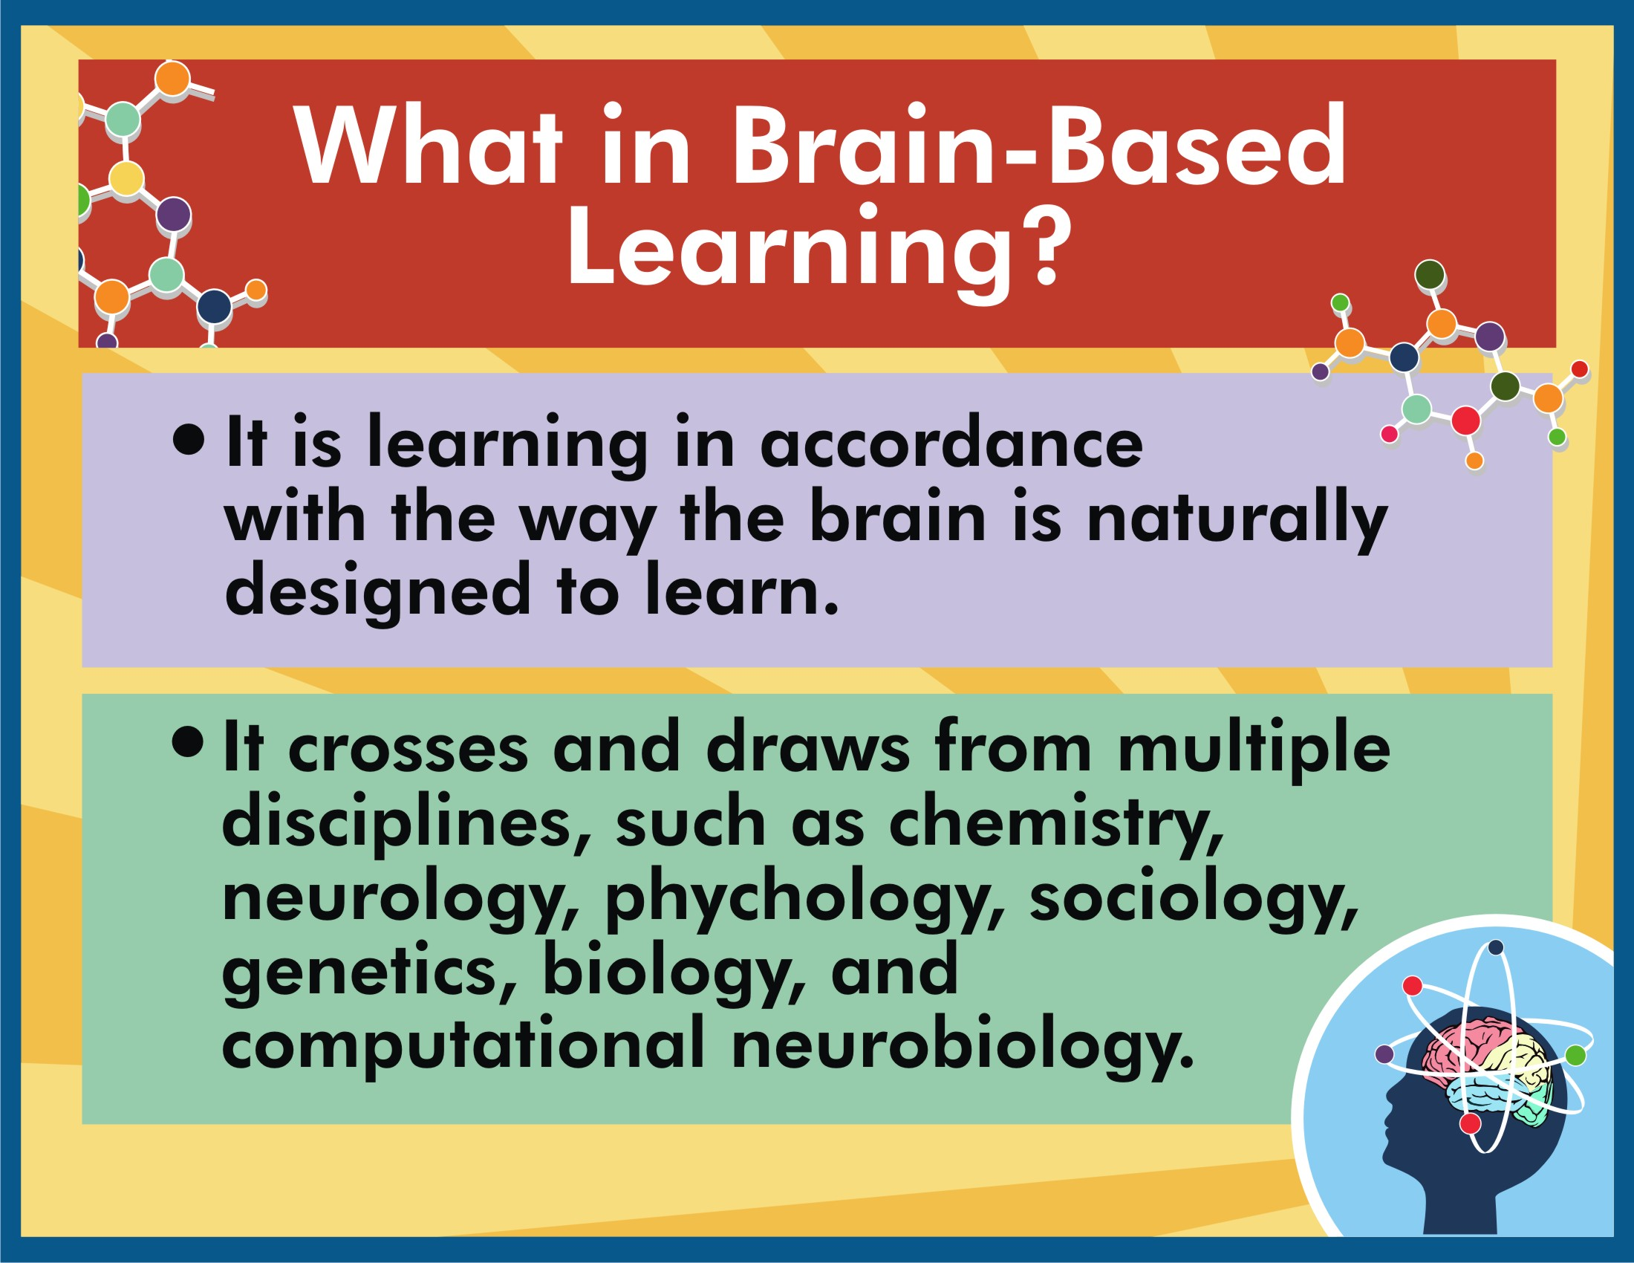

Slide 7
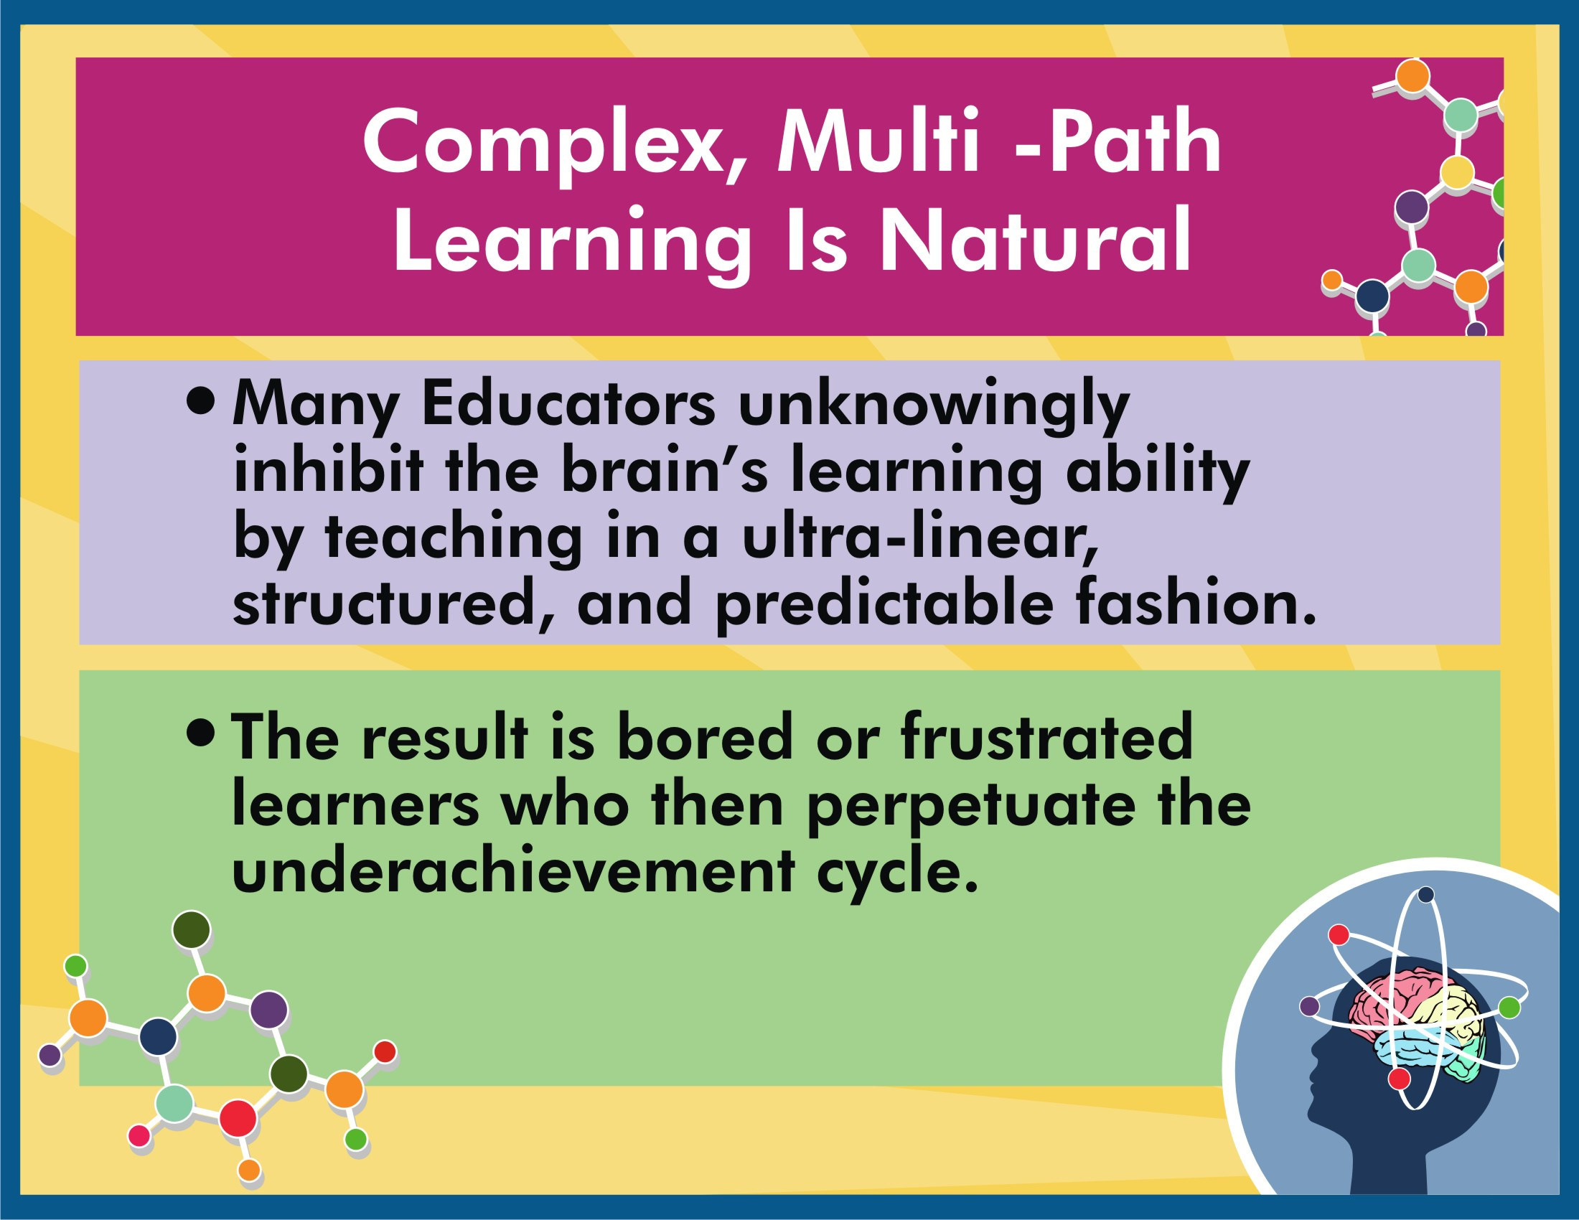

Slide 8
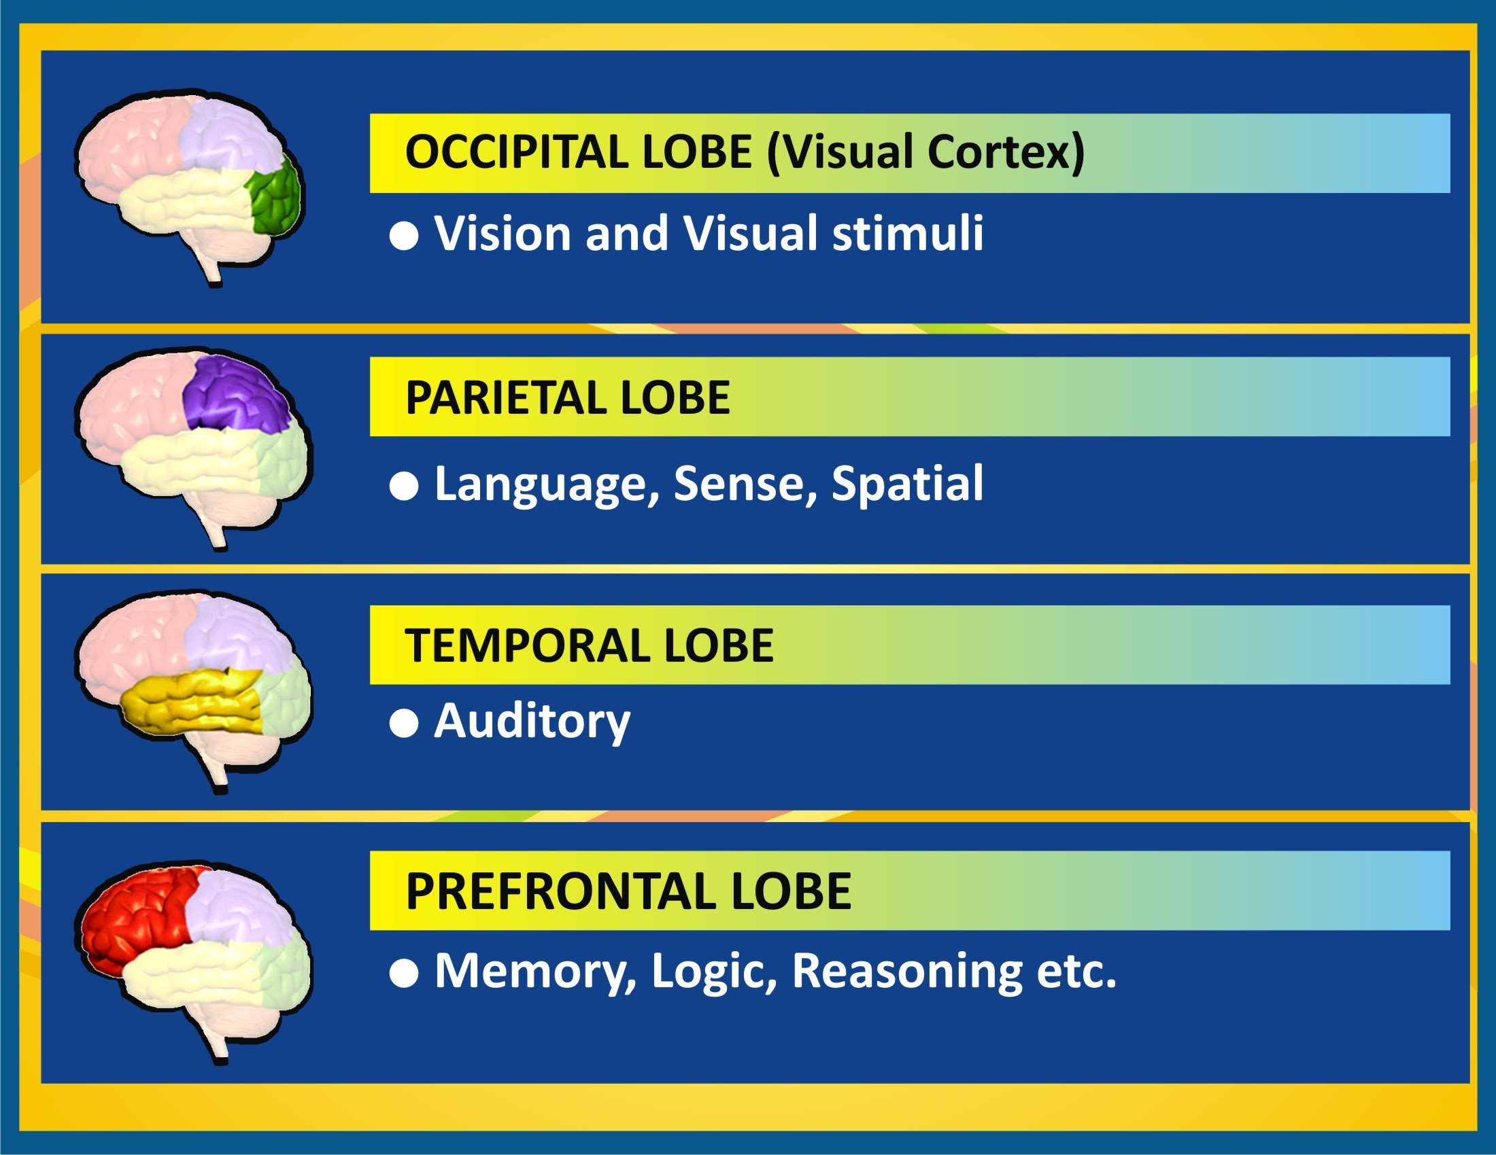

Slide 9
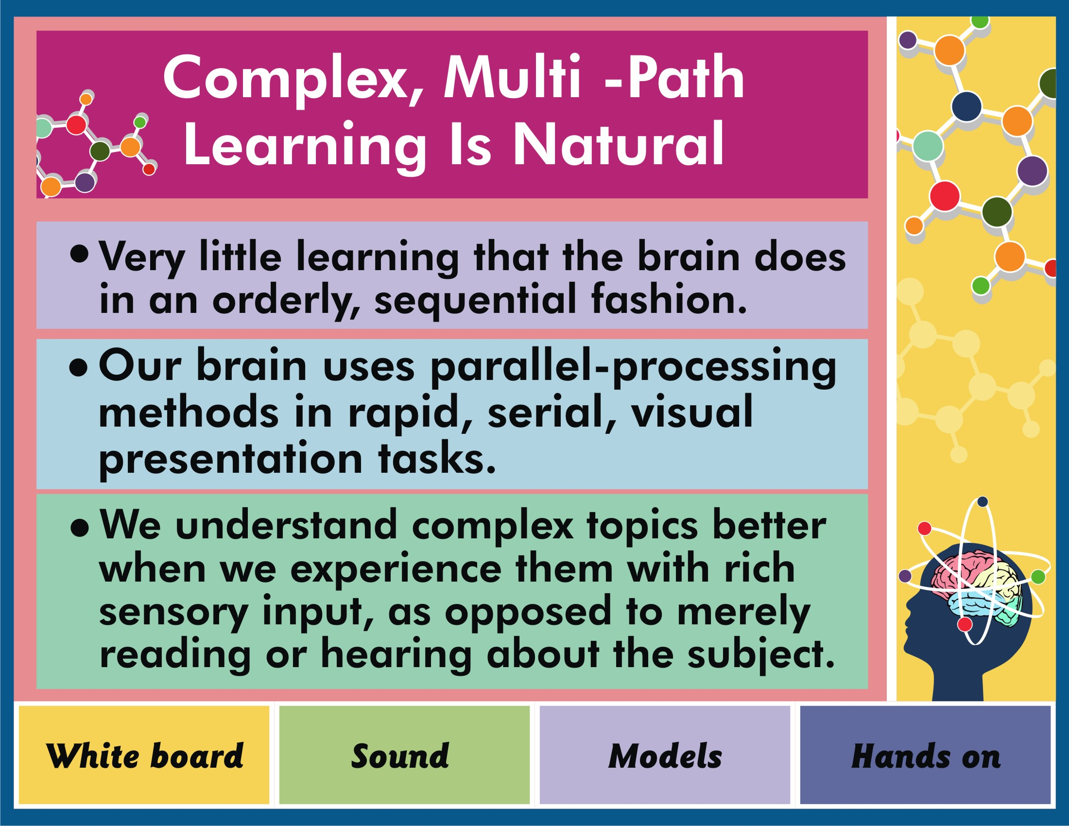

Slide 10
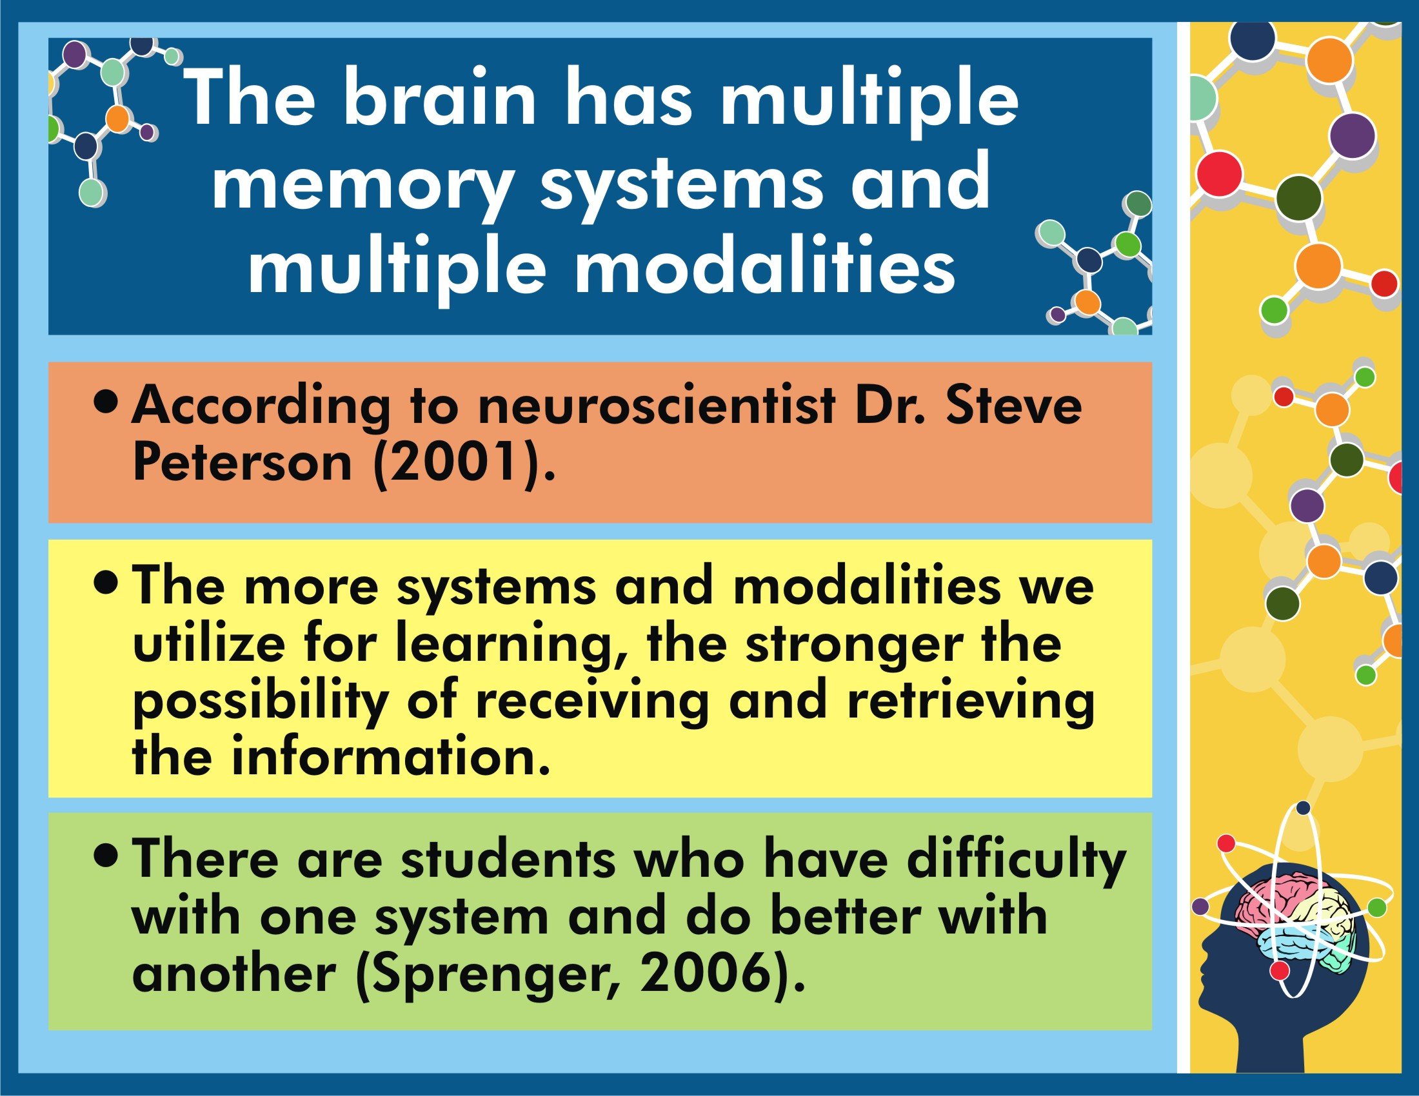

Slide 11
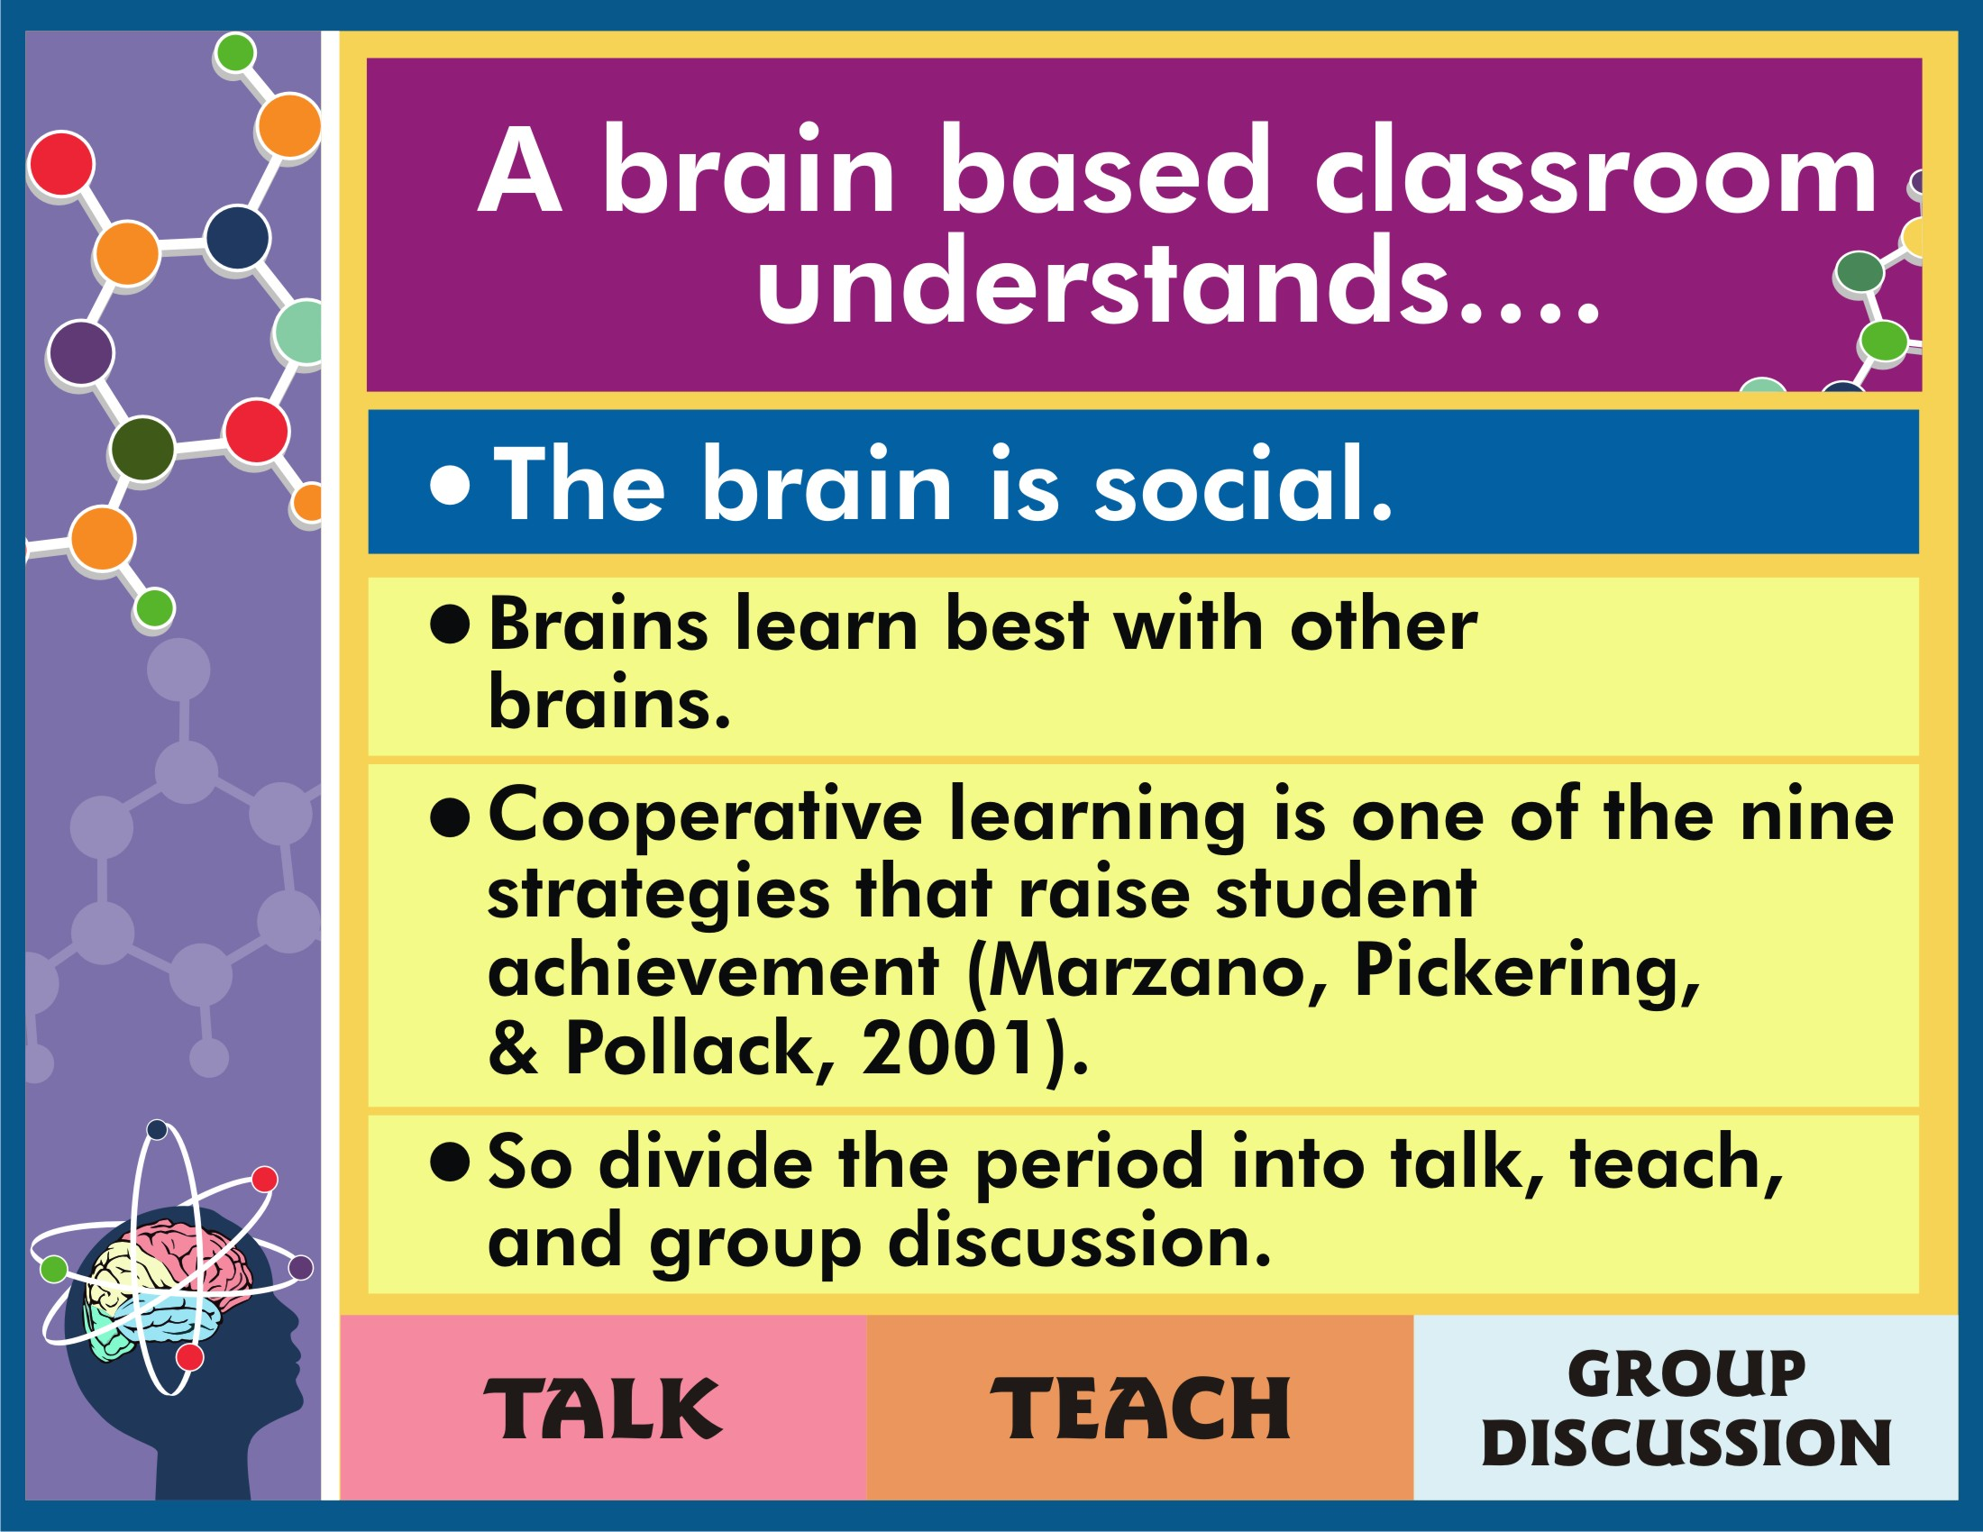

Slide 12
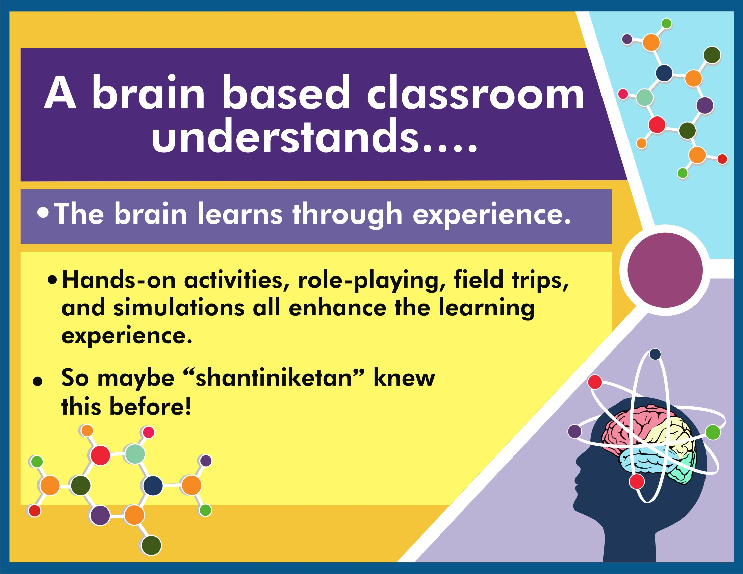

Slide 13
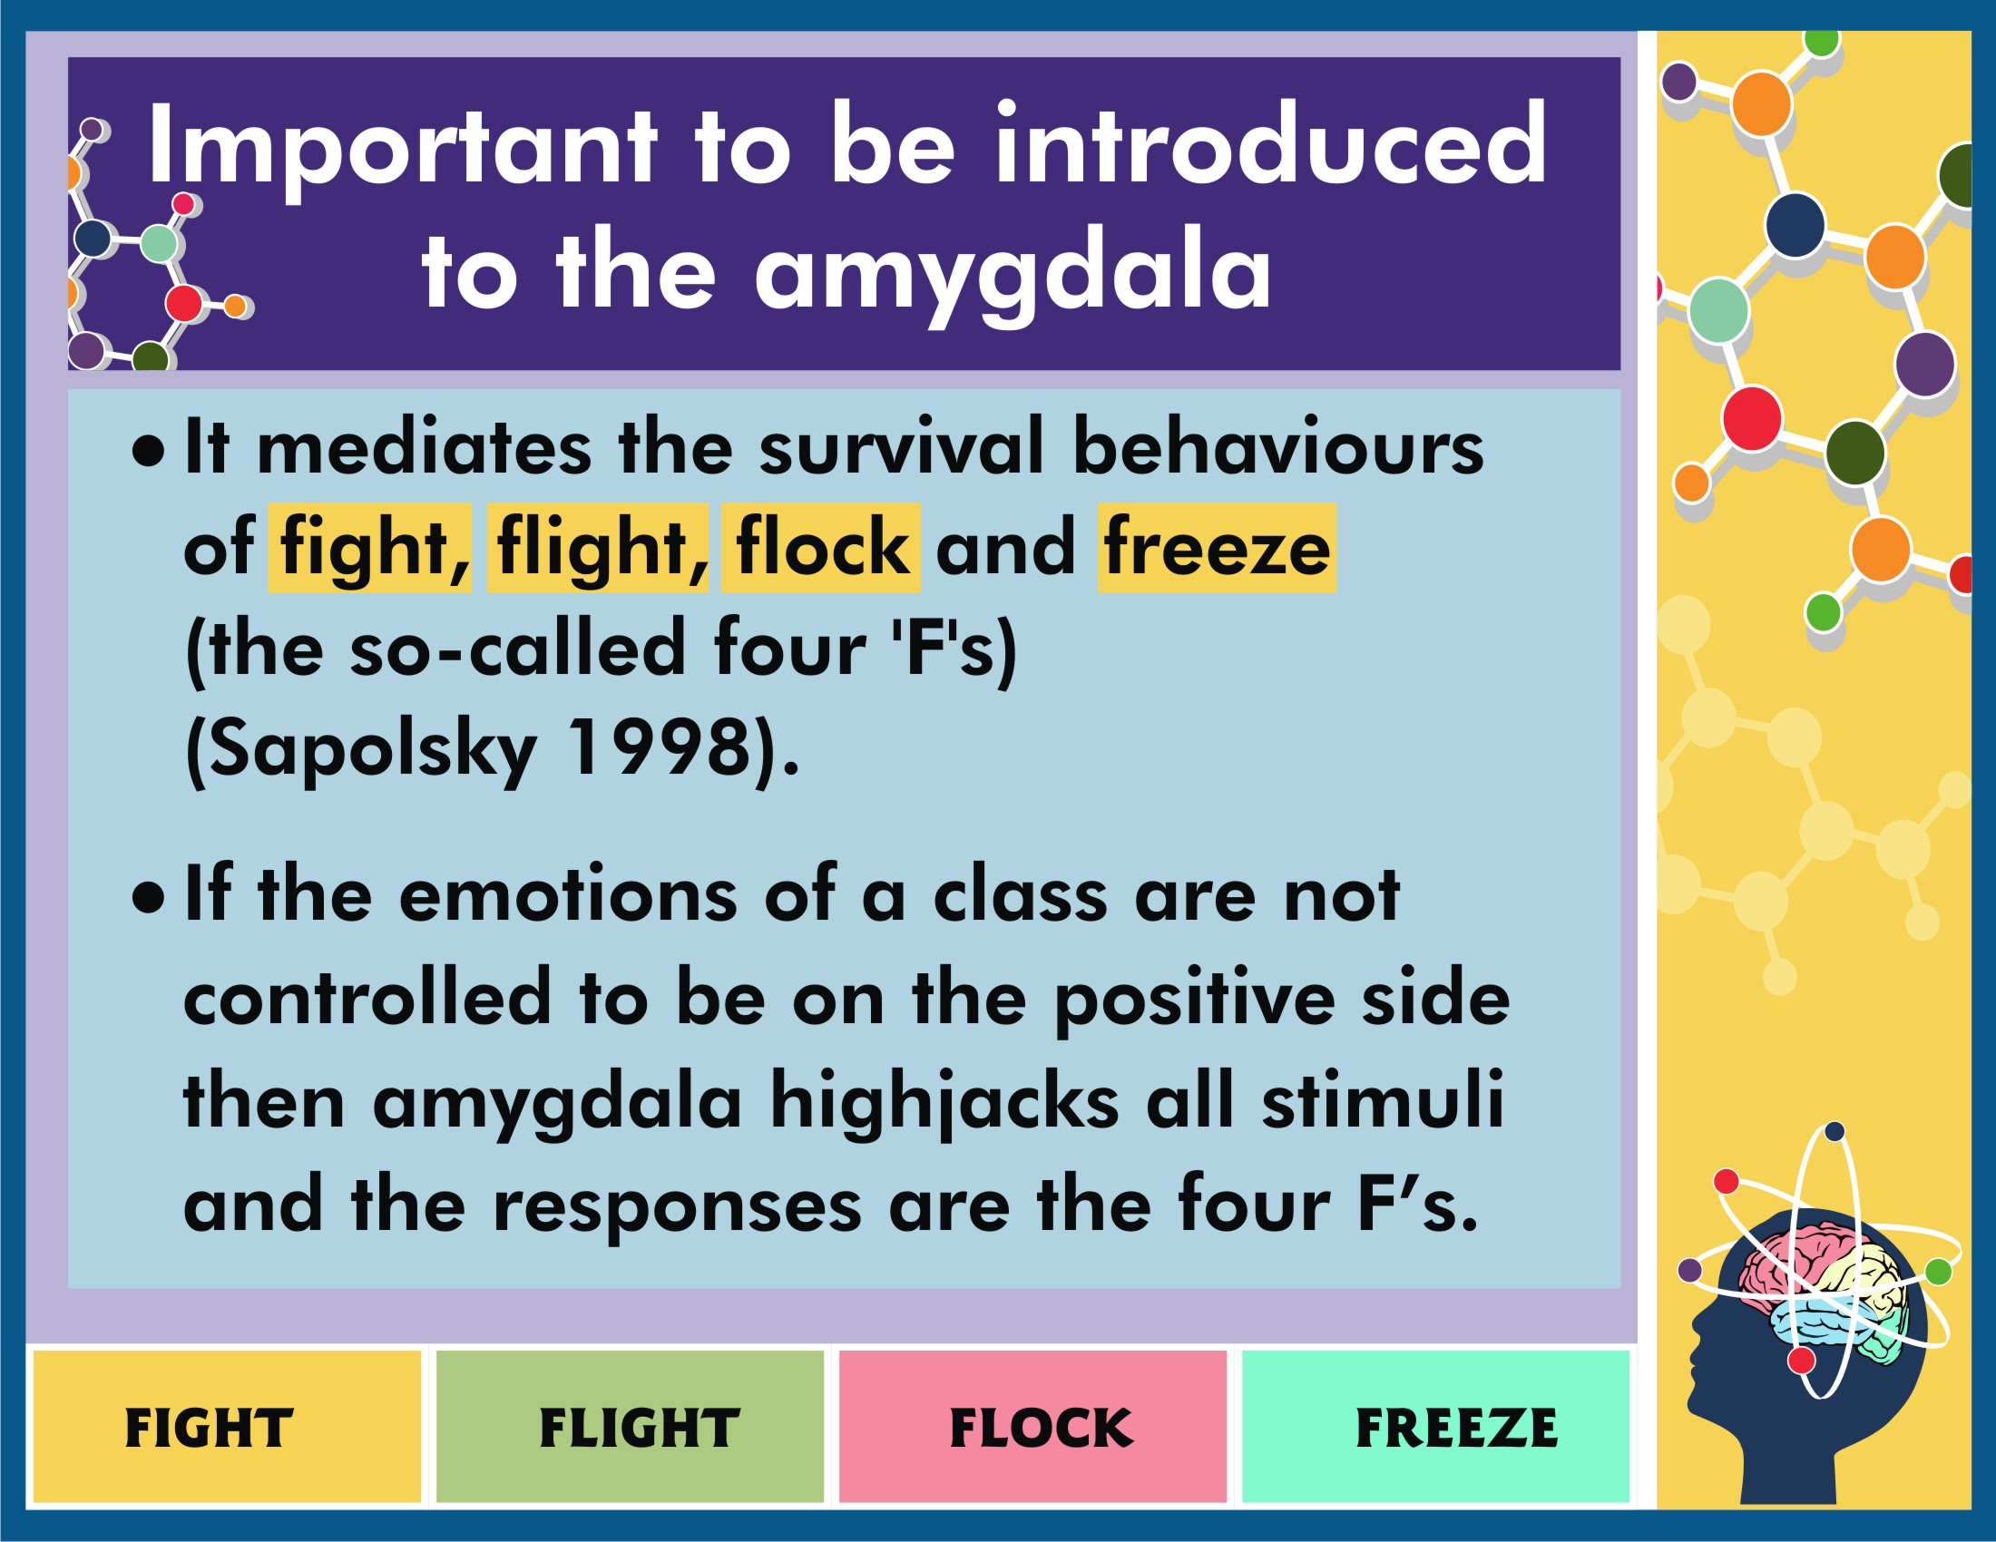

Slide 14
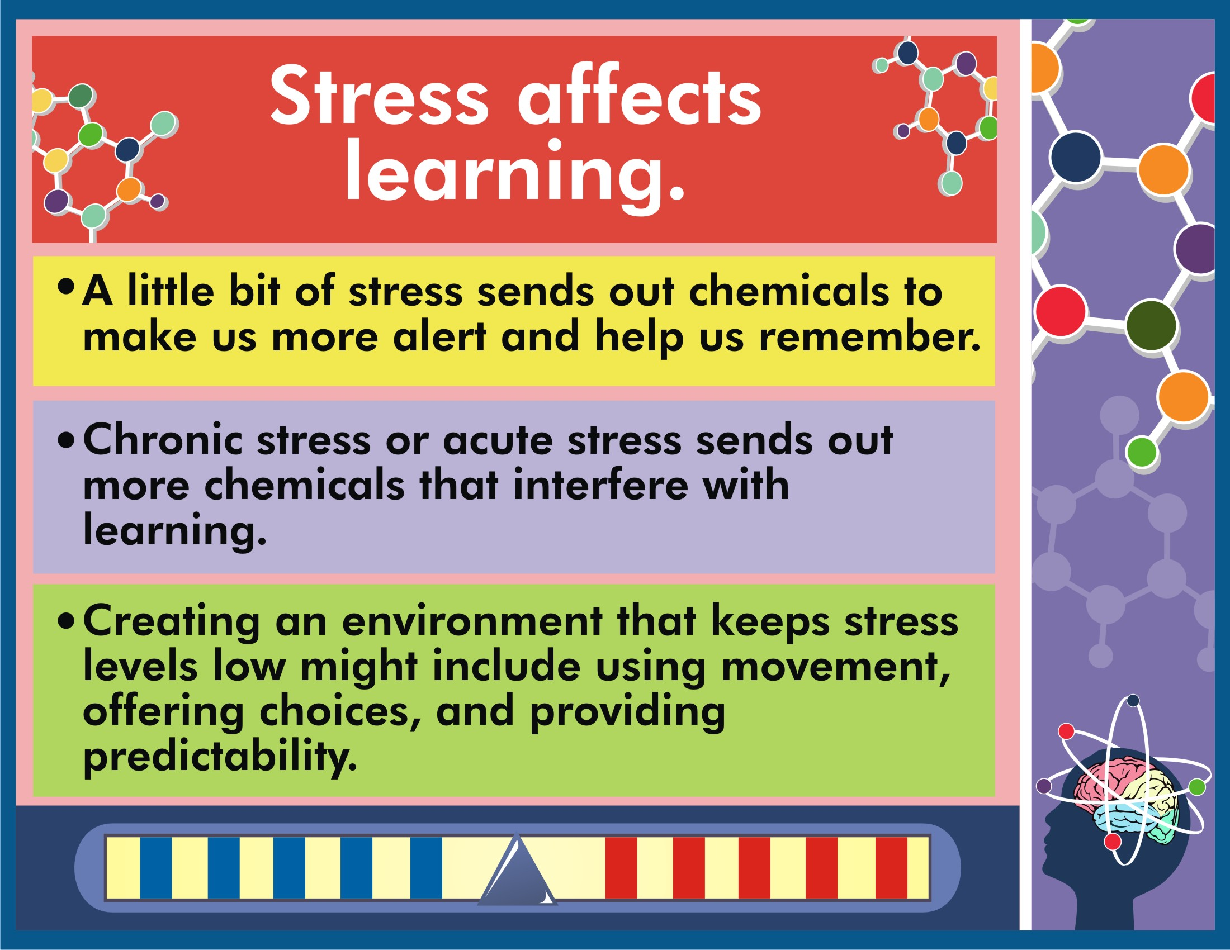

Slide 15
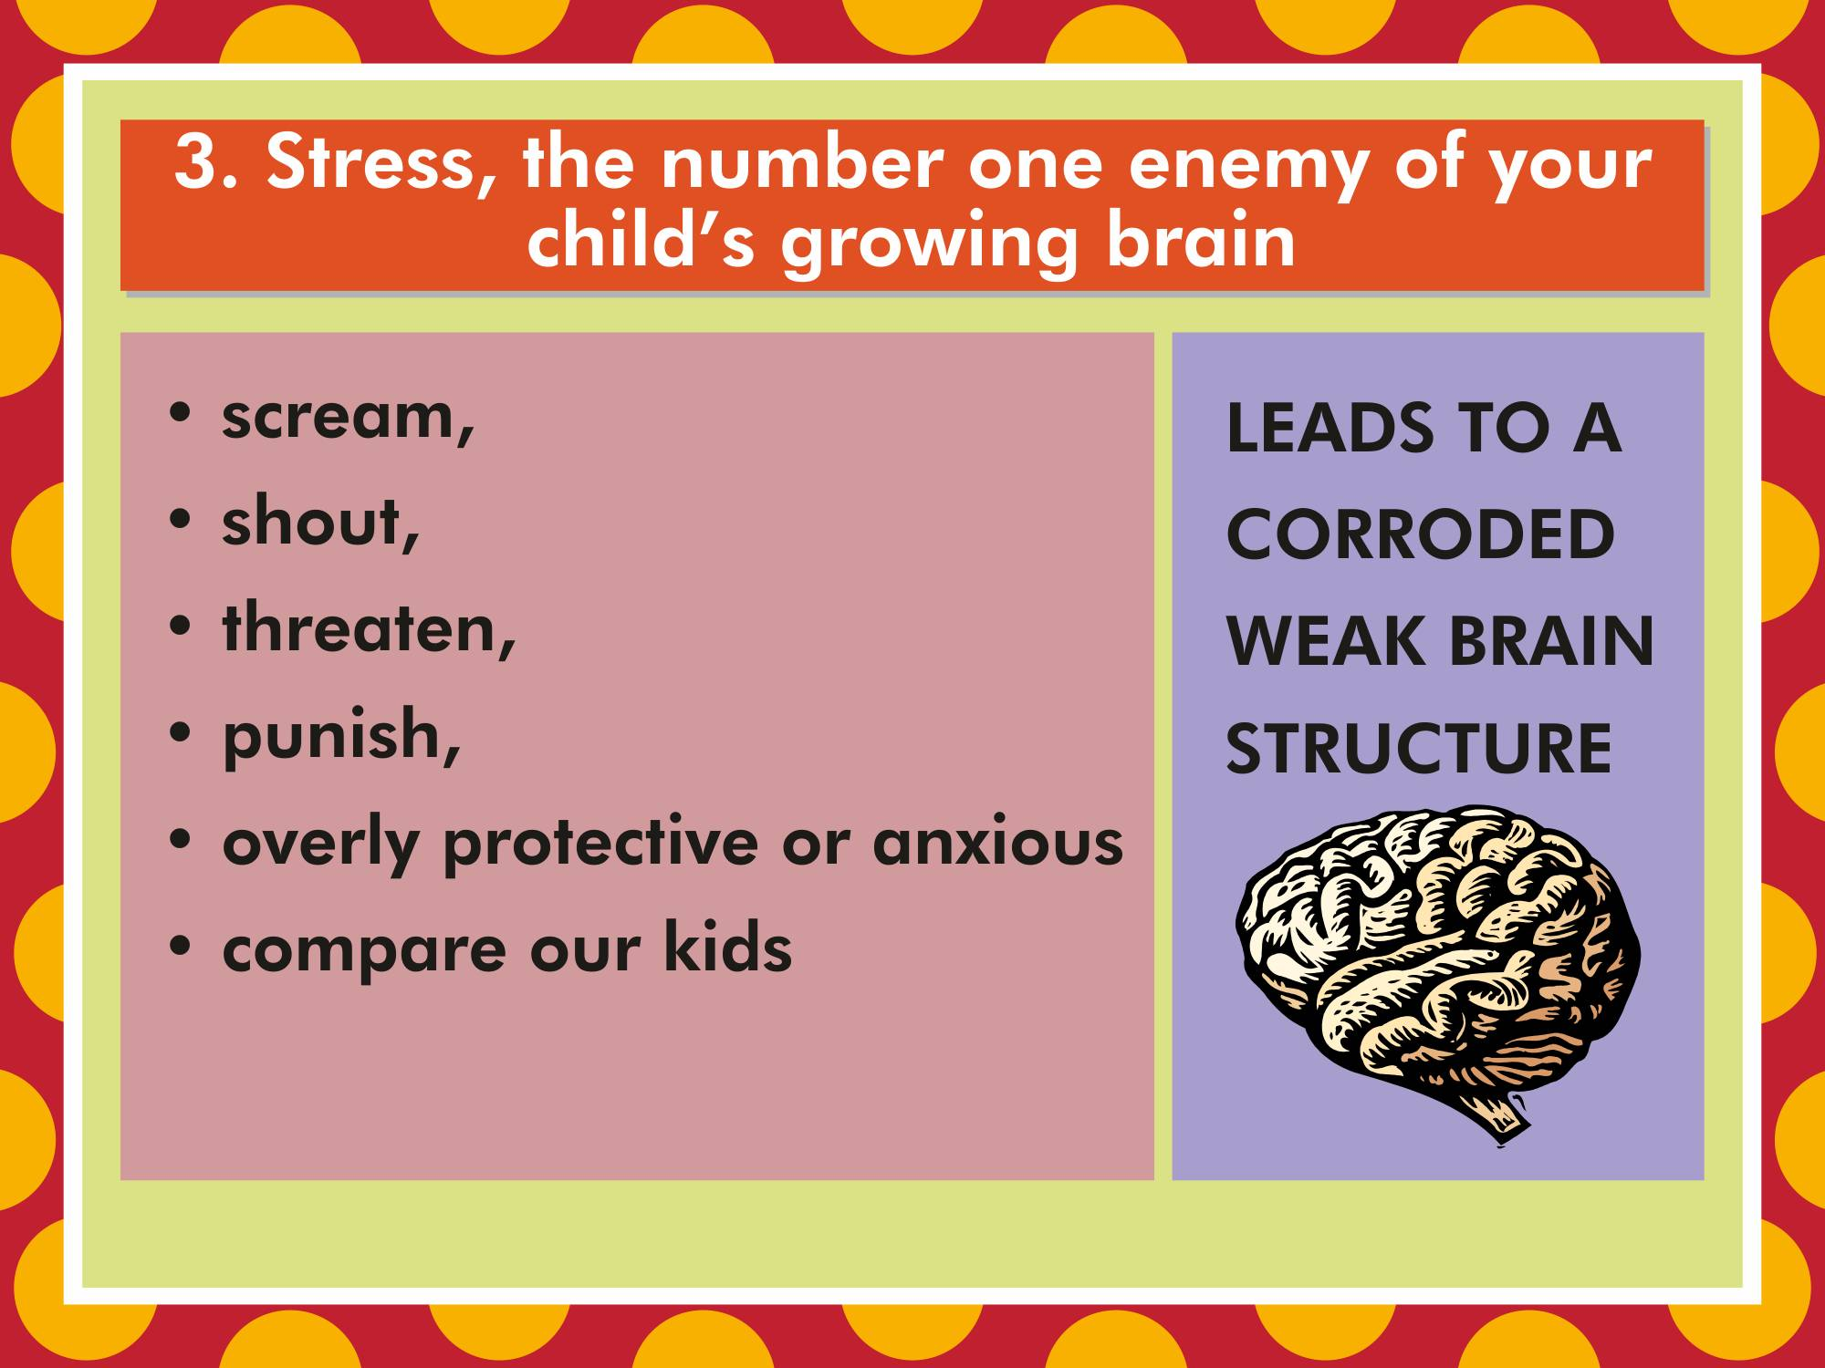

Slide 16
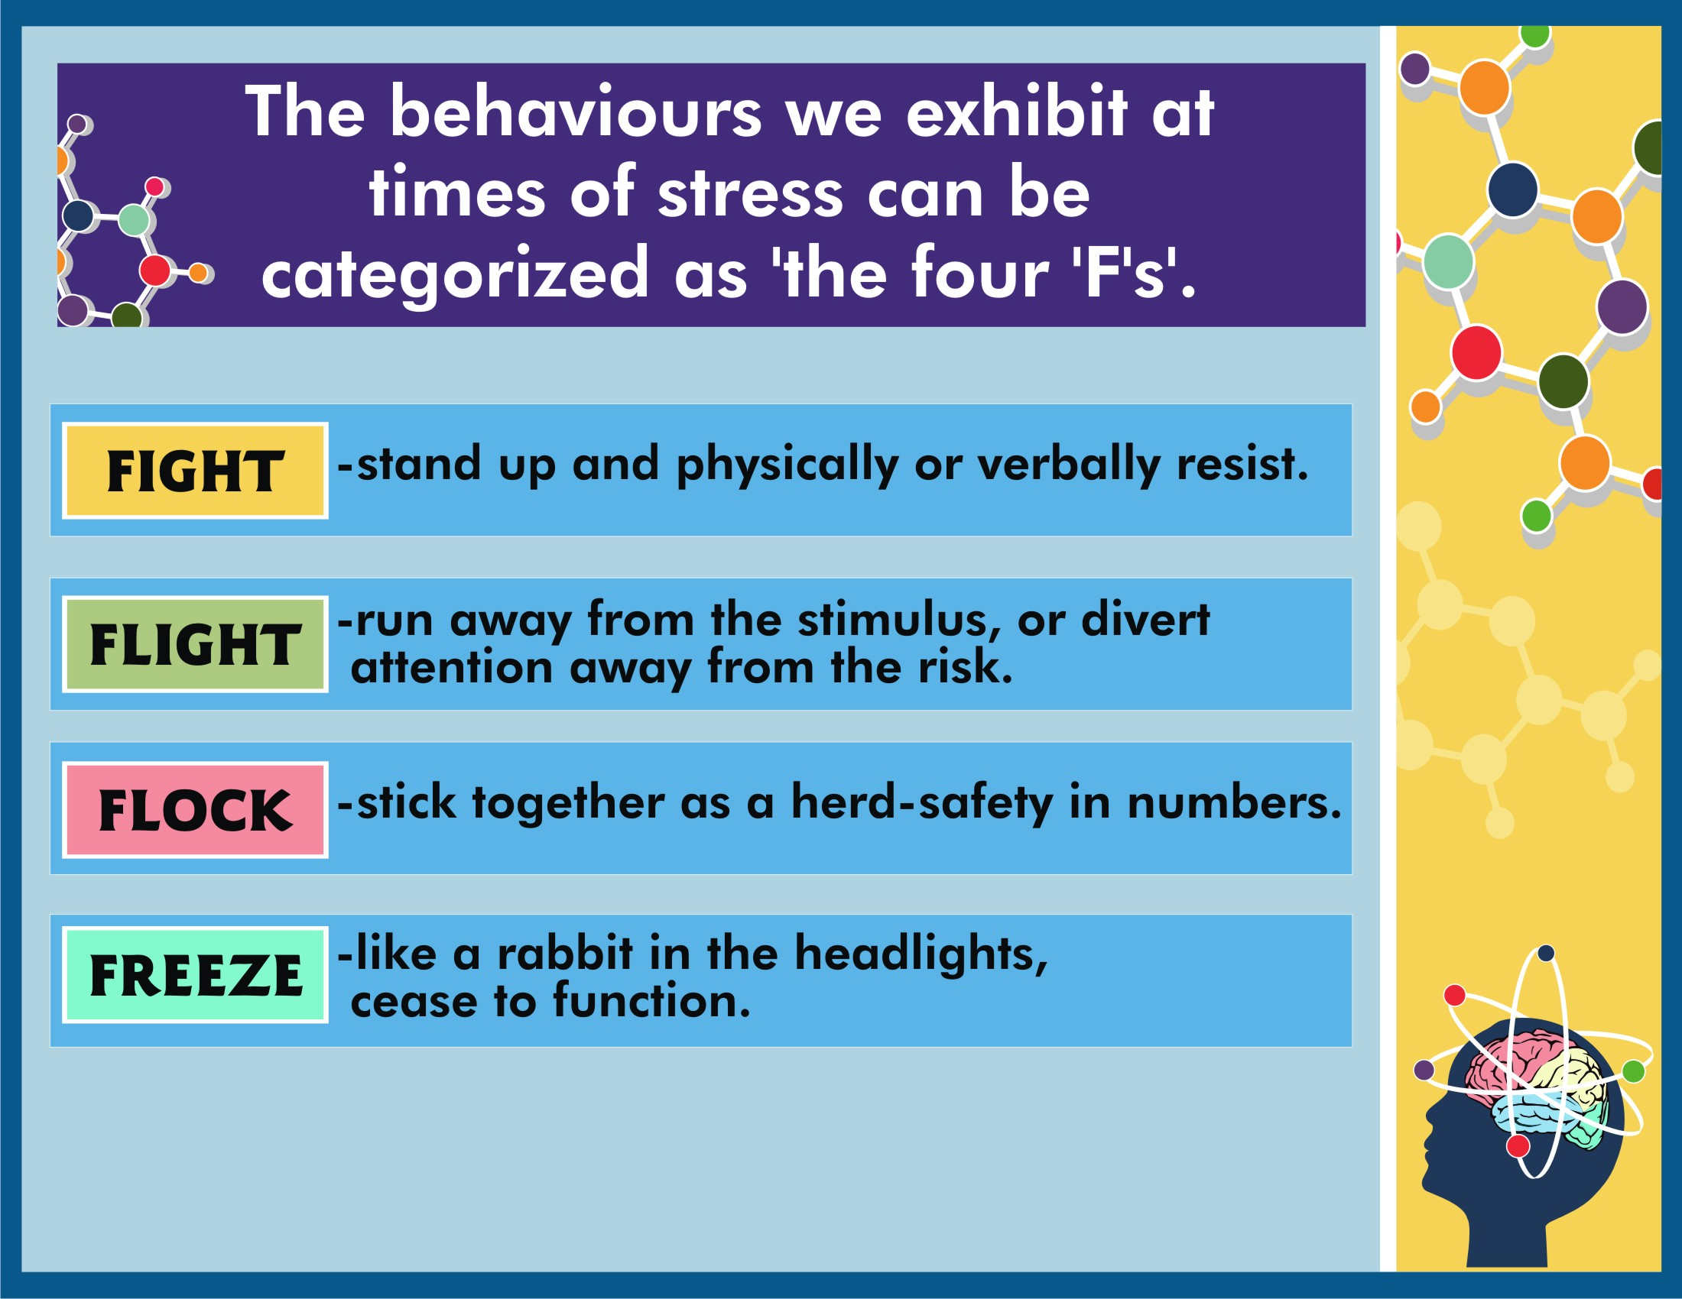

Slide 17
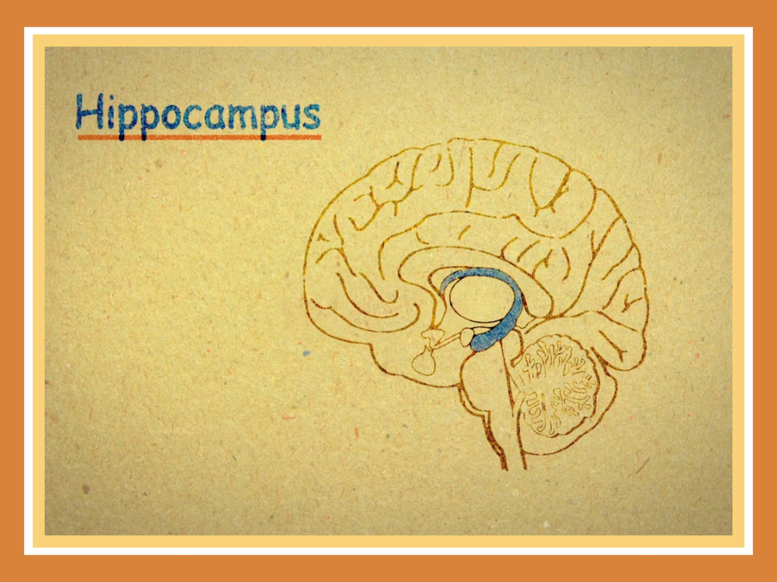

Slide 18
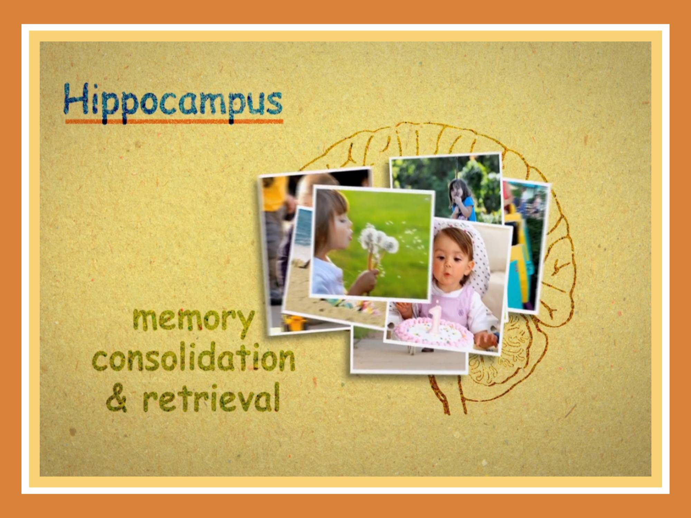

Slide 19
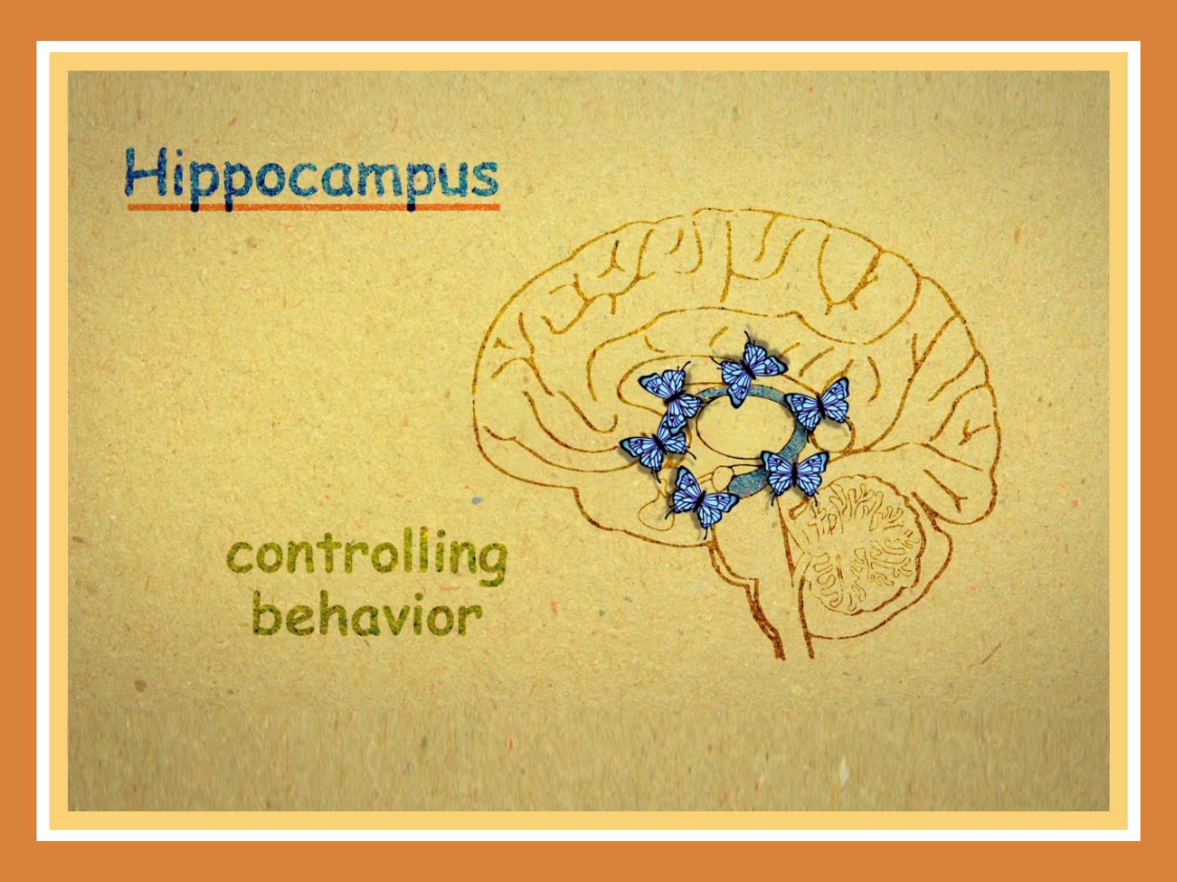

Slide 20
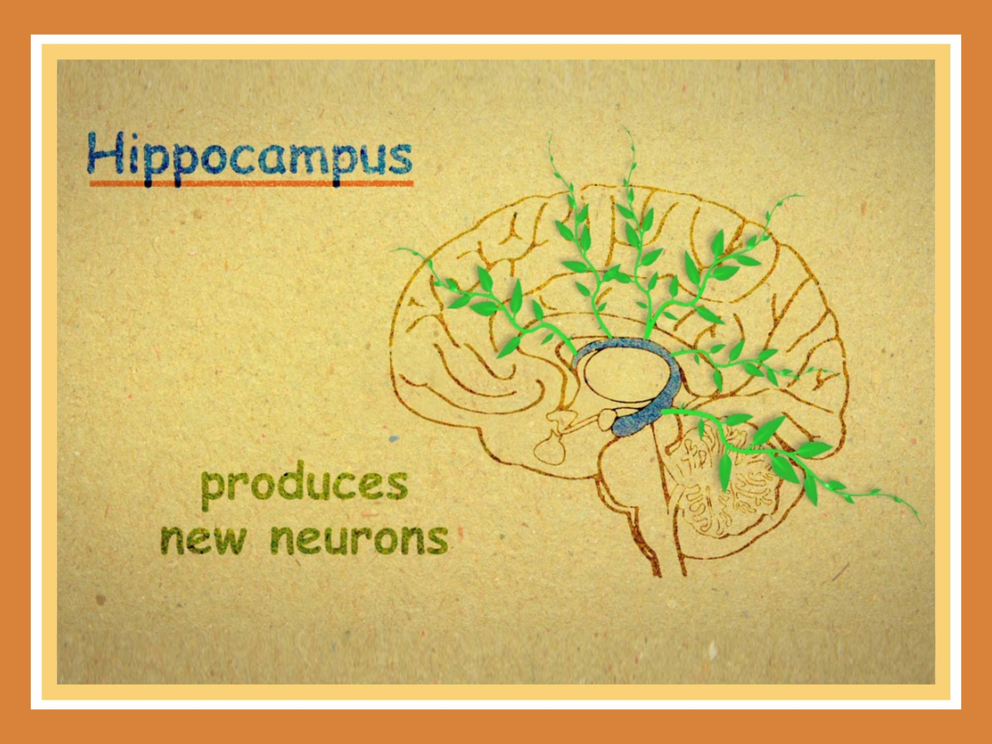

Slide 21
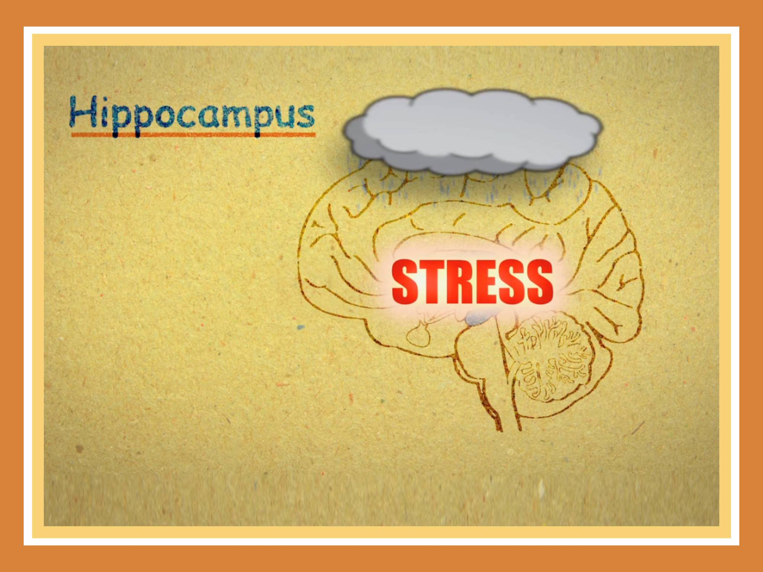

Slide 22
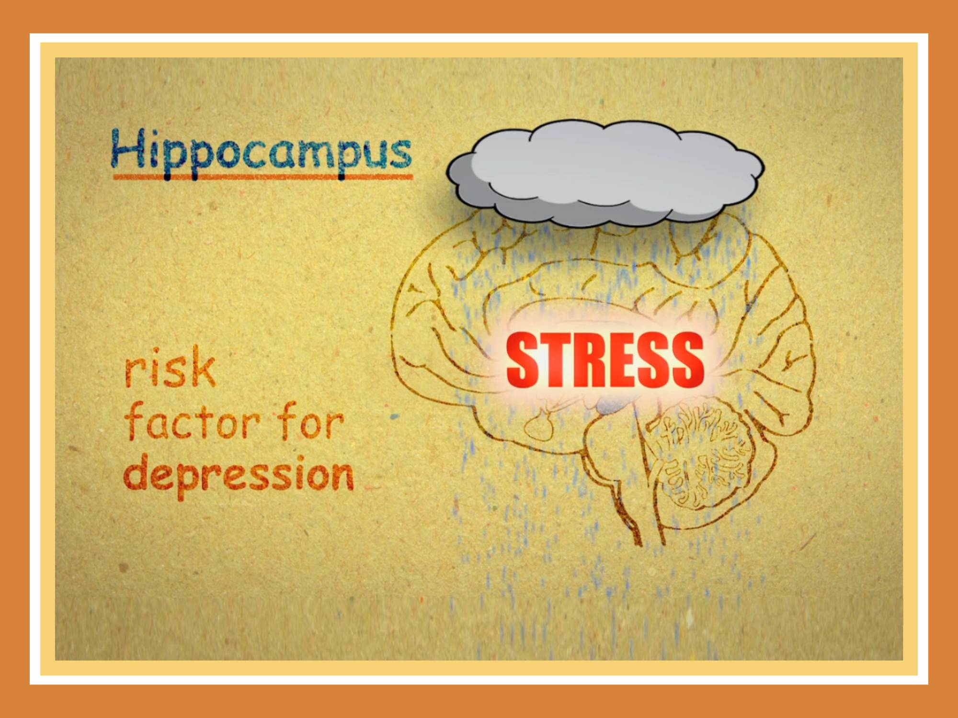

Slide 23
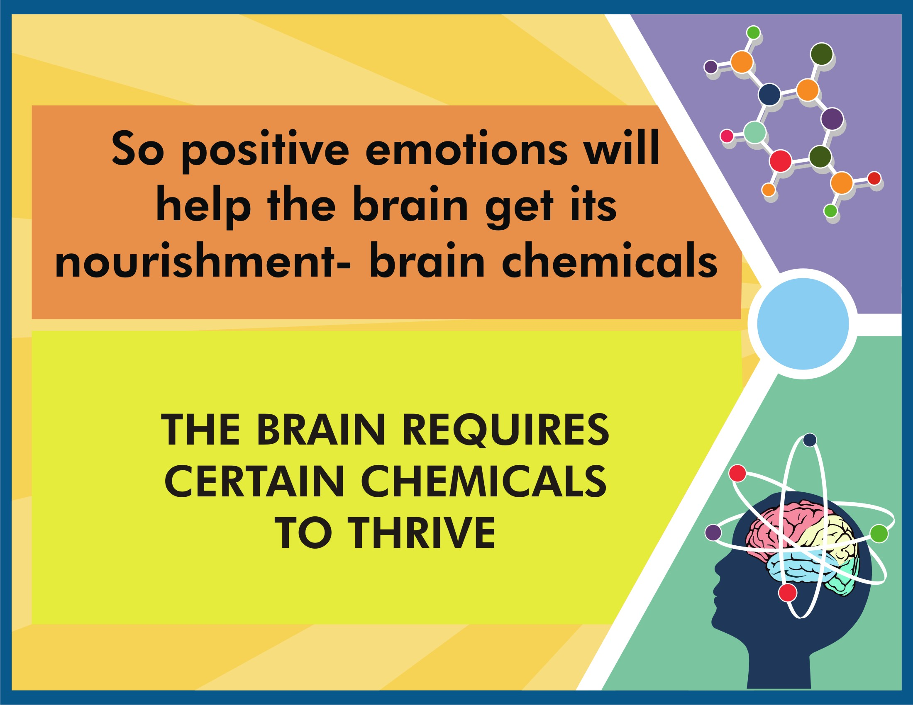

Slide 24
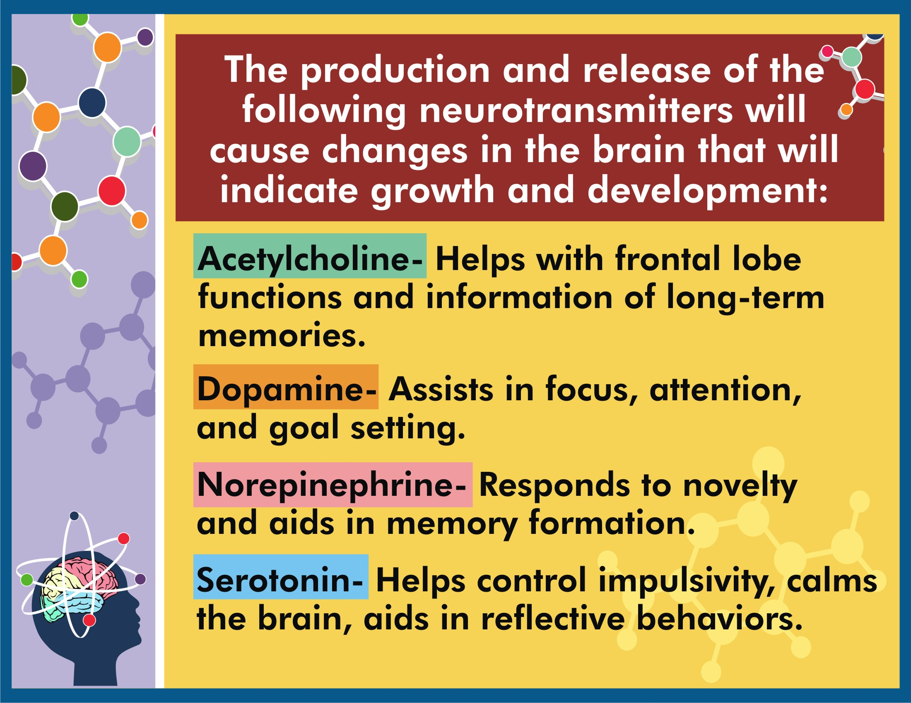

Slide 25
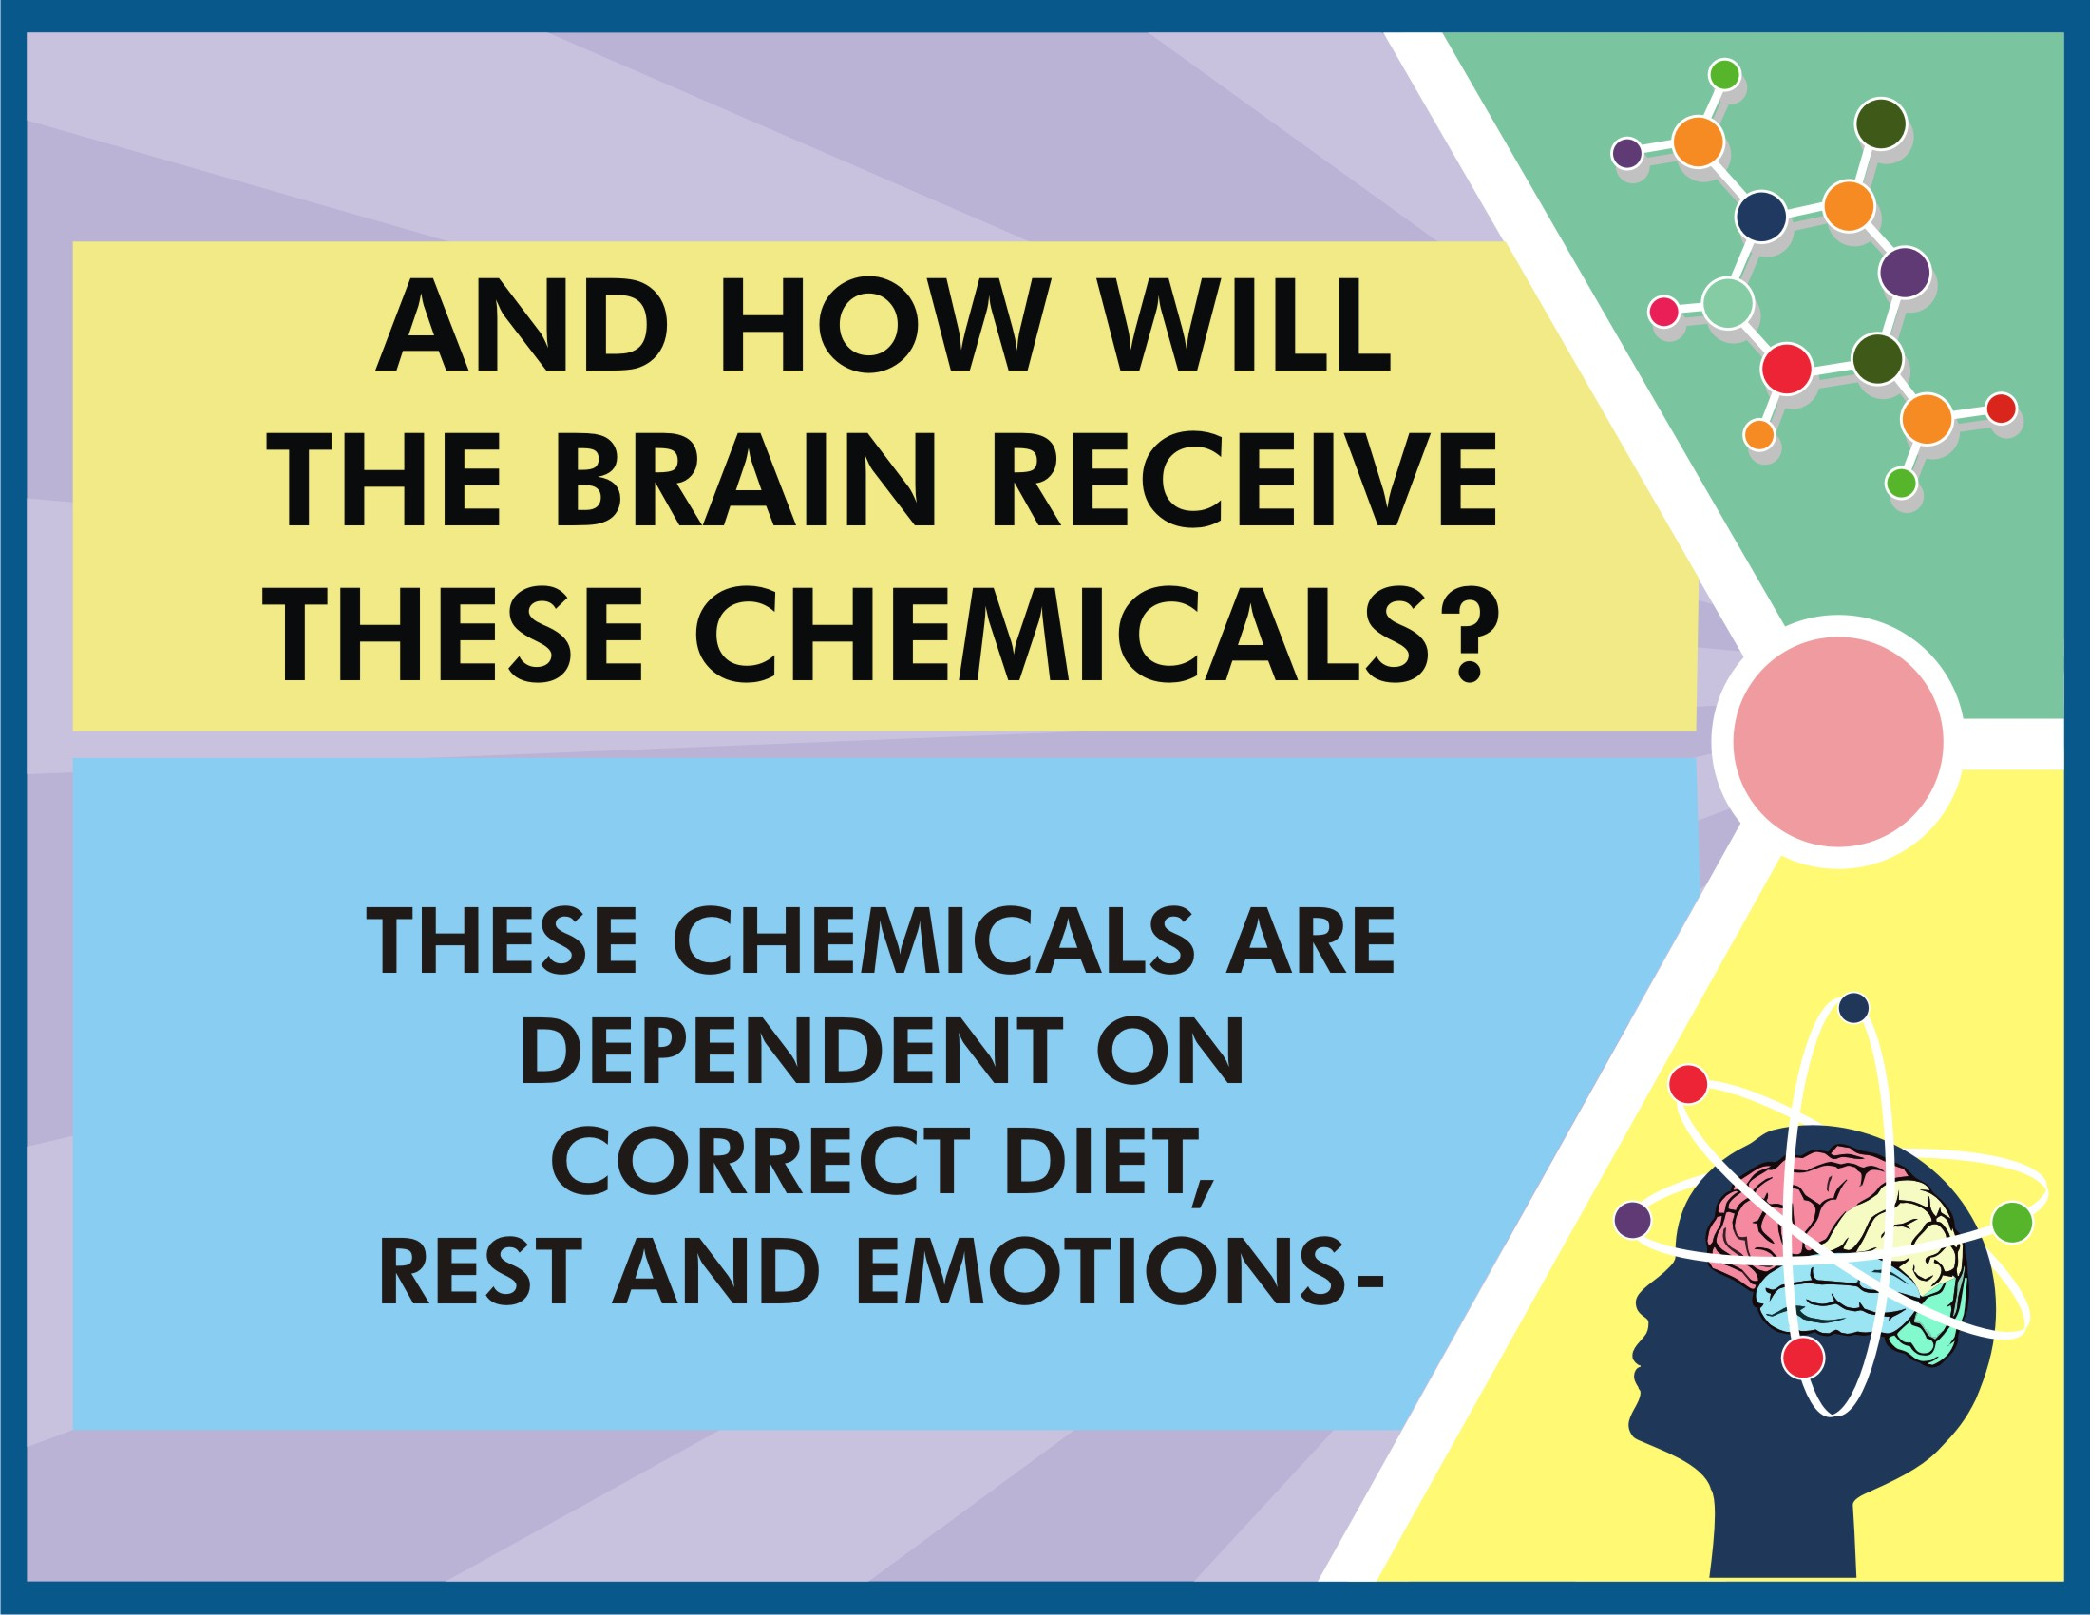

Slide 26
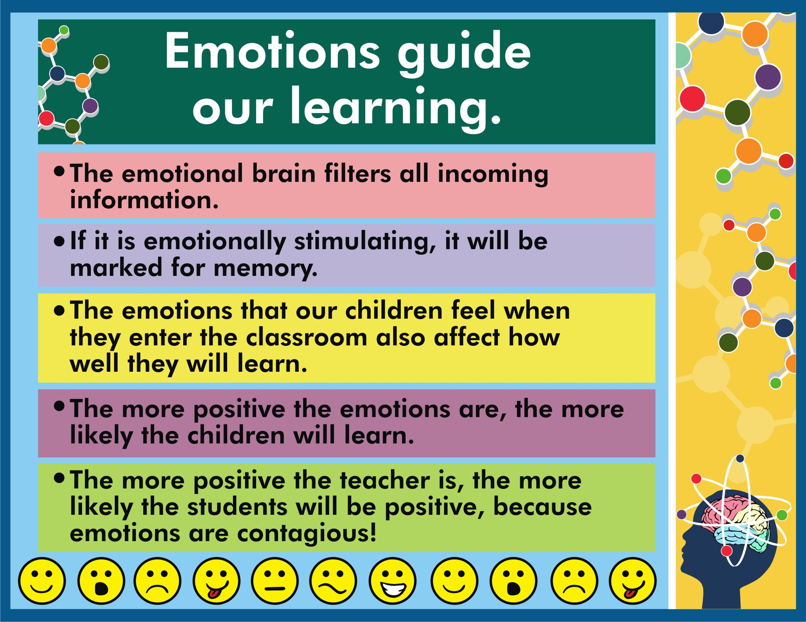

Slide 27
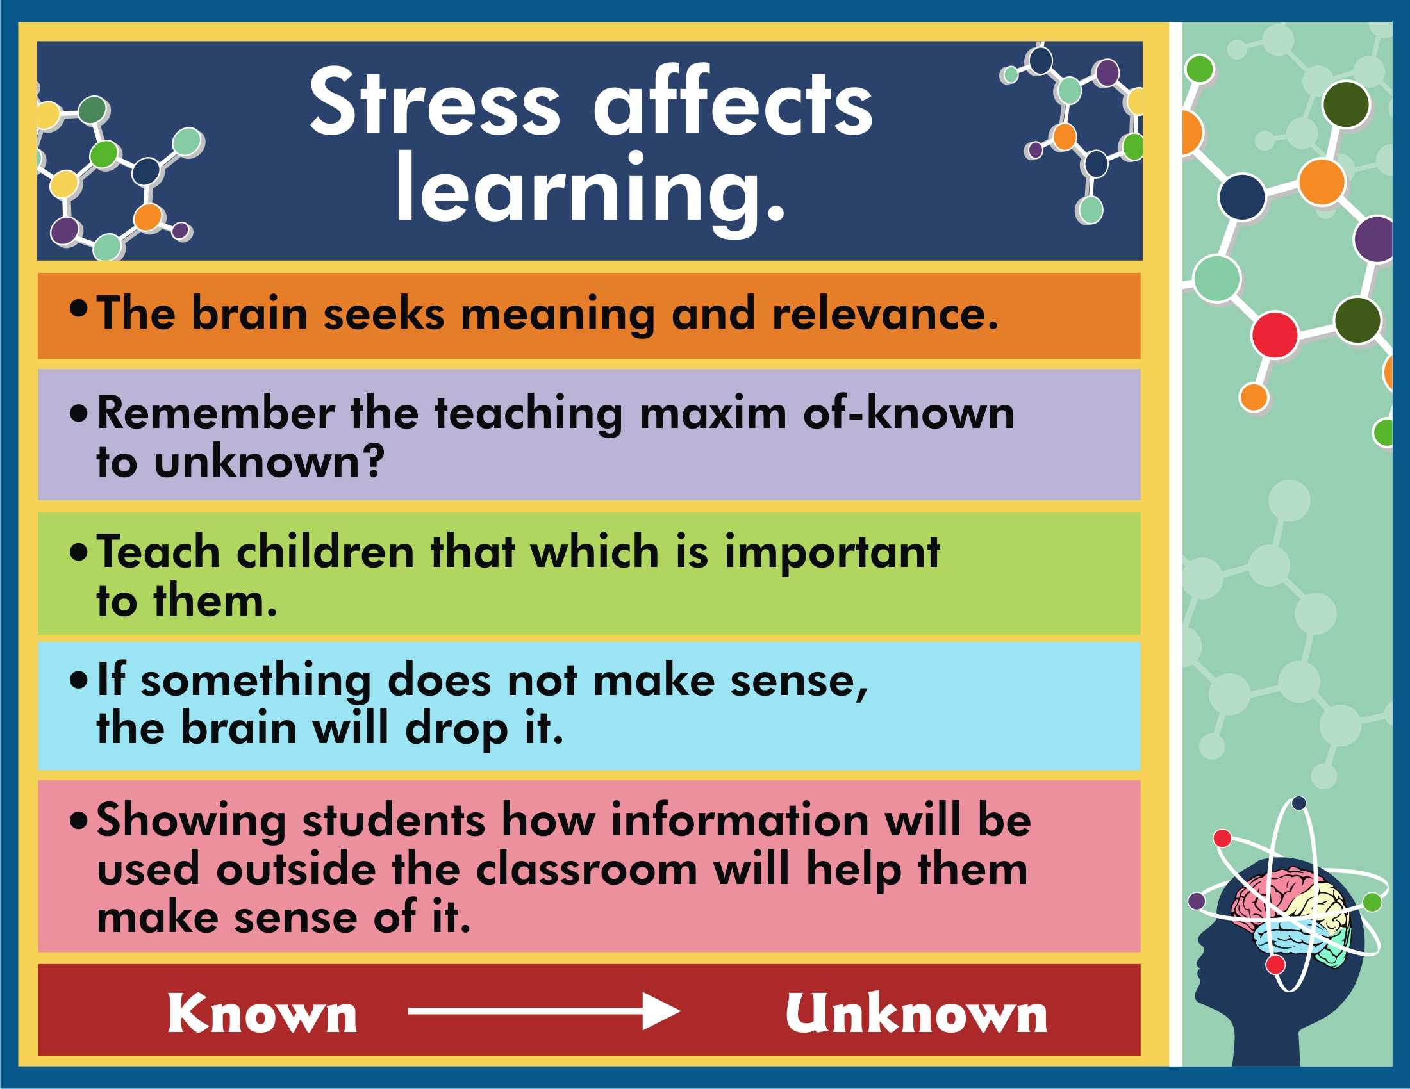

Slide 28
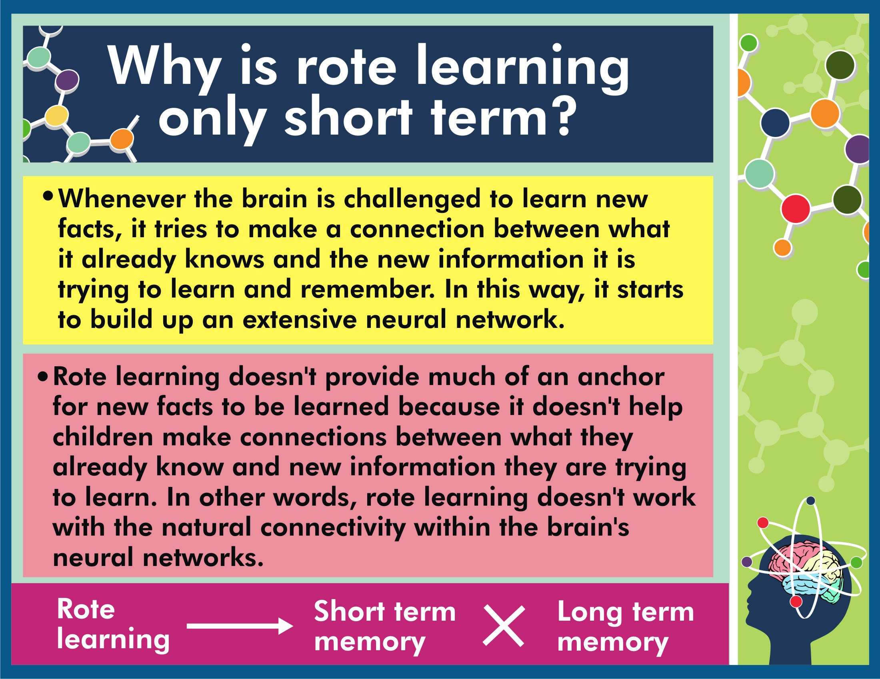

Slide 29

Why does ‘C’ make two sounds??
Sometimes the c says, “s“s“s”-“s” “s”“s”s”- “s”s”s”
Sometimes the c says, “s” “s” “s” I’ll tell you why!
If after the c you see an i,
Or an e or a y,
They all make the c say, “s” “s” “s”
You give it a try.
C is soft cent and cell, cent and cell, cent and cell,
C is soft cent and cell, and now you know why!

Slide 30
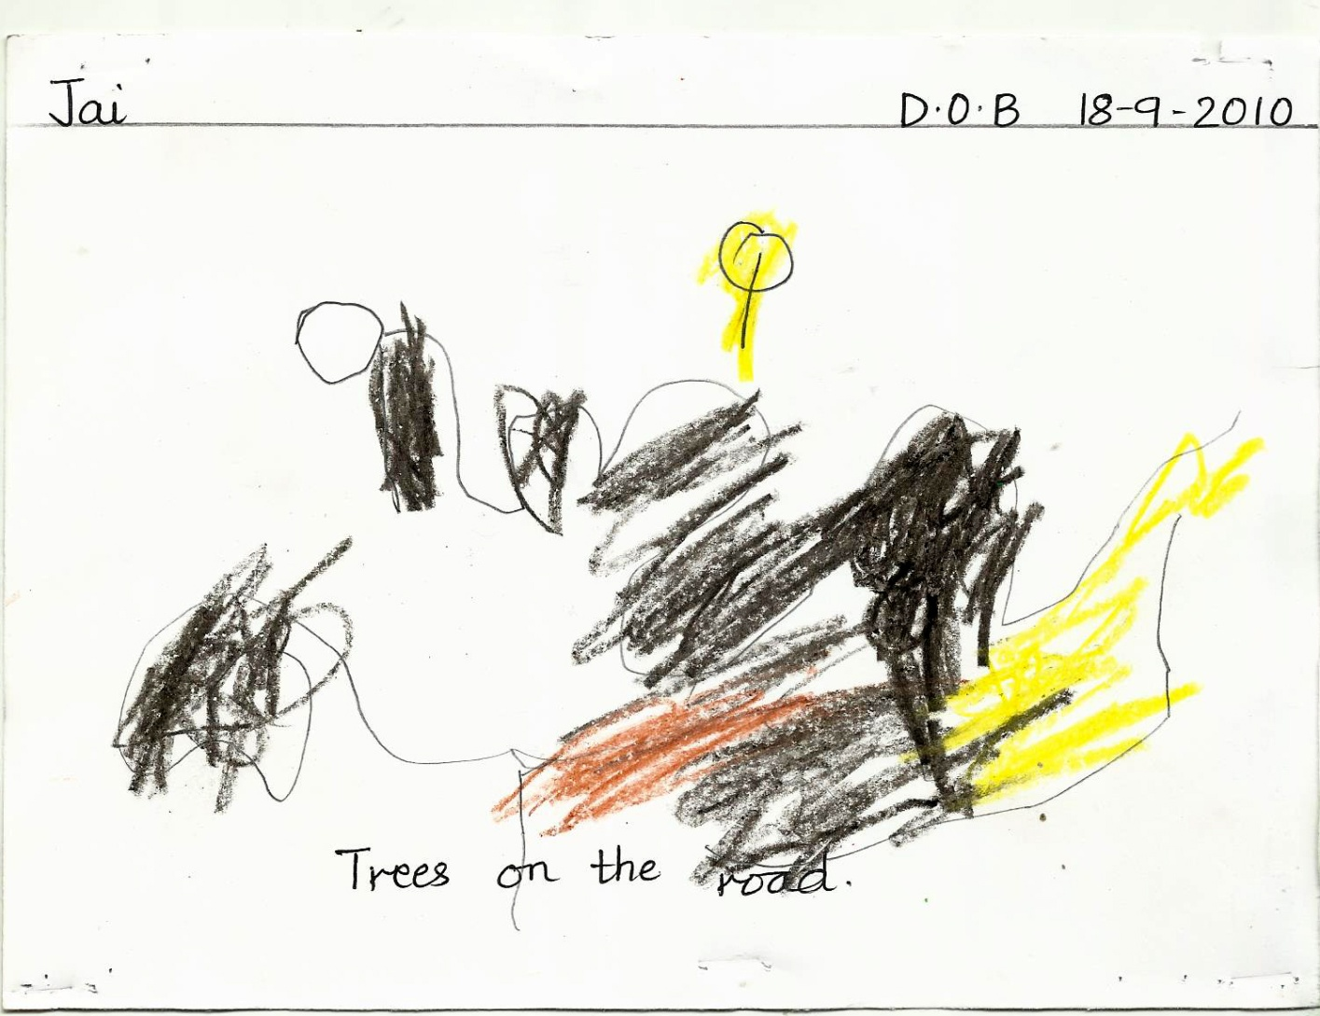
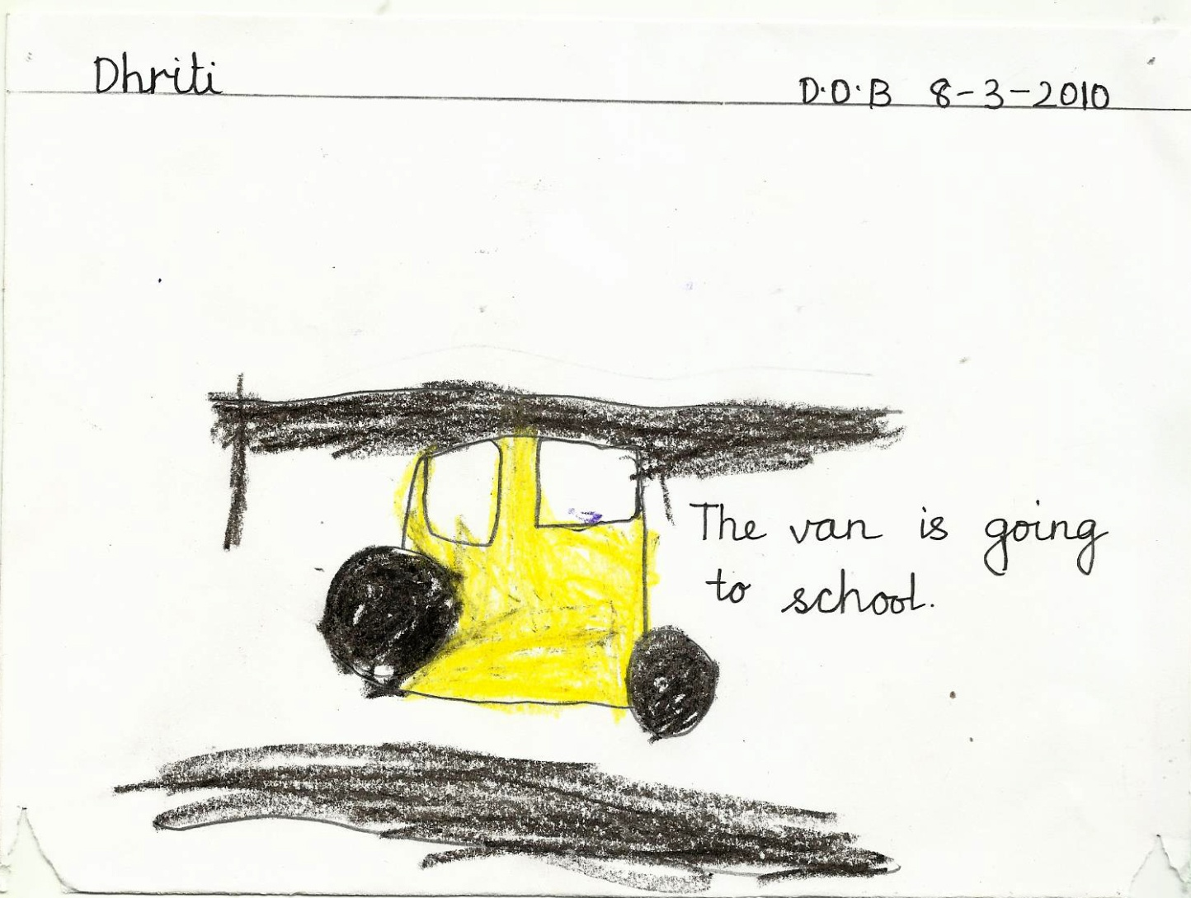
Why parents/teachers should not compare two worksheets or performance with another child?
Dob- 18-9-2010
Dob- 8-3-2010

Slide 31
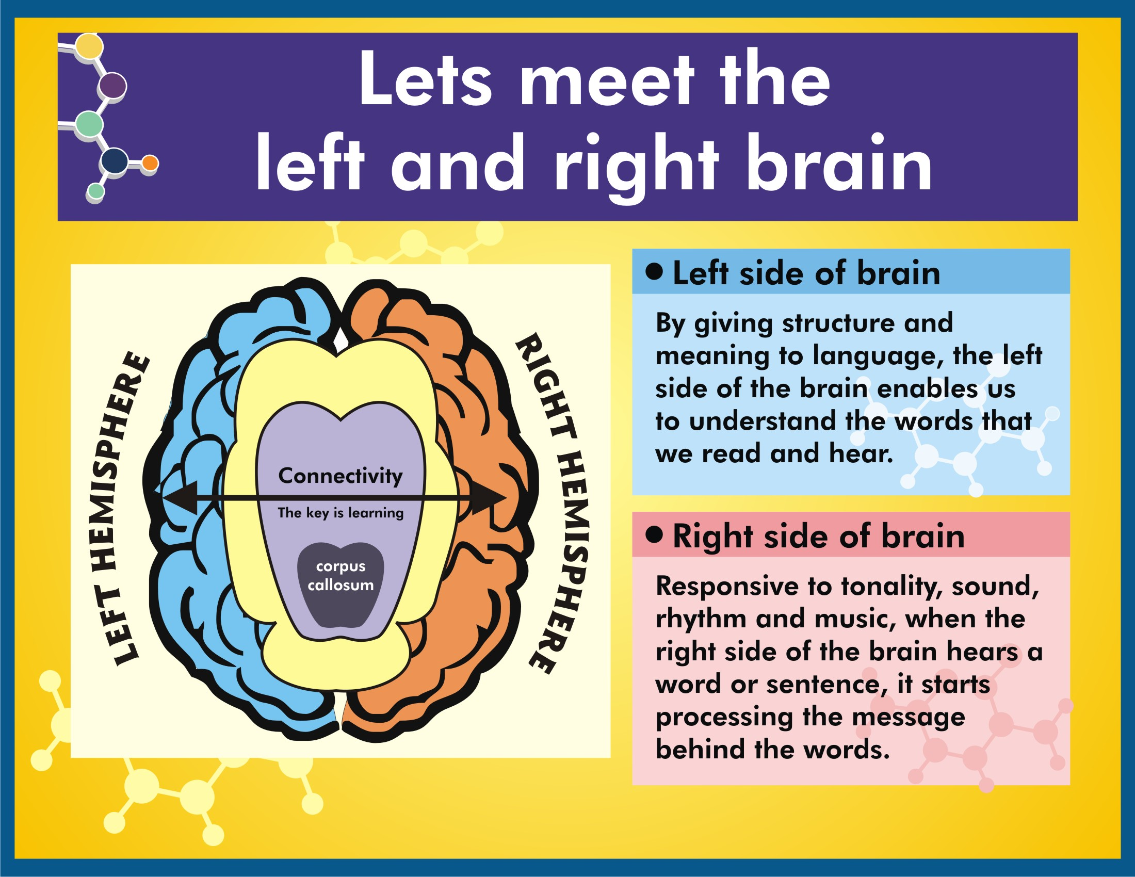

Slide 32
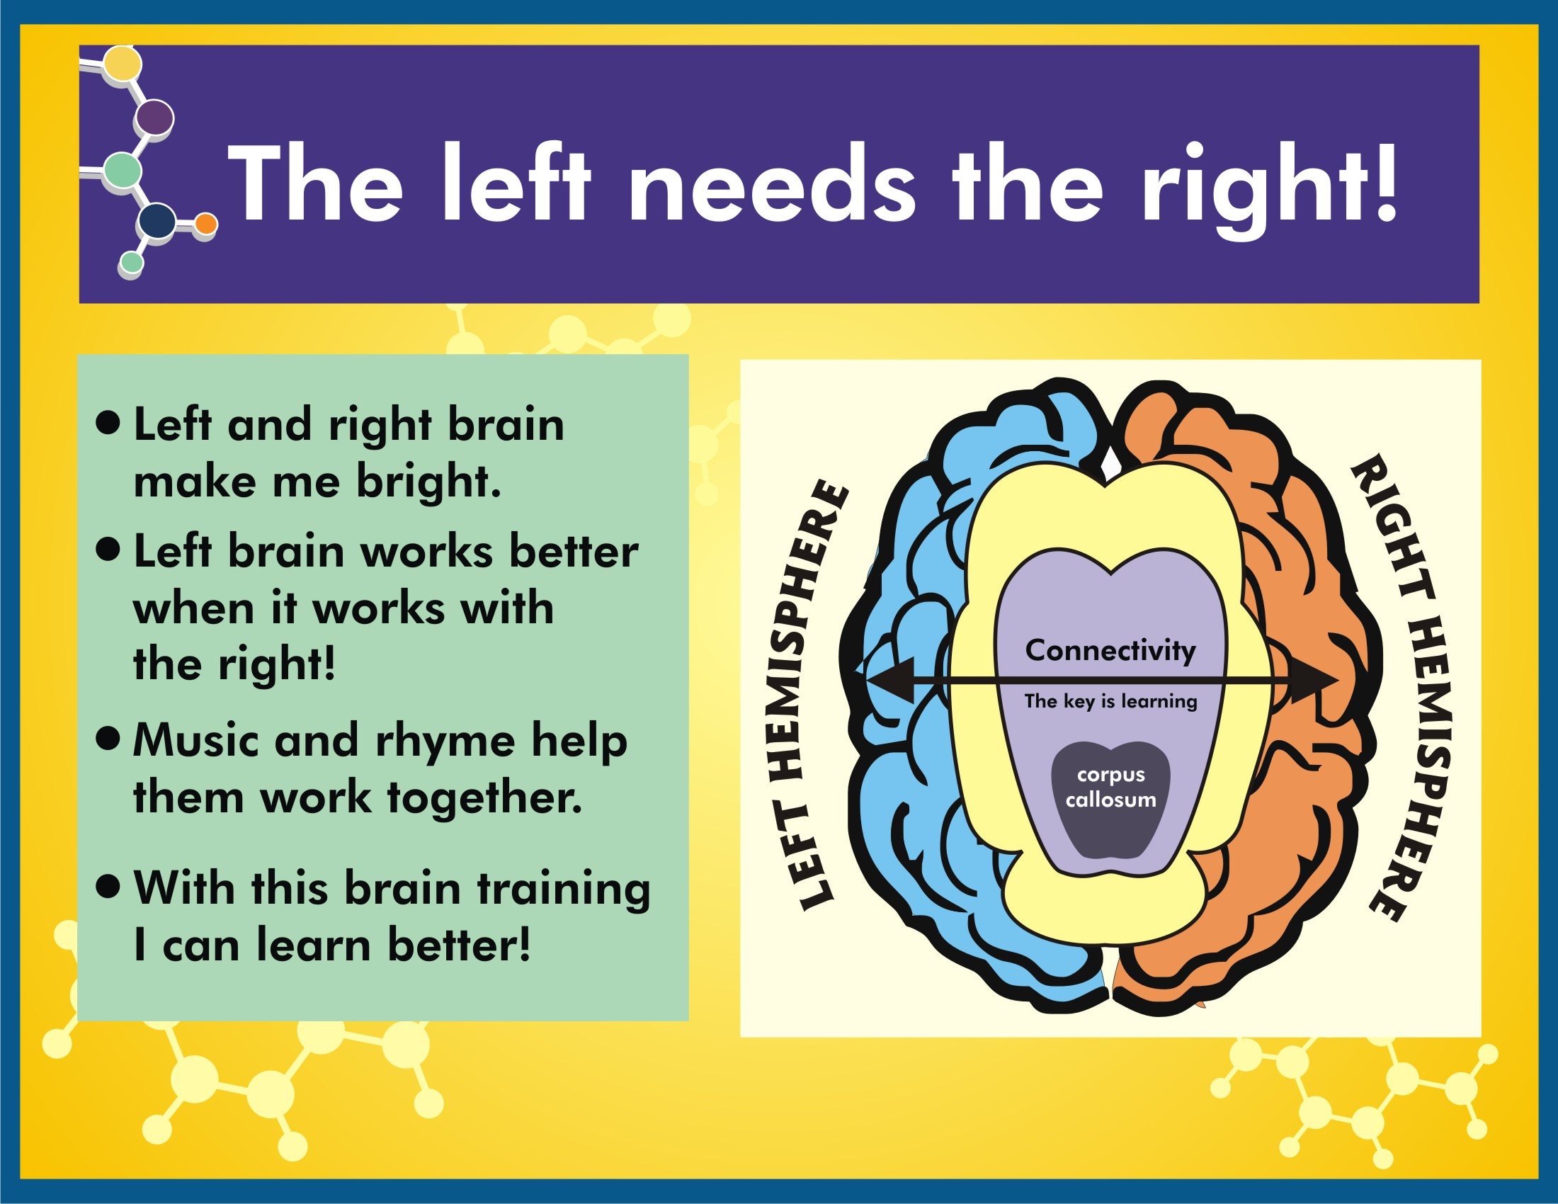

Slide 33
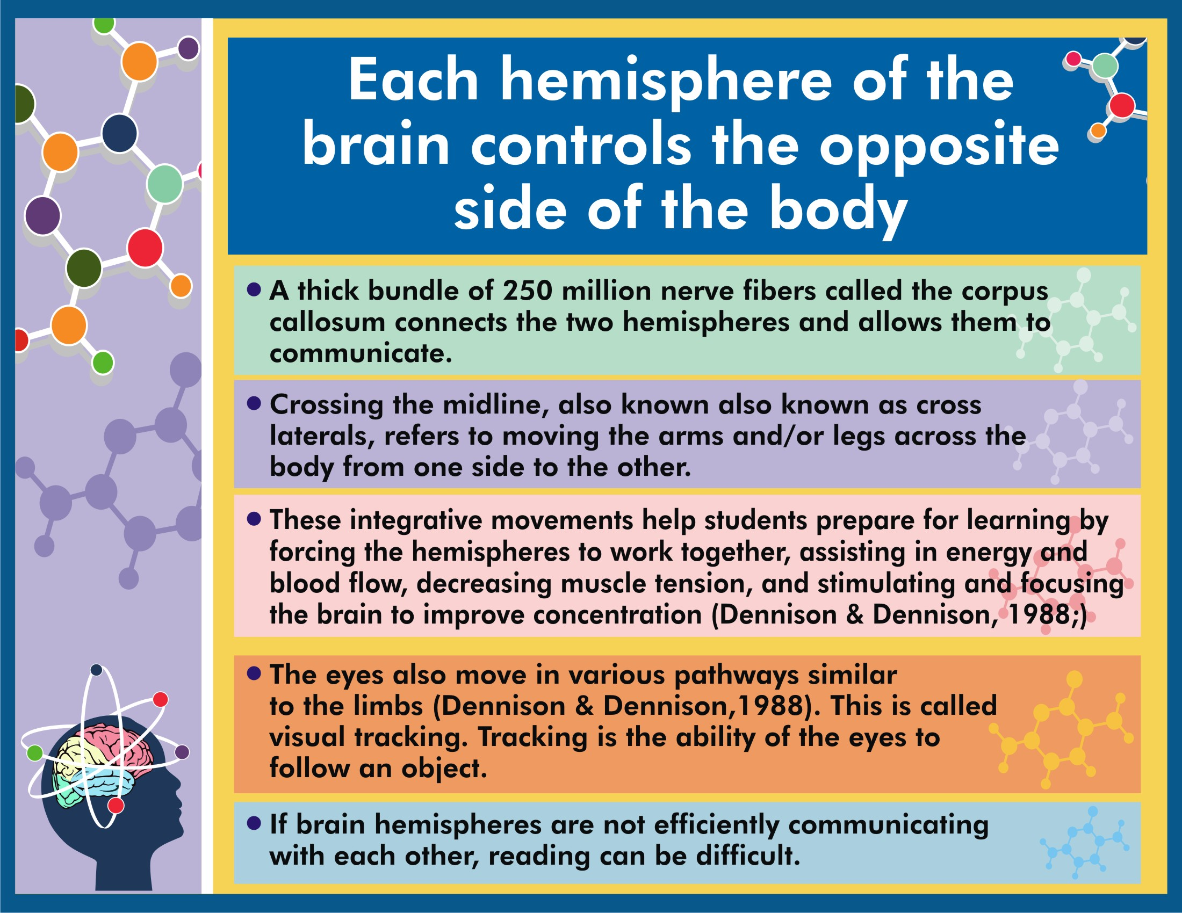

Slide 34
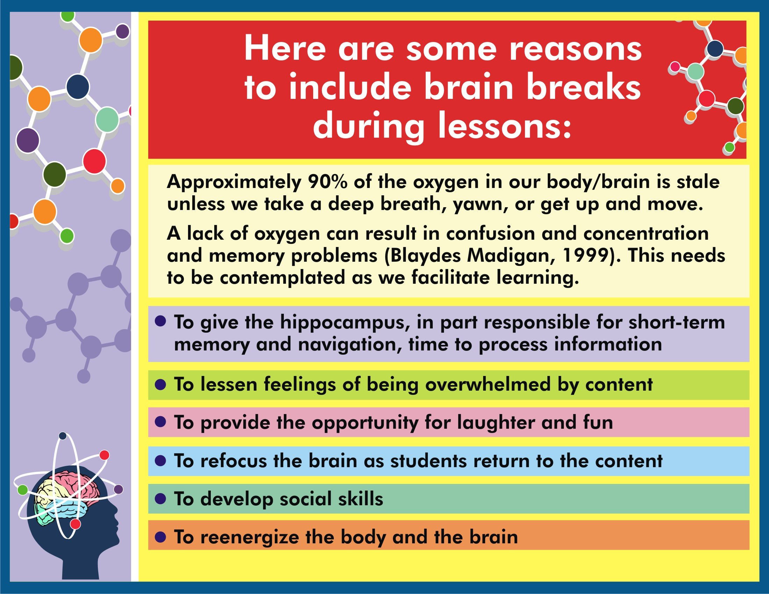

Slide 35
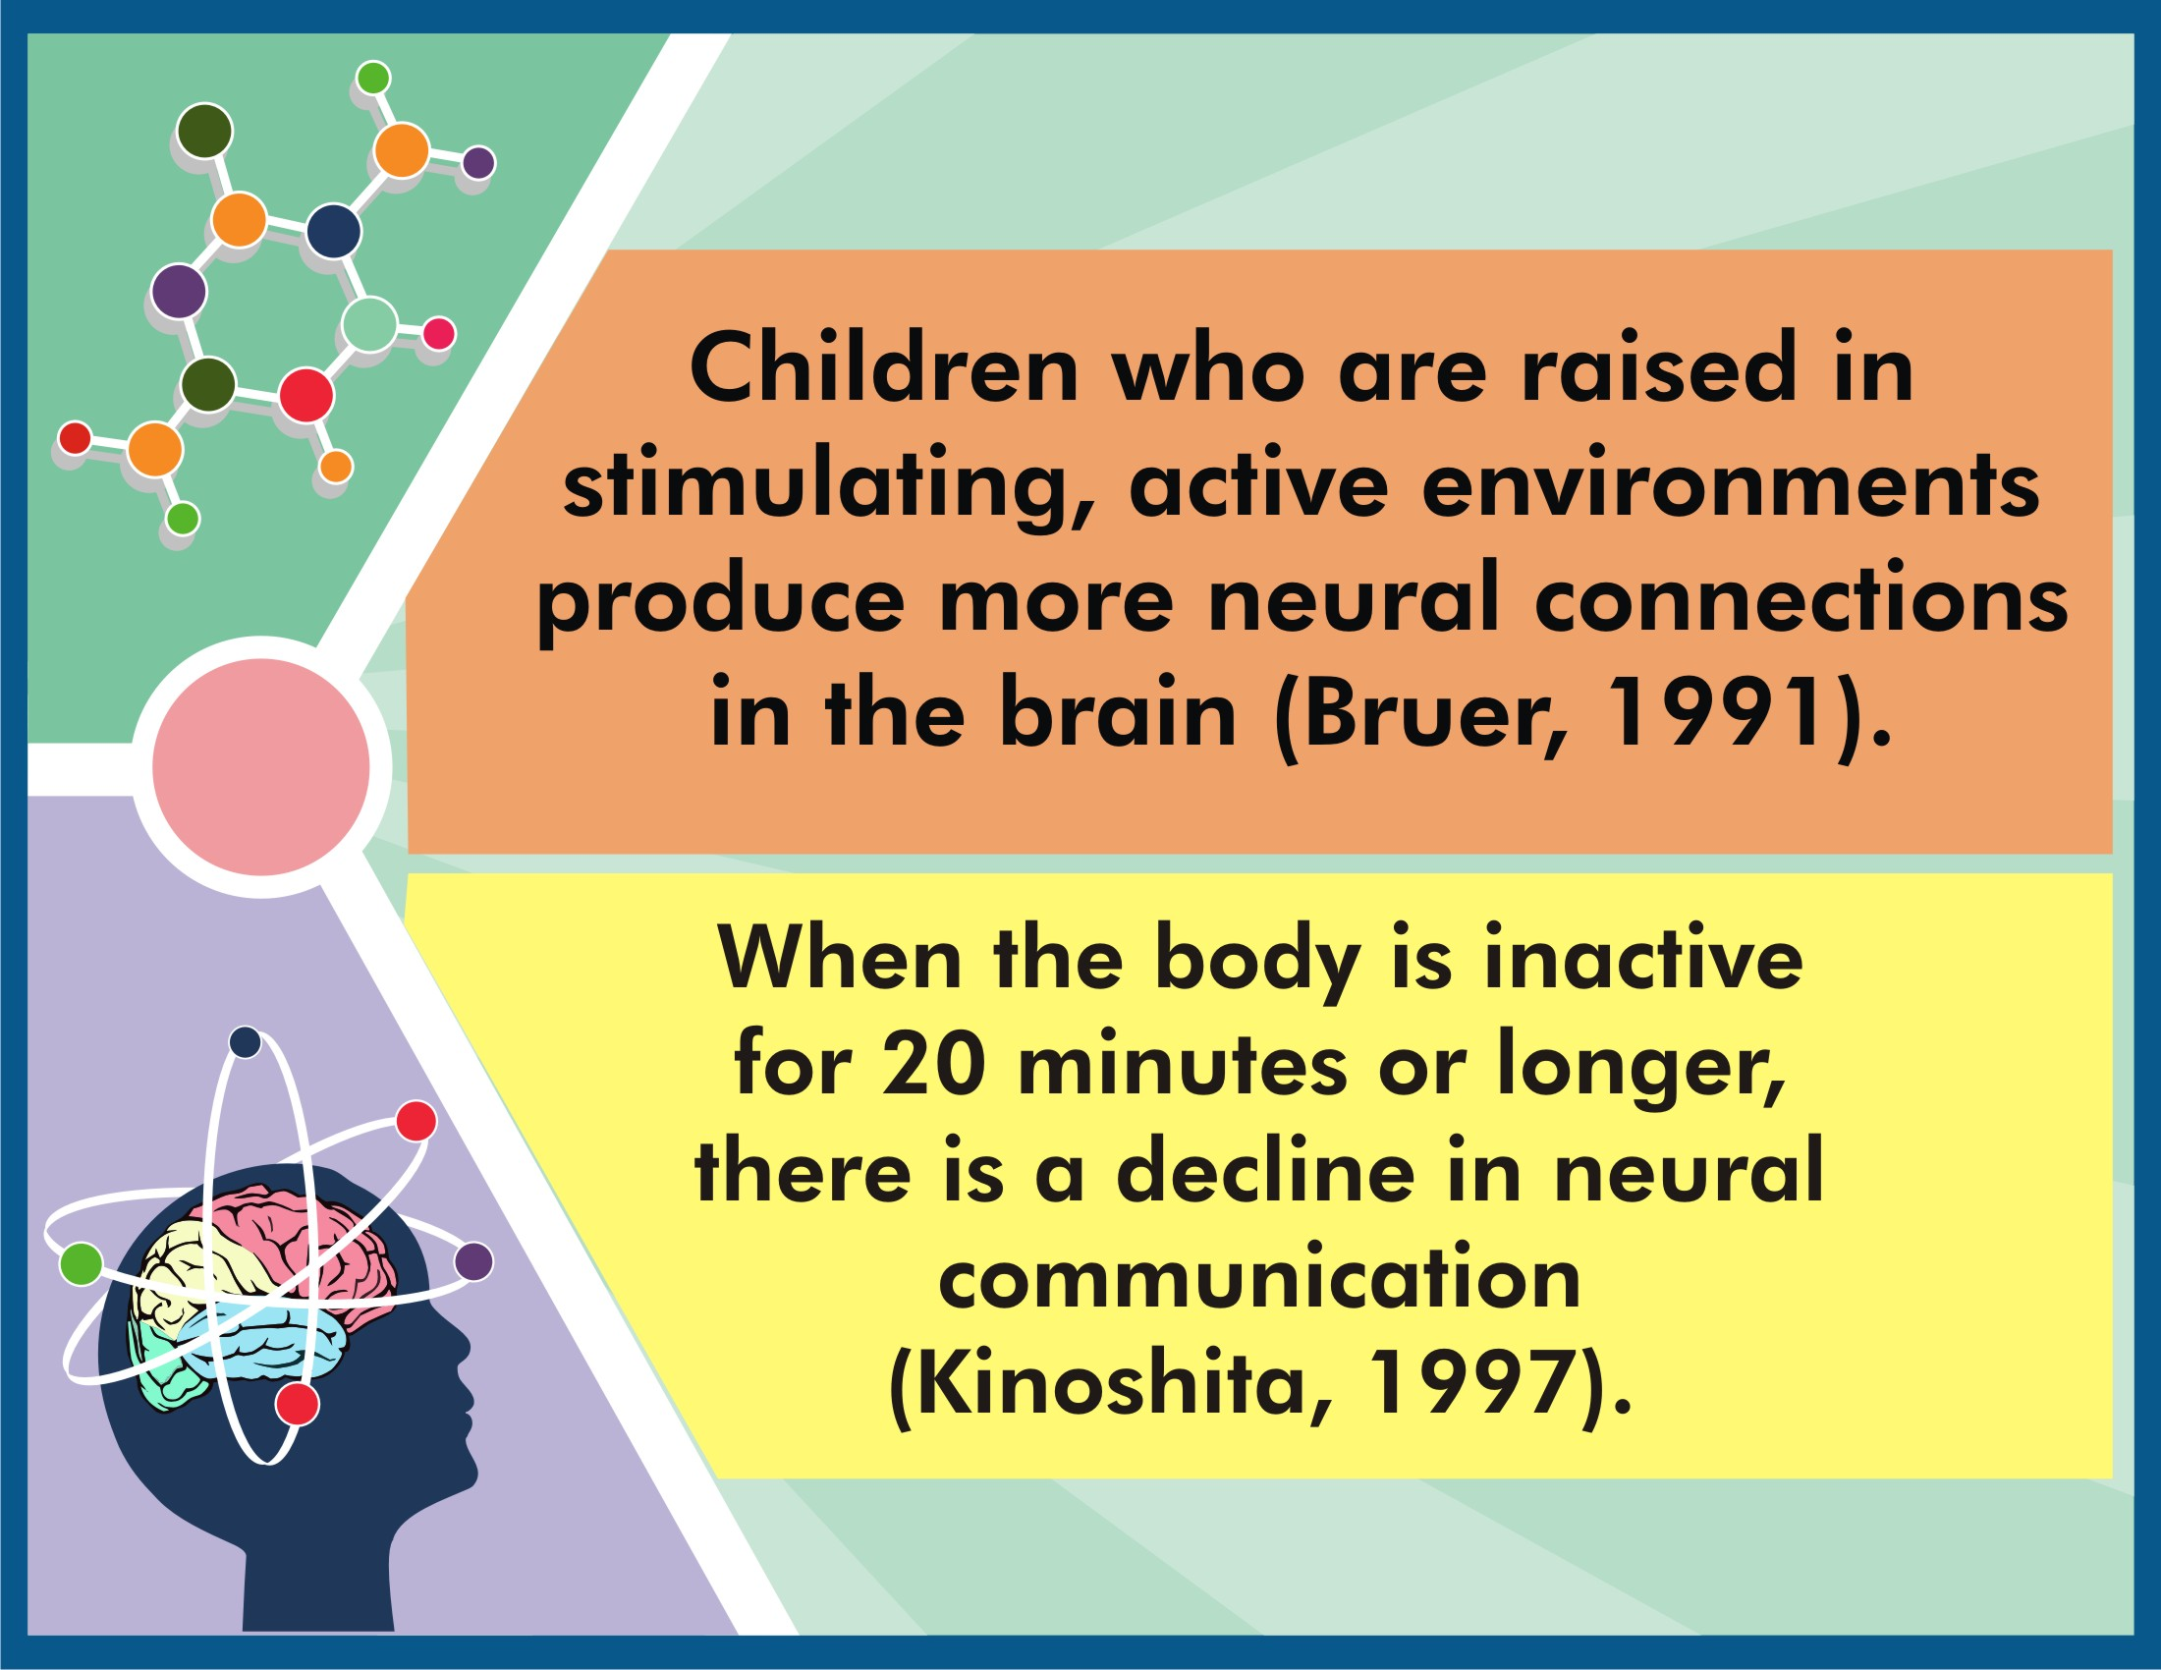

Slide 36
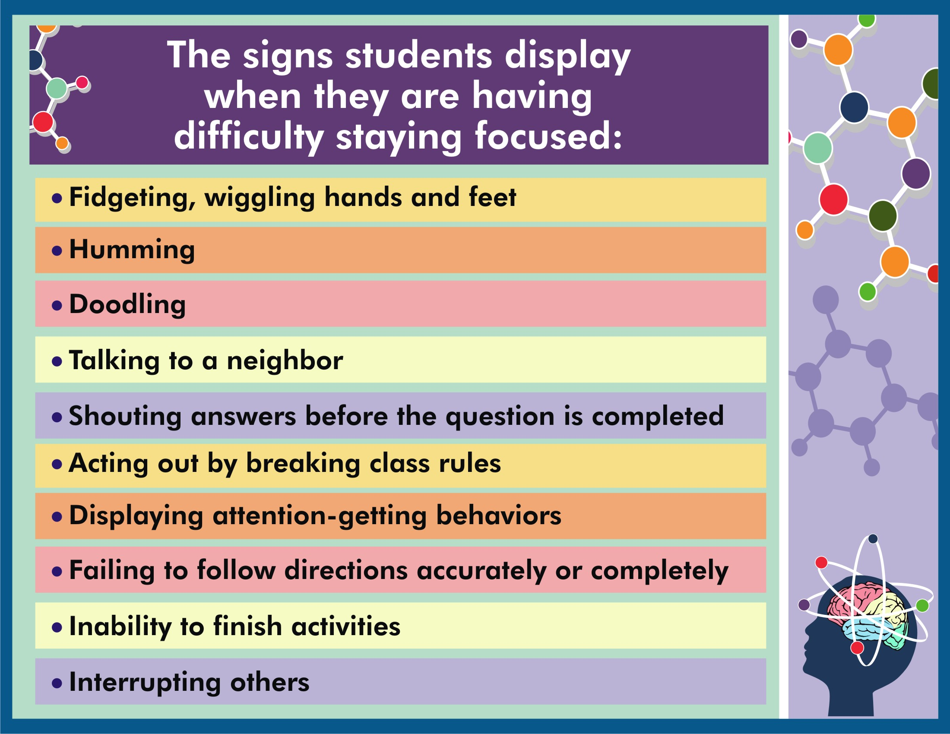

Slide 37
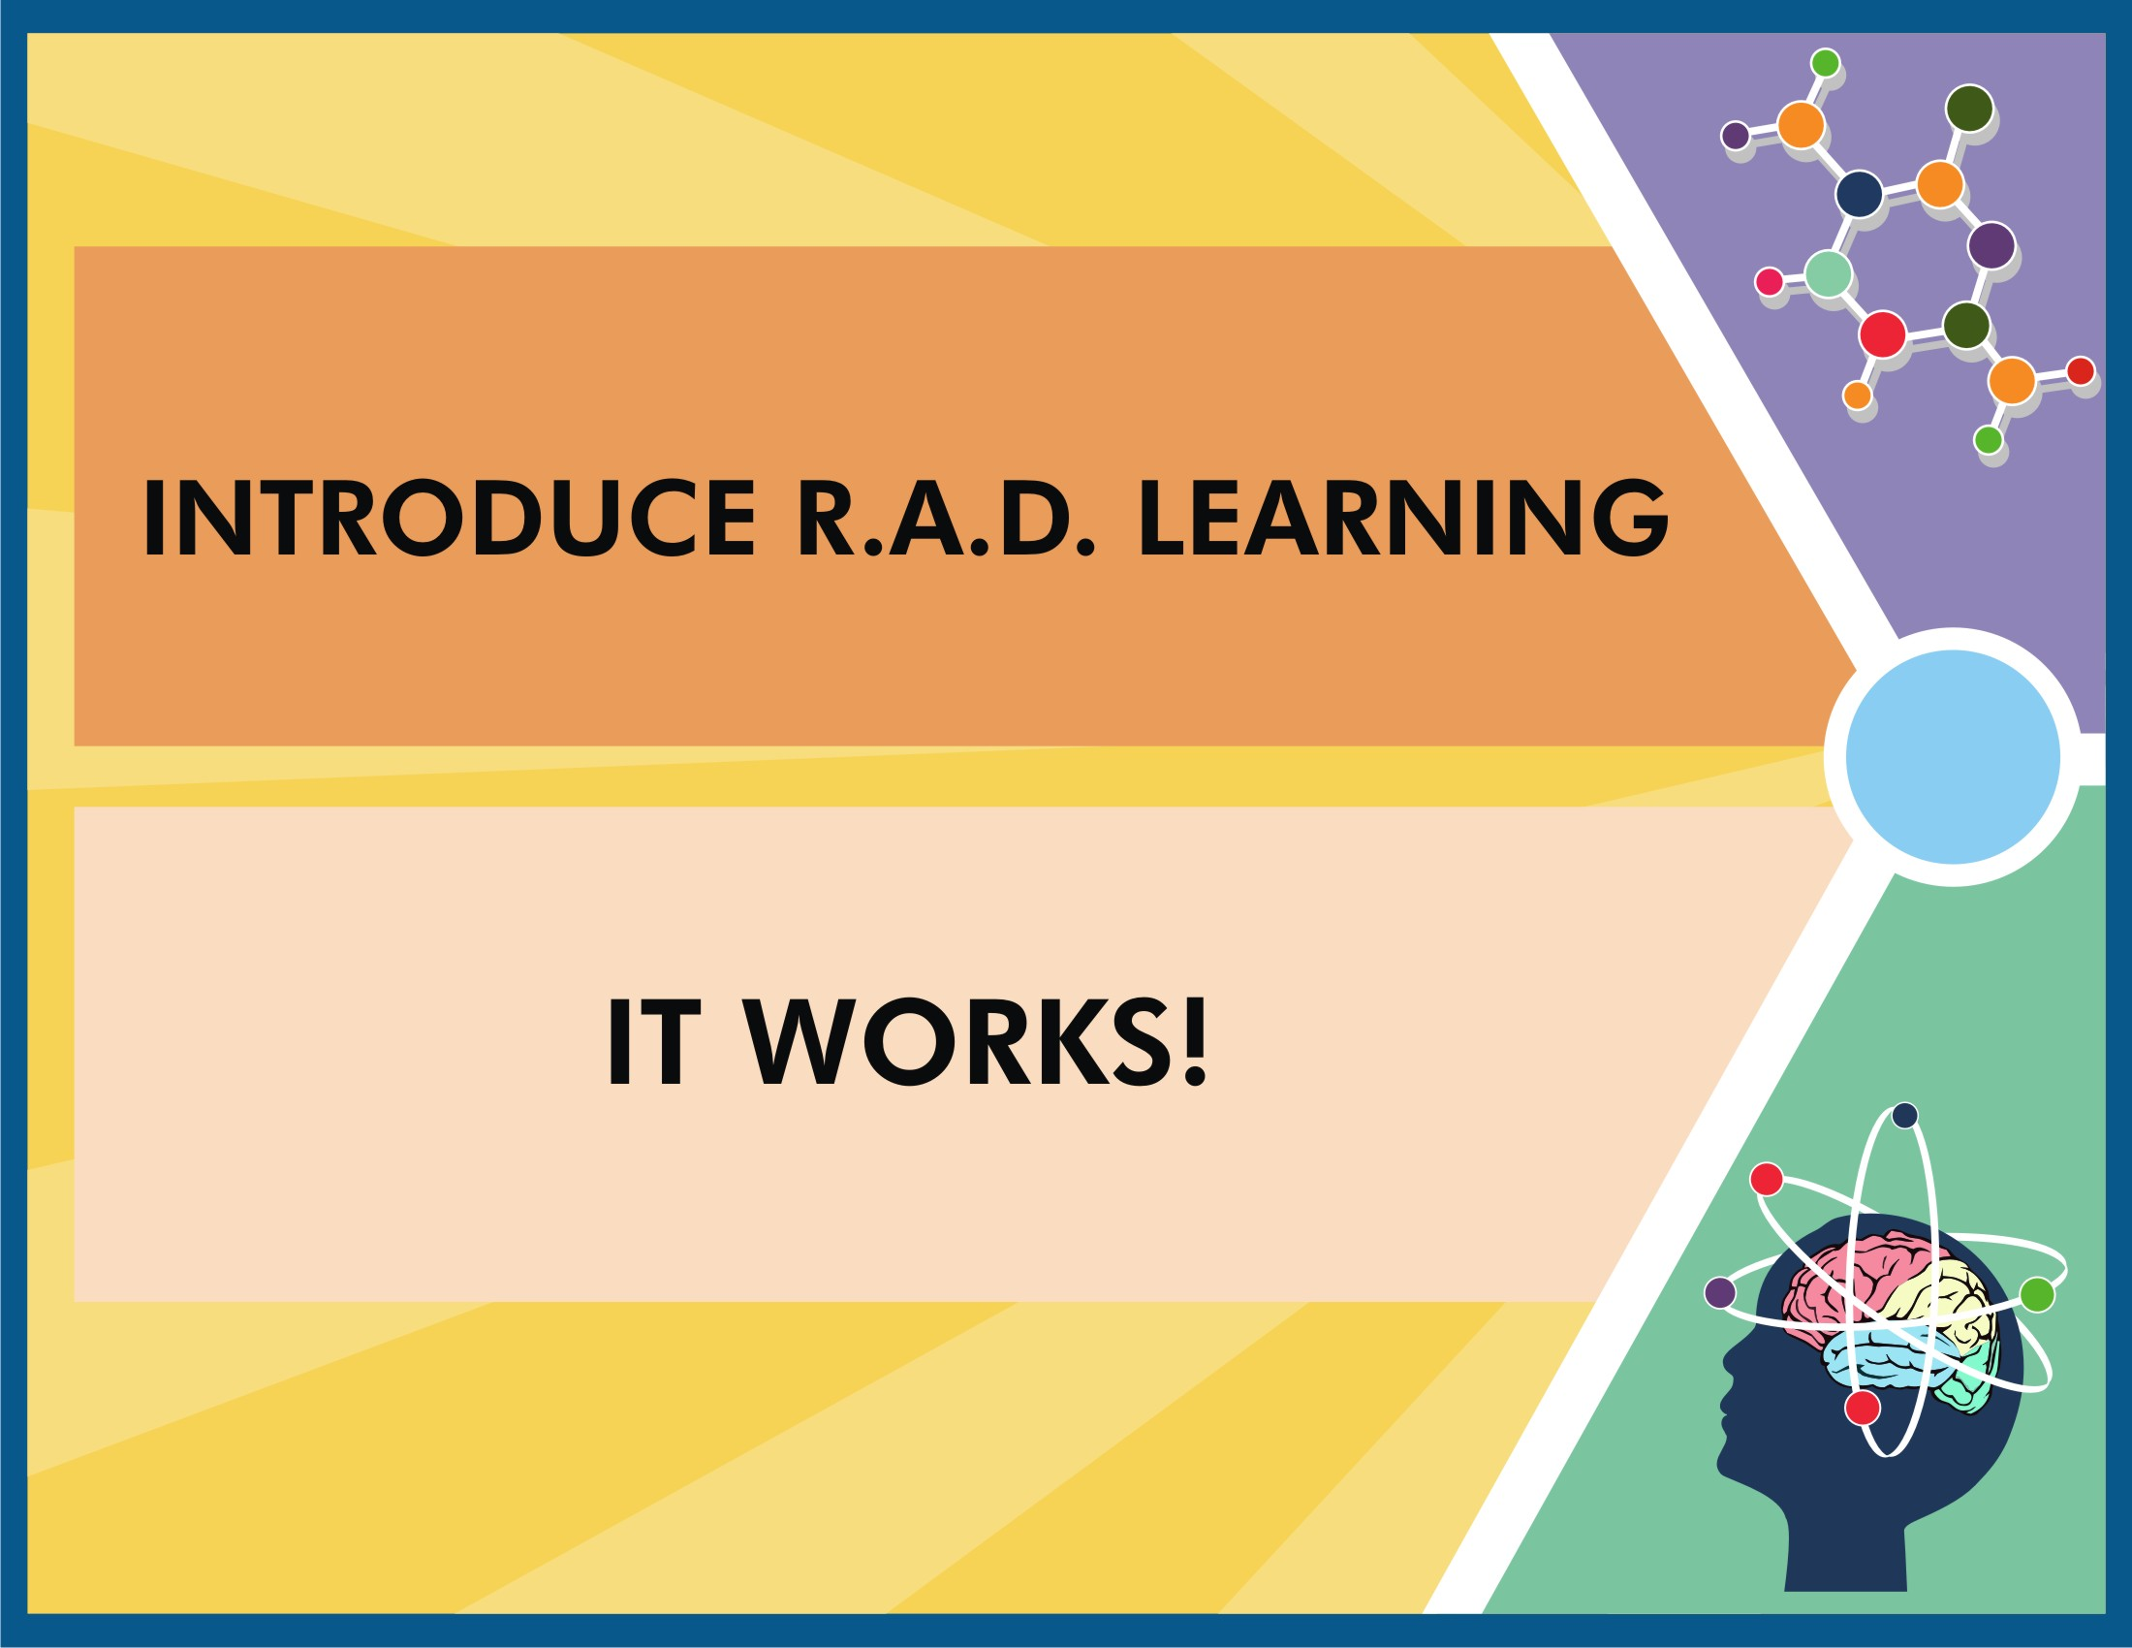

Slide 38
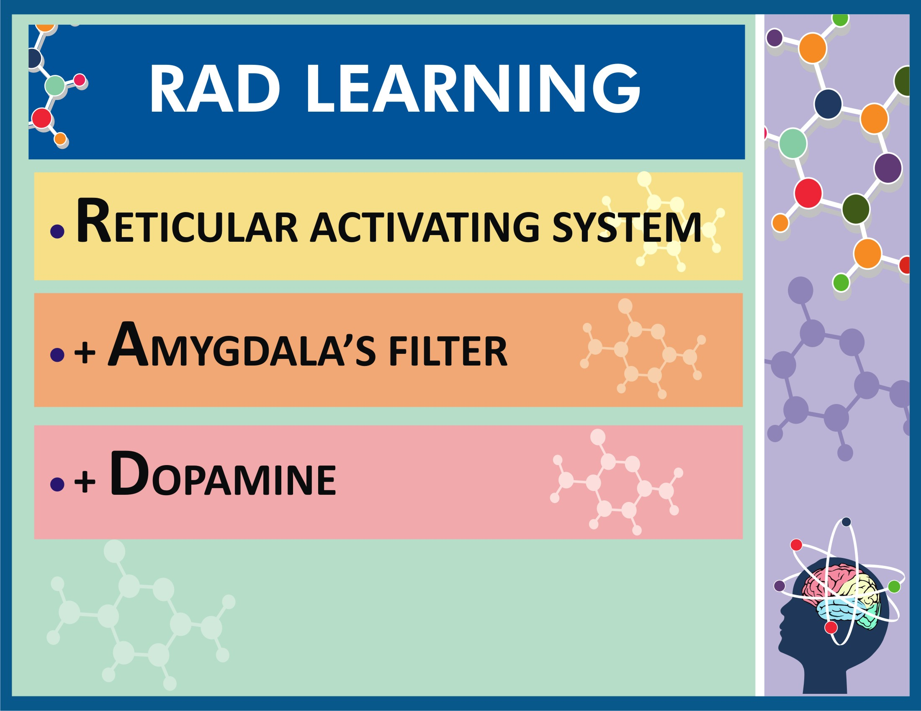

Slide 39
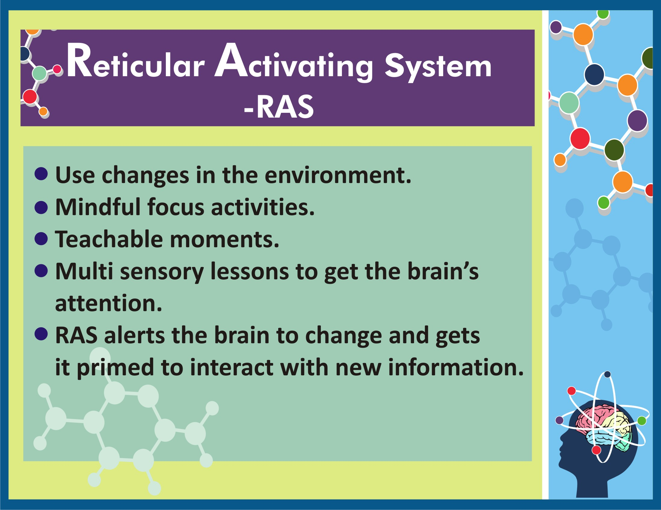

Slide 40
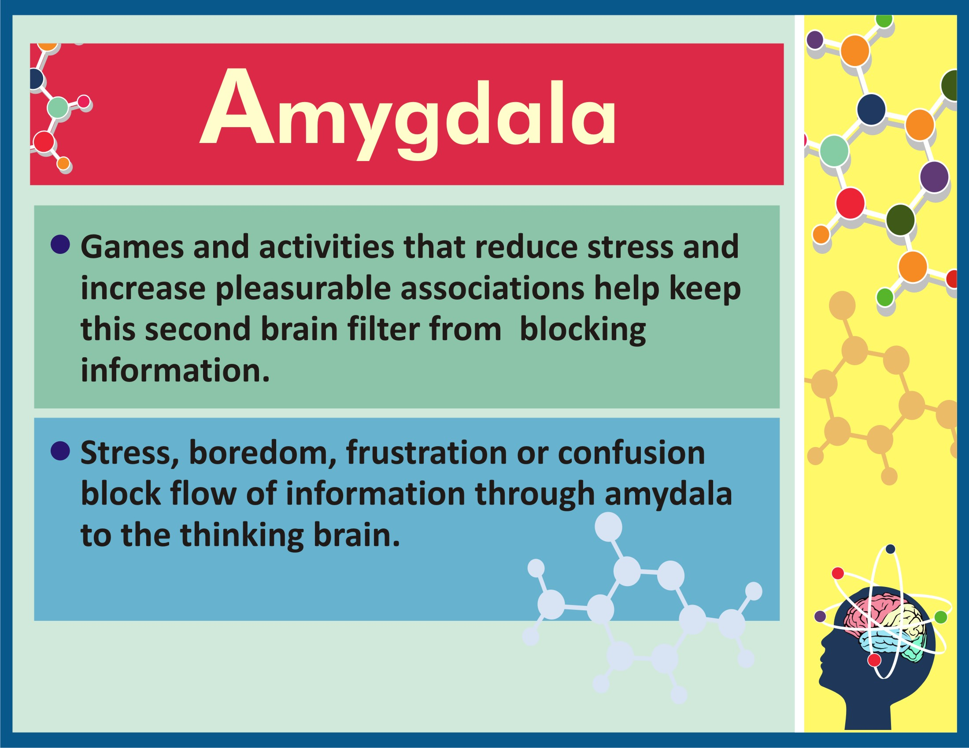

Slide 41
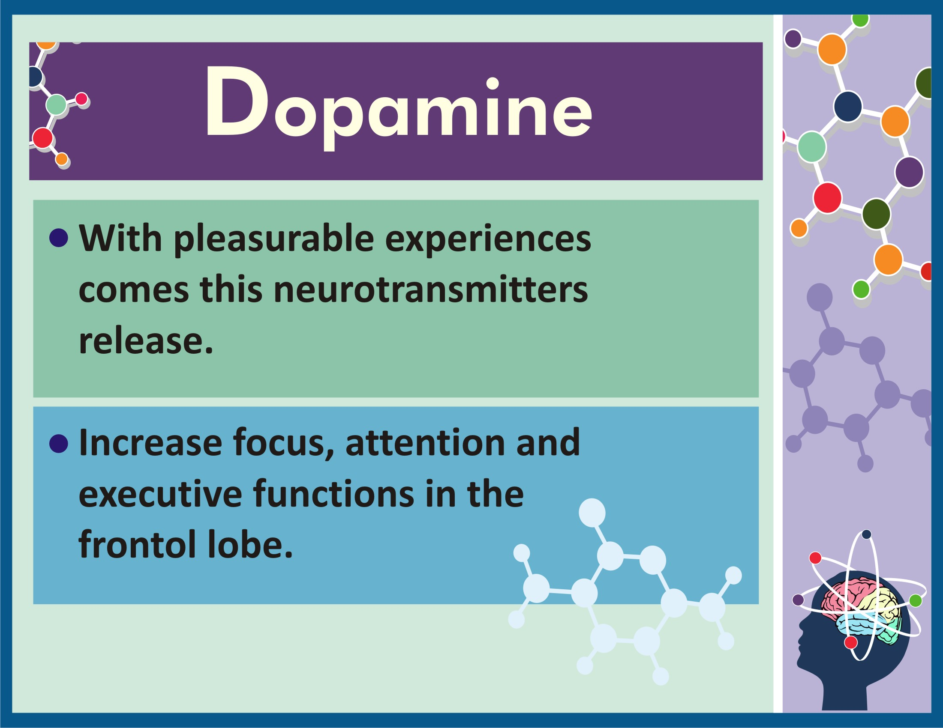

Slide 42


