Slide 1


INTRODUCTION TO
HOLISTIC PROGRESS CARD
DR. SWATI POPAT VATS
PRESIDENT
EARLY CHILDHOOD ASSOCIATION
ASSOCIATION FOR PREPARATORY EDUCATION AND RESEARCH
copyright @ drswatipopatvats@gmail.com

Slide 2

copyright @ drswatipopatvats@gmail.com

Slide 3

copyright @ drswatipopatvats@gmail.com

Slide 4
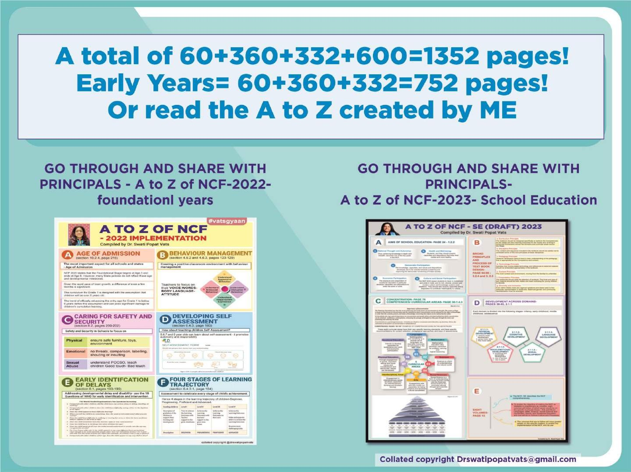
copyright @ drswatipopatvats@gmail.com

Slide 5
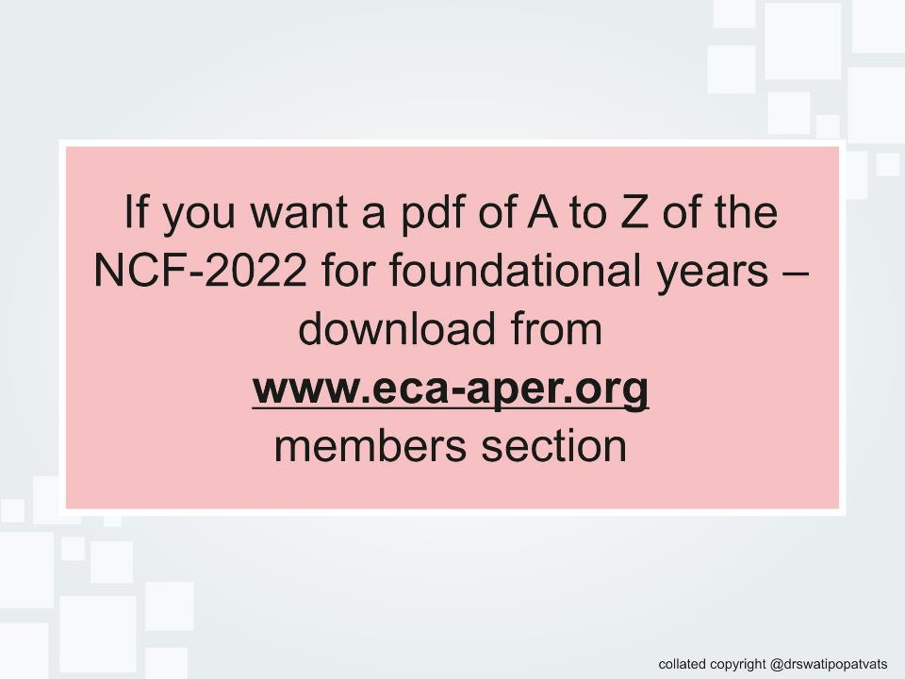
copyright @ drswatipopatvats@gmail.com

Slide 6
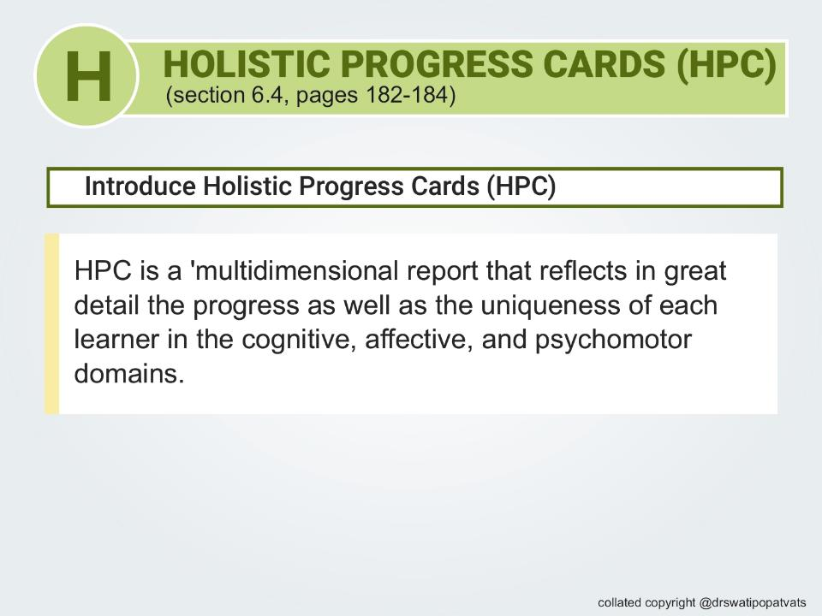
copyright @ drswatipopatvats@gmail.com

Slide 7
Sr. no | Traditional Report Card | NCF- Holistic Progress Card
 | Judges and labels children into slots | Gives a trajectory of growth
2. | Grades and marks or percentages used decrease the self-esteem of the child | The trajectory used helps the parent understand where the child is and how the child will progress
3. | It’s one size fits all | Helps teachers look at each child uniquely
4. | The flow of observation or assessment is of random areas of learning and development | Is a more focussed and monitors both learning and growth.
copyright @ drswatipopatvats@gmail.com

Slide 8
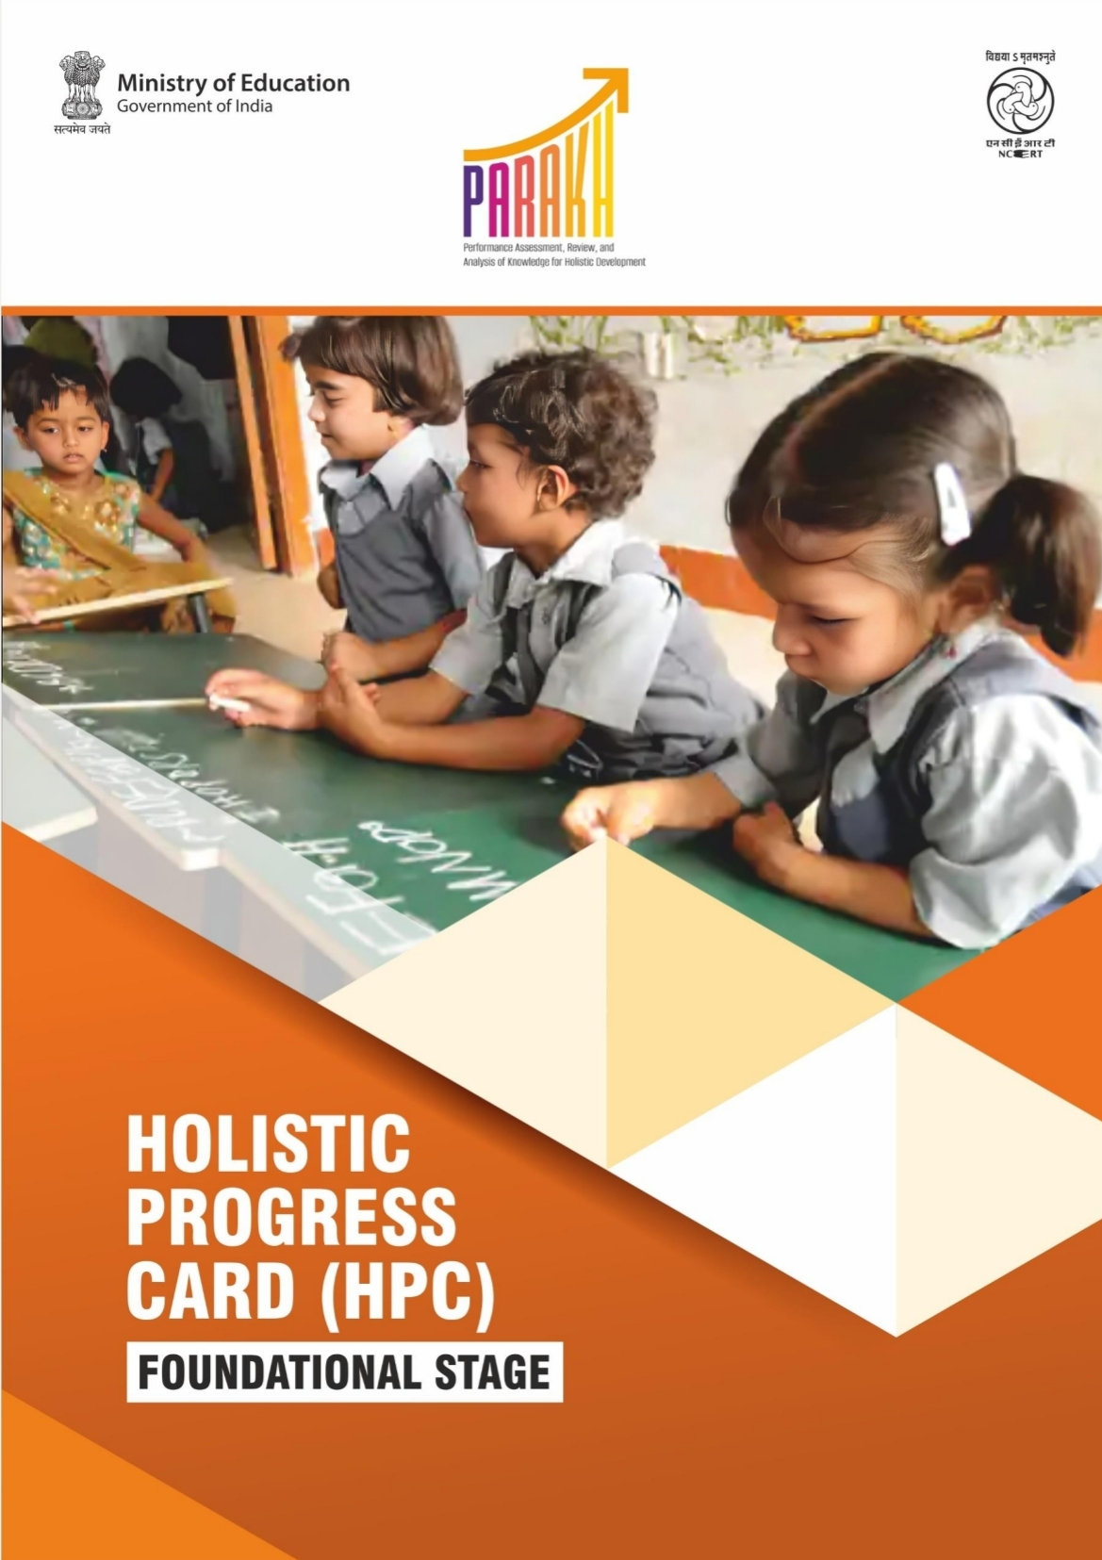
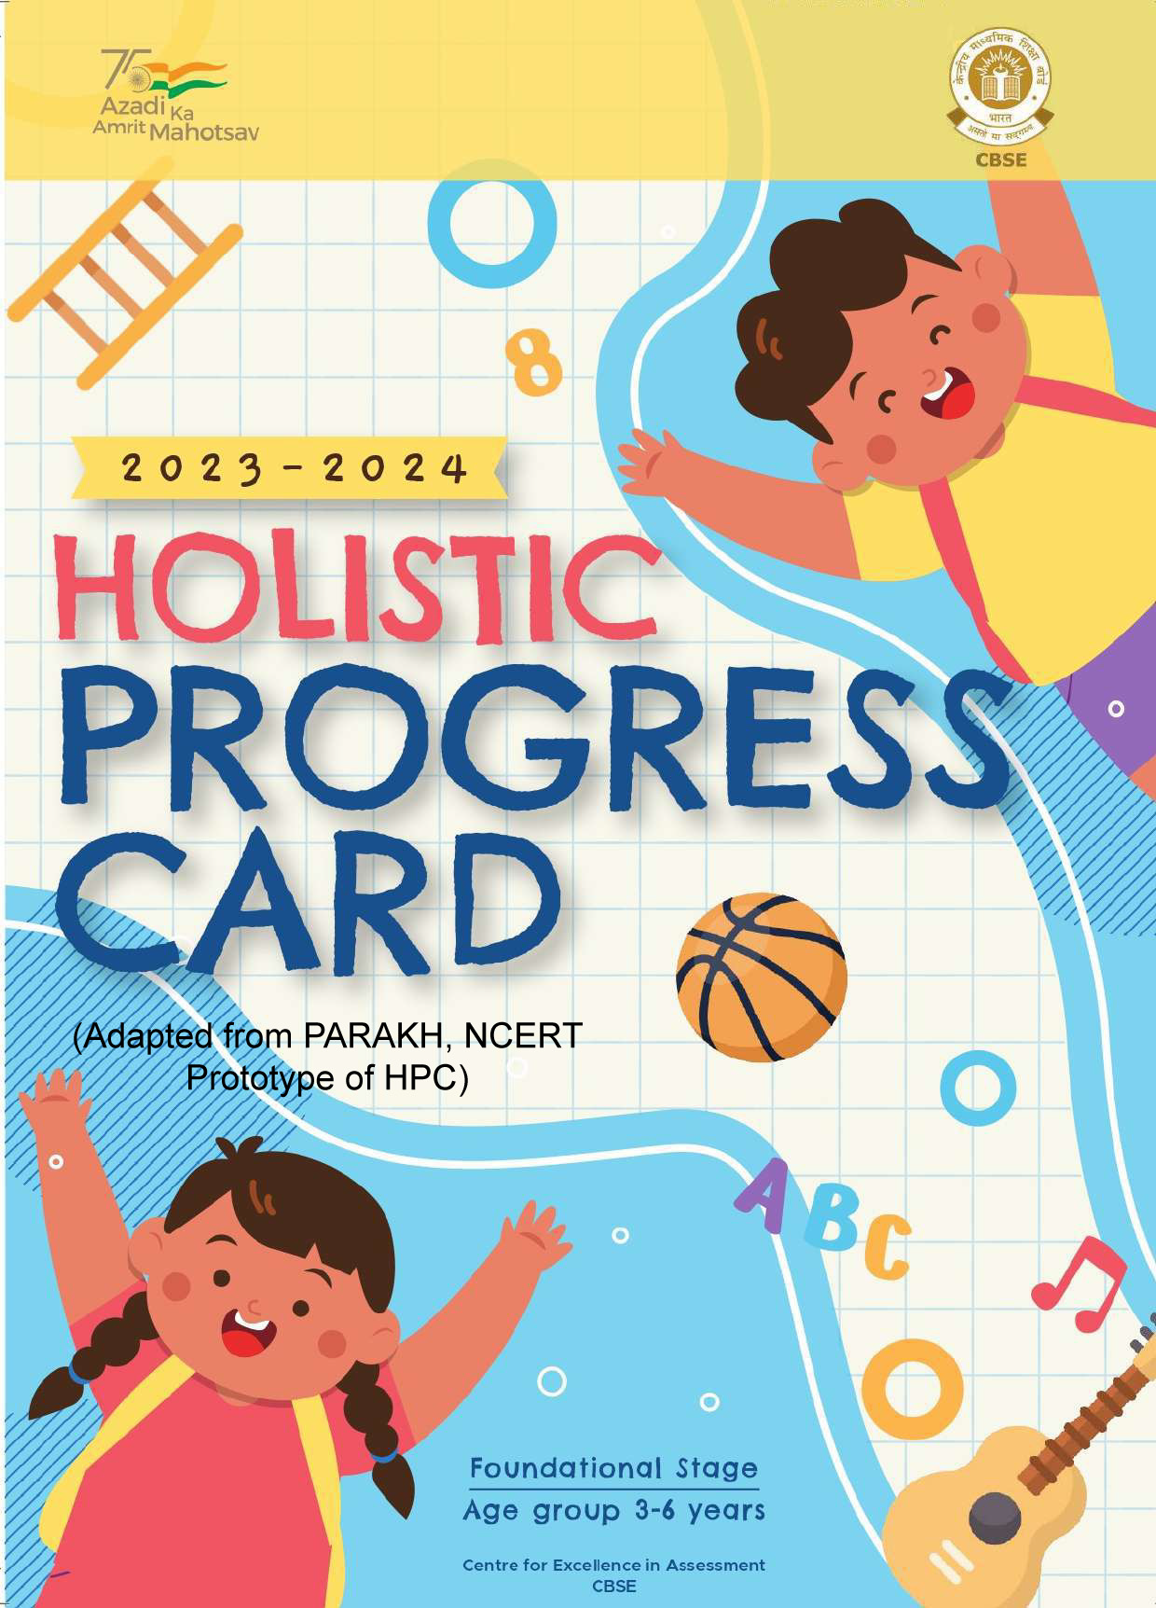
The NCERT HPC AND CBSE HPC
copyright @ drswatipopatvats@gmail.com

Slide 9
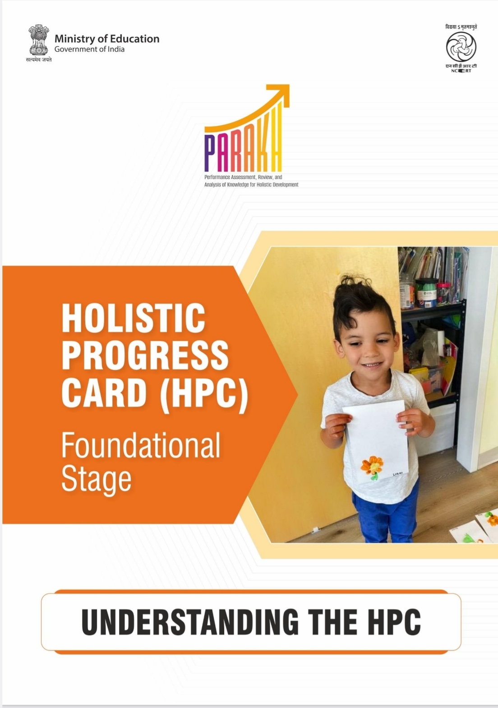
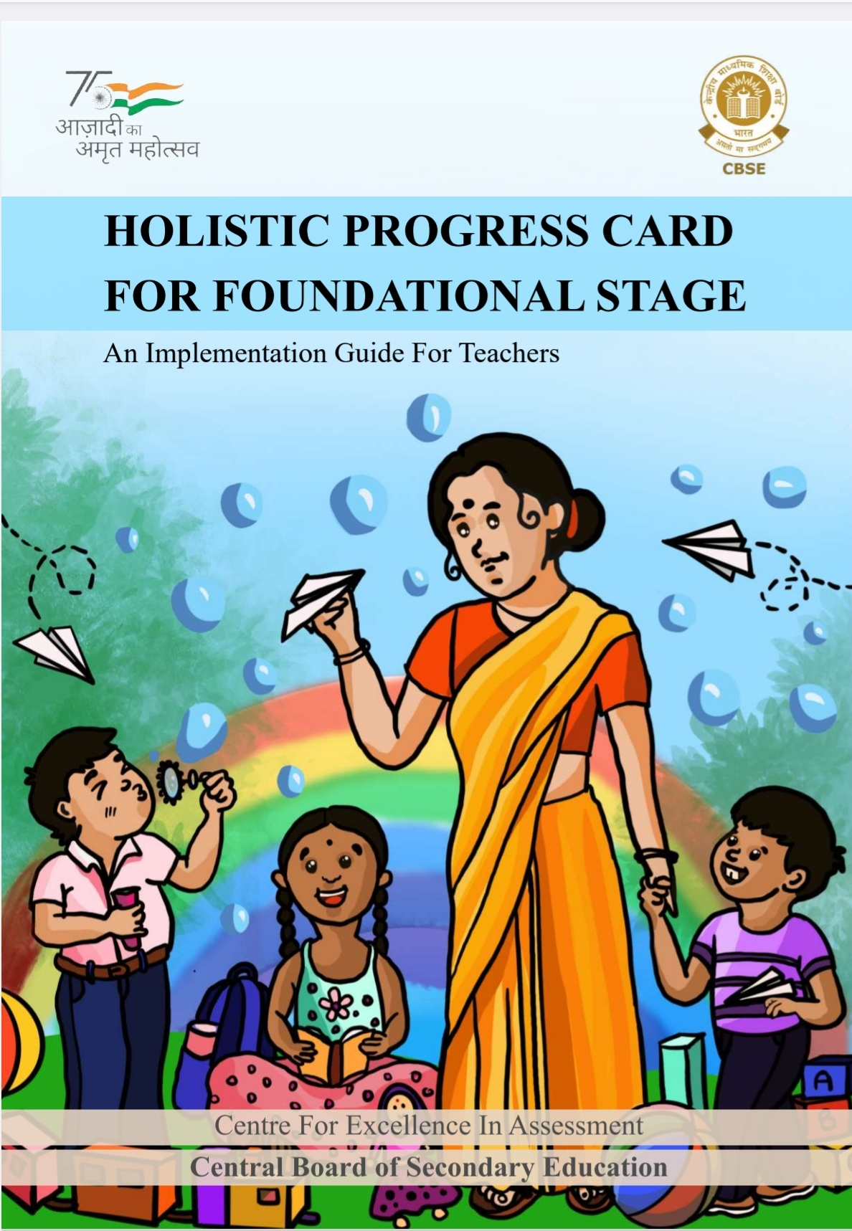
BOTH HAVE AN IMPLEMENTATION MANUAL TOO
copyright @ drswatipopatvats@gmail.com

Slide 10
What is summative and formative assessment?
A formative assessment is like tasting the food as you cook.
In assessment terms it means the assessment is ongoing with the teaching-learning process.
You check the seasoning, texture, and flavour to see if it's turning out right.
Assessment like this means there is scope to modify the teaching-learning process to ensure children’s learning.
You make adjustments as needed to ensure the dish turns out well.
This kind of assessment helps scaffold learning.
copyright @ drswatipopatvats@gmail.com

Slide 11
Curriculum planning and HPC
Curriculum Goals (CG)
B. Domains (D)
C. Competencies (C)
D. Learning Outcomes (LO)
A. Curriculum Goal: Reaching a specific destination (e.g., MUMBAI City)
B. Domain: Mode of transportation (e.g., driving, flying, or taking the train)
C. Competency: Navigating through unfamiliar roads or airports
D. Learning Outcome: Arriving at the destination safely and on time (e.g., arriving at MUMBAI Airport by 5 PM)
copyright @ drswatipopatvats@gmail.com

Slide 12
Curriculum Goals: Reaching a Developmental Milestone
Definition:
Broad, overarching statements that describe what children should achieve through their learning experiences.
In ECE, the curriculum goal is like reaching a specific developmental milestone, such as developing social skills or mastering fine motor skills.
Example: "Children will develop a strong foundation in literacy and numeracy skills."
copyright @ drswatipopatvats@gmail.com

Slide 13
Domains: Area of Development
The domain is like the area of development that the child needs to work on to reach the milestone.
Definition: Areas of learning that are interconnected and interdependent.
For example, if the goal is to develop social skills, the domain might be Social-Emotional Learning.
Example: "Language and Literacy", "Mathematics", "Social-Emotional Learning", "Physical Development"
copyright @ drswatipopatvats@gmail.com

Slide 14
Competencies: Skill or Behaviour
The competency is like the specific skill or behaviour that the child needs to develop to reach the milestone.
Definition: Specific skills, abilities, or behaviours that children demonstrate as they progress through their learning journey.
For example, if the domain is Social-Emotional Learning, the competency might be "Shares toys with friends."
Example: In the domain of Language and Literacy, a competency might be "Uses vocabulary to communicate effectively."
copyright @ drswatipopatvats@gmail.com

Slide 15
Learning Outcomes: Measurable Achievement
The learning outcome is like the measurable achievement that the child demonstrates when they reach the milestone.
Definition: Specific, measurable statements that describe what children will know, understand, or be able to do as a result of their learning experiences.
For example, "Shows an increase in sharing toys with friends during playtime."
Example: In the domain of Mathematics, a learning outcome might be "Counts up to 100 objects with accuracy."
copyright @ drswatipopatvats@gmail.com

Slide 16
Here's an example of how this might look in practice:
A. Curriculum Goal: Children will develop problem-solving skills.
B. Domain: Mathematics
C. Competency: Uses logical reasoning to solve problems.
D. Learning Outcome: Solves simple math problems using objects and counting.
A. Curriculum Goal: Develops social skills
B. Domain: Social-Emotional Learning
C. Competency: Shares toys with friends
D. Learning Outcome: Shows an increase in sharing toys with friends during playtime
copyright @ drswatipopatvats@gmail.com

Slide 17



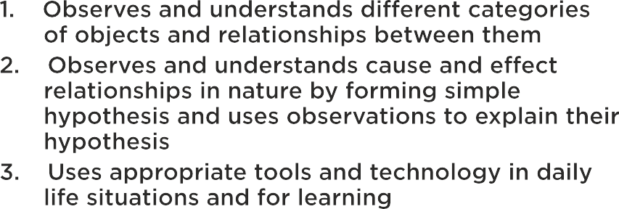
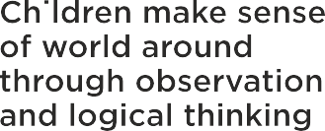
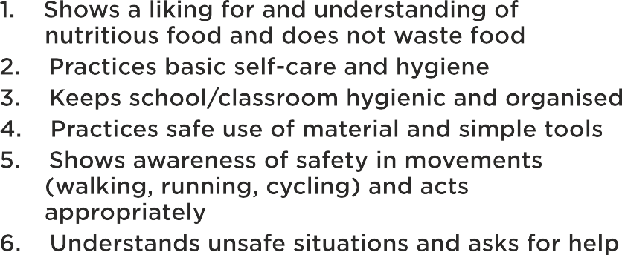
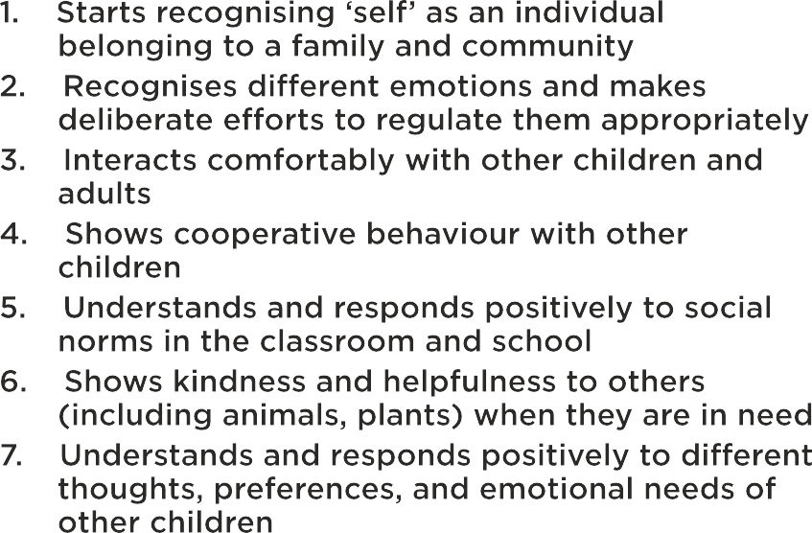

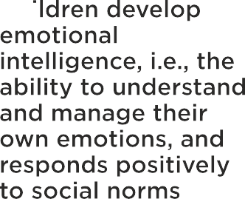
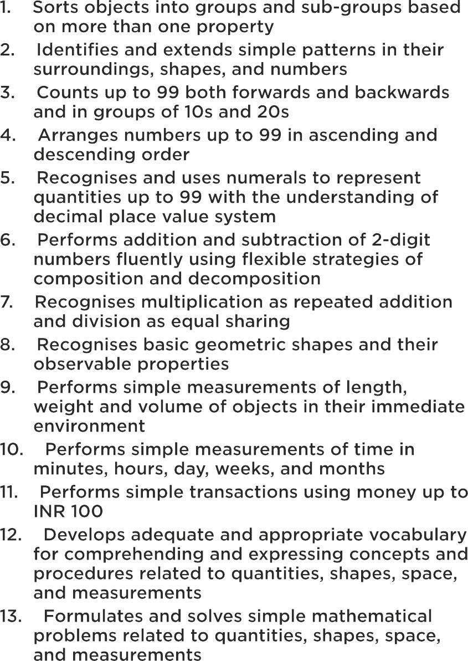
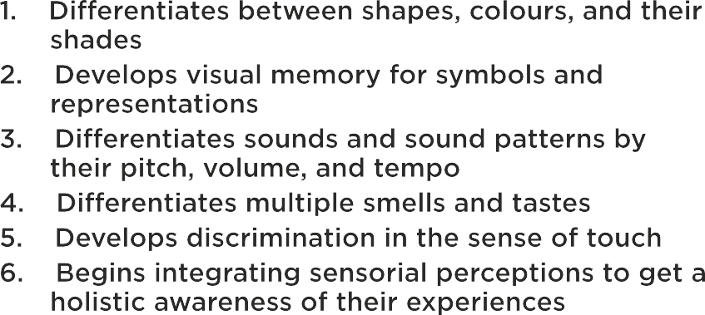

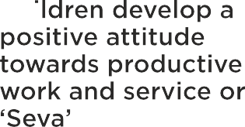
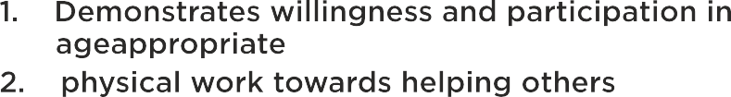



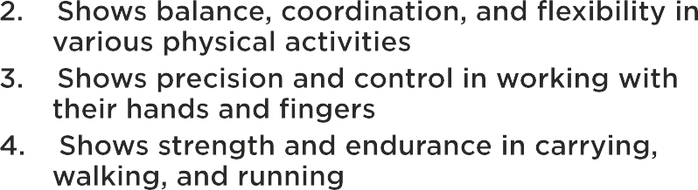


Slide 18
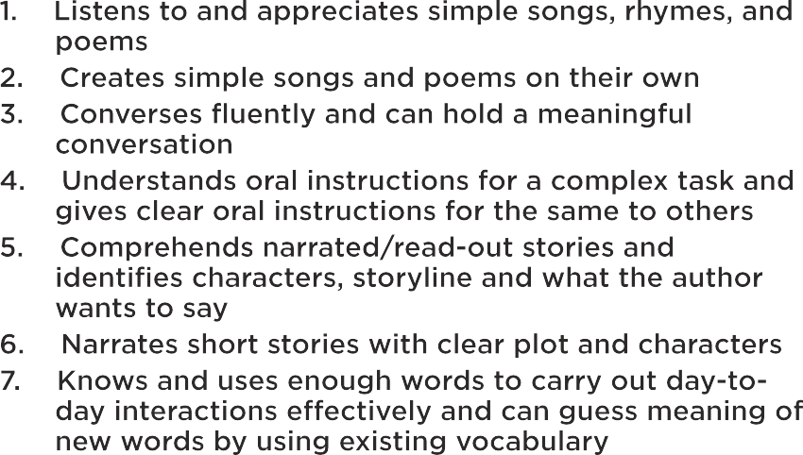
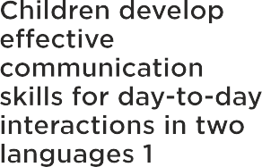
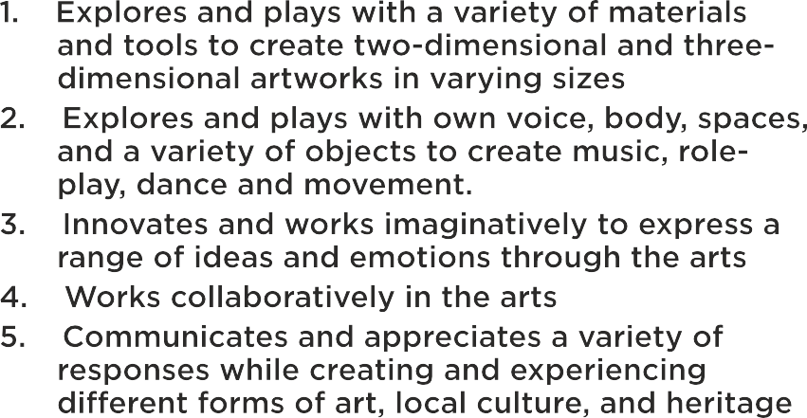

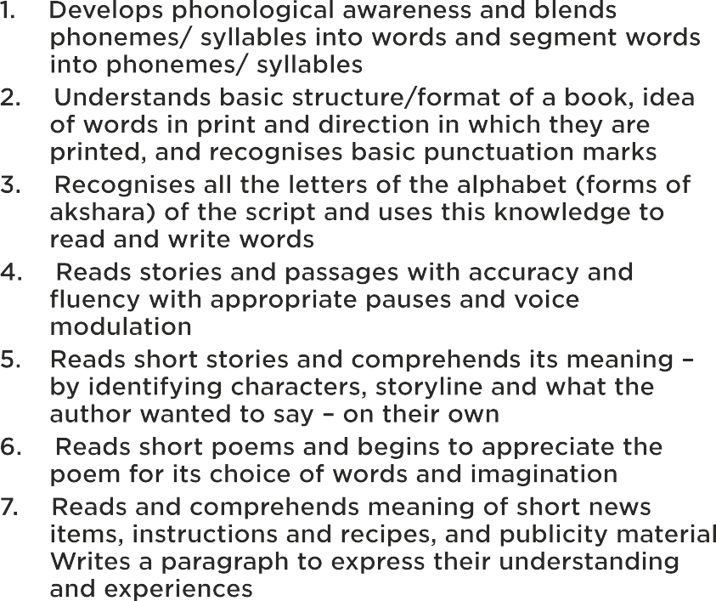
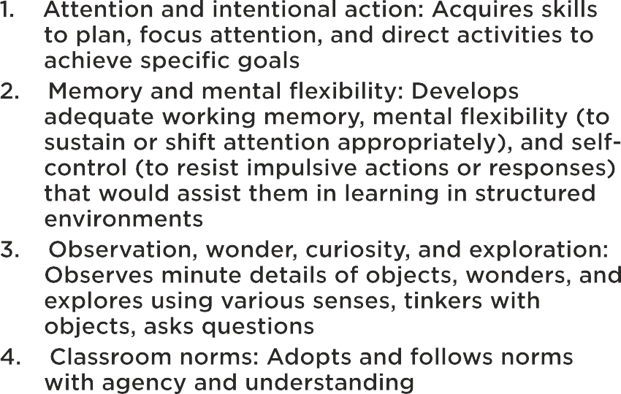
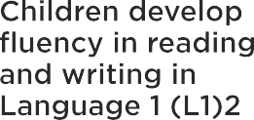
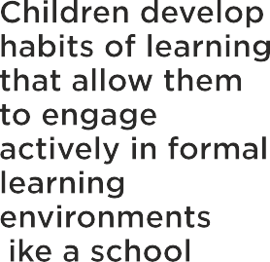
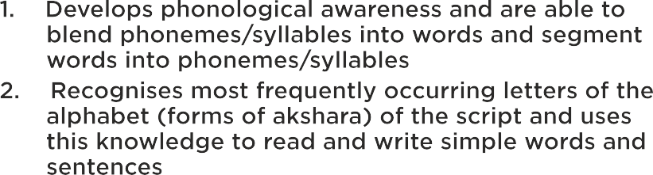


Slide 19
Measuring and observing
Check list/ Pre coded categories
Time sampling/ structured description.
Tracking/structured description
copyright @ drswatipopatvats@gmail.com

Slide 20
Checklist and precoded categories
Sr.no | activity | Mary (20-3-2013) | Sharukh (12-9-2013) | Anisha (1-12-2013) | Johnny (23-6-2013)
1. | Stands on one leg for 3 seconds
2. | Catches ball
3. | Hops on one foot
4. | Kicks ball
copyright @ drswatipopatvats@gmail.com

Slide 21
Time sampling/structured description
10.01 am- sitting quietly looking at the teacher
10.02 am- concentrating on the picture being shown in the group
10.03 am- pulling up her socks and carefully turning over the tops
10.04 am- responds to her name being called by the teacher
10.05 am- has her hand up to answer a question which is asked about the story etc.
copyright @ drswatipopatvats@gmail.com

Slide 22
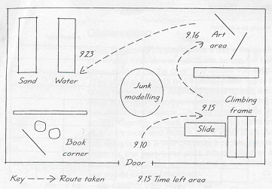
Tracking
copyright @ drswatipopatvats@gmail.com

Slide 23

How often to observe..
Observations of each child should be undertaken about once every half – term, of more frequently if deemed necessary.
This information can be used in three ways:
to make a direct comparison with the child’s development a few month ago;
to make a comparison with child development ‘norms’;
to record the child’s progress in attaining the desirable outcomes for learning.
Whichever reason is decided on, it is important that the observation be promptly recorded, legible, dated, and signed.
copyright @ drswatipopatvats@gmail.com

Slide 24
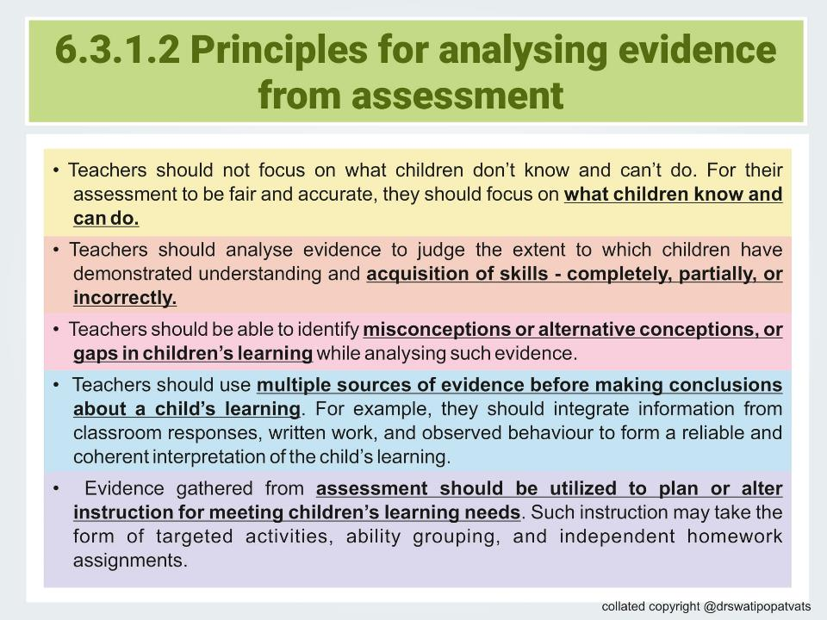
copyright @ drswatipopatvats@gmail.com

Slide 25
How to communicate the learning trajectory?
Moving from grades, marks and smiley faces to a growth trajectory
copyright @ drswatipopatvats@gmail.com

Slide 26
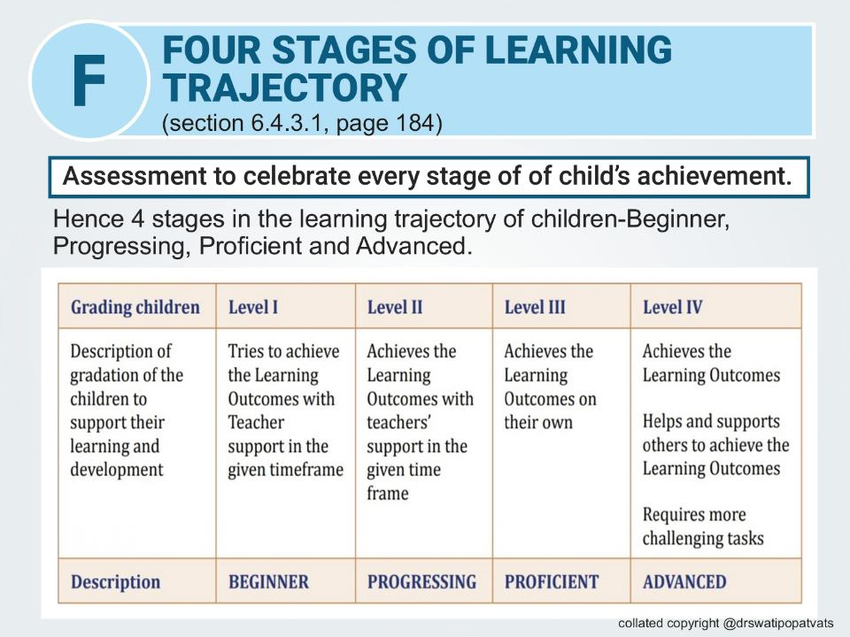
copyright @ drswatipopatvats@gmail.com

Slide 27

Lets use this with visuals
Beginner or Emerging
Progressing or Developing
Seed: Representing the initial stage of growth, where the child is just beginning to show signs of understanding or skill development.
Sprout: Symbolizing the early stages of growth, where the child is starting to demonstrate progress and development, but still requires support and nurturing.
Advanced
Proficient
Fruit-bearing Tree: Embodying the stage where the child has not only mastered the skill or concept but is also able to apply it in new and innovative ways, demonstrating a high level of understanding and expertise.
Blooming Flower: Representing the stage where the child has developed a strong foundation and is consistently demonstrating proficiency in the skill or concept.
copyright @ drswatipopatvats@gmail.com

Slide 28
Let us not forget:
self assessment
parent assessment
peer assessment
copyright @ drswatipopatvats@gmail.com

Slide 29



Self Assessment
copyright @ drswatipopatvats@gmail.com

Slide 30

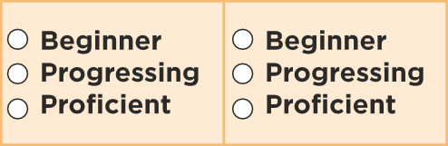




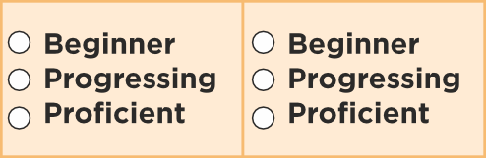
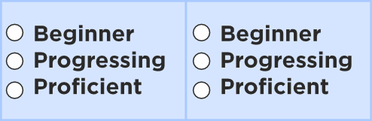





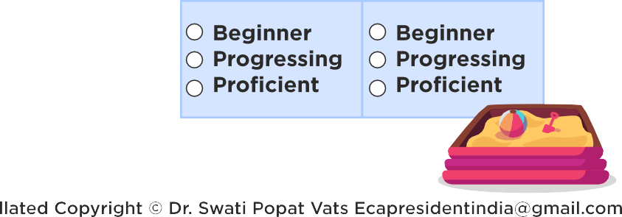

Parent/Caregiver/Guardian Assessment
copyright @ drswatipopatvats@gmail.com

Slide 31
Self Assessment
copyright @ drswatipopatvats@gmail.com

Slide 32


Peer Assessment
copyright @ drswatipopatvats@gmail.com

Slide 33
How to support children after assessment…
Helping children grown from ‘beginner’ to ‘proficient’
copyright @ drswatipopatvats@gmail.com

Slide 34
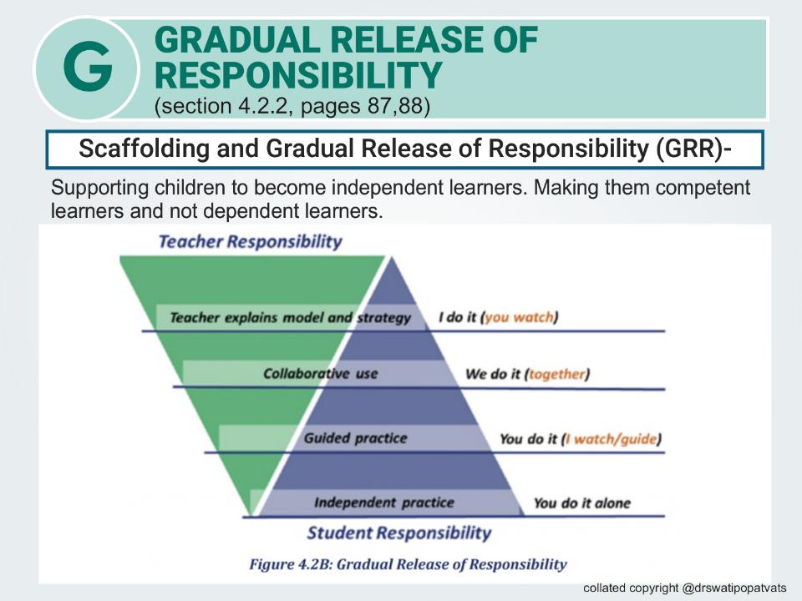
copyright @ drswatipopatvats@gmail.com

Slide 35
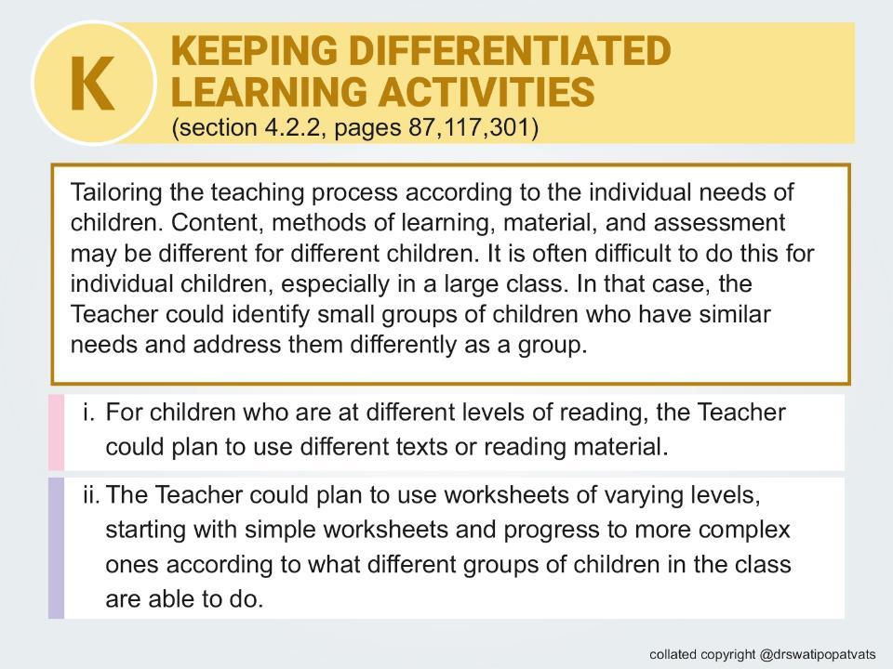
copyright @ drswatipopatvats@gmail.com

Slide 36
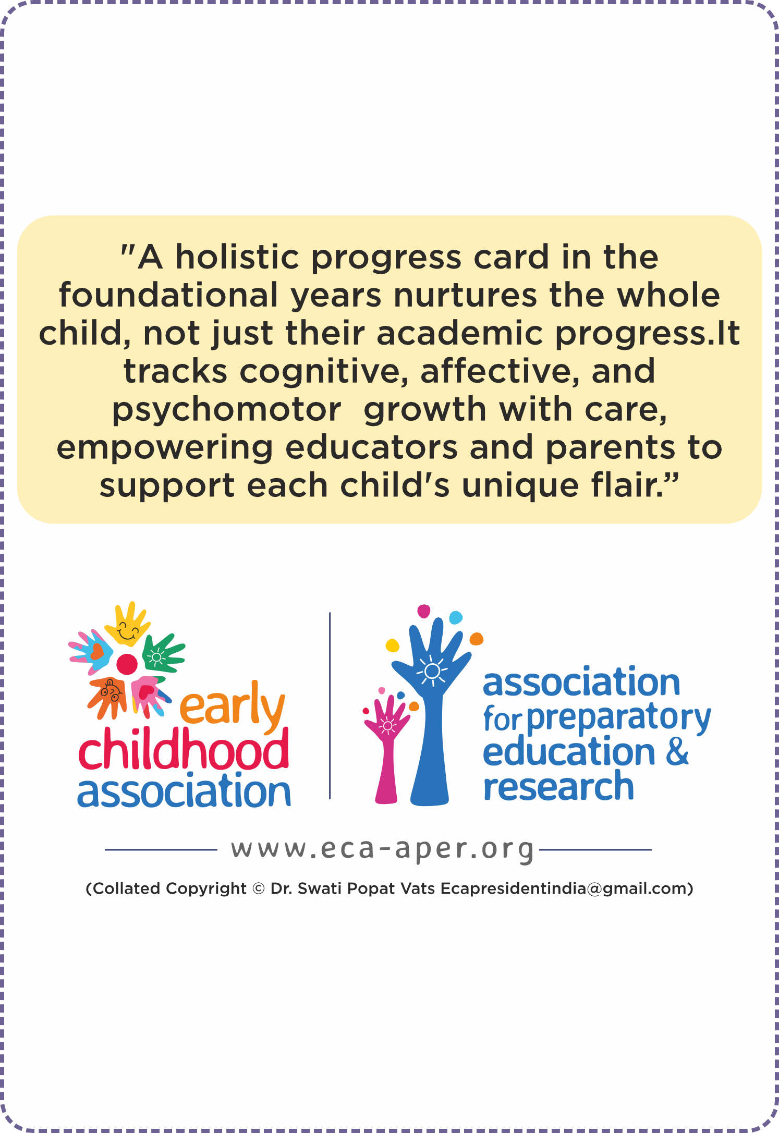

Slide 37
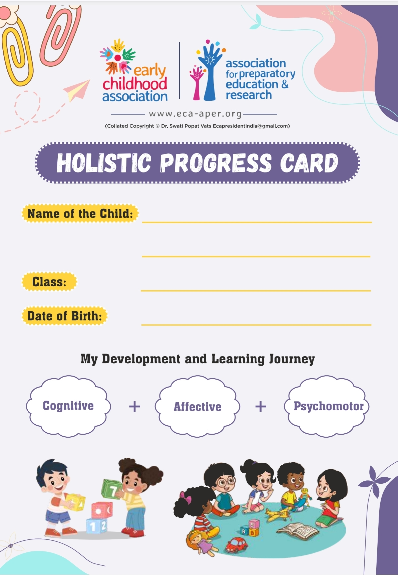
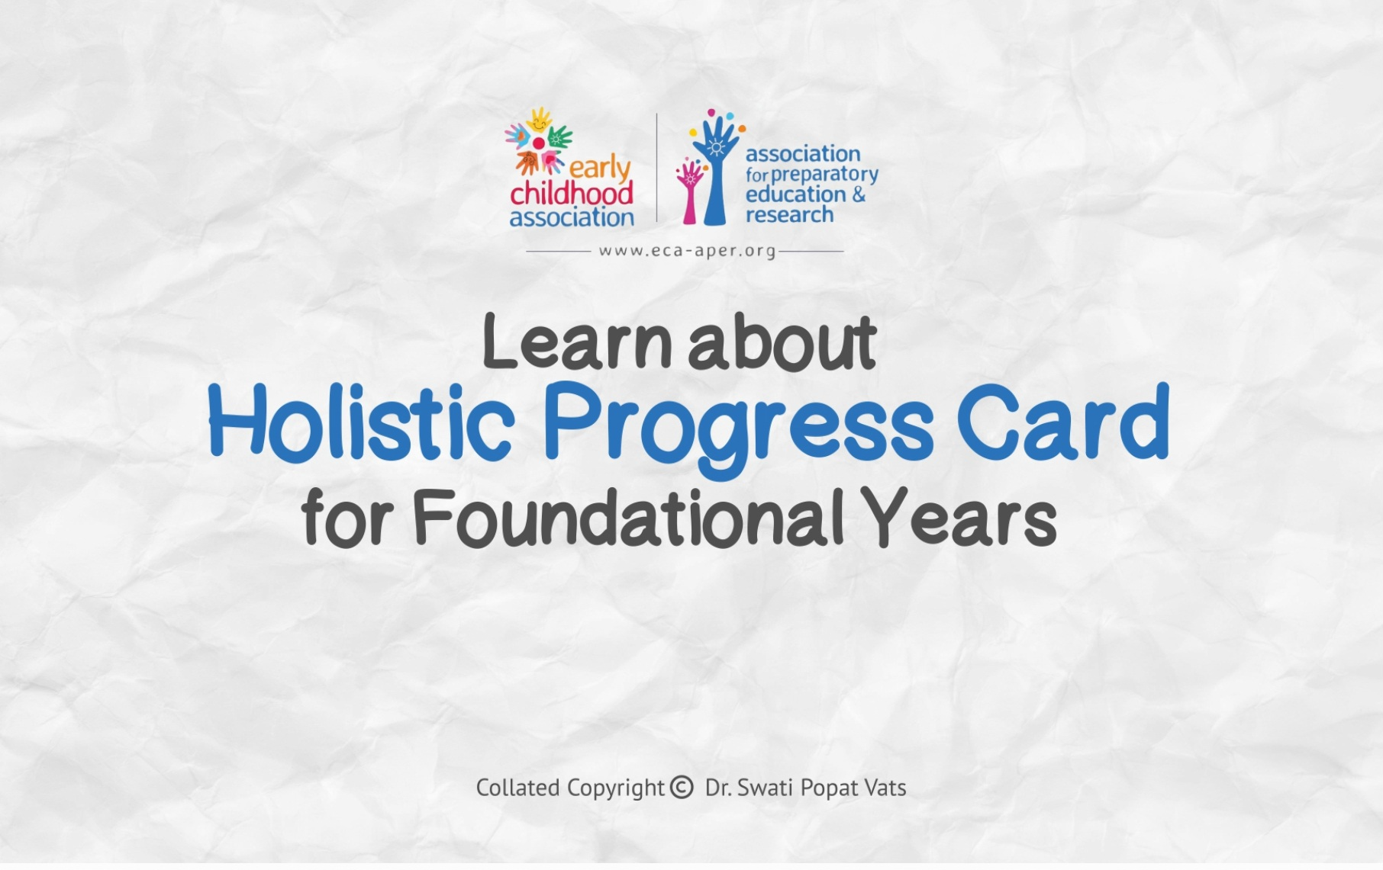
For a sample copy of HPC and video of HPC write to ecapresidentindia@gmail.com

