Slide 1
IB AND NCF 2022 = “GLOCAL” EDUCATIONAL THEORIES
DR. SWATI POPAT VATS
PRESIDENT
PODAR EDUCATION NETWORK
EARLY CHILDHOOD ASSOCIATION
ASSOCIATION FOR PRIMARY EDUCATION AND RESEARCH

Slide 2
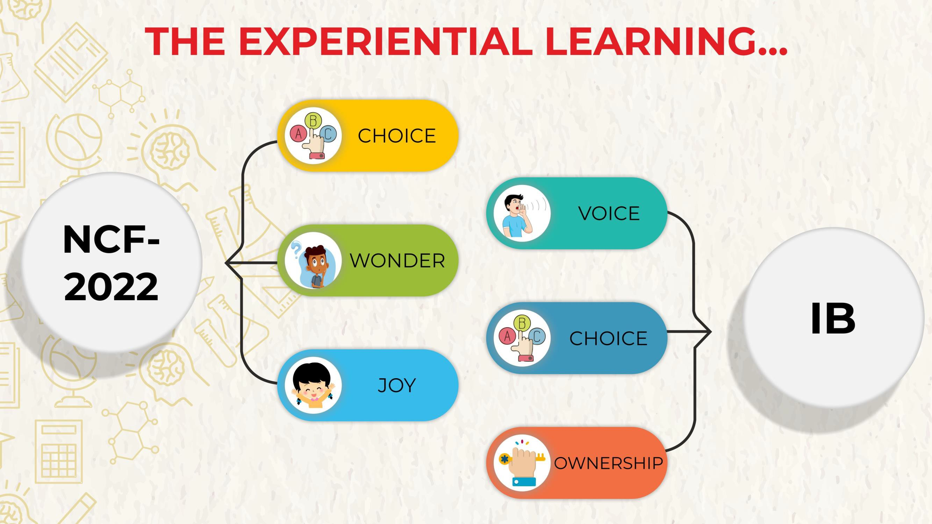

Slide 3

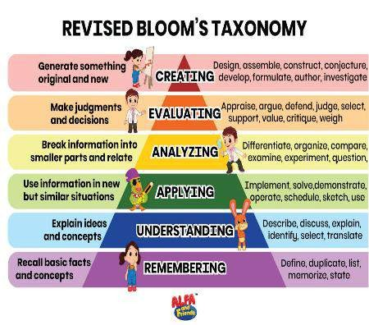

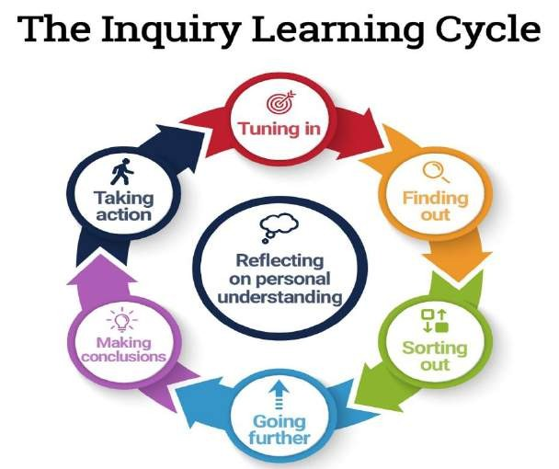
BLOOM’s TAXONOMY

Slide 4


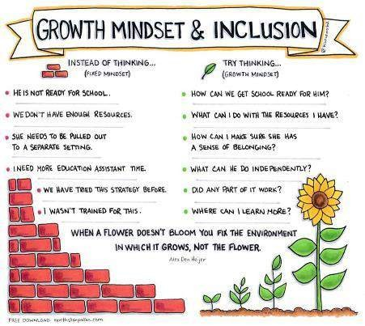
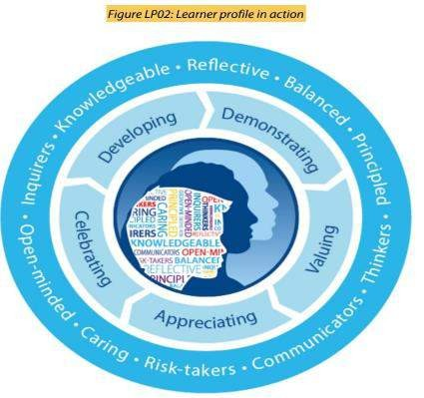
CAROL DWECK- Growth v/s Fixed Mindset

Slide 5

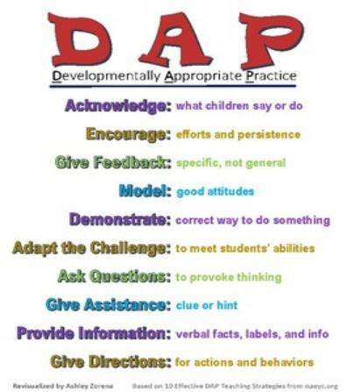

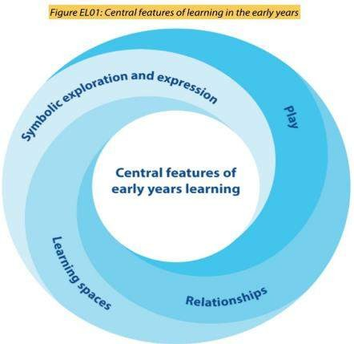
DAP- Developmentally Appropriate Practice

Slide 6


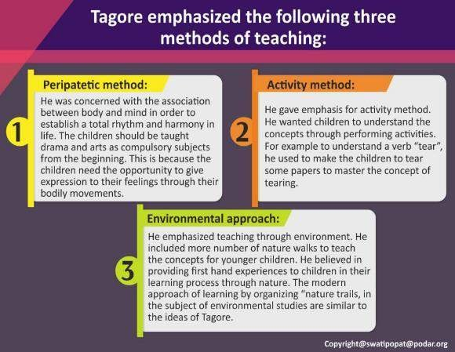






RABINDRANATH TAGORE- educational philosophy
Inquiry
Action
Nature advocacy Skills for thinking Working with others
Managing self
Communicating

Slide 7


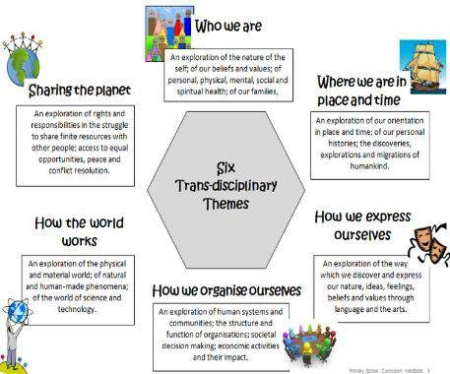
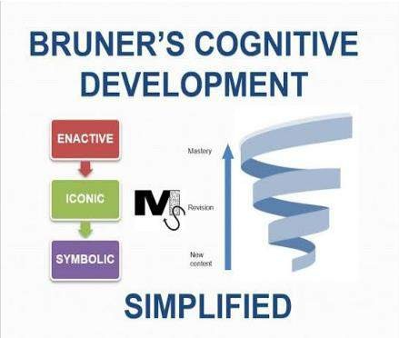
JEROME BRUNER- spiral curriculum and the CPA model

Slide 8

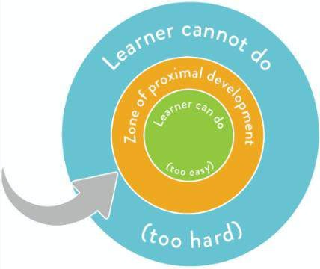

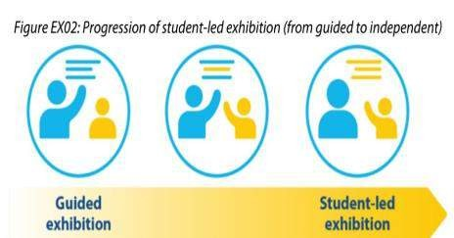
LEV VYGOTSKY-
ZONE OF PROXIMAL DEVELOPMENT

Slide 9


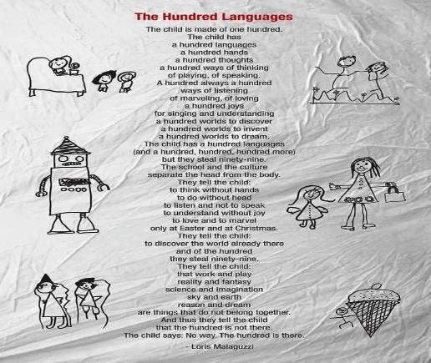

REGGIO EMILIA- 100 languages of children.

Slide 10
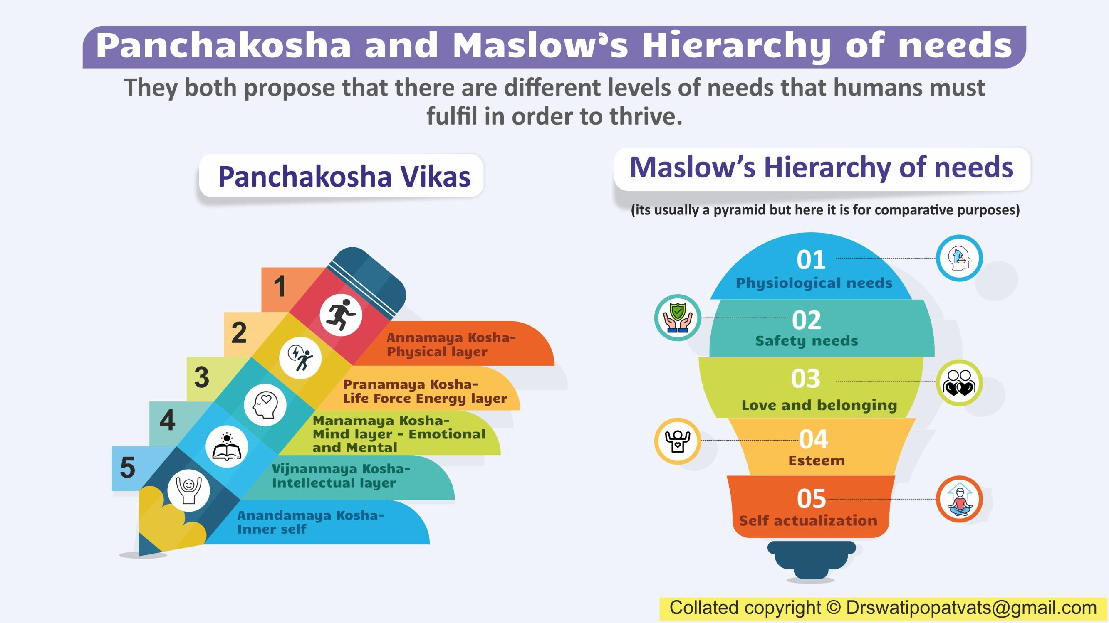

Slide 11

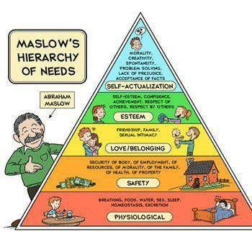

ABRAHAM MASLOW- understanding the hierarchy of needs
In the IB curriculum the unhurried agenda
and care for children sets the stage to achieve the hierarchy of
needs

Slide 12
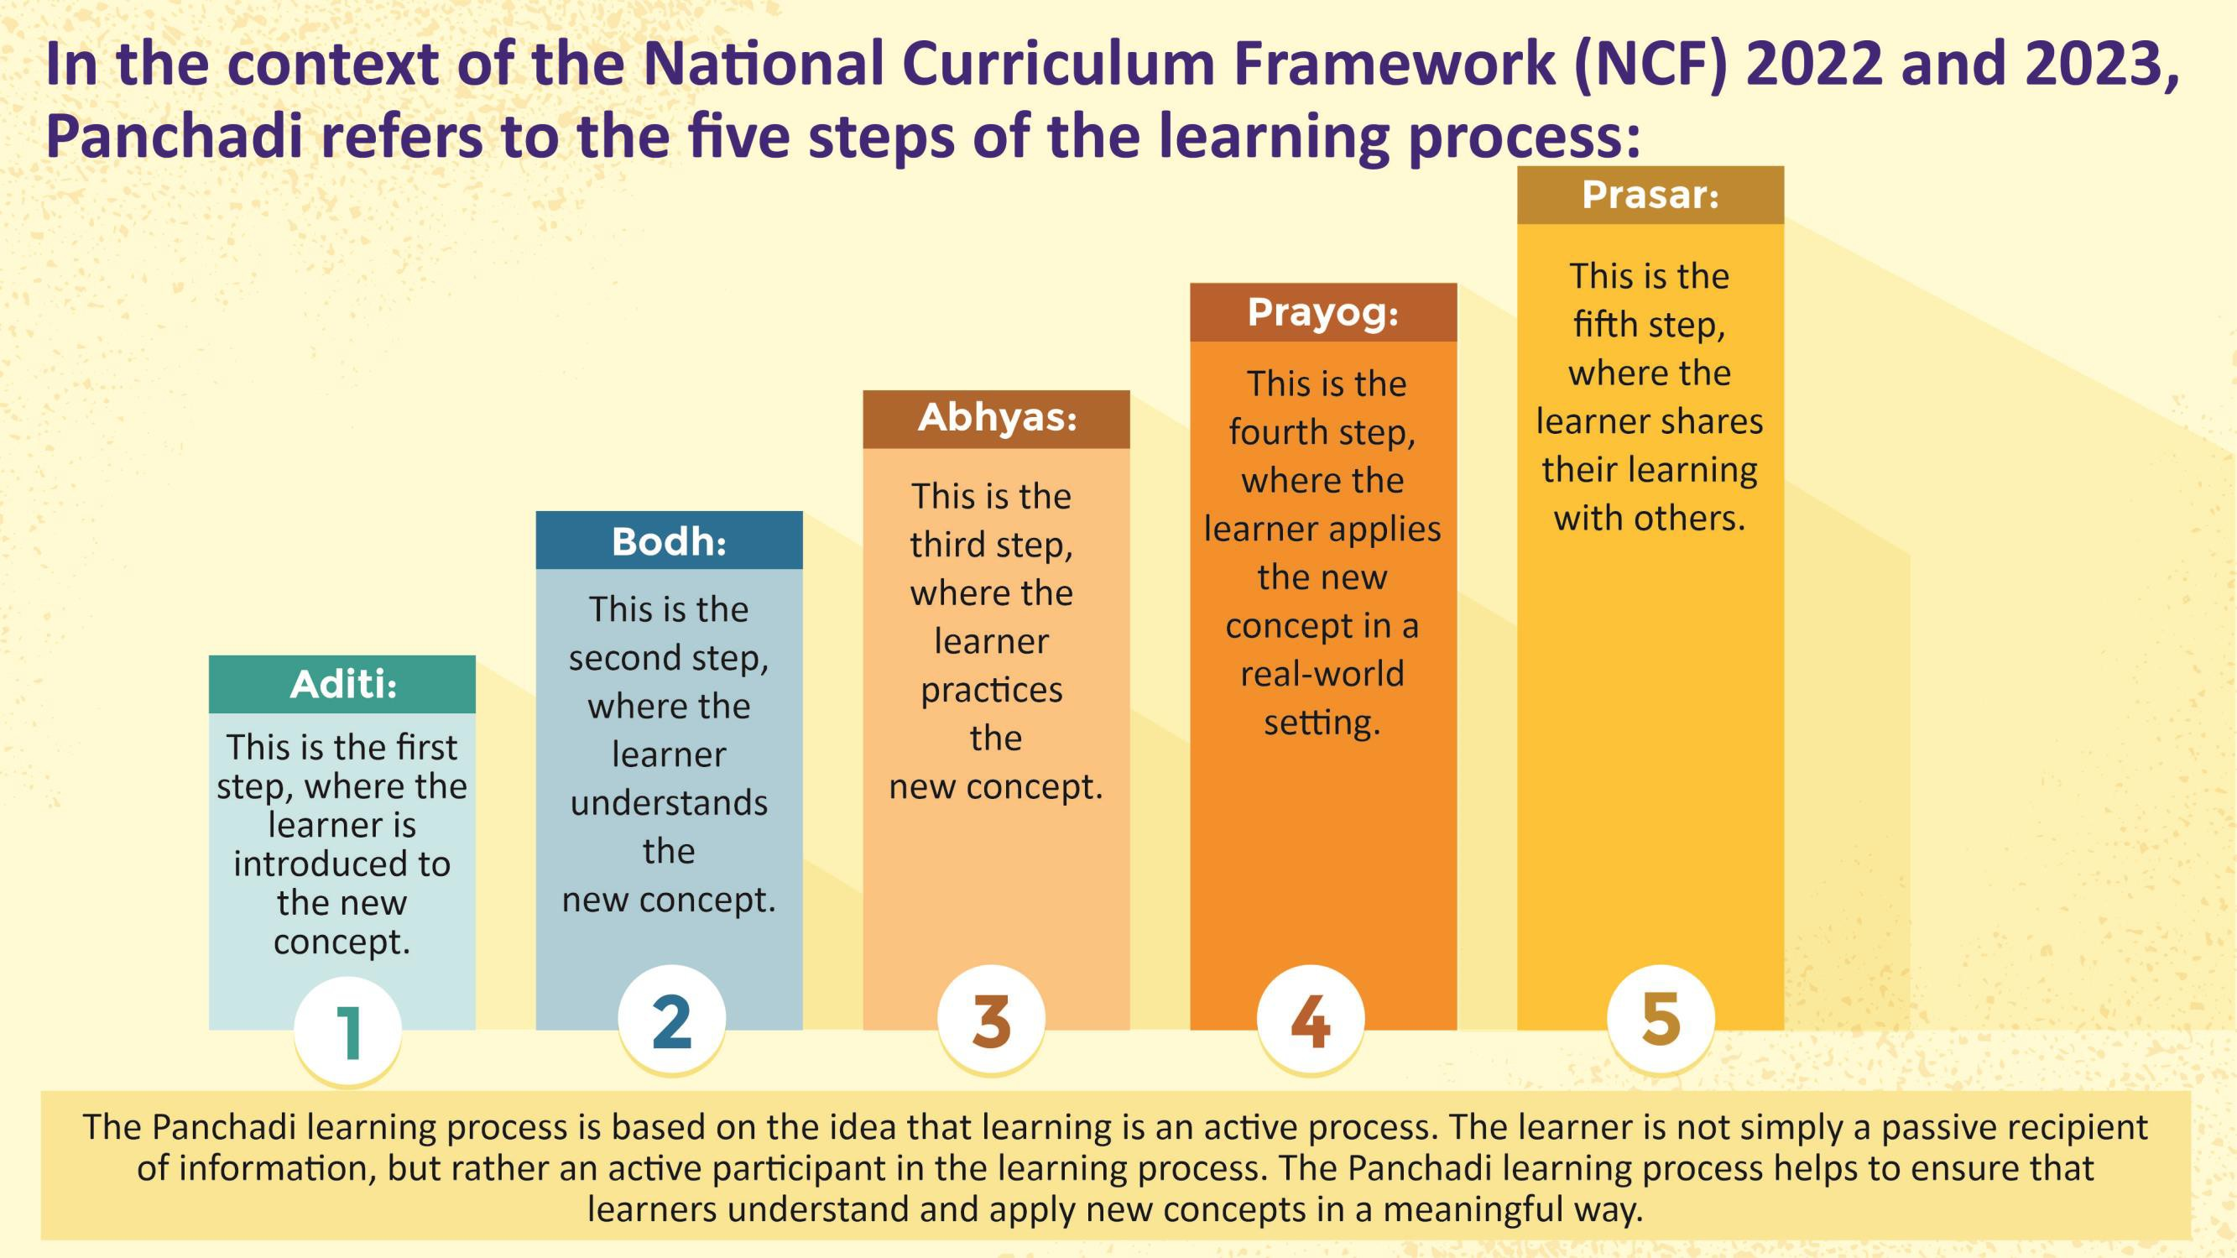

Slide 13
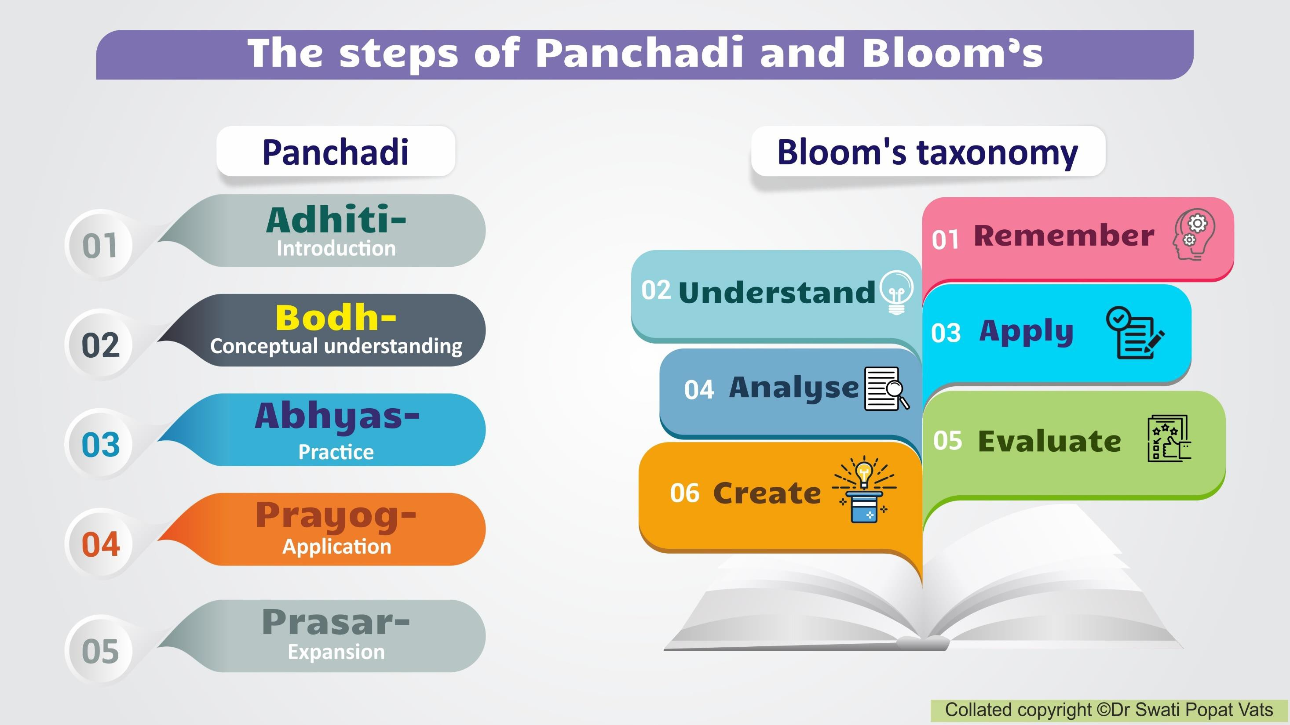

Slide 14
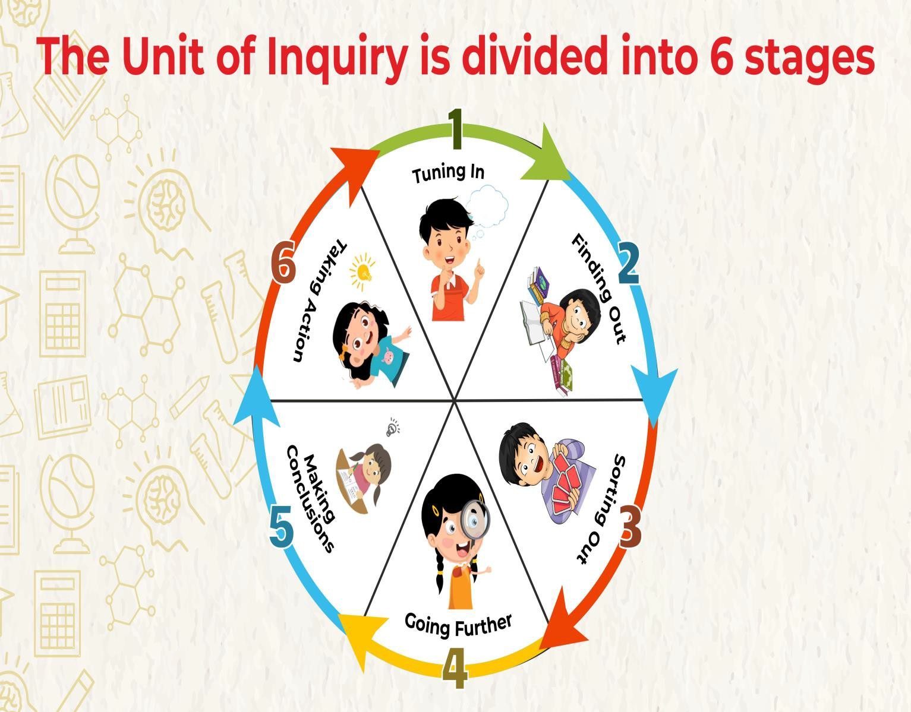
Tuning In- Prior knowledge-prepare to find out more
Finding Out- learning experiences- finding information
Sorting Out-Processing-sorting information
Going Further- Extending- individual or group research
Drawing Conclusions/Reflection- Make connections-draw conclusion- self/peer/group/teacher assess
Taking Action- what other questions
do I have?

Slide 15
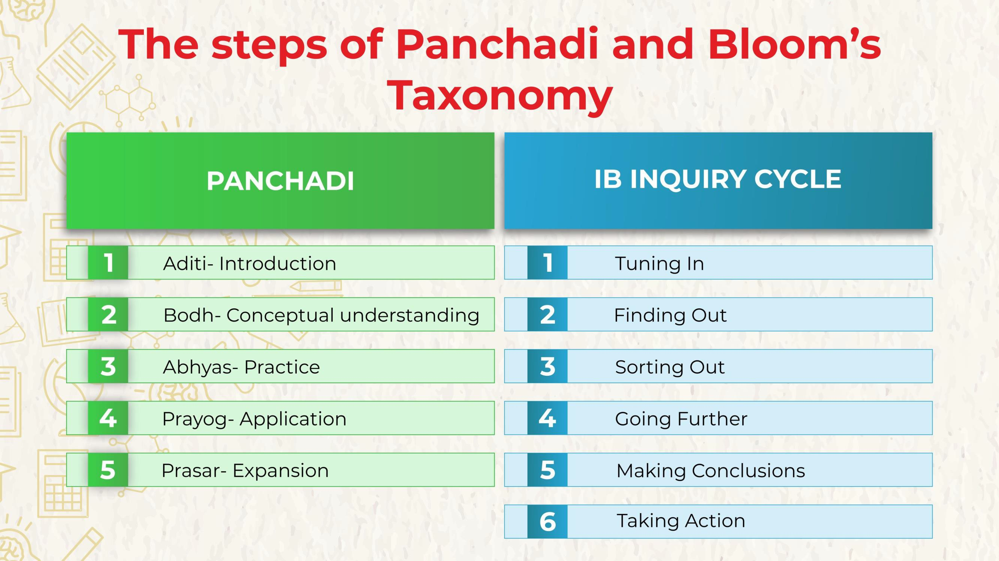

Slide 16
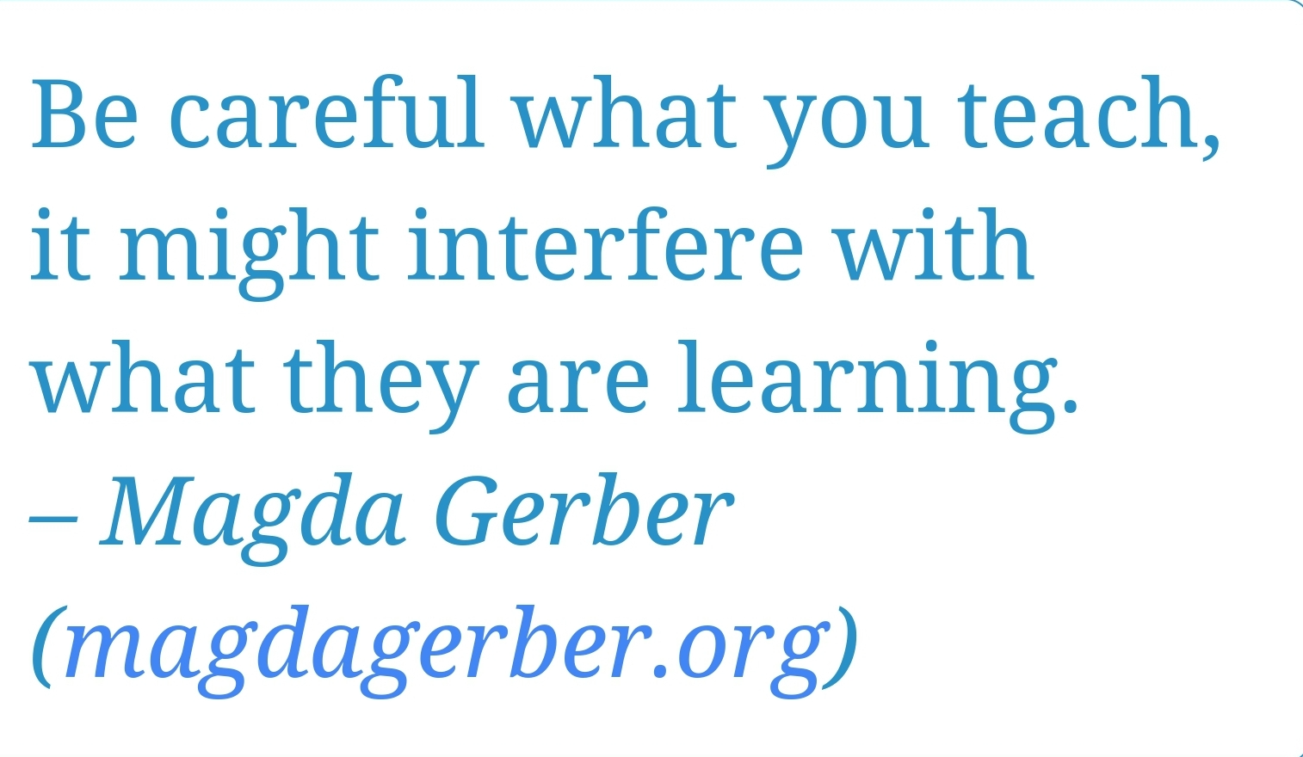

Slide 17


CONNECT WITH ME ON-
drswatipopatvats@gmail.com
www.eca-india.org
7506639870

