Slide 1

Collated copyright ©️ drswatipopatvats@gmail.com

Slide 2
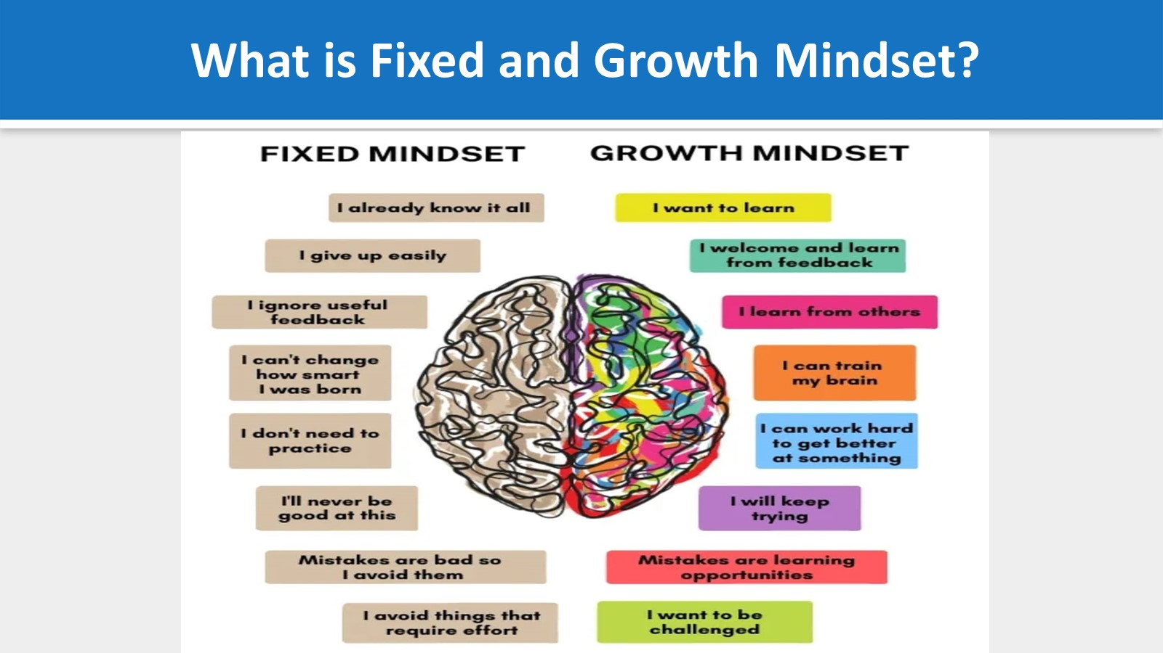
Collated copyright ©️ drswatipopatvats@gmail.com

Slide 3

Collated copyright ©️ drswatipopatvats@gmail.com

Slide 4
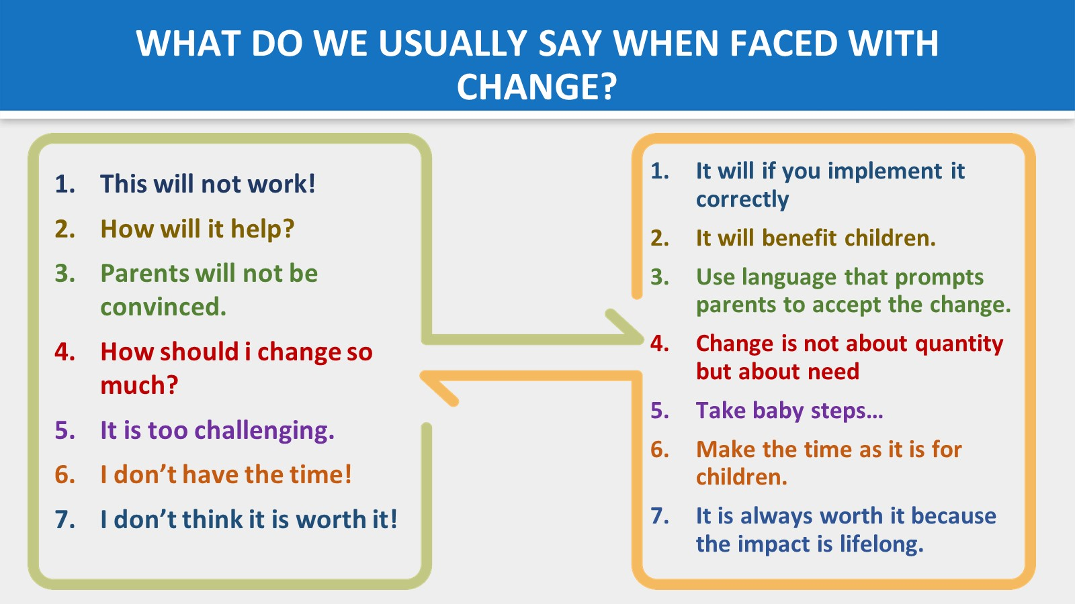
Collated copyright ©️ drswatipopatvats@gmail.com

Slide 5

Collated copyright ©️ drswatipopatvats@gmail.com

Slide 6
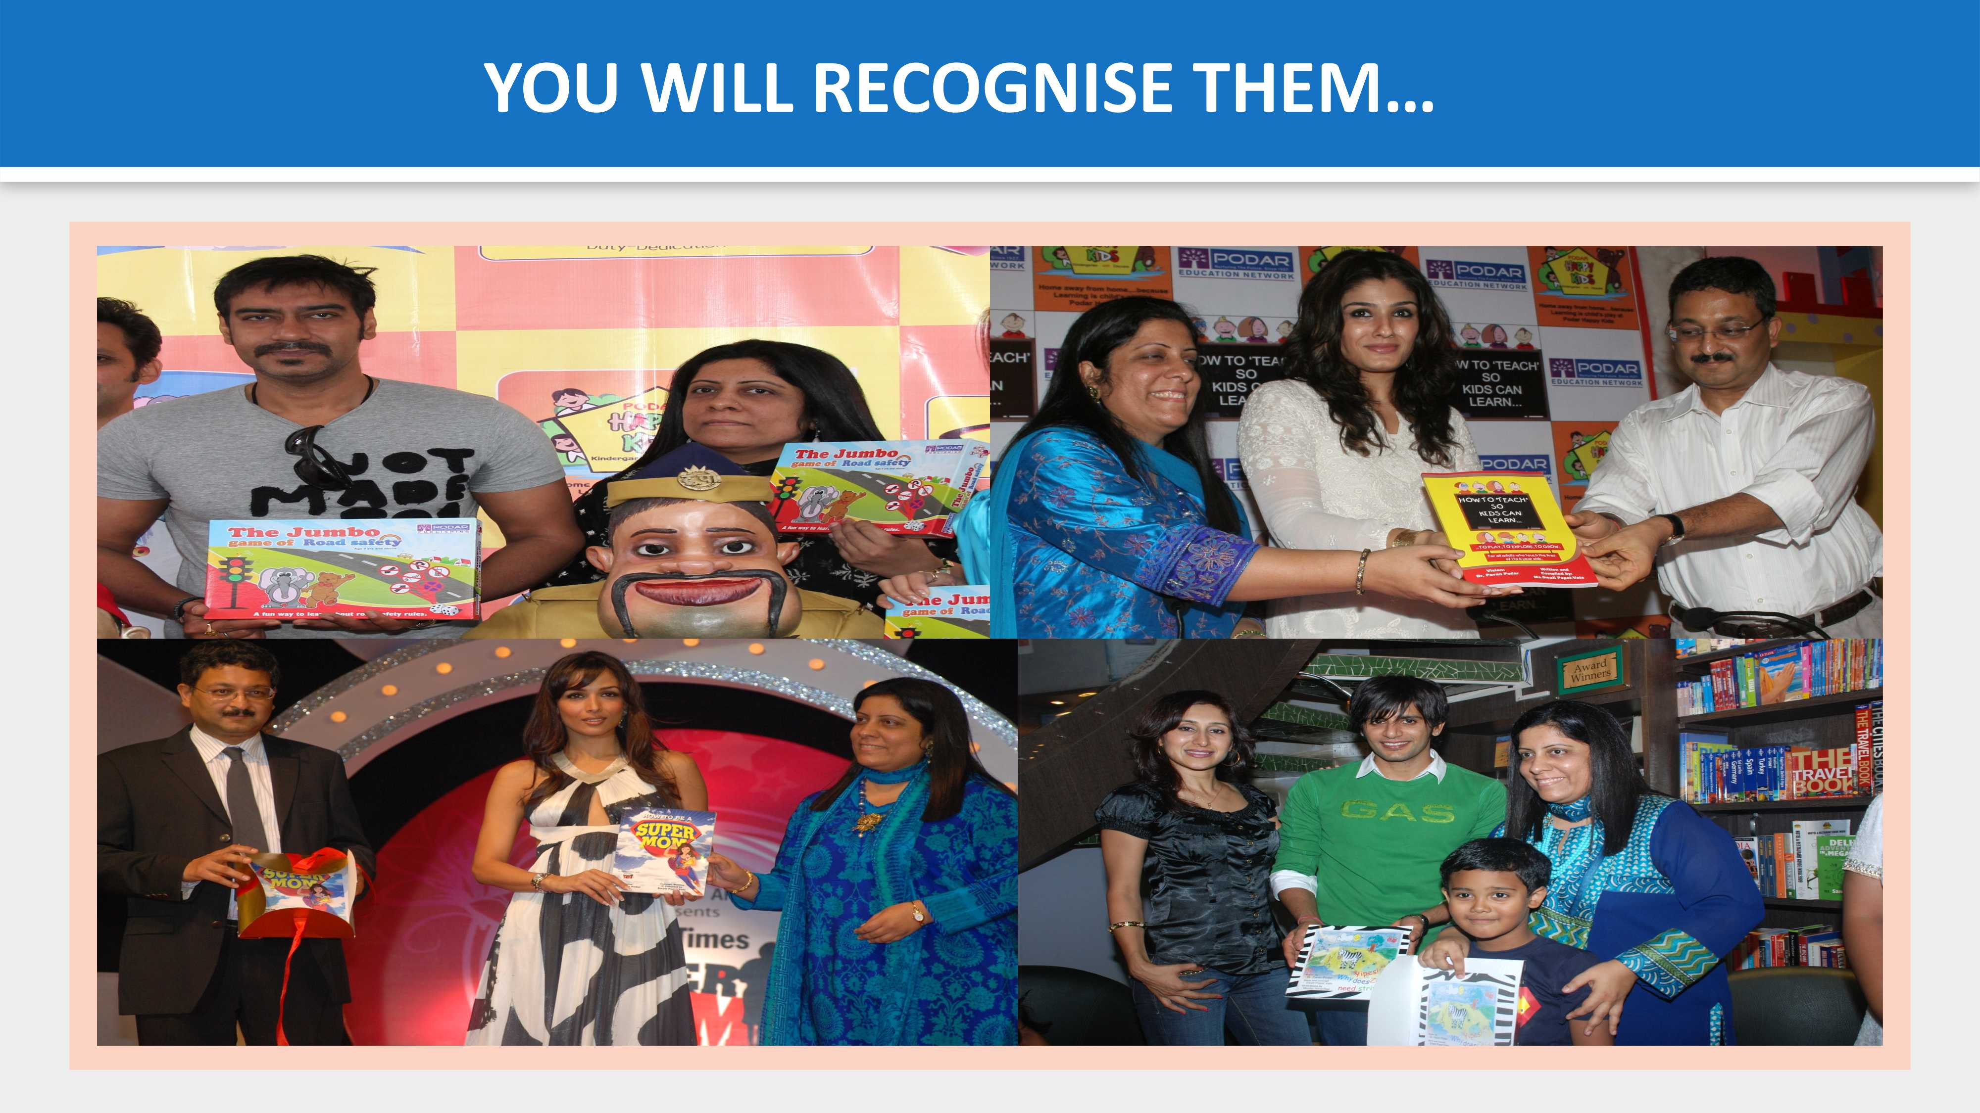
Collated copyright ©️ drswatipopatvats@gmail.com

Slide 7
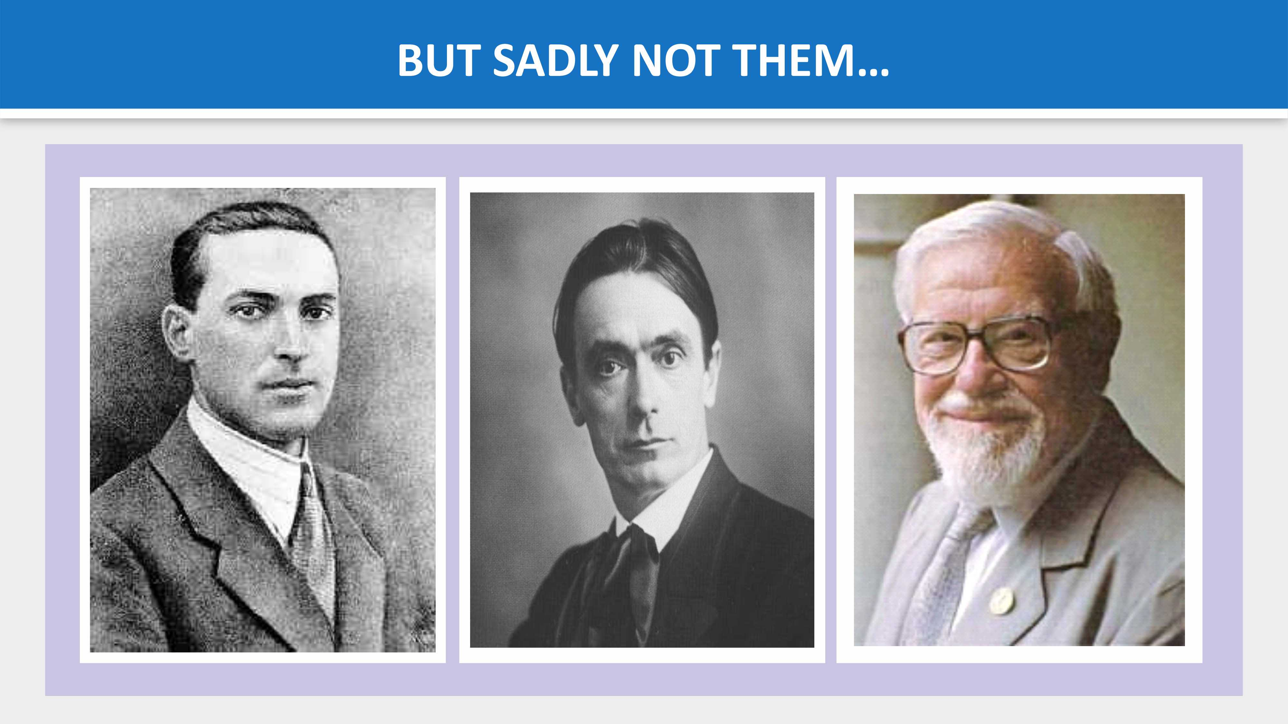
Collated copyright ©️ drswatipopatvats@gmail.com

Slide 8

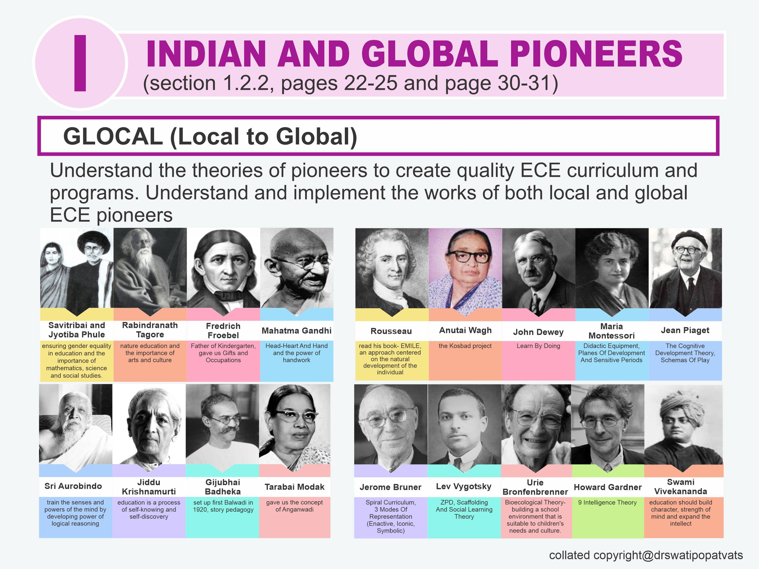
Collated copyright ©️ drswatipopatvats@gmail.com

Slide 9

Collated copyright ©️ drswatipopatvats@gmail.com

Slide 10
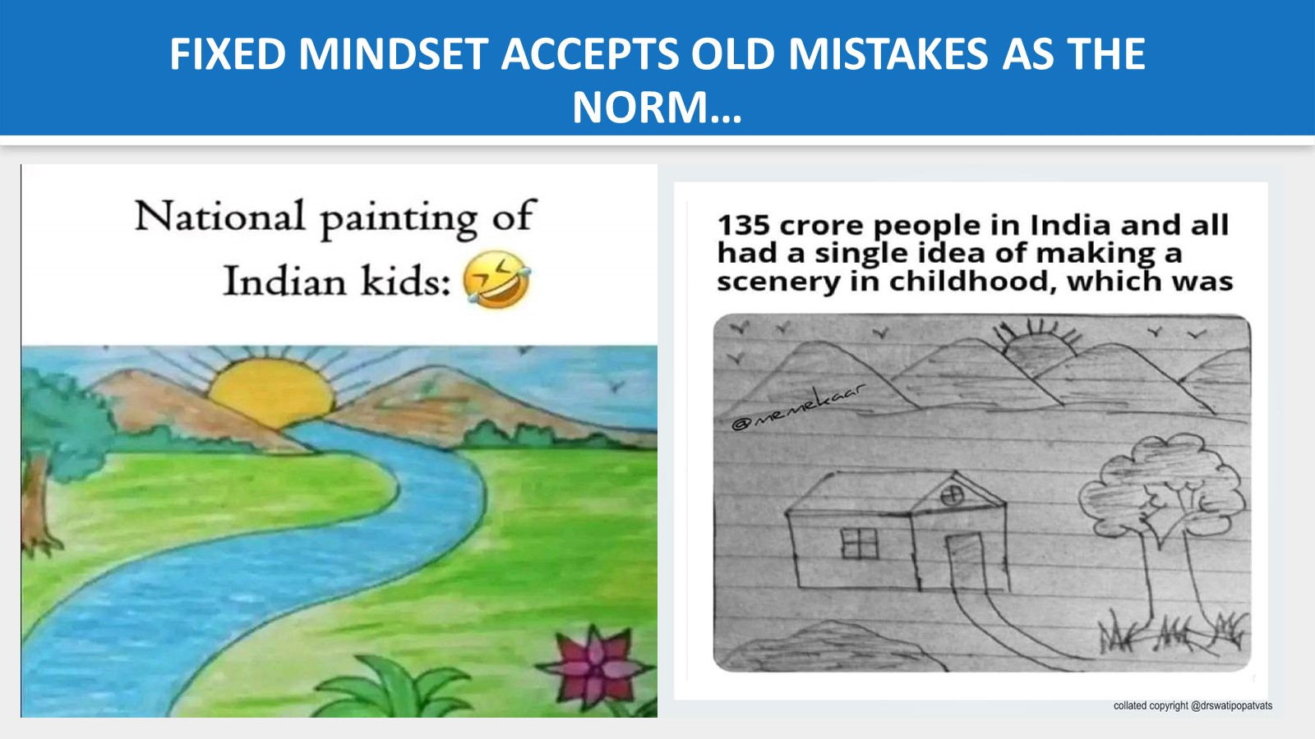
Collated copyright ©️ drswatipopatvats@gmail.com

Slide 11
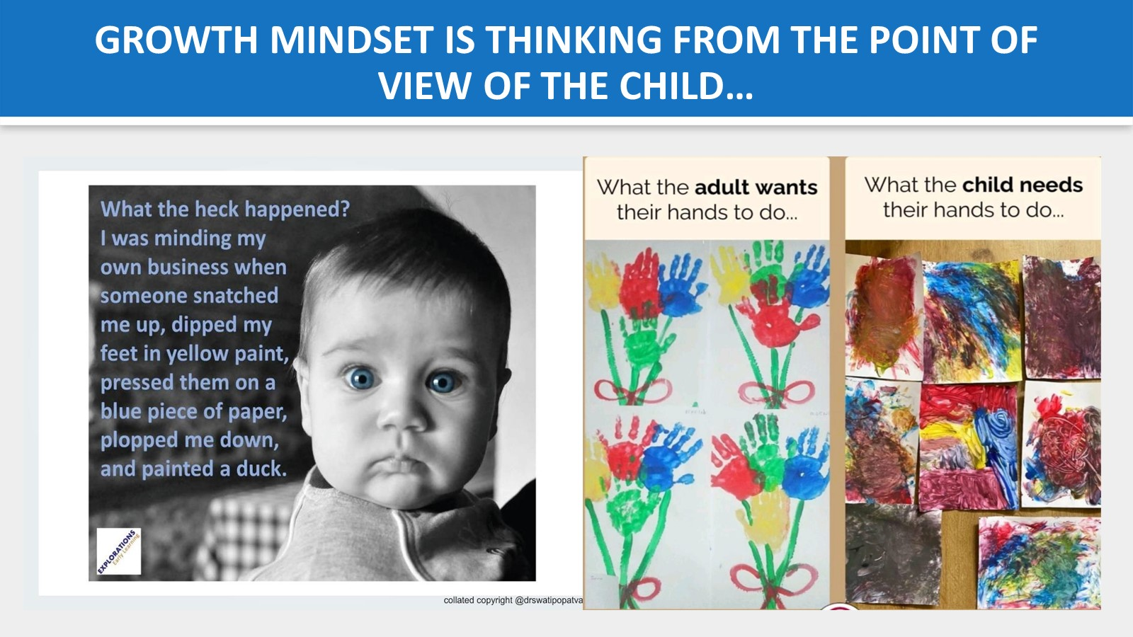
Collated copyright ©️ drswatipopatvats@gmail.com

Slide 12
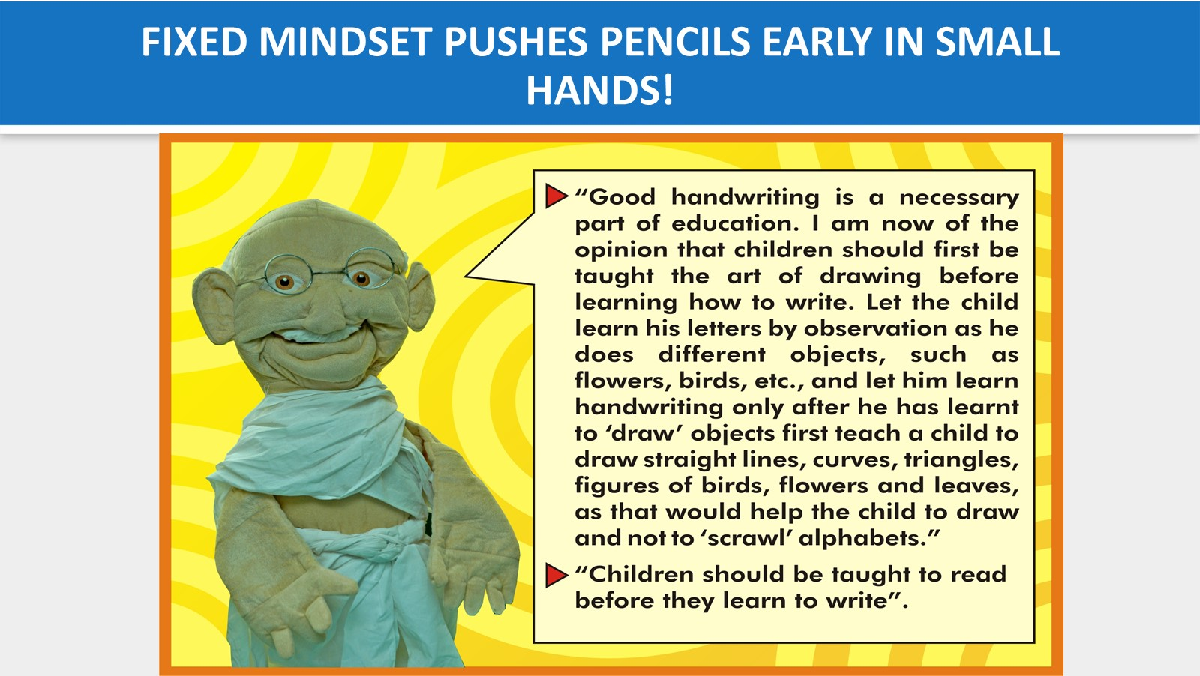
copyright@swatipopatvats
Collated copyright ©️ drswatipopatvats@gmail.com

Slide 13
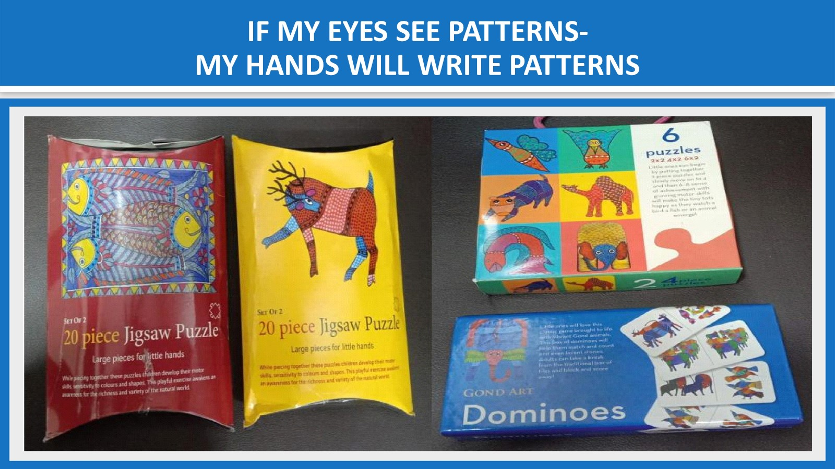
Collated copyright ©️ drswatipopatvats@gmail.com

Slide 14
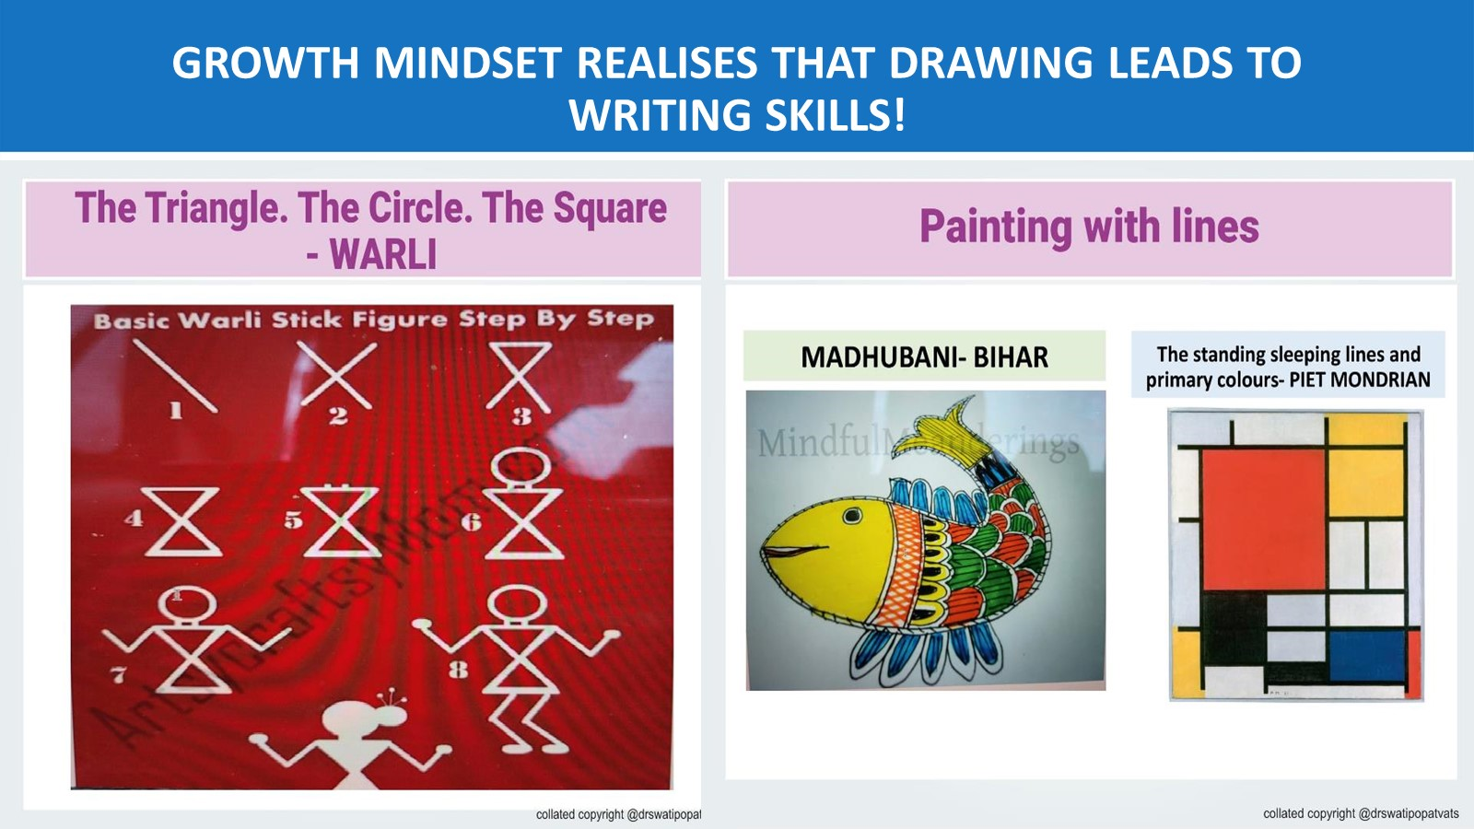
Collated copyright ©️ drswatipopatvats@gmail.com

Slide 15

Collated copyright ©️ drswatipopatvats@gmail.com

Slide 16
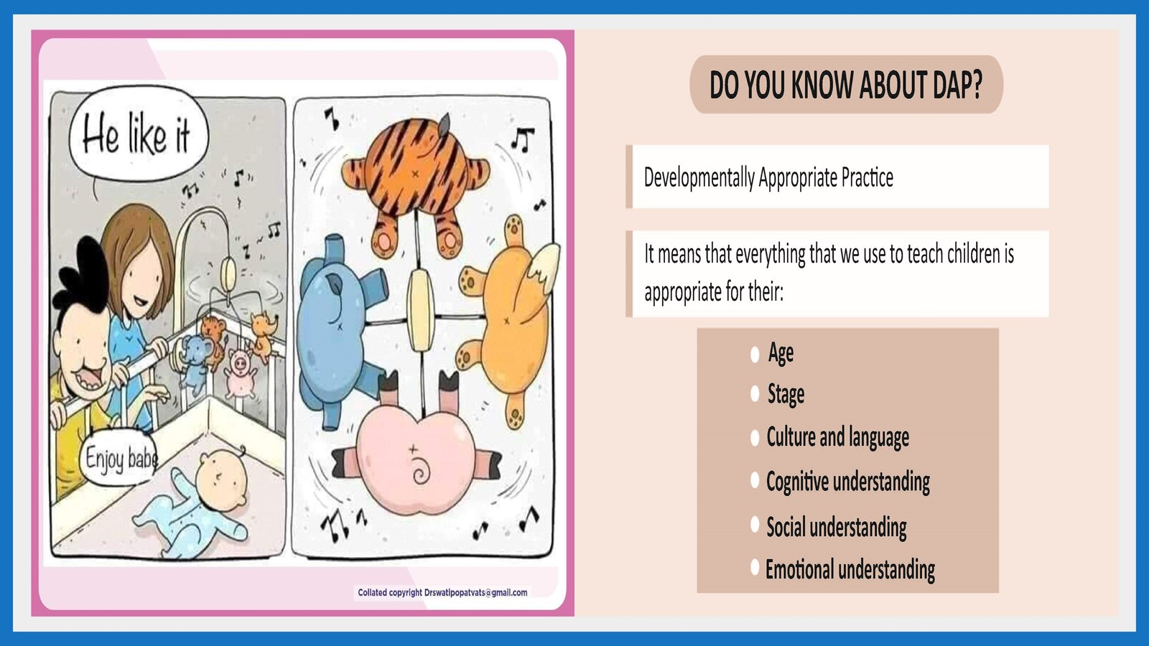
Collated copyright ©️ drswatipopatvats@gmail.com

Slide 17

Collated copyright ©️ drswatipopatvats@gmail.com

Slide 18
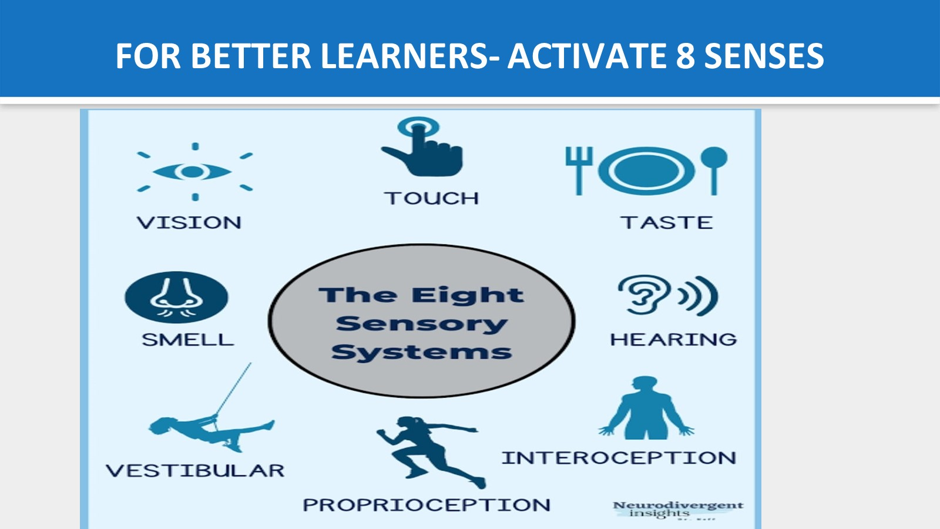
Collated copyright ©️ drswatipopatvats@gmail.com

Slide 19
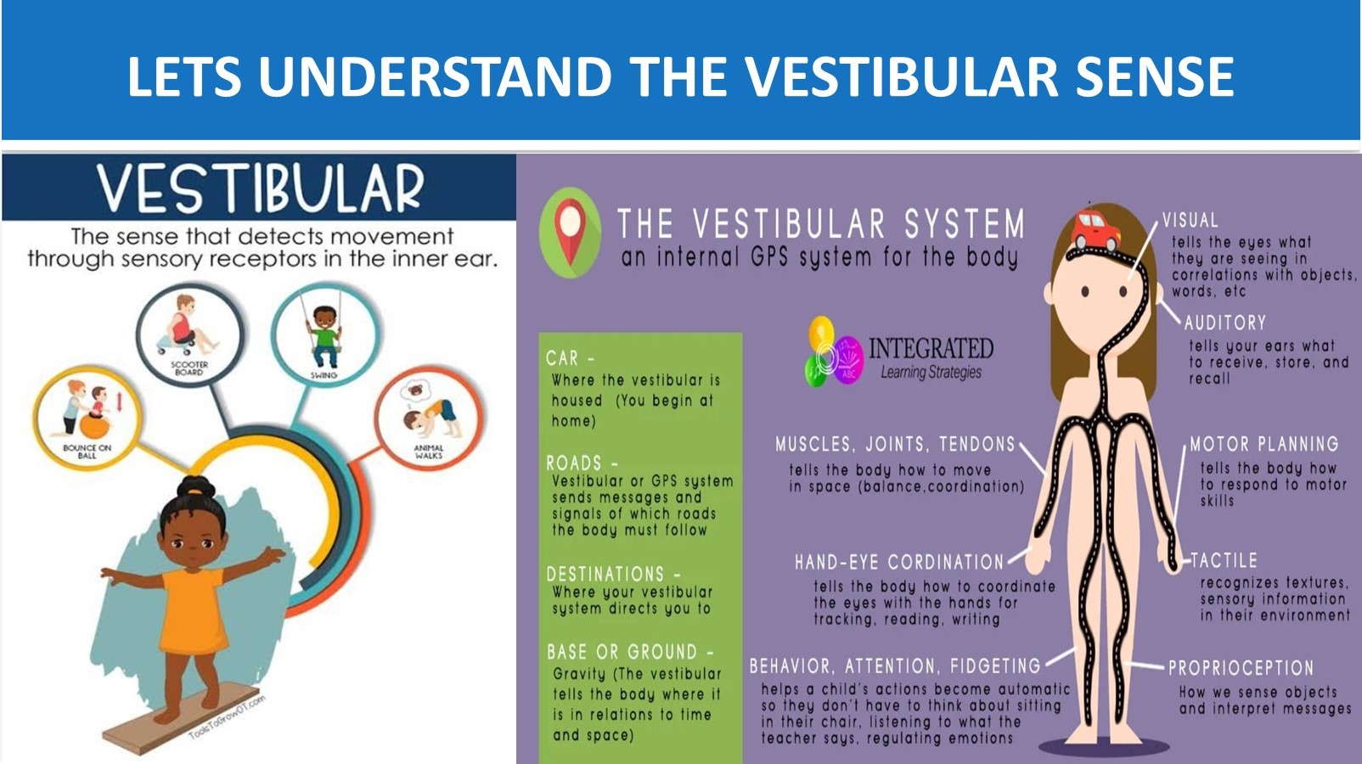
Collated copyright ©️ drswatipopatvats@gmail.com

Slide 20
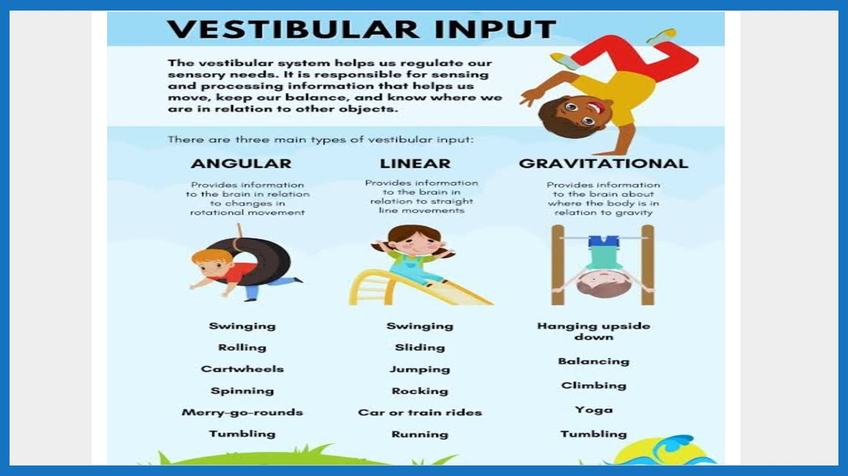
Collated copyright ©️ drswatipopatvats@gmail.com

Slide 21
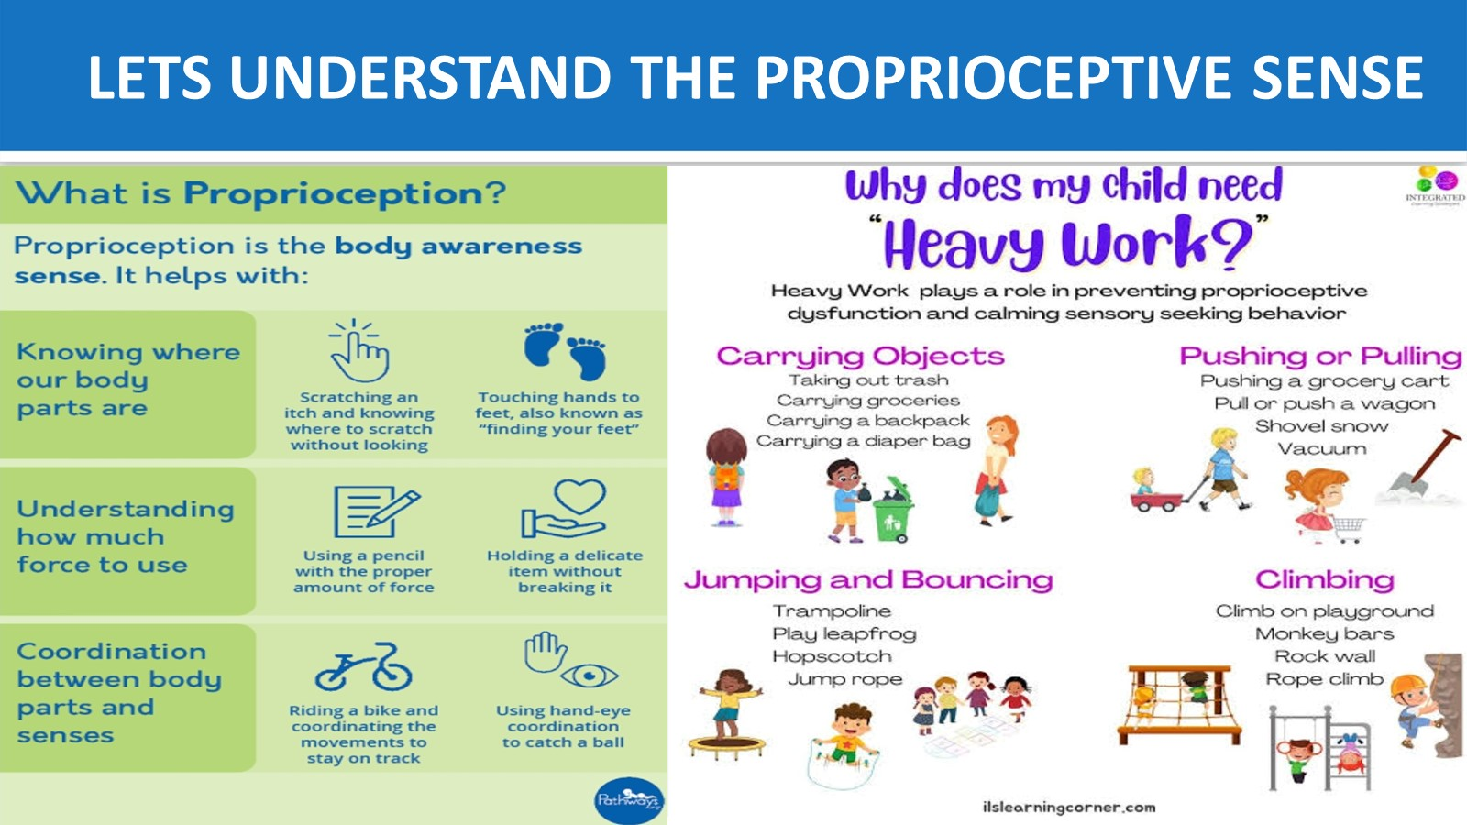
Collated copyright ©️ drswatipopatvats@gmail.com

Slide 22
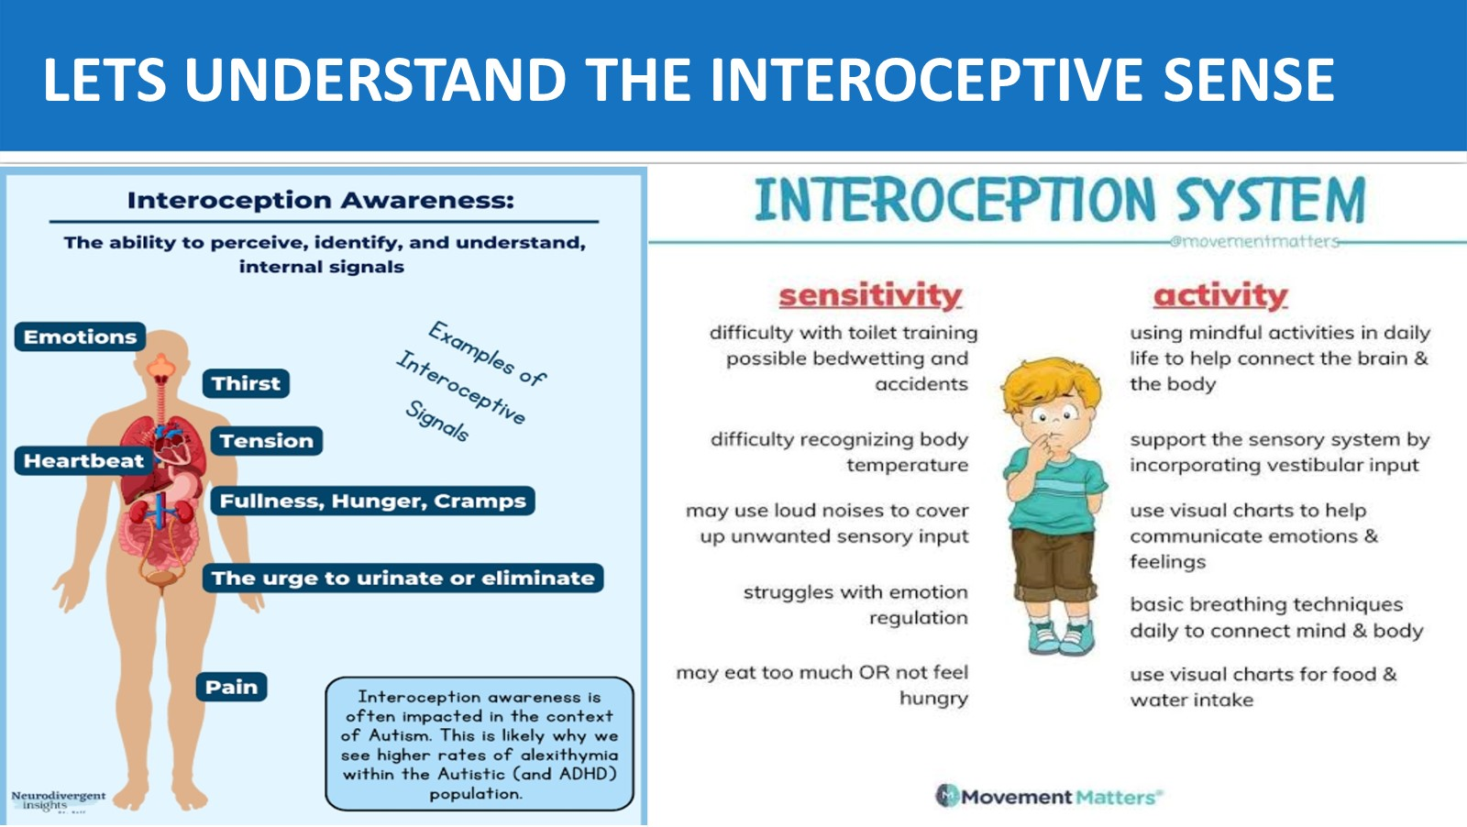
Collated copyright ©️ drswatipopatvats@gmail.com

Slide 23
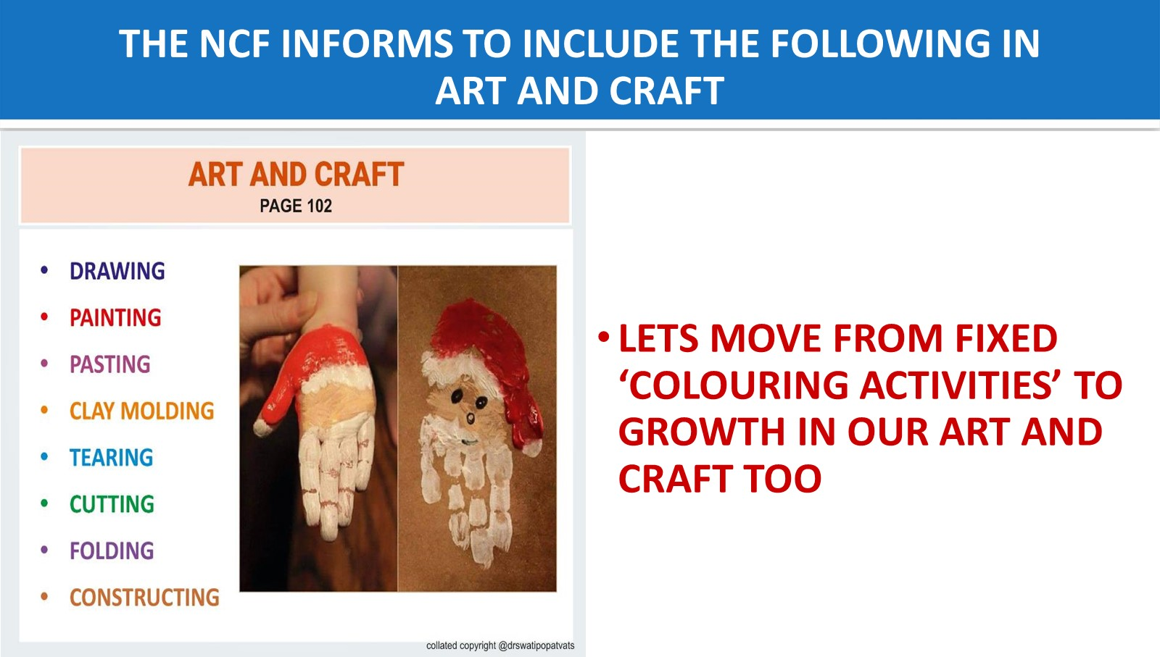
Collated copyright ©️ drswatipopatvats@gmail.com

Slide 24
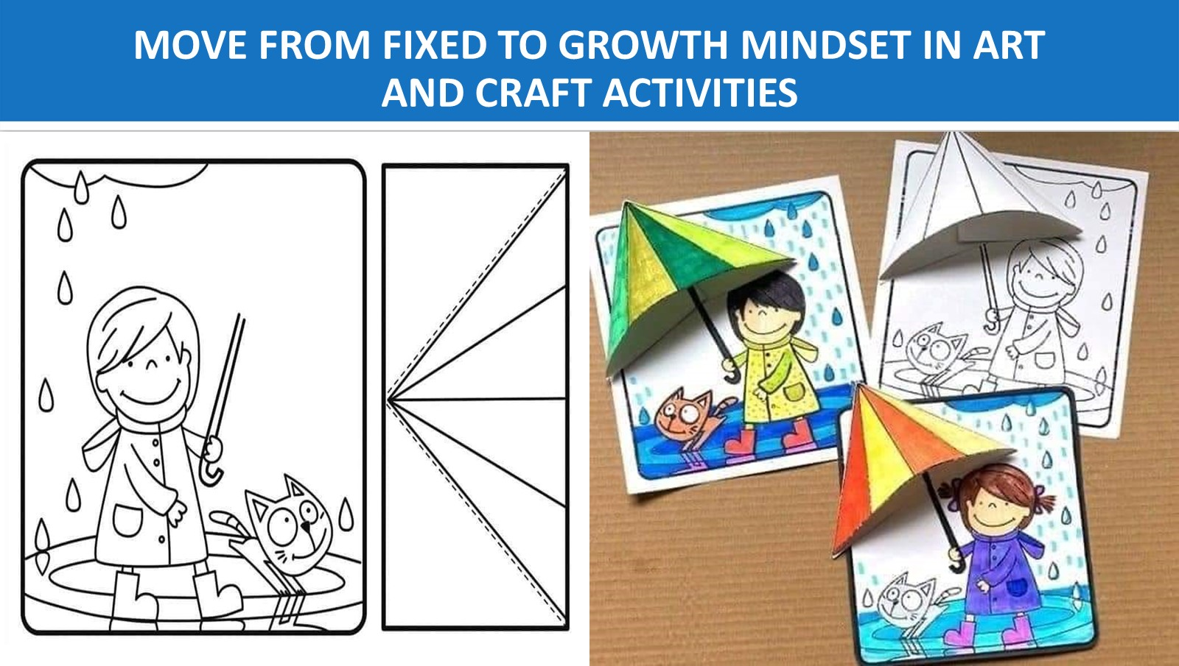
Collated copyright ©️ drswatipopatvats@gmail.com

Slide 25
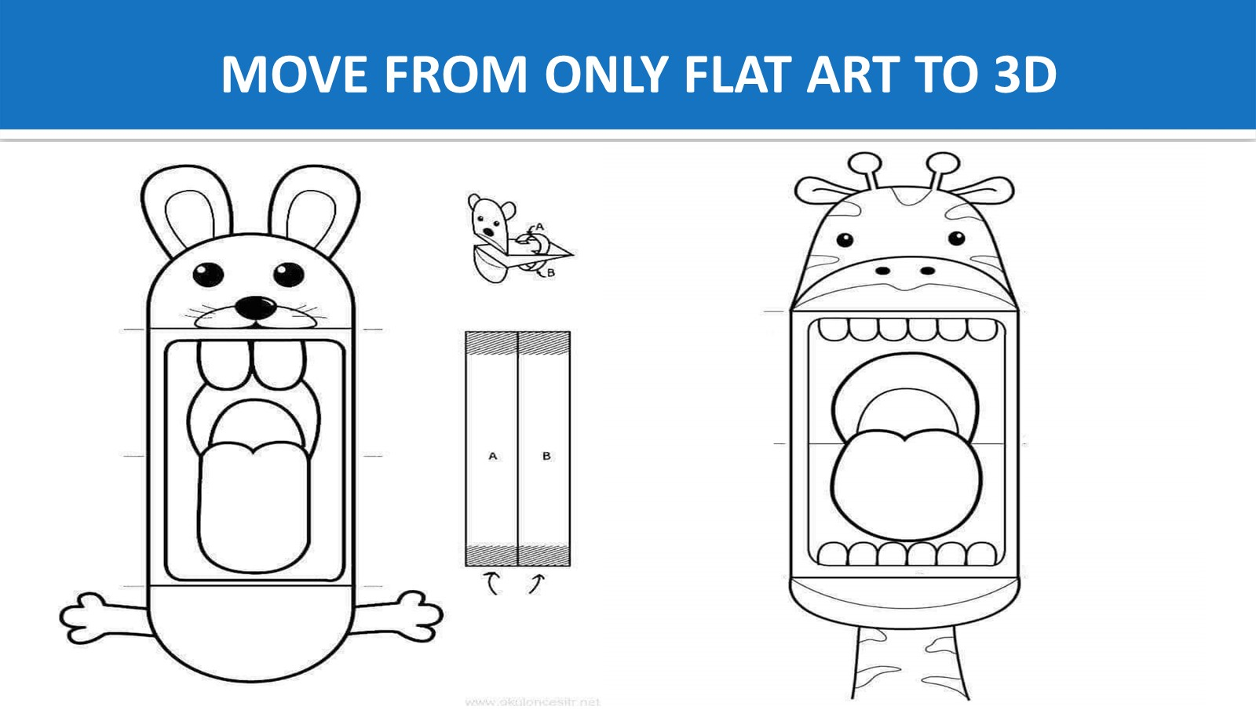
Collated copyright ©️ drswatipopatvats@gmail.com

Slide 26
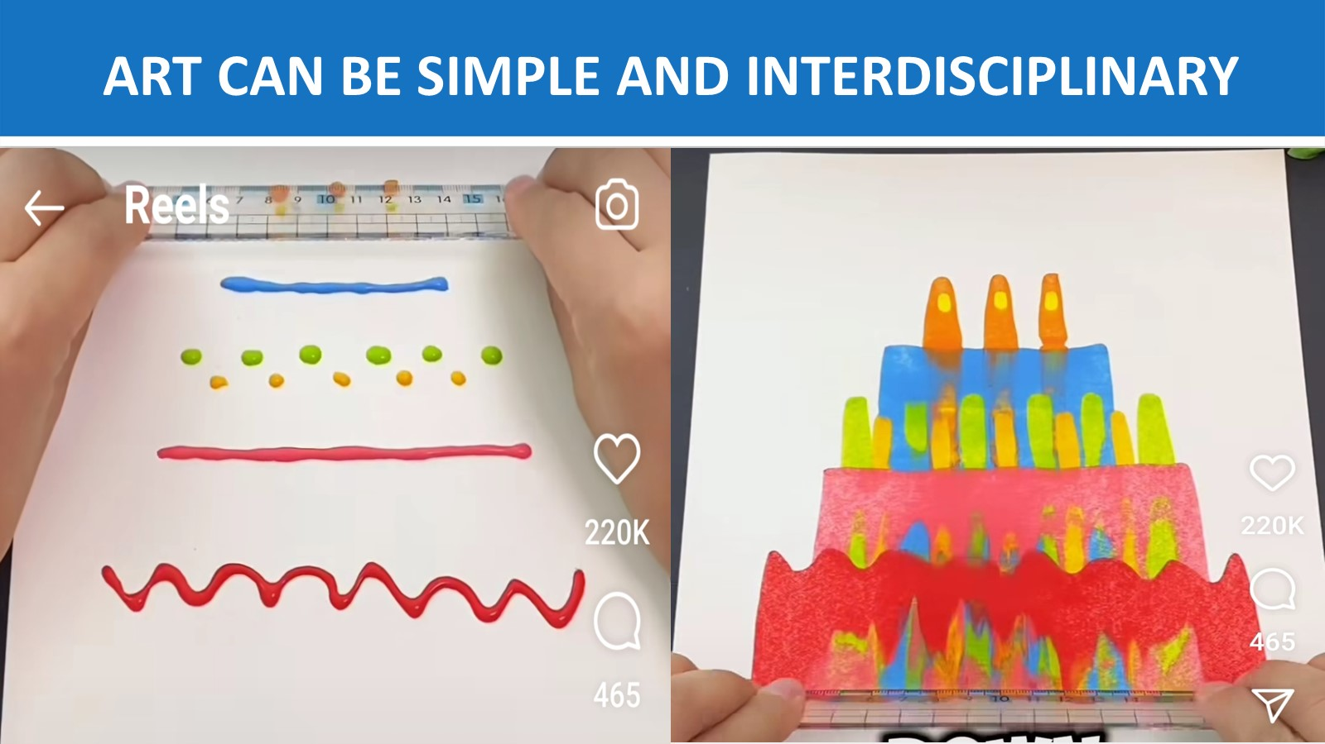
Collated copyright ©️ drswatipopatvats@gmail.com

Slide 27

Collated copyright ©️ drswatipopatvats@gmail.com

Slide 28

Collated copyright ©️ drswatipopatvats@gmail.com

Slide 29
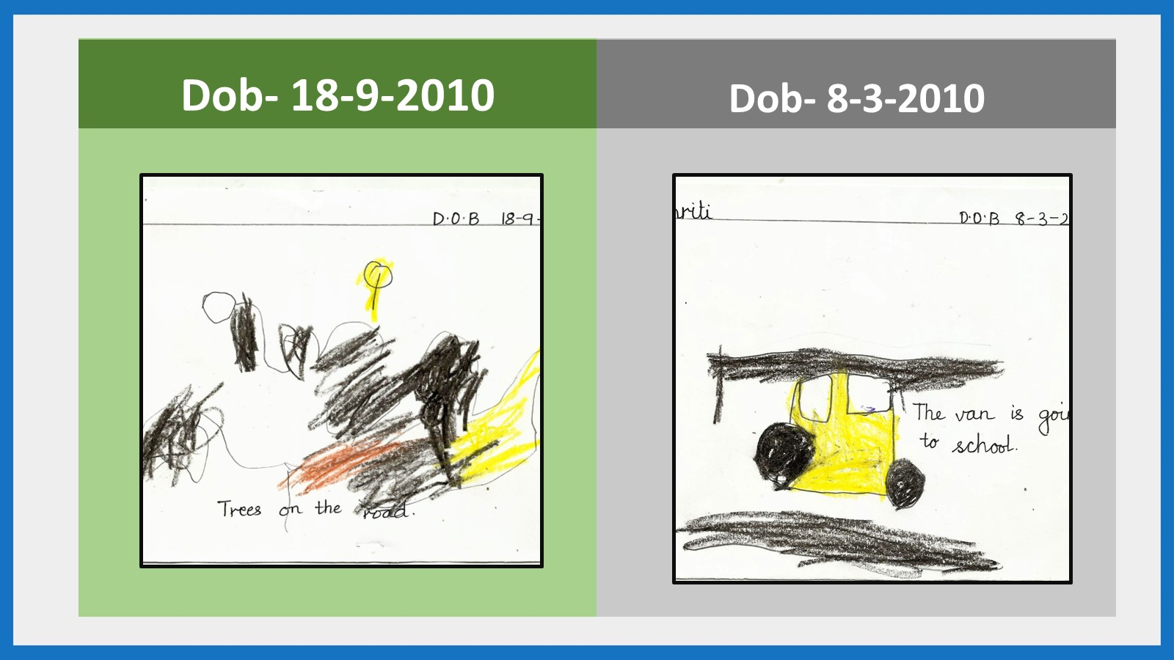
Collated copyright ©️ drswatipopatvats@gmail.com

Slide 30
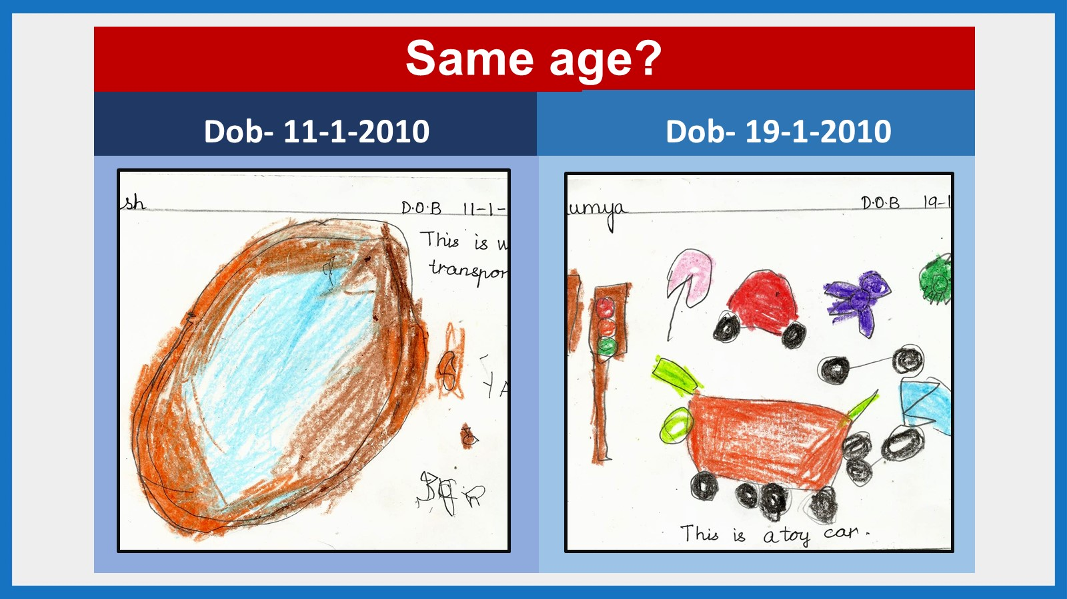
Collated copyright ©️ drswatipopatvats@gmail.com

Slide 31

Collated copyright ©️ drswatipopatvats@gmail.com

Slide 32

Collated copyright ©️ drswatipopatvats@gmail.com

Slide 33
Collated copyright ©️ drswatipopatvats@gmail.com

Slide 34
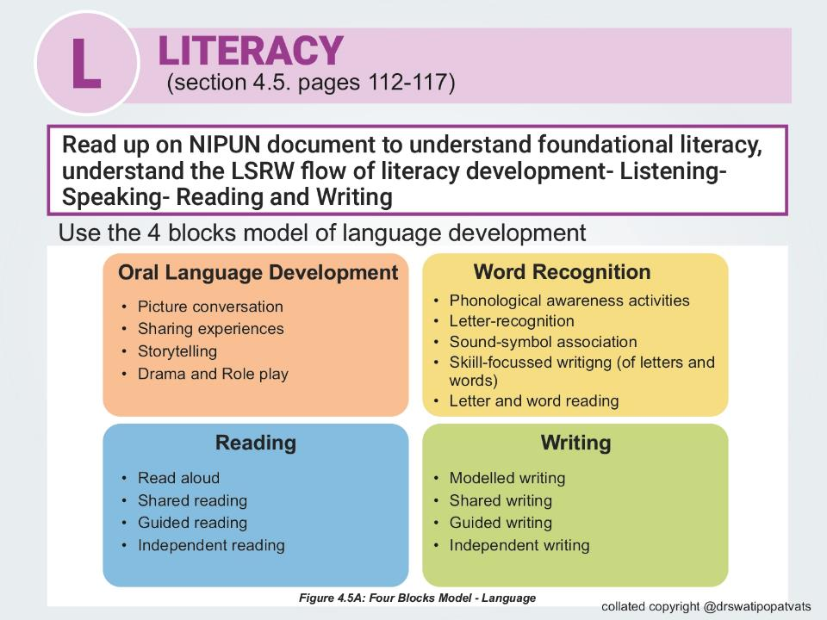

Collated copyright ©️ drswatipopatvats@gmail.com

Slide 35
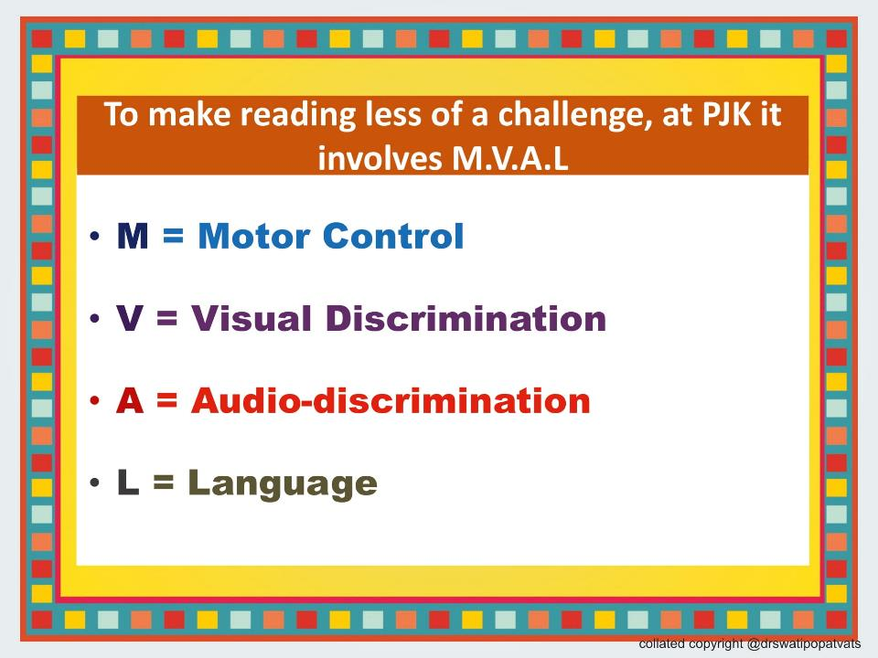
Collated copyright ©️ drswatipopatvats@gmail.com

Slide 36
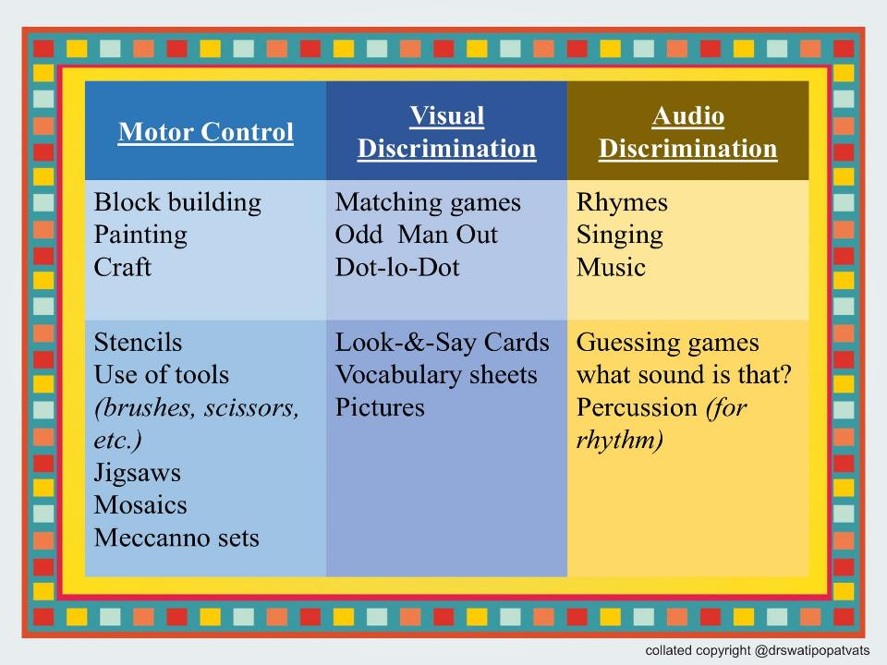
Collated copyright ©️ drswatipopatvats@gmail.com

Slide 37
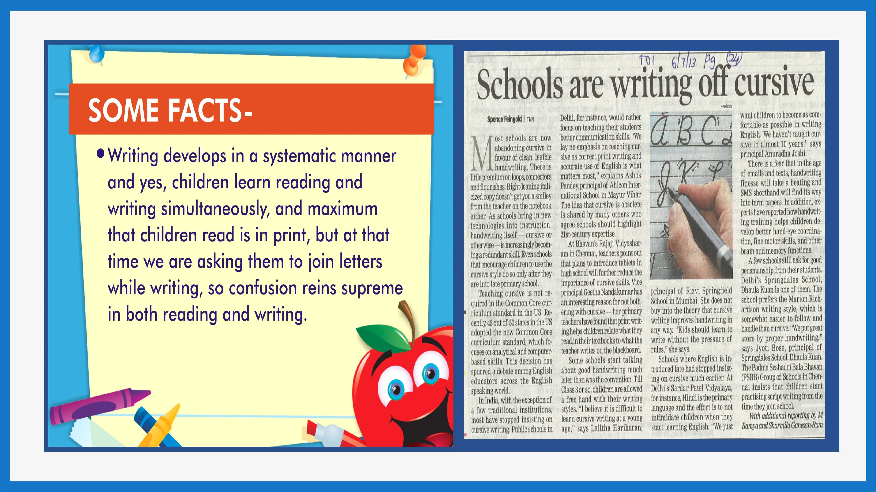
Collated copyright ©️ drswatipopatvats@gmail.com

Slide 38
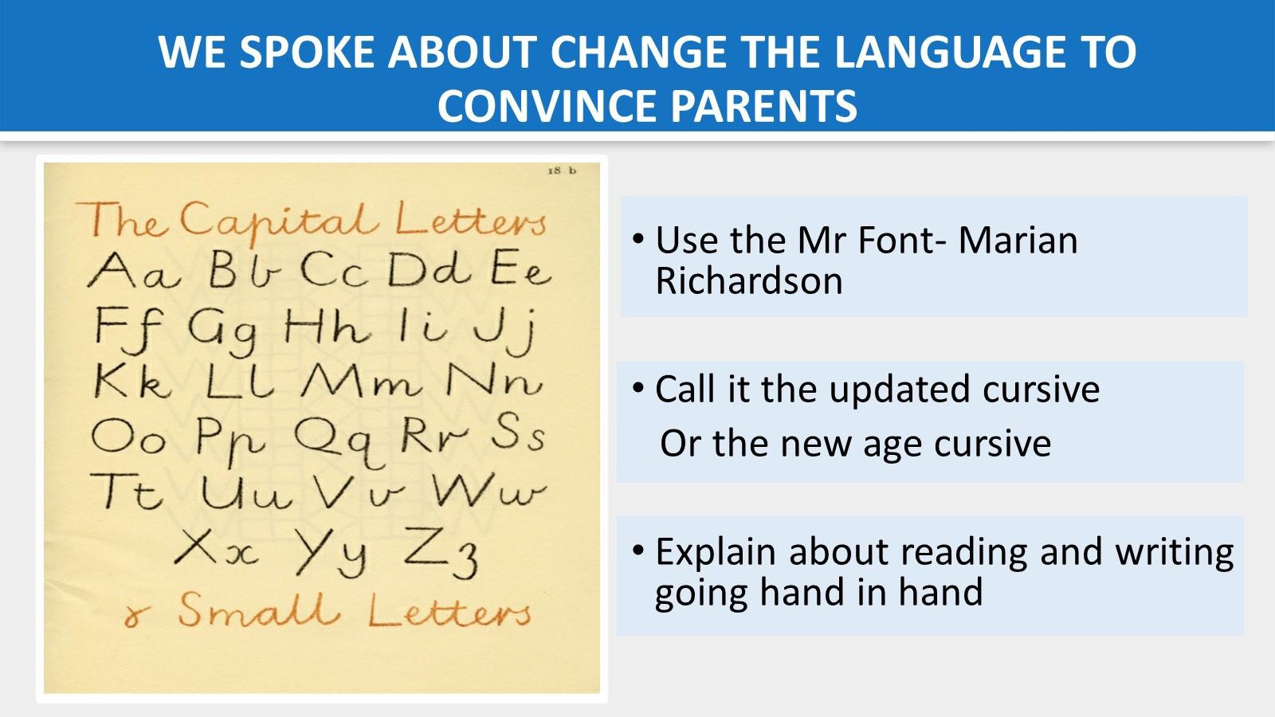
Collated copyright ©️ drswatipopatvats@gmail.com

Slide 39
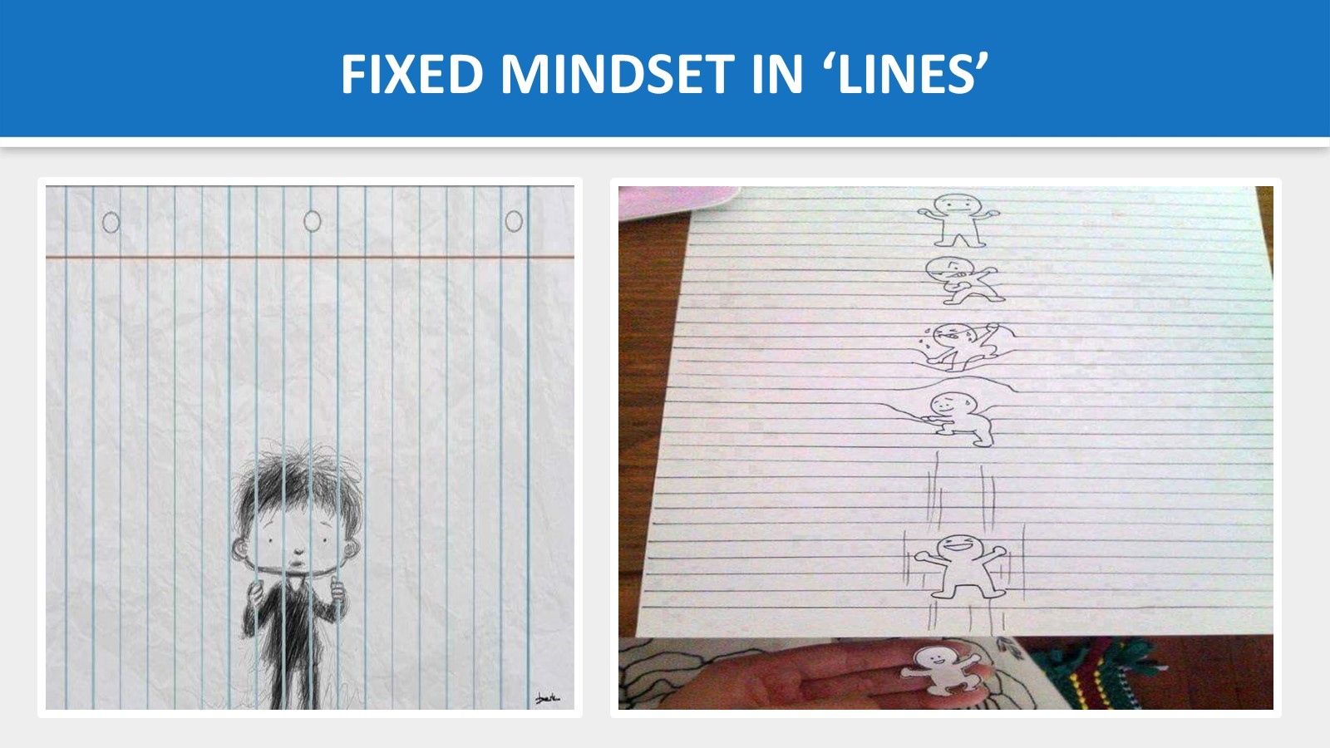
Collated copyright ©️ drswatipopatvats@gmail.com

Slide 40
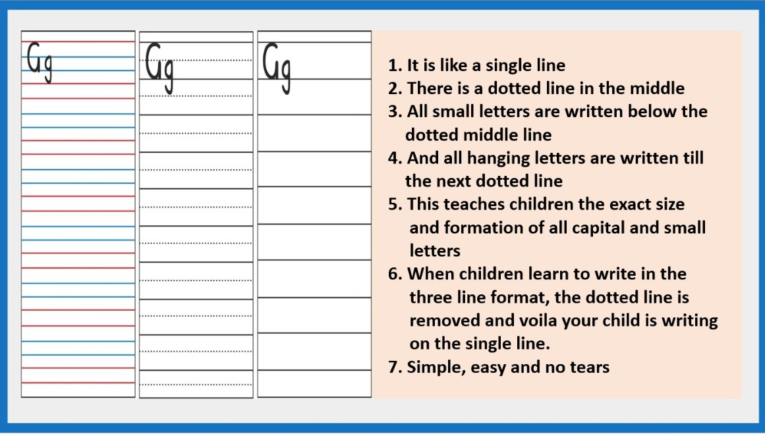

Slide 41

Collated copyright ©️ drswatipopatvats@gmail.com

Slide 42

Collated copyright ©️ drswatipopatvats@gmail.com

Slide 43
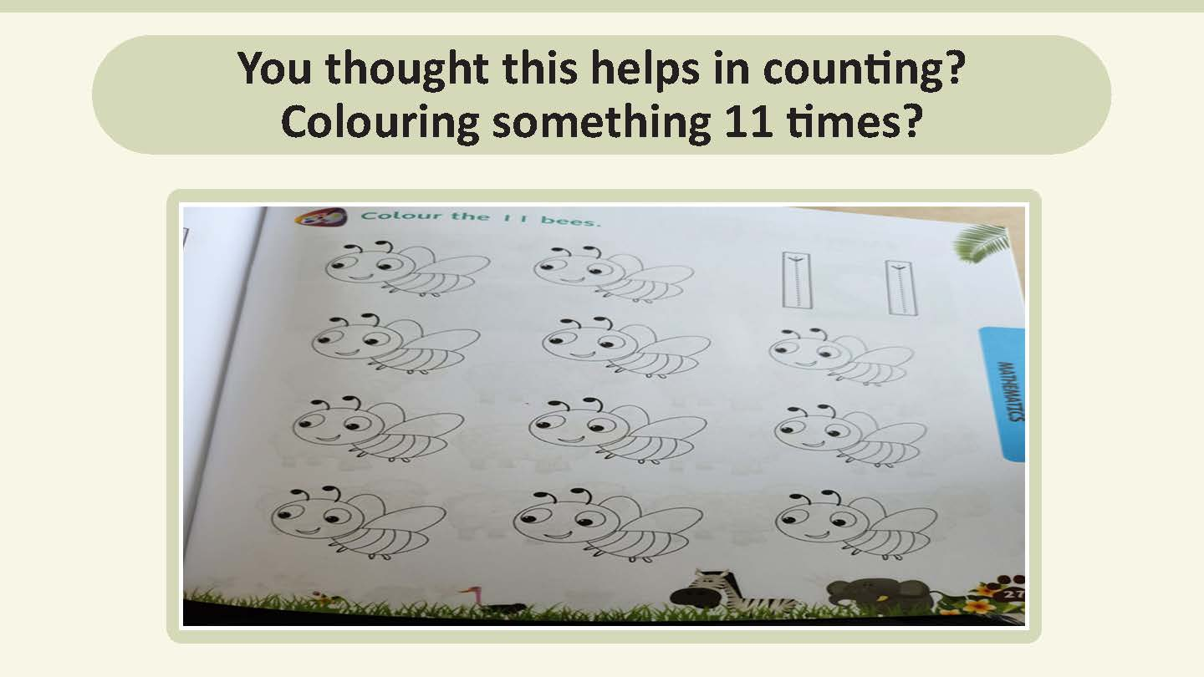
Collated copyright ©️ drswatipopatvats@gmail.com

Slide 44

Collated copyright ©️ drswatipopatvats@gmail.com

Slide 45
Collated copyright ©️ drswatipopatvats@gmail.com

Slide 46
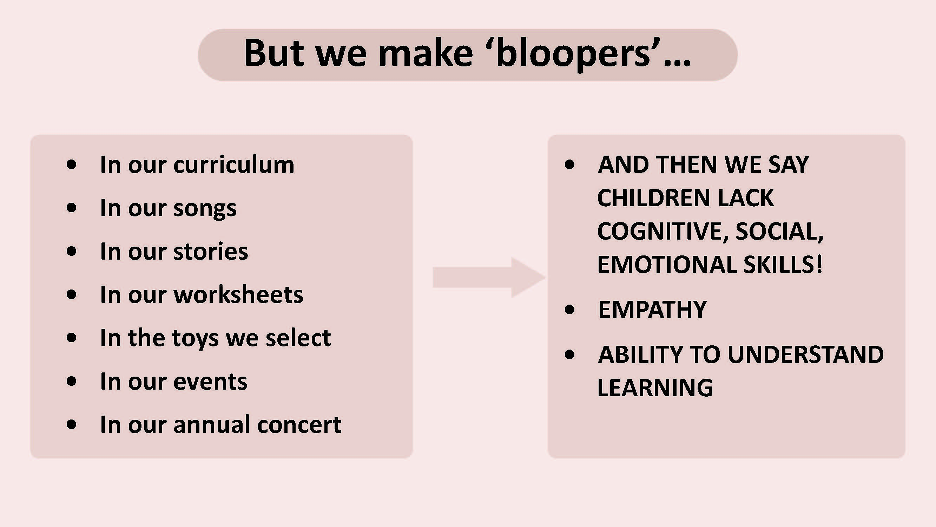
Collated copyright ©️ drswatipopatvats@gmail.com

Slide 47
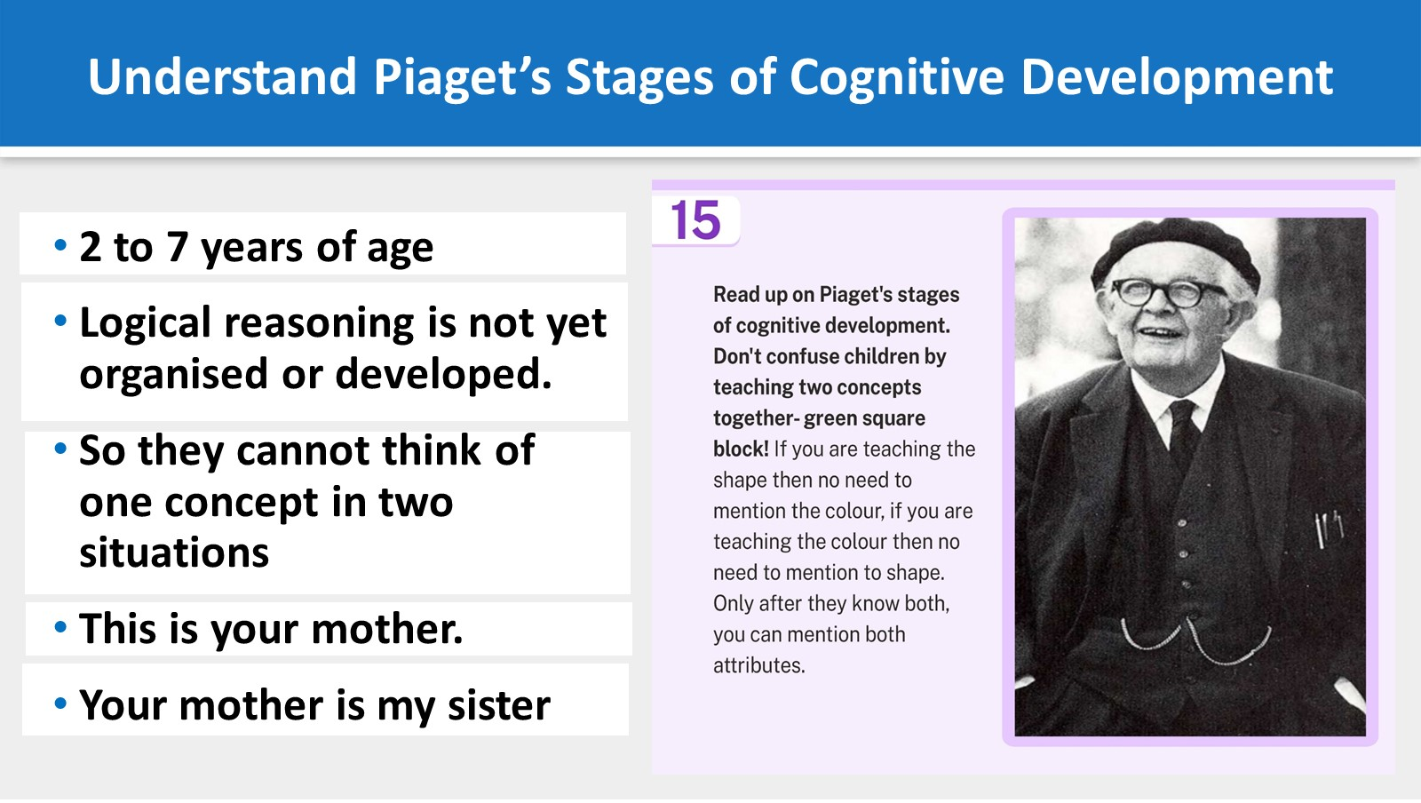
Collated copyright ©️ drswatipopatvats@gmail.com

Slide 48
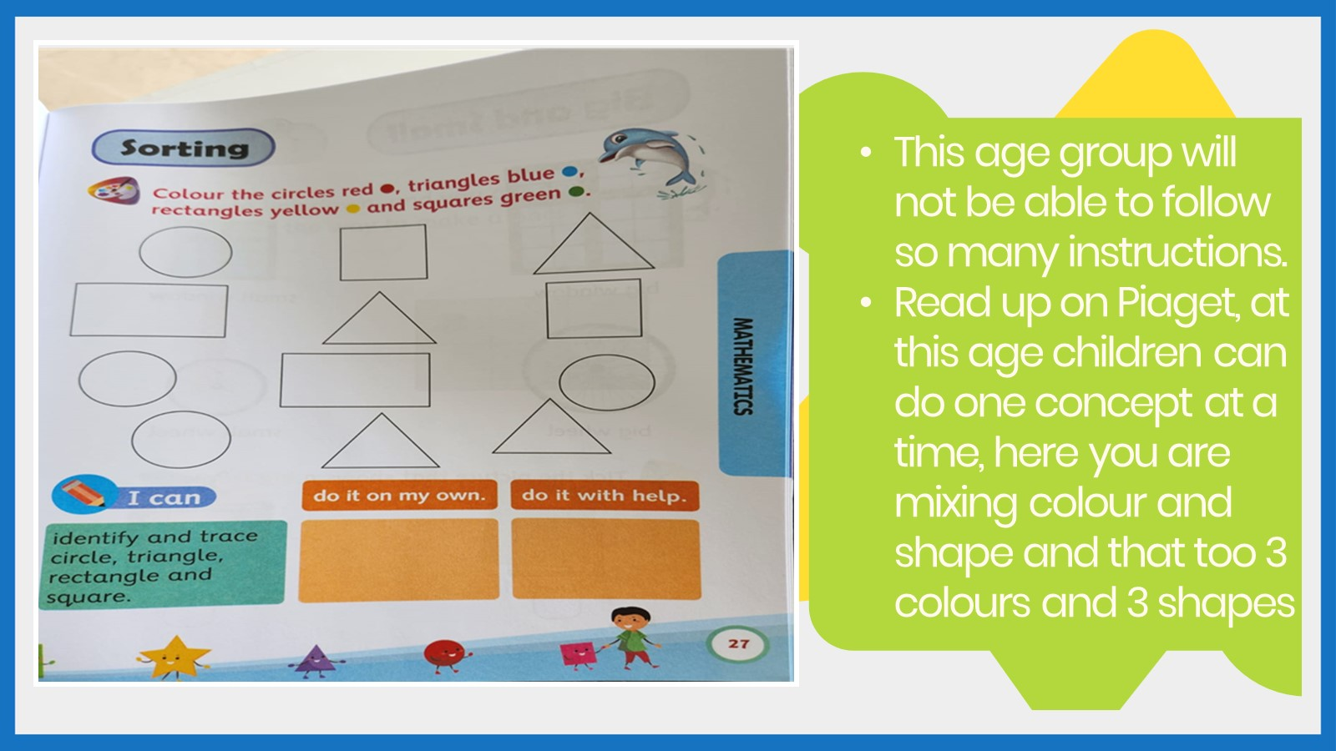
Collated copyright ©️ drswatipopatvats@gmail.com

Slide 49

Collated copyright ©️ drswatipopatvats@gmail.com

Slide 50
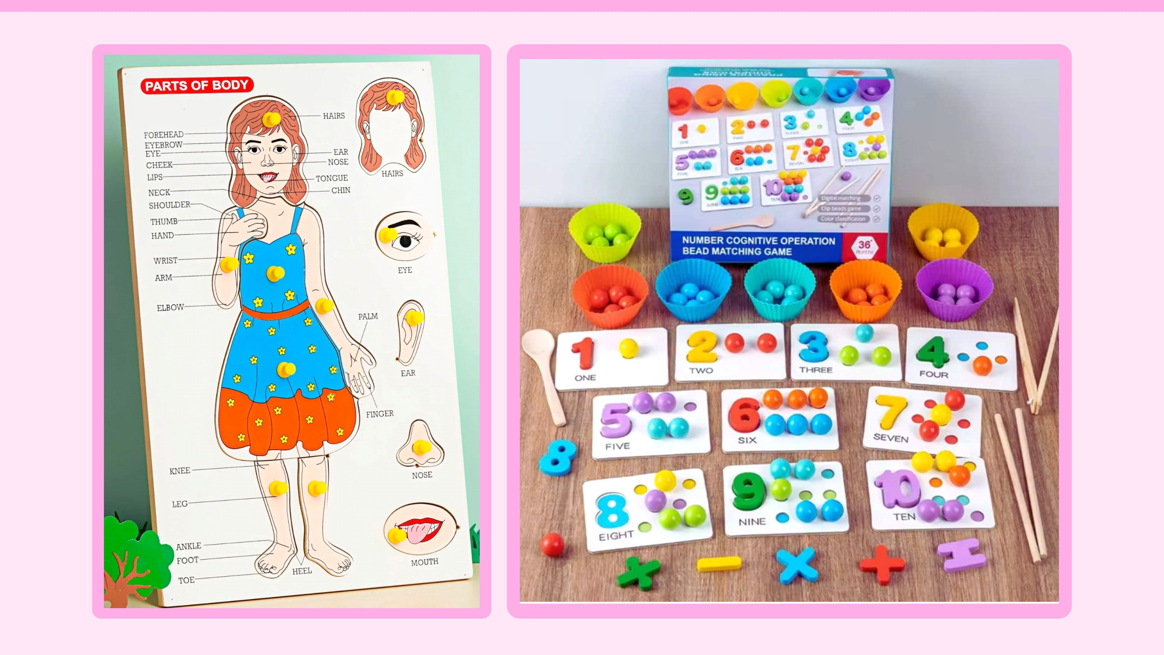
Collated copyright ©️ drswatipopatvats@gmail.com

Slide 51
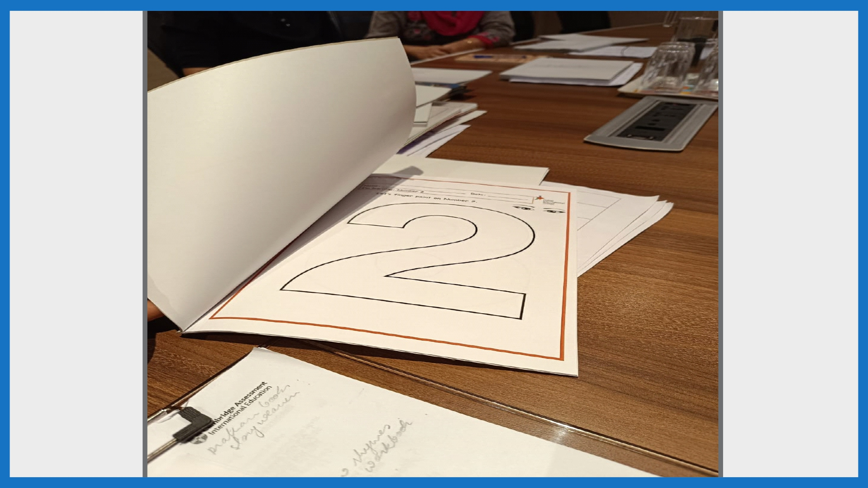
Collated copyright ©️ drswatipopatvats@gmail.com

Slide 52
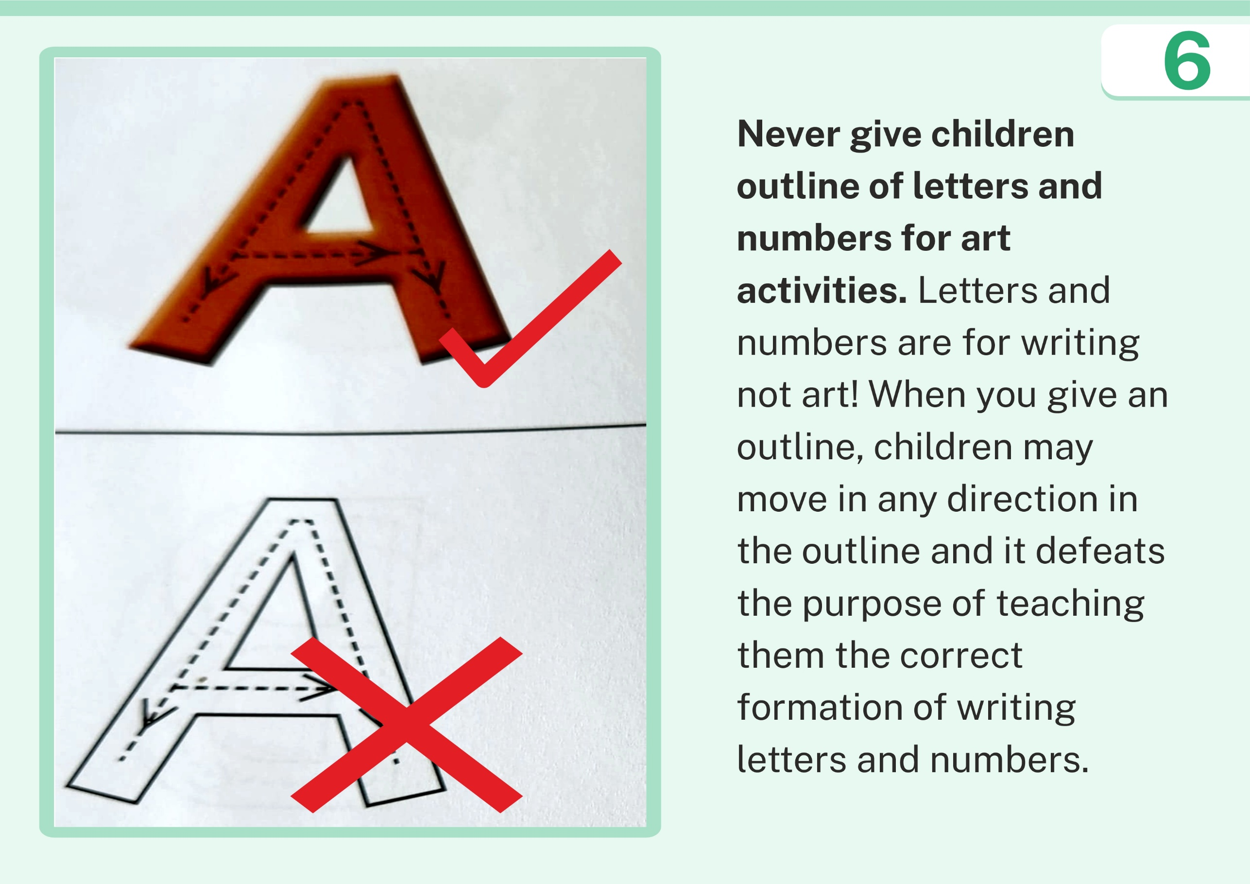
Collated copyright ©️ drswatipopatvats@gmail.com

Slide 53

Collated copyright ©️ drswatipopatvats@gmail.com

Slide 54
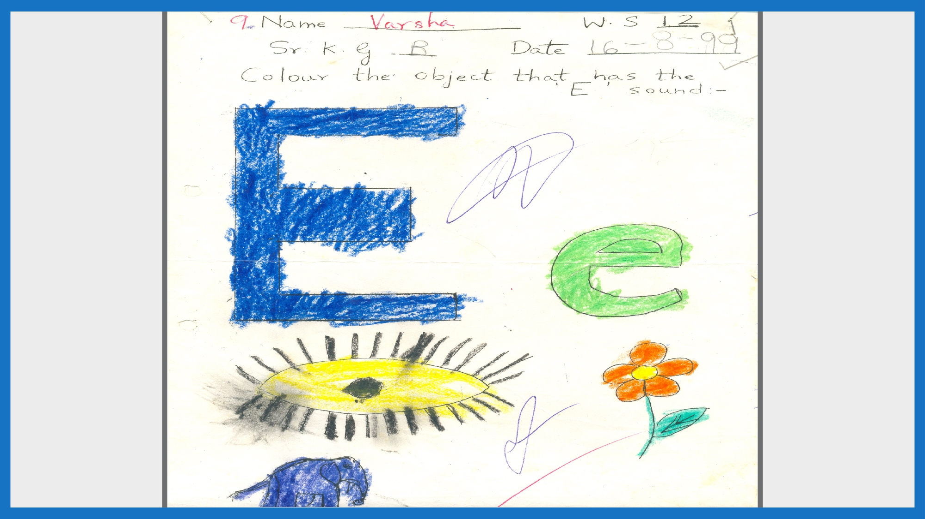
Collated copyright ©️ drswatipopatvats@gmail.com

Slide 55
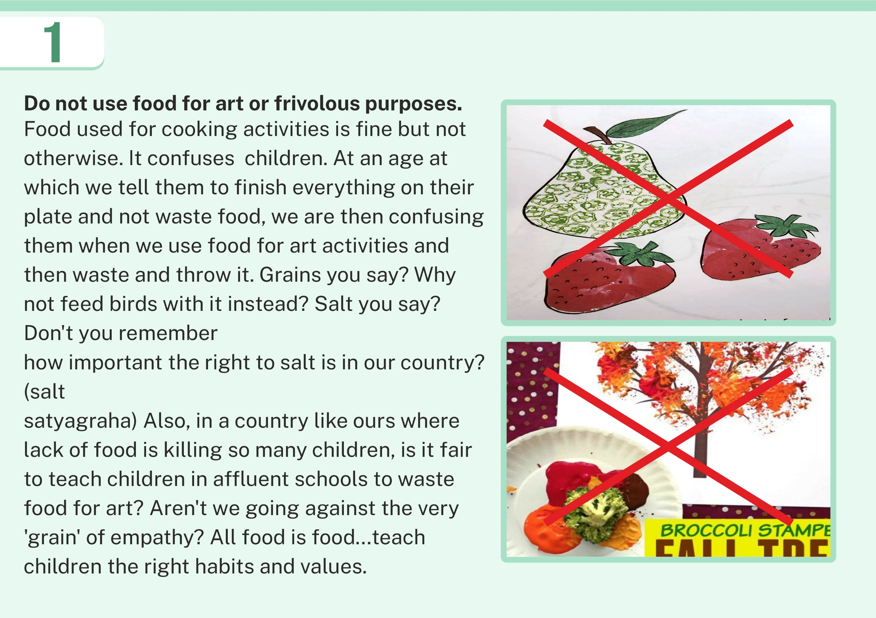
Collated copyright ©️ drswatipopatvats@gmail.com

Slide 56
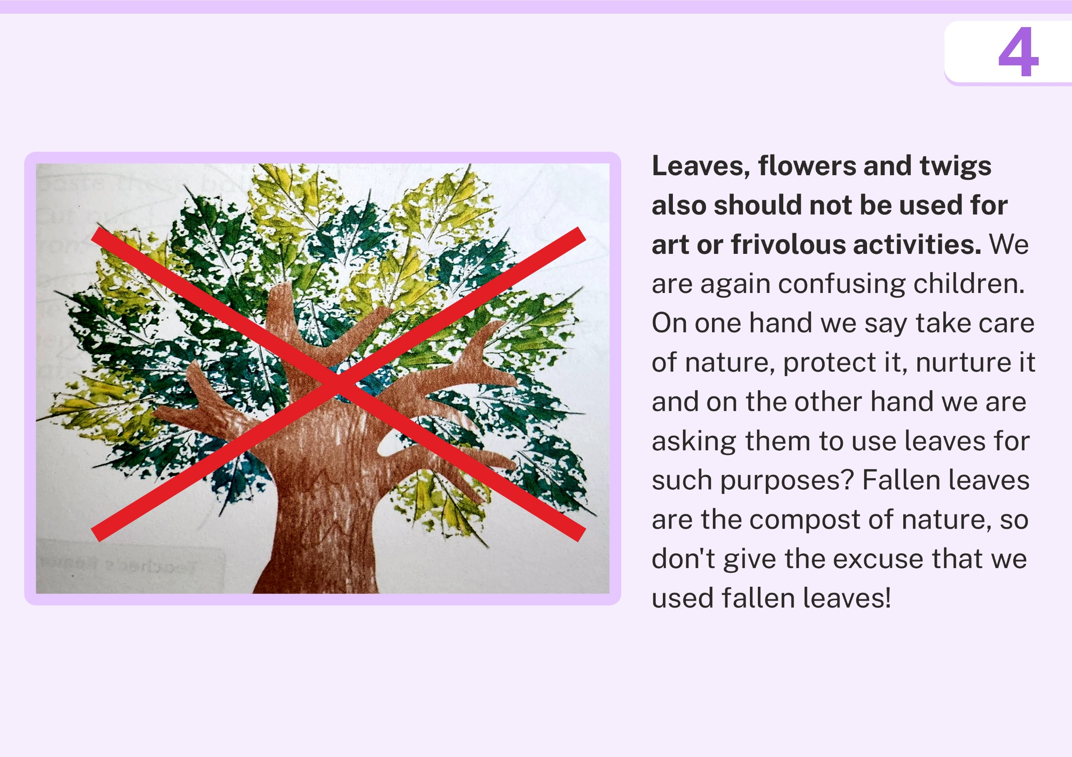
Collated copyright ©️ drswatipopatvats@gmail.com

Slide 57
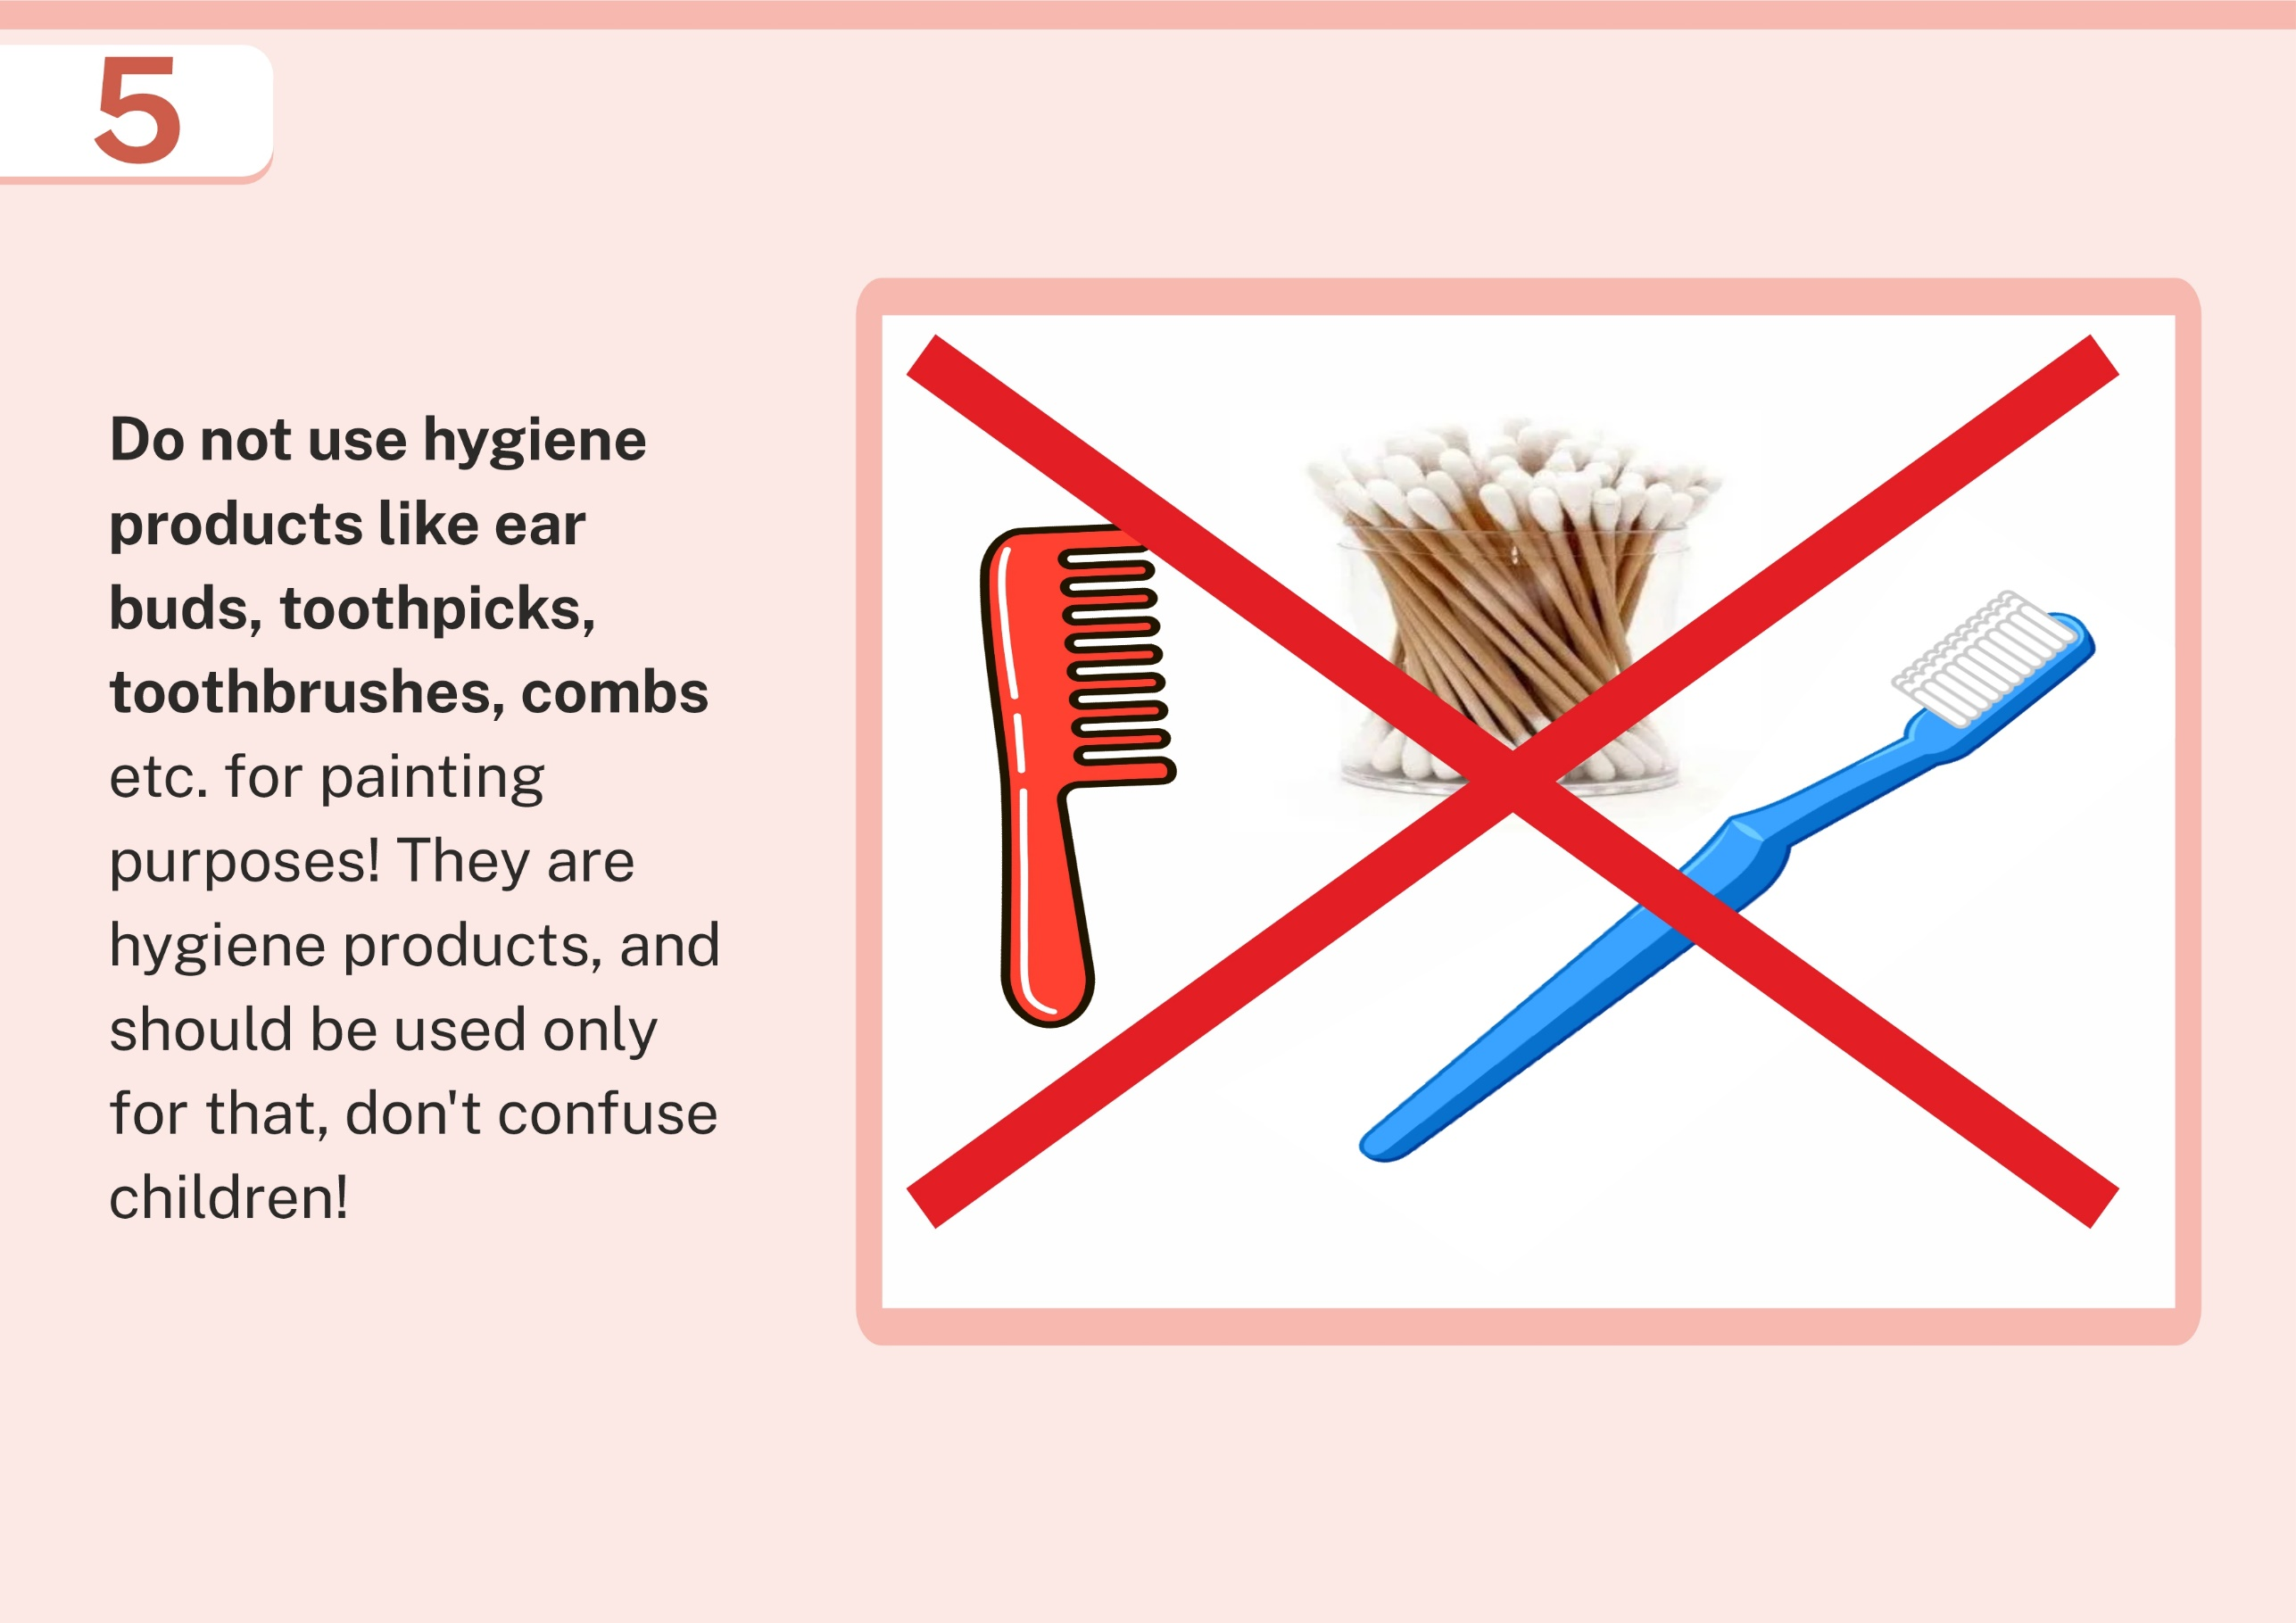
Collated copyright ©️ drswatipopatvats@gmail.com

Slide 58
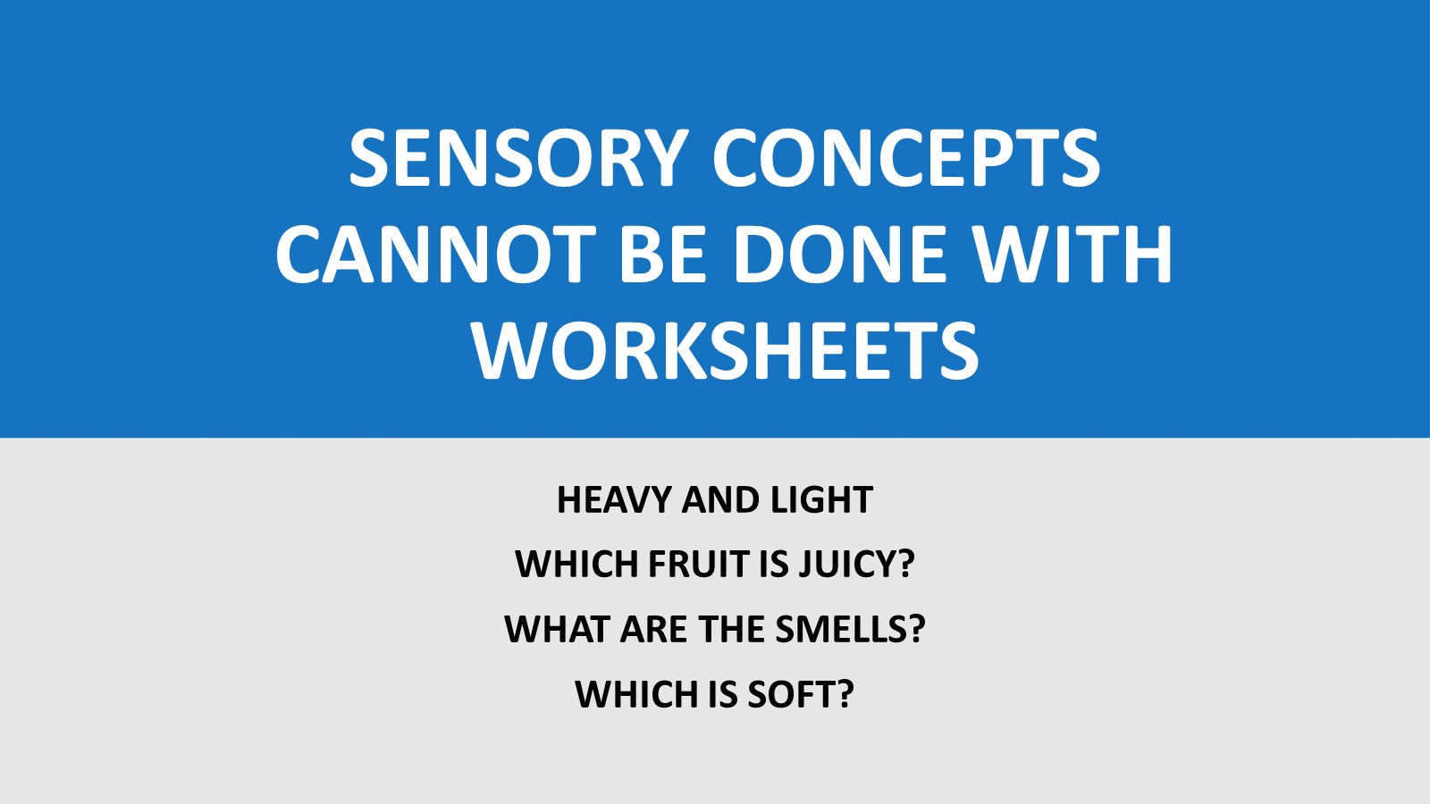
Collated copyright ©️ drswatipopatvats@gmail.com

Slide 59
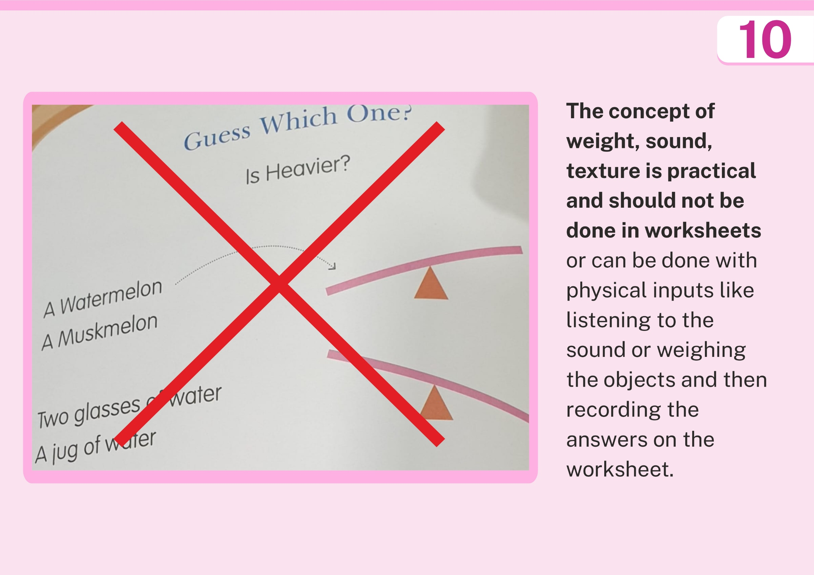
Collated copyright ©️ drswatipopatvats@gmail.com

Slide 60

Collated copyright ©️ drswatipopatvats@gmail.com

Slide 61
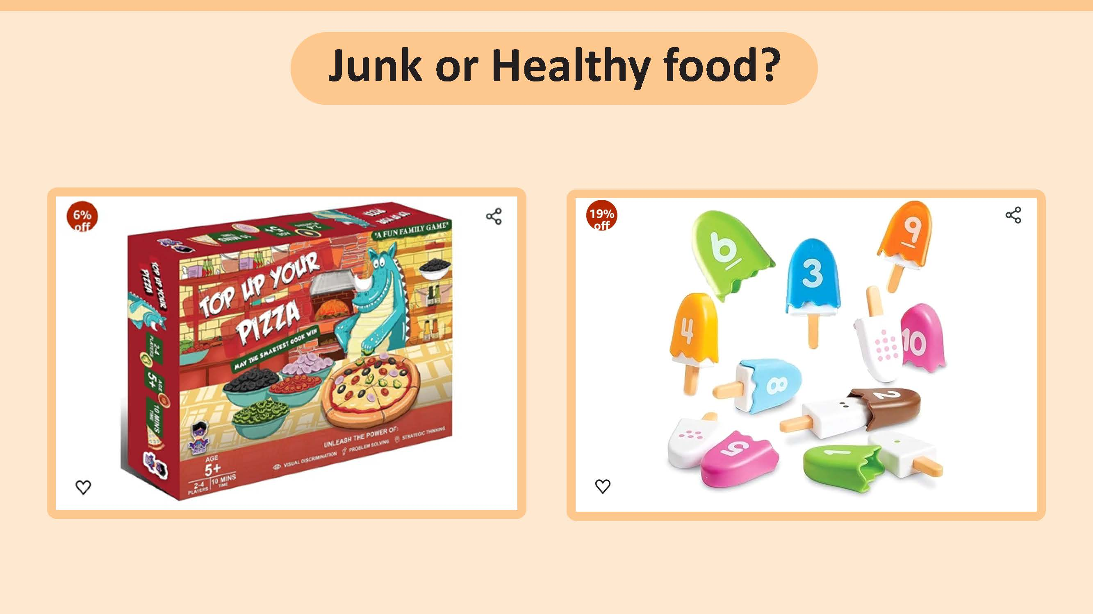
Collated copyright ©️ drswatipopatvats@gmail.com

Slide 62
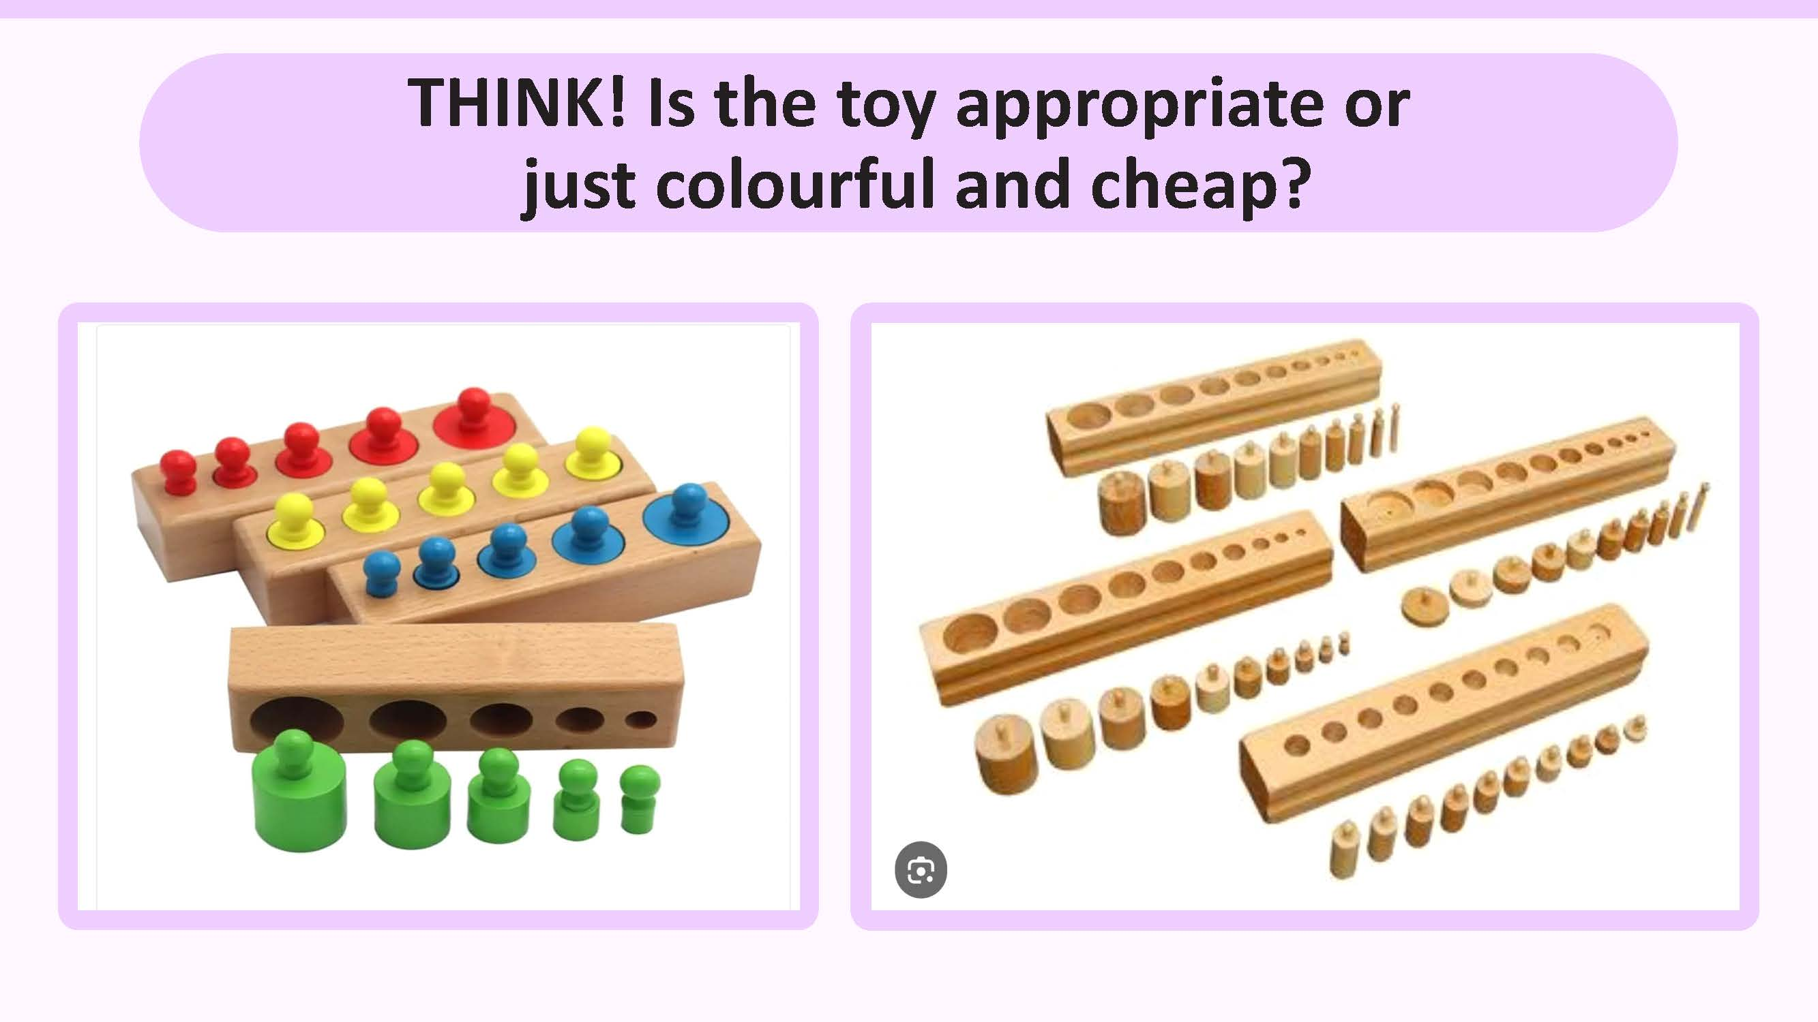
Collated copyright ©️ drswatipopatvats@gmail.com

Slide 63

Collated copyright ©️ drswatipopatvats@gmail.com

Slide 64
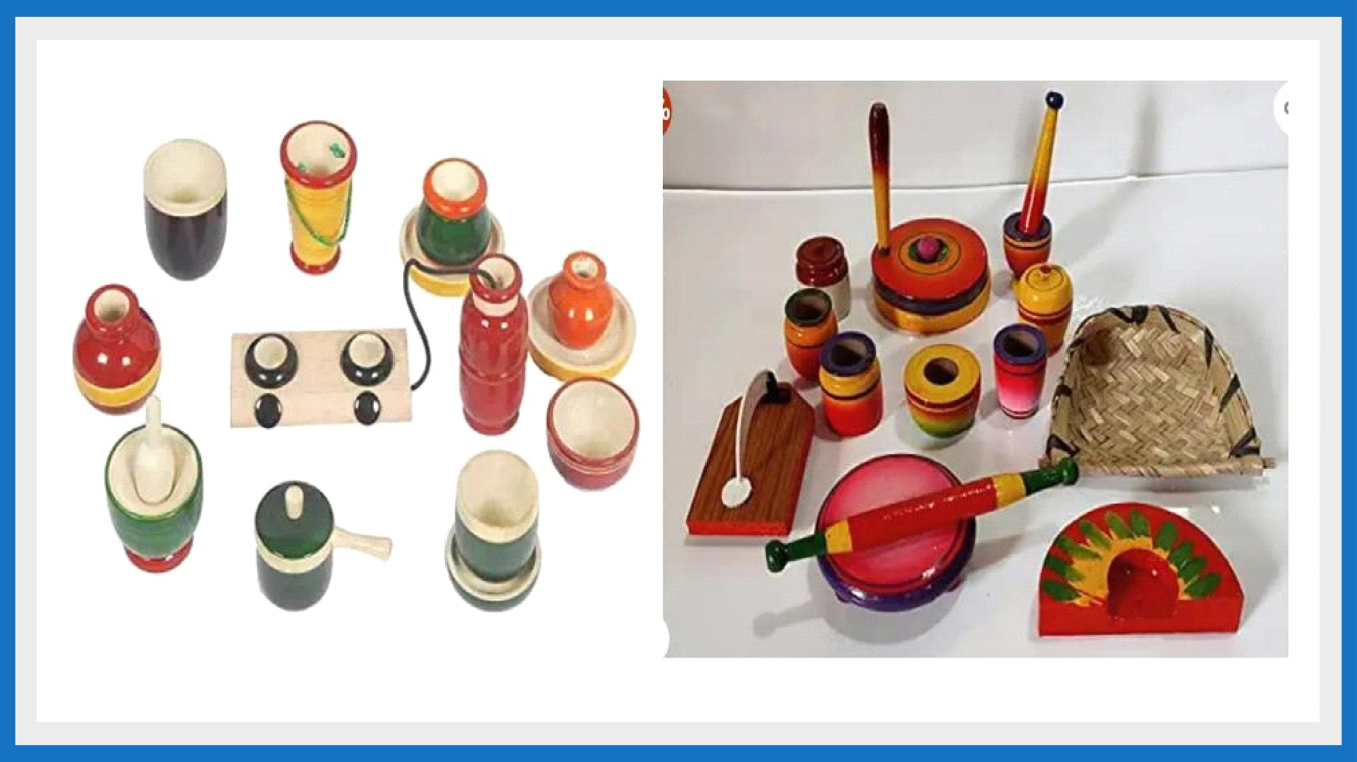
Collated copyright ©️ drswatipopatvats@gmail.com

Slide 65
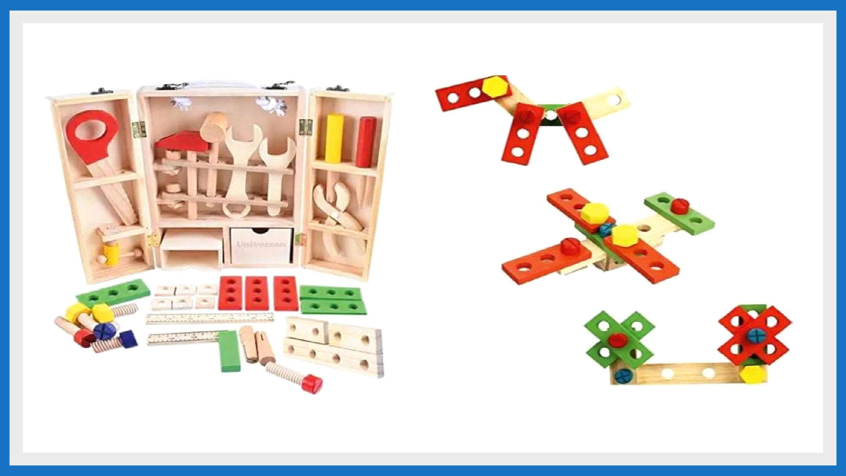
Collated copyright ©️ drswatipopatvats@gmail.com

Slide 66
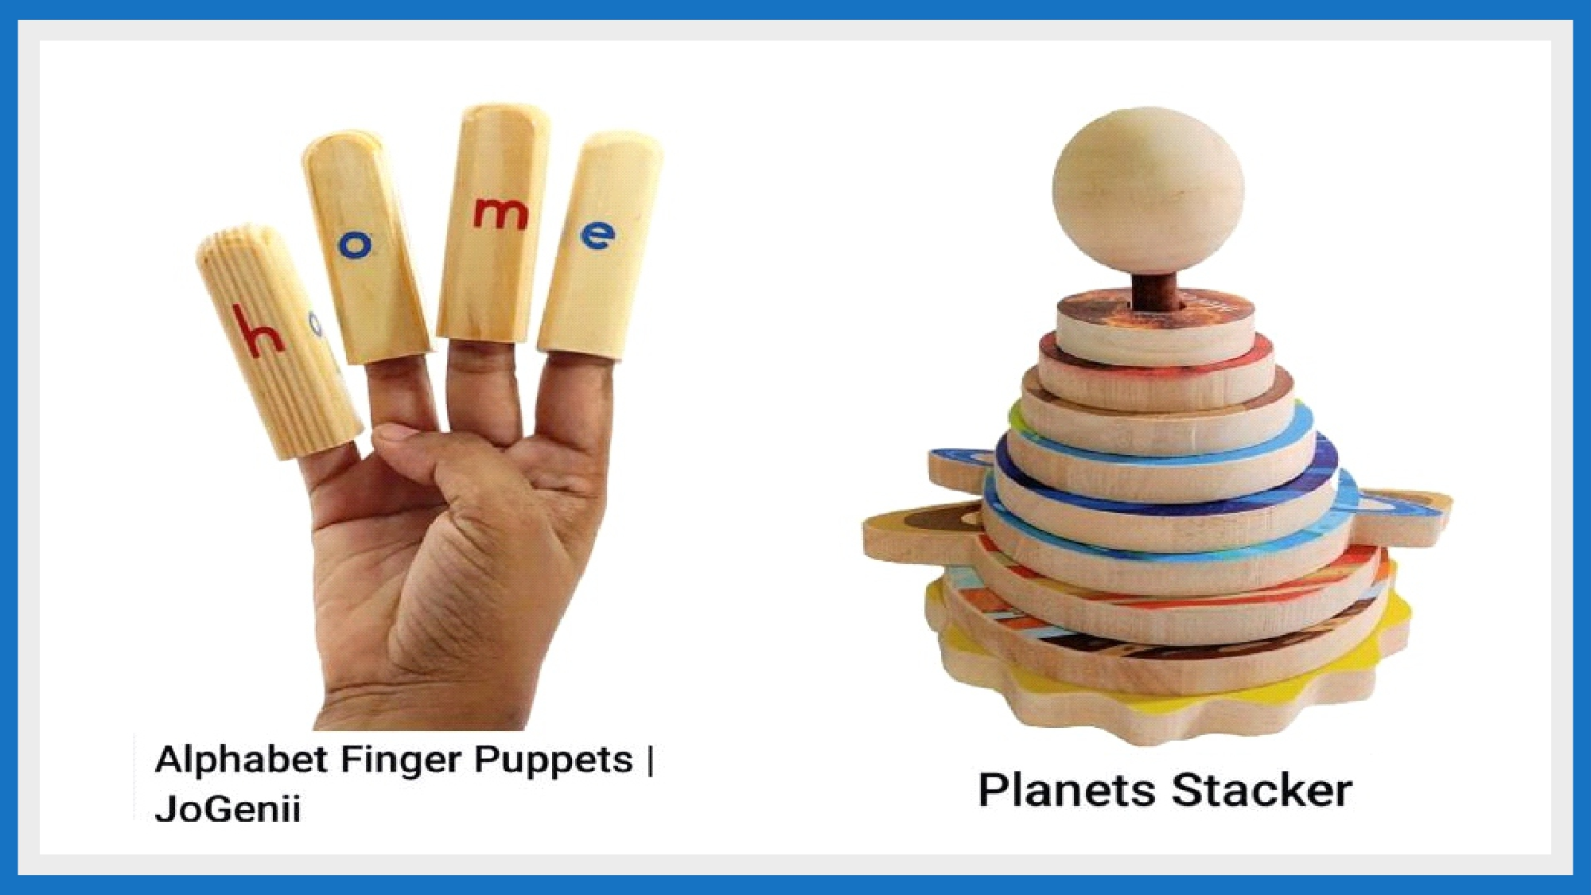
Collated copyright ©️ drswatipopatvats@gmail.com

Slide 67
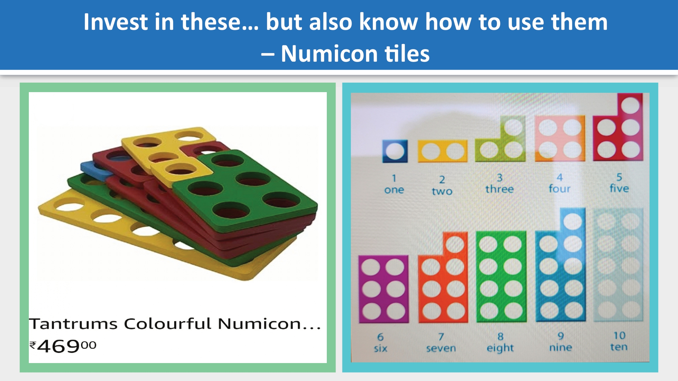
Collated copyright ©️ drswatipopatvats@gmail.com

Slide 68

Collated copyright ©️ drswatipopatvats@gmail.com

Slide 69
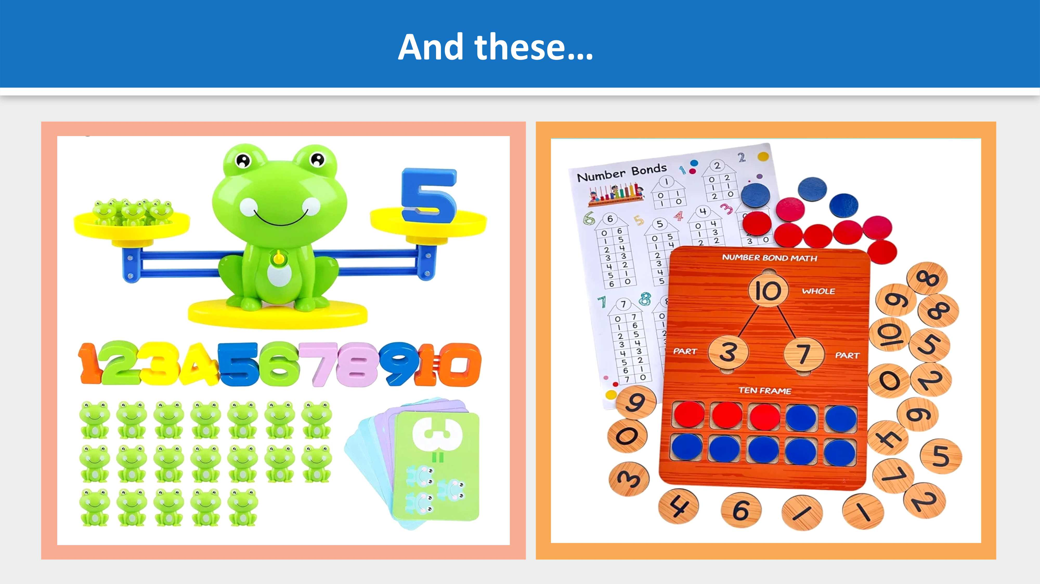
Collated copyright ©️ drswatipopatvats@gmail.com

Slide 70
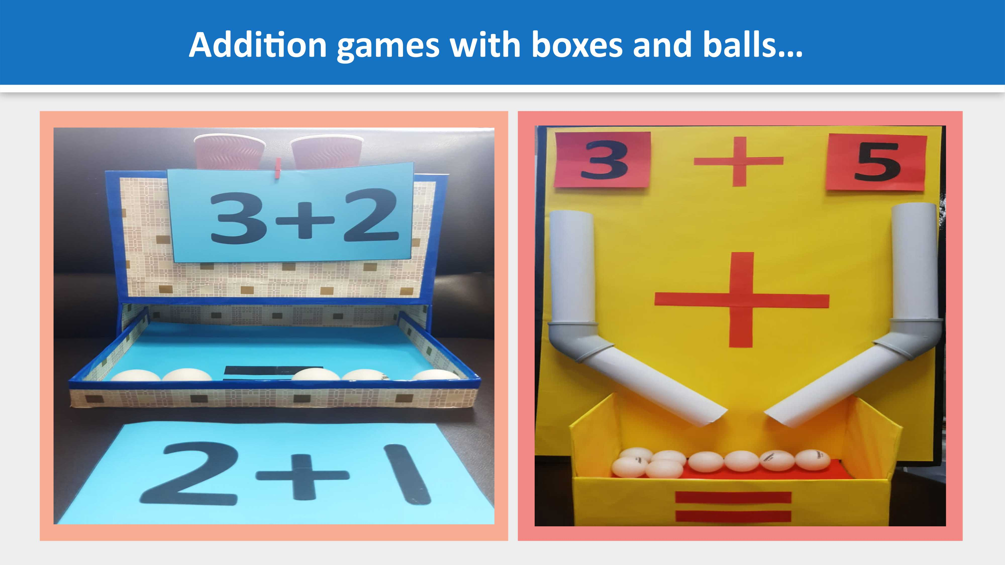
Collated copyright ©️ drswatipopatvats@gmail.com

Slide 71

Collated copyright ©️ drswatipopatvats@gmail.com

Slide 72

Collated copyright ©️ drswatipopatvats@gmail.com

Slide 73
Collated copyright ©️ drswatipopatvats@gmail.com

Slide 74
Collated copyright ©️ drswatipopatvats@gmail.com

Slide 75
Collated copyright ©️ drswatipopatvats@gmail.com

Slide 76

Collated copyright ©️ drswatipopatvats@gmail.com

Slide 77
Collated copyright ©️ drswatipopatvats@gmail.com

Slide 78
Collated copyright ©️ drswatipopatvats@gmail.com

Slide 79
Collated copyright ©️ drswatipopatvats@gmail.com

Slide 80
Collated copyright ©️ drswatipopatvats@gmail.com

Slide 81
Collated copyright ©️ drswatipopatvats@gmail.com

Slide 82
Collated copyright ©️ drswatipopatvats@gmail.com

Slide 83
Collated copyright ©️ drswatipopatvats@gmail.com

Slide 84
Collated copyright ©️ drswatipopatvats@gmail.com

Slide 85
Collated copyright ©️ drswatipopatvats@gmail.com

Slide 86
Collated copyright ©️ drswatipopatvats@gmail.com

Slide 87
Collated copyright ©️ drswatipopatvats@gmail.com

Slide 88
Collated copyright ©️ drswatipopatvats@gmail.com

Slide 89
Collated copyright ©️ drswatipopatvats@gmail.com

Slide 90
Collated copyright ©️ drswatipopatvats@gmail.com

Slide 91
CHILDREN MAY BE 20% OF OUR PRESENT BUT THEY ARE 100% OUR FUTURE.
GIVE YOUR 100% TO YOUR FUTURE TODAY.
swatipopatvatskiducation@blogspot.in
Collated copyright ©️ drswatipopatvats@gmail.com

Slide 92
Collated copyright ©️ drswatipopatvats@gmail.com

