Slide 1
Understanding and dealing with child sexual abuse the sounds of silence
Podar Education Group
Early Childhood Association

Slide 2
Why call it sounds of silence?
Child sexual abuse happens silently
Victims keep quiet about it, out of fear or lack of knowledge that something wrong has been done to them
Parents of victims want to keep it silent
Too embarrassing for the school or community to discuss and so silence from there too

Slide 3
But all this silence has suddenly started making sounds
Its time to break the silence… and make a noise
Because touch should never become trouble in any child’s life
The sounds we hear now are of
broken emotional development, social development and lasting impact on personality and health

Slide 4
So why is child abuse on the rise?
Blame the over-sexualized nature of society
Sexy clothes for children, are increasingly popular in India
Little girls performing the ITEM SONGS done by film actresses
As Ms. Pinky Virani says whether this contributes directly to childhood sexual abuse is unclear, but the connection cannot entirely be rejected

Slide 5
Who is a child abuser?
50% of sexual offenders were known to the trusted victim (family member, relative, friend or neighbour)
Can be male and even female
Abusers can be from any particular socio-economic class or educational background
Is a "regular" person who leads a "routine" life and is known to the victim

Slide 6
There are many definitions of child sexual abuse
The United Nations has defined child sexual abuse as contacts or interactions between a child and an older or more knowledgeable child or adult (a stranger, sibling or person in position of authority, a parent or a caretaker) when the child is being used as an object of gratification for the older child's or adult's sexual needs.
These contacts or interactions are carried out against the child using force, trickery, bribes, threats or pressure (UNICEF, 2003).

Slide 7
There are many definitions of child sexual abuse
The NSW Child Protection Council definition states, 'child sexual assault occurs when an adult or someone bigger than a child uses his power or authority over the child and takes advantage of the child's trust and respect to involve the child in sexual activity.
In all cases the offender / abuser has more power than the child and misuses that power to take advantage of the child's.

Slide 8
Non-contact abuse or "Unsafe Actions" are:
Following or stalking a child Using sexually suggestive language with the child that includes lewd comments about the child or her/his body parts, stories or songs with a sexual overtone, sexual innuendos.
Showing the child pornographic material - pictures, films, videos or taking the child's pictures in semi nude or nude state or in sexually suggestive postures.
Watching the child undress, bathe, urinate or defecate or forcing the child to do all this in the presence of the adult.
Contact abuse or "Unsafe Touch" includes Touching, fondling, caressing, kissing the child's body parts including her/his genitals
Having the child touch, caress, fondle, kiss the body parts or genitals of the adult.

Slide 9
Myth 1:
Only strangers abuse children sexually
Fact :
Danger from strangers is only a small part of the problem. Research evidence world over indicates that in a majority of cases, (upto 85%) the child's relatives, family, friends or someone known and trusted by the child is involved.

Slide 10
Myth 2: only men sexually abuse children
Fact:
An overwhelming majority of those who sexually abuse children is men although women are the ones who spend most time with children. Only a small minority of women report to have abused children.

Slide 11
Myth 3:
Men who sexually abused child are mentally sick or perverted
Fact:
Prevalence of child sexual abuse ranges between 30 to 85% in any society depending on the definition used for child sexual abuse.
Mental illness on the other hand accounts for not more than 15% of the total population.
If those who sexually abuse children were truly sick or perverted then we are living in a .sick and perverted. society.
Unfortunately the men who sexually abuse children are often ordinary, respectable men holding positions of responsibility in the family, society, workplace and fulfilling their duties as per the demand of their role.

Slide 12
Myth 4:
Child sexual abuse happens only in poor or problem families
Fact:
Child sexual abuse cuts across classes, caste, religious and educational barriers and occurs irrespective of what the background of the abuser and the child is.

Slide 13
Myth 5:
When children say they have been abused, it is often a figment of their imagination or fantasy.
Fact:
Most times, children are unable to disclose or talk about abuse. In rare instances, when they do talk, it is not their imagination or fantasy but very real; children need to be believed and supported if they talk about any sexual touching or if they express any reservations about interacting with particular adults.

Slide 14
Myth 6:
Only beautiful or sexually precocious children are abused.
Fact:
All children, irrespective of their age, colour, family background, sexual knowledge are vulnerable to abuse. They are perceived as easy targets because of the power the abuser has and the inability of children to speak up or stop abuse.

Slide 15
Myth 7:
Children enjoy being touched sexually, that is the reason they do not report sexual abuse
Fact:
Children do not report abuse for several reasons:
They are afraid no one will believe them,
They are afraid that the abuser may harm or kill them or their loved ones,
They are afraid they will lose the love of their parents and near and dear ones, they do not have a language to disclose abuse.
At no point does a child enjoy the sexual attention of an adult; children feel extremely overwhelmed and distressed by such attention

Slide 16
Myth 8:
We can tell if a child is sexually abused
Fact:
Children are experts at hiding their pain. It is difficult to say from external appearance if the child is sexually abused.
However, adults need to be alert to any changes in the child's behavior, performance at school, emotionality, fear of certain places or people, resistance to go or meet some people and sleeping and eating patterns.
A traumatic experience in a child's life is often expressed through indirect means. Also many children may not show any change in their behaviors or other patterns until much later.

Slide 17
Myth 9:
Child Sexual Abuse can never happen in one's home.
Fact:
Almost 30-50% children are abused by persons known to them; relatives, family friends, neighbours, drivers, watchmen, doctors, religious leaders.
Such abuse often takes place in one's home which is considered as a .safe haven..
The abuser enjoys the trust of the family members and has easy access to the child.

Slide 18
Myth 10:
Boys cannot be abused
Fact:
Although more girls are reported to be sexually abused, (one in every four) research indicates one in every seven boy's world over are abused.

Slide 19
Some laws and organisations that we should be aware of -
Teachers in Maharashtra face six months' jail if they don't report child sex abuse to cops
COMMISION FOR THE PROTECTION OF CHILD RIGHTS
WOMEN AND CHILD WELFARE GROUPS
CHILD SEXUAL ABUSE ACT
LOCAL NGO’S
CHILD PROTECTION COUNCIL

Slide 20
Highlights of the 'Protection of Children from Sexual Offences Act 2012':
The Act defines a child as any person below the age of 18 years and provides protection from the offences of sexual assault, sexual harassment and pornography.
This is the first time that an Act has listed aspects of touch as well as non touch behaviour (eg: photographing a child in a obscene manner) under the ambit of sexual offences.
The Act incorporates child friendly procedures for reporting, recording of evidence, investigation and trial of offences
The attempt to commit an offence under the Act has also been made liable for punishment for upto half the punishment prescribed for the commission of the offence.
The Act also provides for punishment for abetment of the offence, which is the same as for the commission of the offence. This would cover trafficking of children for sexual purposes.
The media has been barred from disclosing the identity of the child without the permission of the Special Court.

Slide 21
Please keep a detailed copy of-
THE PROTECTION OF CHILDREN FROM SEXUAL OFFENSES ACT 2012

Slide 22
WHEN A COMPLAINT OF CHILD ABUSE COMES TO YOU, HERE ARE THE STEPS
If parent comes -
Meet the parent in presence of another staff
Ask the parent to write down the details of the complaint
If parent unwilling or unable to write then ask the parent to speak and you or someone from your office to write down verbatim, and then take parents signature on it
Reassure the parent that now you will conduct an enquiry to look into the matter
If parent says why cant you punish the culprit, quote chapter v 22.1 and 22.2 of the sexual offenses act given below
If parent wants to go to the police, do not stop.
Go along with the parent and help file complaint
While filing a complaint at the police station and for all further procedures of the police ensure that you have read chapter vi – procedures for recording statement of the child- of the act

Slide 23
WHEN A COMPLAINT OF CHILD ABUSE COMES TO YOU, HERE ARE THE STEPS
If child comes to you with complaint -
Write down or record what the child is saying in the presence of another staff
Call the parents and brief them about the complaint and then follow the steps given in previous slide

Slide 24
IF BOTH THE ABUSER AND ABUSED ARE CHILDREN-
Ensure that you speak to each child in the presence of another staff.
Call both the parents for a meeting.
Interview and brief both parents seperately.
Inform them not to handle it directly (like many parents will get into a verbal or physical fight)
Ensure that you document all meetings
Do not ask teacher to conduct any inquiry unless someone senior is not present.
Ensure that both the children’s reputations are not dented due to gossip.

Slide 25
FOR MEDIA- BE AWARE OF YOUR RIGHTS
CHAPTER V-23-1
No reports in any media shall disclose, the identity of a child including his name, address, photograph, family details, school, neighbourhood or any other particulars which may lead to disclosure of identity of the child.
The publisher or owner of the media or studio or photographic facilities shall be jointly and severally liable for the acts and commissions of his employee.
Any person who contravenes the provisions of sub-section(1) or sub-section (2) shall be liable to be punished with imprisonment of either description for a period which shall not be less than six months but which may extend to one year or with fine or with both.

Slide 26
SOME DO’S AND DON’T IN CHILD SEXUAL
ABUSE CASES
ALWAYS KEEP ANOTHER STAFF WITH YOU IN ALL MEETINGS
DOCUMENT OR RECORD ALL MEETINGS WITH PARENTS AND CHILDREN
ALWAYS REASSURE THE PARENT BY SAYING – WE ARE WITH YOU AND WE WANT TO ENSURE THAT THE RIGHT CULPRIT IS PUNISHED.
BRIEF THE PARENT ABOUT THE SCENARIO AND STEPS THAT WILL HAPPEN WHEN A POLICE COMPLAINT IS FILED, MANY A TIMES PARENTS FEEL THAT THE CASE BECAME PUBLIC AND YOU SHOULD HAVE WARNED US ABOUT GOING TO THE POLICE, GENTLY HANDLE THIS.
TAKE THE PARENTS PERSMISSION AND CALL A MEETING AND INFORM PARENTS THAT AN INCIDENT HAS HAPPENED WITHOUT TAKING NAMES AND THAT THE SCHOOL IS TAKING IT SERIOUSLY.
ALL INFORMATION TO GO TO MEDIA IN WRITING
IMMEDIATELY CALL A MEETING OF THE CONCERNED DEPARTMENT STAFF AND APPRAISE THEM ABOUT THE SITUATION AND INSTRUCT THEM TO BE VIGILANT AND DISCREET.
GIVE ONLY AS MUCH INFORMATION AS NEEDED
ALWAYS HAVE PROPER DOCUMENTATION OF ALL MEETINGS ETC

Slide 27
SOME DO’S AND DON’T IN CHILD SEXUAL ABUSE CASES
NEVER TAKE THE SIDE OF THE CULPRIT EVEN IF IT IS YOUR STAFF
NEVER SAY THINGS LIKE- HE IS AN OLD STAFF, I KNOW HIM WELL, OR HE HAS DAUGHTERS HOW CAN HE DO SOEMTHING LIKE THIS- ALL THIS AMOUNTS TO ABBETMENT AS PER THE SEXUAL OFFENCES ACT
TRY TO KEEP IT CONFIDENTIAL BUT IF OTHER PARENTS COME TO KNOW THEN DO NOT HIDE
NEVER HIDE FROM OTHER PARENTS, IT WILL ONLY CREATE MORE SPECULATION AND GOSSIP.
DO NOT GIVE ANY VERBAL INFORMATION TO MEDIA
MEDIA IS NOT SUPPOSED TO GIVE ANY DETAILS INCULDING SCHOOL NAME SO IF MEDIA CALLS QUOTE TO THEM THE CLAUSE FROM THE ACT (CHAPTER V-23-1)

Slide 28
IF A PARENT SAYS WHY ARE YOU CONDUCTING INQUIRY-
THE LAW IS NOW VERY STRICT ABOUT FALSE REPORTS, SO EXPLAIN TO THE PARENT THAT YOU WANT TO BE SURE OF ALL FACTS. GIVEN BELOW IS THE RULE ACCORDING TO LAW-
Where a false complaint has been made or false information has been provided by a child, no punishment shall be imposed on such child.
Whoever, not being a child, makes a false complaint or provides false information against a child, knowing it to be false, thereby victimizing such child in any of the offences under this Act, shall be punished with imprisonment which may extend to one year or with fine or with both.

Slide 29
IT IS IMPORTANT THAT SCHOOL DOES NOT SUPPORT THE SUSPECT-
THE LAW HAS A VERY STRICT RULE AND PUNISHMENT FOR ABETMENT SO ENSURE THAT YOUR ACTS, COMMENTS ARE NOT MISTAKEN FOR IT-
A person abets an offence, who-
First - Instigates any person to do that offence; or
Secondly - Engages with one or more other person or persons in any conspiracy for the doing of that offence, if an act or illegal omission takes place in pursuance of that conspiracy, and in order to the doing of that offence; or
Thirdly - Intentionally aids, by any act or illegal omission, the doing of that offence.

Slide 30
WHAT HAS PODAR DONE TO EDUCATE KIDS AND PARENTS ABOUT CHILD SEXUAL ABUSE
SOME IMPORTANT INITIATIVES

Slide 31
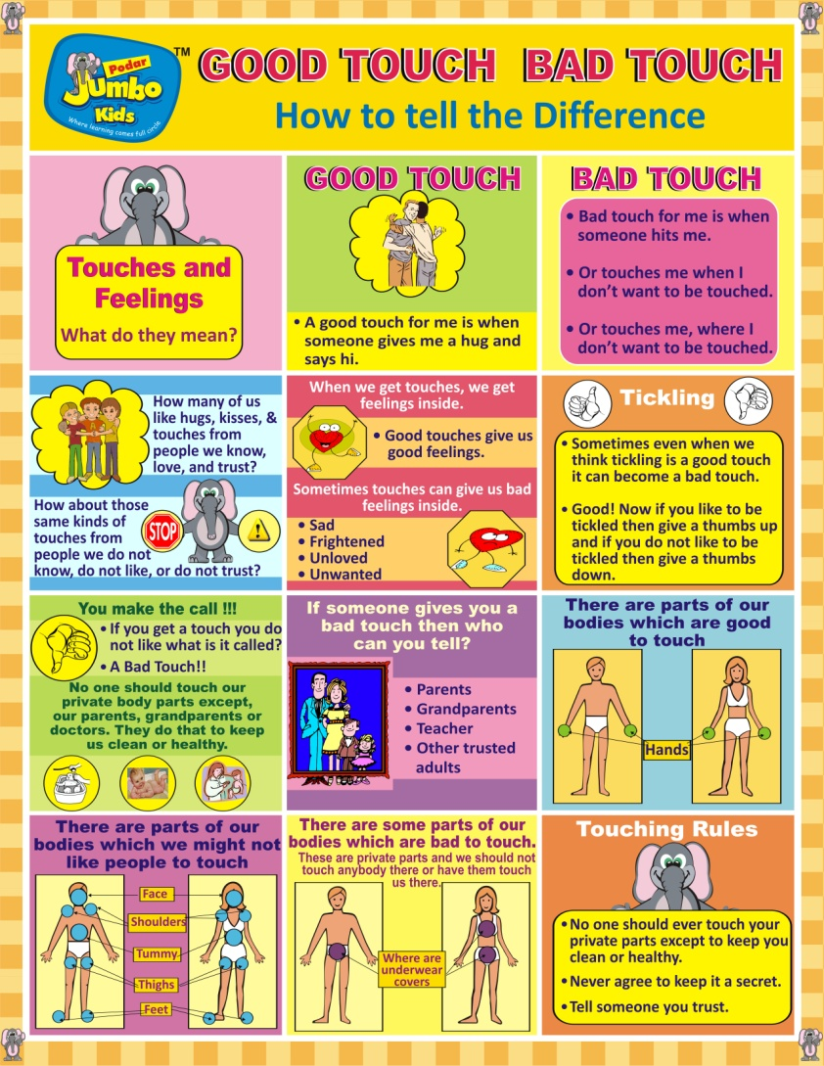
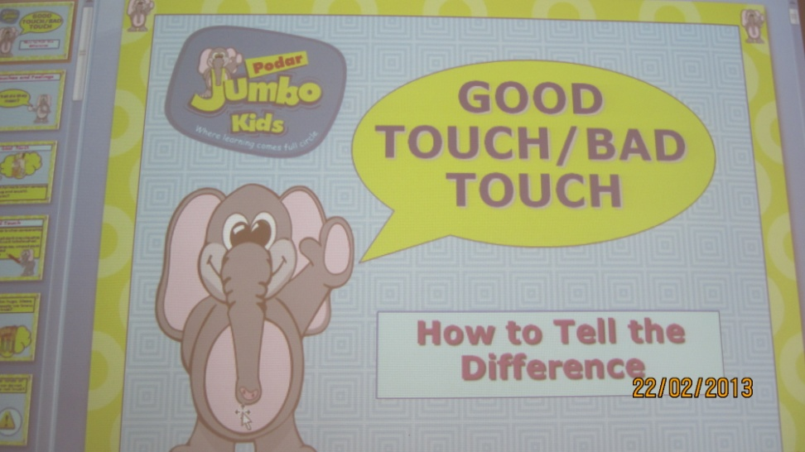
Teaching children about GOOD TOUCH - BAD TOUCH through posters and power points

Slide 32
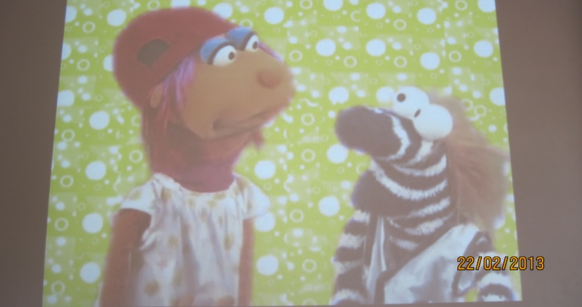
Reaching out to the community
We have made a child friendly video using muppets to talk to children about GOOD TOUCH- BAD TOUCH and show the same to parents and care givers so everyone is aware and alert about boundaries.

Slide 33
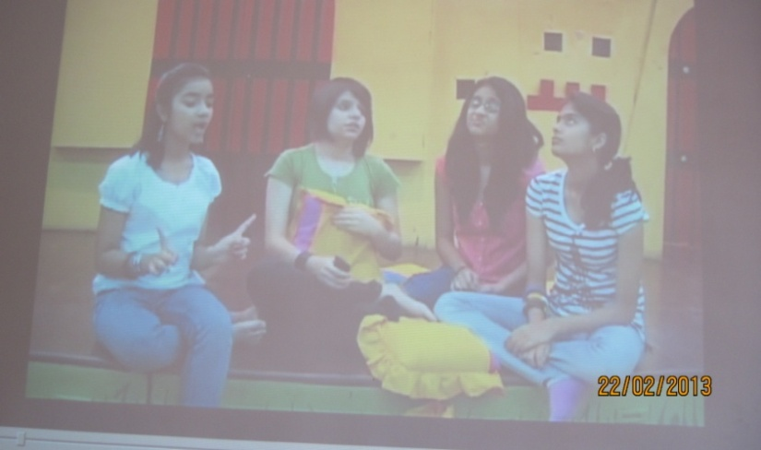
Reaching out to the community
We have made a video using teenagers to talk about the issue so that young adolescent girls at risk can be made more alert.
We go to housing societies and schools and show the video

Slide 34

Let touch never become trouble…
We have come out with a hard hitting book- a story about a boy and a girl who are abused. One in an urban school and one in a rural setting. This story book cum handbook for parents comes with a video that parents can use with kids.

Slide 35
Lip locking a new trouble on the horizon…
In many urban cities parents have adopted a habit of kissing their children on the lips.
This is leading to kids being comfortable with other adults kissing them on the lips too
This makes them an easy target for child abuse
To create awareness about this we created a video for parents and kids educating them about not lip locking with everyone.

Slide 36
PLEASE UNDERSTAND THE POINTS GIVEN IN THIS PRESENTATION TO ENABLE YOUR SCHOOL TO HANDLE CHILD SEXUAL ABUSE CASES CORRECTLY. swatipopat@podar.org

