Slide 1
WORKSHOP FOR SUPPORT STAFF
SAMPLE WORKSHOP TO UNDERSTAND WHAT ALL TO INCLUDE WHEN TRAINING SUPPORT STAFF

Slide 2
WHO ARE SUPPORT STAFF?
BAI/AYAH/MAUSHI
SECURITY GUARDS
PEONS
MALI/ GARDNER
BUS DRIVERS
BUS ATTENDANTS
NURSE
ANY OTHER

Slide 3
WHY SHOULD THEY BE TRAINED?
So that they are aware of the rules
And the consequences- Jail!
They are aware of what we expect them to do and not do.
There is clarity and no ambiguity.
They will also know that vigilance level is high here and will be more careful.

Slide 4
Explain to them…
That this training is not because we do not trust them.
But because we want to safeguard them.
We want them to be educated and careful.
We are training them because they may be involved in the care of children at some stage or the other and we want them to know what is appropriate/approved and inappropriate/not approved.

Slide 5
You will be touching children for your work…but carefully
In the toilet
In the bus
In the medical room
As a physical activity teacher (skating, balancing, etc.)
So should you stop touching children?
No. you just have to be careful to keep in mind the points we are teaching you.

Slide 6
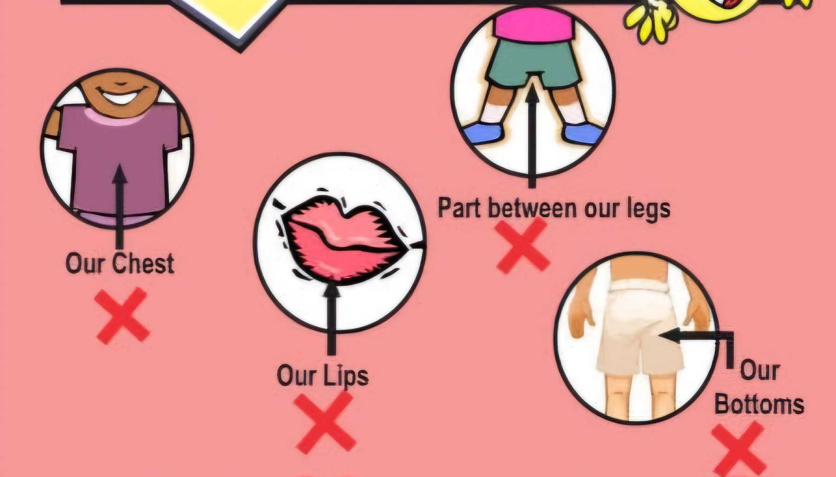
UNDERSTAND BAD TOUCH
DO NOT TOUCH CHILDREN IN THESE 4 PARTS
DO NOT ASK CHILDREN TO TOUCH YOU IN THESE 4 PARTS
LETS NAME THEM

Slide 7
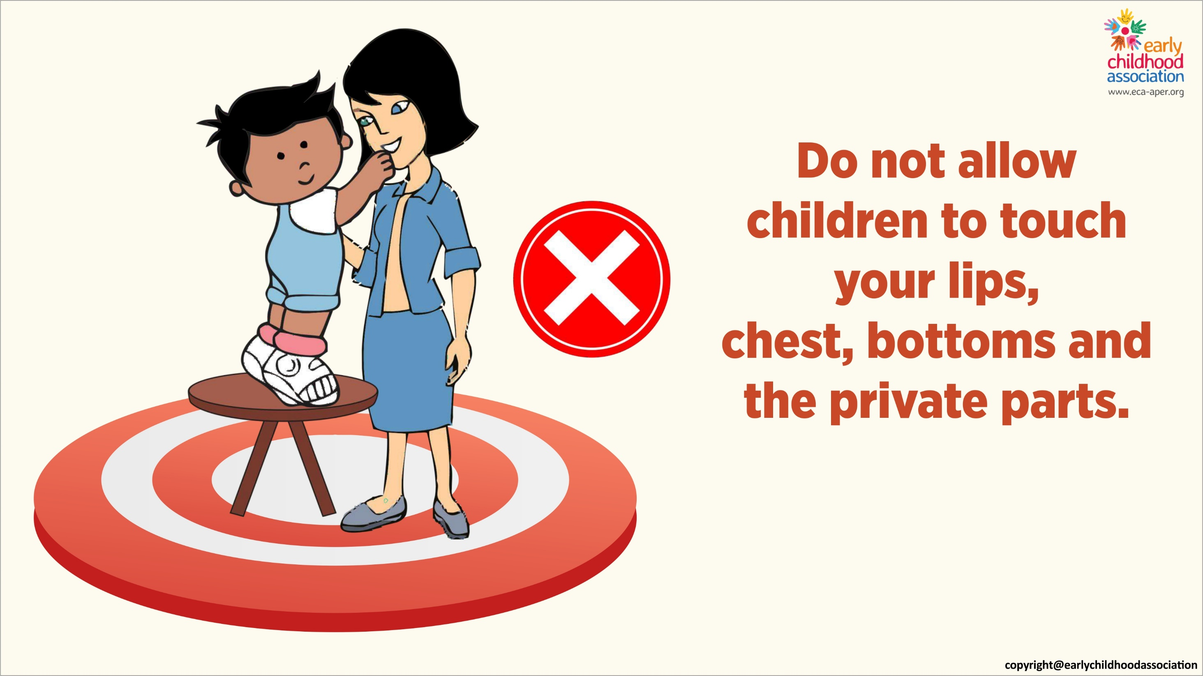

Slide 8


Slide 9
SO HOW DO I WASH A CHILD IN THE TOILET
While cleaning be quick and professional
Don’t ‘linger’ your touch
Don’t pinch
Don’t comment or tease
And most importantly talk to the child about what you are doing.
I am taking your pants down so that I can clean you.
I am now going to wash your bum, I will be gentle
I am now wiping because you are wet.
I am now putting your pants up

Slide 10
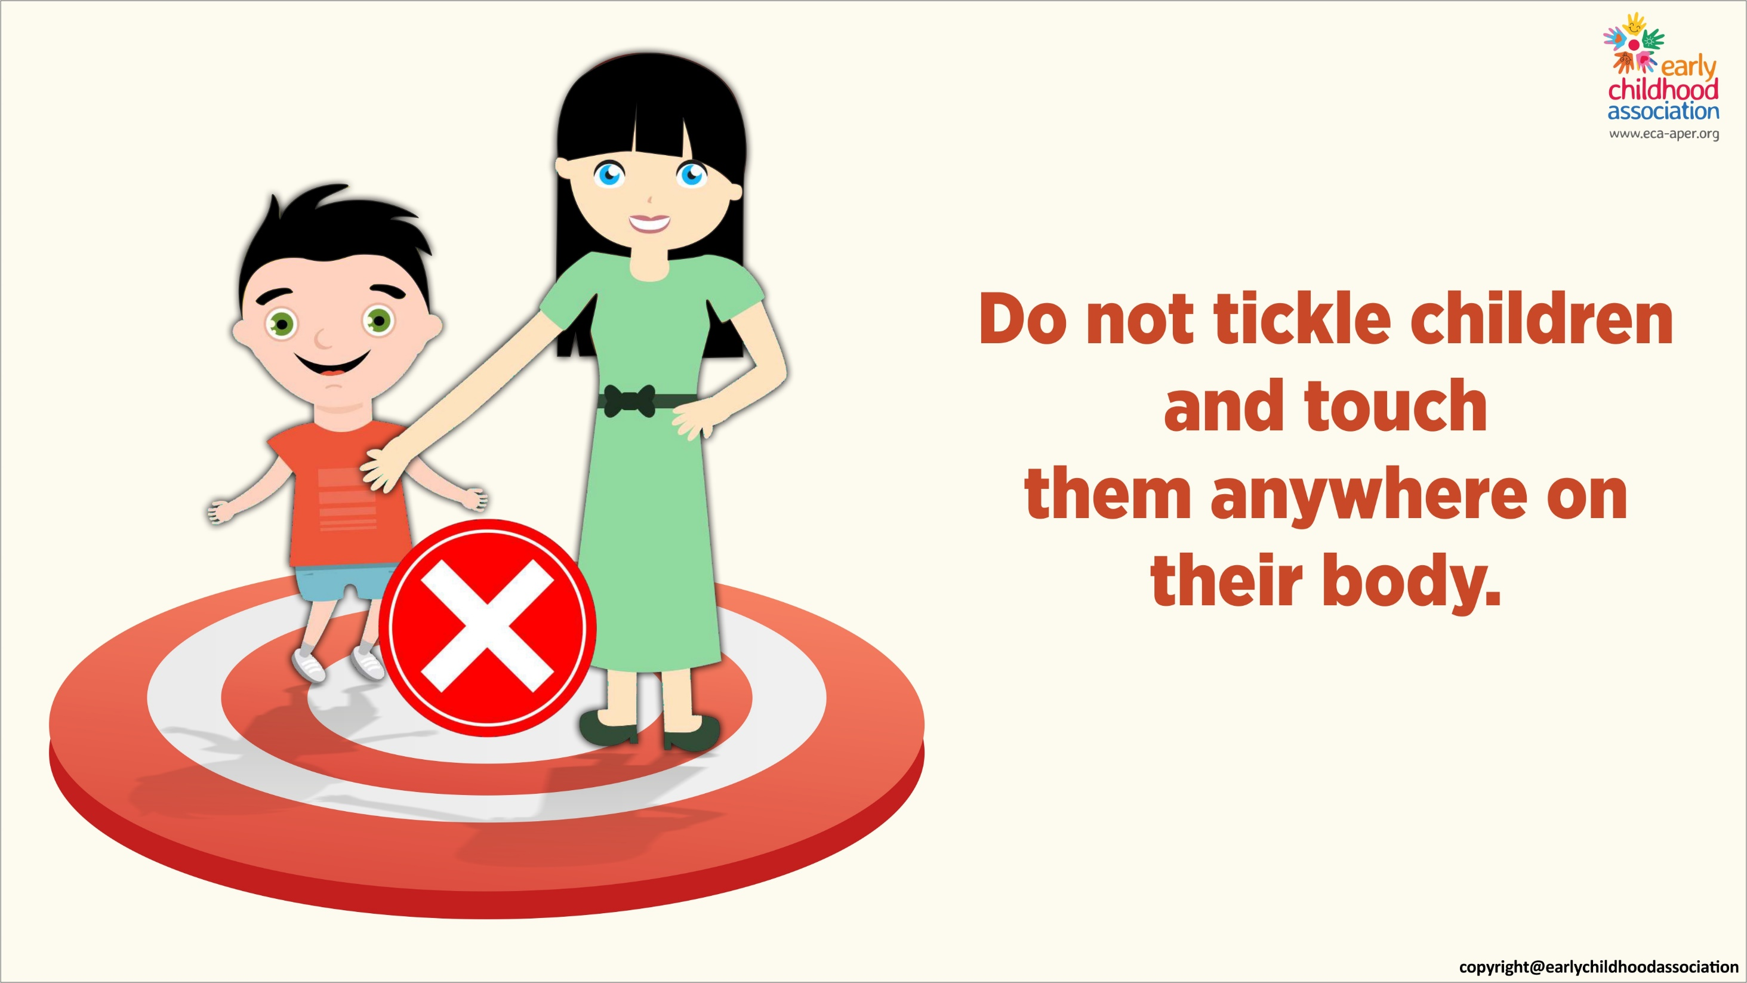

Slide 11
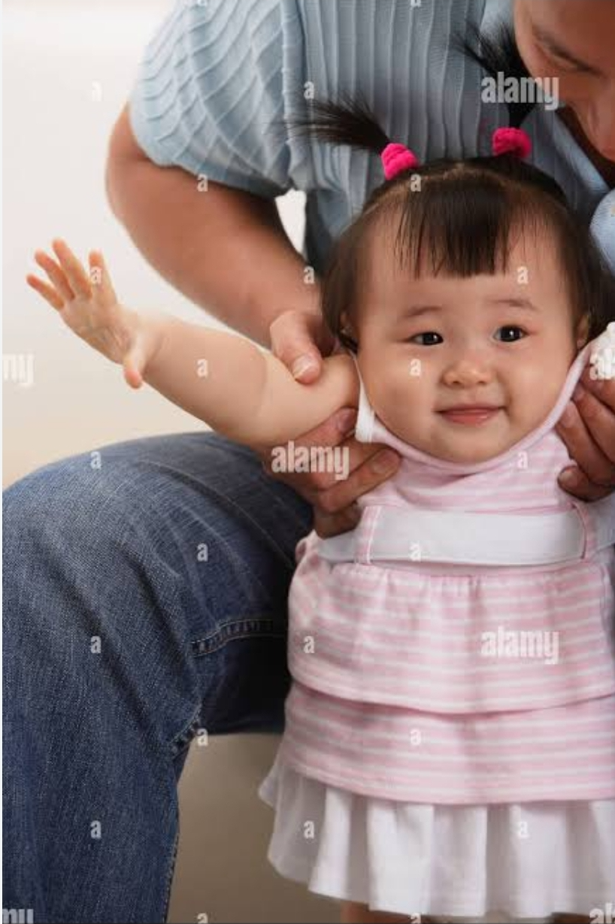
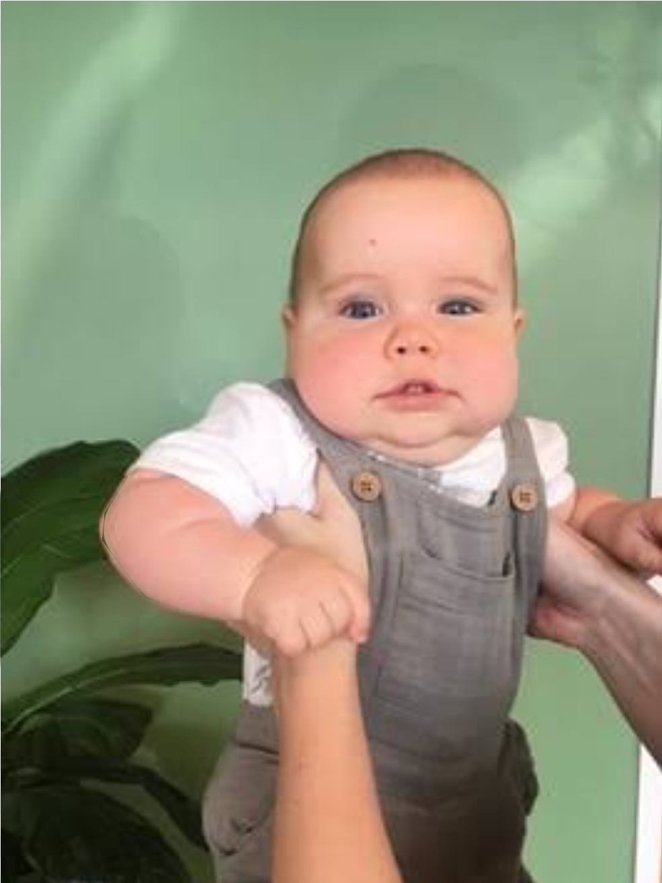
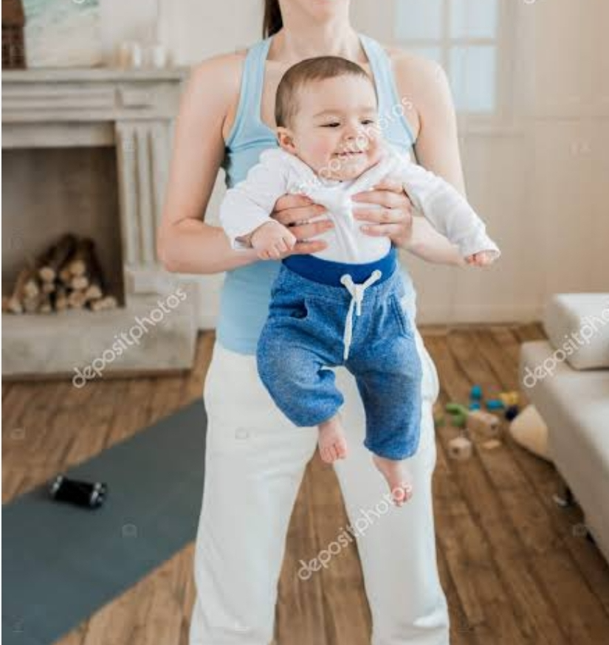
Why you are lifting a child, which one is right?

Slide 12
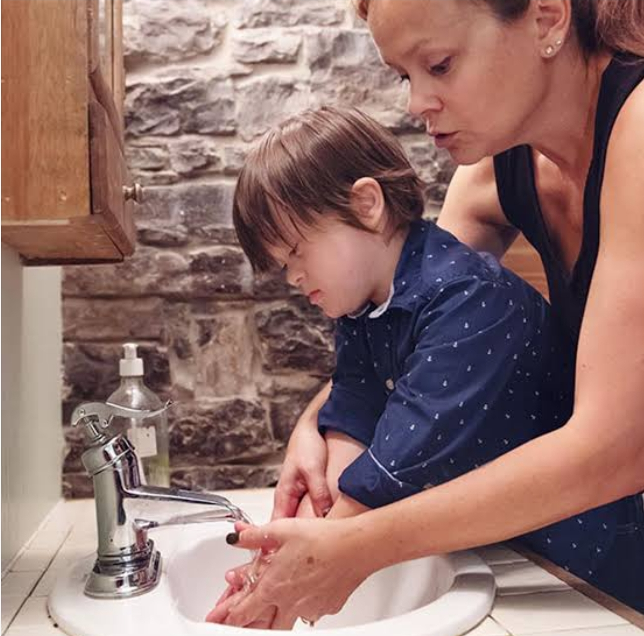
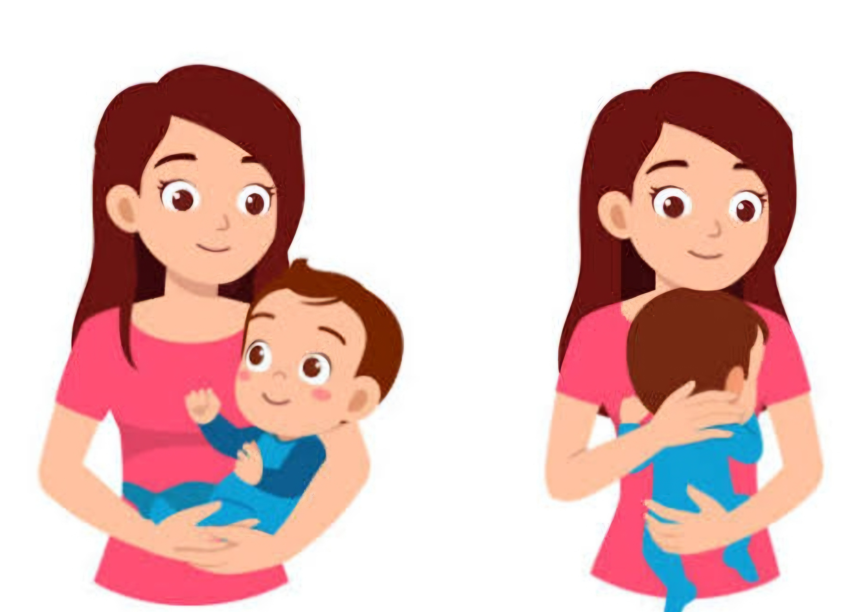
Don’t get too close to the children, keep safe distance

Slide 13


