Slide 1



ProSocial Values Community International Conference
Online Multiplier Event
STEAM AND
DIVERGENT MINDS
Dr. Swati Popat Vats
President
Podar Education Network
Early Childhood Association
India
The information and views set out in this document are those of the author(s) and do not necessarily reflect the official opinion of the European Union. Neither the European Union institutions and bodies nor any person acting on their behalf may be held responsible for the use which may be made of the information contained therein.
copyright@swatipopat@podar.org

Slide 2

What is S.T.E.A.M?
Science involves asking questions, exploring, and discovering new things.
Technology is the use of tools or equipment. They can be simple or complex.
Engineering is designing and constructing new structures.
Art is all about emotions, creativity, language.
Mathematics includes counting, matching, rhythms, and sorting.
copyright@swatipopat@podar.org

Slide 3
What is divergent thinking?
Divergent thinking is a thought process or method used to generate creative ideas by exploring many possible solutions.
It typically occurs in a spontaneous, free-flowing, "non-linear" manner, such that many ideas are generated in an emergent cognitive fashion.
copyright@swatipopat@podar.org

Slide 4
Examples of divergent thinking include:
Wondering how many ways you can use a fork.
Showing a person a photo and asking them to create a caption for the photo.
Giving a child a stack of blocks and asking them to see how many shapes they can create with those blocks.
copyright@swatipopat@podar.org

Slide 5
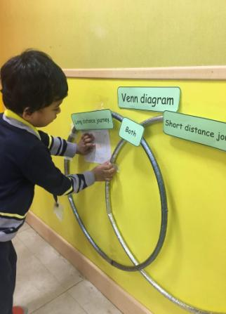
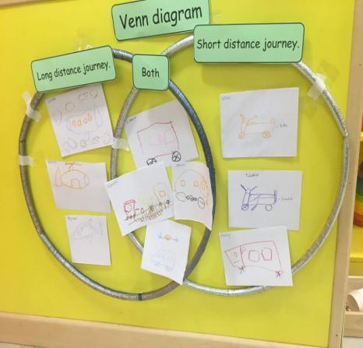
Venn diagrams is Divergent thinking
copyright@swatipopat@podar.org

Slide 6
PLAY SCHEMAS-PIAGET’S SCHEMAS
(juhi this is engineering)
copyright@swatipopat@podar.org

Slide 7
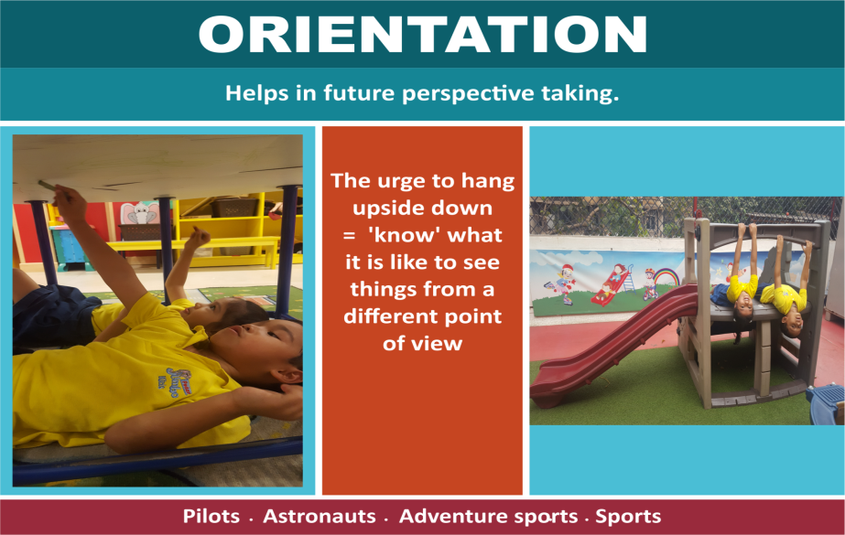
copyright@swatipopat@podar.org

Slide 8
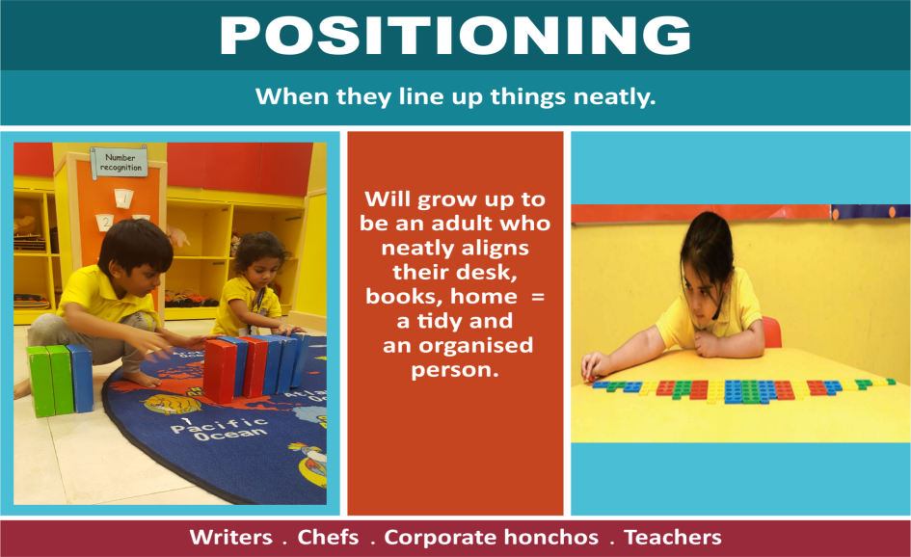
copyright@swatipopat@podar.org

Slide 9
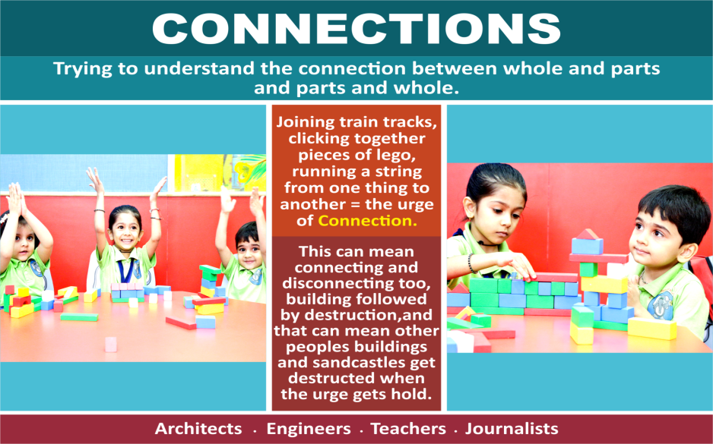
copyright@swatipopat@podar.org

Slide 10
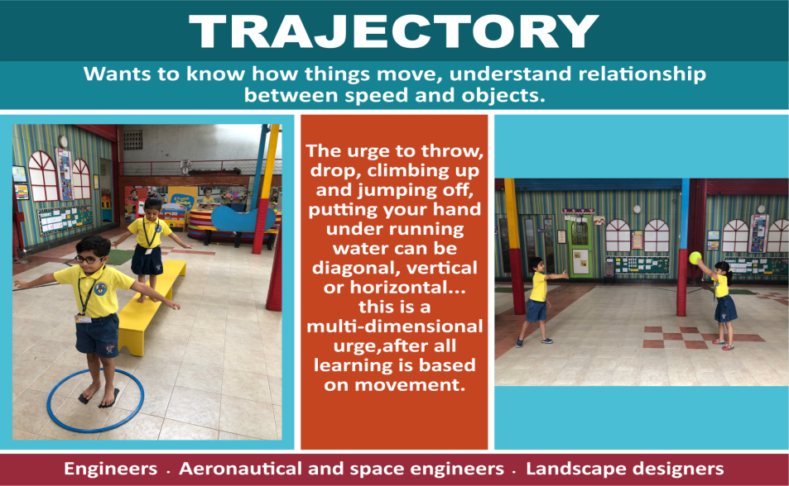
copyright@swatipopat@podar.org

Slide 11
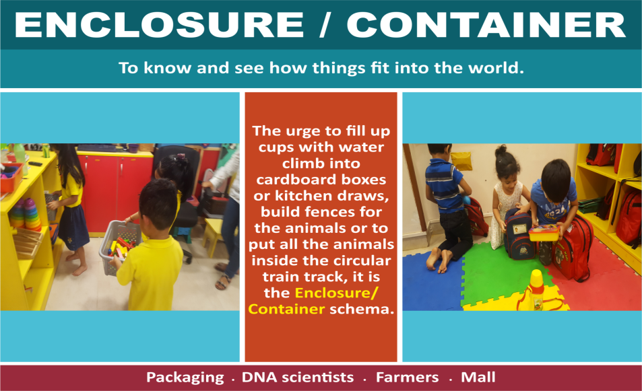
copyright@swatipopat@podar.org

Slide 12
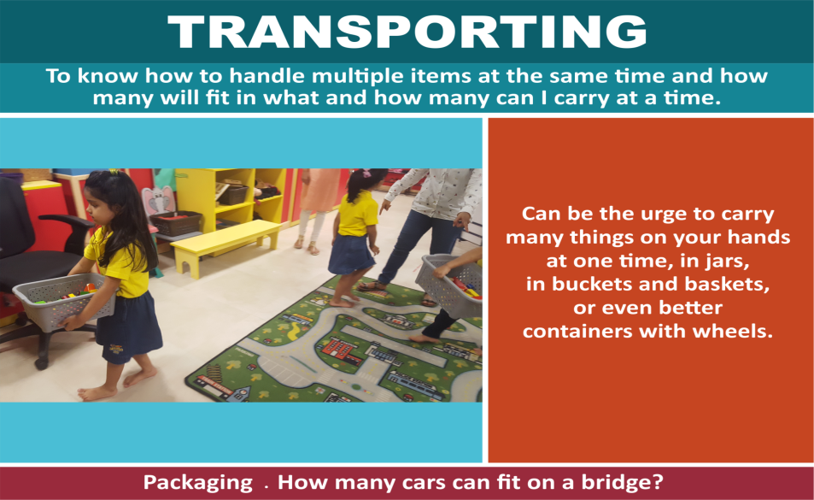
copyright@swatipopat@podar.org

Slide 13
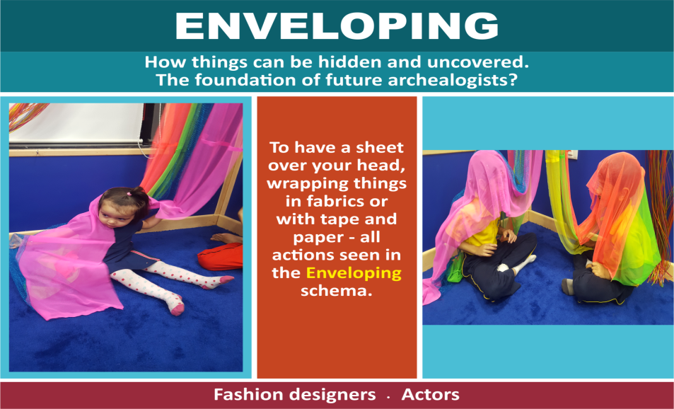
copyright@swatipopat@podar.org

Slide 14
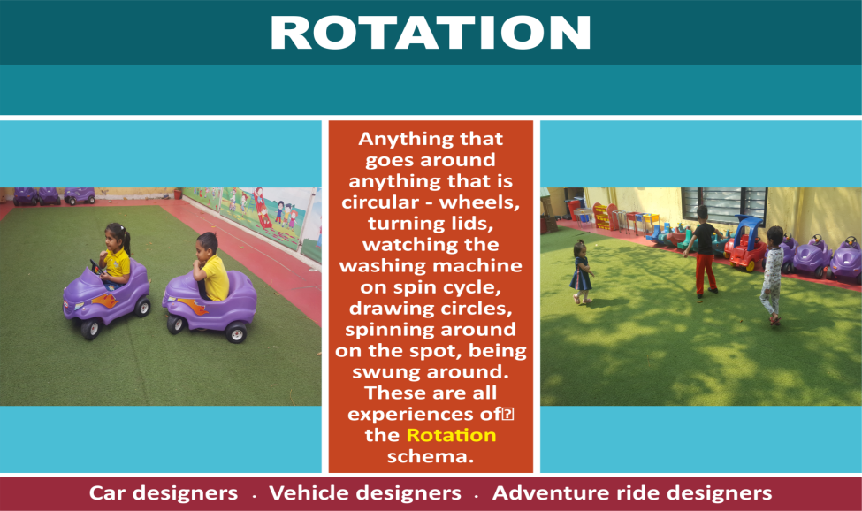
copyright@swatipopat@podar.org

Slide 15
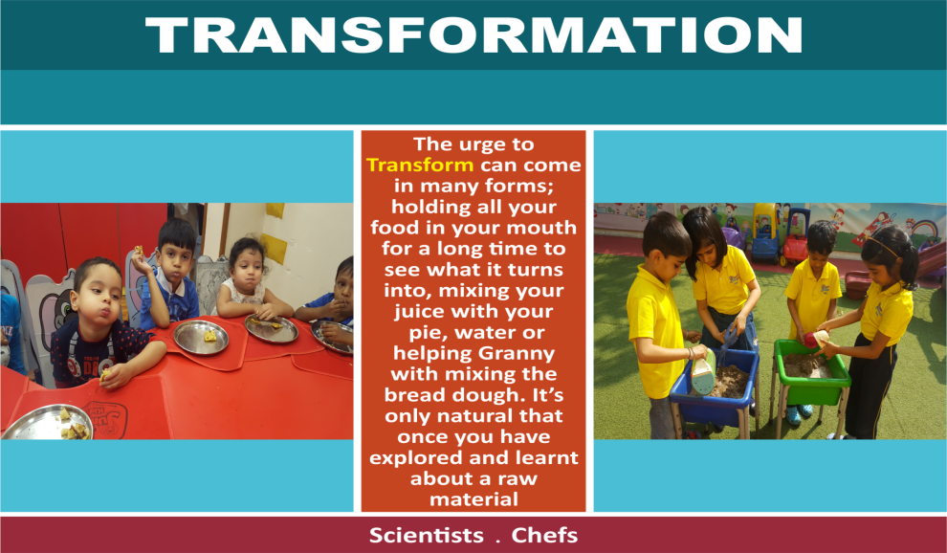
copyright@swatipopat@podar.org

Slide 16
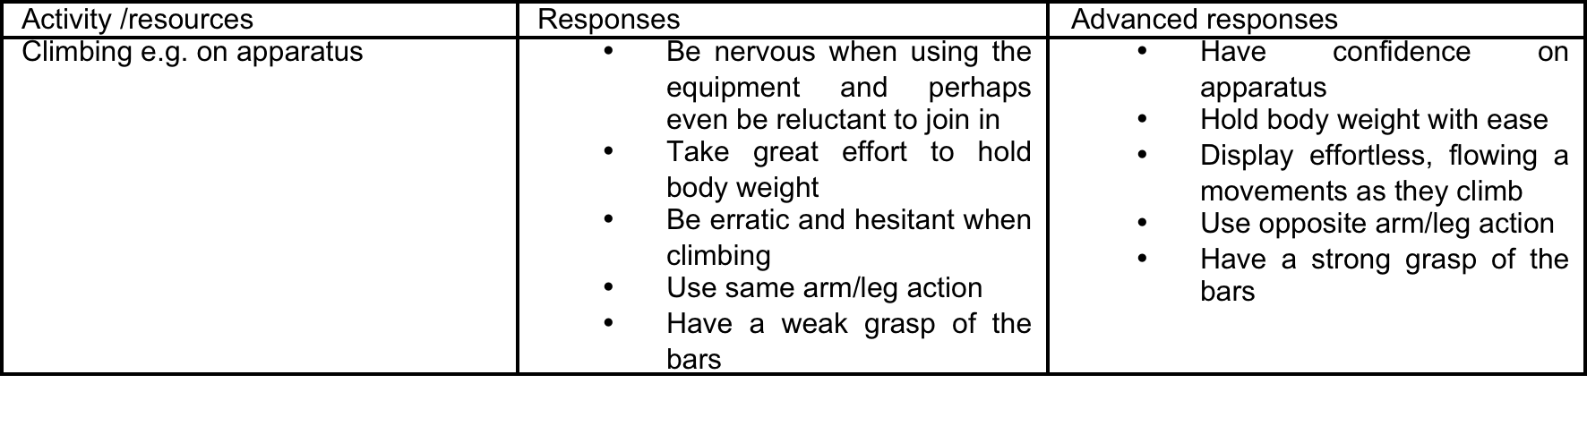

Slide 17
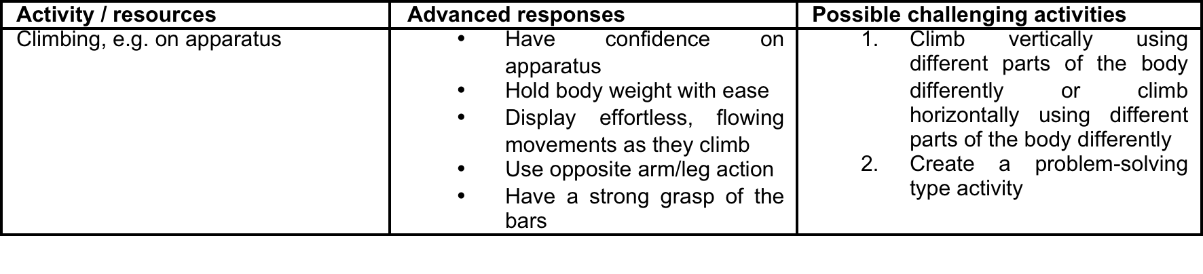

Slide 18
Suggest challenges- age appropriate
Right hand and left leg only
Left hand and right leg only
Different kinds of grips
Add a further challenge by linking up two children with a short length of rope, like mountain climbers, and ask them to reach the top of the island together. This activity would need close adult supervision.

Slide 19
Challenge with jigsaws…
with a greater number of pieces,
physically smaller pieces,
no picture to copy,
turn the jigsaw pieces over so shape is the only clue, etc.
Combining two or more jigsaws’ pieces together can add challenge and mean that the children have to complete more than one puzzle at a time.

Slide 20
Creating jigsaws..
Give the children a blank piece of paper and ask them to cut it into a particular number of pieces and in particular shapes; e.g. 12 pieces – four squares, four triangles and four rectangles – and then piece it together again.
The above can be repeated but first the children can draw a picture on the paper before cutting it or print out a picture they have taken and make it into jigsaw.

Slide 21
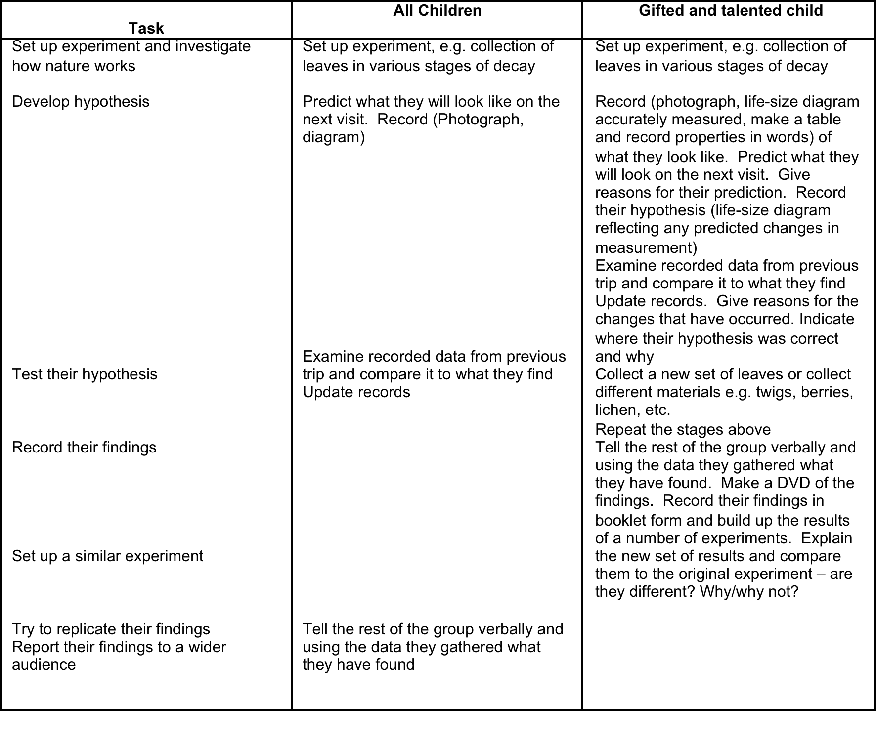

Slide 22
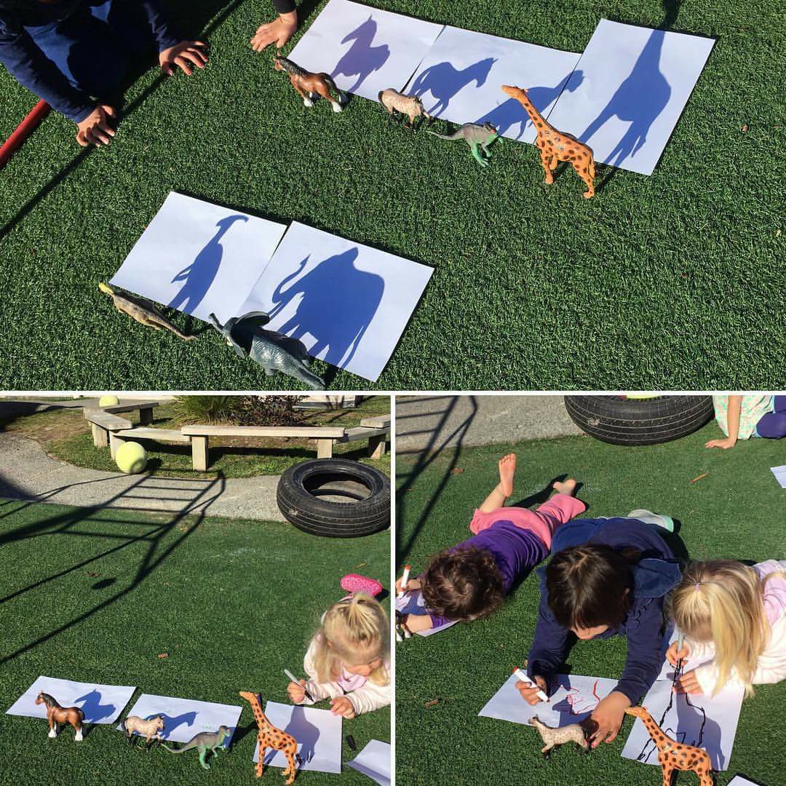

Slide 23
S.T.E.A.M During story telling…
Show a picture or a story- predict what will happen next.
Show a picture and ask them about the sounds and smells that could be experienced by the people in the picture
Goldilocks and the 3 bears- sight, taste, touch, sound , smell
Involve words to do with STEAM-
S- talk about the weather
T- talk about a watch or did not have binoculars
E- describe the building or other structures
A- involve descriptive vocabulary
M- add math, 4 flowers, one wolf, 10 items in the basket

Slide 24
S.T.E.A.M During rhyme sessions
Water cycle song- S
Song on traffic lights- T
Song on bridges, buildings- E
Songs that talk about words, phrases- A
Songs on shapes, colours, numbers- M

Slide 25
TALK IN S.T.E.A.M introduce words that help them describe what they see and feel, and don't dumb it down.
Speckled, shiny, bumpy, spongy, thorny, jagged, scaly.
Use spatial language that helps kids think more clearly about directions and spatial relationships.
Above, below, between, inside, straight, curved, tiny, huge, thin, thick, edge, side.
And call attention to words that describe the movements, processes, and forces they experience.
Twist, sprinkle, rustle, melt, float, sink, current, flow.

Slide 26
S.T.E.A.M During story telling…
Show a picture or a story- predict what will happen next.
Show a picture and ask them about the sounds and smells that could be experienced by the people in the picture
Goldilocks and the 3 bears- sight, taste, touch, sound , smell
Involve words to do with STEAM-
S- talk about the weather
T- talk about a watch or did not have binoculars
E- describe the building or other structures
A- involve descriptive vocabulary
M- add math, 4 flowers, one wolf, 10 items in the basket
copyright@swatipopat@podar.org

Slide 27
S.T.E.A.M During rhyme sessions
Water cycle song- S
Song on traffic lights- T
Song on bridges, buildings- E
Songs that talk about words, phrases- A
Songs on shapes, colours, numbers- M
copyright@swatipopat@podar.org

Slide 28
TALK IN S.T.E.A.M
introduce words that help them describe what they see and feel, and don't dumb it down.
Speckled, shiny, bumpy, spongy, thorny, jagged, scaly.
Use spatial language that helps kids think more clearly about directions and spatial relationships.
Above, below, between, inside, straight, curved, tiny, huge, thin, thick, edge, side.
And call attention to words that describe the movements, processes, and forces they experience.
Twist, sprinkle, rustle, melt, float, sink, current, flow.
copyright@swatipopat@podar.org

Slide 29
S.T.E.A.M is COGNITIVE FLEXIBILITY
When we involve steam in our teaching-learning plans, we are training young brains for cognitive flexibility.
The brain has to adapt to looking at the same thing but differently .
At a higher level steam it is about divergent thinking
copyright@swatipopat@podar.org

Slide 30
Froebel the father of Kindergarten
Promoted divergent thinking in the 3 ways his ‘gifts’ were used…
copyright@swatipopat@podar.org

Slide 31
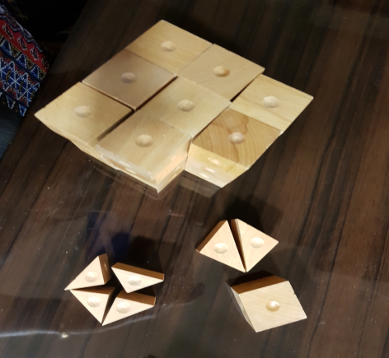
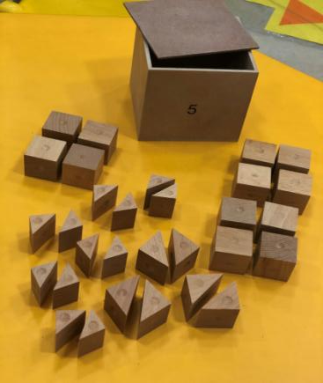
FROEBEL Gift Five: Cubes & Triangular Prisms
copyright@swatipopat@podar.org

Slide 32
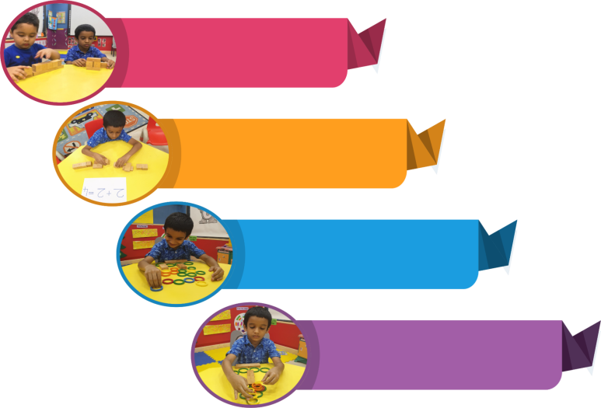
Observe - Understand - Design
Froebel designed 3 different ways to play with the gifts.
Forms of life-
Observe
Forms of knowledge - Understand
Forms of beauty -Design
“Always use every piece and modify but never destroy a design”- modify an existing design in stages to arrive at the new design or concept.
copyright@swatipopat@podar.org

Slide 33
Creativity is deemed as an integral part of twenty first century skills
CREATIVITY= DIVERGENT THINKING
=
STEAM
copyright@swatipopat@podar.org

Slide 34
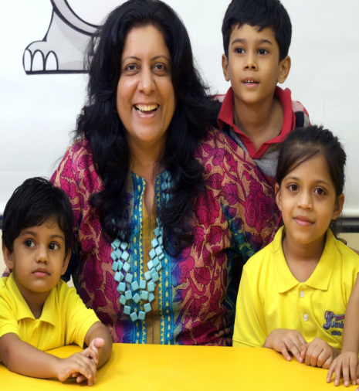
Dr. Swati Popat Vats
President
Podar Education Network
www.jumbokids.com
President
Early Childhood Association and
Association for Primary Education and Research
www.eca-india.org
Contact me on-
swatipopat@podar.org
Or whatsapp me on
+91 7506639870
copyright@swatipopat@podar.org

