Slide 1






Integrated Classroom Strategies- Teacher- Led Activities

Slide 2
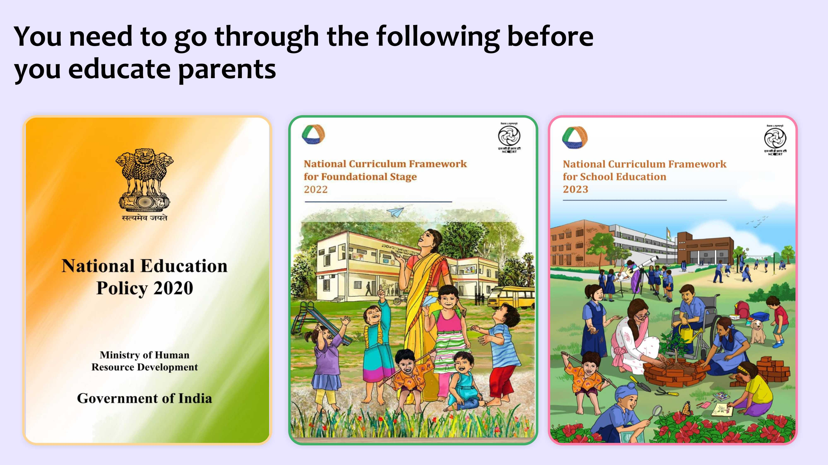

Slide 3
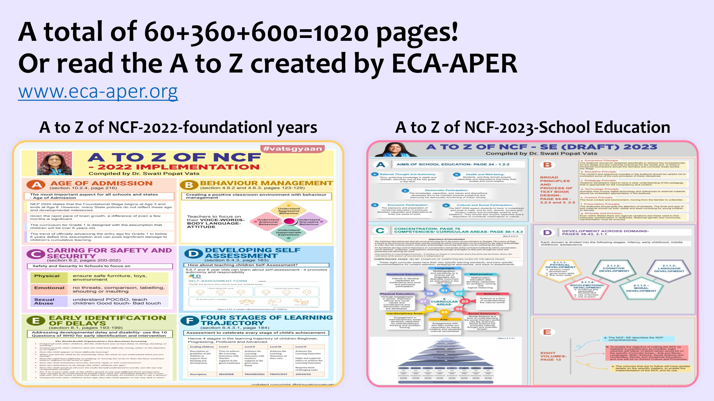

Slide 4
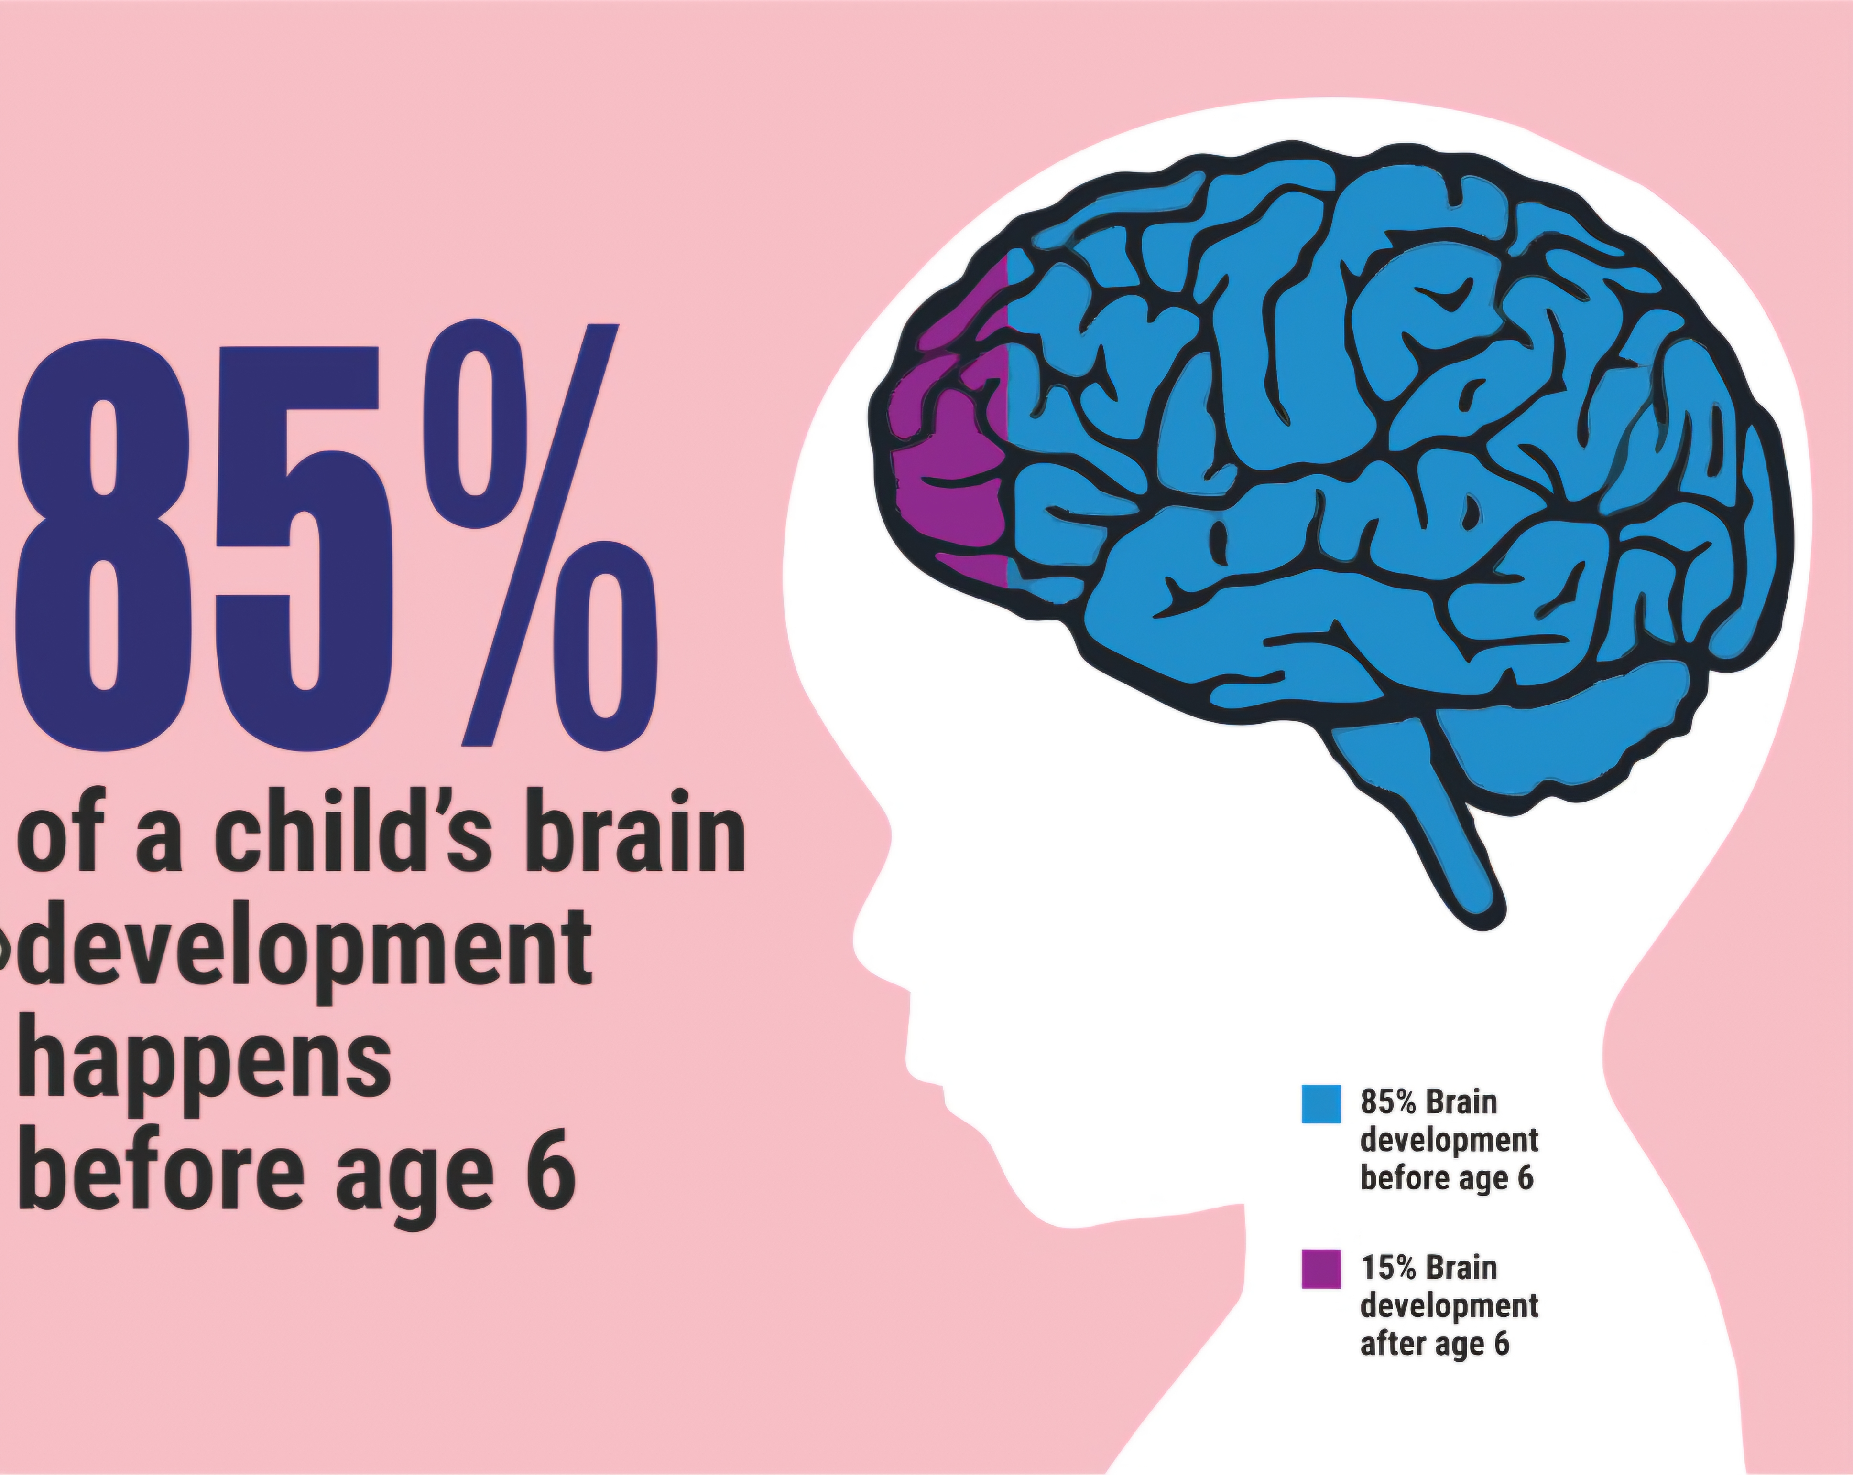

Slide 5
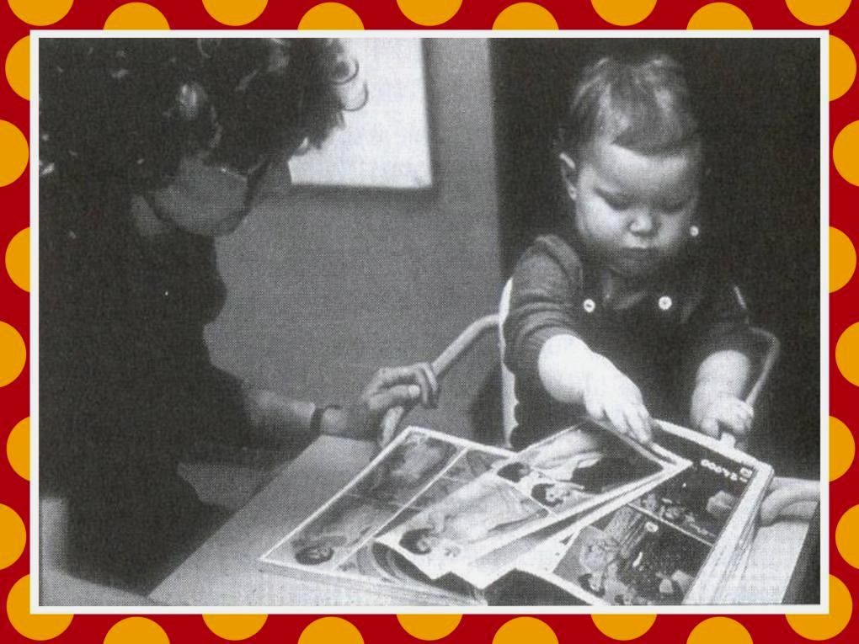
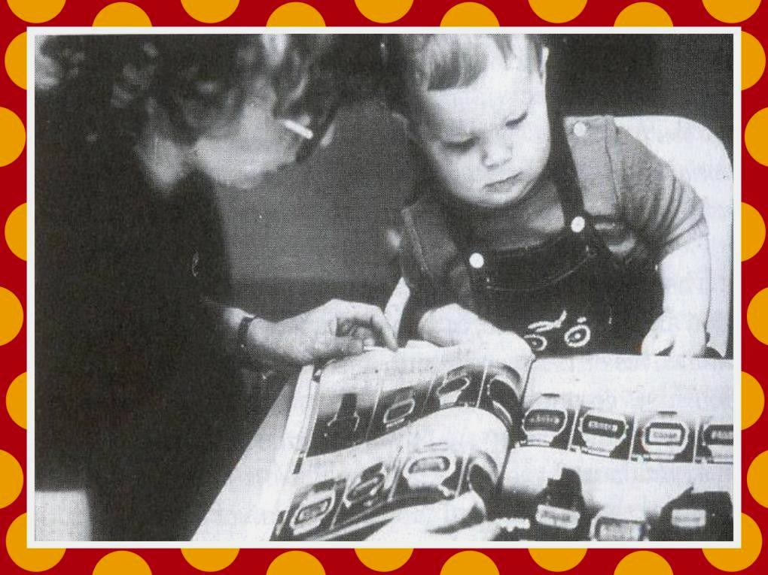
copyright@swatipopat@podar.org

Slide 6
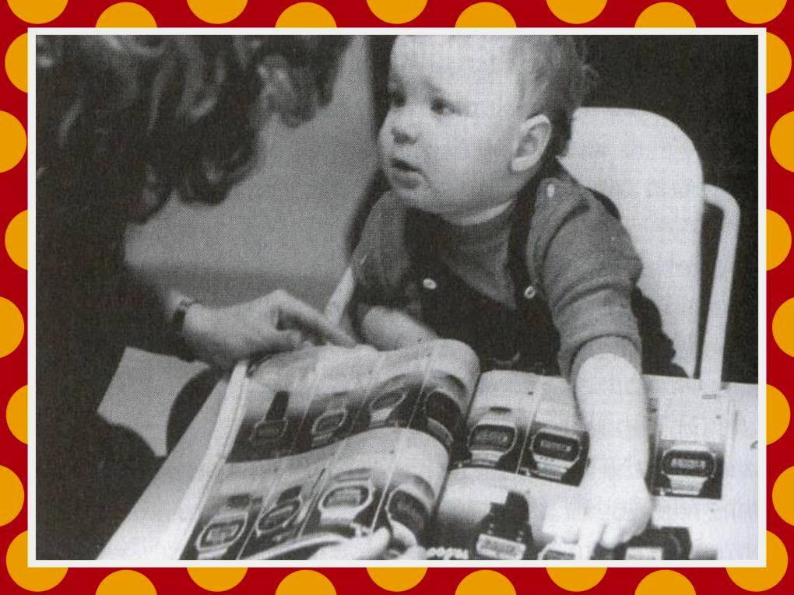
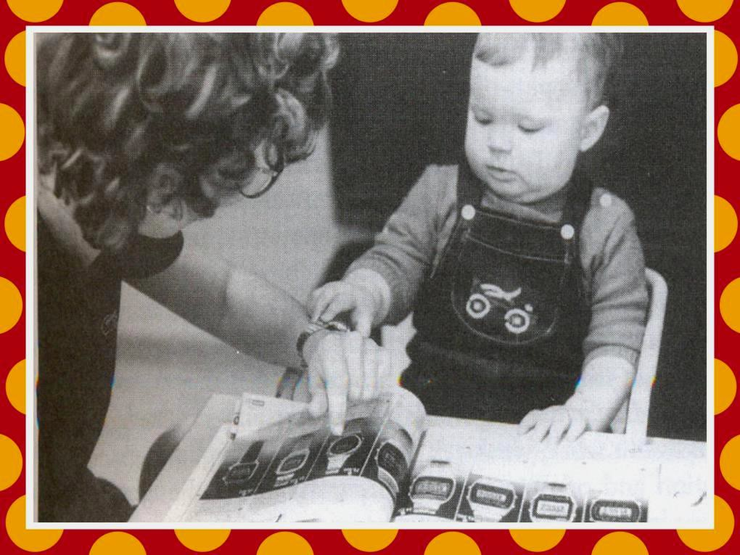
copyright@swatipopat@podar.org

Slide 7
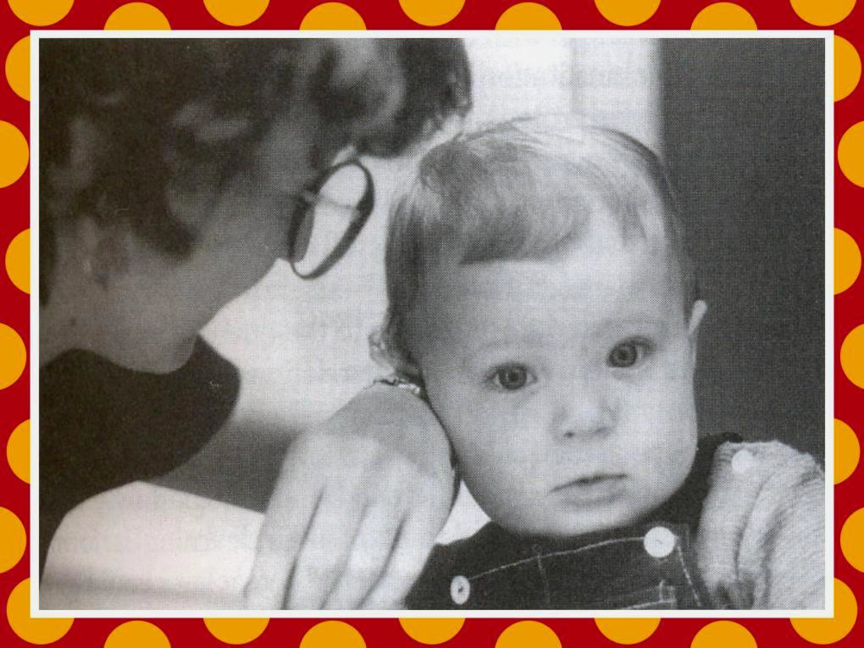

Slide 8
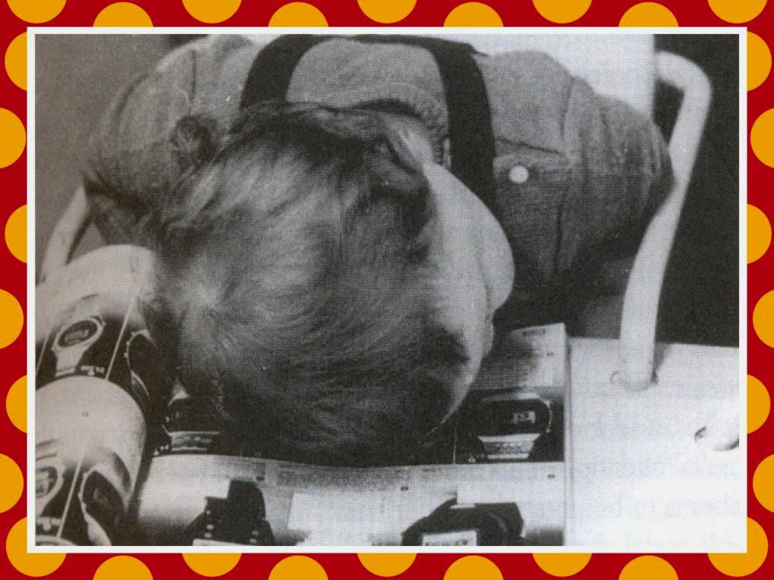

Slide 9


Slide 10
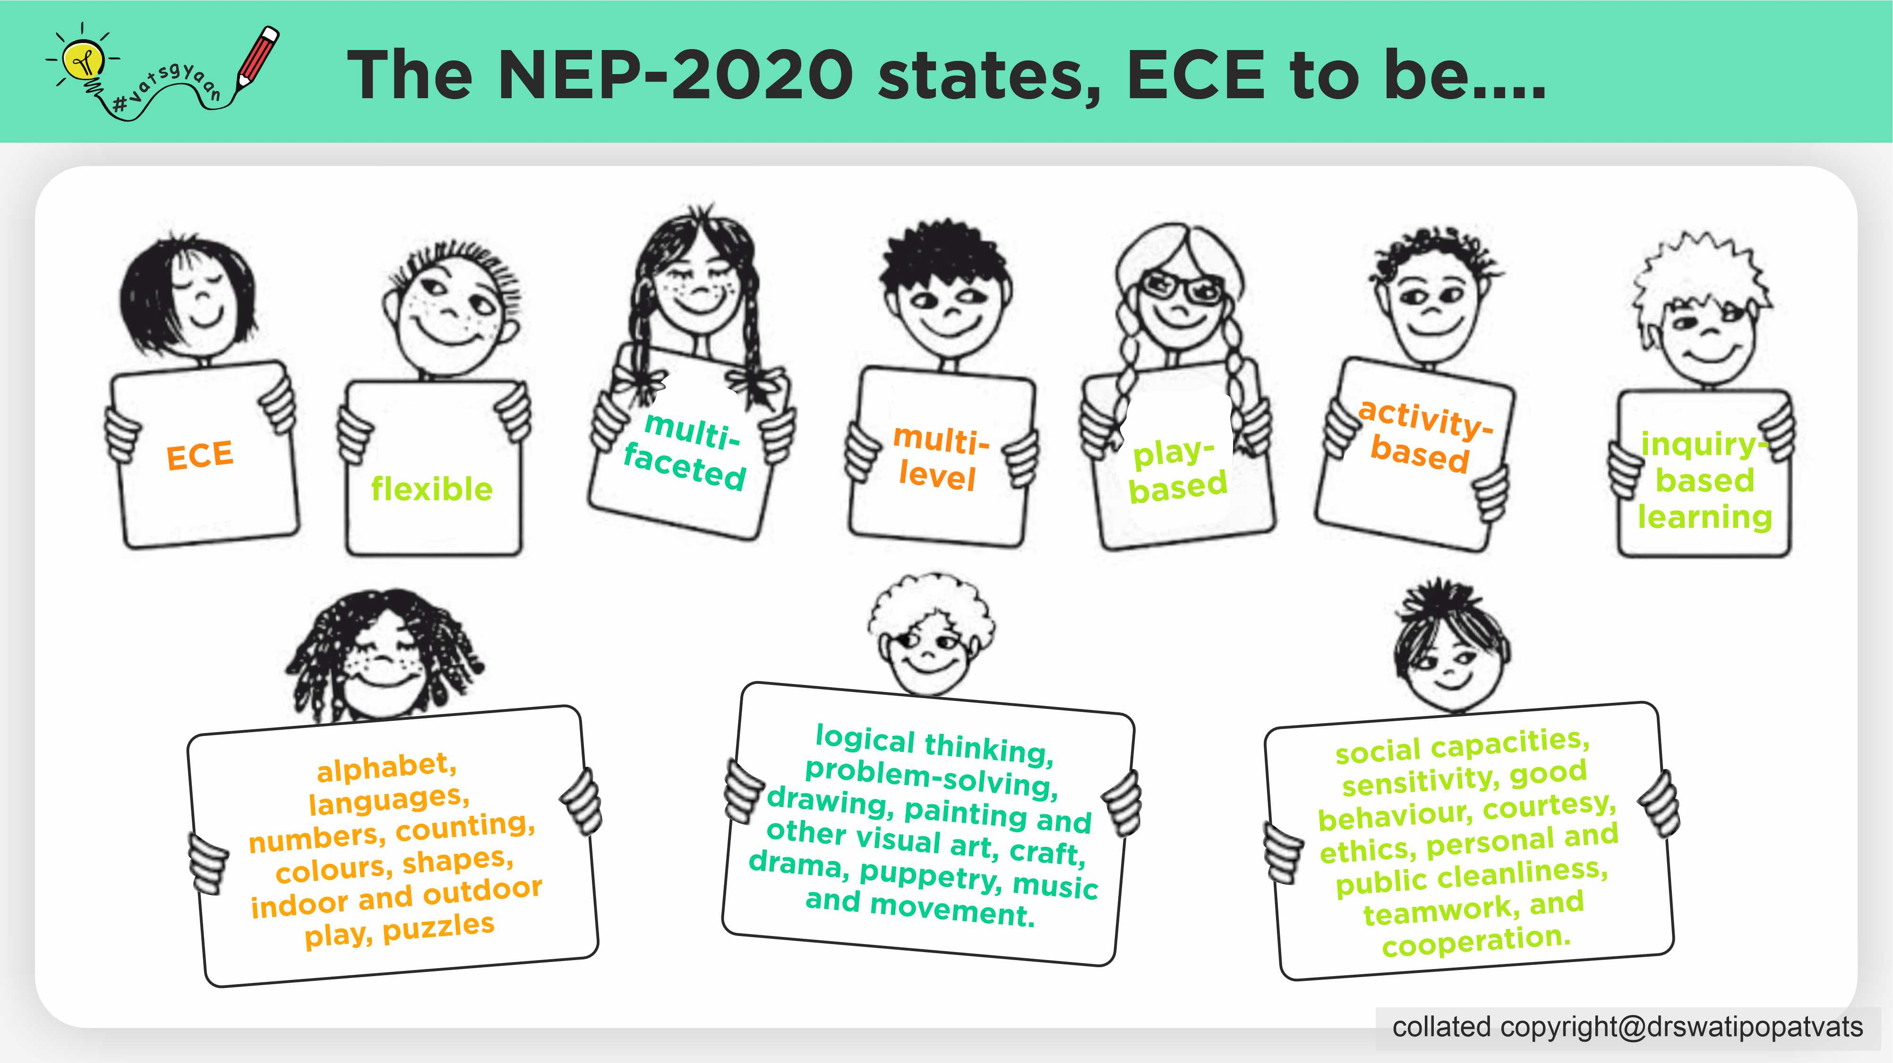

Slide 11
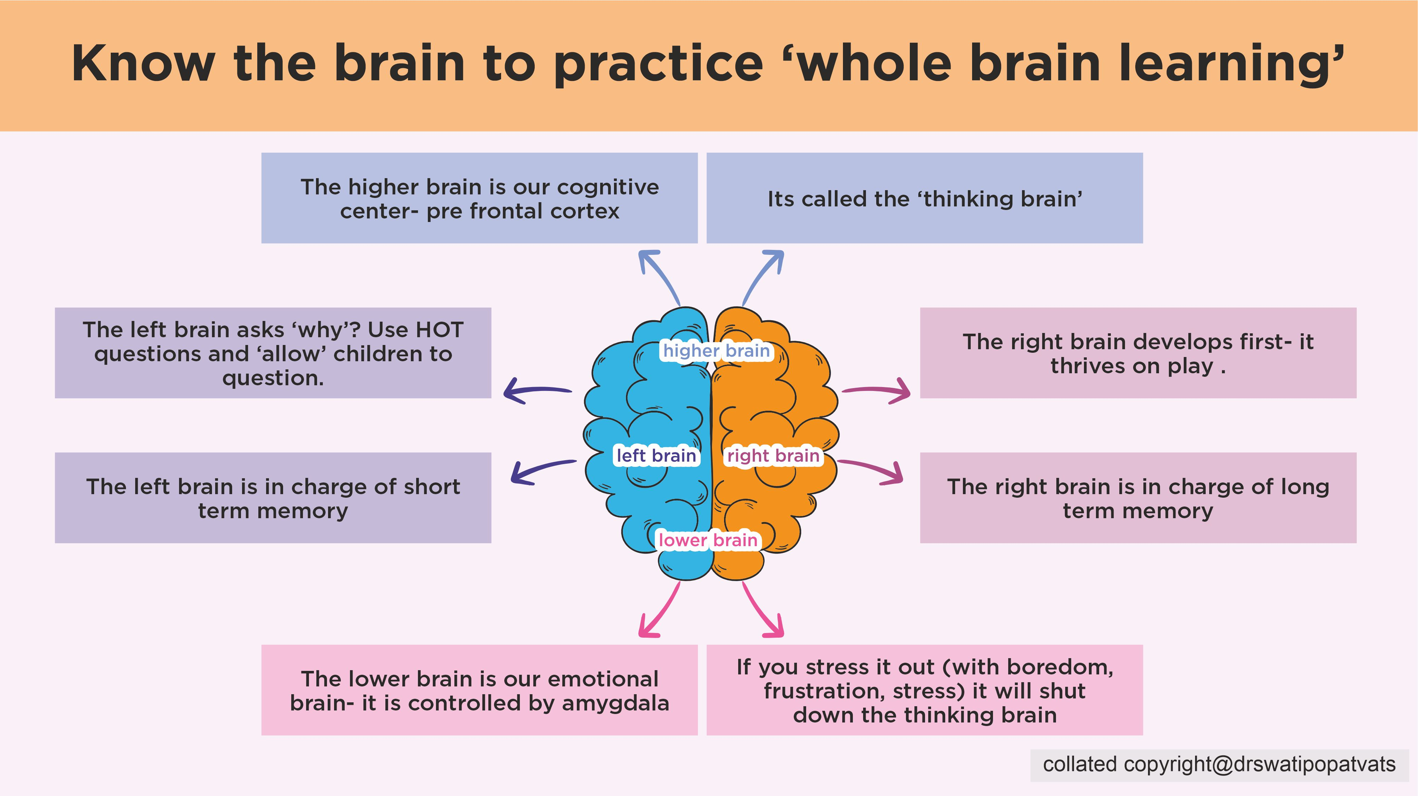

Slide 12
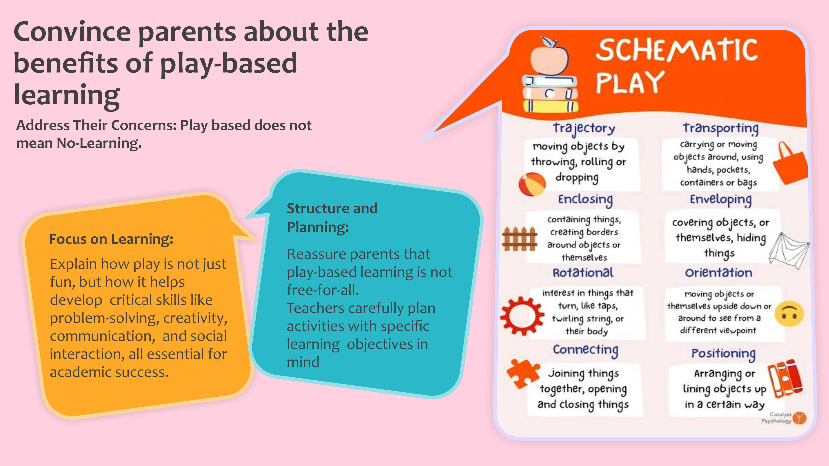

Slide 13
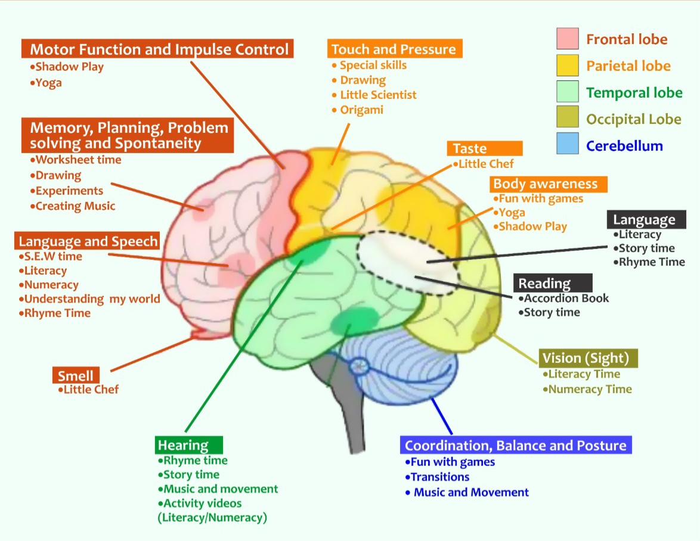

Slide 14
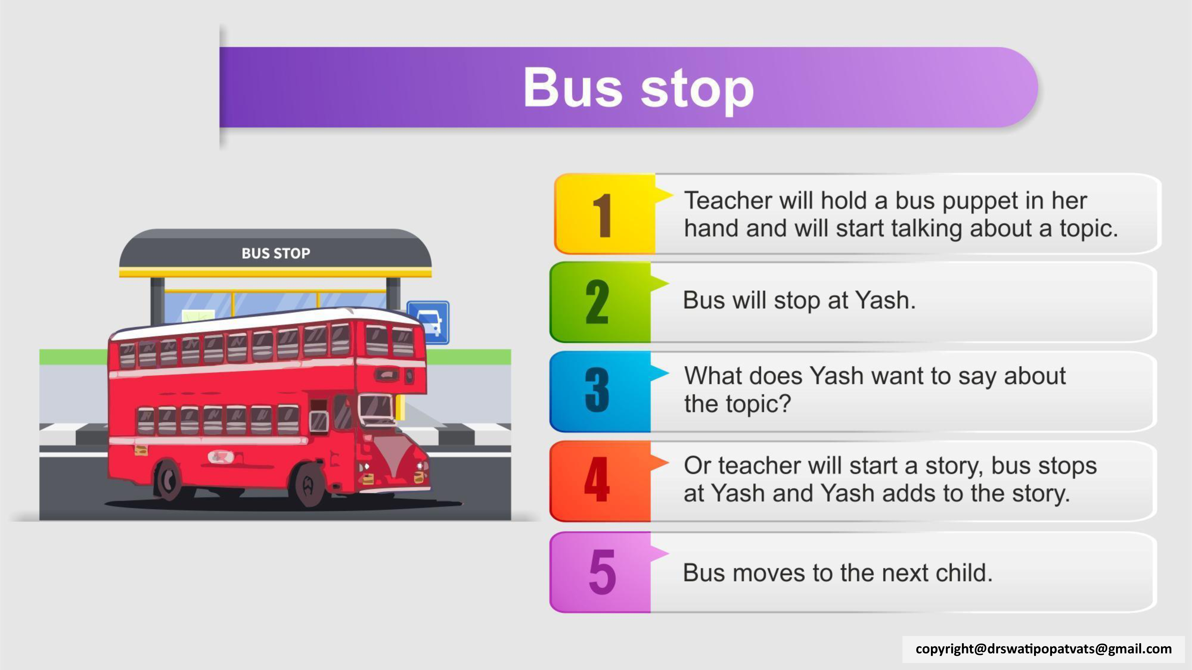






Bus Stop
In this activity your child will develop language, thinking and social skills.
Parent will hold a bus puppet in her hand and will start talking about a topic
Bus will stop at Yash.
What does Yash want to say about the topic?
Or Parent will start a story, bus stops at Yash and Yash adds to the story.
Bus moves to the next family member.

Slide 15
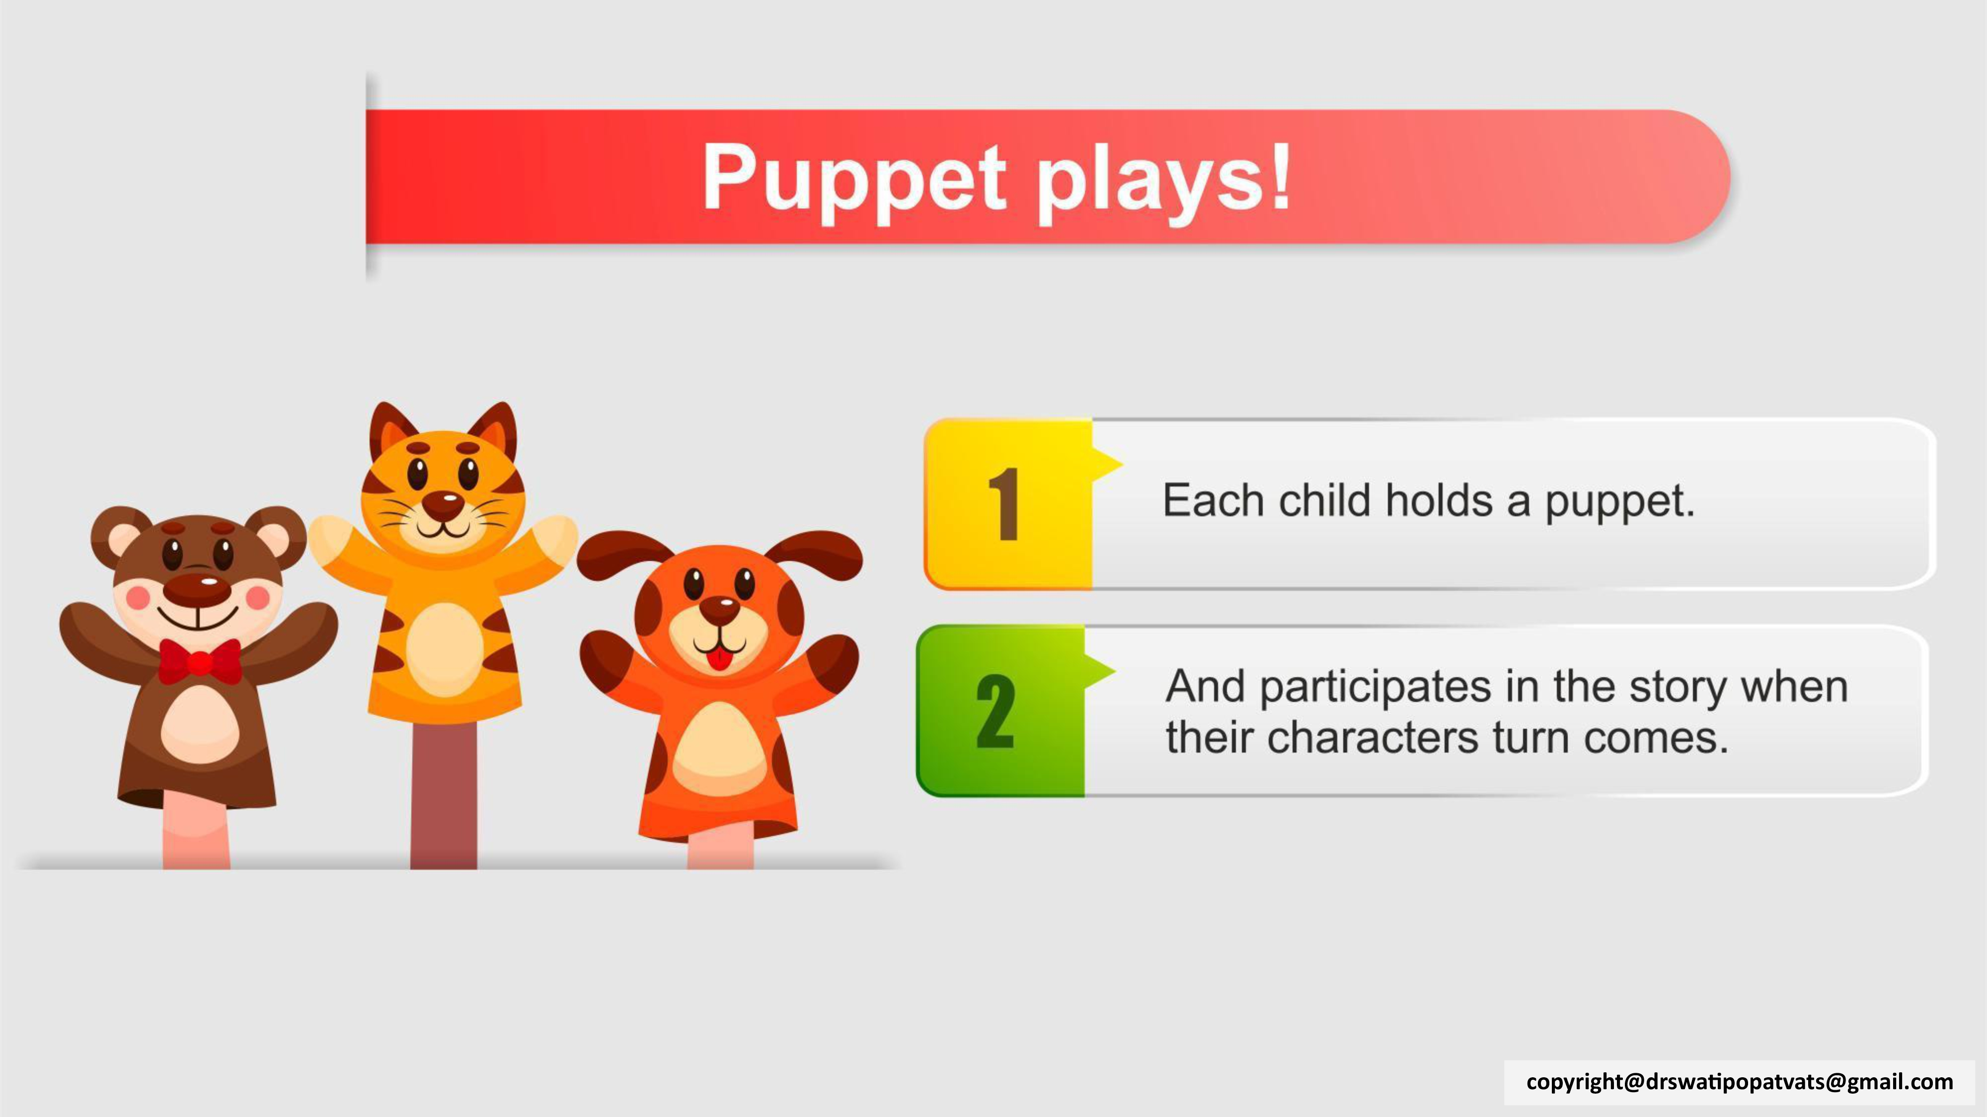



Puppet Plays!
In this activity your child will learn how to wait for their turn, it also develops language and memory skills
Each family member holds a puppet or toy that represents character's of a story
And participates in the story when their character's turn comes.

Slide 16
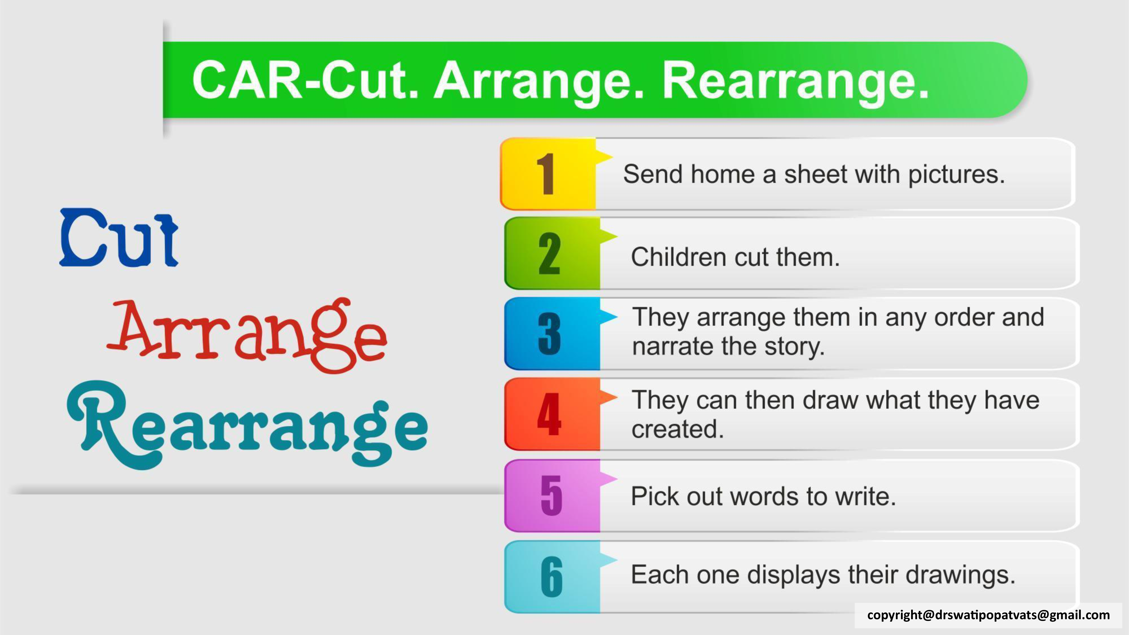

C.A.R- Cut, Arrange, Rearrange
in this activity your child will nurture fine motor skills required for writing and learn to think, and connect art to reading and writing.
Send home a sheet with pictures.
Children cut them.
They arrange them in any order and narrate the story.
They can then draw what they have created.
As per the age of the child, parent can write or help child write key words for the drawing

Slide 17
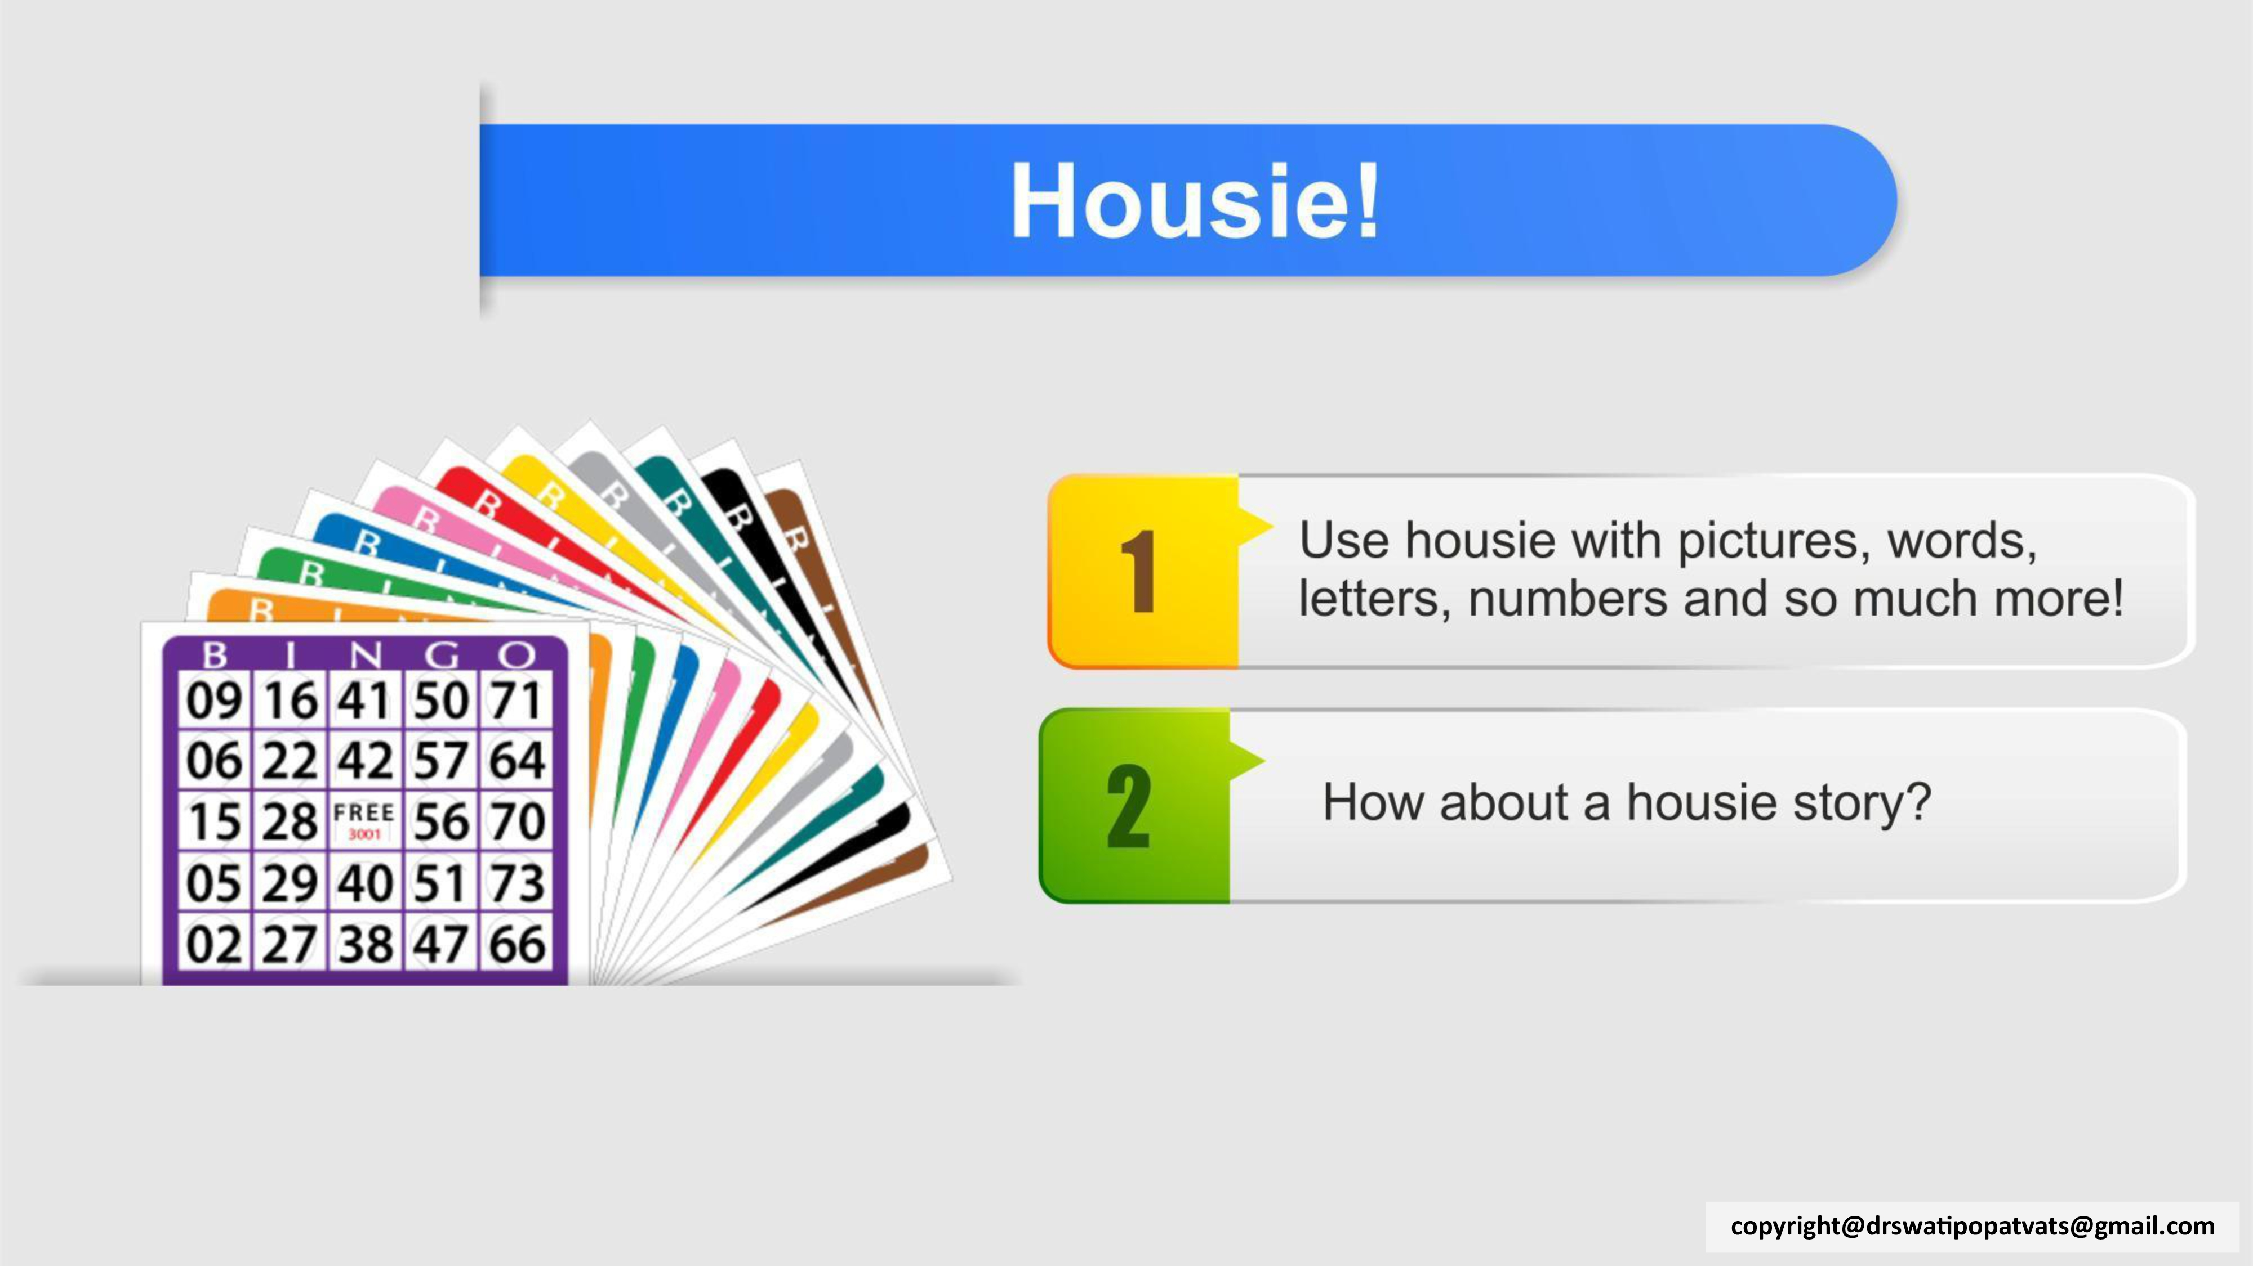


Memory and fun game- Housie
in this housie of letters-numbers, your child will learn memory, identification skills and more in a fun manner
create a housie card for each family member with different pictures, letters, words or numbers
Then say the words, name of the pictures, letters or numbers and each person marks it on their card if they have it
Like the normal housie, the one who gets first line, last line, middle line, all lines wins. A fun way for full family to be part of literacy and numeracy for the child.

Slide 18
