Slide 1

ECCE Management.
Instructional Design and Pedagogy
Dr. Swati Popat Vats
President
Podar Education Network
Early Childhood Association
Association for Primary Education and Research
copyright@swatipopatvats

Slide 2

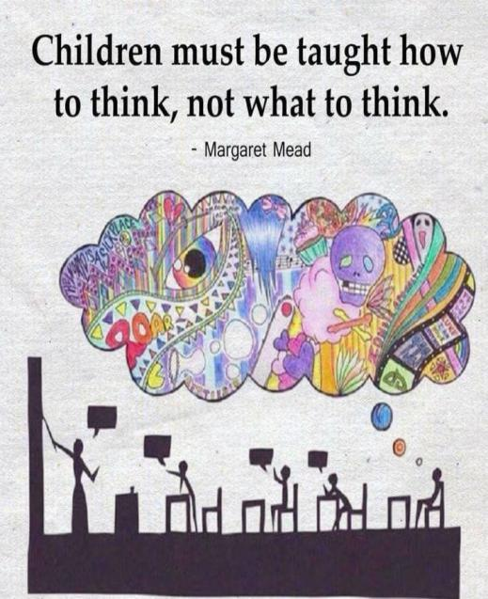
copyright@swatipopatvats

Slide 3
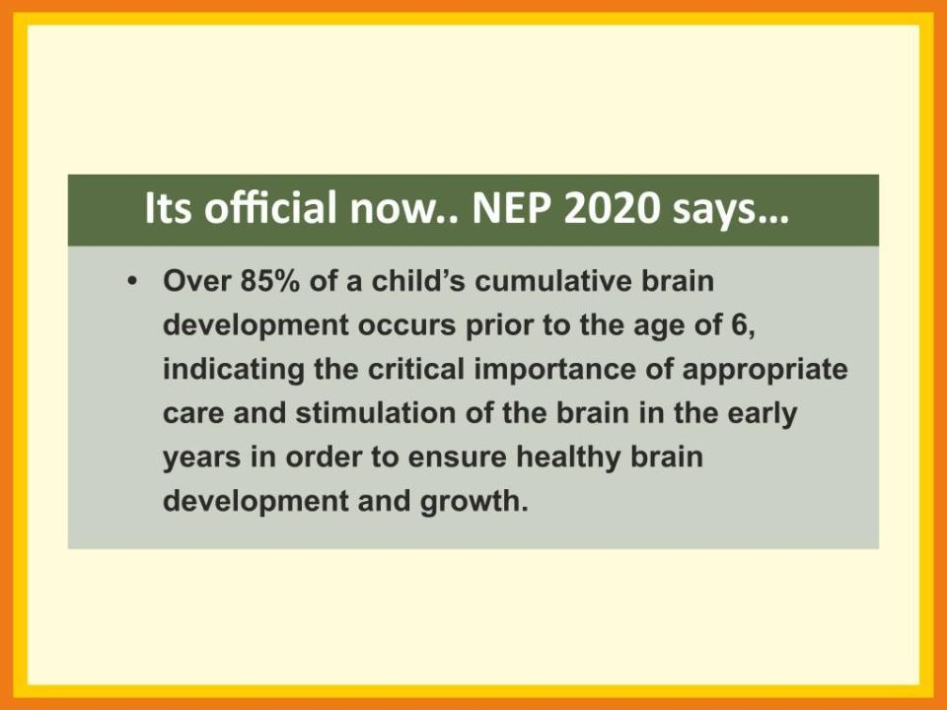
copyright@swatipopatvats

Slide 4
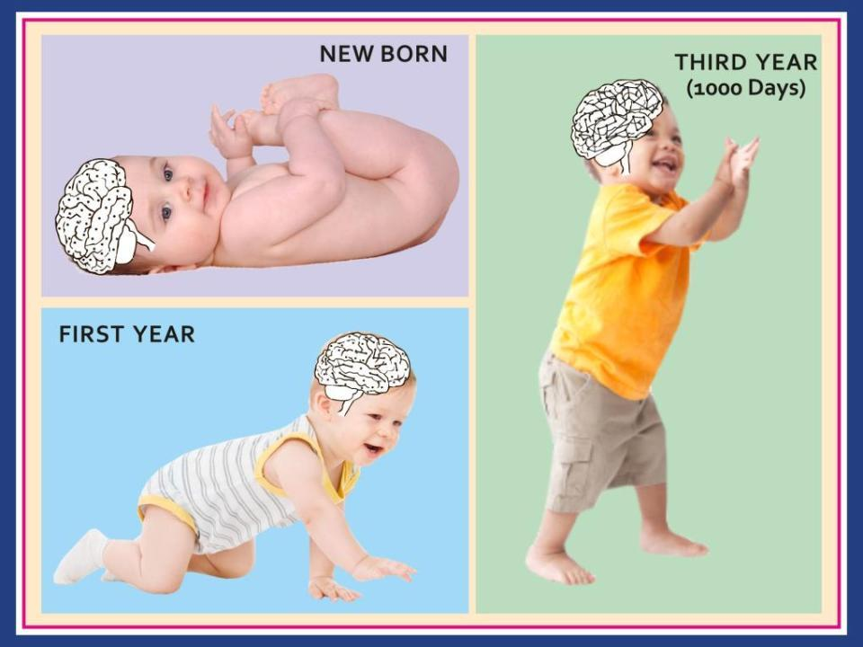
copyright@swatipopatvats
Notes:
Same here, brain should be white so that the connections difference is seen. Babies real, also in new born only dots, in first year show some lines between the dots and the three years how it is complex connections

Slide 5
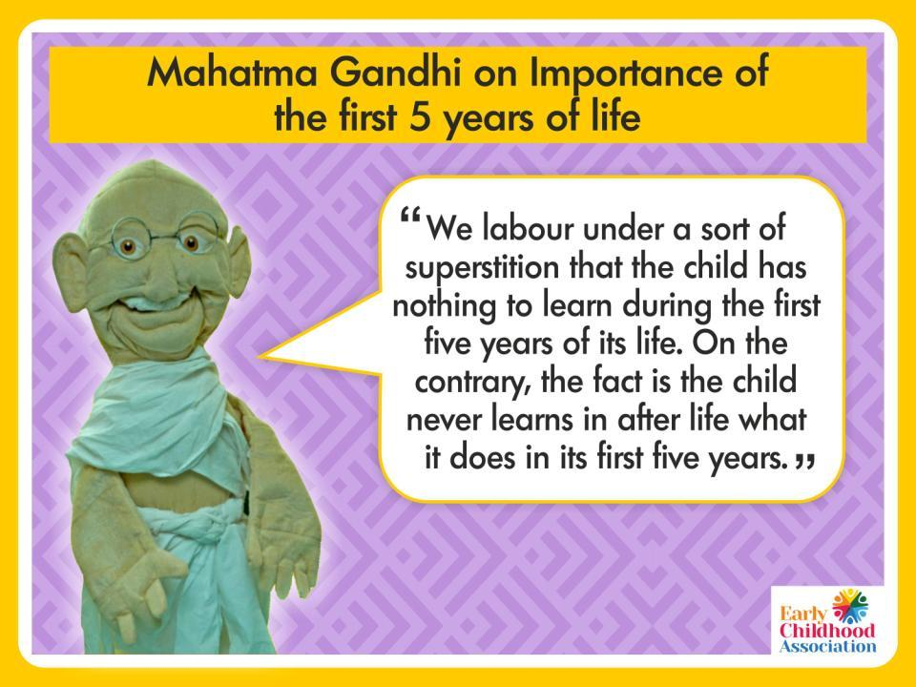
copyright@swatipopatvats

Slide 6

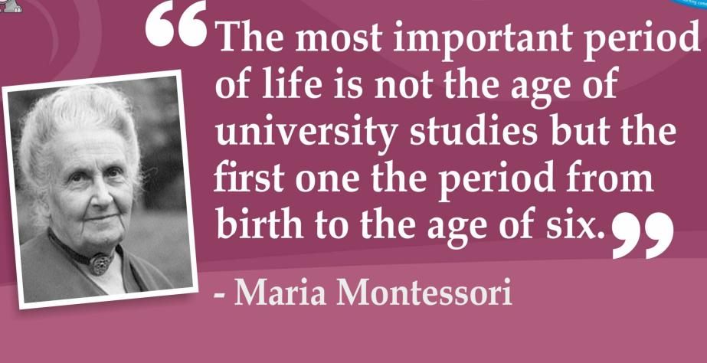
copyright@swatipopatvats

Slide 7
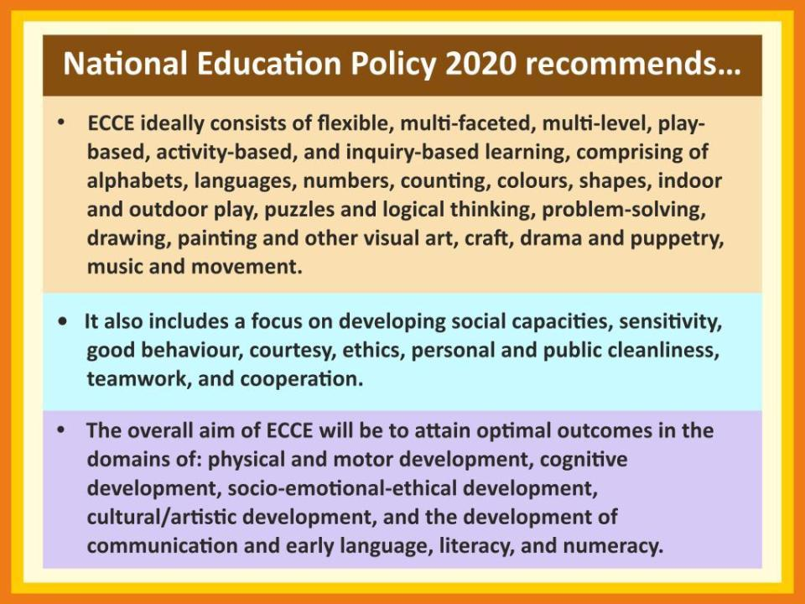
copyright@swatipopatvats

Slide 8
What is this play based learning that NEP stresses on?
Does it mean no learning?
copyright@swatipopatvats

Slide 9
IF WE TEACH THROUGH ‘PLAY’, DO WE TEACH LESS?
A high quality play based kindergarten program teaches as much as other preschools.
What is not evident in a play based kindergarten are skill-and-drill activities. Instead, the learning of all academic subjects is playful and exploratory.
Because a program uses playful ways to build children’s success does not mean the curriculum is not rigorous or academic. It means that it is just right for what’s best for three,four and five year old children (Gaye Gronlund)
copyright@swatipopatvats

Slide 10
Did you know that the right brain develops first?
It does so by the time children are 3-4 years of age.
copyright@swatipopatvats

Slide 11
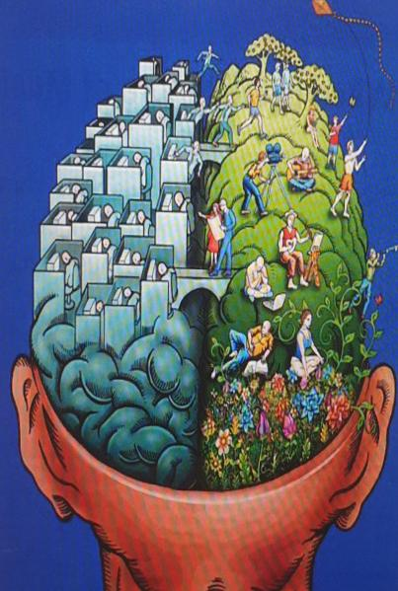
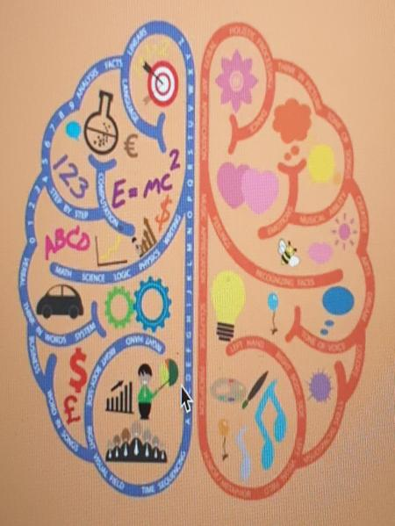
copyright@swatipopatvats

Slide 12
Left and right brain learning?
This theory is based on the fact that the brain’s two hemispheres function differently.
In 1981 Dr. Roger Sperry received the Nobel Prize for his split brain research.
Prior to that, little was known about the separate responsibilities of the two brain hemispheres.
copyright@swatipopatvats

Slide 13
Short term-left
Long term- right
The right brain is responsible for long-term memory storage.
Ultimately, we all store learned material in our right brain, for easy retrieval.
Generally this process of storing material in the short term memory (the left brain’s responsibility),
And then transferring it to our long-term memory (the right brain’s responsibility) is automatic,
copyright@swatipopatvats

Slide 14
A RIGHT BRAIN LEARNER STUCK IN A LEFT BRAIN CURRICULUM
School curriculum is generally more left brain oriented- focusing on auditory and sequential aspects, as well as writing,
So children who learn by songs, art, visual- the right brain learners feel left out.
They struggle with learning and retaining material using the same curriculum.
copyright@swatipopatvats

Slide 15
How can teachers make this transfer more efficient?
If left brain methods of repetition (either orally or in writing) are not transferring to the right brain long-term memory storage unit.
Then use right brain teaching strategies- children are required to use much less energy to store learned material.
Both right and left brain learners love these techniques- then why does education use only left brain strategies?
copyright@swatipopatvats

Slide 16
Left and Right brain
The left brain ‘digital brain’, is connected to:
The right brain ‘analog brain’, is connected to:
logic
sequencing
linear thinking
mathematics
facts
thinking in words
imagination
holistic thinking
intuition
arts
rhythm
nonverbal cues
feelings visualization
copyright@swatipopatvats

Slide 17
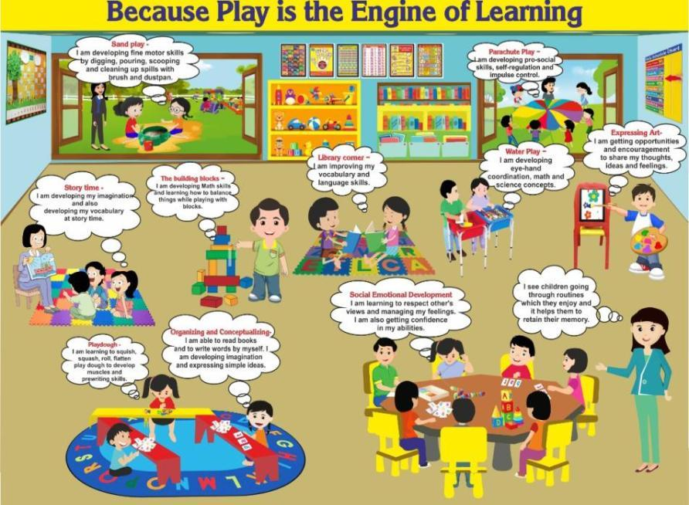
copyright@swatipopatvats

Slide 18
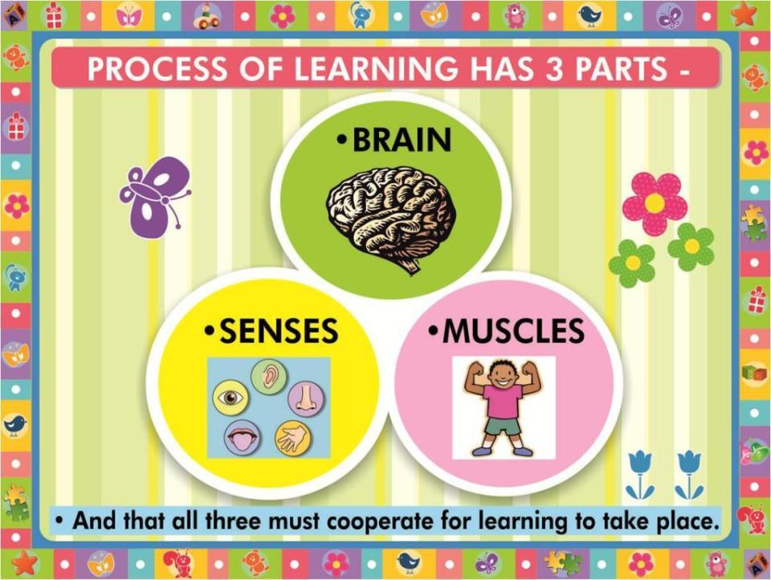
copyright@swatipopatvats

Slide 19
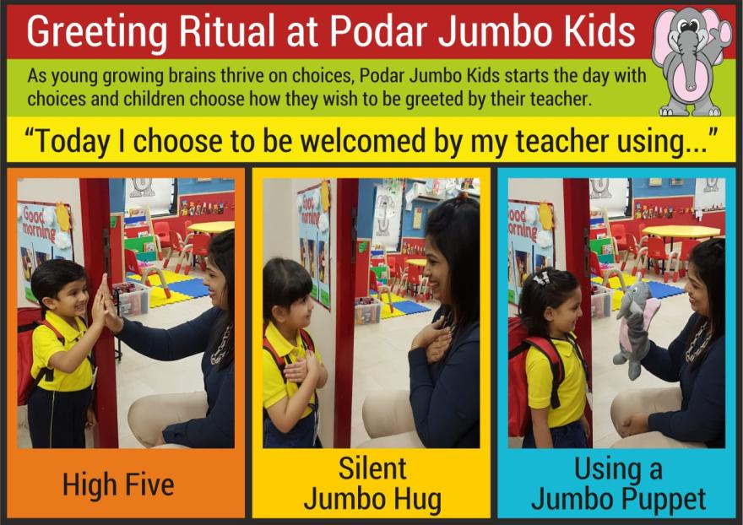
copyright@swatipopatvats

Slide 20
Why does ‘G’ make two sounds??
Sometime the g says, “j” “j” “j”
I’ll tell you why!
If after the g you see an i
Or an e or a y,
They all make the g say, “j” “j” “j”
You give it a try.
G is soft in gym and gel,
Gym and gel, gym and gel
G is soft in gym and gel,
And now you know why!
copyright@swatipopatvats

Slide 21
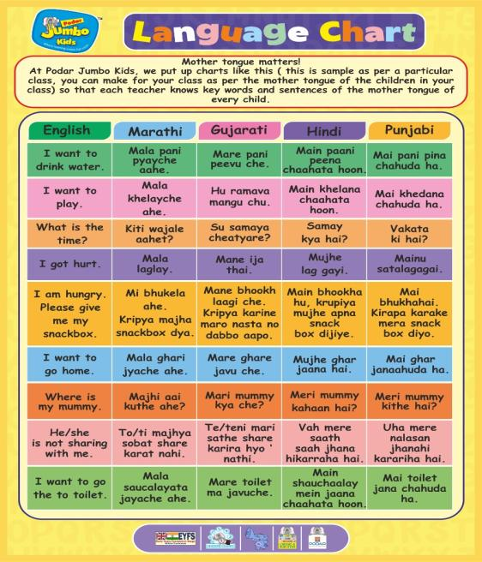
copyright@swatipopatvats

Slide 22

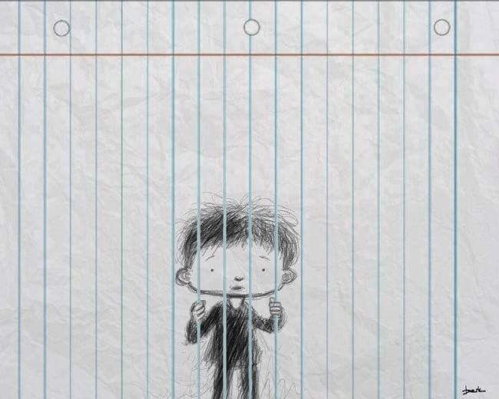
copyright@swatipopatvats

Slide 23
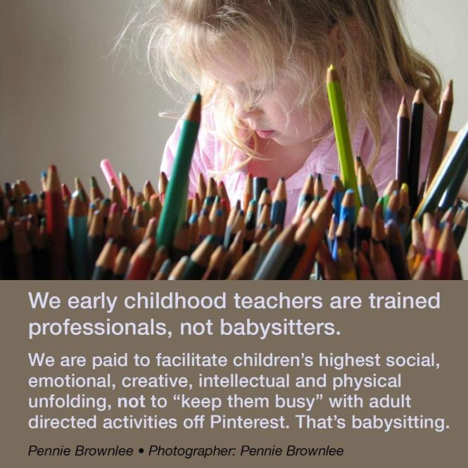
copyright@swatipopatvats

Slide 24
Learning requires senses
Art is the best activity to stimulate the senses…and we have lots of art and crafts in our curriculum, right?
copyright@swatipopatvats

Slide 25

copyright@swatipopatvats

Slide 26
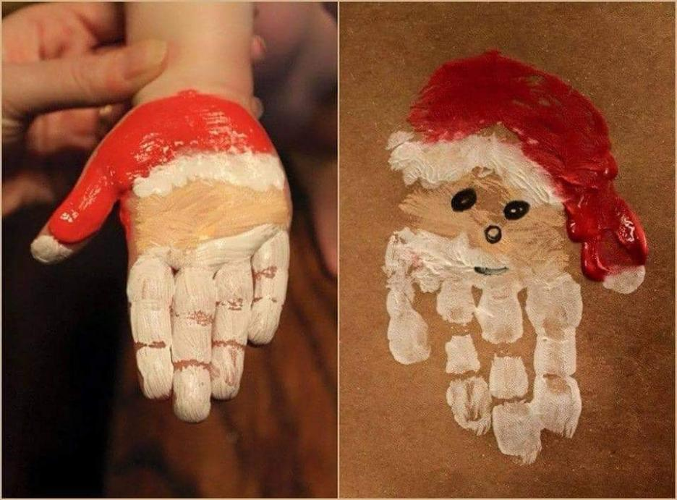
copyright@swatipopatvats

Slide 27
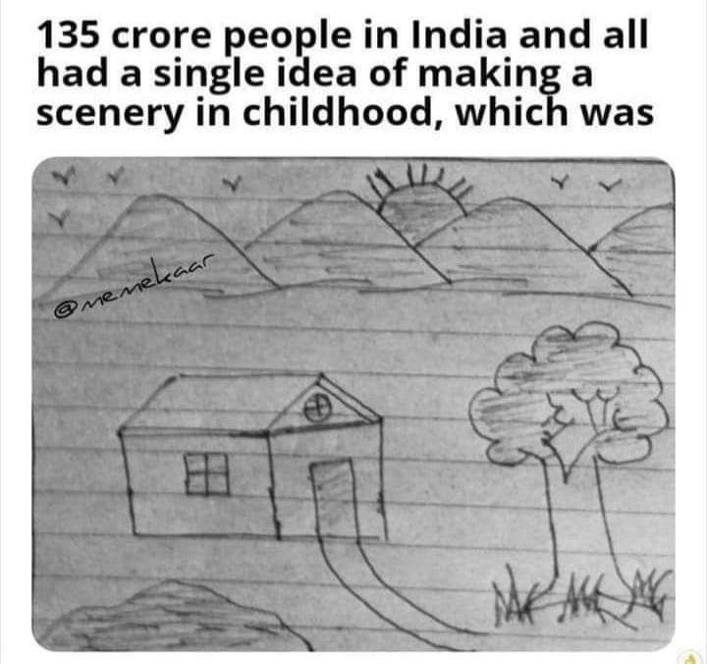
copyright@swatipopatvats

Slide 28
Art for creating not competing!
We see art squeezed into obedient slots that require no mess, quick results and easy success.
We see children who have never had to solve the problem of a sculpture that doesn’t balance.
We see children who have never felt success from using a tool to help them manipulate material.
copyright@swatipopatvats

Slide 29
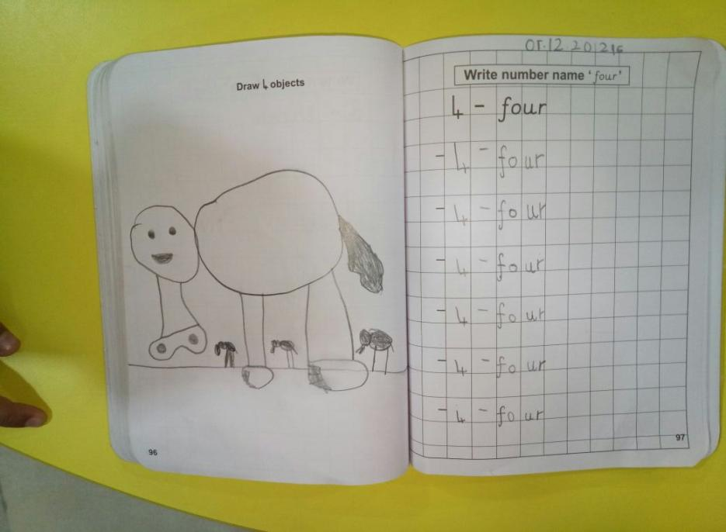
copyright@swatipopatvats

Slide 30
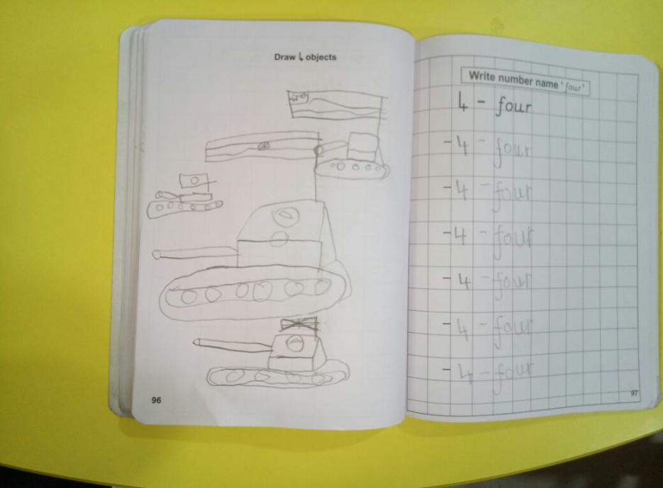
copyright@swatipopatvats

Slide 31

Behaviour has a cause. When you can get to the root of what is driving the behaviour, you can then begin to teach a child a better way.
copyright@swatipopatvats

Slide 32
All Children have basic emotional needs: to feel loved, secure, wanted and valued.
The purpose of discipline is to ensure the safety of all children and to encourage respect for others and for property.
Insisting on good behaviour shows that you care.
copyright@swatipopatvats

Slide 33
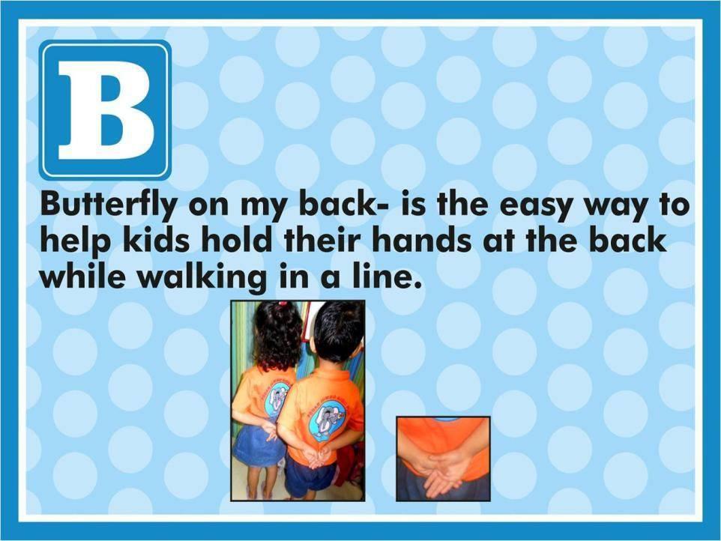
copyright@swatipopatvats

Slide 34
AVOID SAYING…
“Stop hitting!”
“Don’t stand up during circle time.”
“Don’t throw the books!”
“How many times d I have to ask you to clean up?”
“Don’t colour on the table!”
“Don’t yell!”
“Don’t run!”
“Don’t take this toy!”
“Don’t you remember how to line up?”
“Don’t touch.”
“Don’t talk to me that way!”
“You are not playing nicely together.”
copyright@swatipopatvats

Slide 35
GAMES THAT DEVELOP IMPULSE CONTROL
Traditional games:
Red Light, Green Light
Simon Says
Freeze Tag
Ready, Set, Go! (child must wait for “Go!”)
copyright@swatipopatvats

Slide 36
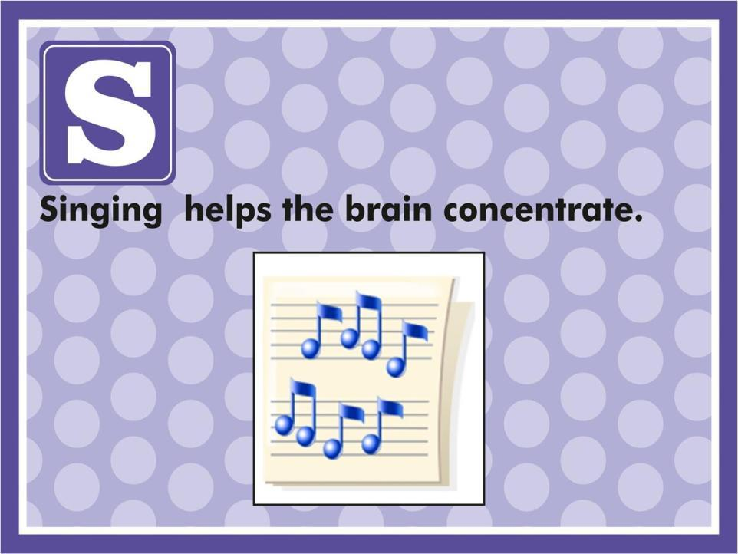
copyright@swatipopatvats

Slide 37
This Is How We Learn to Share
(Sing to tune of “Mary had a Little Lamb”)
This is how we learn to share,
Learn to share, learn to share.
This is how we learn to share
Every day at school.
We can share by taking turns,
Taking turns, taking turns.
We can share by taking turns
Every day at school.
We can share our favourite books
Favourite books, favourite books.
We can share our favourite books
Every day at school.
Add more verses with these ideas
Or let children create their own;
We can share our lunch or snack,
We can share our teacher’s time’
We can share our crayons or glue.
We will share with our friends,
With our friends, with our friends.
We will share with our friends
Every day at school.
copyright@swatipopatvats

Slide 38
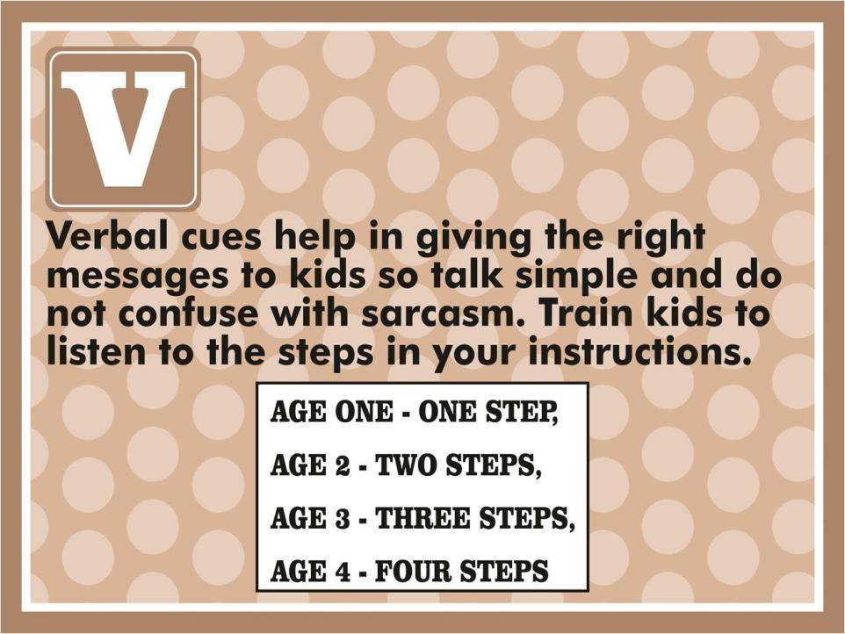
copyright@swatipopatvats

Slide 39
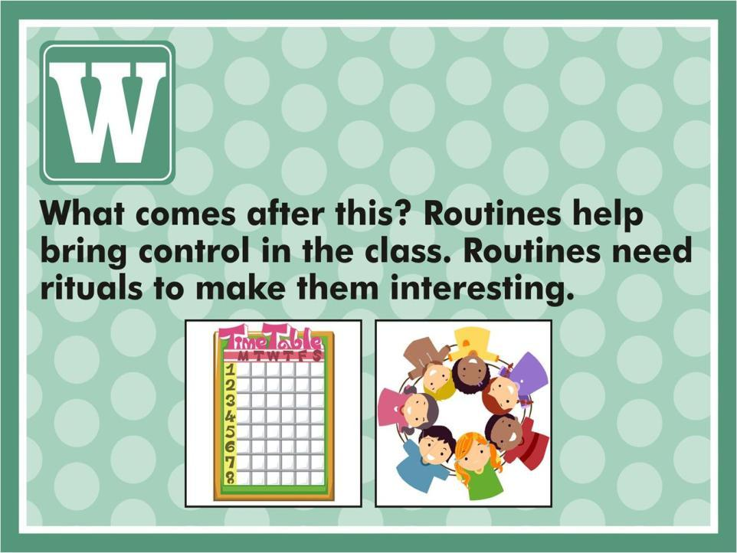
copyright@swatipopatvats

Slide 40
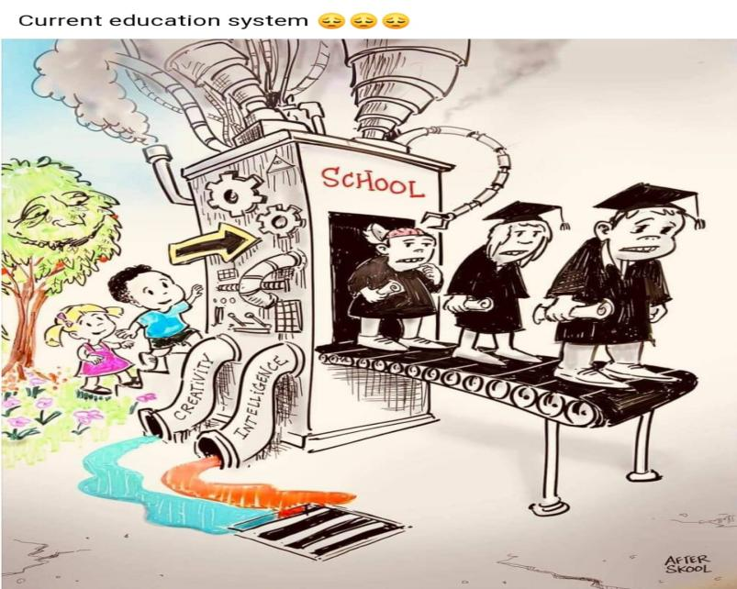
copyright@swatipopatvats

Slide 41
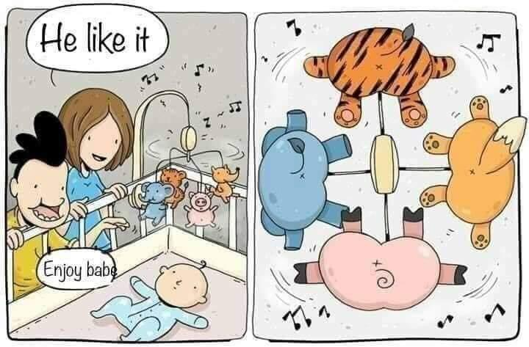
copyright@swatipopatvats

Slide 42
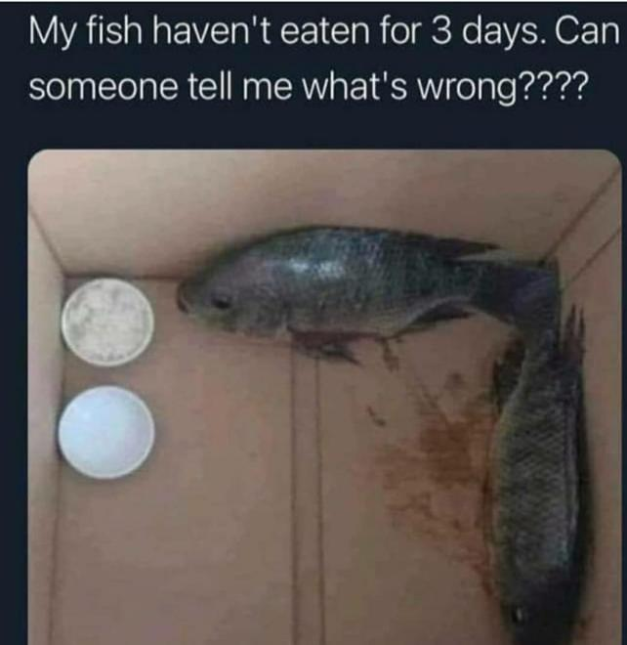
copyright@swatipopatvats

Slide 43
Are we teaching contradictory concepts?
copyright@swatipopatvats

Slide 44
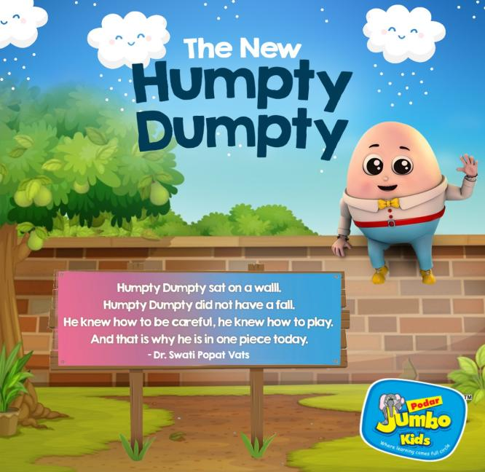
copyright@swatipopatvats

Slide 45
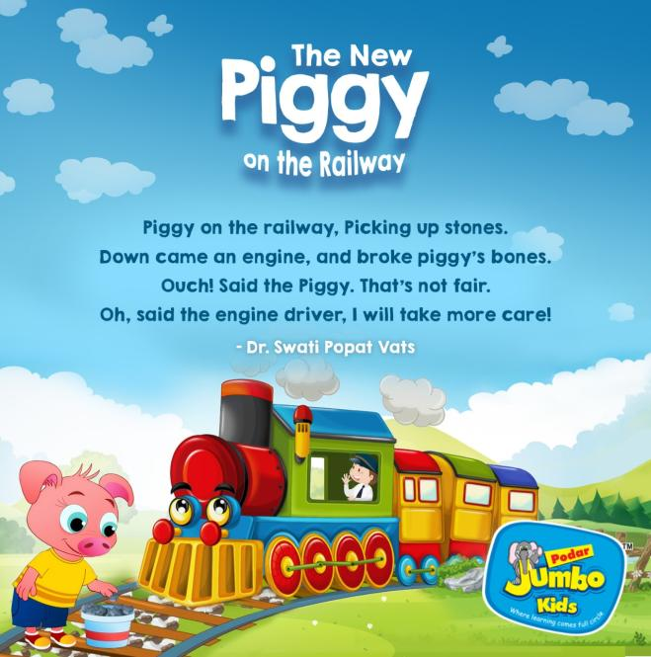
copyright@swatipopatvats

Slide 46

copyright@swatipopatvats

Slide 47
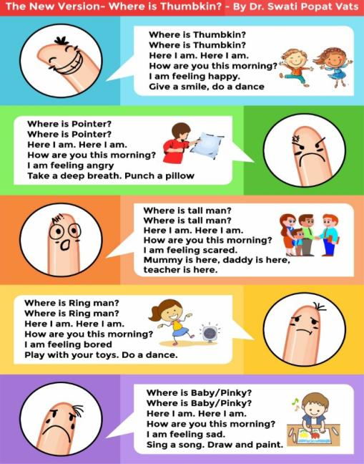
copyright@swatipopatvats

Slide 48





copyright@swatipopatvats

Slide 49
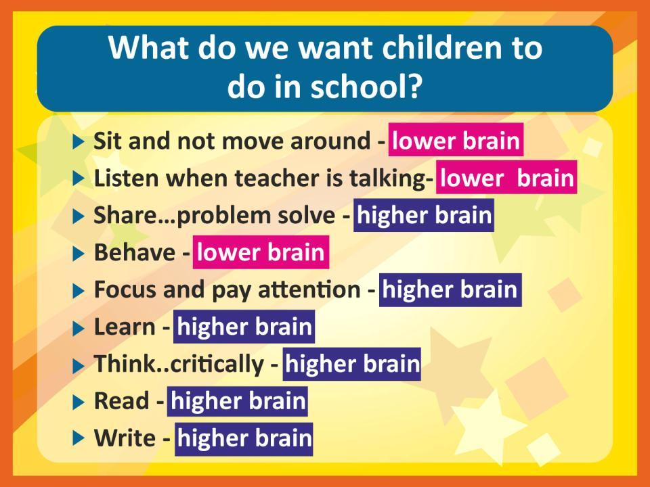
copyright@swatipopatvats

Slide 50
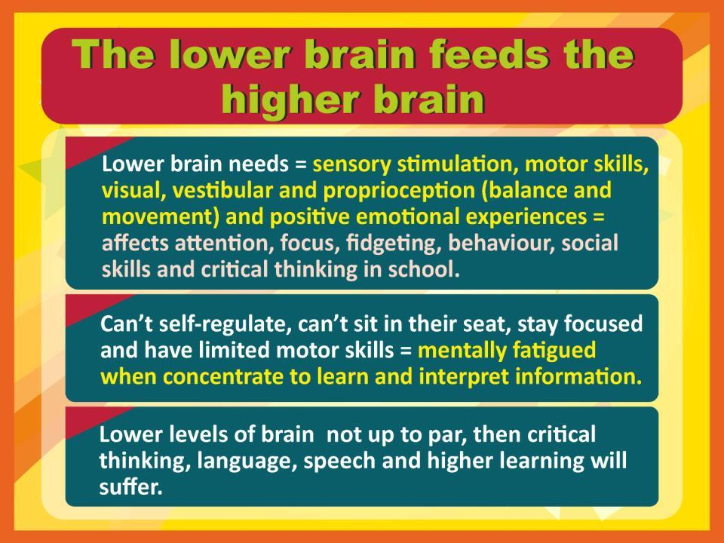
copyright@swatipopatvats

Slide 51
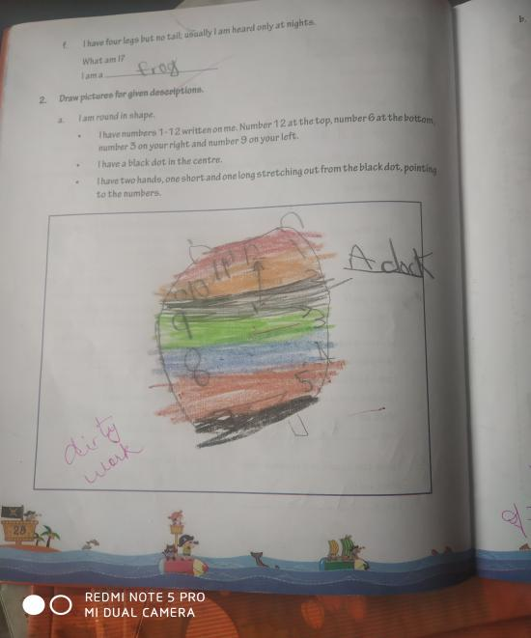
copyright@swatipopatvats

Slide 52
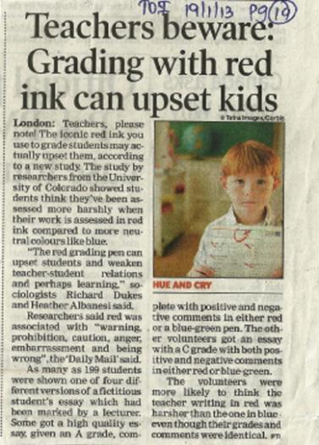
AND SCIENCE SAYS THE SAME-
copyright@swatipopatvats

Slide 53
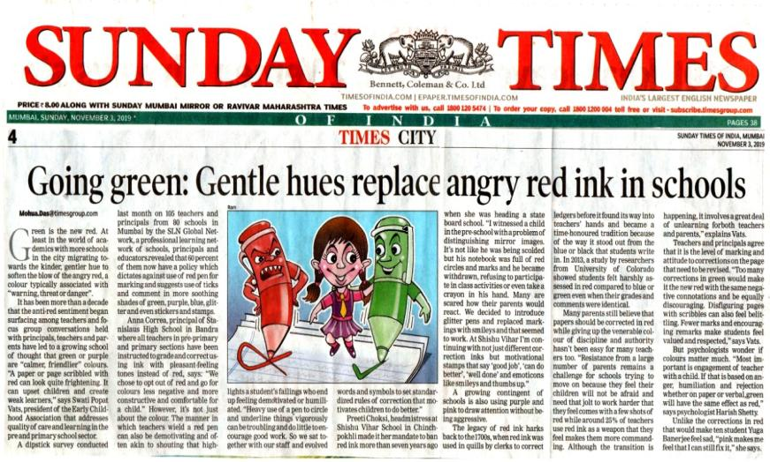
copyright@swatipopatvats

Slide 54
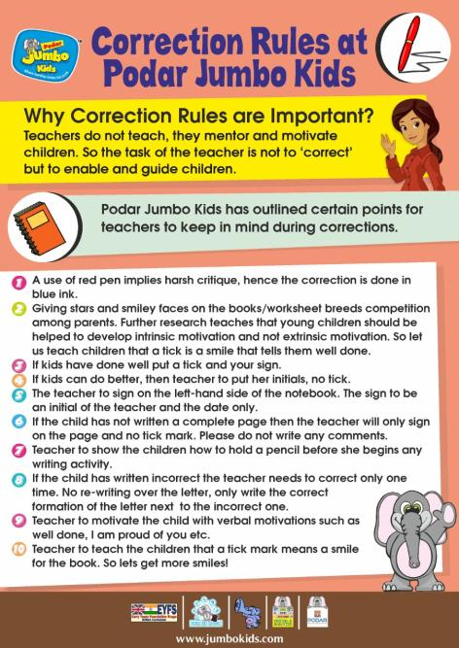
copyright@swatipopatvats

Slide 55
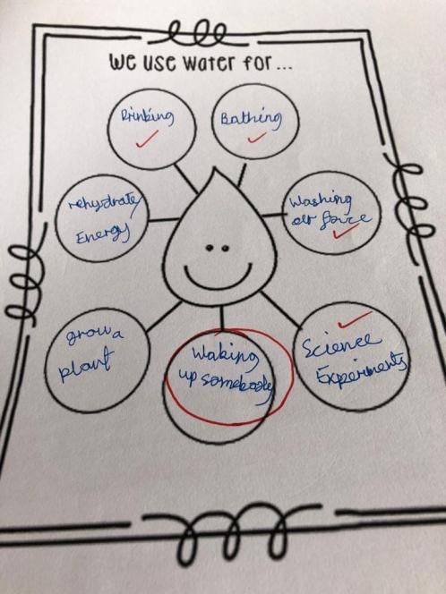
copyright@swatipopatvats

Slide 56
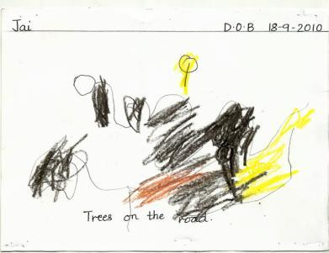
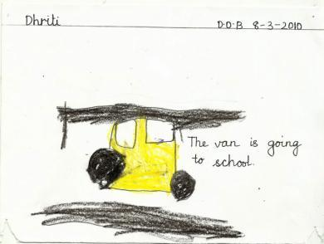
Why parents should not compare two worksheets or performance with another child?
Dob- 18-9-2010
Dob- 8-3-2010
copyright@swatipopatvats

Slide 57
Left-right brain learning
There is a connection between how the brain transitions from right-brained learning (creative, emotions) to left-brained learning (logical, critical thinking).
If the brain fails to transition from right-brained learning to left-brained learning, children become more emotional instead of logical as they get older.
That is why many parents and teachers today see more attention issues in the classroom, sensory struggles, meltdowns , anxiety and emotional grounding issues.
copyright@swatipopatvats

Slide 58
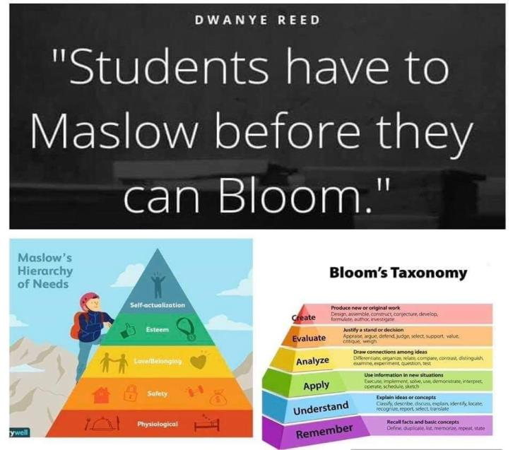
copyright@swatipopatvats

Slide 59
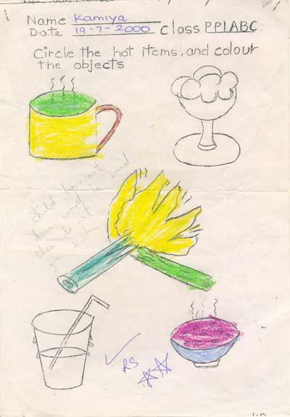
copyright@swatipopatvats

Slide 60
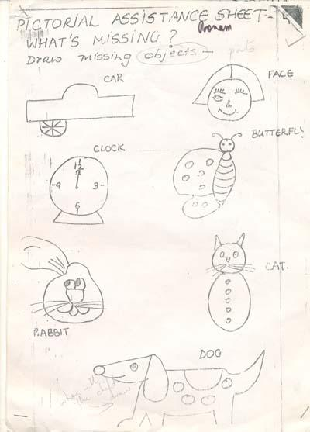
copyright@swatipopatvats

Slide 61
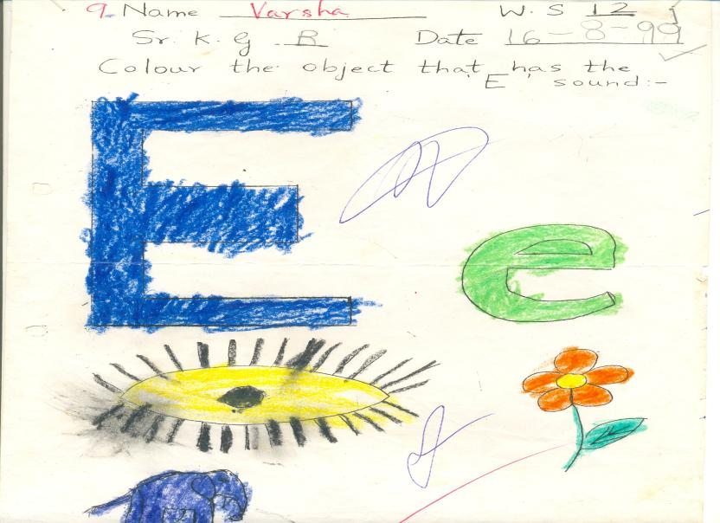
copyright@swatipopatvats

Slide 62
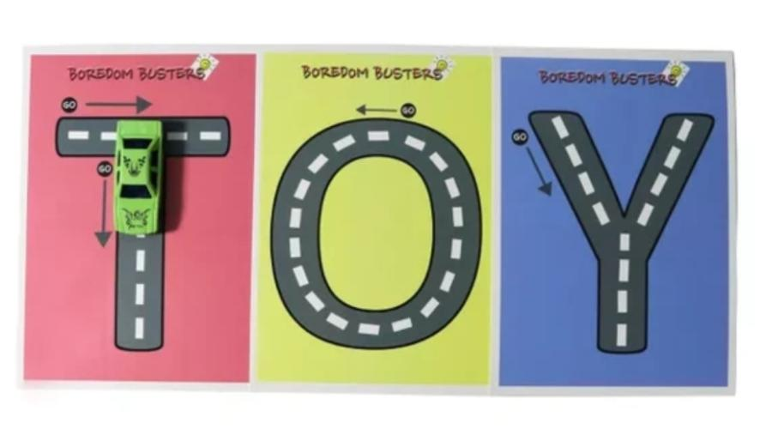
copyright@swatipopatvats

Slide 63
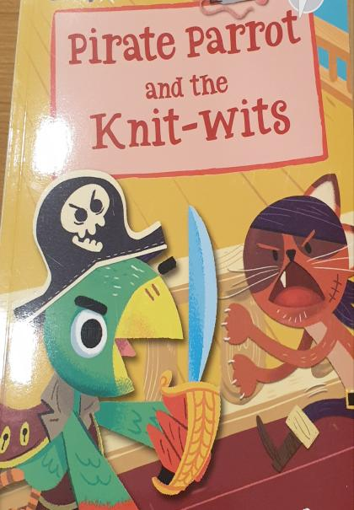
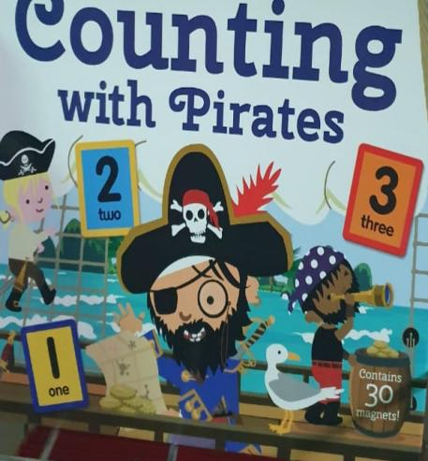
copyright@swatipopatvats

Slide 64
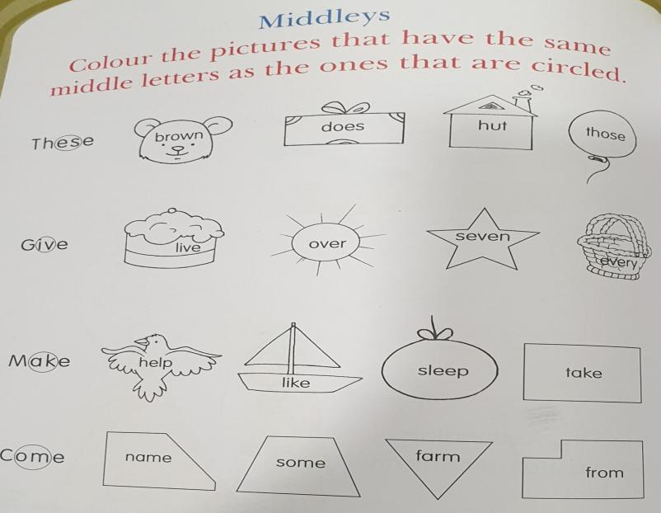
copyright@swatipopatvats

Slide 65
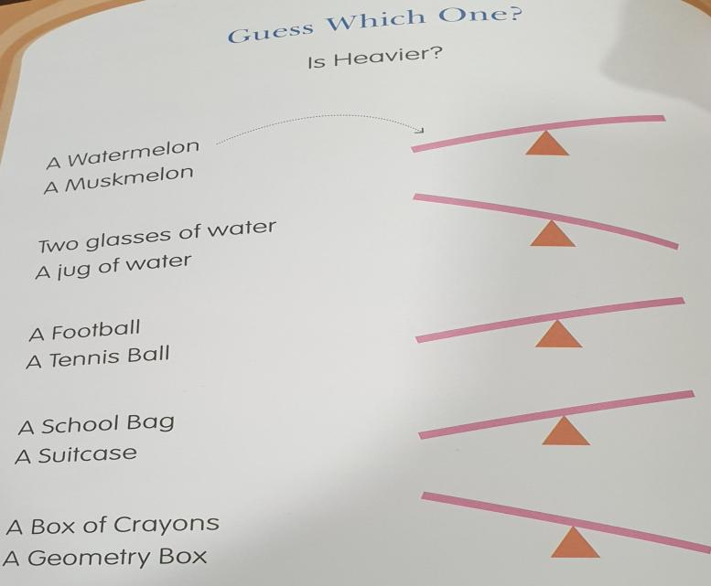
copyright@swatipopatvats

Slide 66
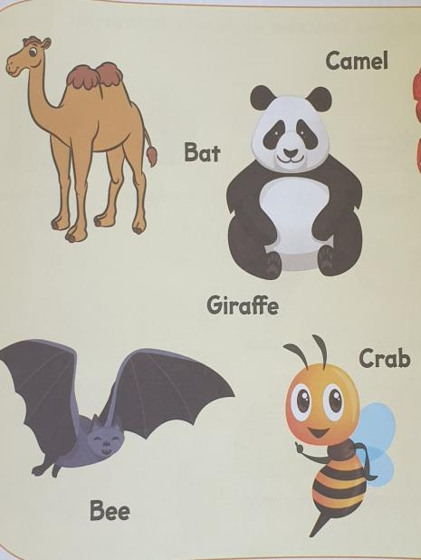
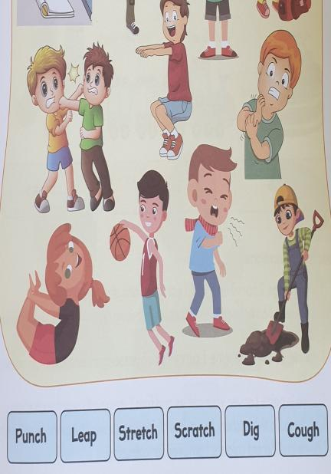
copyright@swatipopatvats

Slide 67
Teaching through stories…
It helps both left and right brain learning.
copyright@swatipopatvats

Slide 68
Bringing the learning maxims to life for learning to make sense…
Known to unknown
Simple to complex
Concrete to abstract
copyright@swatipopatvats

Slide 69
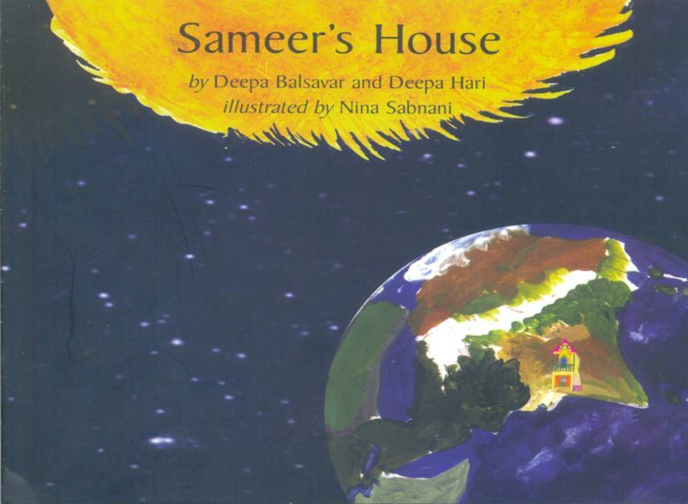
copyright@swatipopatvats

Slide 70
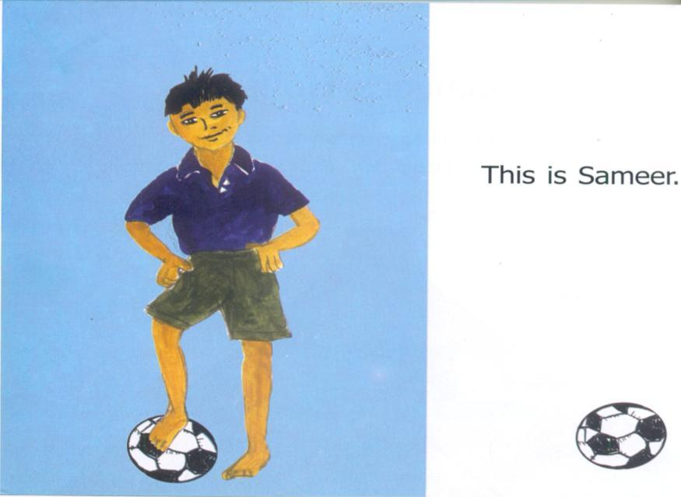
copyright@swatipopatvats

Slide 71

copyright@swatipopatvats

Slide 72

copyright@swatipopatvats

Slide 73

copyright@swatipopatvats

Slide 74

copyright@swatipopatvats

Slide 75

copyright@swatipopatvats

Slide 76

copyright@swatipopatvats

Slide 77

copyright@swatipopatvats

Slide 78

copyright@swatipopatvats

Slide 79

copyright@swatipopatvats

Slide 80
Once upon a story…
They developed focus and self control- Gijubhai would retell the story by changing certain key facts but because the students were focused they were able to identify and point out these errors to Gijubhai. They learnt to sit in an organized manner just to listen to stories. This is focus and self control.
They developed the skill of perspective taking- by listening to the stories the students learnt to be happy, sad, angry along with the characters of the story, they learnt to be empathetic. And that is perspective taking, when you put yourself in the shoes of another person and start to understand how it feels to be that person.
copyright@swatipopatvats

Slide 81
Once upon a story…
Communication- because of the stories that Gijubhai told in his class, his class started to communicate with him, also communicate their needs, like and dislikes, thoughts and ideas to him.
Cognitive flexibility- the ability to switch from one situation to another, from one emotion to another, the ability to believe that the story is leading in a particular direction and then the story teller gets in an element of surprise and you have to change your direction of thoughts and start on the other tangent, this is cognitive flexibility which Gijubhai nurtured in his students.
copyright@swatipopatvats

Slide 82
Once upon a story…
Ability to defer gratification- this is the ability to be patient and wait for what you want. Research has proven that those who are able to defer gratification are more successful in life. Well, students of Gijubhai’s class also deferred gratification when Gijubhai had to stop the story because time was up and asked the children to wait till the next day.
copyright@swatipopatvats

Slide 83
Once upon a story…
waiting for the next day to complete the story, the students ‘working memory’ and ‘inhibition’ both were nurtured. Students had to remember where the story stopped the previous day and remember the facts of the story.
Estimation of time also is something that is developed during story telling, if the teacher makes the children conscious of the time left for a particular session, this can be done with visual cues like using a sand timer or by a warning bell that they hear which tells them that in the next 10 minutes the story time will be over.
copyright@swatipopatvats

Slide 84

Now available on Amazon and at Crosswords bookstore.
copyright@swatipopatvats

Slide 85

copyright@swatipopatvats

Slide 86

copyright@swatipopatvats

Slide 87

copyright@swatipopatvats

Slide 88

copyright@swatipopatvats

Slide 89

copyright@swatipopatvats

Slide 90

copyright@swatipopatvats

Slide 91

copyright@swatipopatvats

Slide 92

copyright@swatipopatvats

Slide 93

copyright@swatipopatvats

Slide 94

copyright@swatipopatvats

