Slide 1
GANDHI AND TAGORE IN ECE
DR. SWATI POPAT VATS
PRESIDENT
PODAR EDUCATION NETWORK
EARLY CHILDHOOD ASSOCIATION
www.eca-india.org

Slide 2
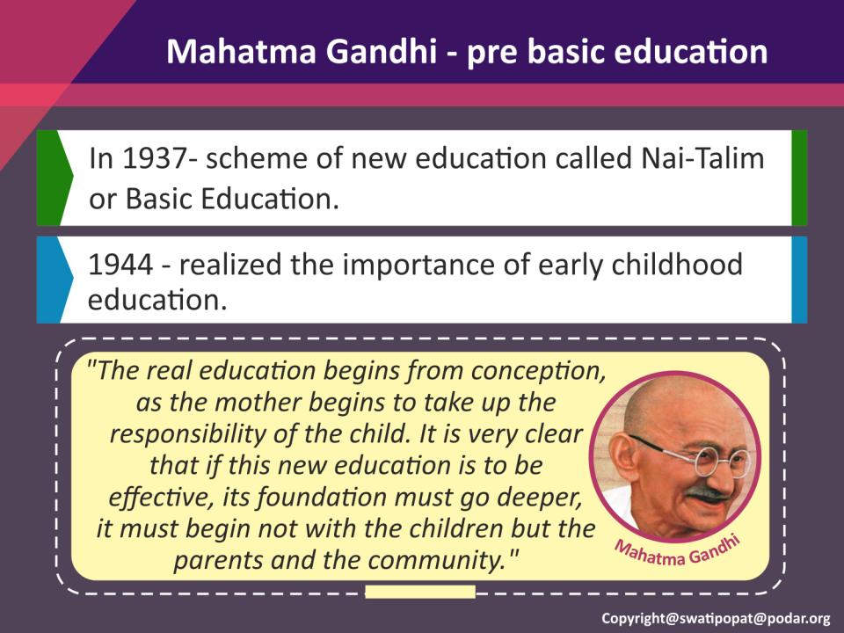

Slide 3
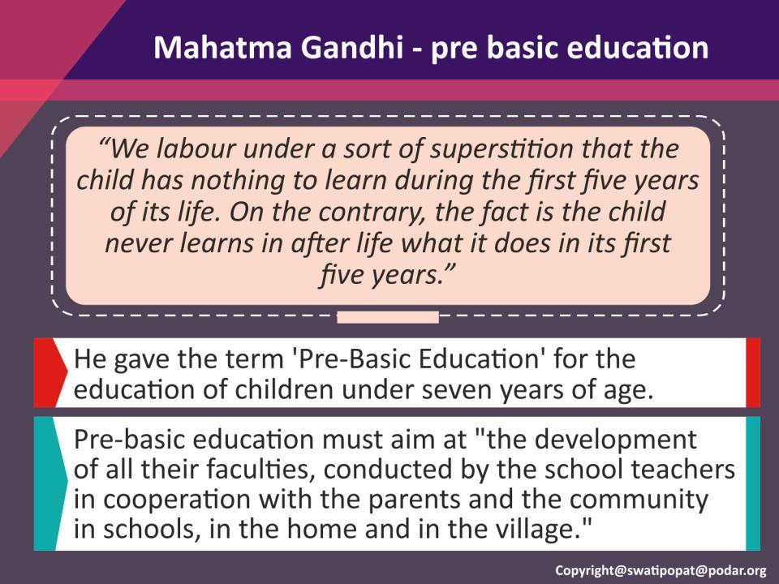

Slide 4
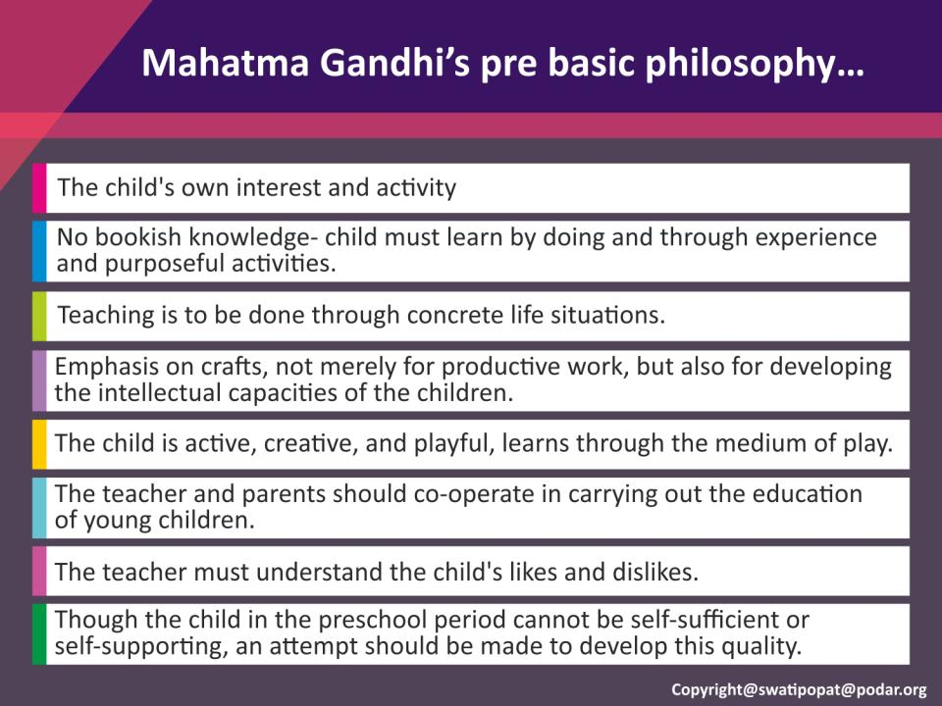

Slide 5
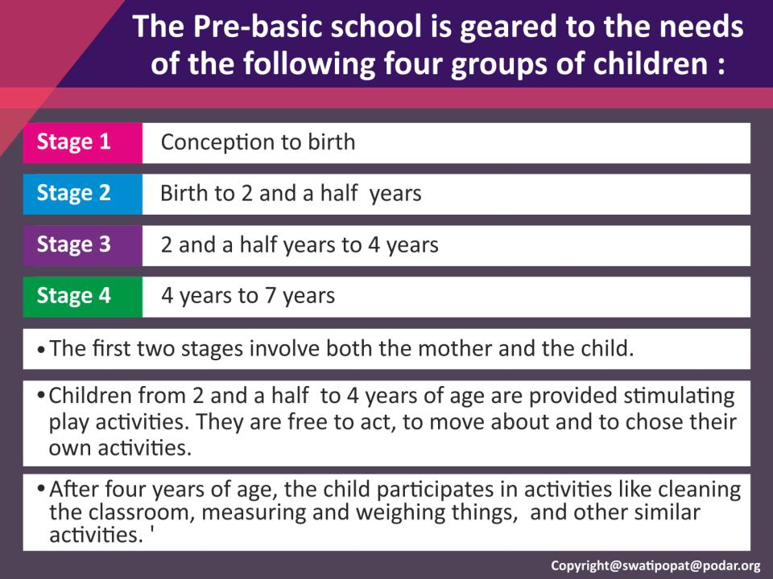

Slide 6
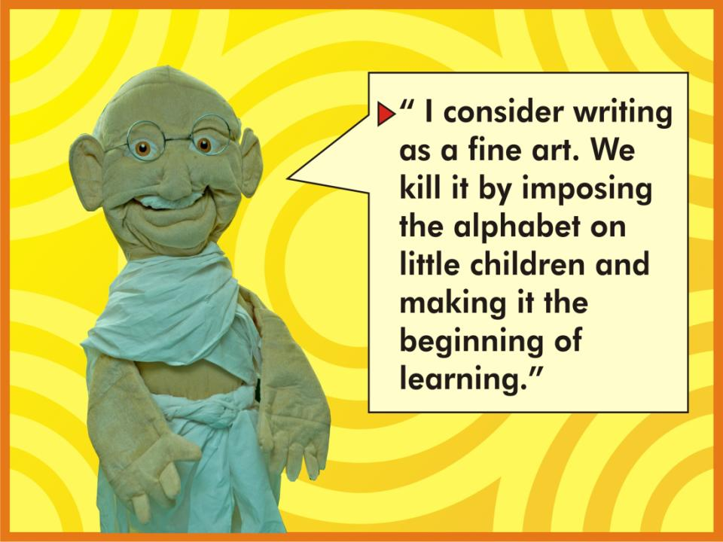
Copyright@swatipopat@podar.org

Slide 7
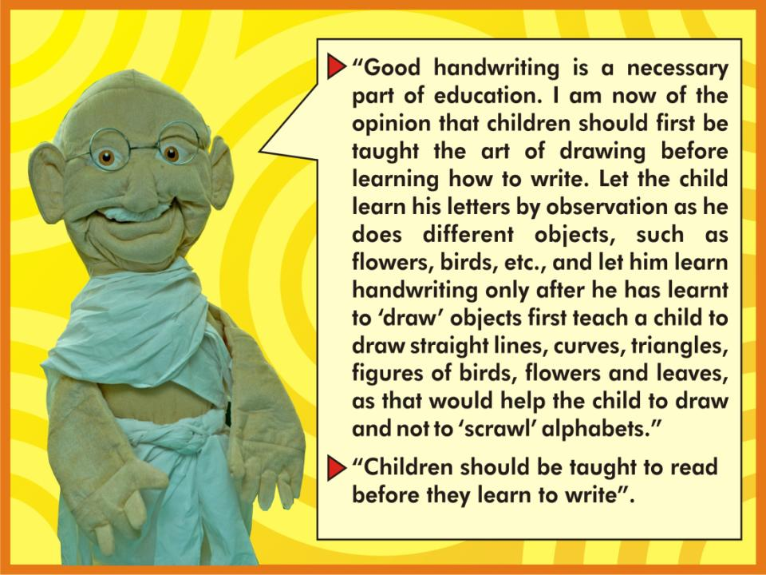
Copyright@swatipopat@podar.org

Slide 8
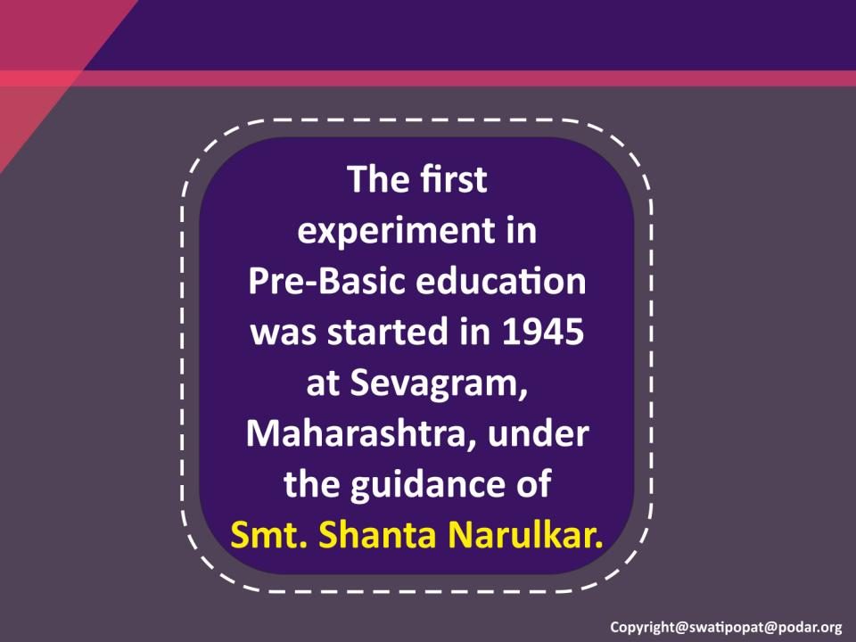

Slide 9
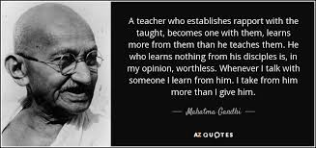

Slide 10
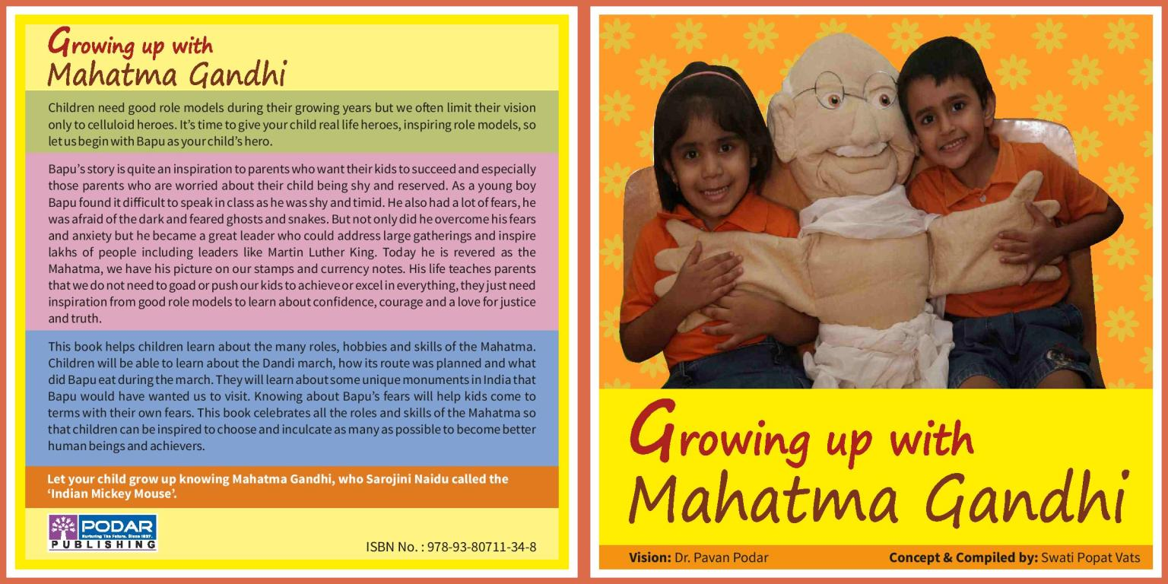

Slide 11
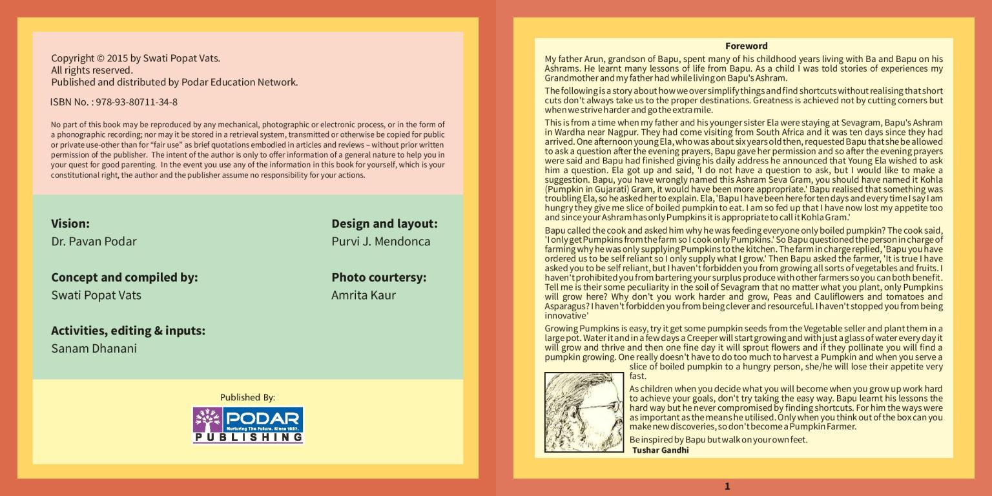

Slide 12
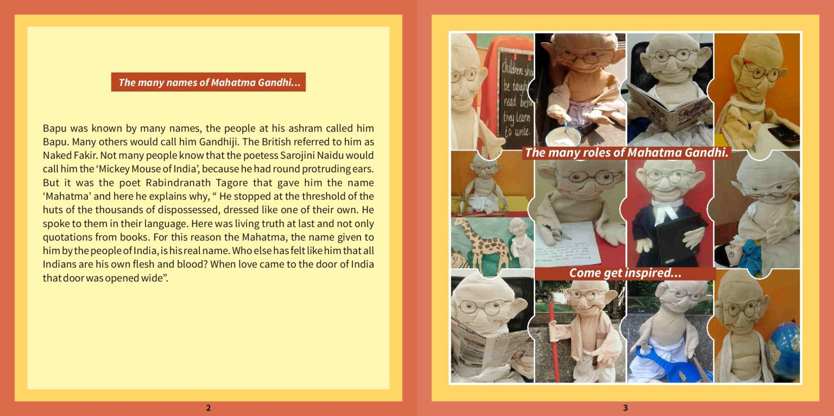

Slide 13
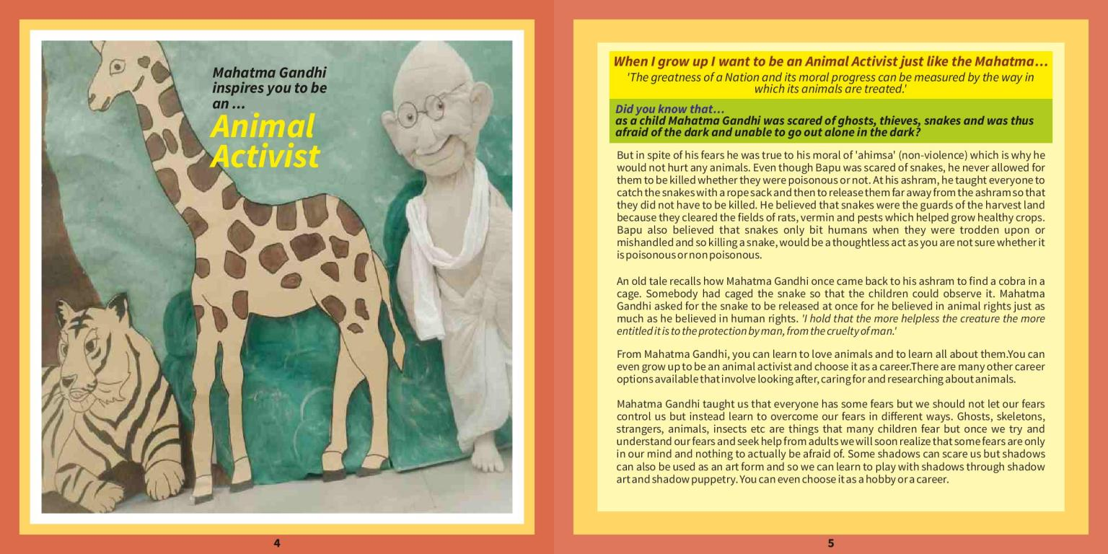

Slide 14
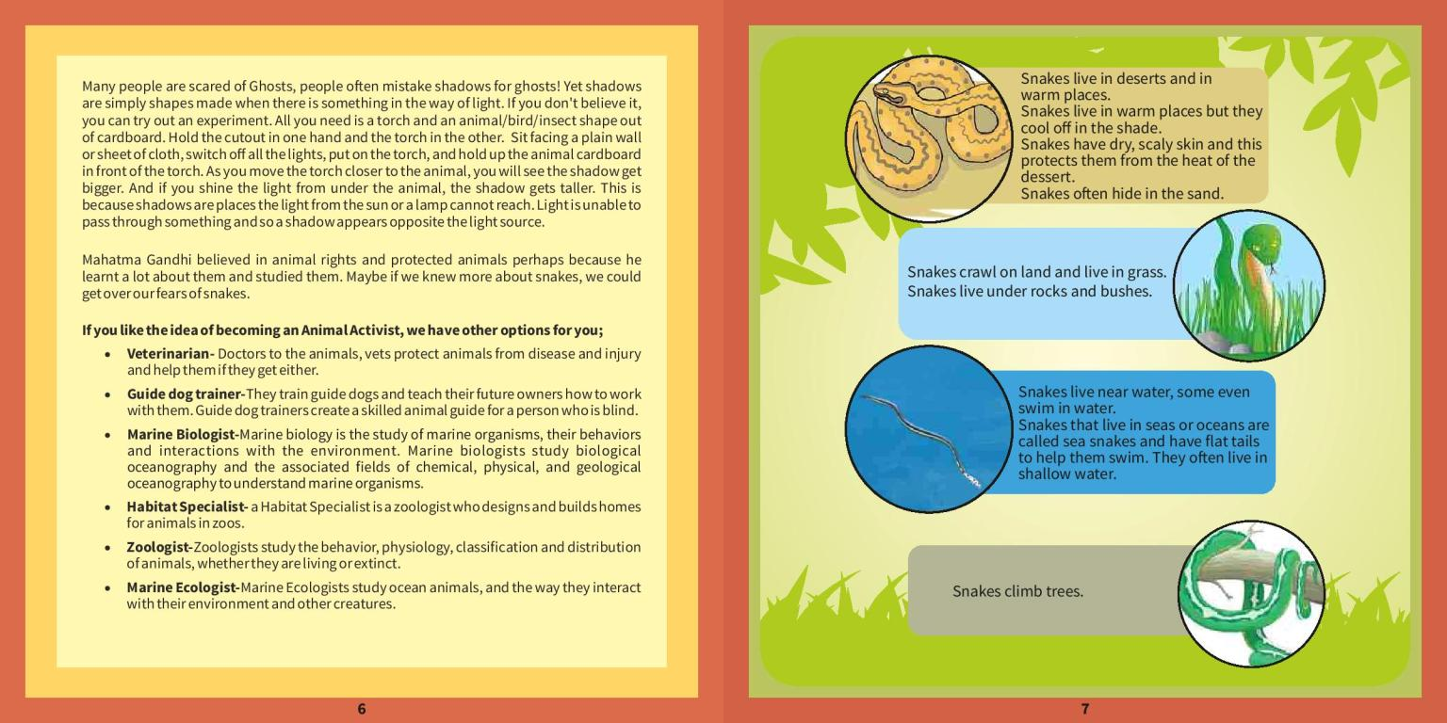

Slide 15
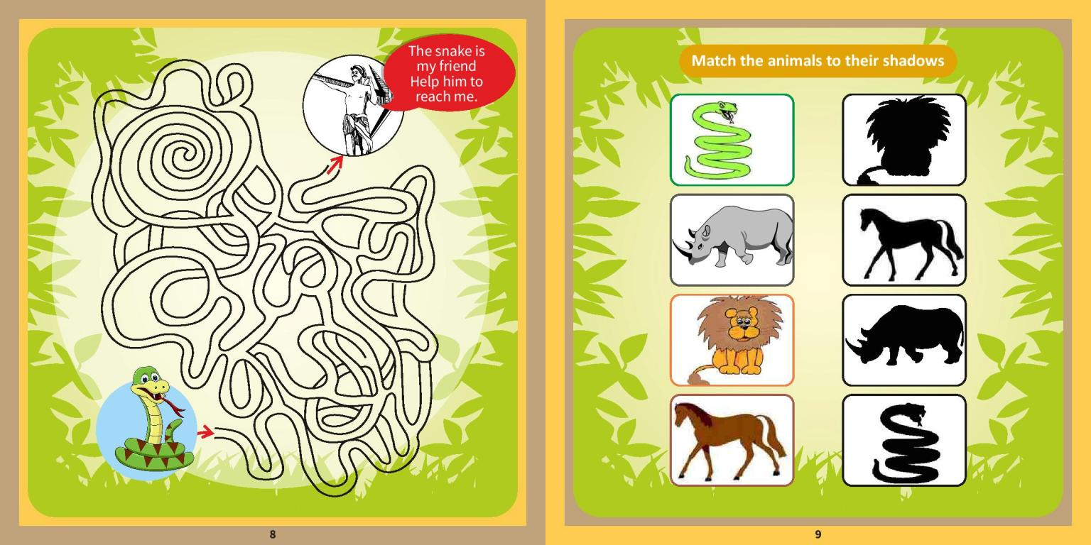

Slide 16
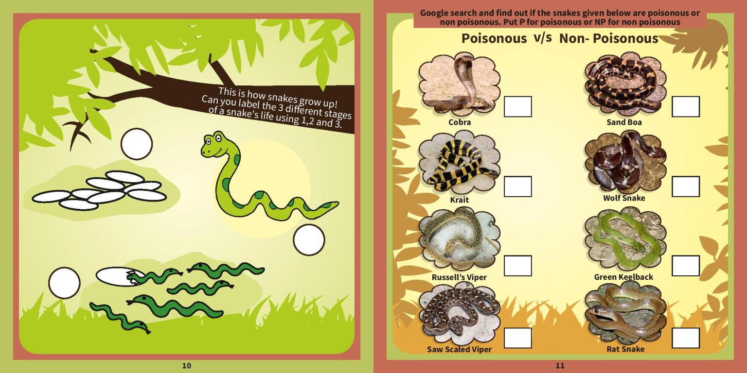

Slide 17
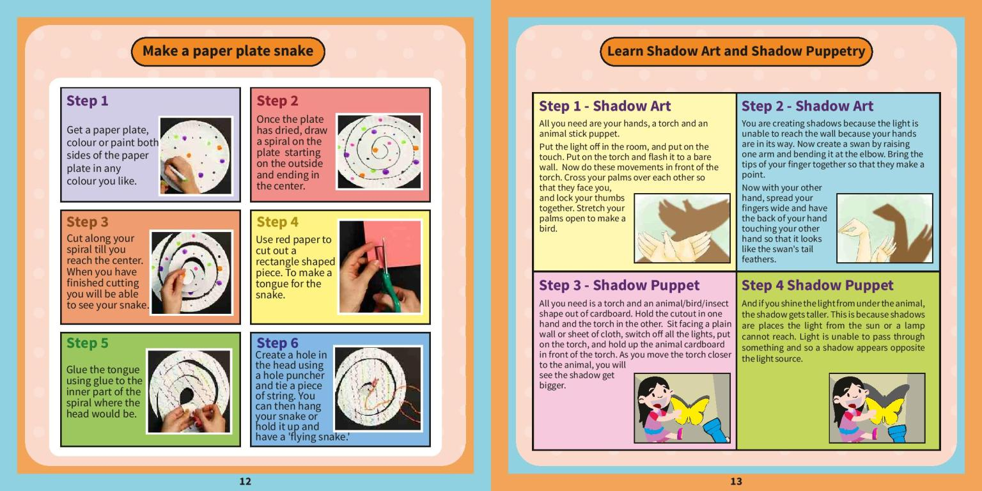

Slide 18
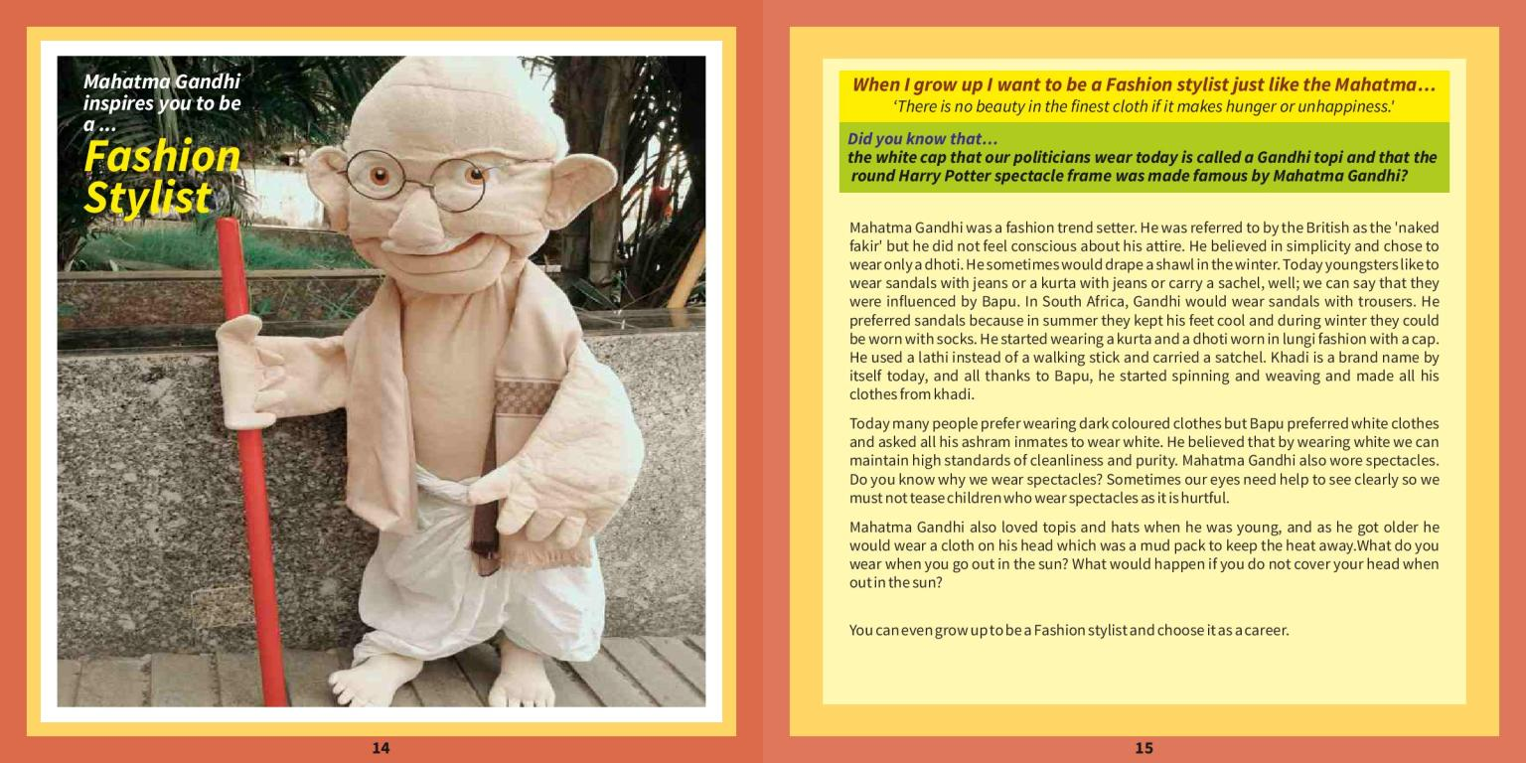

Slide 19
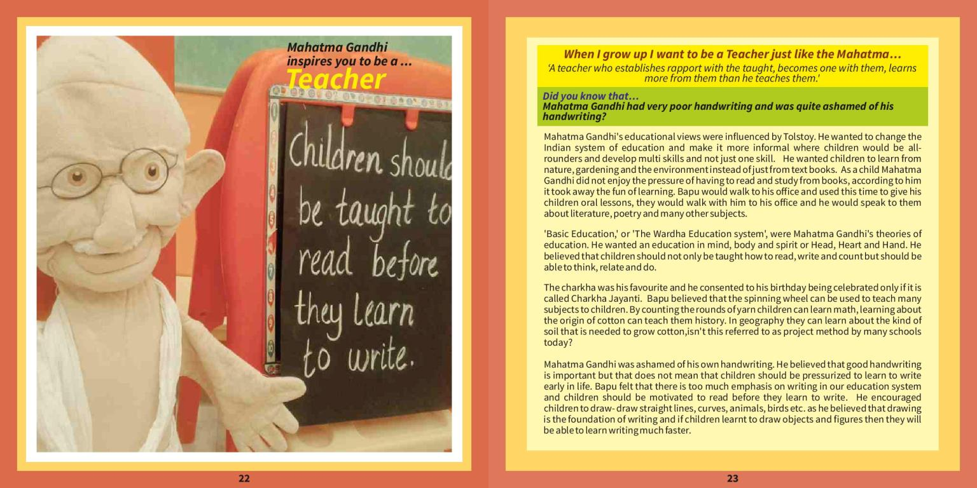

Slide 20
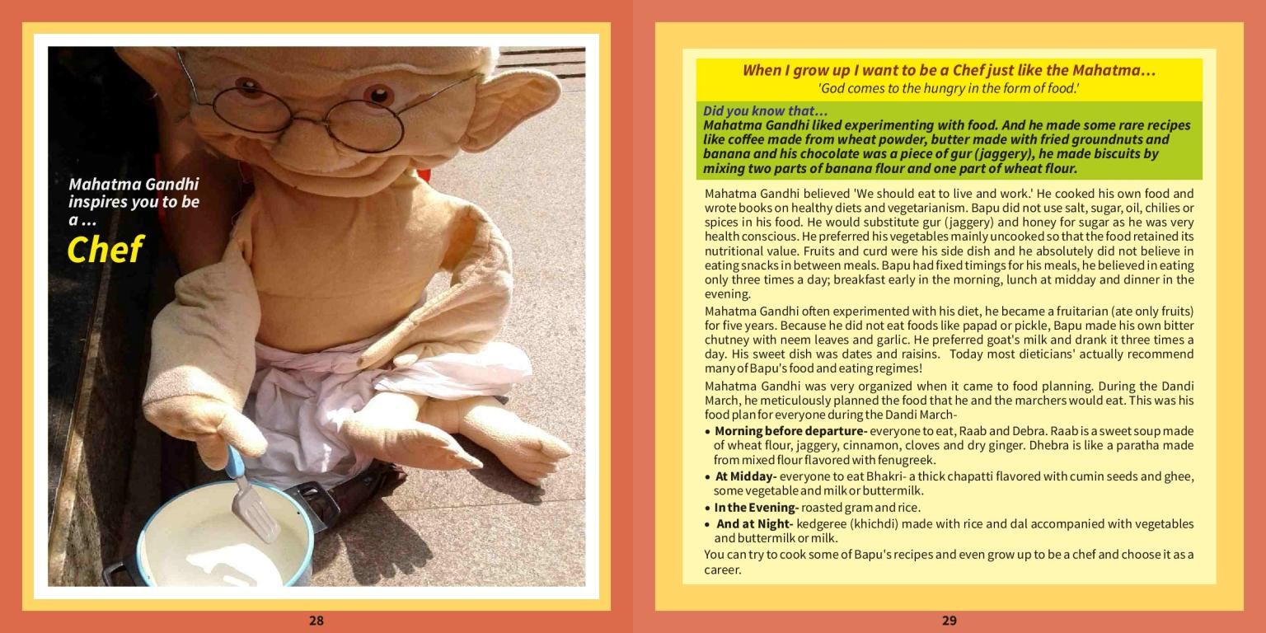

Slide 21
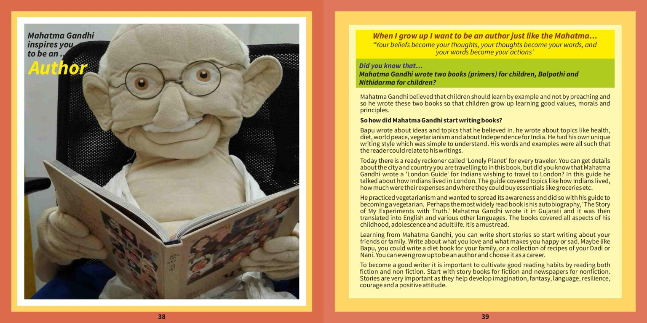

Slide 22


Slide 23
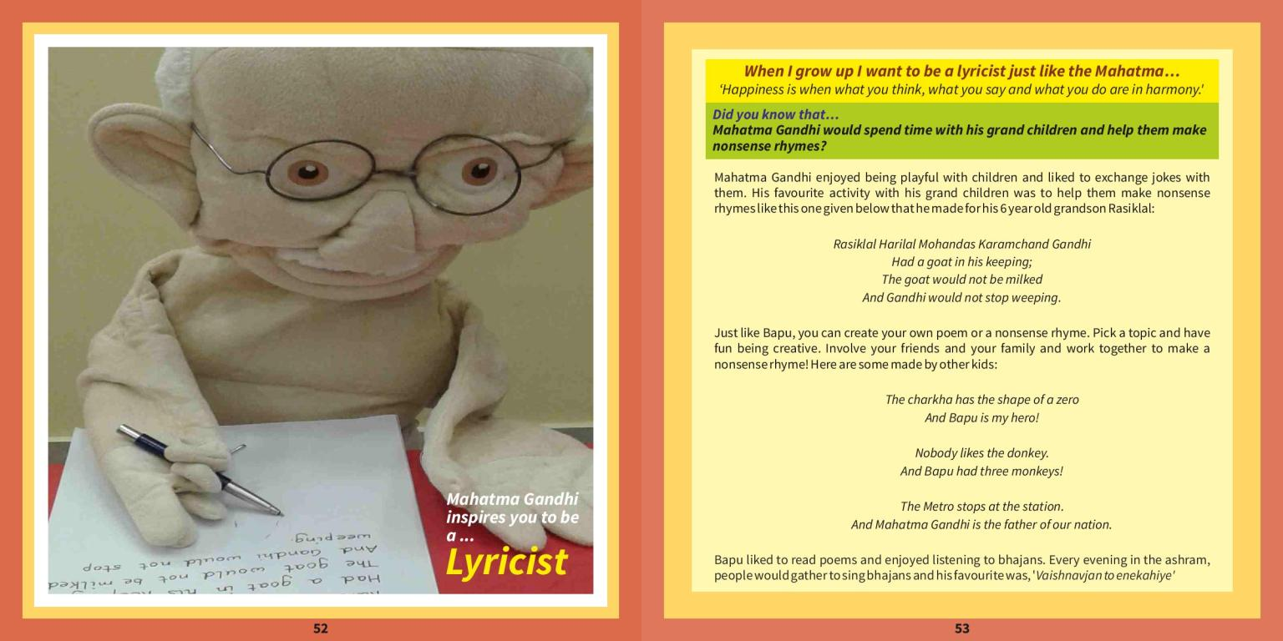

Slide 24
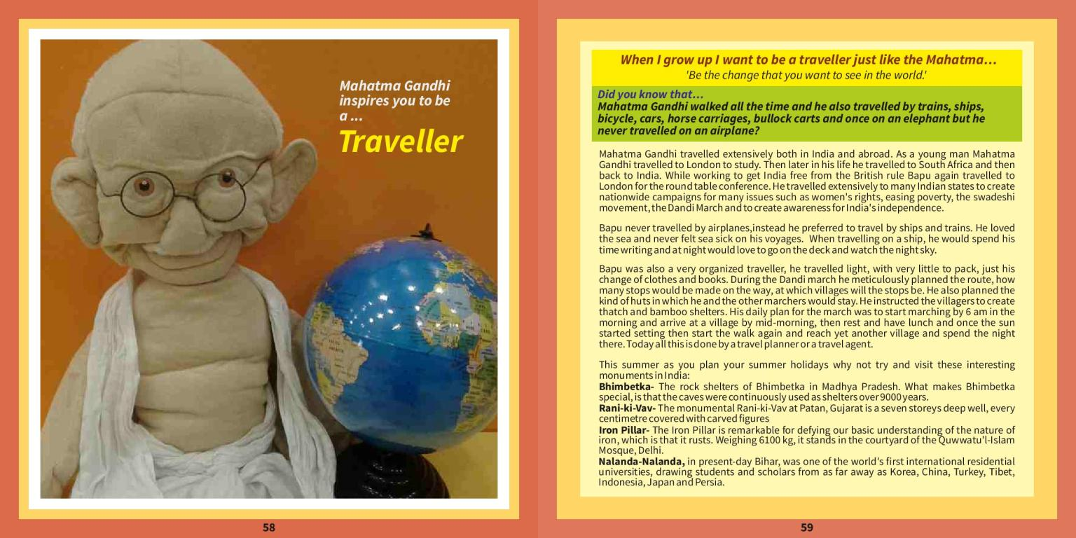

Slide 25
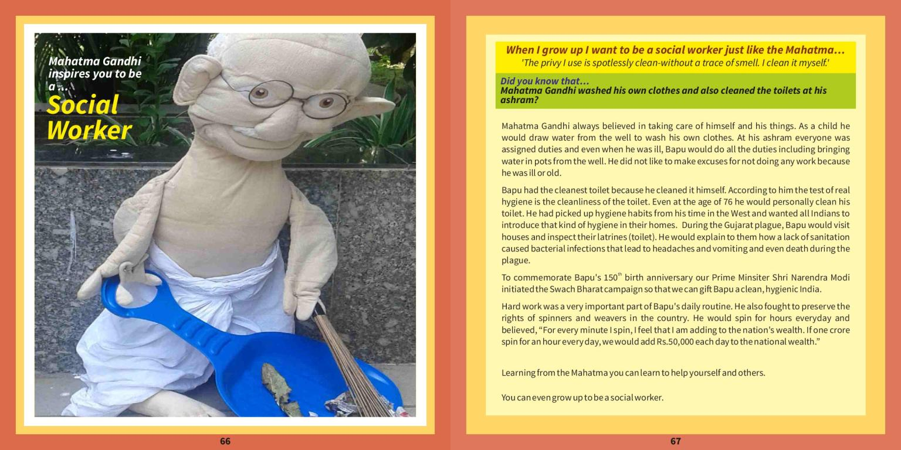

Slide 26
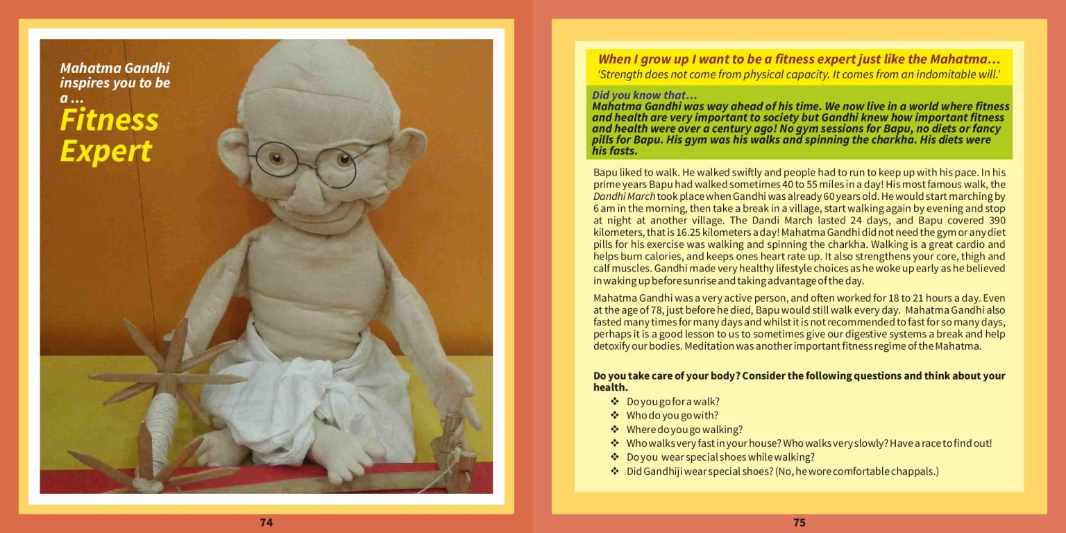

Slide 27
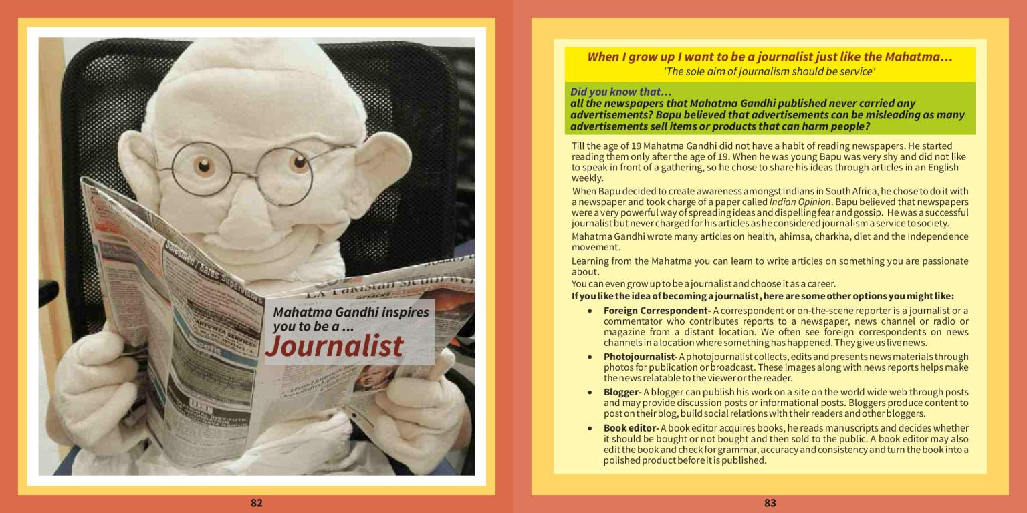

Slide 28
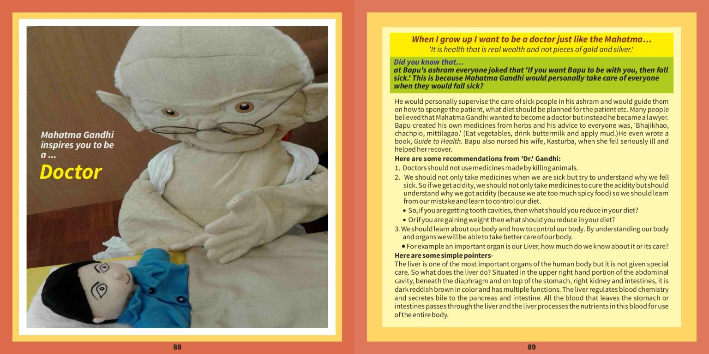

Slide 29
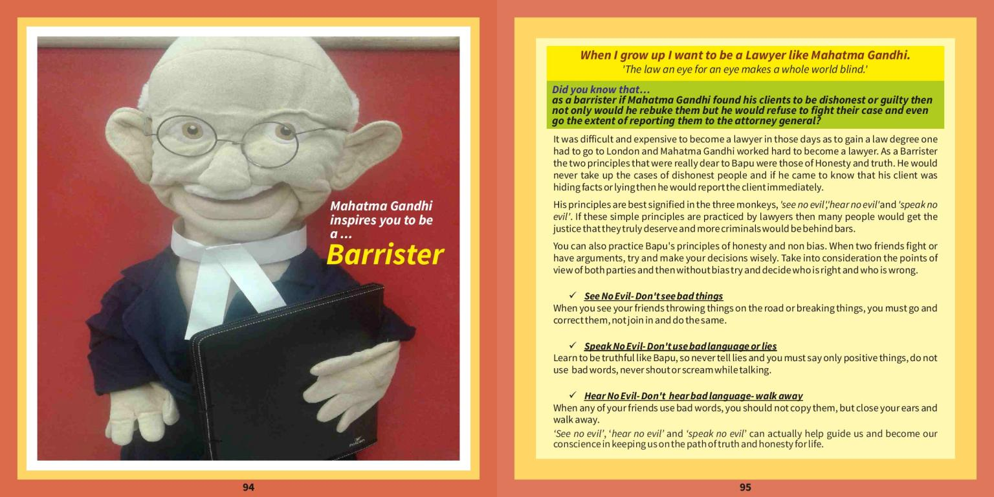

Slide 30
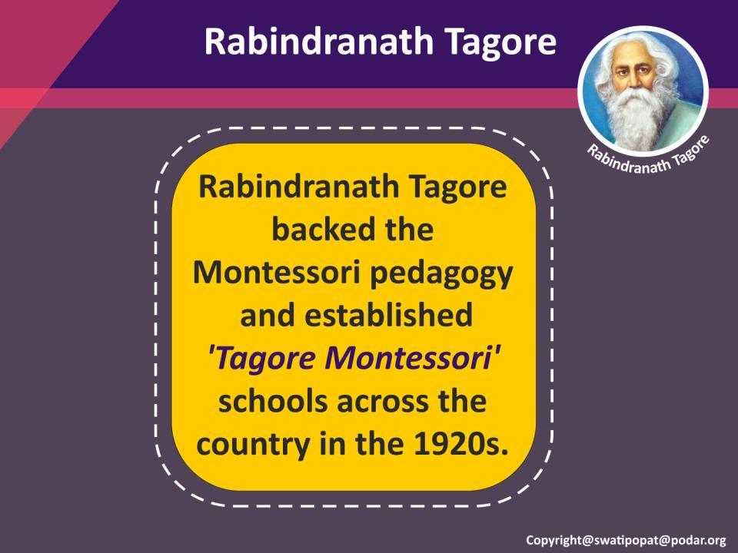

Slide 31
Tagore’s satire on Education Tota Kahini (Parrot’s training)
1918

Slide 32
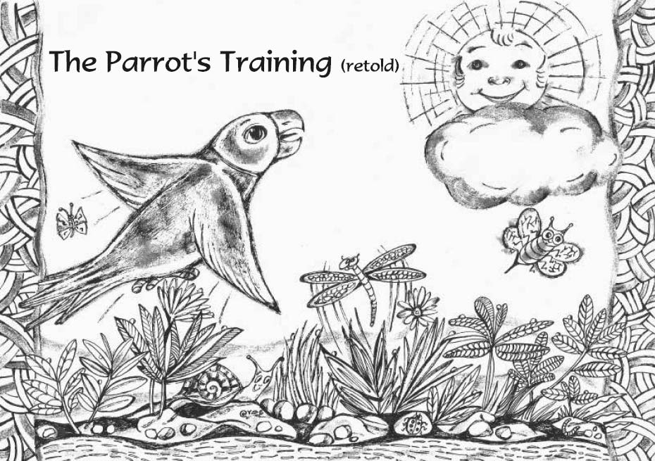

Slide 33
THE PARROT’S TRAINING
Rabindranath Tagore
Once upon a time, there was a bird. It was ignorant. It sang all right, but never recited scriptures. It hopped pretty frequently, but lacked manners. Said the Raja to himself: ‘Ignorance is costly in the long run. For fools consume as much food as their betters, and yet give nothing in return.’ He called his nephews to his presence and told them that the bird must have a sound schooling. The pundits were summoned, and at once went to the root of the matter. They decided that the ignorance of birds was due to their natural habit of living in poor nests. Therefore, according to the pundits, the first thing necessary for this bird's education was a suitable cage.
The pundits had their rewards and went home happy. A golden cage was built with gorgeous decorations. Crowds came to see it from all parts of the world. ‘Culture, captured and caged!’ exclaimed some, in a rapture of ecstasy, and burst into tears. Others remarked:

Slide 34
‘Even if culture be missed, the cage will remain, to the end, a substantial fact. How fortunate for the bird!’
The goldsmith filled his bag with money and lost no tune in sailing homewards. The pundit sat down to educate the bird. With proper deliberation he took his pinch of snug: as he said: ‘Textbooks can never be too many for our purpose!’ The nephews brought together an enormous crowd of scribes. They copied from books, and copied from copies, till the manuscripts were piled up to an unreachable height. Men murmured in amazement. ‘Oh, the tower of culture, egregiously high! The end of it lost in the clouds!’ The scribes, with light hearts, hurried home, their pockets heavily laden. The nephews were furiously busy keeping the cage in proper trim. As their constant scrubbing and polishing went on, the people said with satisfaction: ‘This is progress indeed!’ Men were employed in large numbers and supervisors were still more numerous. These, with their cousins of all different degrees of distance, built a palace for themselves and lived there happily ever after.
Whatever may be its other deficiencies, the world is never in want of fault-finders; and they went about saying that every creature remotely connected with the cage flourished beyond words, excepting only the bird. When this remark reached the Raja's ears, he

Slide 35
summoned his nephews before him and said: ‘My dear nephews, what is this that we hear?’ The nephews said in answer: ‘Sire, let the testimony of the goldsmiths and the pundits, the scribes and the supervisors be taken, if the truth is to be known. Food is scarce with the fault-finders, and that is why their tongues have gained in sharpness.’
The explanation was so luminously satisfactory that the Raja decorated each one of his nephews with his own rare jewels. The Raja at length, being desirous of seeing with his own eyes how his Education Department busied itself with the little bird, made his appearance one day at the great Hall of Learning. From the gate rose the sounds of conch-shells and gongs, horns, bugles and trumpets, cymbals, drums and kettledrums, tomtoms, tambourines, flutes, fifes, barrel-organs and bagpipes. The pundits began chanting mantras with their topmost voices, while the goldsmiths, scribes, supervisors, and their numberless cousins of all different degrees of distance, loudly raised a round of cheers. The nephews smiled and said: ‘Sire, what do you think of it all?’ The Raja said: ‘It does seem so fearfully like a sound principle of Education!’ Mightily pleased, the Raja was about to remount his elephant, when the fault-finder, from behind some bush, cried out: ‘Maharaja, have you seen the bird?’ ‘Indeed, I have not!’ exclaimed the Raja. ‘I completely forgot about the bird.’

Slide 36
Turning back, he asked the pundits about the method they followed in instructing the bird. It was shown to him. He was immensely impressed. The method was so stupendous that the bird looked ridiculously unimportant in comparison. The Raja was satisfied that there was no flaw in the arrangements. As for any complaint from the bird itself, that simply could not be expected. Its throat was so completely choked with the leaves from the books that it could neither whistle nor whisper. It sent a thrill through one's body to watch the process. This time, while remounting his elephant, the Raja ordered his State ear-puller to give a thorough good pull at both the ears of the fault-finder. The bird thus crawled on, duly and properly, to the safest verge of inanity. In fact, its progress was satisfactory in the extreme.
Nevertheless, Nature occasionally triumphed over training, and when the morning light peeped into the bird's cage it sometimes uttered its wings in a reprehensible manner. And, though it is hard to believe, it pitifully pecked at its bars with its feeble beak. ‘What impertinence!’ growled the kotwal. The blacksmith, with his forge and hammer, took his place in the Raja’s Department of Education. Oh, what resounding blows! The iron chain was soon completed, and the bird's wings were clipped. The Raja's brothers-in-law looked black, and shook their heads, saying: ‘These birds not only lack good sense, but also

Slide 37
gratitude!’ With text-book in one hand and baton in the other, the pundits gave the poor bird what may fitly be called lessons!
The kotwal was honoured with a title for his watchfulness, and the blacksmith for his skill in forging chains. The bird died. Nobody had the least notion how long ago this had happened. The fault-finder was the first man to spread the rumour. The Raja called his nephews and asked them, ‘My dear nephews, what is this that we hear?’ The nephews said: ‘Sire, the bird's education has been completed.’ ‘Does it hop?’ the Raja enquired. ‘Never!’ said the nephews. ‘Does it fly?’ ‘No.’ ‘Bring me the bird,’ said the Raja. The bird was brought to him, guarded by the kotwal and the sepoys and the sowars. The Raja poked its body with
his finger.
Only its inner stuffing of book-leaves rustled. Outside the window, the murmur of the spring breeze amongst the newly budded asoka leaves made the April morning wistful.

Slide 38
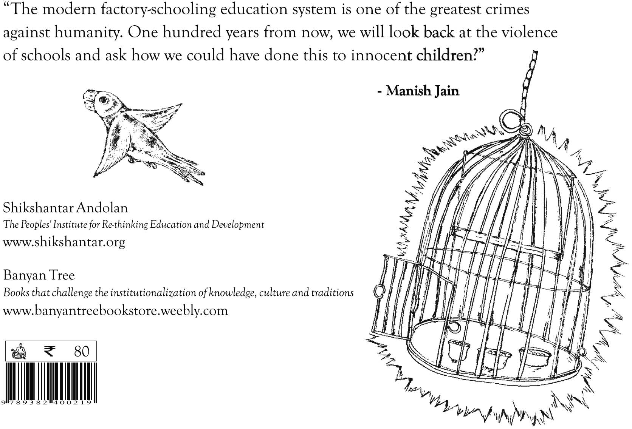

Slide 39
The Parrot's Training (retold)
I would like to share a story that I adapted from the Nobel prize- winning poet and visionary freedom fighter, Rabindranath Tagore, in which he tried to warn us of the dangers of ‘McEducation for All’ almost 75 years ago.

Slide 40
In ‘The Parrot's Training’, we are told of a golden cage that is built to imprison the wild and uncivilized parrot so that she can be properly ‘educated’ by the king's pundits under the Ministry of Animal Resource Development (MARD).
The king was keen that she learn the 3Rs : reading, (w)riting, and (a)rithmetic. In addition, she should learn how to believe in and obey his authority, be proud of her newfound nationalism and borders, know enough English to identify with all the latest corporate brands (and work at a call centre) and be a good global netizen. She should be well-trained to be an engine of economic growth.

Slide 41
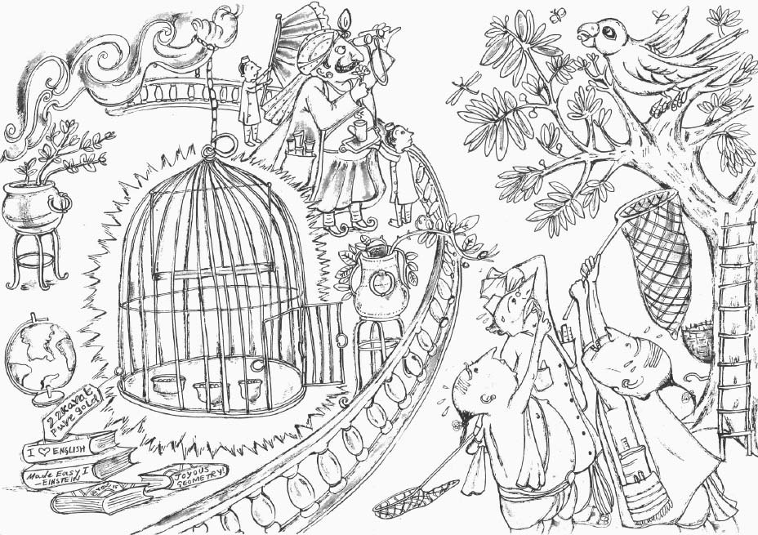

Slide 42
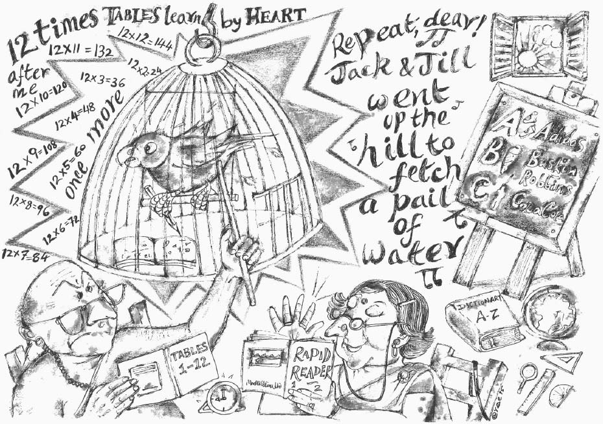

Slide 43
First, the teachers tried stuffing the bird with pages of knowledge from the official government textbooks. When she did not cooperate, she was prescribed Ritalin to improve her concentration and tame her
‘hyper-activity’. Extra private tuition classes were also given and time for free play was drastically reduced. That did not work.

Slide 44
Then, a project came with all kinds of child-friendly and joyful teaching-learning materials and training programs for the teachers. A special Happy School leadership training was given to the principal. They also taught the girl-child parrot about her child rights. That did not work.

Slide 45
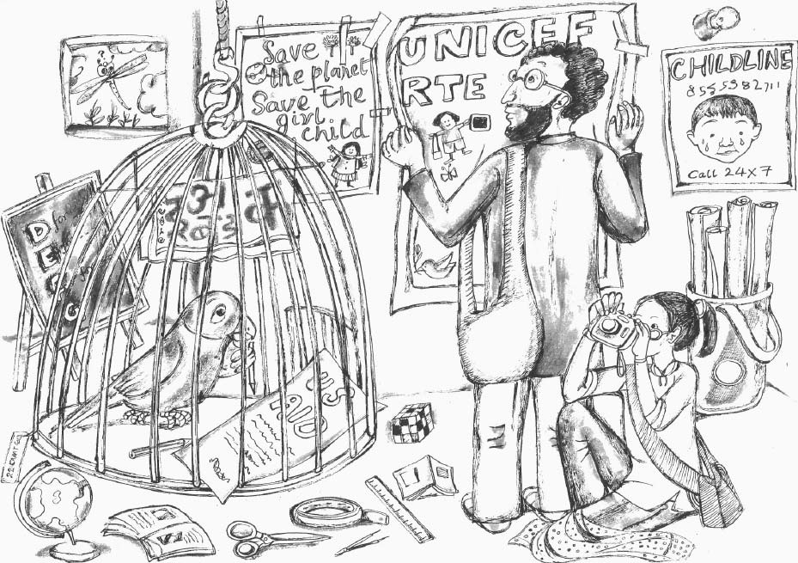

Slide 46
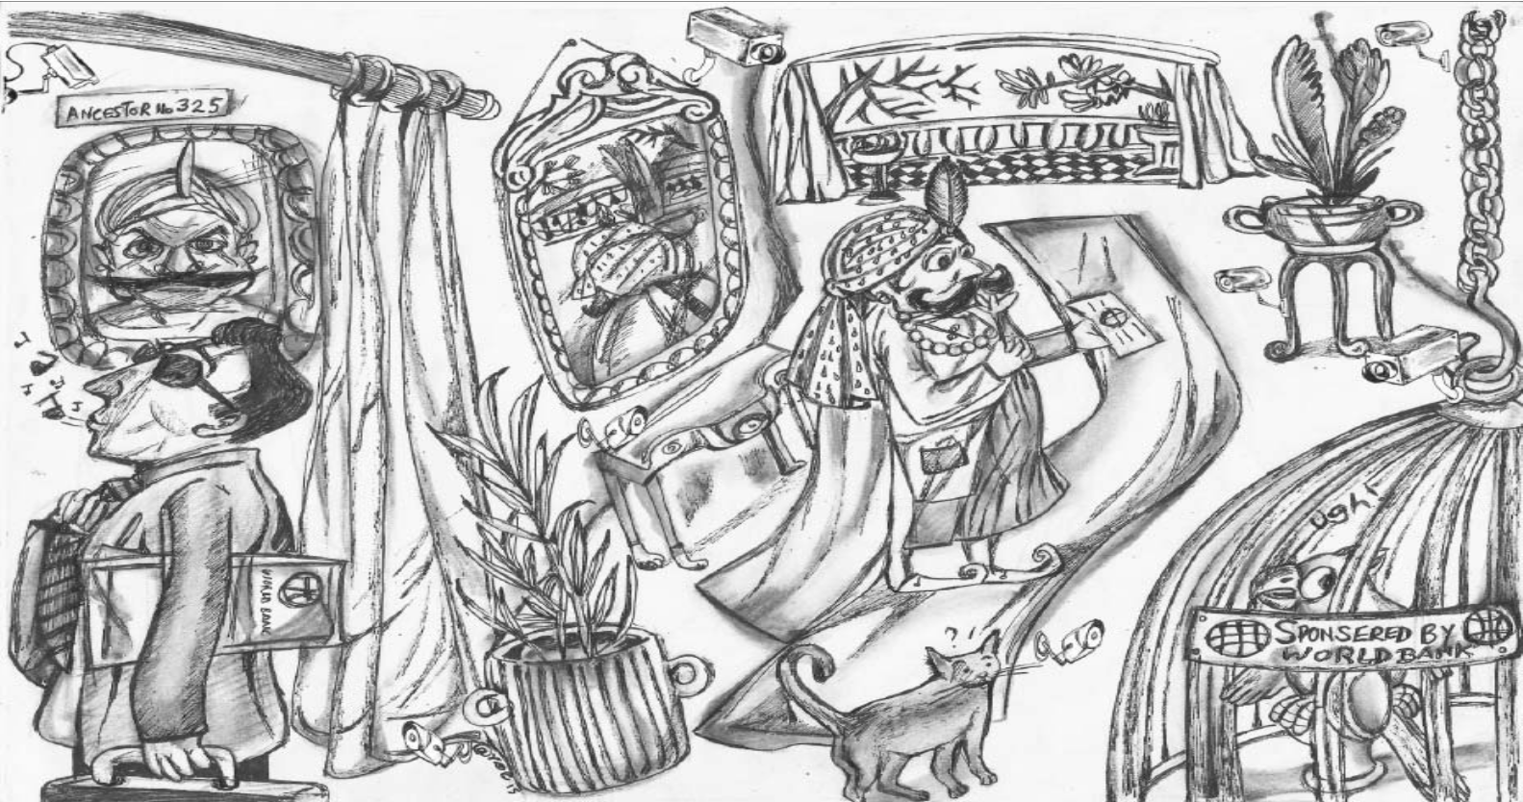

Slide 47
She wanted to leave the cage but was not allowed. The World Bank gave a loan to the king (with austerity conditionalities, of course) to build a bigger cage with a nice toilet. CCTV cameras were also installed to ensure discipline of the teachers and the parrot. ‘Big Brother’ was grinning incessantly. But even that did not work.

Slide 48
Harvard researchers were invited to conduct studies on the parrot's brain and multiple intelligences. Many research papers were written. The parrot was bombarded with every latest theory after theory. With time, she started losing confidence in her own gift of song.

Slide 49
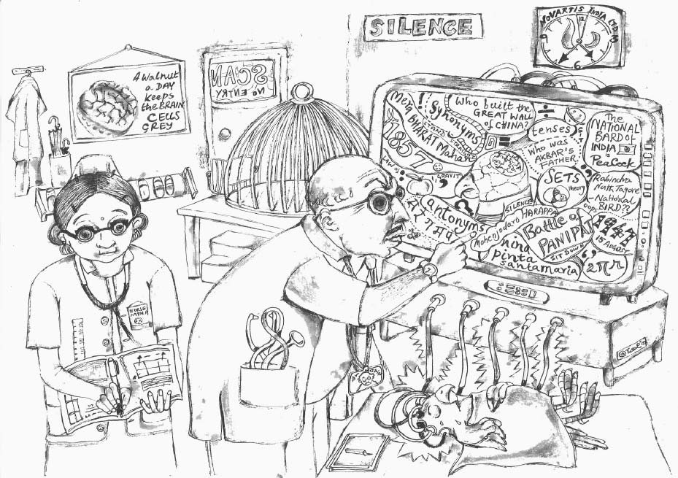

Slide 50
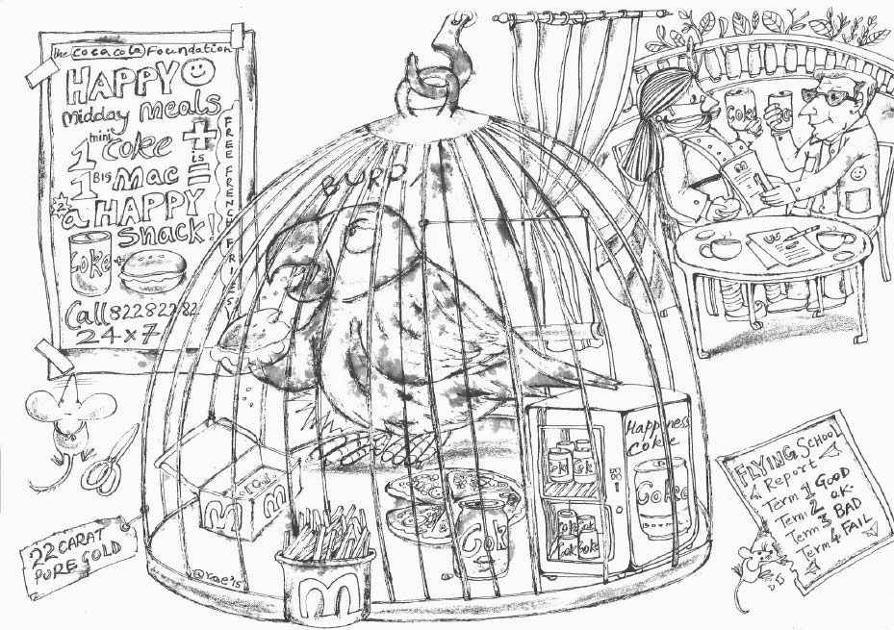

Slide 51
In a great display of public-private partnership, Cola-Cola Foundation helped to set up a special Happiness Coke vending machine in the cage. McTonald's too decided to help out by offering a mid-day Happy Meal for the parrot. The parrot started to become obese from all the empty calories and could no longer fly.

Slide 52
Then, the OECD came with the PISA standardized tests and a new national policy white paper was written. The king and his ministers lined up to take lots of photographs celebrating their renewed commitment to educate poor, backward, illiterate parrots.
These photos were published with great fanfare in newspapers around the world. But even that did not work.

Slide 53
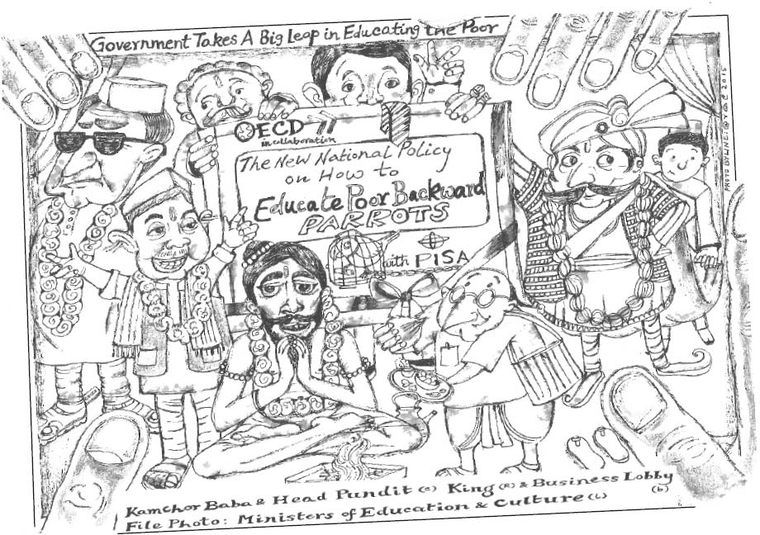

Slide 54
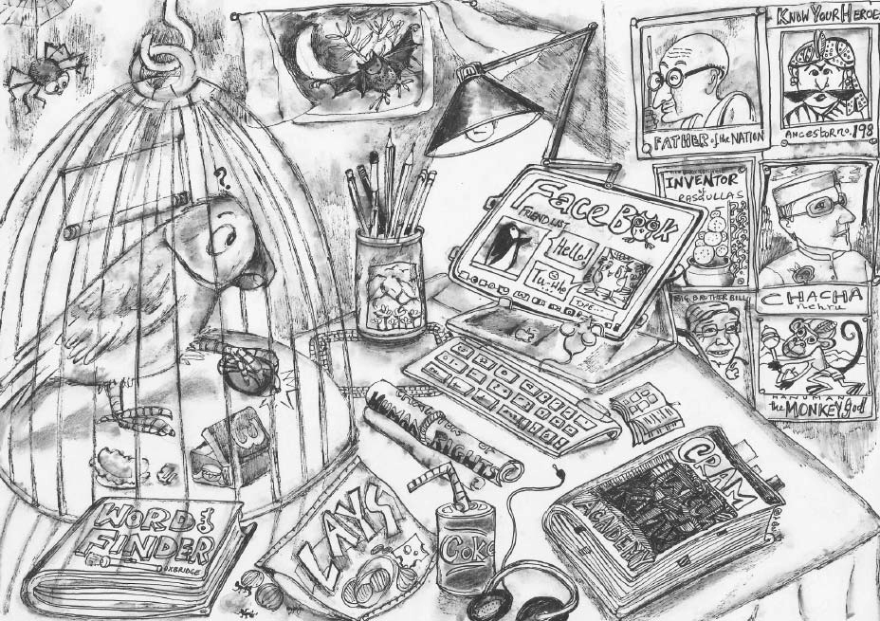

Slide 55
Then, technology gurus from PineApple gave her an iPad and a free high speed WIFI connection to access the cloud. She was made to watch videos from K Academy. Soon, they even set up a Facebook account for her and encouraged her to make thousands of ‘friends’. That only left her feeling more alone and depressed.

Slide 56
The parrot was not allowed to leave the cage despite her obvious distress. In fact, she was scolded for being ungrateful and impertinent. Time and again, she was reprimanded and made to feel guilty. “We have spent a lot of money for your education and you do not even care. You are wasting your life. You are spoiling your future.”

Slide 57
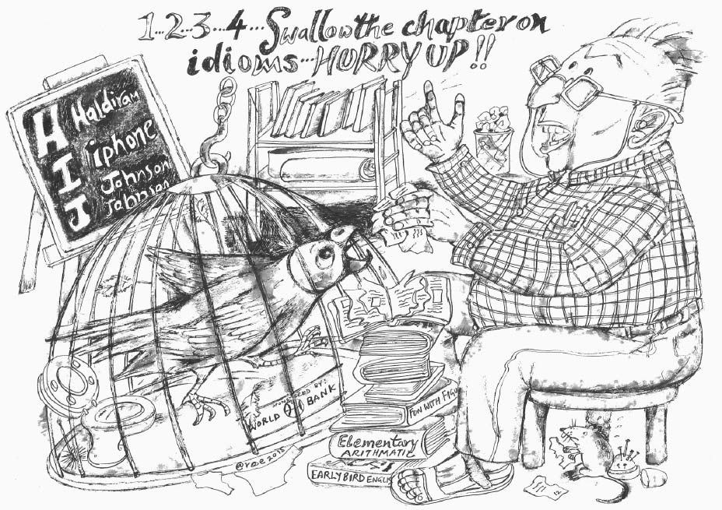

Slide 58
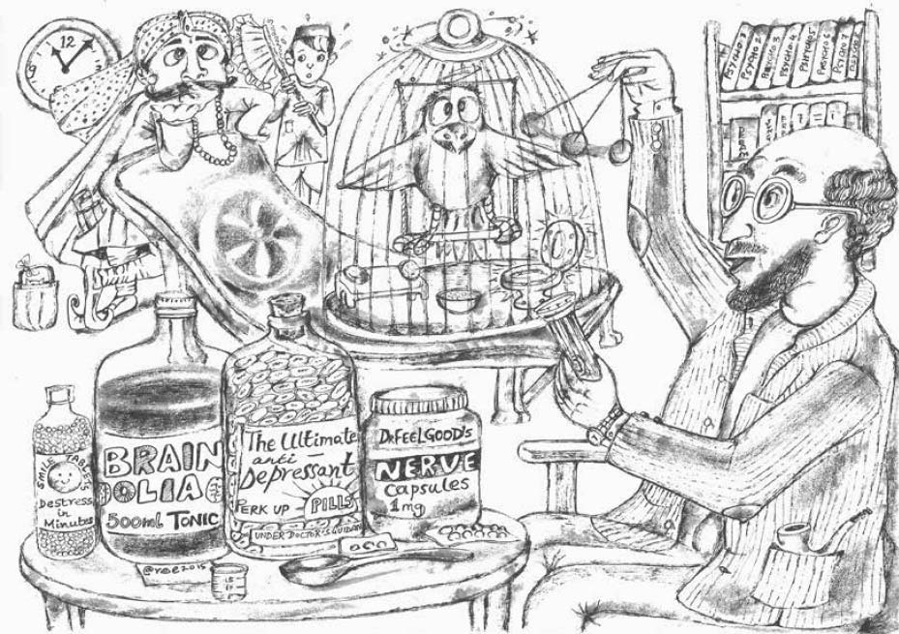

Slide 59
When that didn't work, an hour of mindfulness training was instituted to release all her built-up frustration and aggression.
After all these years of being locked up, the parrot was diagnosed with Nature Deficit Disorder. The king was told that the parrot (and the cage) should be taken to an expensive organic eco-resort during summer holidays to ‘experience nature’.
Later, anti-depressant drugs had to be prescribed as the parrot was caught slitting her wings.

Slide 60
As the parrot was overstuffed with information and tormented by the pressure ‘to achieve’, she internalized her label as a ‘slow learner’ and ‘failure’, and lost confidence in her ability to communicate with the wild and profound intelligence of nature.

Slide 61
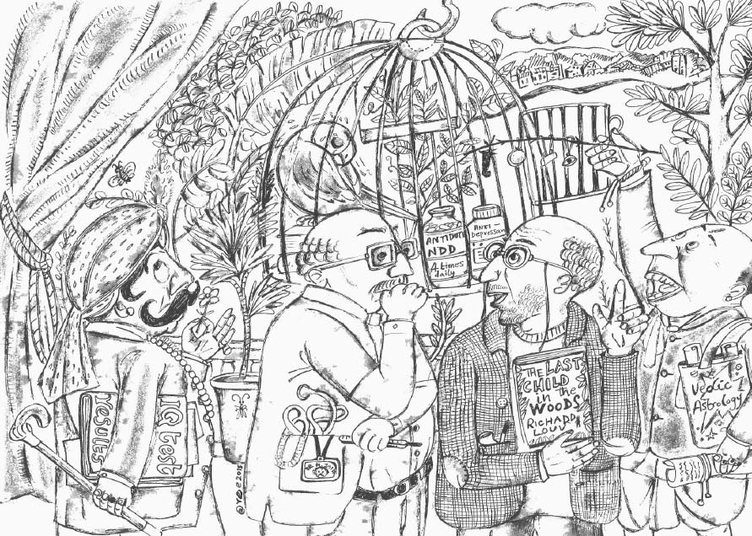

Slide 62
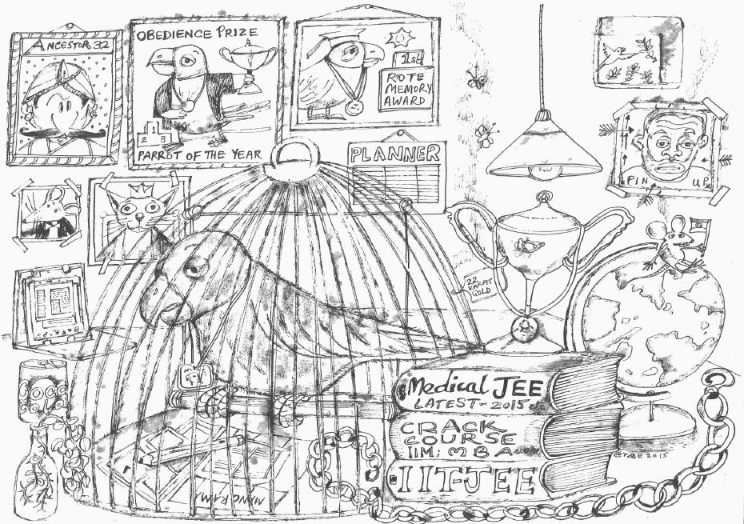

Slide 63
She slowly became totally dependent on the cage. One day, the cage was accidently left open but she was afraid to venture out. She had lost confidence in her natural capacities to learn without institutions.
Her dreams were reduced to being a rat trapped in the rat-race. A deep loss of purpose ensued. Slowly, her spirit withered away.

Slide 64
In the end, a lot of people made a lot of money on the parrot's education. Everyone benefited except the parrot...

Slide 65
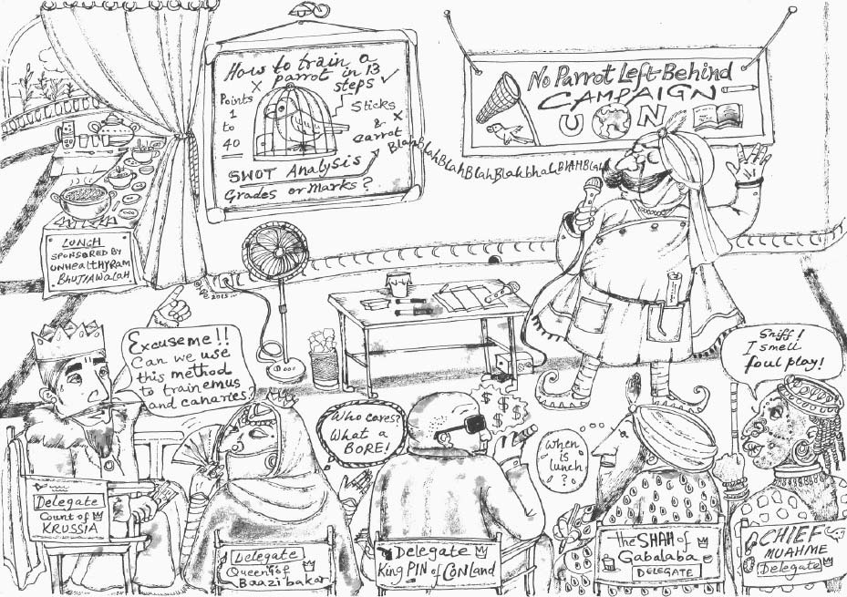

Slide 66
We need to stop recycling educational reforms, solutions or techno-gimmicks from the West (most of which have even failed in their own context).
Co-creating our own visions of a learning society will start with appreciating and re-valuing our own unique cultural gifts and the magical learning spaces and abundant learning resources which surround us all the time. Reclaiming the spirit of laughter, love, gratitude and playfulness is essential to decolonizing our selves.
This story is also a reminder that if we can connect with the pain of the parrot, all is not lost yet. Despite whatever labels the cage has inflicted upon us, each of us still has the power to walk-out and walk-on, to reclaim our own ways of learning and to start rebuilding our diverse local learning systems.
We are not born to be bricks in the Wall, cogs in the Machine, human resources, etc. This life we have been given is wild, magical and precious...

Slide 67
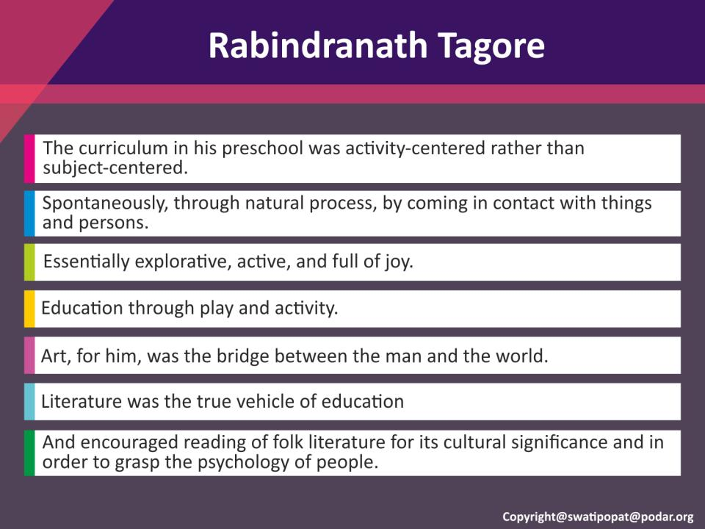

Slide 68
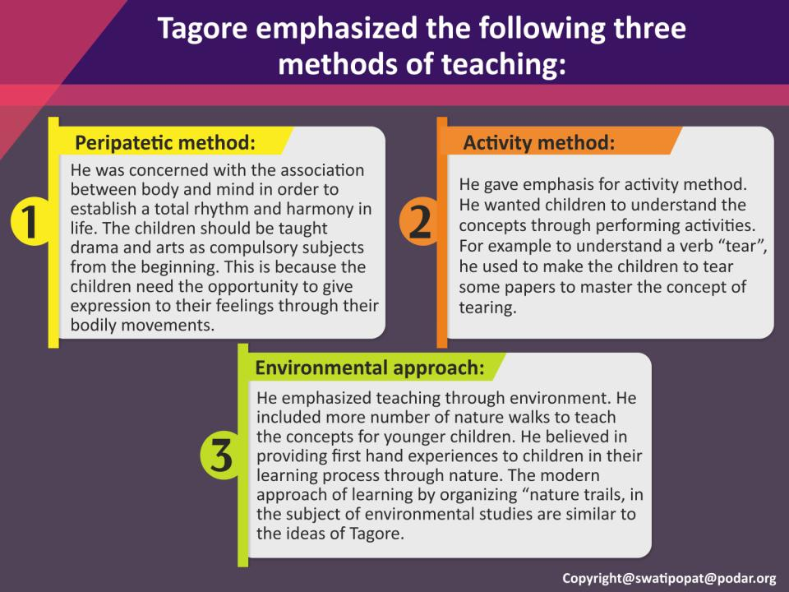

Slide 69
Its time to remove the parrot from the cage and let it fly…
Its time to listen to the pioneers, the same ideas have been incorporated in our National Education Policy 2020

Slide 70
Its time to acknowledge ECE as the starting point of life and learning
ecapresidentindia@gmail.com

