Slide 2
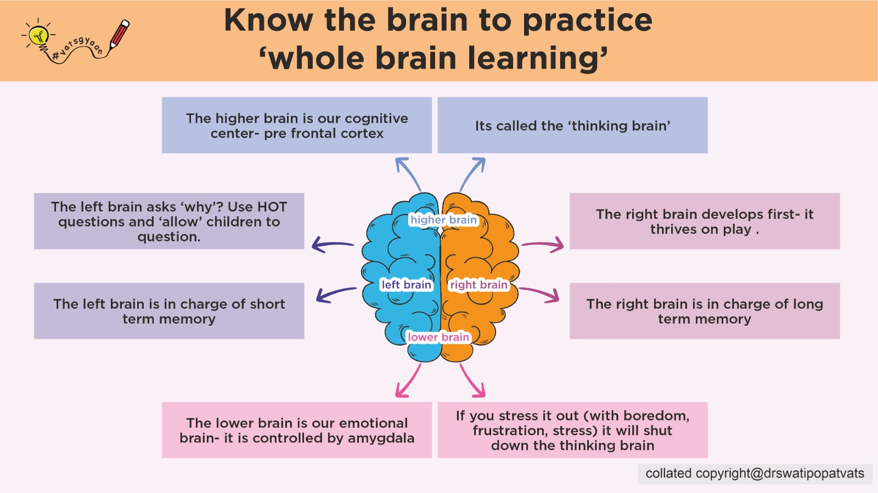

Slide 4
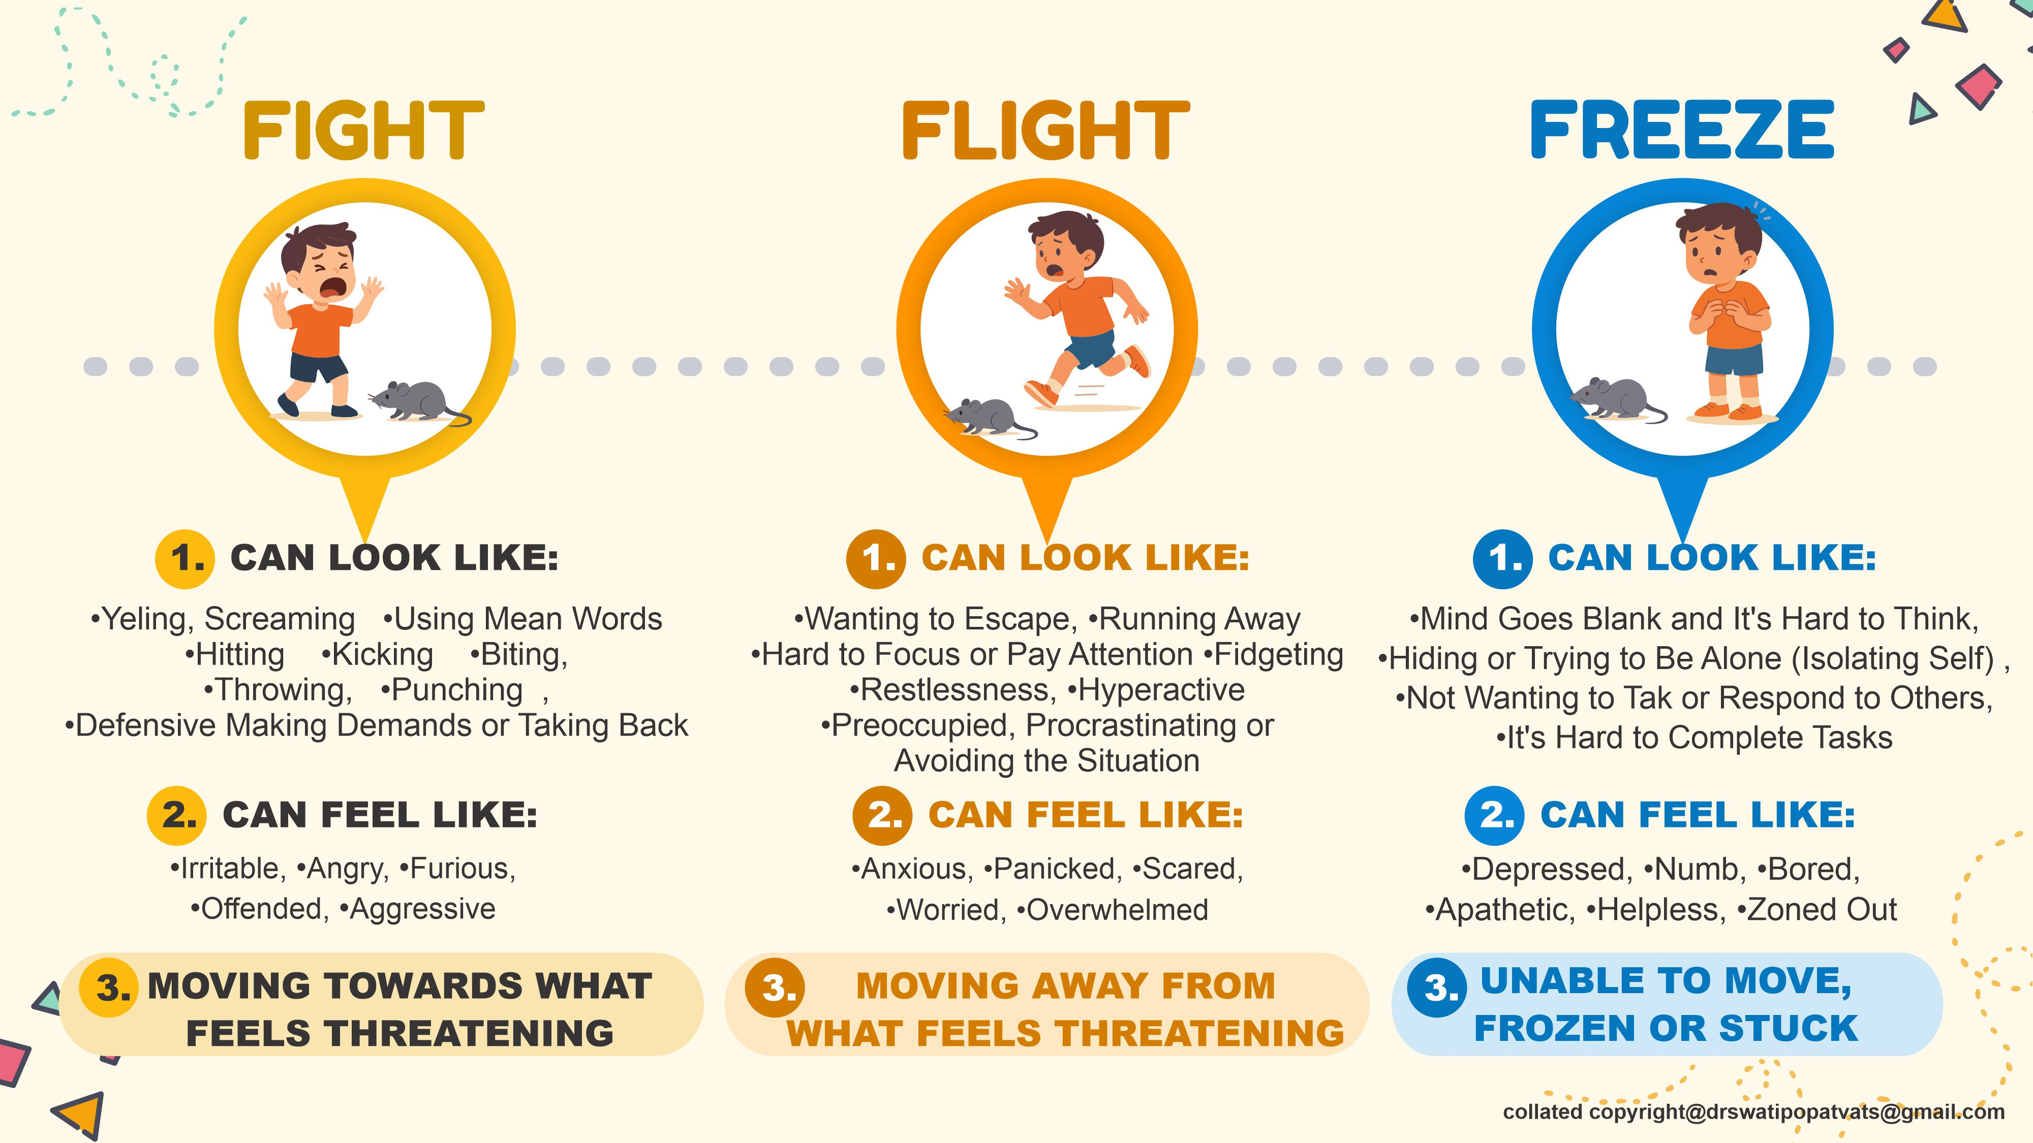

Slide 5
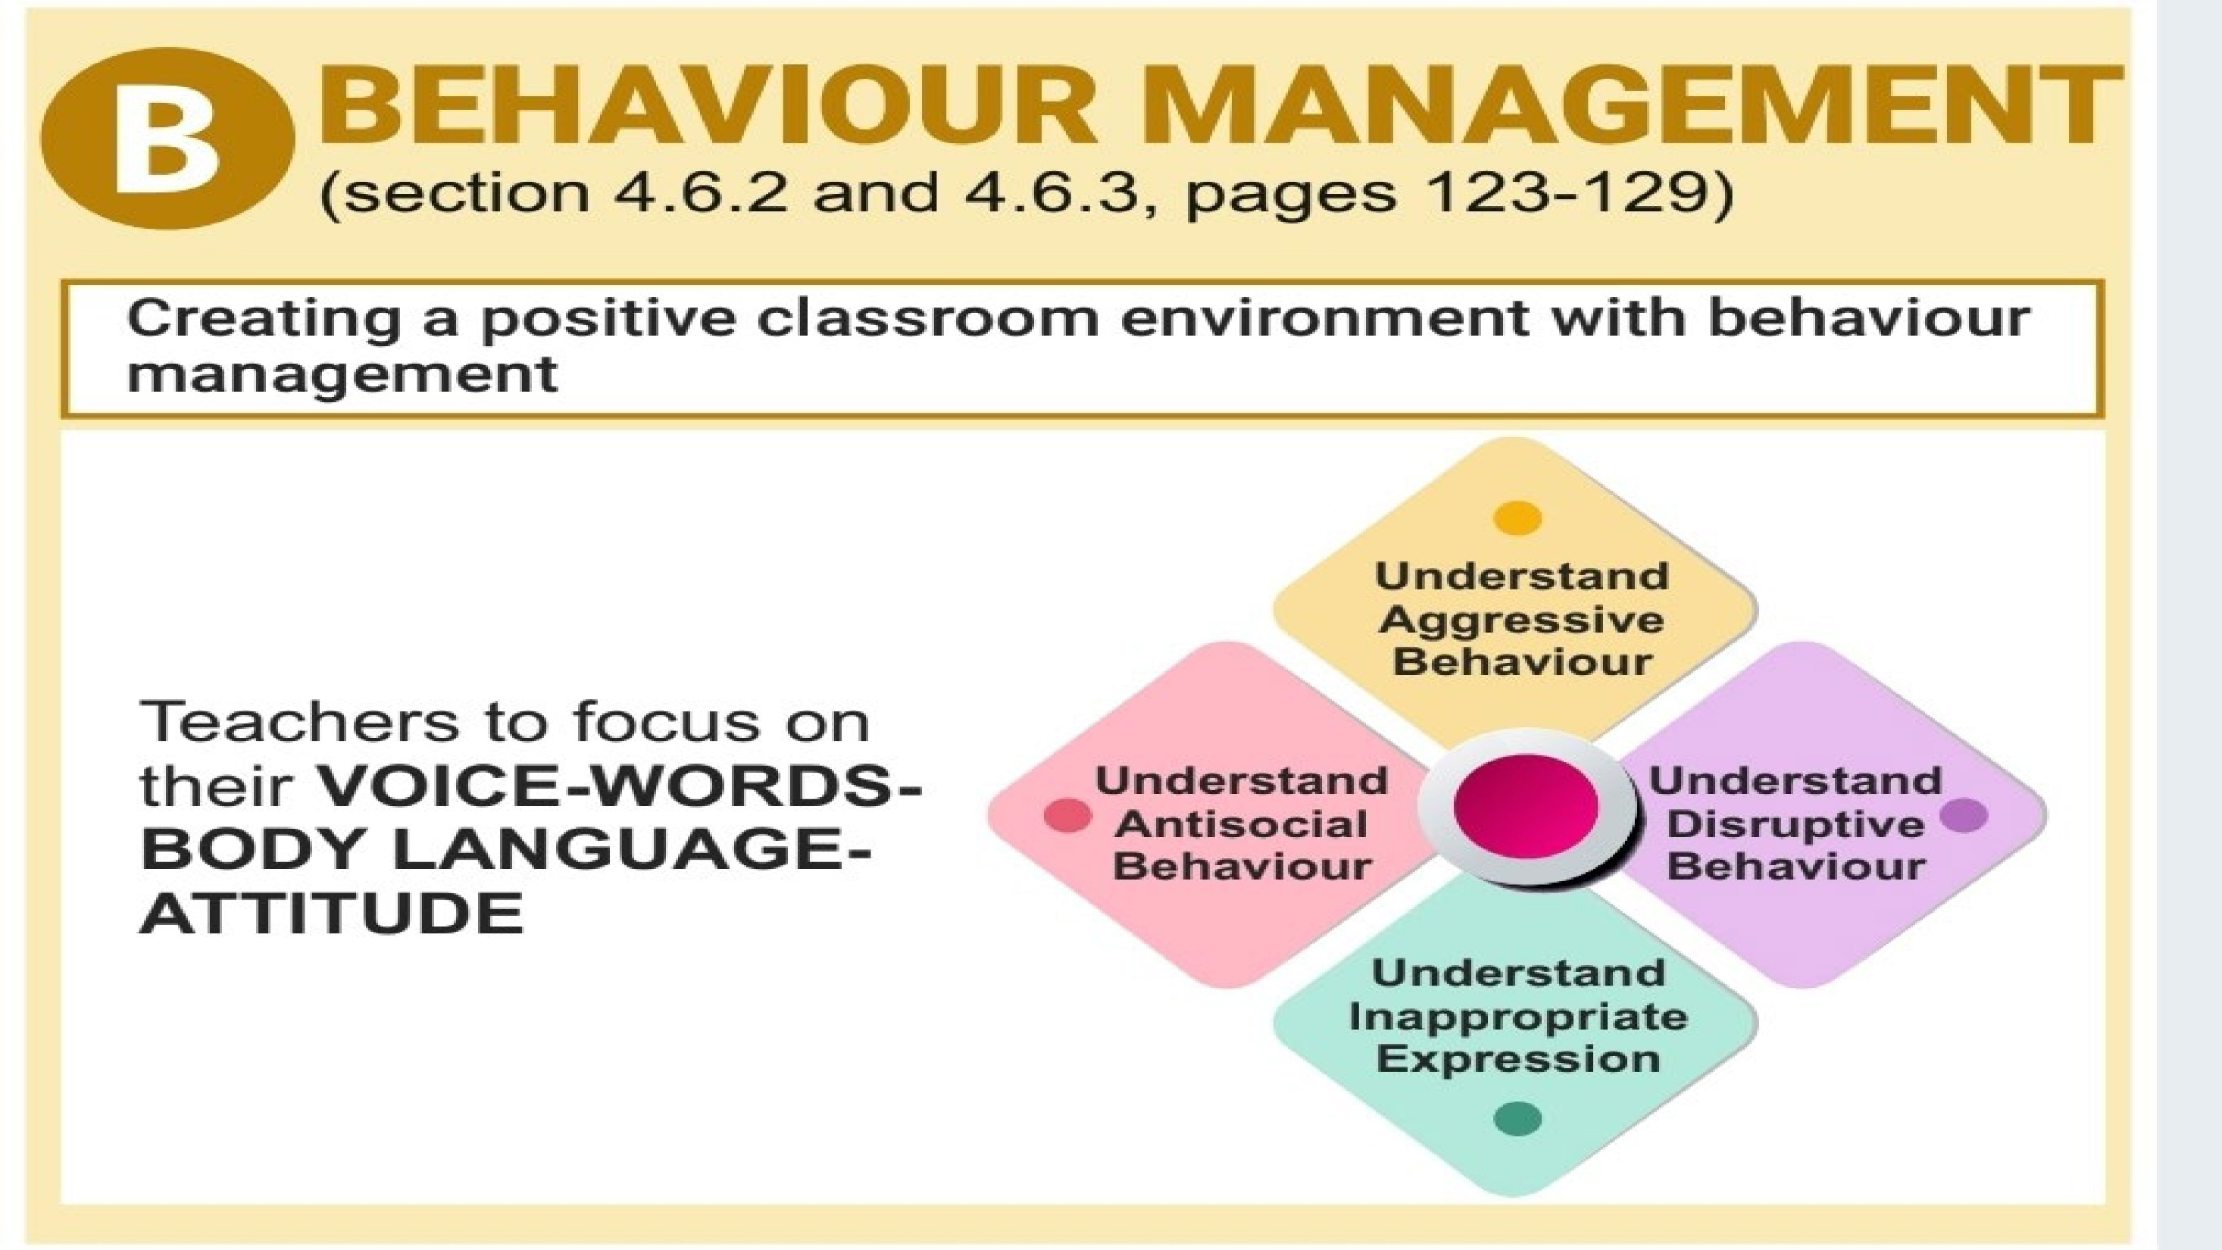
copyright@drswatipopatvats@gmail.com

Slide 6

copyright@drswatipopatvats@gmail.com

Slide 7


Slide 8


Slide 9
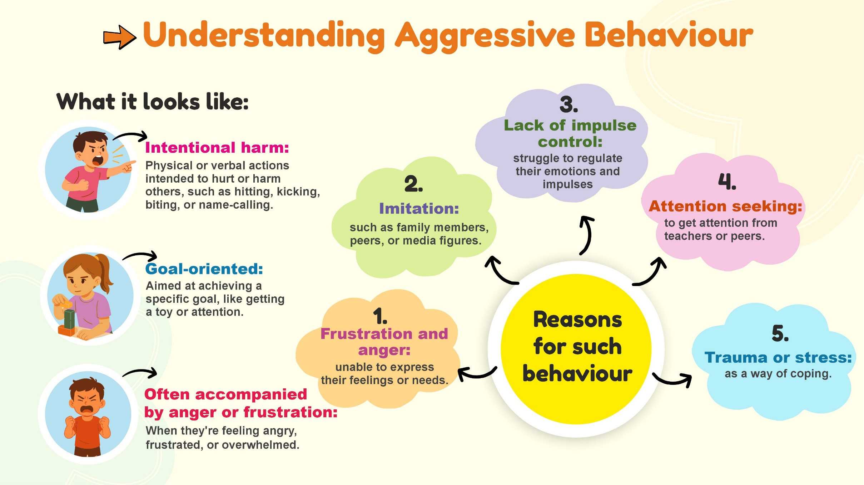
copyright@drswatipopatvats@gmail.com

Slide 10
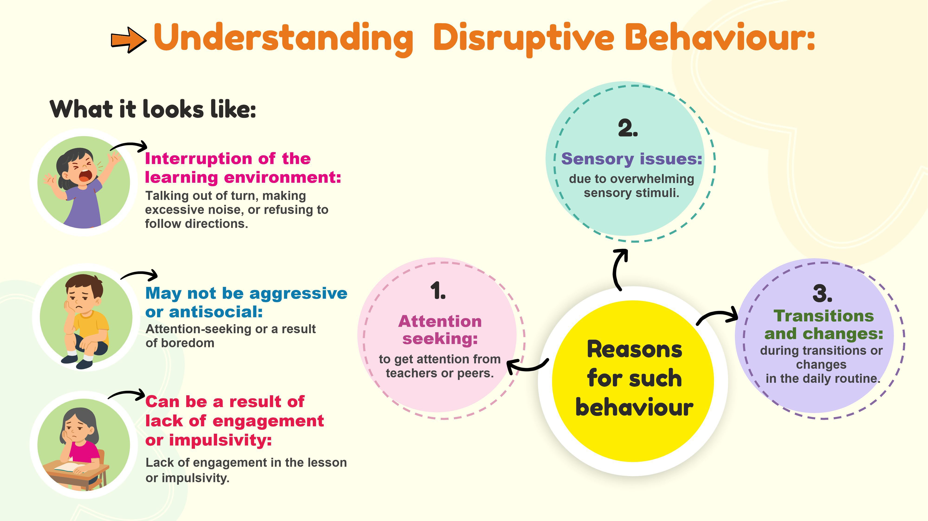
copyright@drswatipopatvats@gmail.com

Slide 11
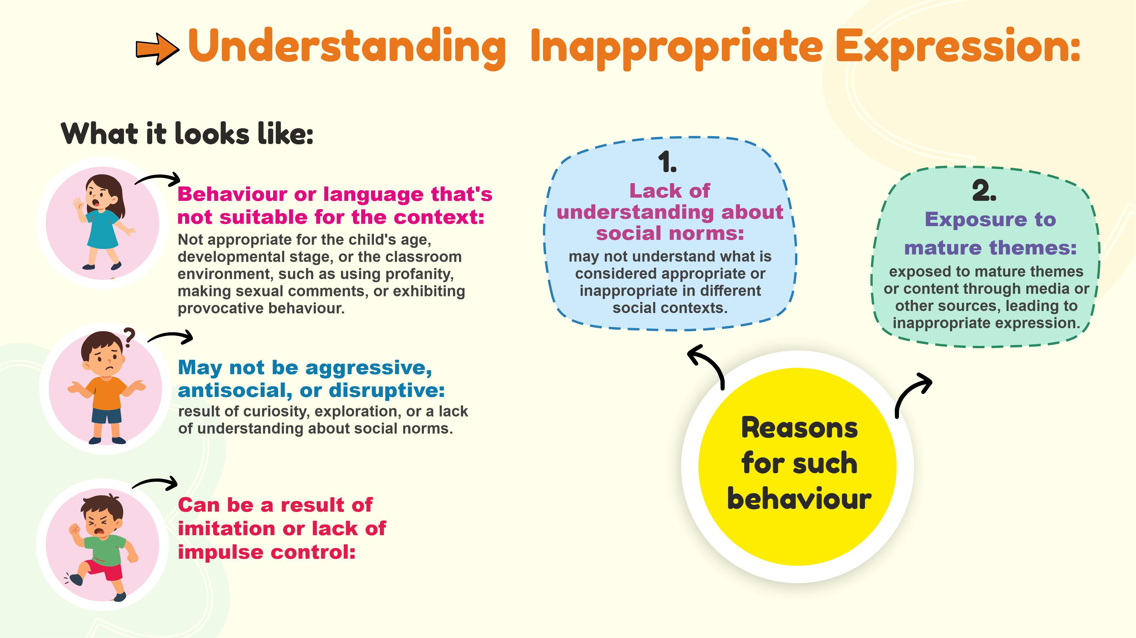
copyright@drswatipopatvats@gmail.com

Slide 12
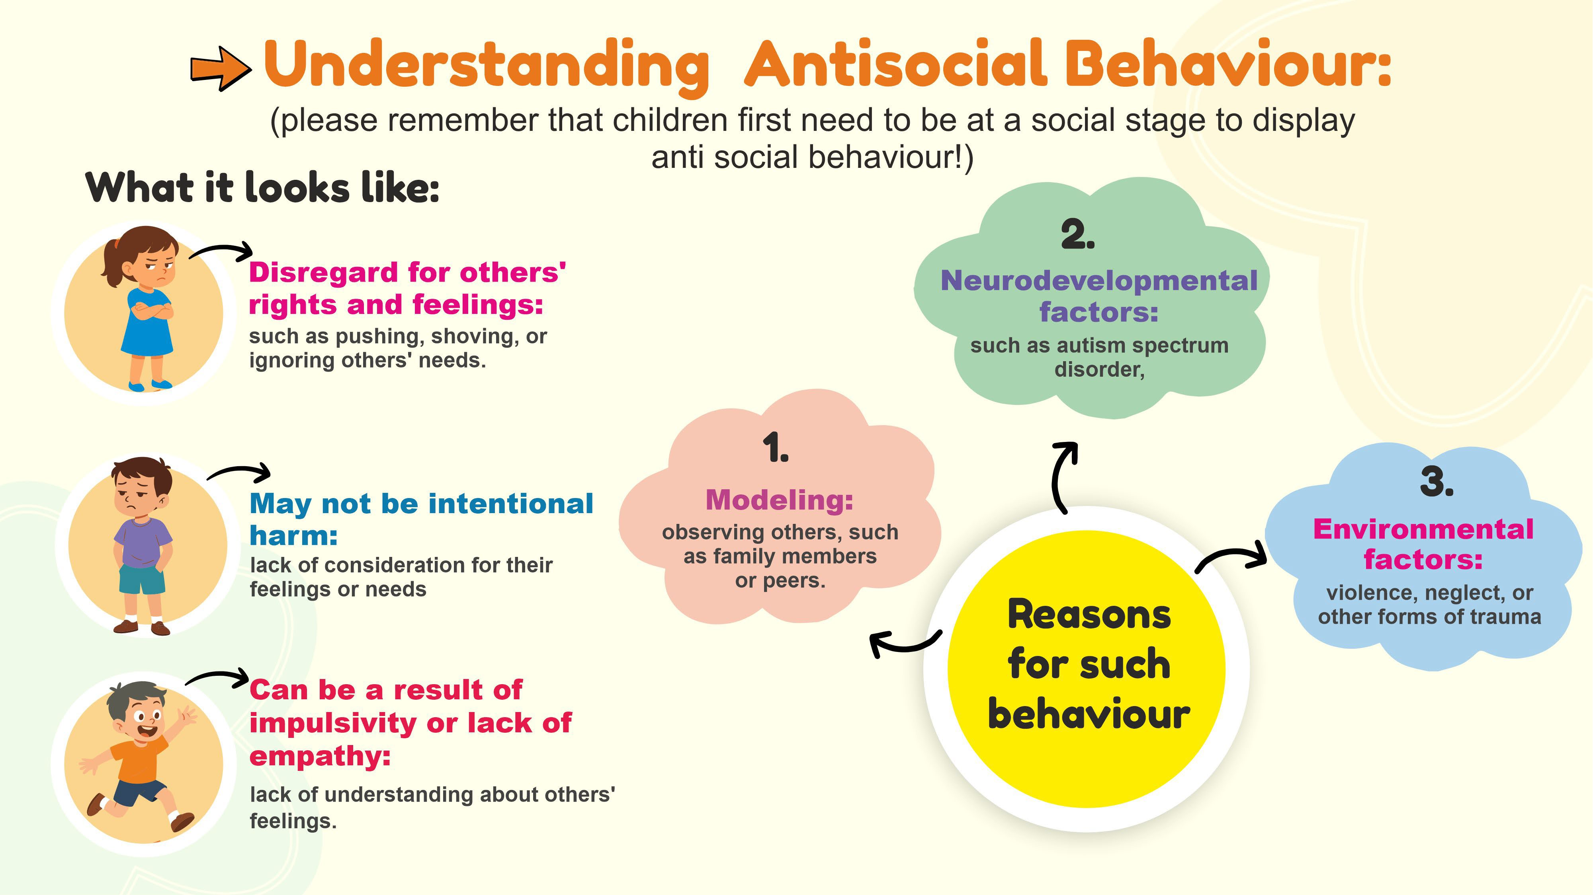
copyright@drswatipopatvats@gmail.com

Slide 13
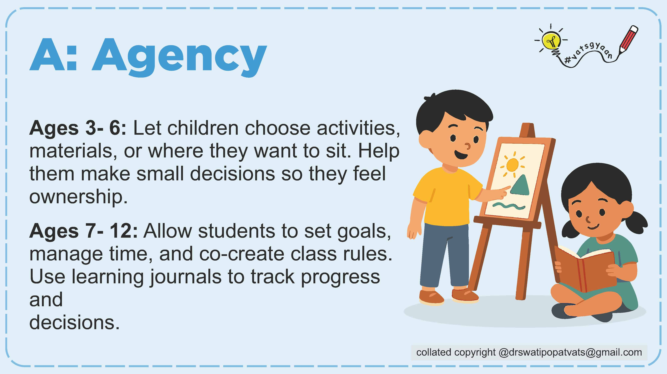

Slide 14
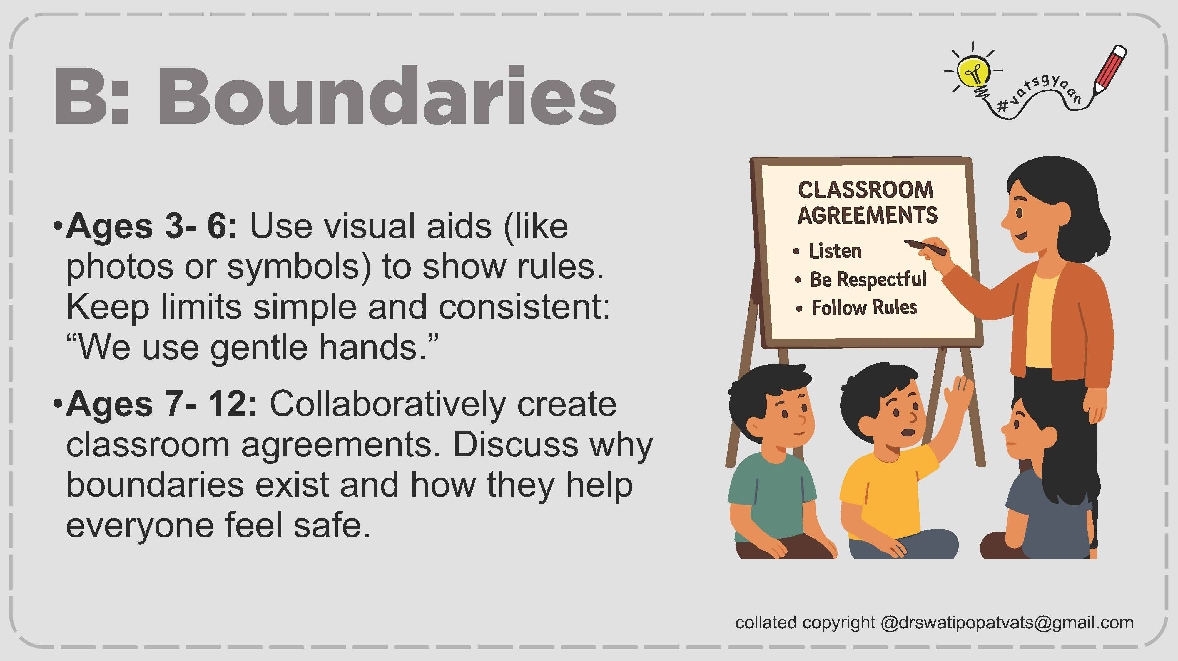

Slide 15

copyright@drswatipopatvats@gmail.com

Slide 16
copyright@drswatipopatvats@gmail.com

Slide 17
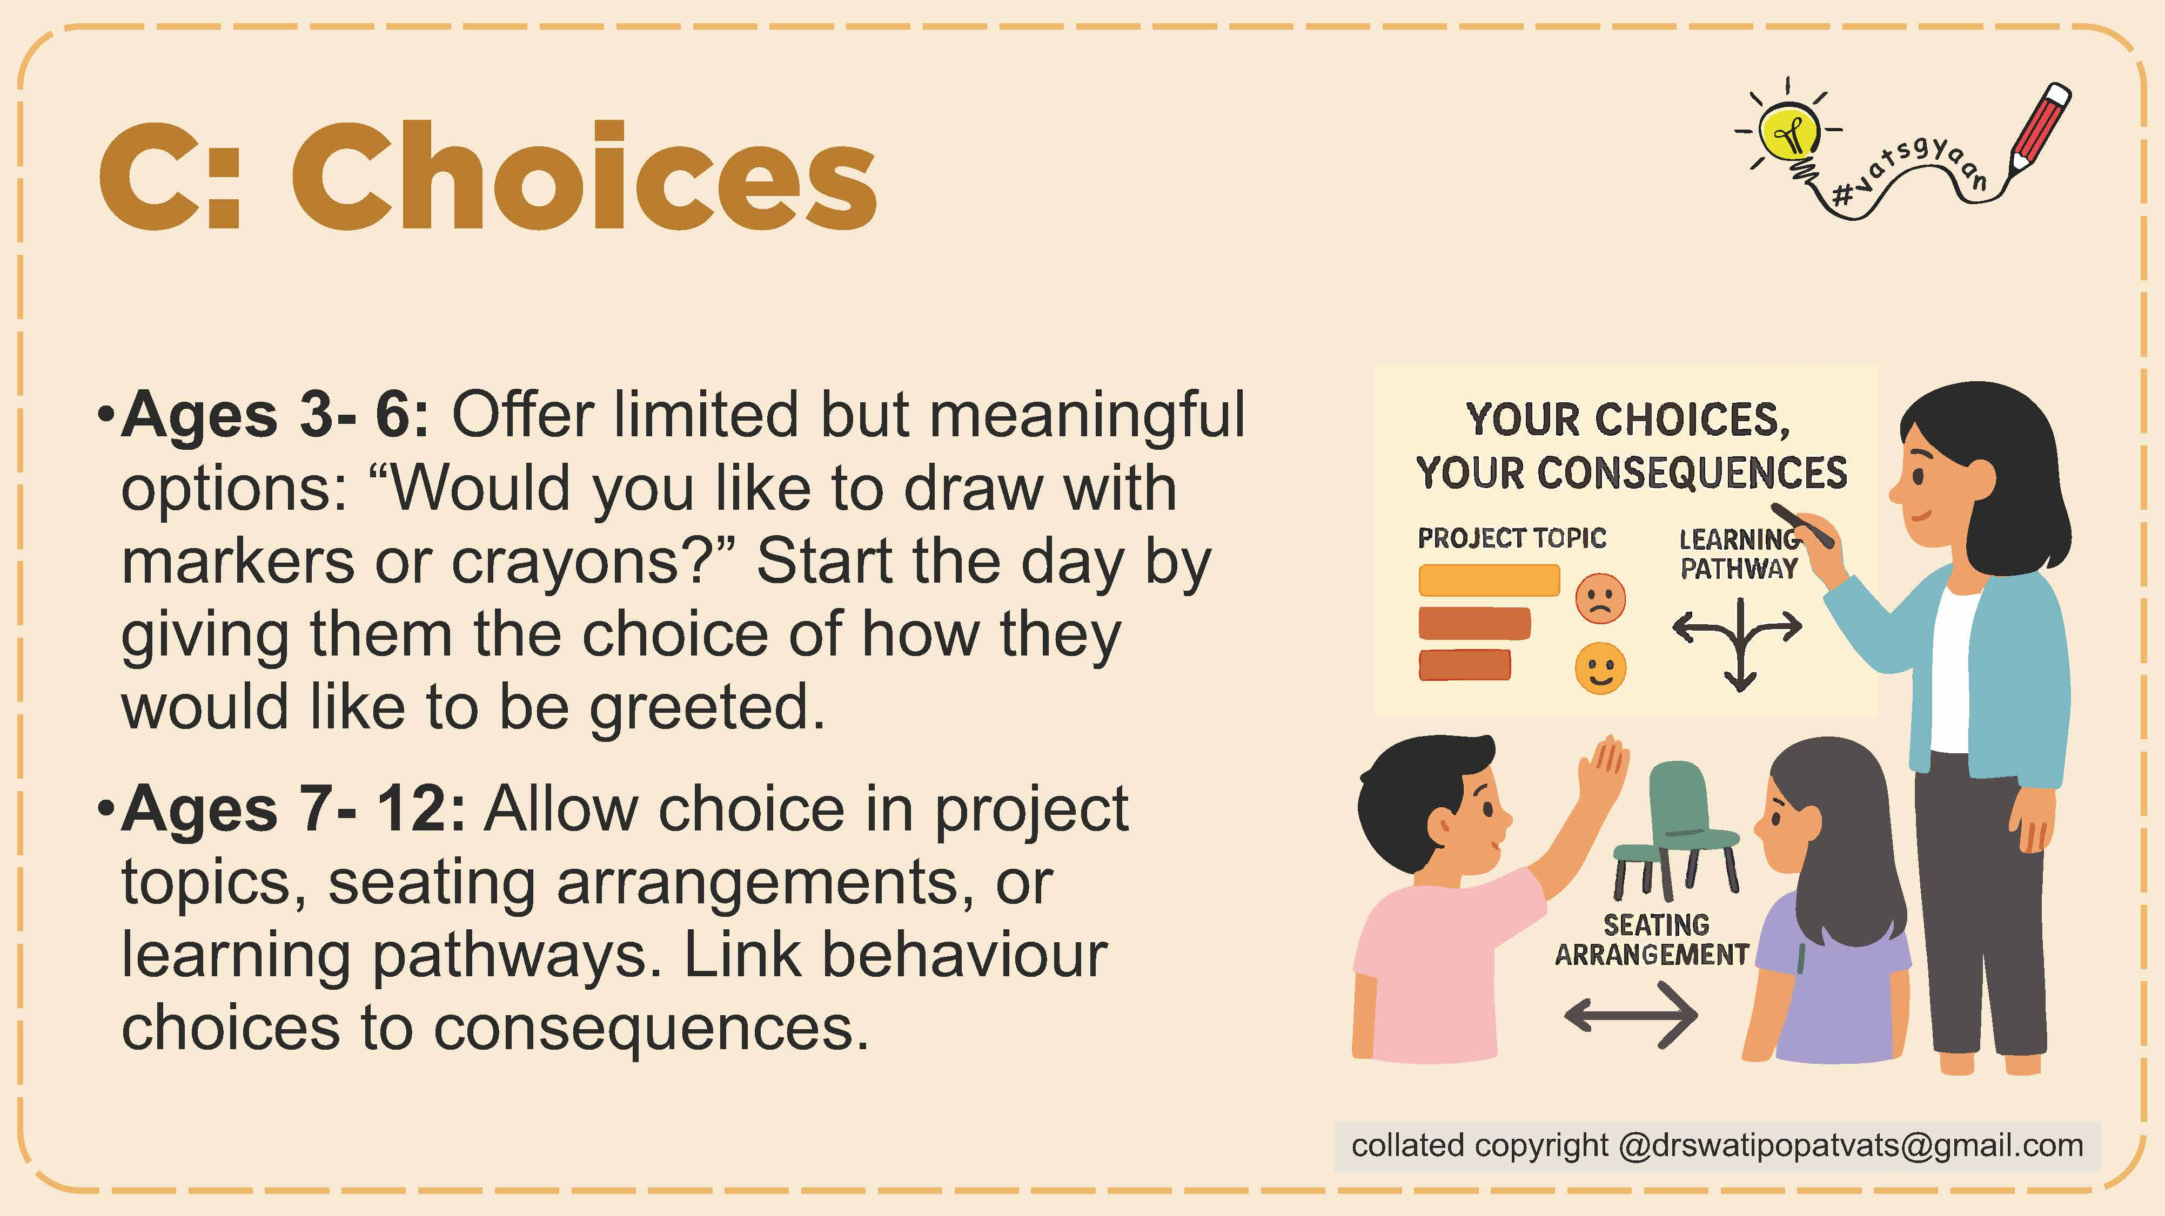

Slide 18
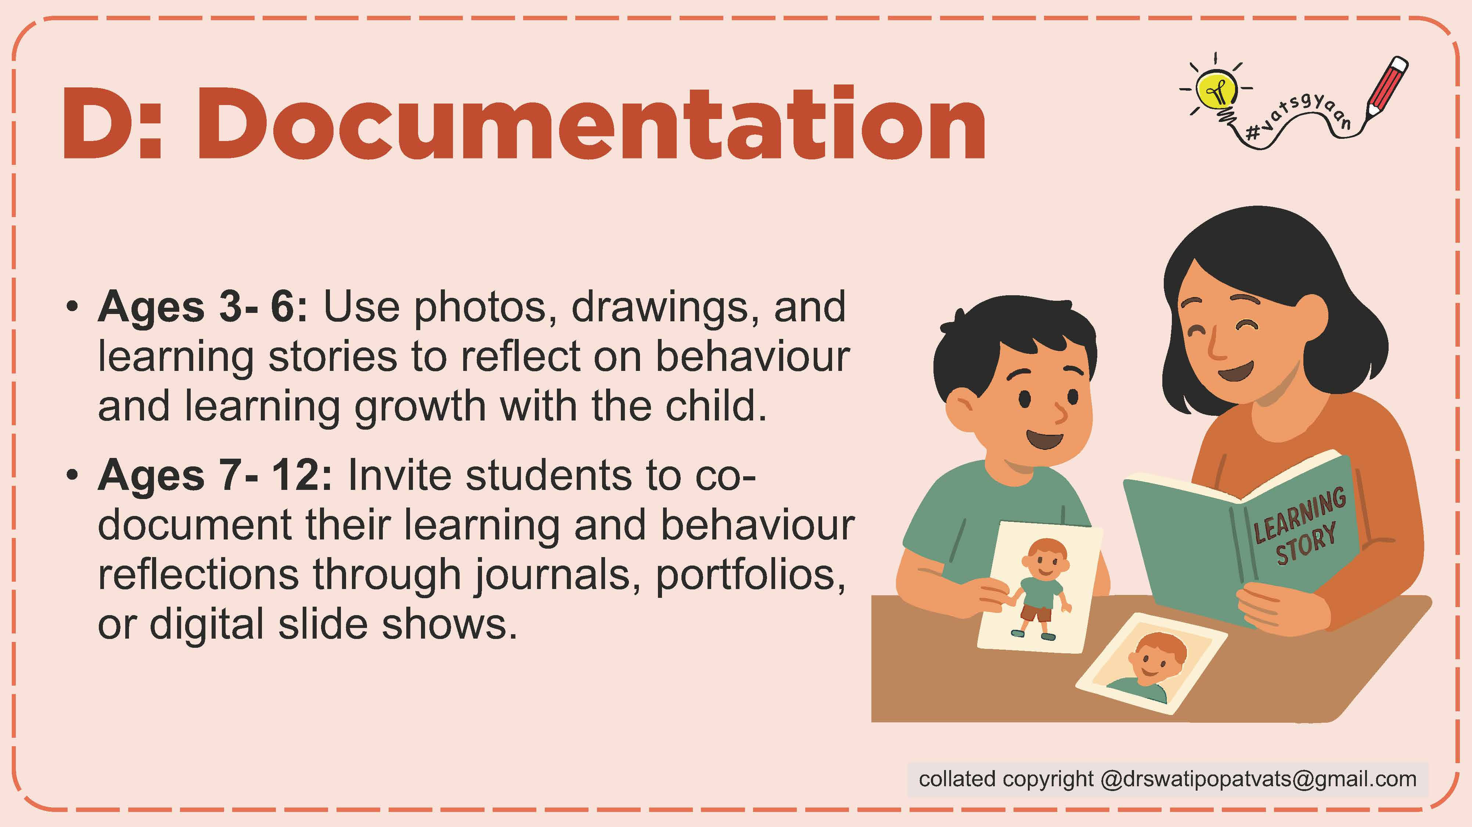

Slide 20



Slide 21
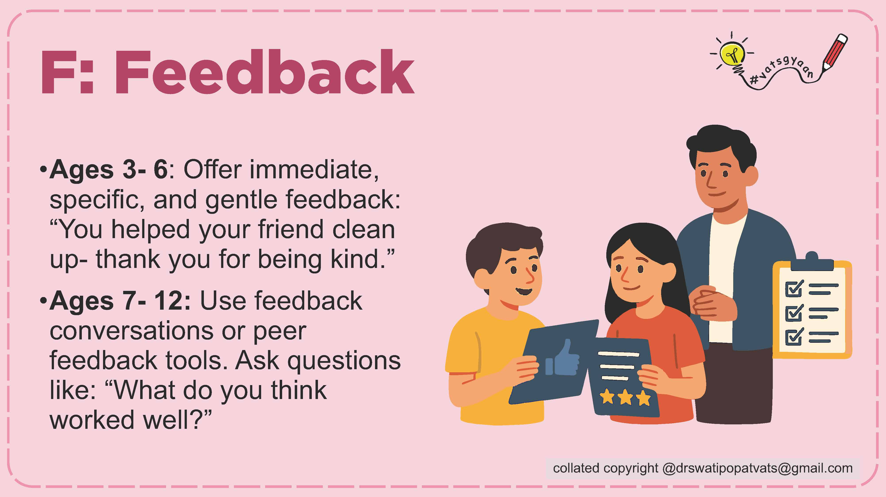

Slide 22


Slide 23
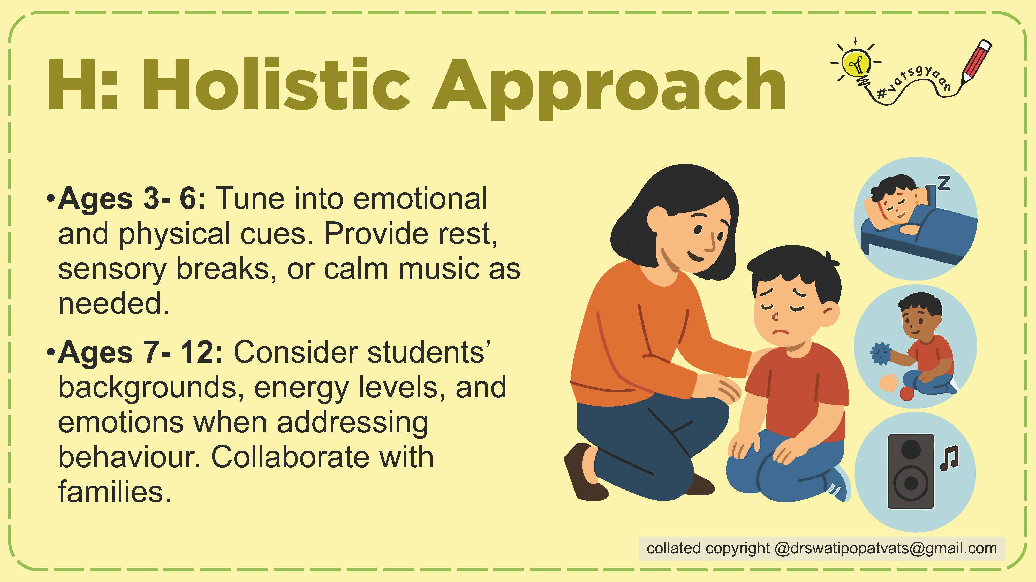

Slide 24
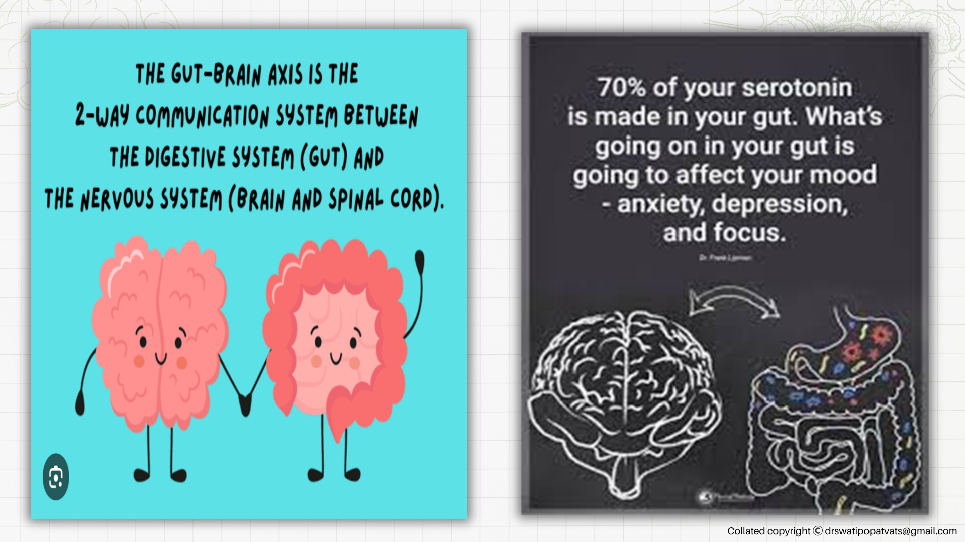

Slide 25
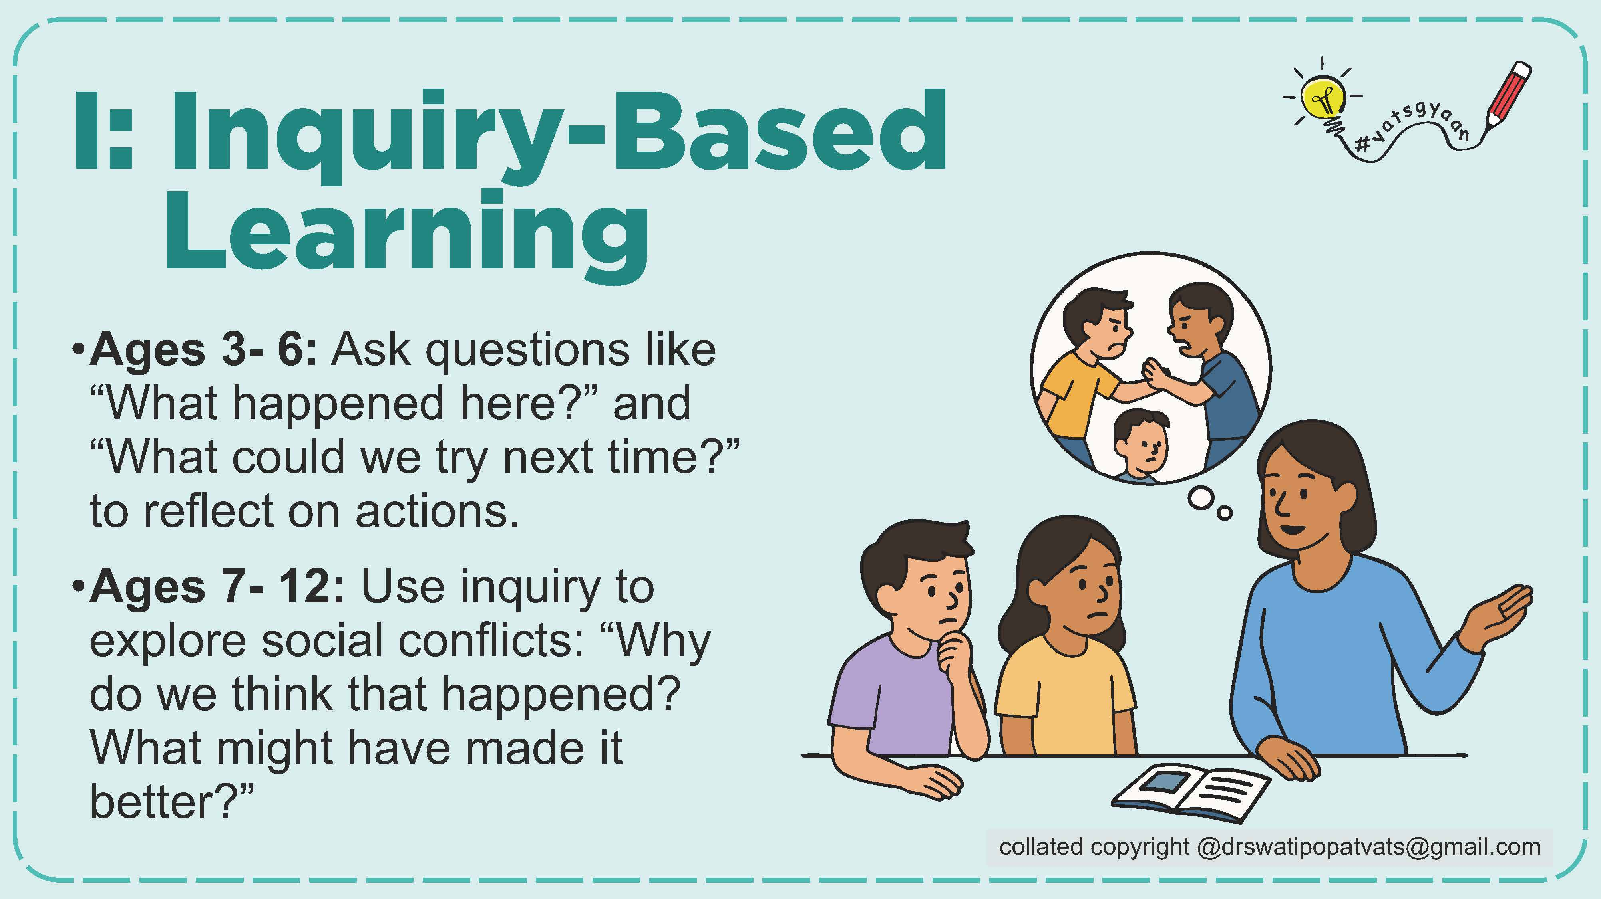

Slide 26
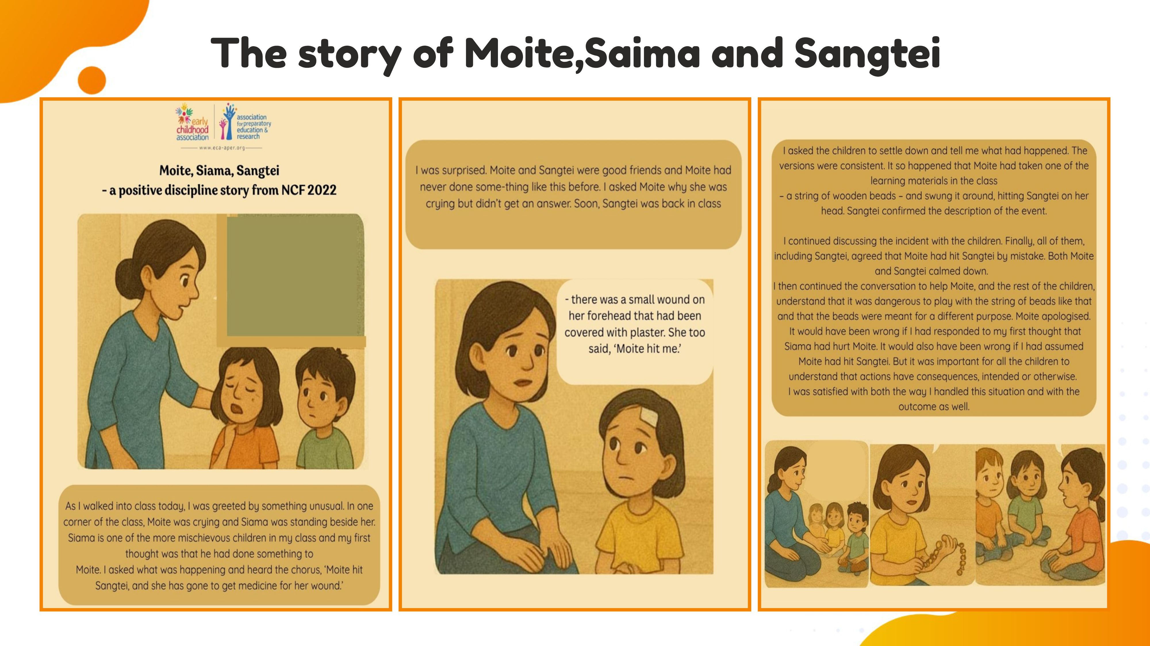

Slide 27


Slide 29


Slide 30
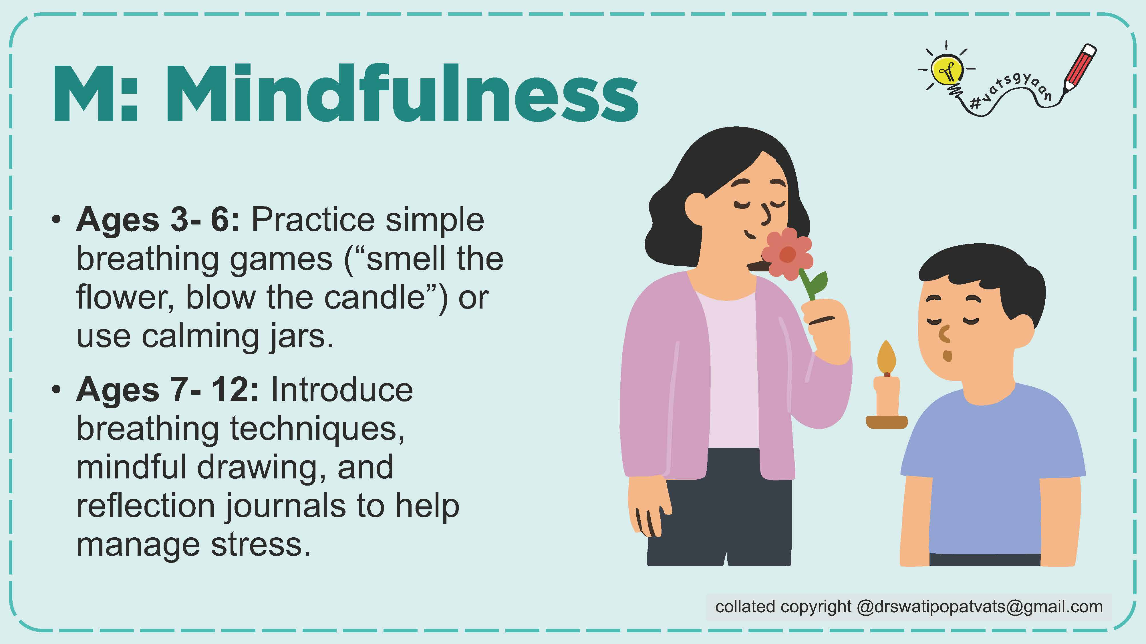

Slide 31
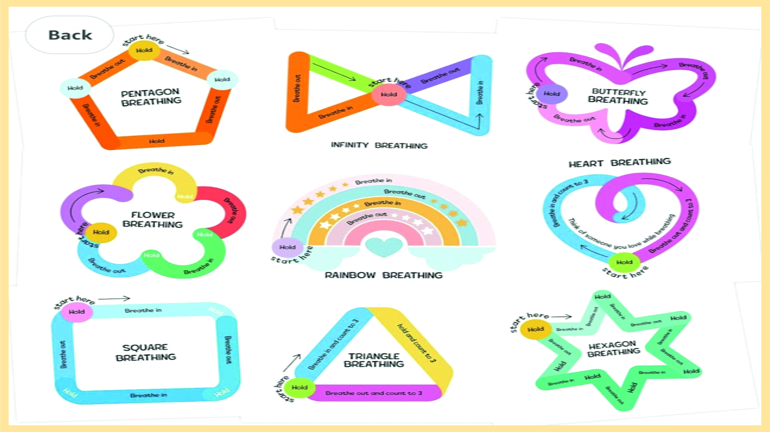
copyright@drswatipopatvats@gmail.com

Slide 32
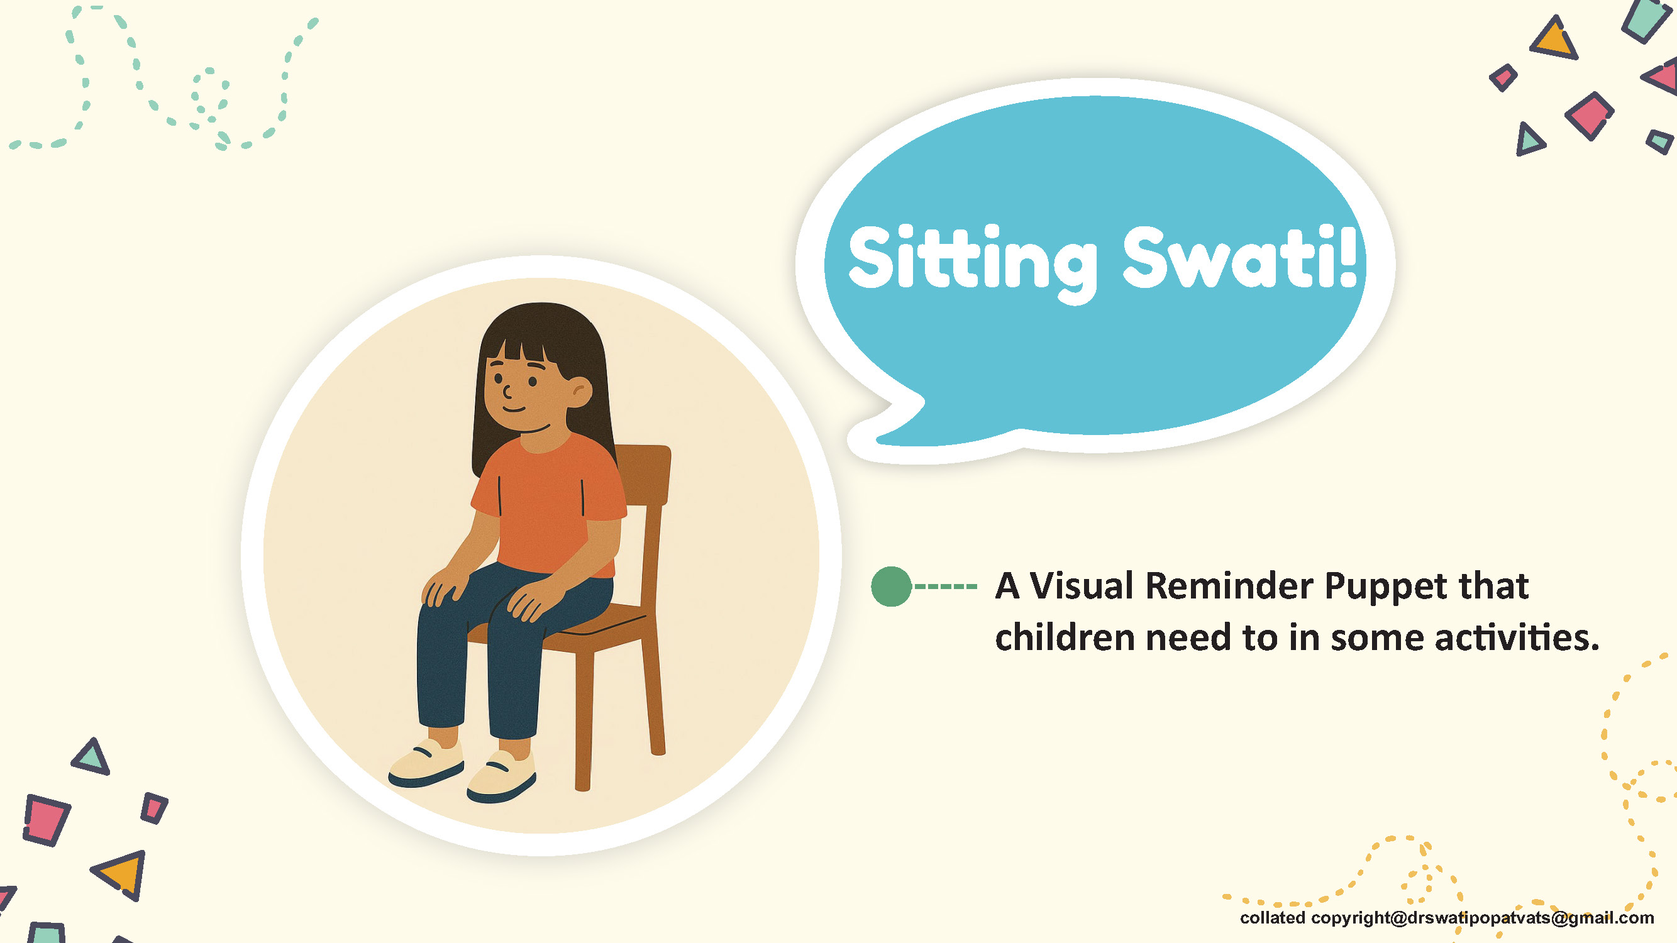

Slide 33
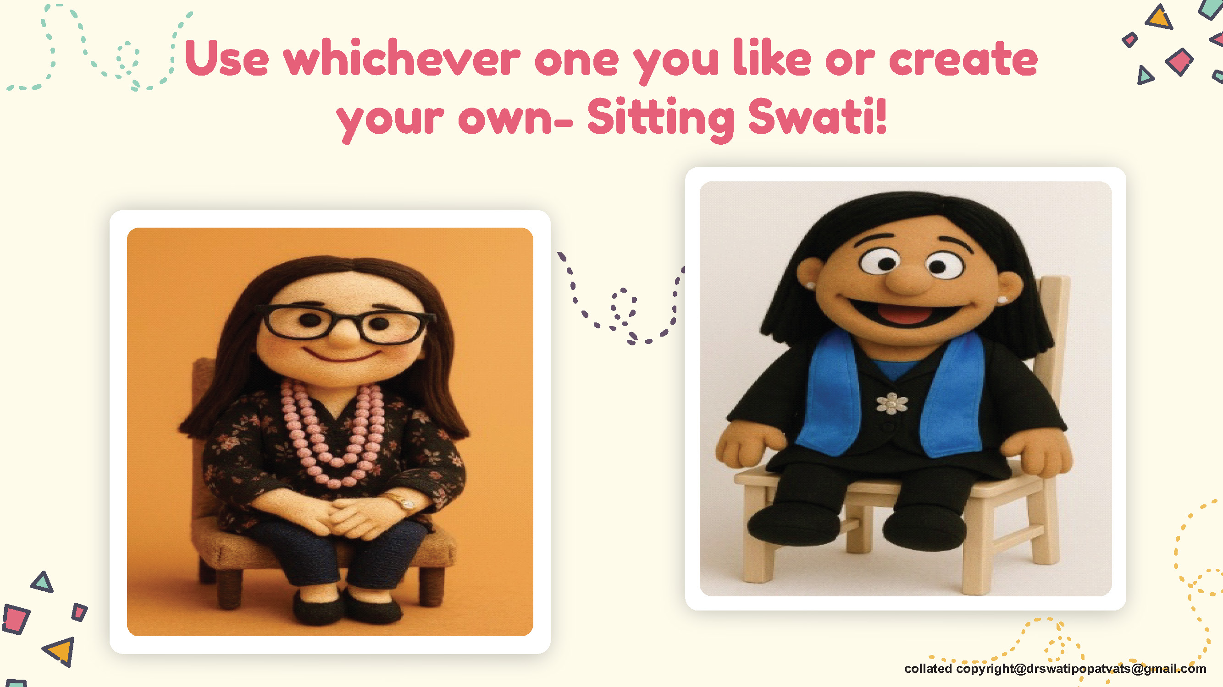

Slide 34


Slide 35
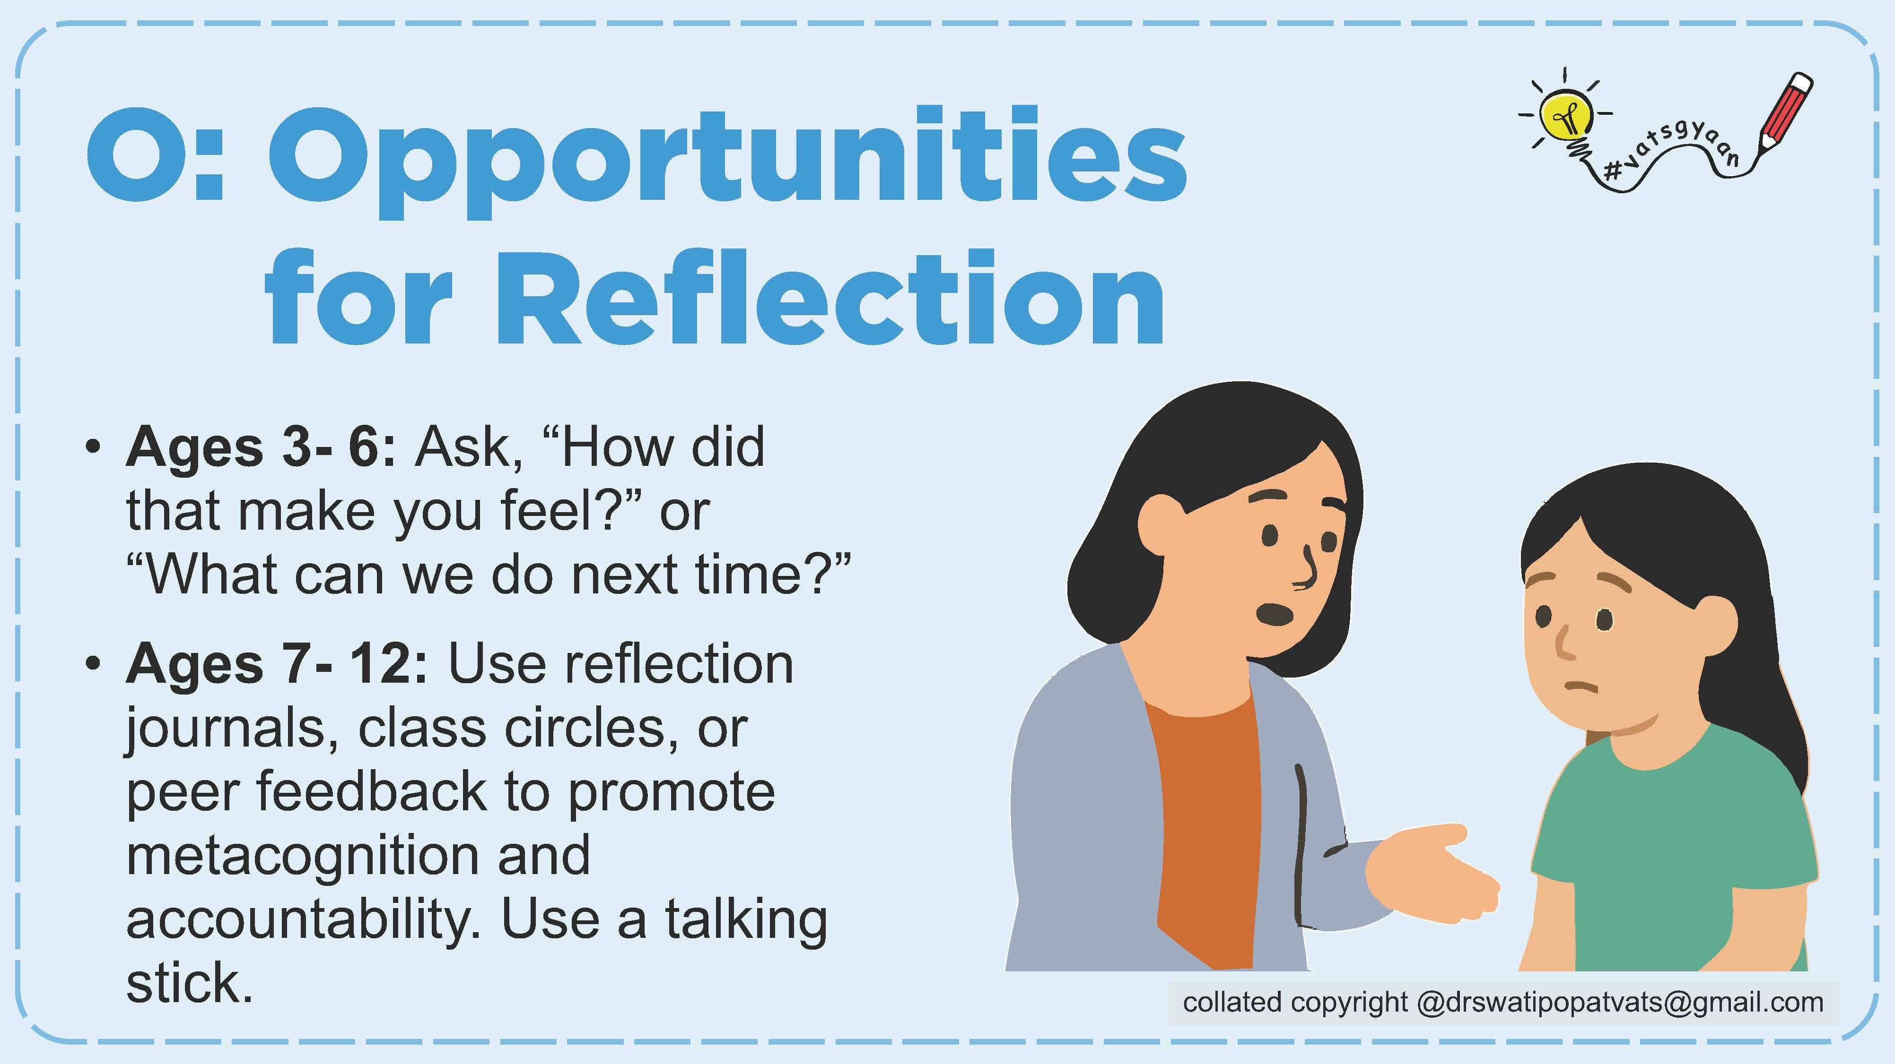

Slide 36


Slide 38
copyright@drswatipopatvats@gmail.com

Slide 42
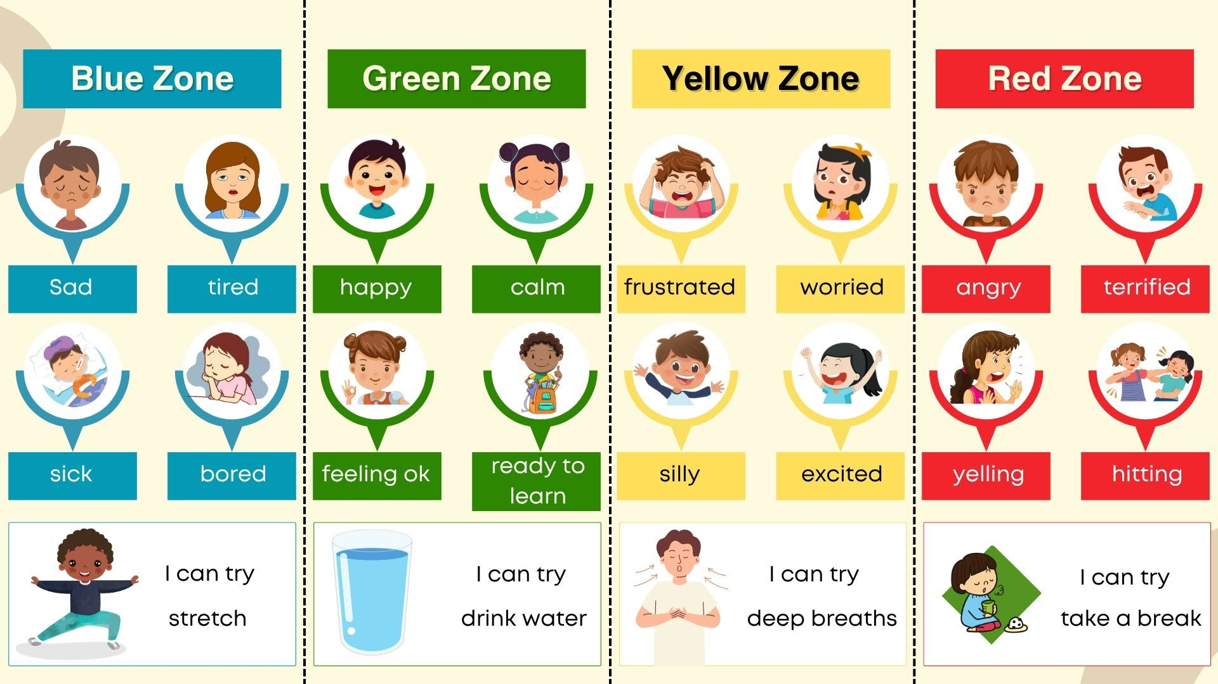
copyright@drswatipopatvats@gmail.com

Slide 55
copyright@drswatipopatvats@gmail.com

