Slide 1
IMPORTANCE OF ECE FOR FUTURE LEARNING
DR. SWATI POPAT VATS
PRESIDENT
EARLY CHILDHOOD ASSOCIATION
ASSOCIATION FOR PREPARATORY EDUCATION AND RESEARCH
PODAR EDUCATION NETWORK

Slide 2


Slide 3



Slide 4
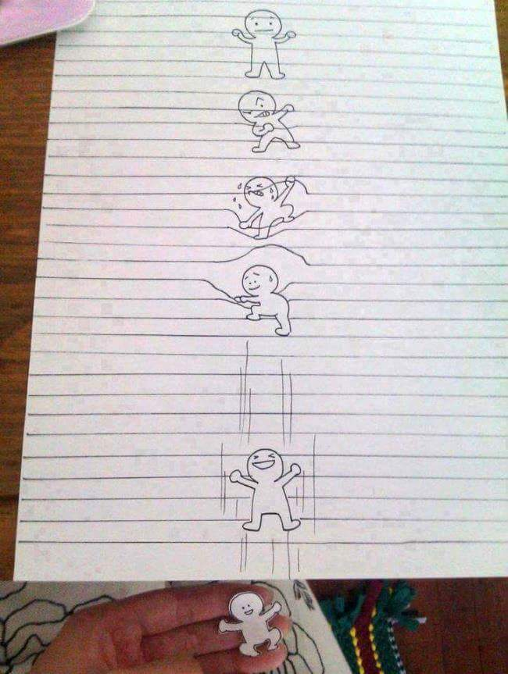

Slide 5
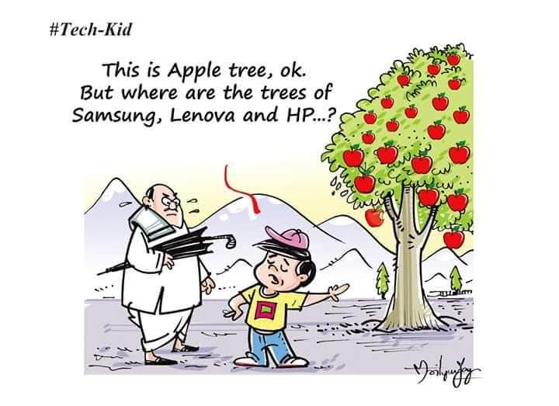

Slide 6
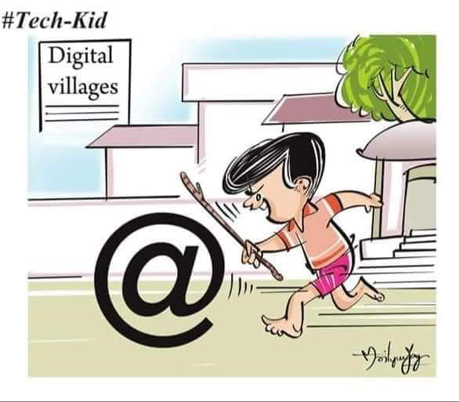

Slide 7
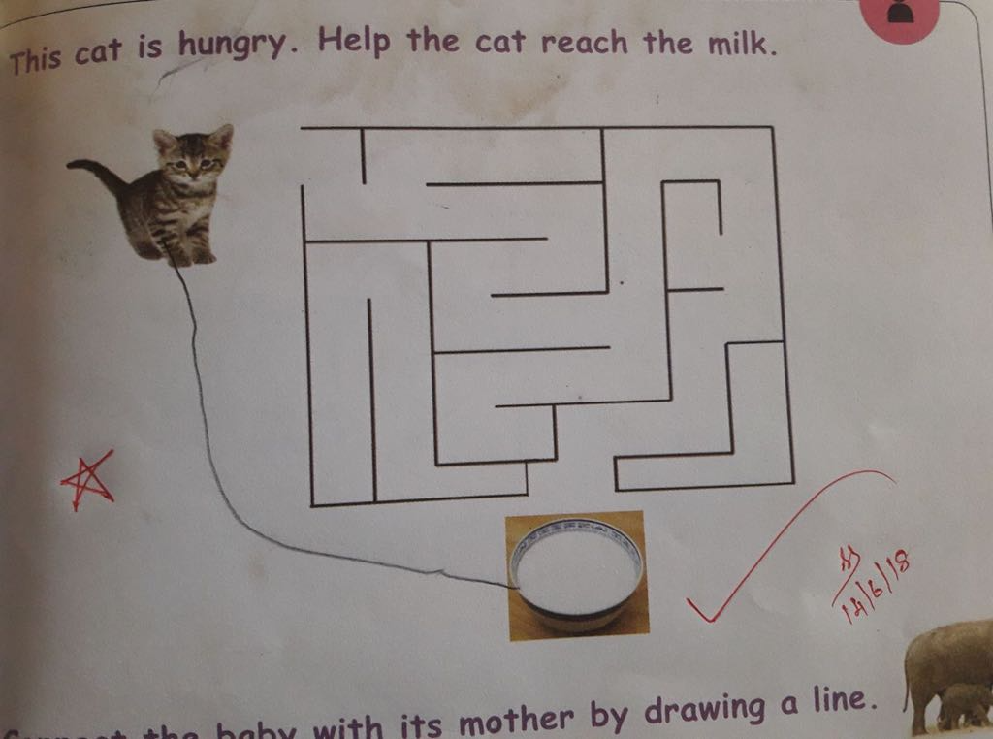

Slide 8
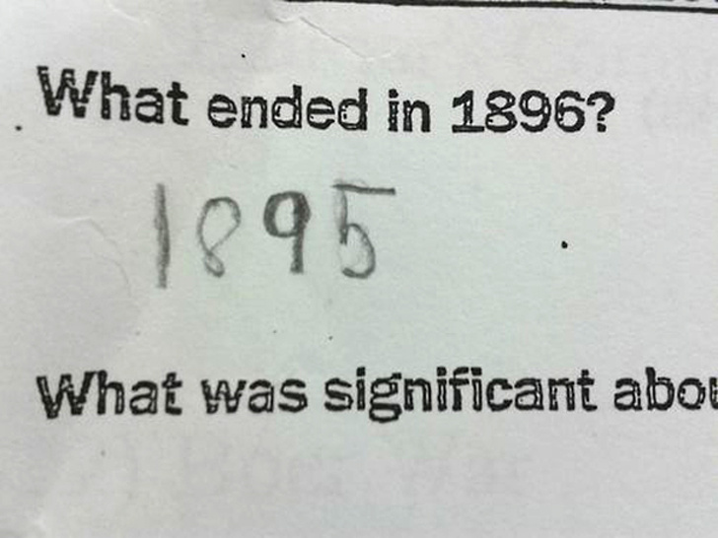

Slide 9
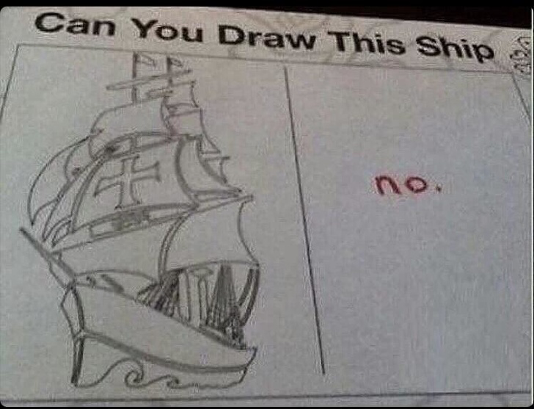

Slide 11


Slide 12
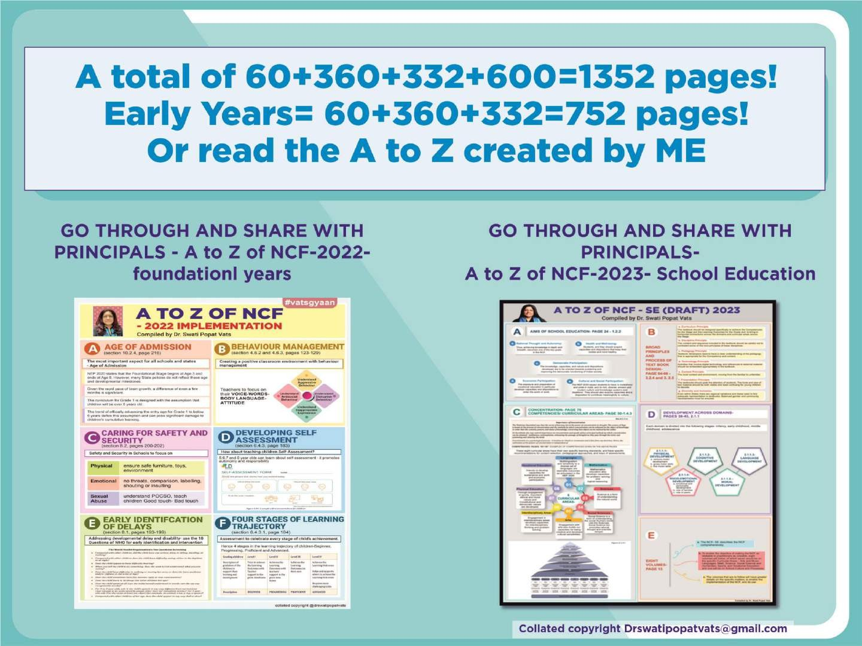

Slide 13


Slide 14


Slide 15


Slide 16


Slide 17
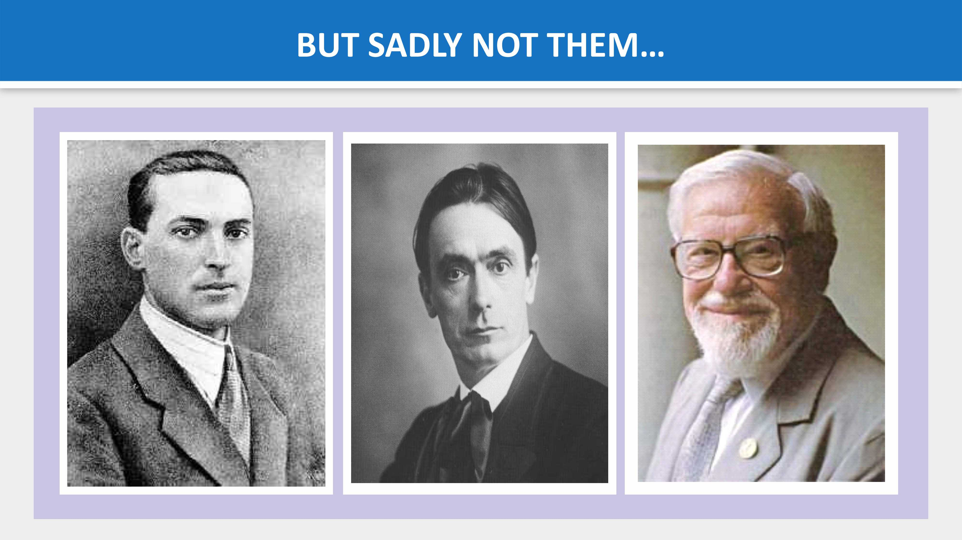

Slide 18
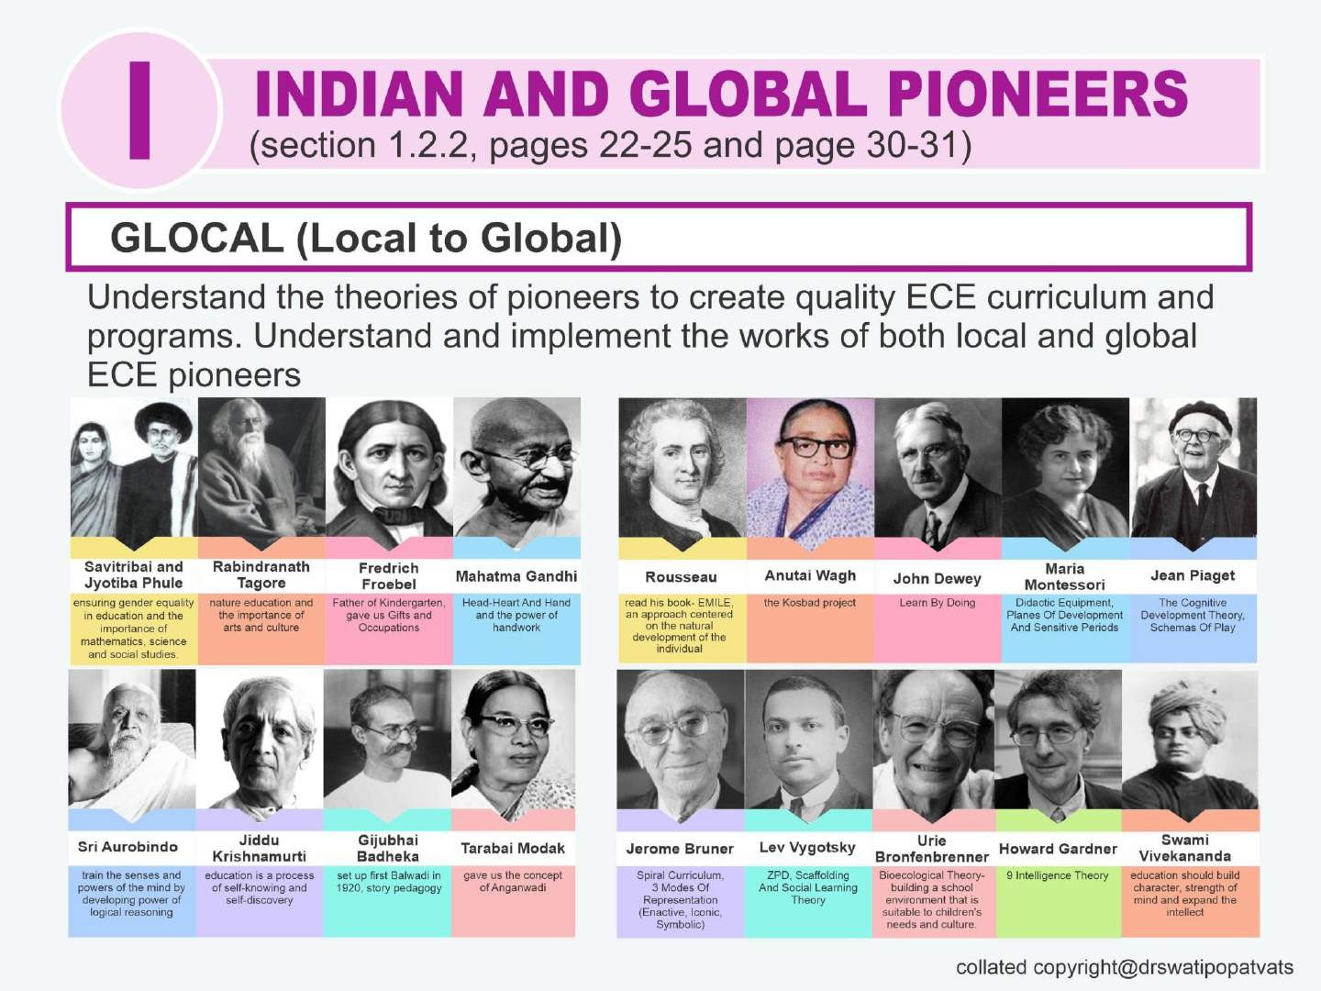

Slide 19
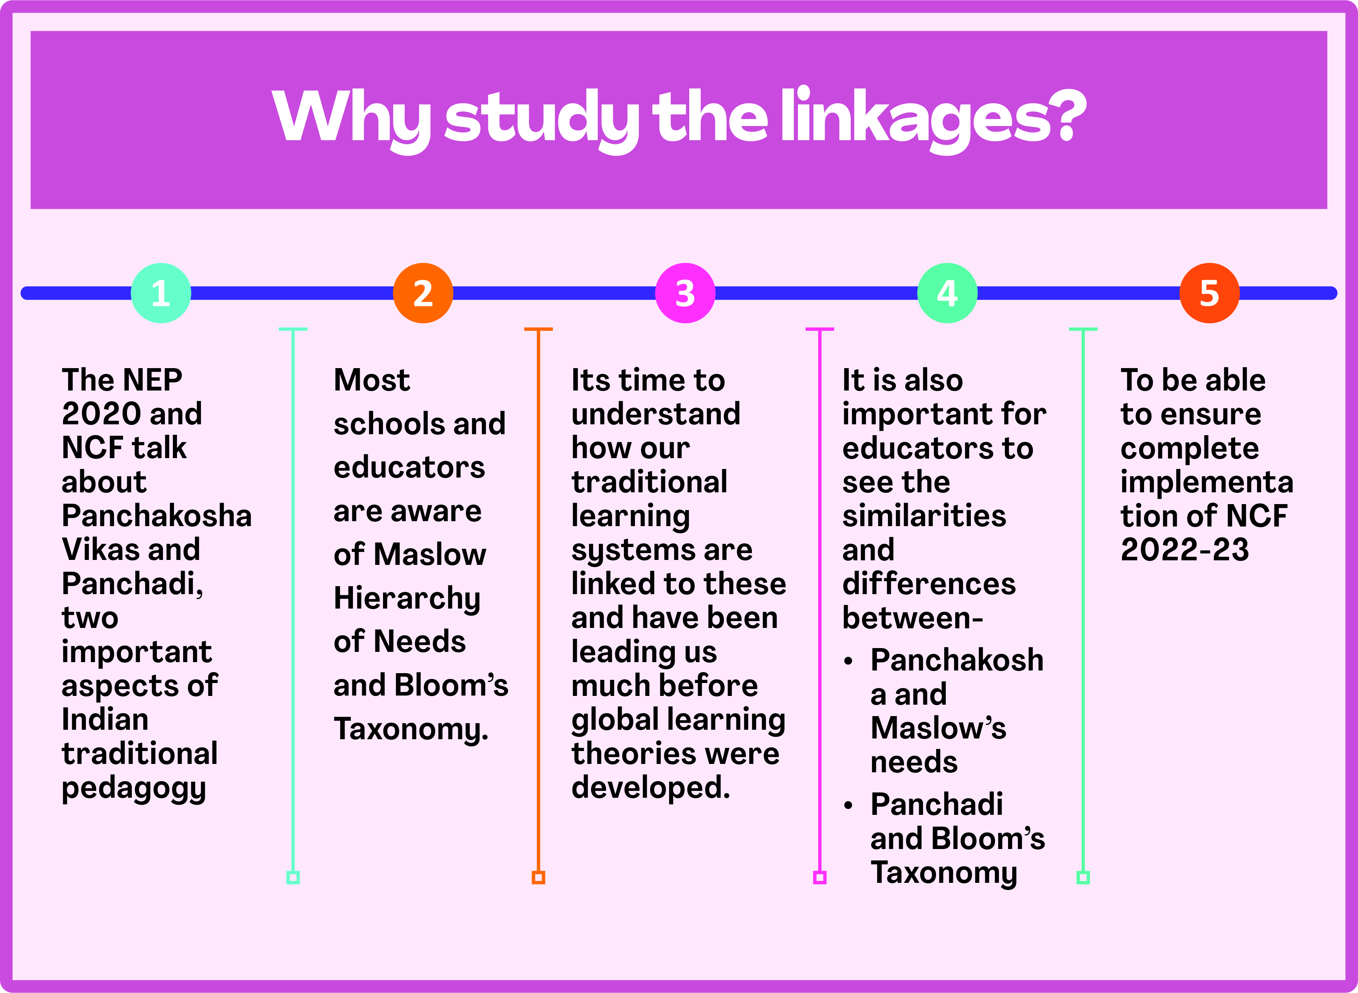

Slide 20
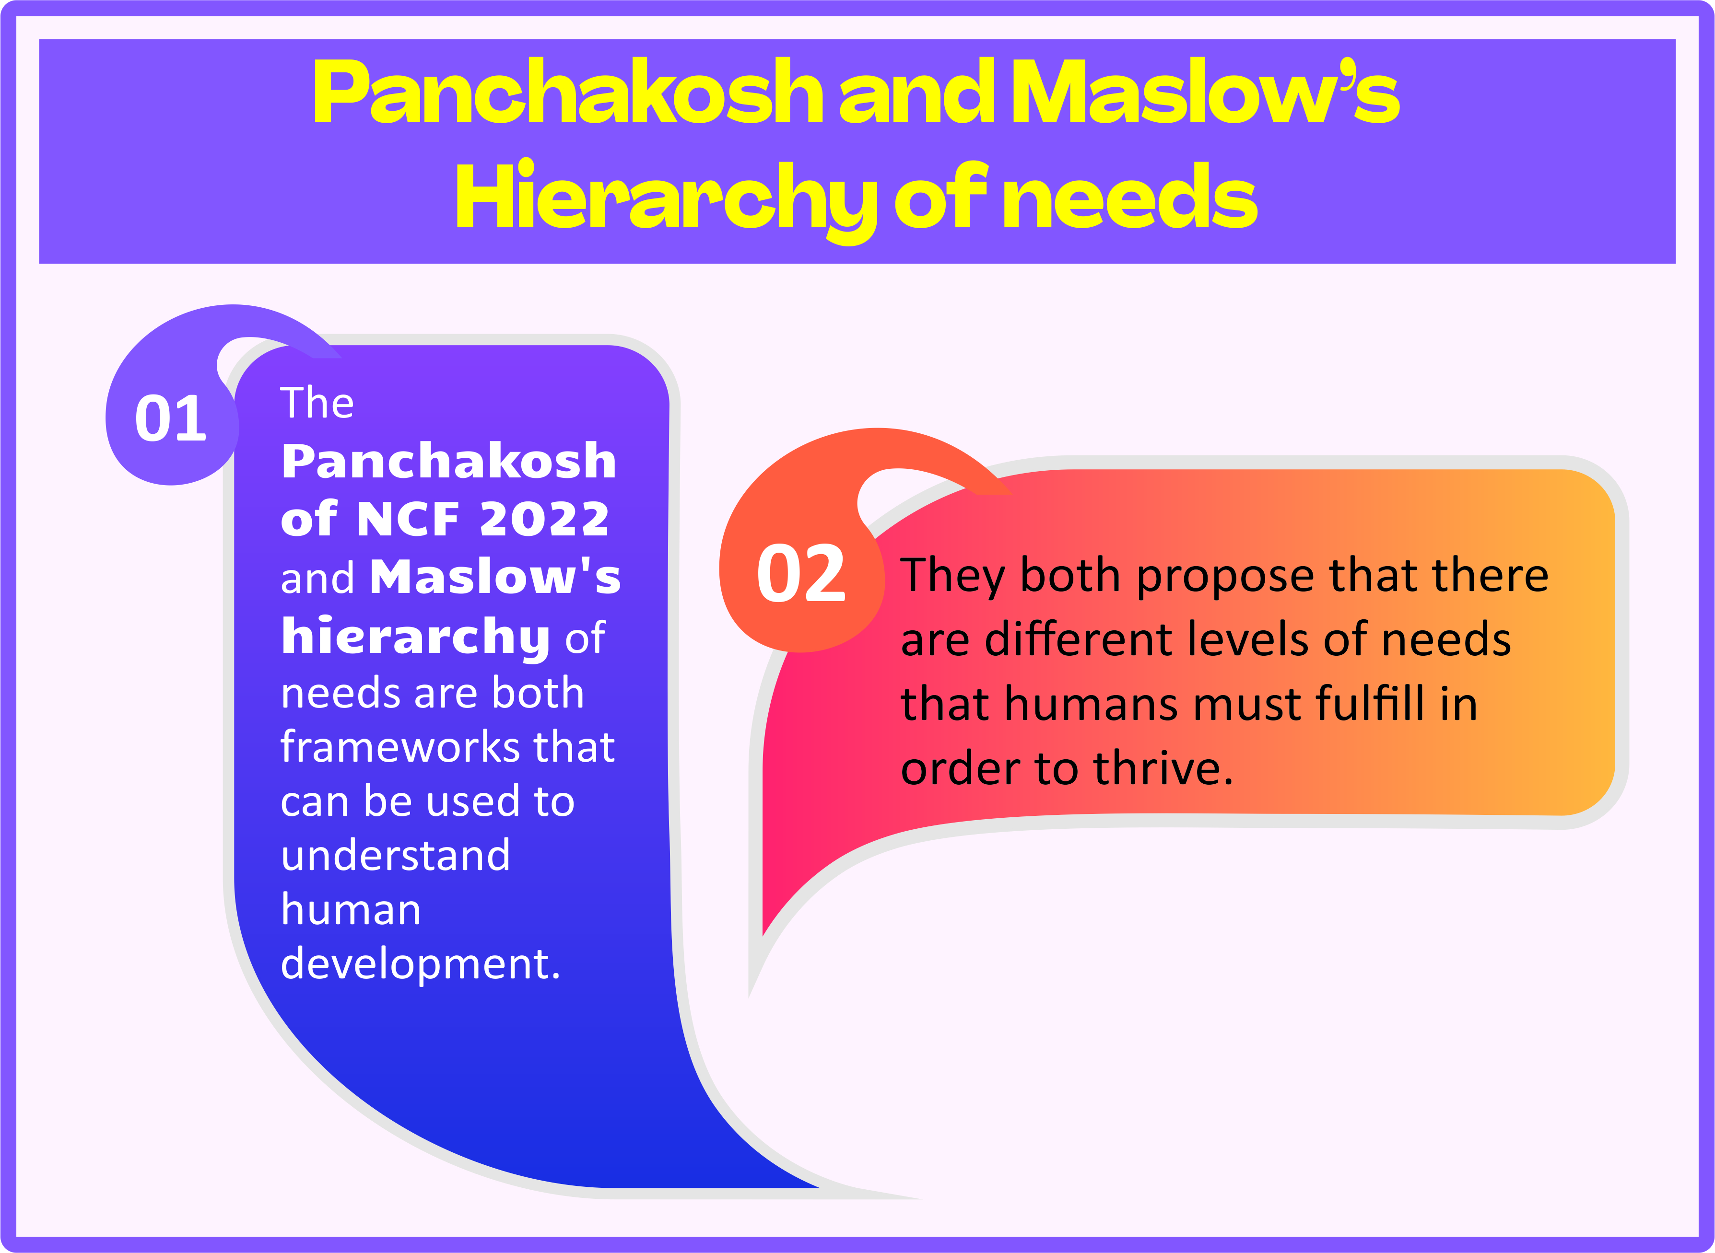

Slide 21
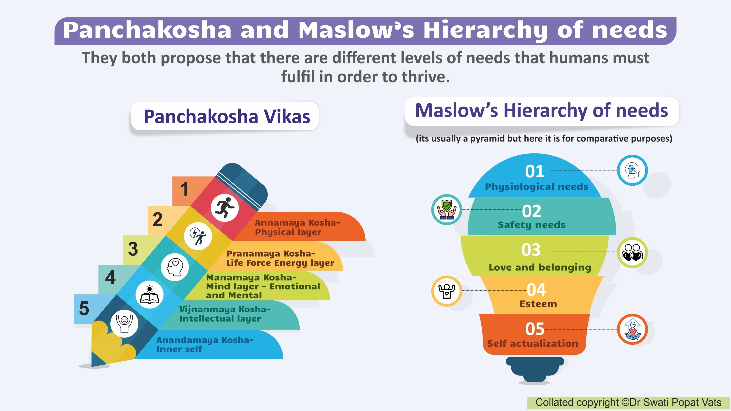

Slide 22
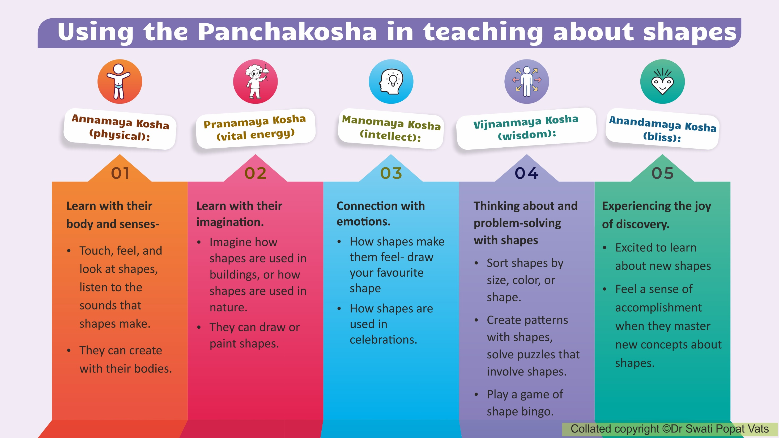

Slide 23
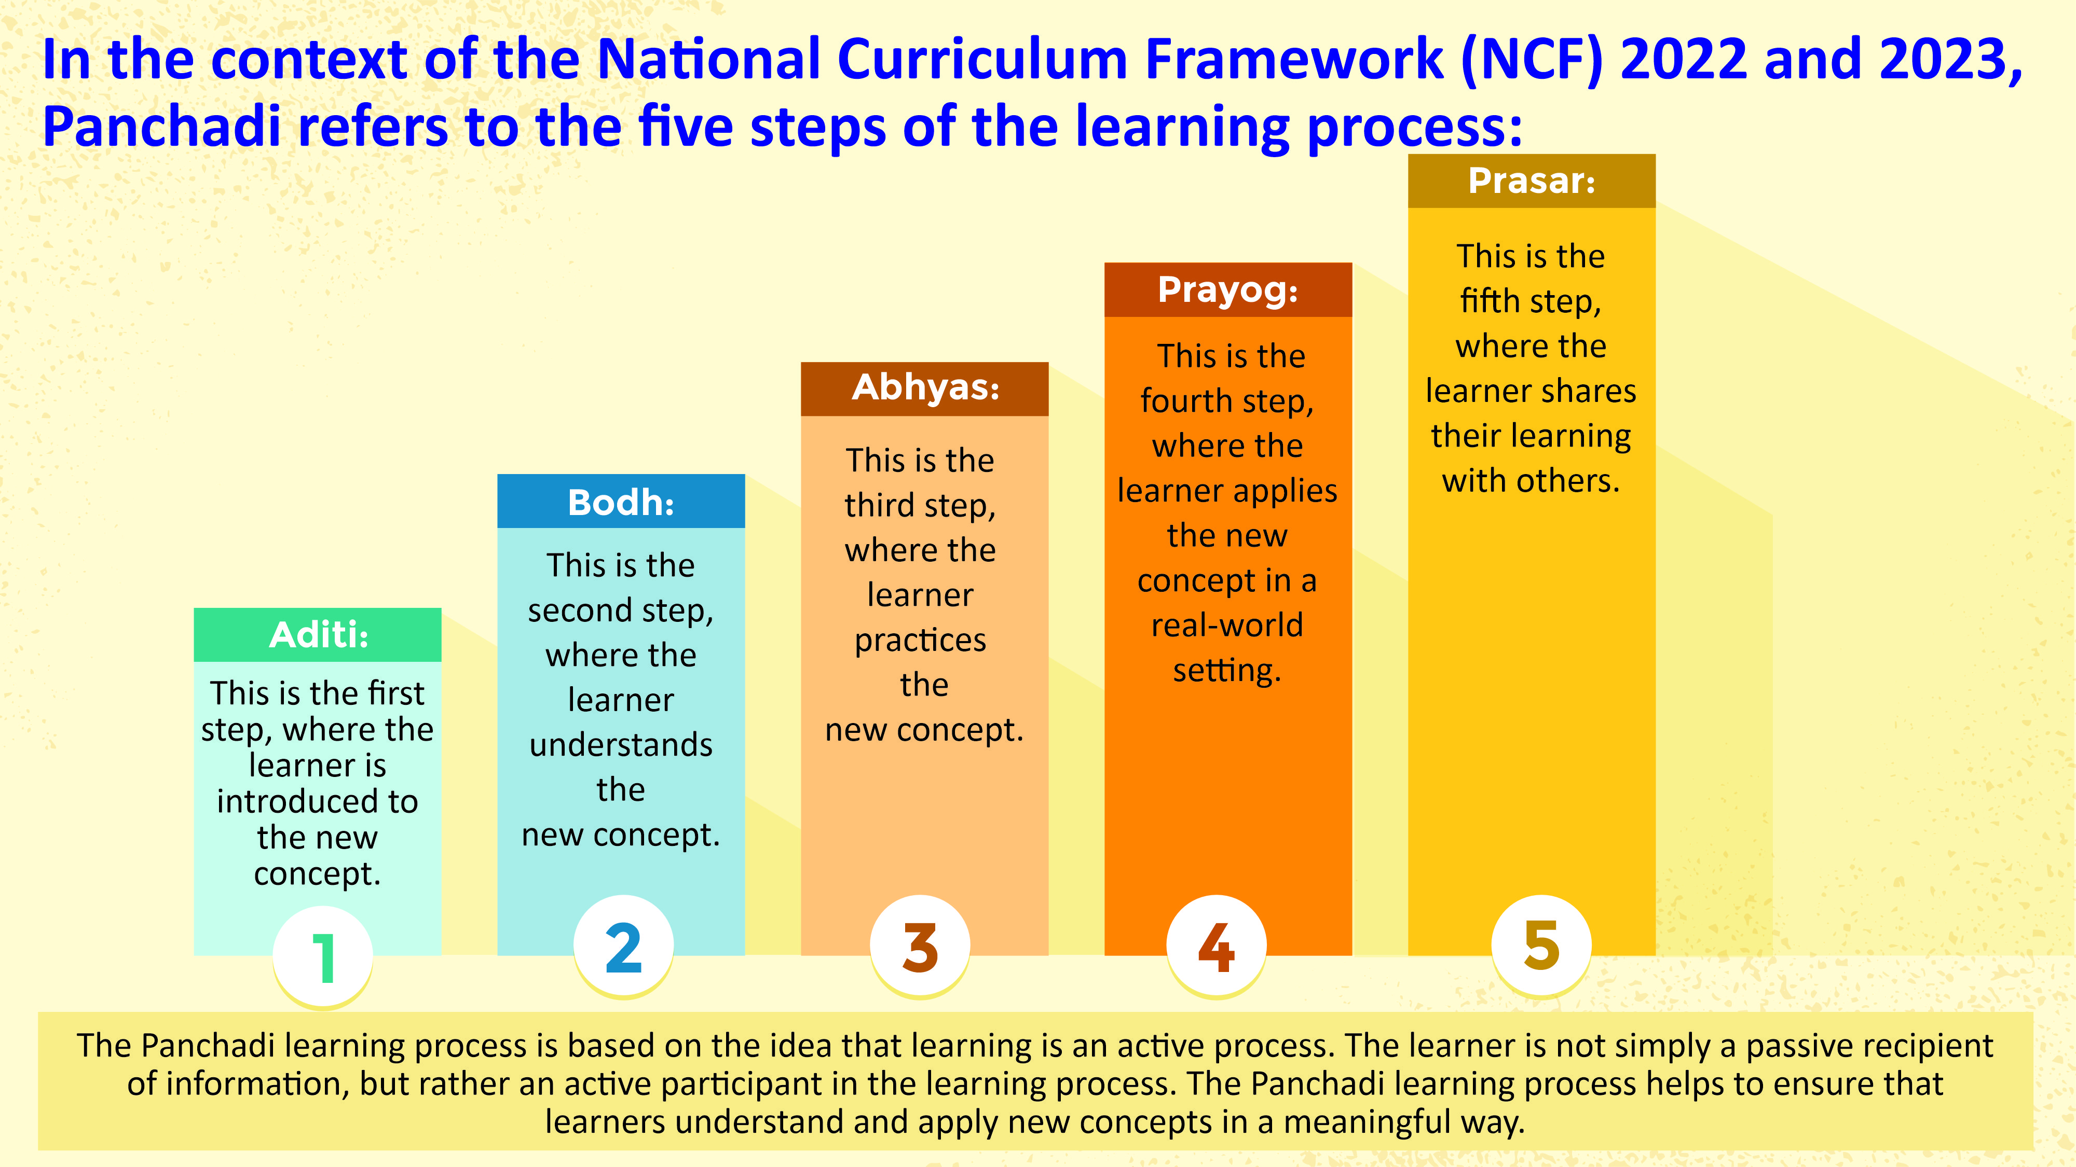

Slide 24
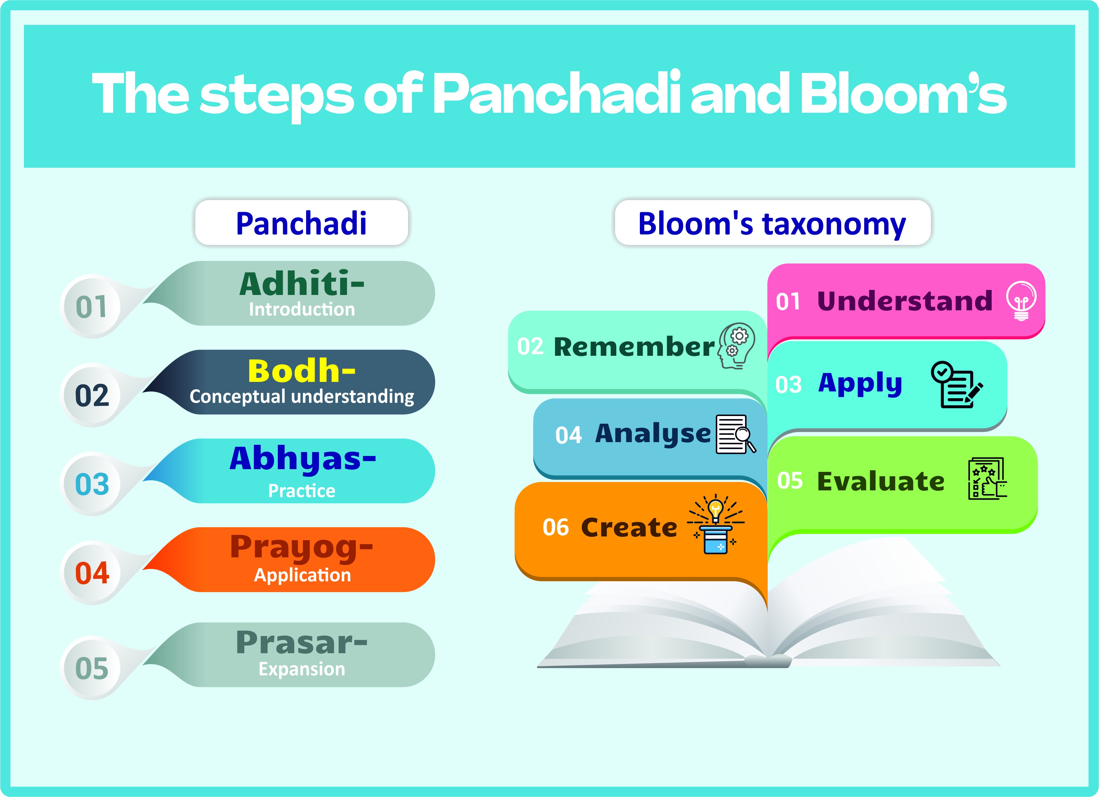

Slide 25
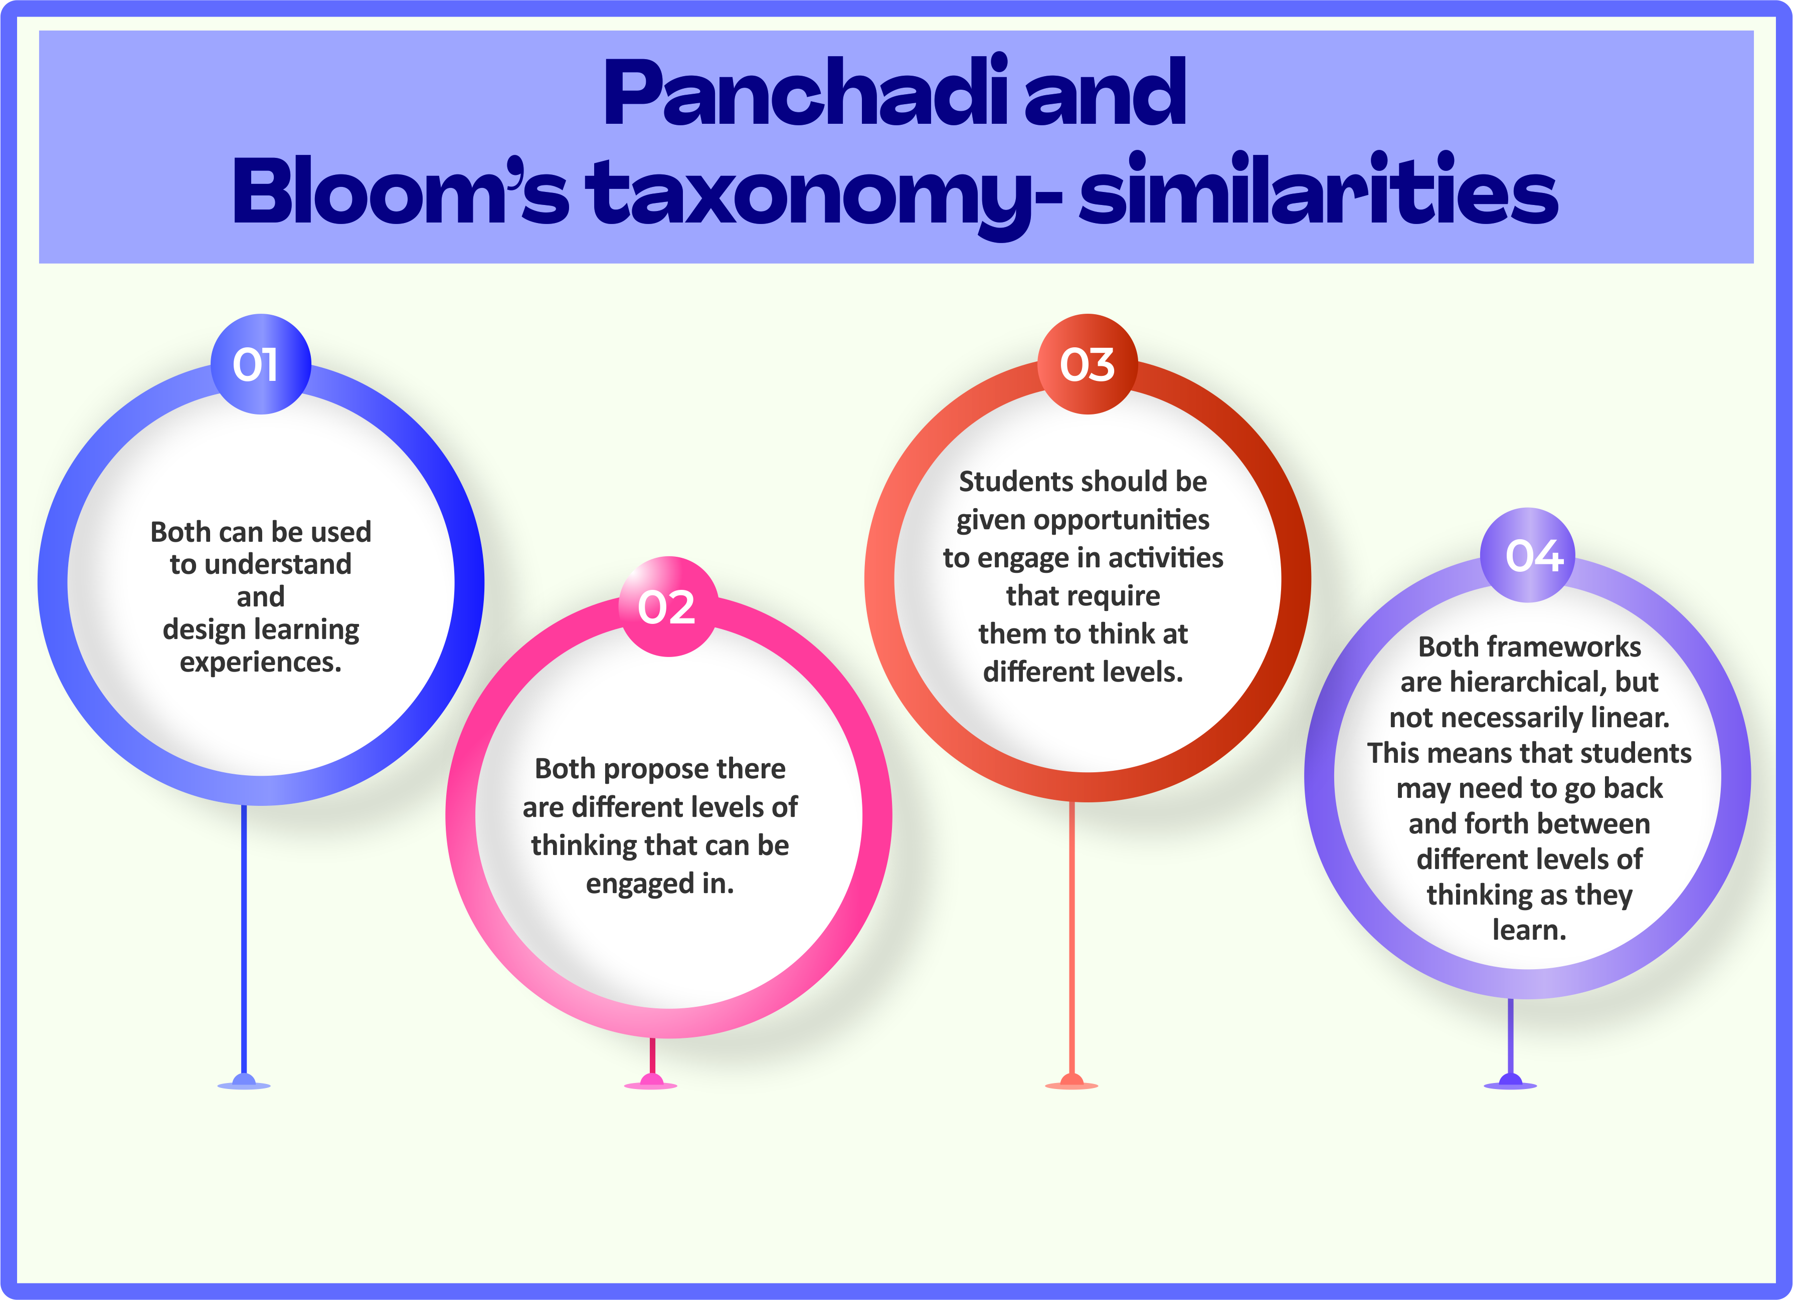

Slide 26
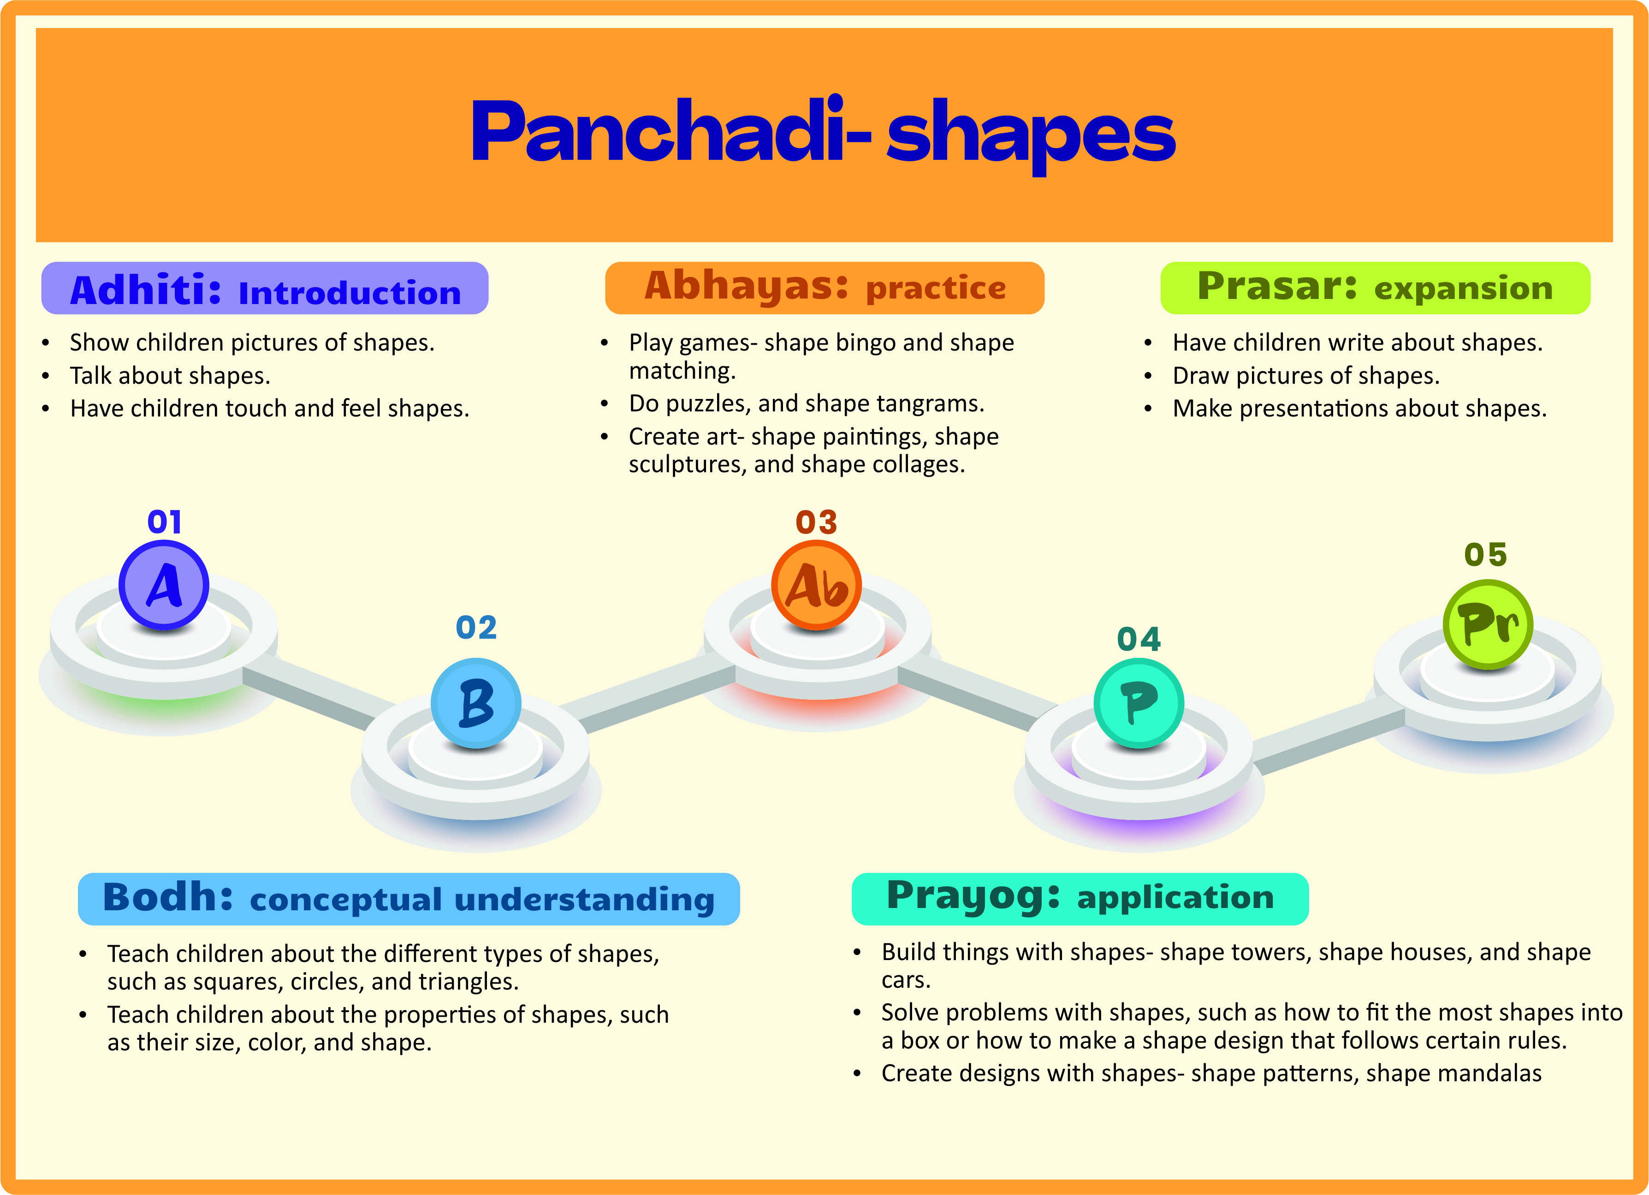

Slide 27
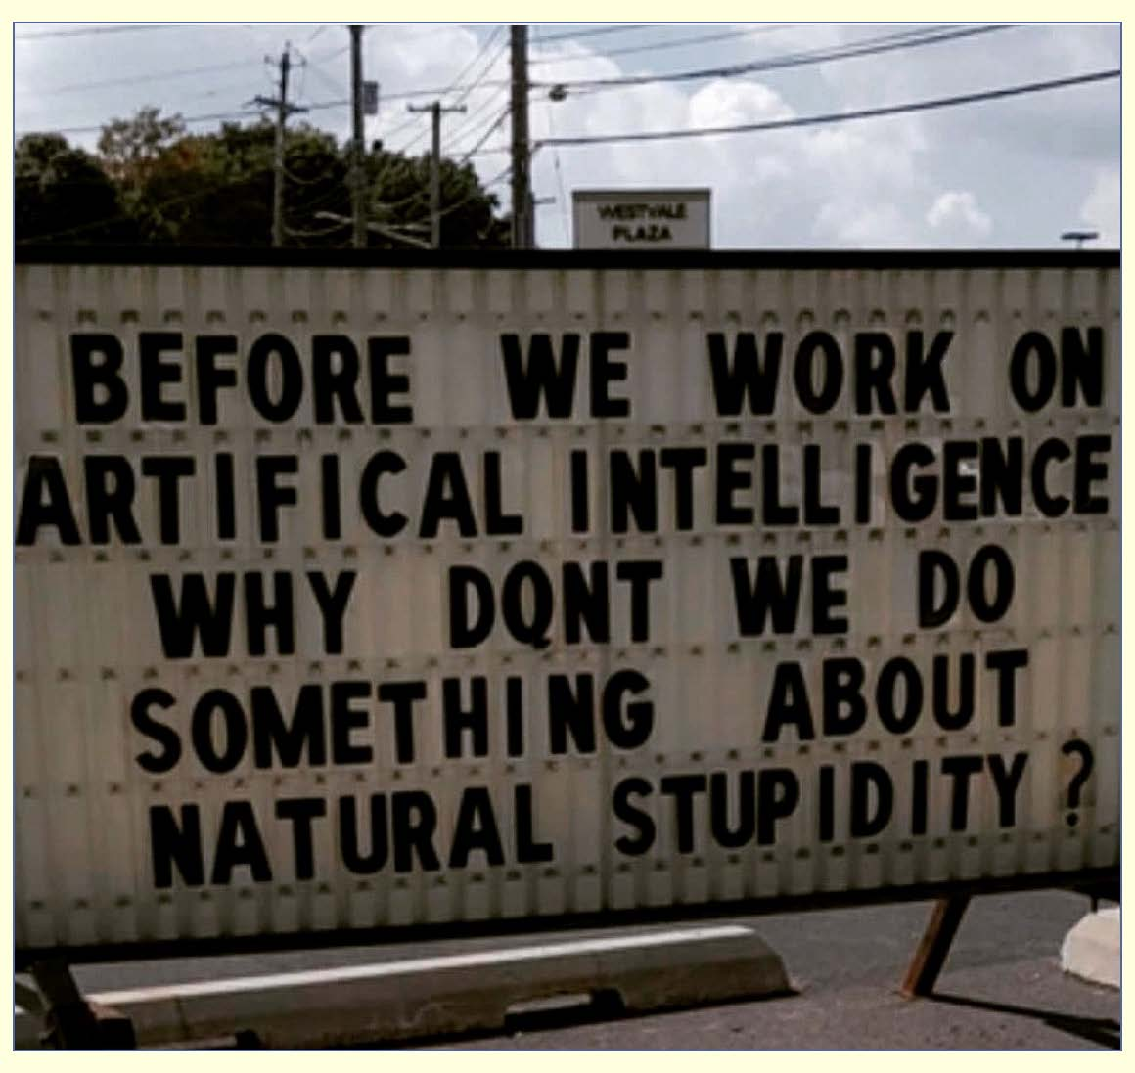

Slide 28
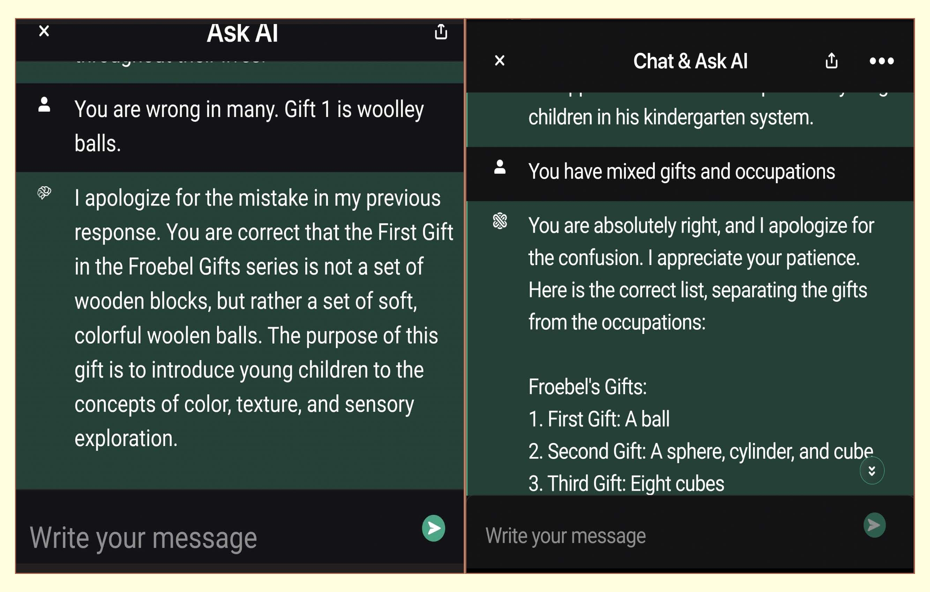

Slide 29


Slide 30
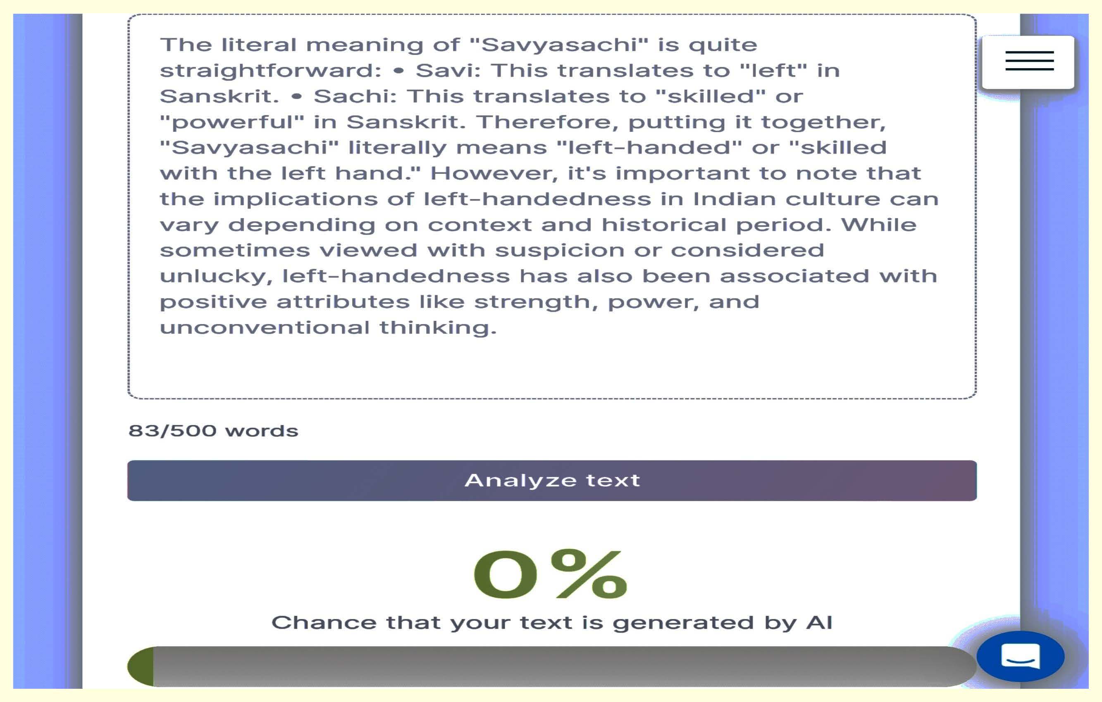

Slide 31
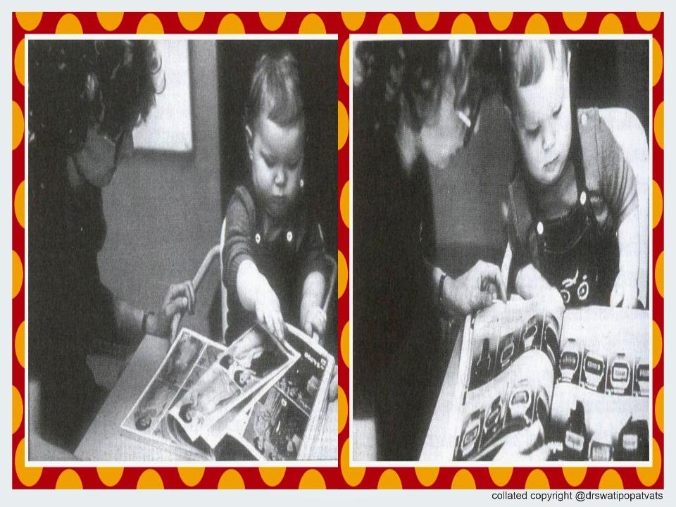

Slide 32
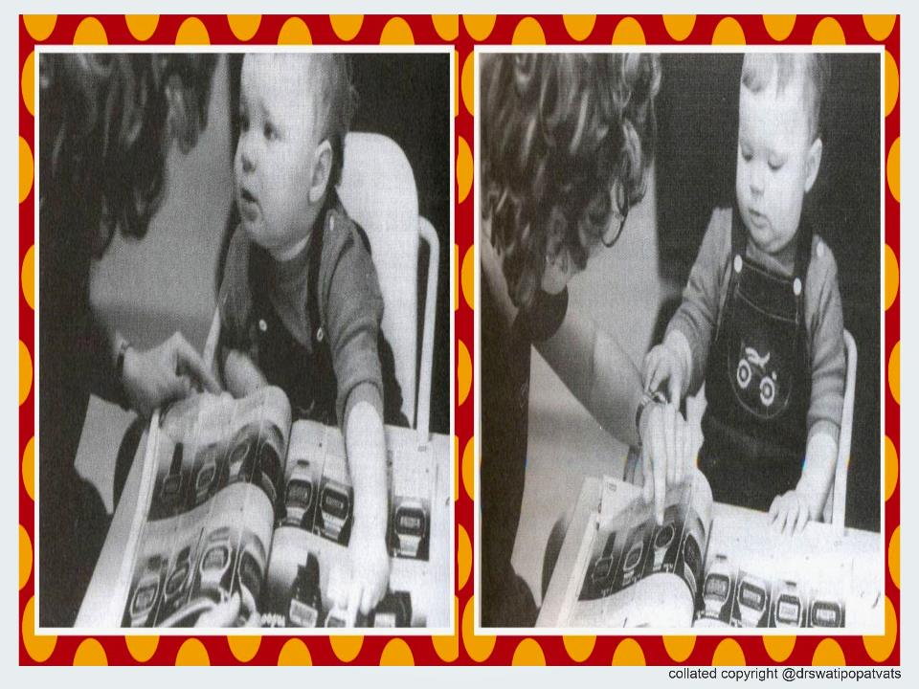

Slide 33
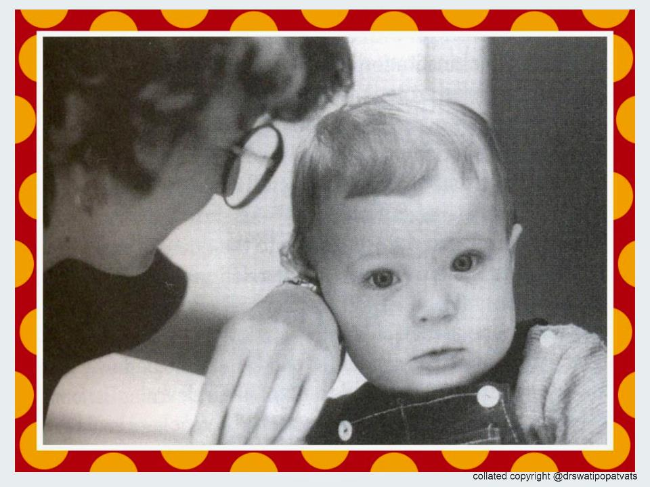

Slide 34
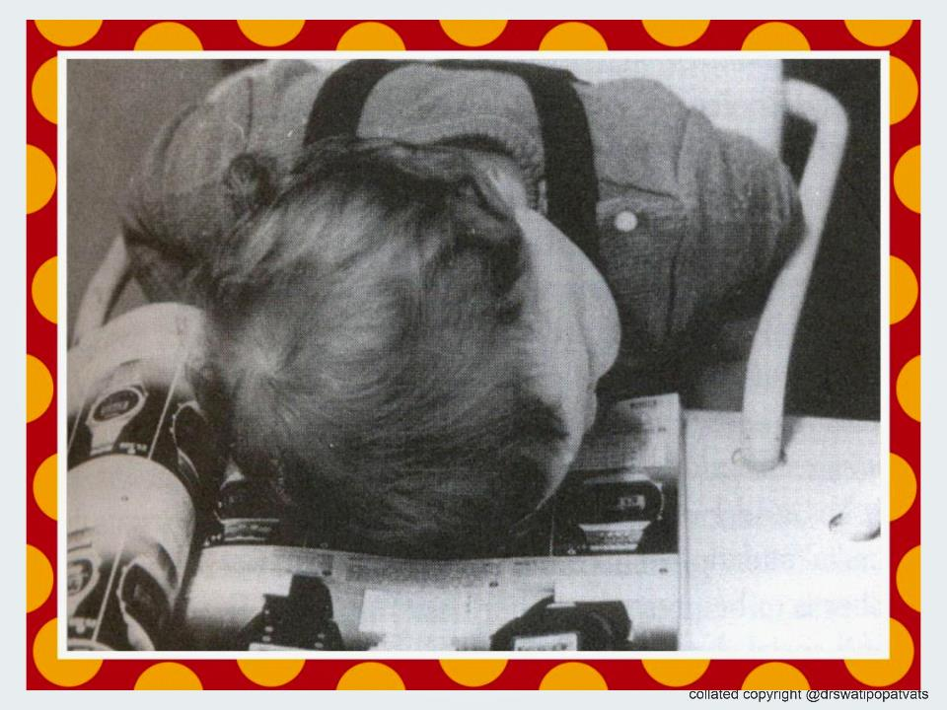

Slide 35
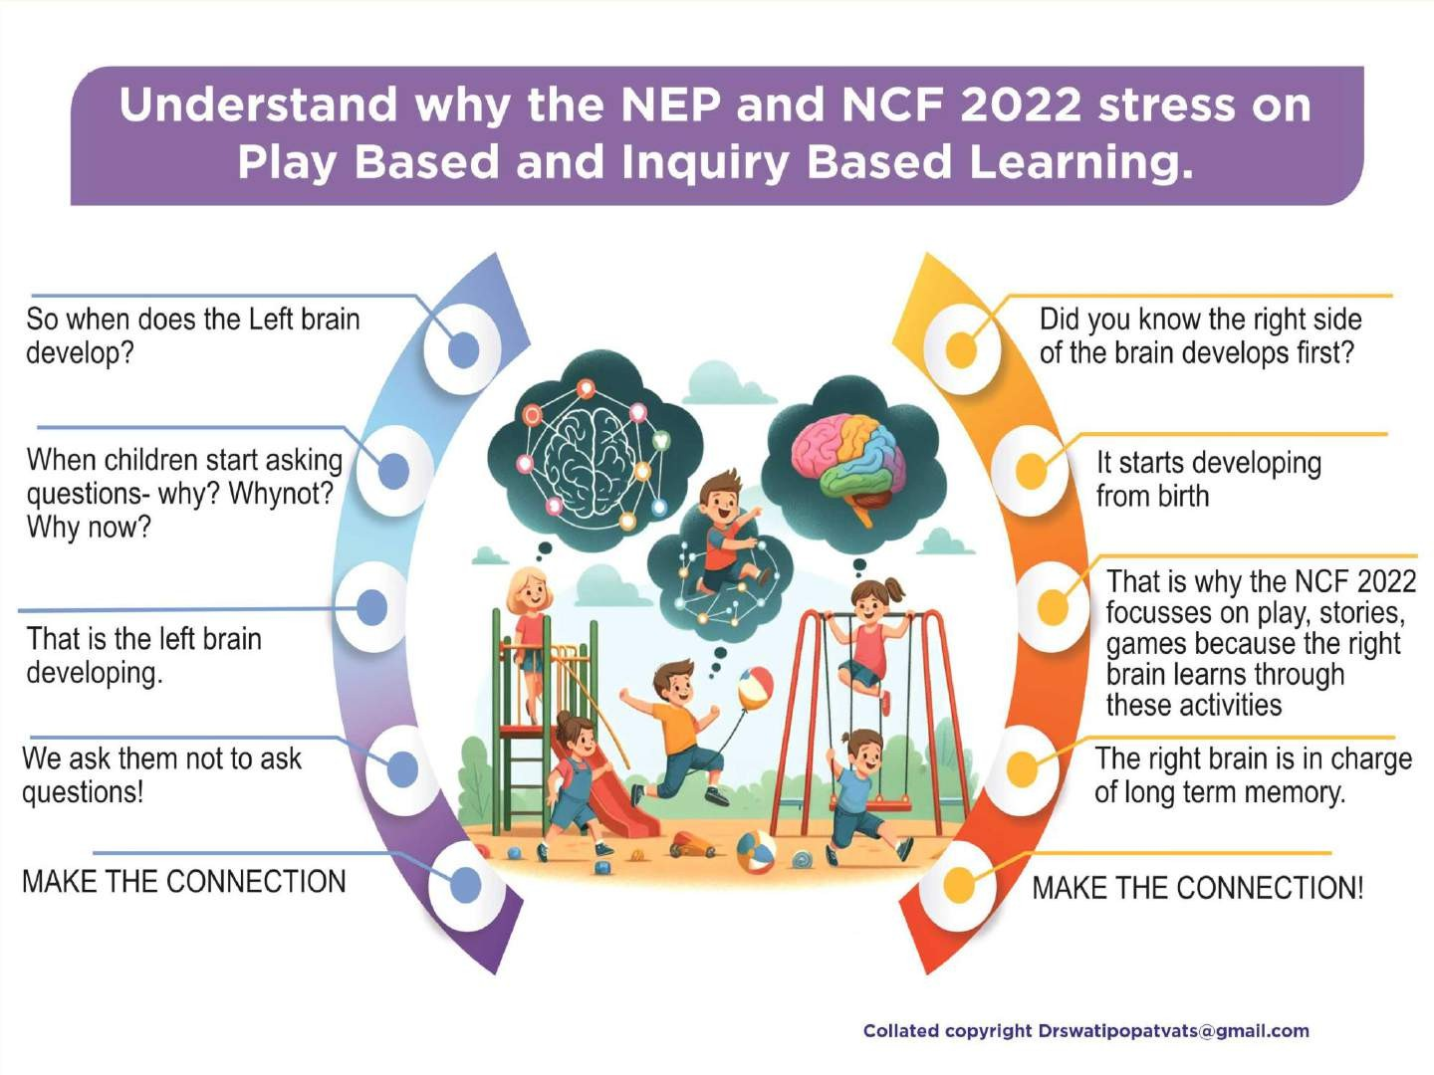

Slide 36


Slide 37
TECHNOLOGY LITERACY AND FOUNDATIONAL LITERACY AND NUMERACY
WHAT IS THE CONNECTION?
BECAUSE IT IS TIME TO TEACH WITH ‘CONNECTIONS’

Slide 38
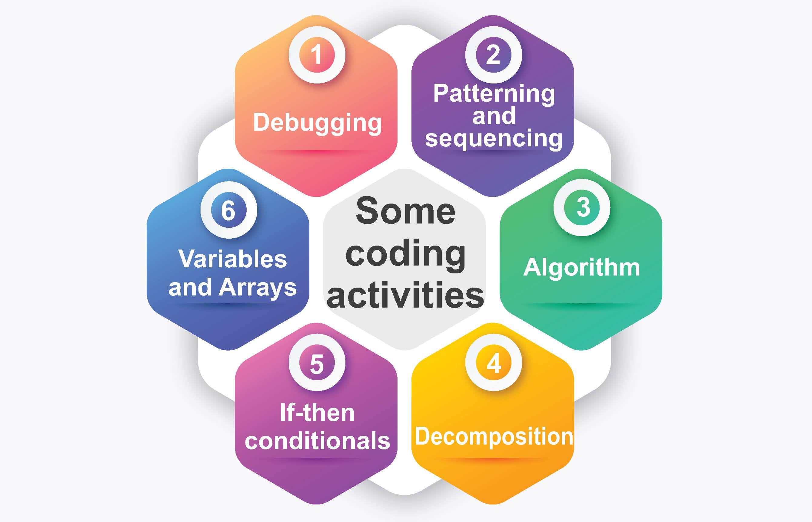

Slide 39
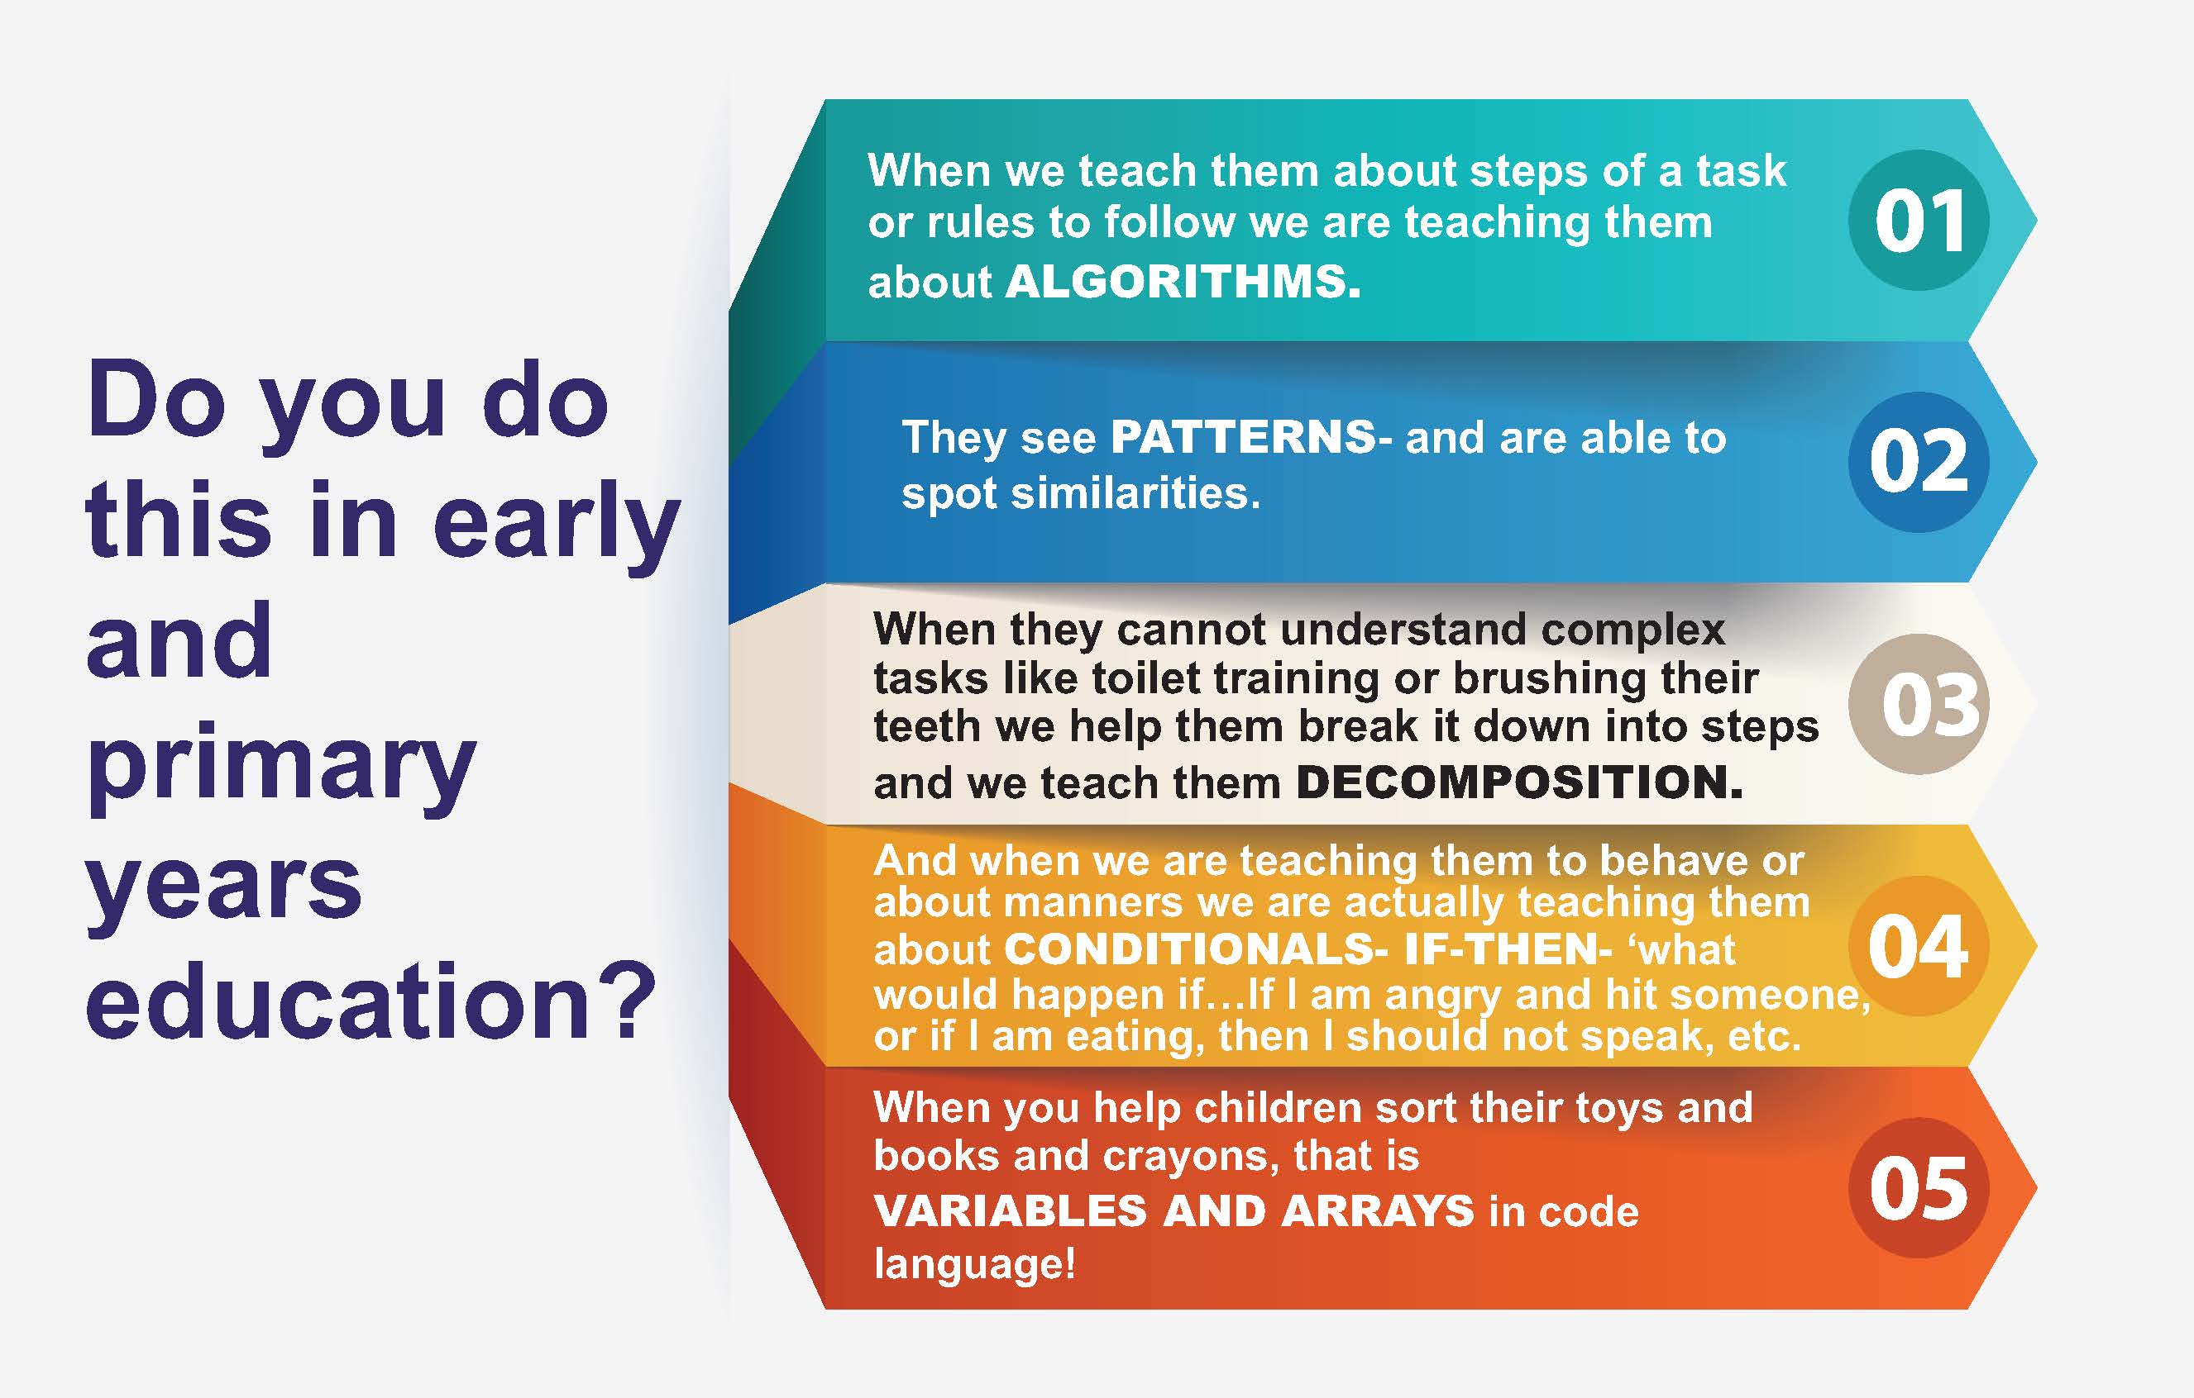

Slide 40


Slide 41

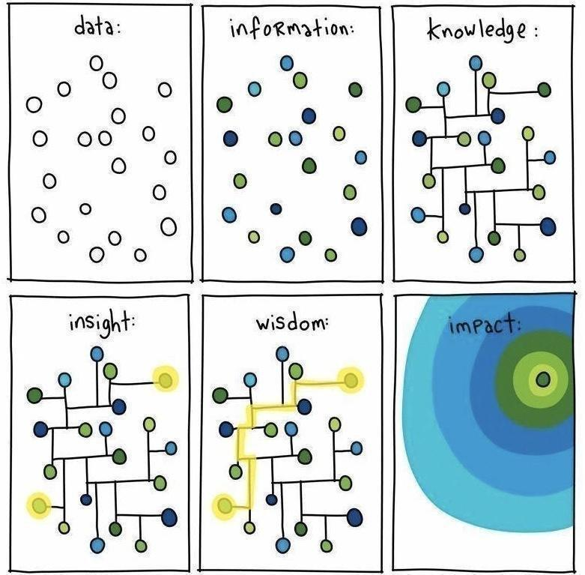

Slide 42


Slide 43
CONNECT WITH ME ON
7506639870 www.eca-aper.org

