Slide 1

NATIONAL CURRICULUM FRAMEWORK- NCF 2022

Slide 2
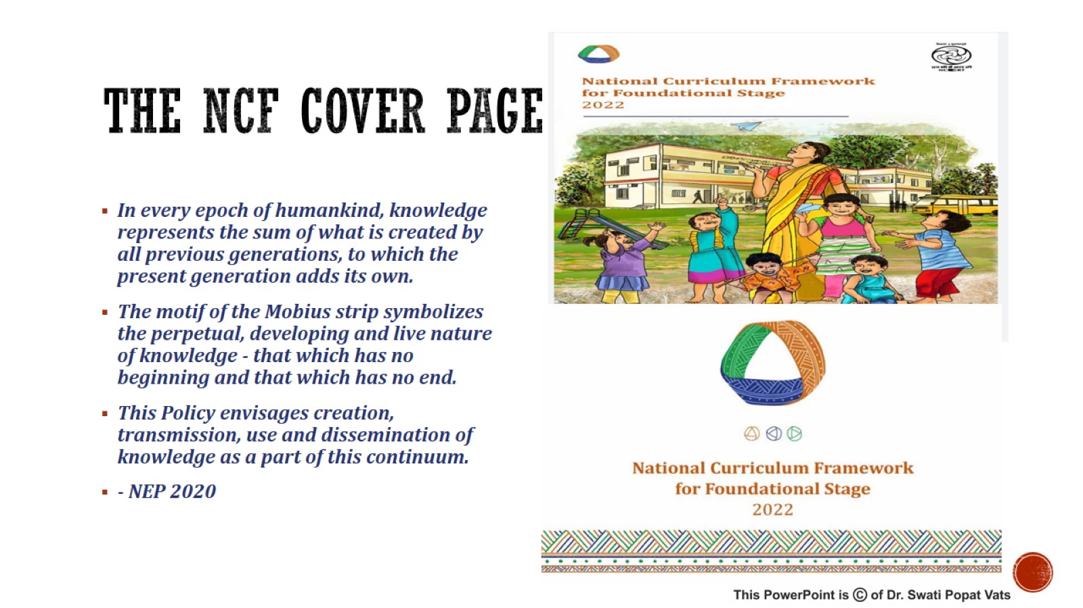
THE NCF COVER PAGE

Slide 3


Slide 4


Slide 5


Slide 6
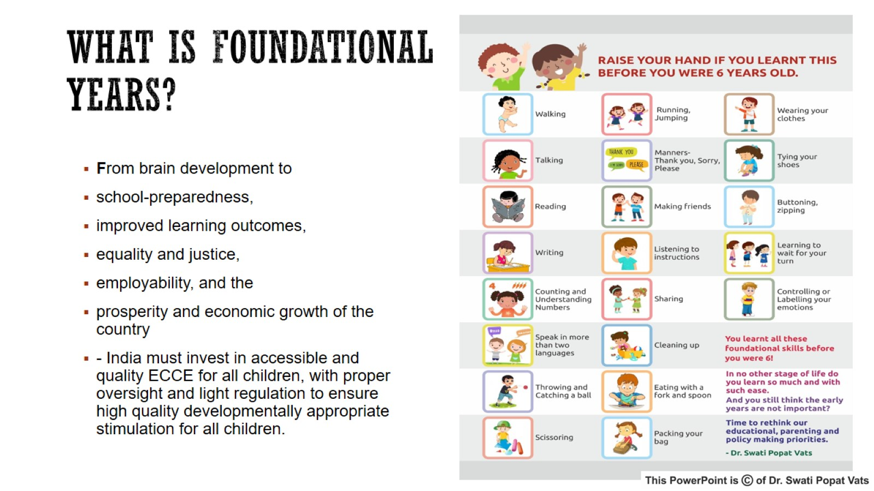
WHAT IS FOUNDATIONAL YEARS?

Slide 7
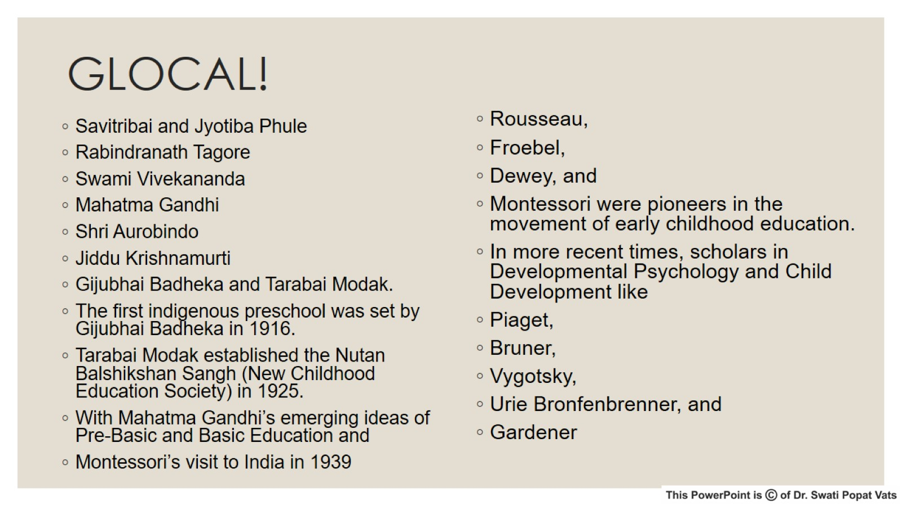
GLOCAL!

Slide 8
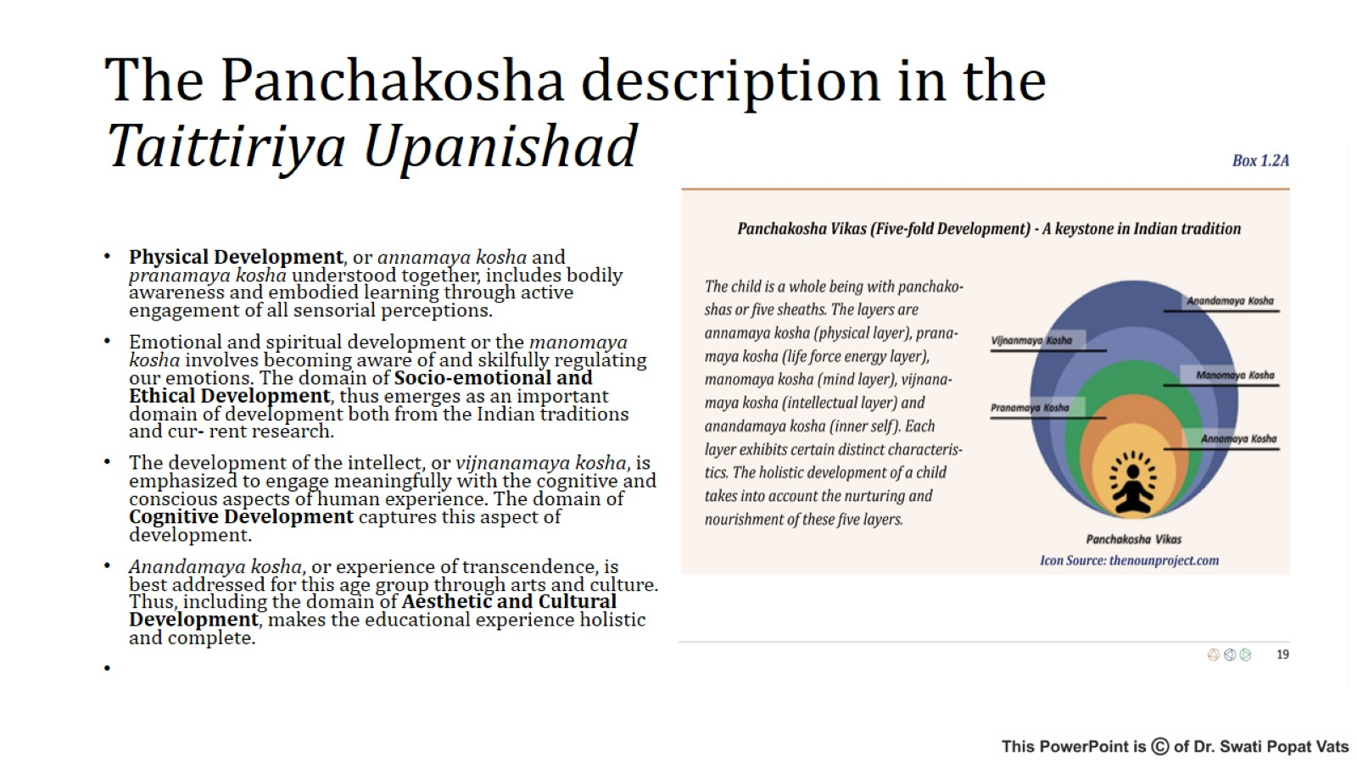
The Panchakosha description in the Taittiriya Upanishad

Slide 9
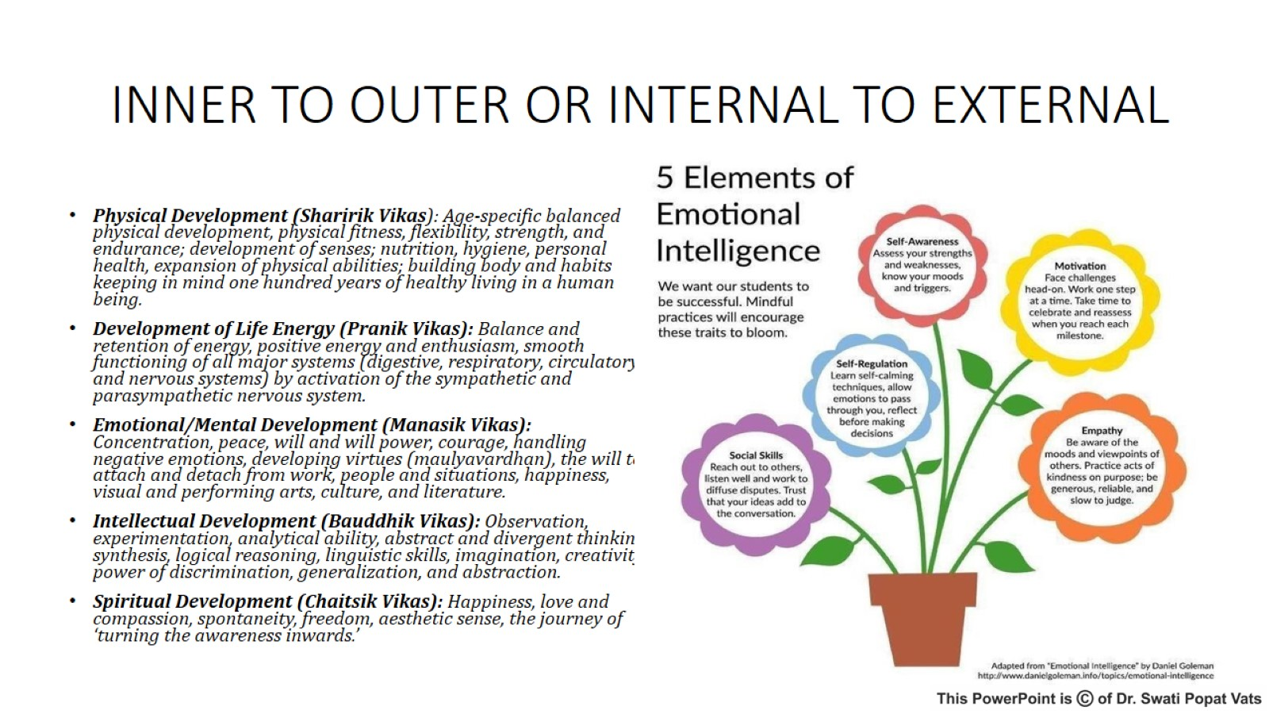
INNER TO OUTER OR INTERNAL TO EXTERNAL

Slide 10
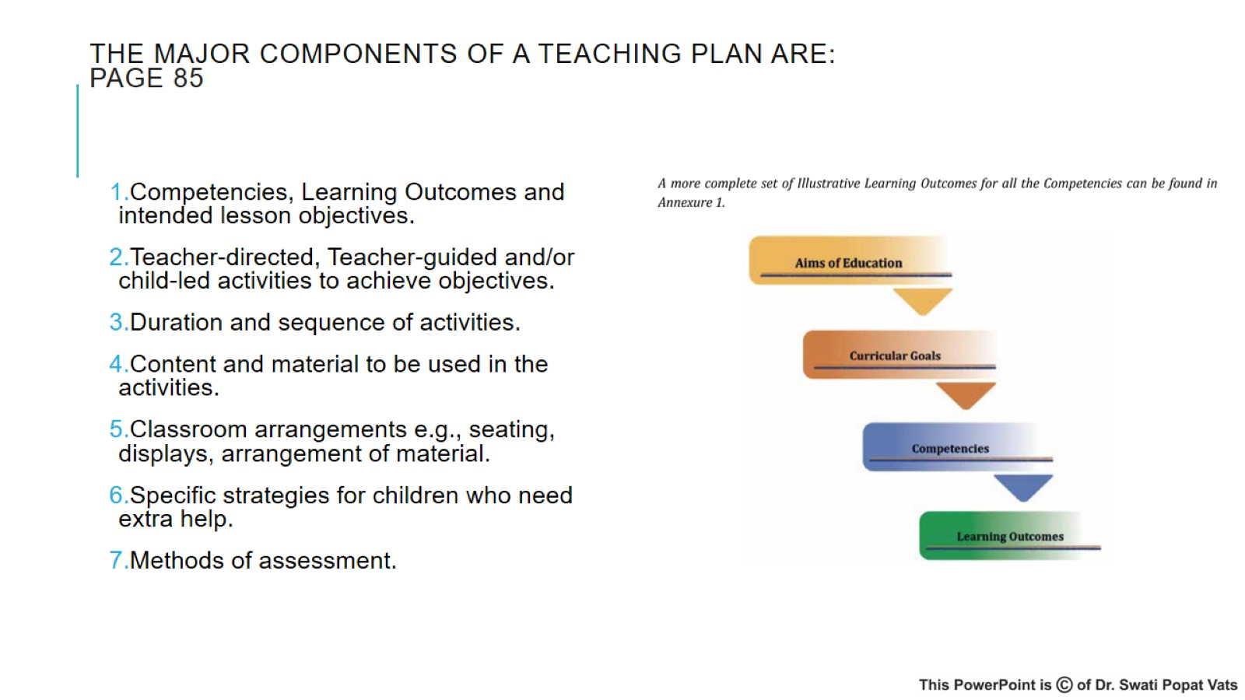
The major components of a teaching plan are:
PAGE 85

Slide 11
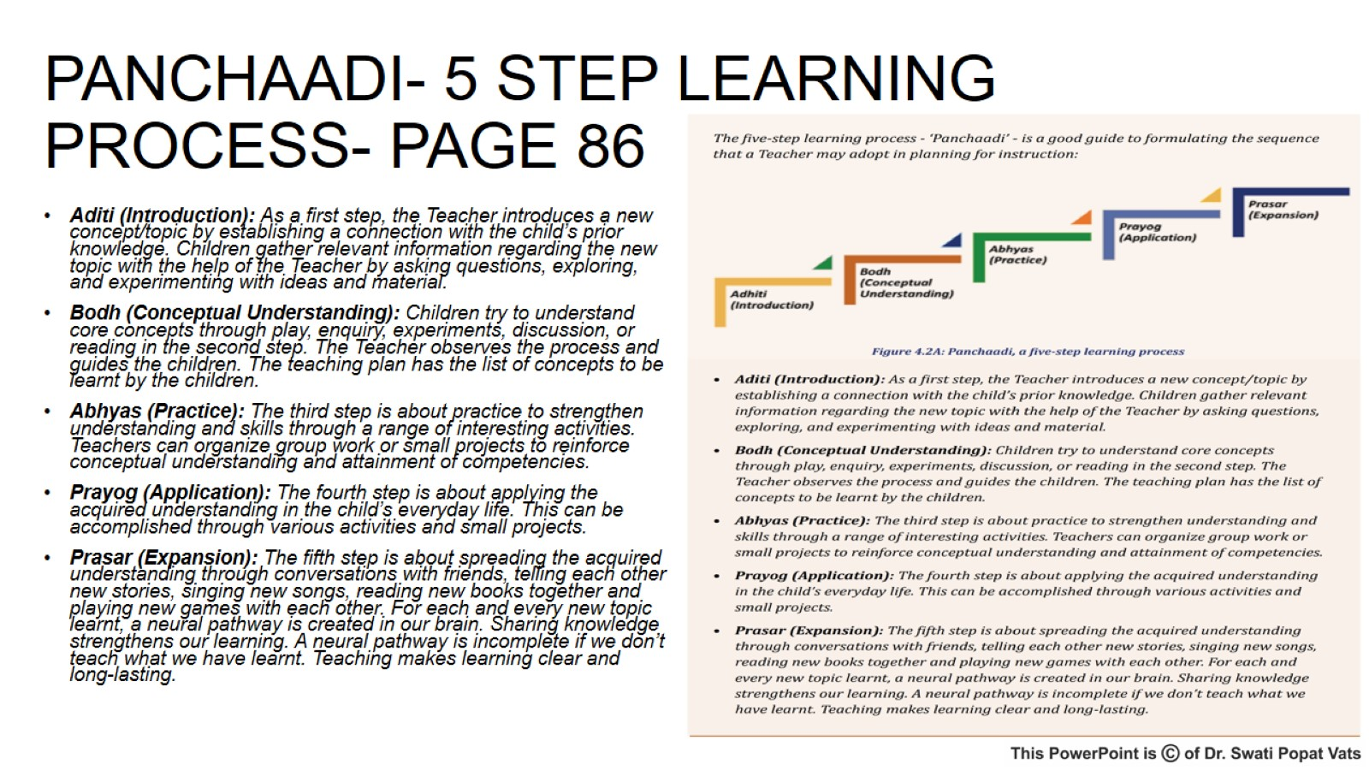
PANCHAADI- 5 STEP LEARNING PROCESS- PAGE 86

Slide 12
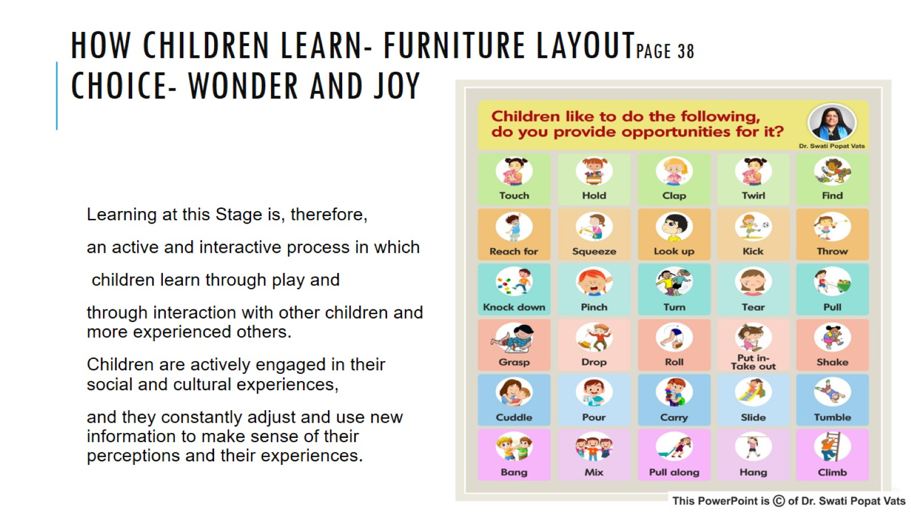
HOW CHILDREN LEARN- FURNITURE LAYOUTPAGE 38
CHOICE- WONDER AND JOY

Slide 13
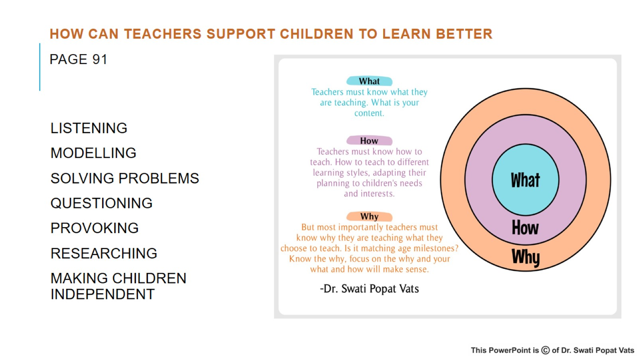
How can Teachers Support Children to Learn Better
PAGE 91

Slide 14
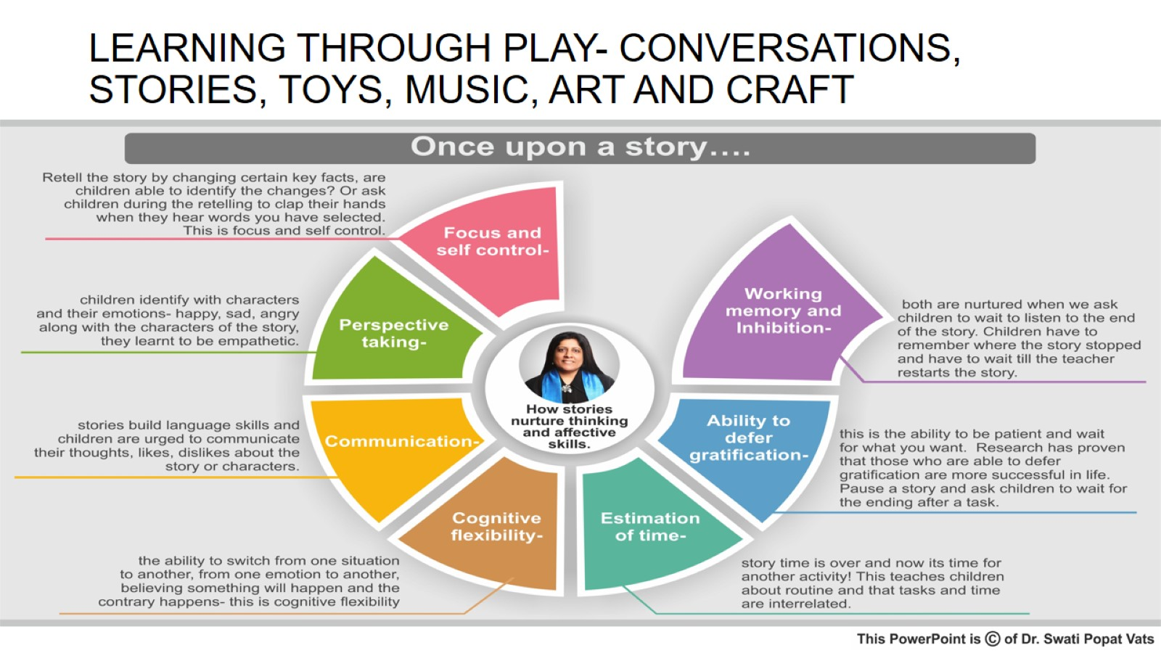
LEARNING THROUGH PLAY- CONVERSATIONS, STORIES, TOYS, MUSIC, ART AND CRAFT

Slide 15
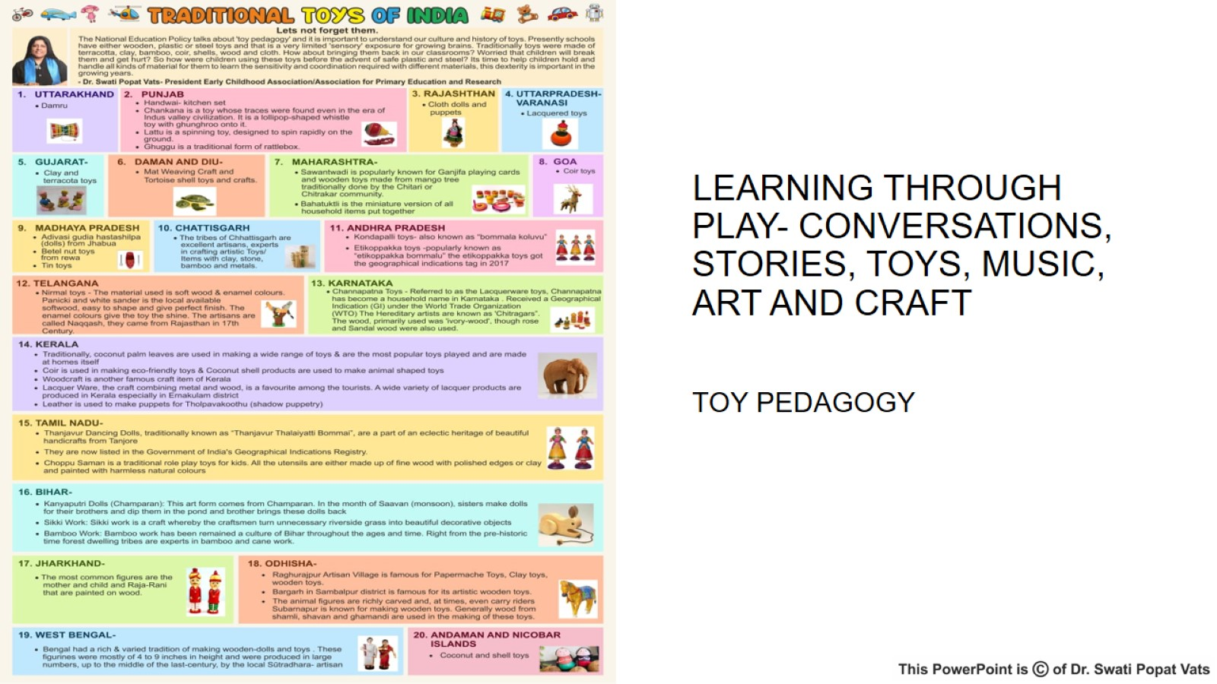

Slide 16
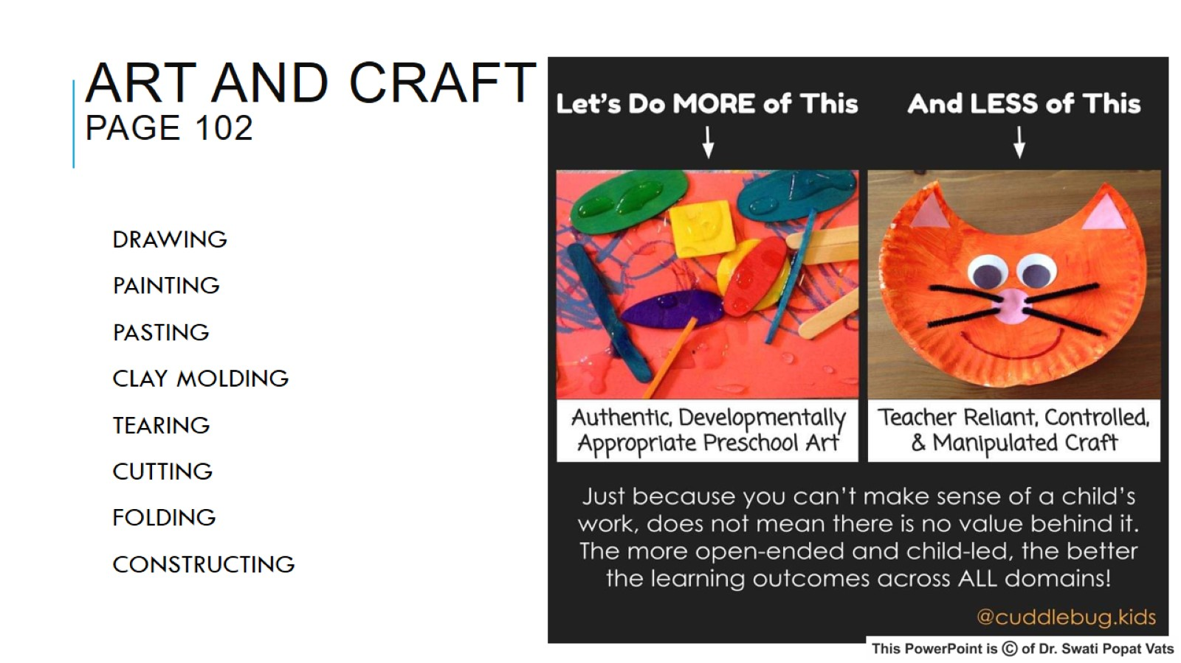
ART AND CRAFT
PAGE 102

Slide 17
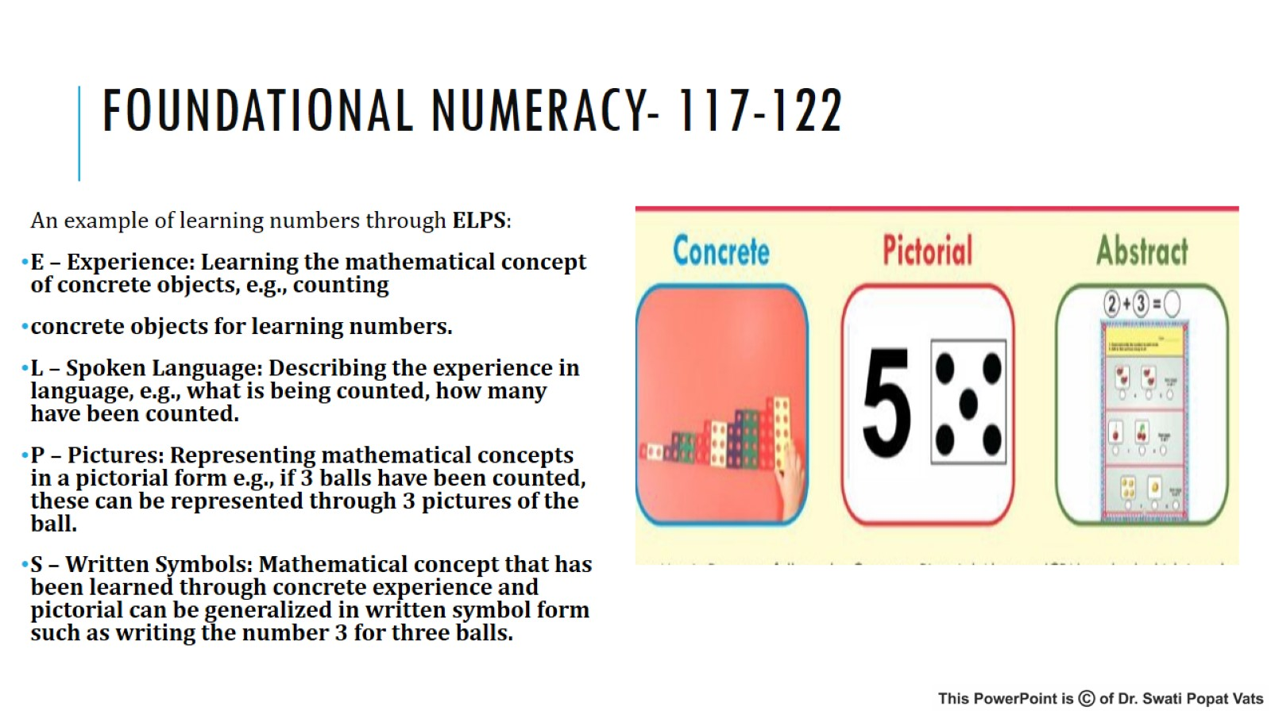
FOUNDATIONAL NUMERACY- 117-122

Slide 18
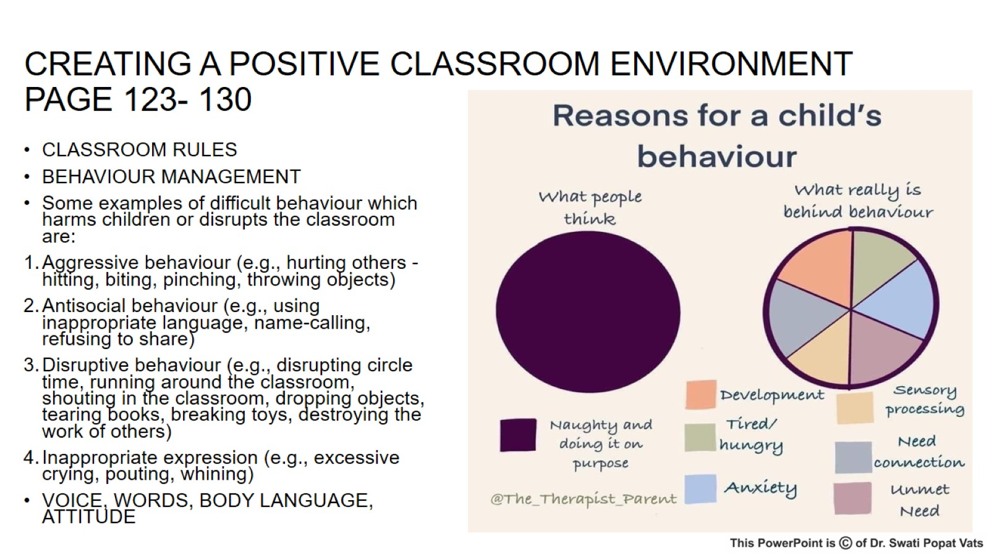
CREATING A POSITIVE CLASSROOM ENVIRONMENT PAGE 123- 130

Slide 19
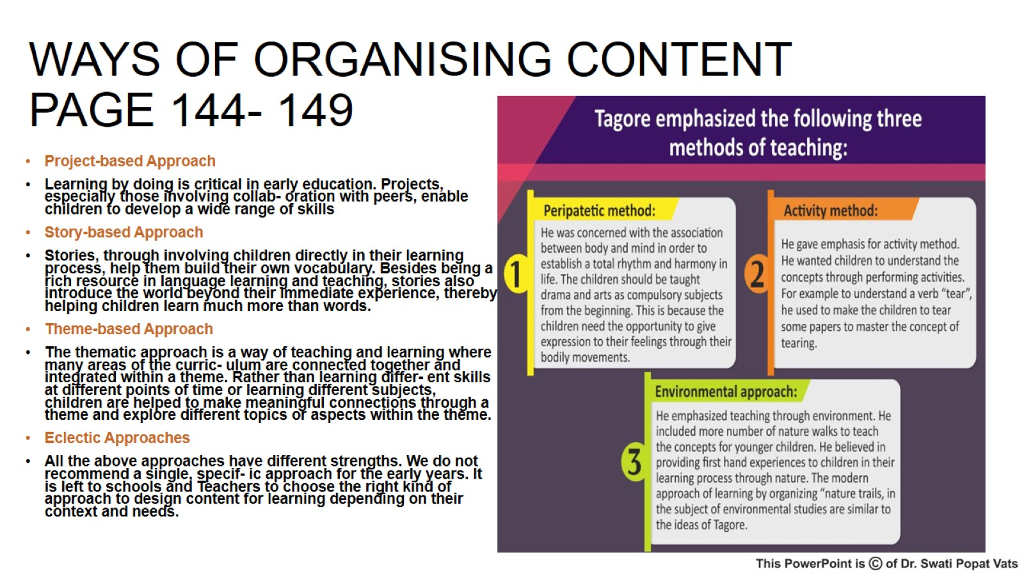
WAYS OF ORGANISING CONTENT
PAGE 144- 149

Slide 20
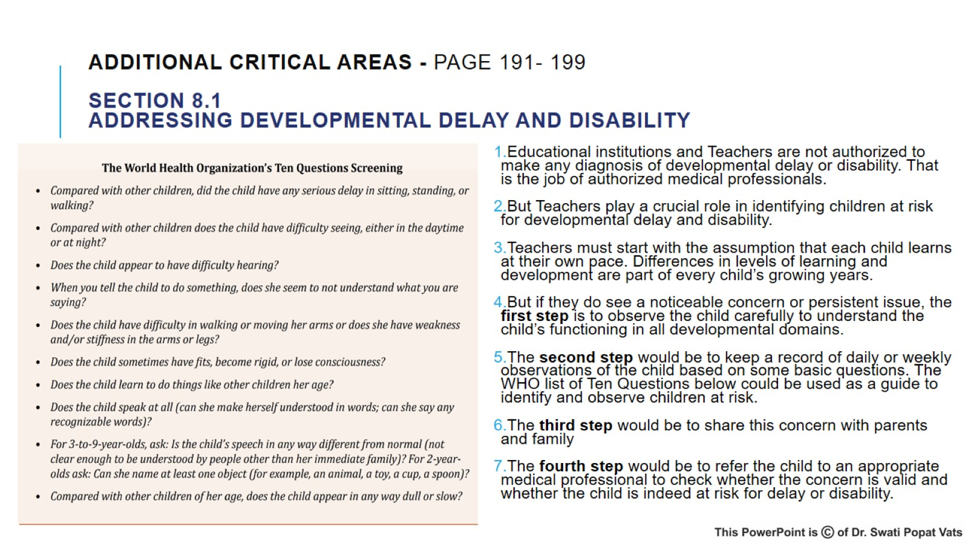
Additional Critical Areas - PAGE 191- 199
Section 8.1
Addressing Developmental Delay and Disability

Slide 21
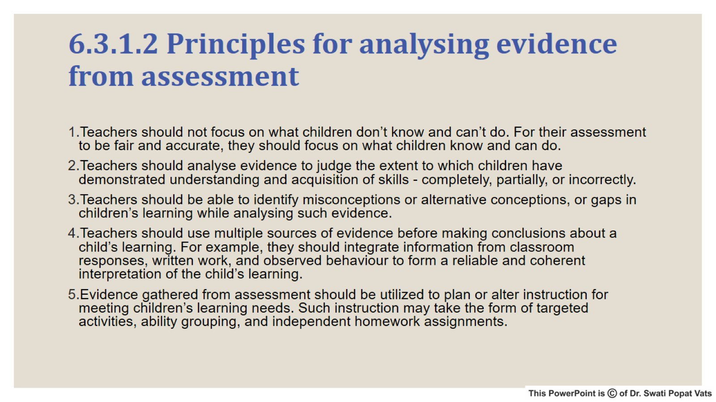
6.3.1.2 Principles for analysing evidence from assessment

Slide 22
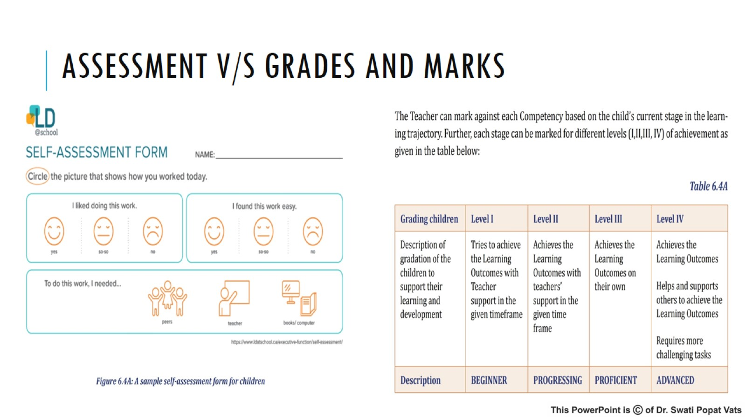
ASSESSMENT V/S GRADES AND MARKS

Slide 23
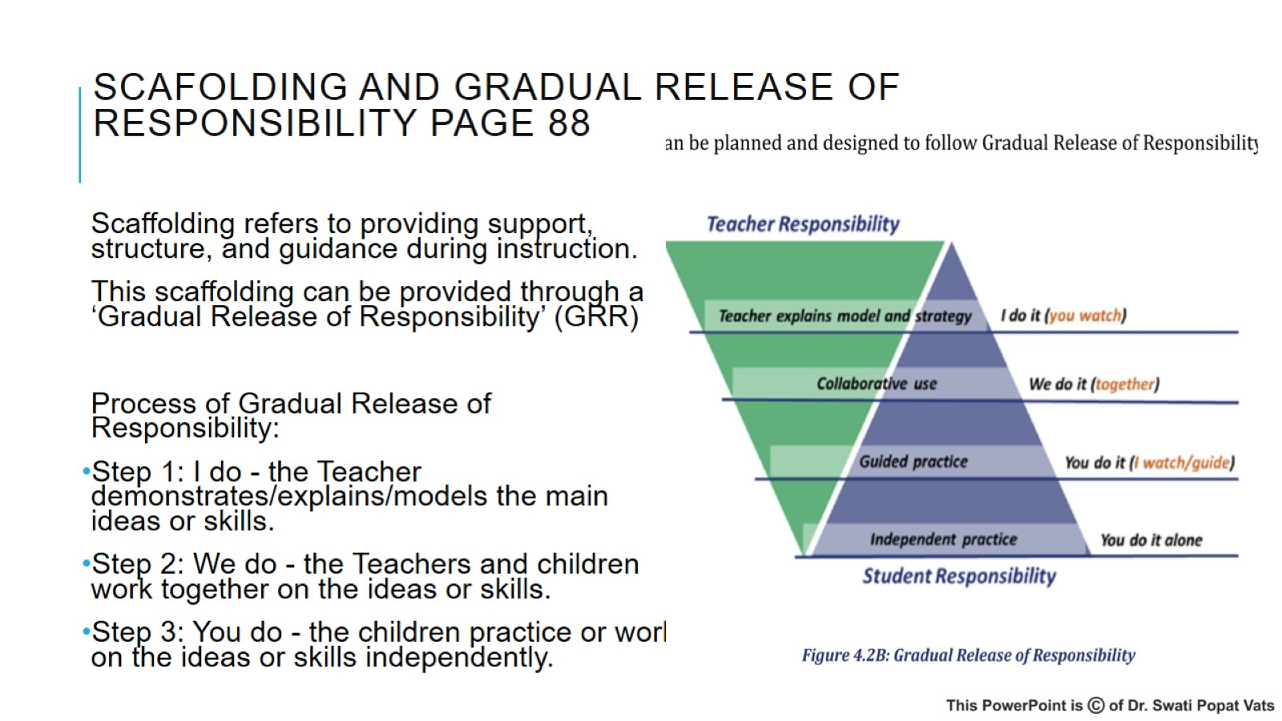
SCAFOLDING AND GRADUAL RELEASE OF RESPONSIBILITY PAGE 88

Slide 24
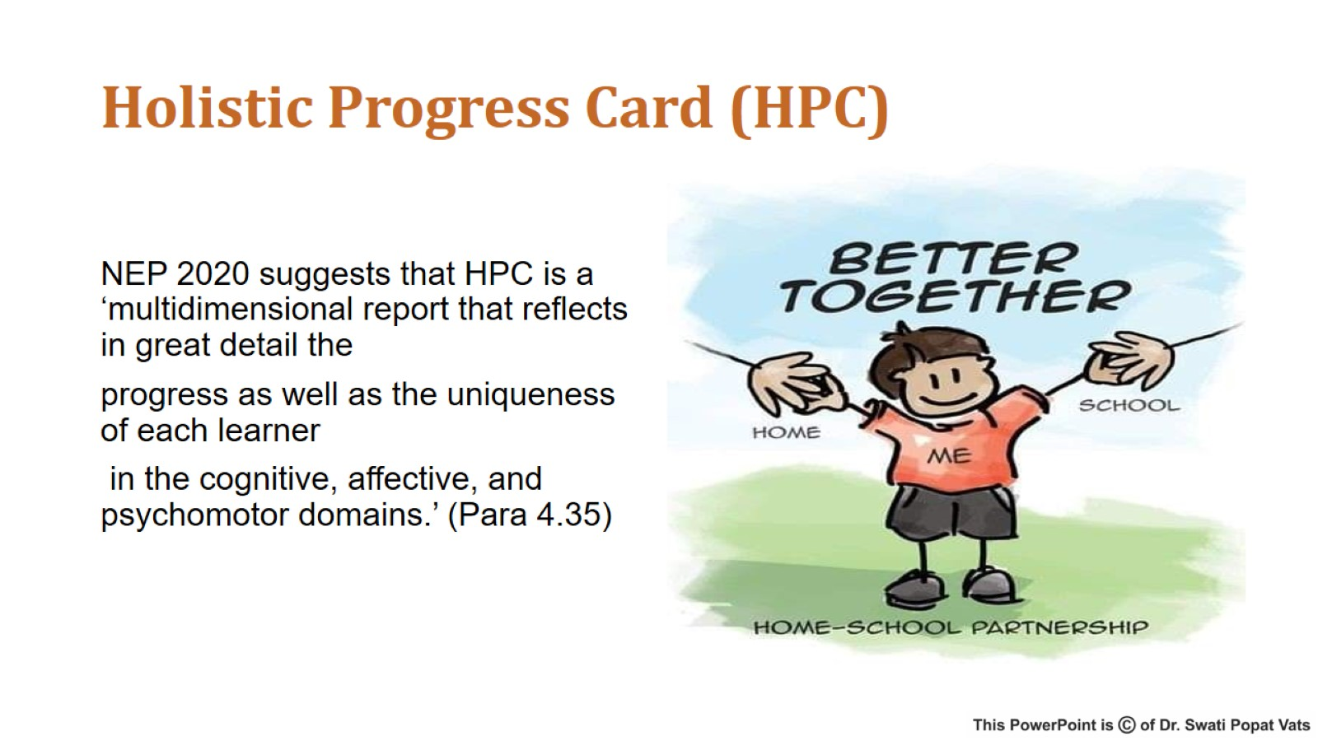
Holistic Progress Card (HPC)

Slide 25
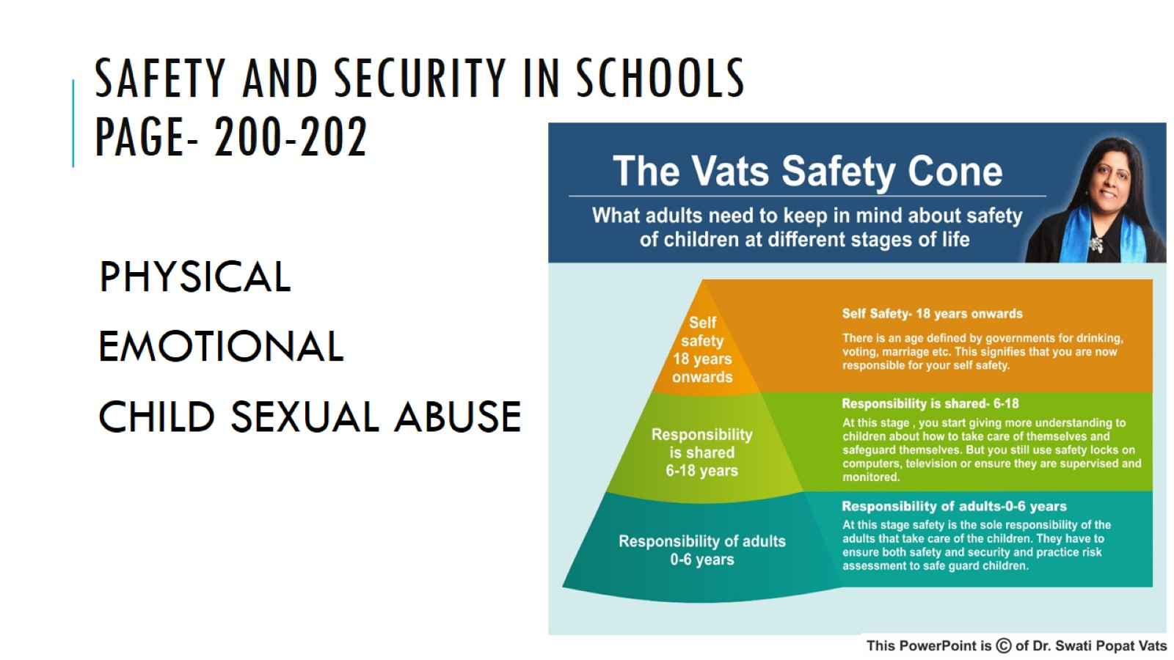
SAFETY AND SECURITY IN SCHOOLS
PAGE- 200-202

Slide 26
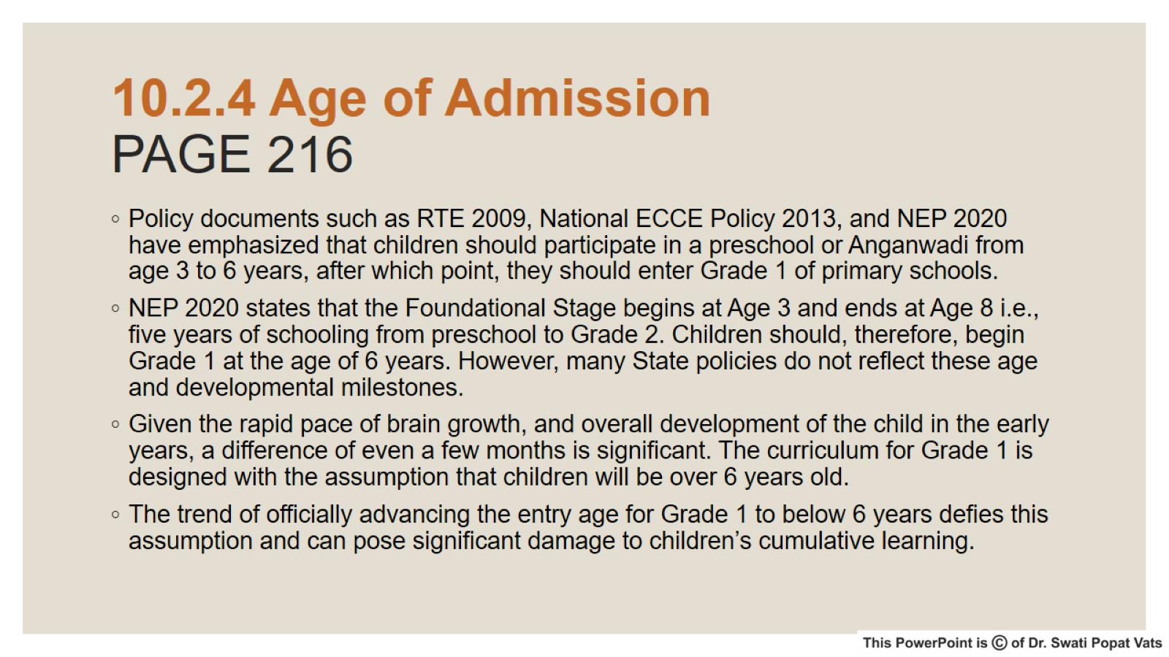
10.2.4 Age of Admission
PAGE 216

Slide 27
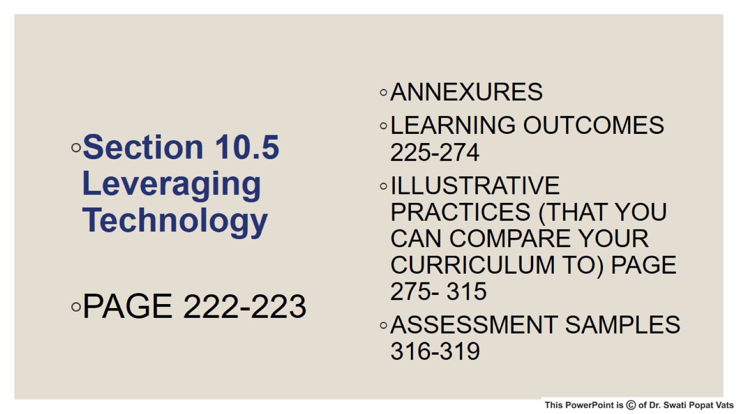

Slide 28


