Slide 1

Panchadi of NCF 2022: A Path from Vedas to Metaverse
In this presentation, we explore the transformative power of Panchadi of NCF 2022 and how it can help us move beyond the oldest scriptures to the immersive world of metaverse.

Slide 2
The Five Pillars of Panchadi of NCF 2022
Knowledge Integration
Encourages a multidisciplinary approach to integrate various fields of knowledge.
Contemporary Relevance
Addresses current issues and challenges to prepare students for the future.
1
2
3
4
4
Learner Centric
Emphasizes the needs, interests, and diversity of learners to provide relevant education.
Contextual Analysis
Uses situational, cultural, and historical contexts to help students connect with their environment.
Creative Engagement
Promotes active participation, imagination, and exploration in the learning process.

Slide 3
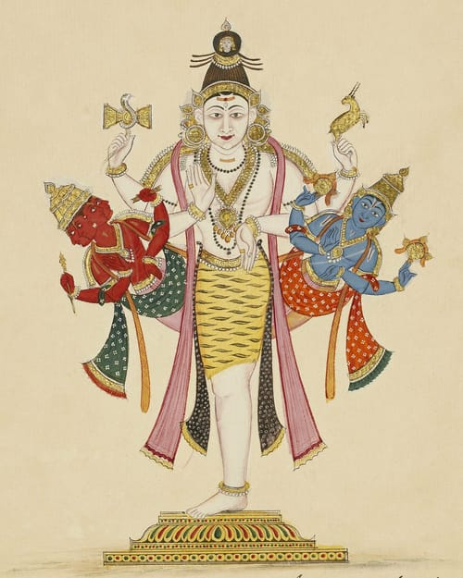


From Vedas to Metaverse with Panchadi
Ancient Indian Wisdom
Panchadi of NCF 2022 builds upon the rich Indian philosophical and spiritual traditions to offer a holistic and inclusive education.
Future Technologies
Panchadi of NCF 2022 prepares students for the advancements in technology and the evolution of human-machine interface in the metaverse.
Dynamic Curriculum
Panchadi of NCF 2022 provides a flexible and adaptable curriculum that can accommodate the changing needs and demands of the contemporary world.

Slide 4
The Benefits of Adopting Panchadi
Inclusive Education
Panchadi of NCF 2022 promotes social justice, equity, and diversity by giving access to education for all.
Global Competence
Panchadi of NCF 2022 fosters a sense of curiosity, empathy, and intercultural understanding to prepare students for the global community.
Cognitive Development
Panchadi of NCF 2022 enhances critical thinking, creativity, and problem-solving skills to stimulate lifelong learning.

Slide 5
Examples of Panchadi in Practice
Rainwater Harvesting
Students learn the science of hydrology, the cultural significance of water, and the practical techniques of rainwater harvesting to tackle the water crisis.
Ethical Hacking
Students explore the ethics, legalities, and technical aspects of cyber security to prevent cybercrime and ensure a safe digital environment.
Heritage Walks
Students discover the historical, architectural, and cultural heritage of their city through guided walks, street performances, and community engagement.
1
2
3

Slide 6

Challenges in Implementing Panchadi
1
Resistance to Change
Some stakeholders may be resistant to change or unfamiliar with the innovative approach and need time and support to adopt it.
Resource Constraints
Implementation of Panchadi of NCF 2022 requires sufficient resources, infrastructure, and expertise, which may be lacking in some settings.
Evaluation and Assessment
Designing and applying appropriate evaluation and assessment methods to measure the success and impact of Panchadi of NCF 2022 is a complex issue.
2
3

Slide 7
Conclusion and Call to Action
Join the Movement
Be a part of the revolution in education by advocating for the implementation of Panchadi of NCF 2022 in your community and beyond.
Transform Education
Support the transformation of education from a static, outdated model to a dynamic, inclusive, and future-ready paradigm with Panchadi of NCF 2022.

