Slide 1

Panchadi of NCF 2022 and AI: Blending Two Worlds
Introducing the Panchadi of NCF 2022 and its potential to blend with AI to revolutionize education. Here, we explore the challenges faced, the benefits of AI to education according to NCF 2022, and strategies for successful integration.

Slide 2
The Purpose of Panchadi of NCF 2022
Goals
The National Curriculum Framework (NCF) aims to provide students with a holistic education that focuses on developing their cognitive, social, emotional, and physical abilities.
Principles
The NCF emphasizes the principles of inclusiveness, gender sensitivity, and the importance of preserving India's cultural heritage.
Flexibility
The Framework allows for flexibility in curriculum design, giving educators the freedom to personalize learning experiences for their students.

Slide 3
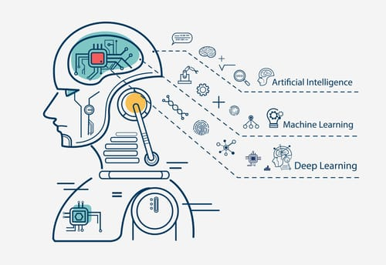
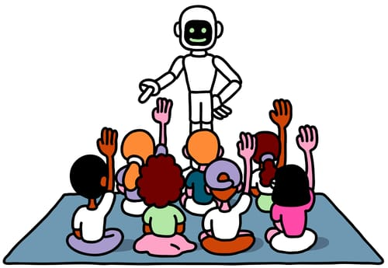
Introduction to AI
What is AI?
AI refers to the development of computer systems that can perform tasks requiring human-like intelligence, including visual perception, speech recognition, decision-making, and language translation.
The Role of AI in Education
AI can supplement traditional teaching methods by providing personalized learning experiences and freeing up teachers’ time for more one-on-one interactions with students.

Slide 4

Challenges with Blending NCF 2022 and AI
Resource Availability
AI adoption in the education sector requires significant financial and technological resources, which may not be available to all institutions.
Teacher Training
Effective integration of AI in education requires teachers to be trained in AI technology to effectively combine standard teaching methods with AI techniques.
Data Privacy and Security
AI requires vast amounts of data to work, and ensuring the data is secure and protected is a major issue that needs to be addressed while implementing it in education.
1
2
3

Slide 5


Benefits of Using AI in Education According to NCF 2022
Personalized Learning
AI can provide personalized learning experiences for students, enabling them to learn at their own pace, and receive feedback instantly.
Improved Assessment
AI allows educators to assess students’ performance more accurately, and in less time, freeing up their time for other instructional activities.

Slide 6
Practical Applications of AI in Education
1
AI-Powered Classroom Management
AI can be used to monitor classroom learning behaviour and provide instant feedback, reducing teacher workload.
Virtual Assistant for Teachers
AI can assist teachers with administrative tasks, lesson planning, and grading assignments.
2
3
AI-Powered Personalized Learning
AI can be used to create personalized educational content for students.

Slide 7
Strategies for Successful Integration of AI into the NCF 2022
Collaboration
Collaboration between educators and AI experts can help to address the challenges surrounding AI integration in education.
Teacher Empowerment
Providing professional training and development opportunities for teachers can help them to more effectively incorporate AI into their classrooms.
Building a Data-Driven Culture
Schools need to establish a data-driven culture that focuses on extracting value from the data collected and making data-driven decisions.
Continuous Evaluation
Continuous evaluation of the impact of AI in education is required to ensure that it meets the needs of students and teachers.

Slide 8
Conclusion and Takeaways
Blending NCF 2022 with AI can improve learning outcomes and lead to more personalized education. However, proper planning, effective implementation, and careful consideration of the challenges are required for successful integration. Collaborative efforts and a data-driven culture can help in harnessing the full potential of AI in education.

