Slide 1

Social and emotional development in early years
DR. SWATI POPAT VATS
PRESIDENT
EARLY CHILDHOOD ASSOCIATION

Slide 2
His theory- the 8 ages of man.
AGE | STAGE | STRENGTH DEVELOPED
0 TO 1YRS | TRUST VS. MISTRUST | HOPE
2 TO 3 YRS | AUTONOMY VS. SHAME AND DOUBT | WILLPOWER
4 TO 5 YRS | INITIATIVE VS. GUILT | PURPOSE
6 TO 12 YRS | INDUSTRY VS. INFERIORITY | COMPETENCE
ADOLESCENSE | IDENTITY VS. ROLE CONFUSION | FIDELITY
YOUNG ADULTHOOD | INTIMACY VS. ISOLATION | LOVE
MIDDLE AGE | GENERATIVITY VS. STAGNATION | CARE
OLD | EGO INTEGRATION VS. DESPAIR | WISDOM

Slide 3
2 to 3 yrs- AUTONOMY VS. SHAME AND DOUBT
The developmental task of this stage is to acquire a sense of autonomy (independence) without suffering extremes of shames and doubt.
A child who successfully adapts during this stage of development will acquire a strong sense of self.
She will be able to separate confidently, for limited periods of times, from parents and primary caregivers. She will demand that she do things for herself whenever possible.

Slide 4
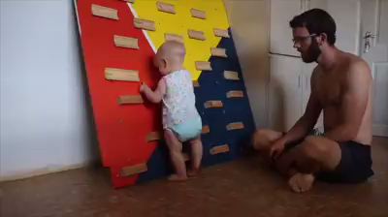
They need support not interference

Slide 5
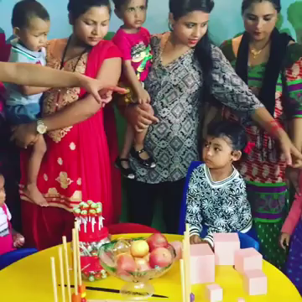
They need support not interference

Slide 6
2 to 3 yrs- AUTONOMY VS. SHAME AND DOUBT
Toddler teacher become accustomed to the shouts of “No! Me! Mine! Me do it!” which are characteristic of this stage of development.
Toddlers also have a way of being fiercely independent one minute and needy and clinging the next.

Slide 7
2 to 3 yrs- AUTONOMY VS. SHAME AND DOUBT
Holding on can also be constructive : attachment to special people, courage in the face of adversity, or plain old persistence in getting a task done.
Letting go can be destructive : tantrums, losing control when angry, hitting or biting.

Slide 8
2 to 3 yrs- AUTONOMY VS. SHAME AND DOUBT
This stage’s outcome determines, to a great extent,
the ratio of love and hate,
cooperation or lack of it, and
freedom of expression or tendency to suppress feelings that become part of who we are for the rest of our lives.
When a child can fully develop a strong sense of self-control without loss of self-esteem, she will feel proud and confident.
When a child experiences loss of control and excessive shame, she will tend to doubt herself.

Slide 9
2 to 3 yrs- AUTONOMY VS. SHAME AND DOUBT
Erikson believed that adults can foster independence in children of this age by :
giving children simple choices
not giving false choices
setting clear, consistent, reasonable limits
accepting children’s swings between independence and dependence, and reassuring them that both are okay.

Slide 10
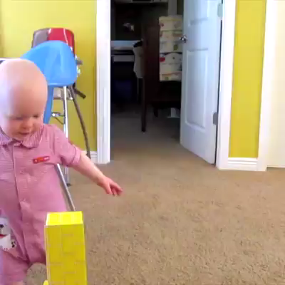
Independence and dependence

Slide 11
4 to 5 yrs-INITIATIVE VS. GUILT
The developmental task of this stage is to acquire a sense of purpose.
At first glance, this stage seems much easier for adults that the previous two. Part of that has to do with the child’s growing cognitive and physical abilities.

Slide 12
4 to 5 yrs-INITIATIVE VS. GUILT
To support children’s development of initiative in the third stage, Erikson says that teachers can encourage children to be as independent as possible
Focus on gains as children practice new skills, not on the mistakes they make along the way
Set expectations that are in line with children’s individual abilities
Focus curriculum on real things and on doing things

Slide 13
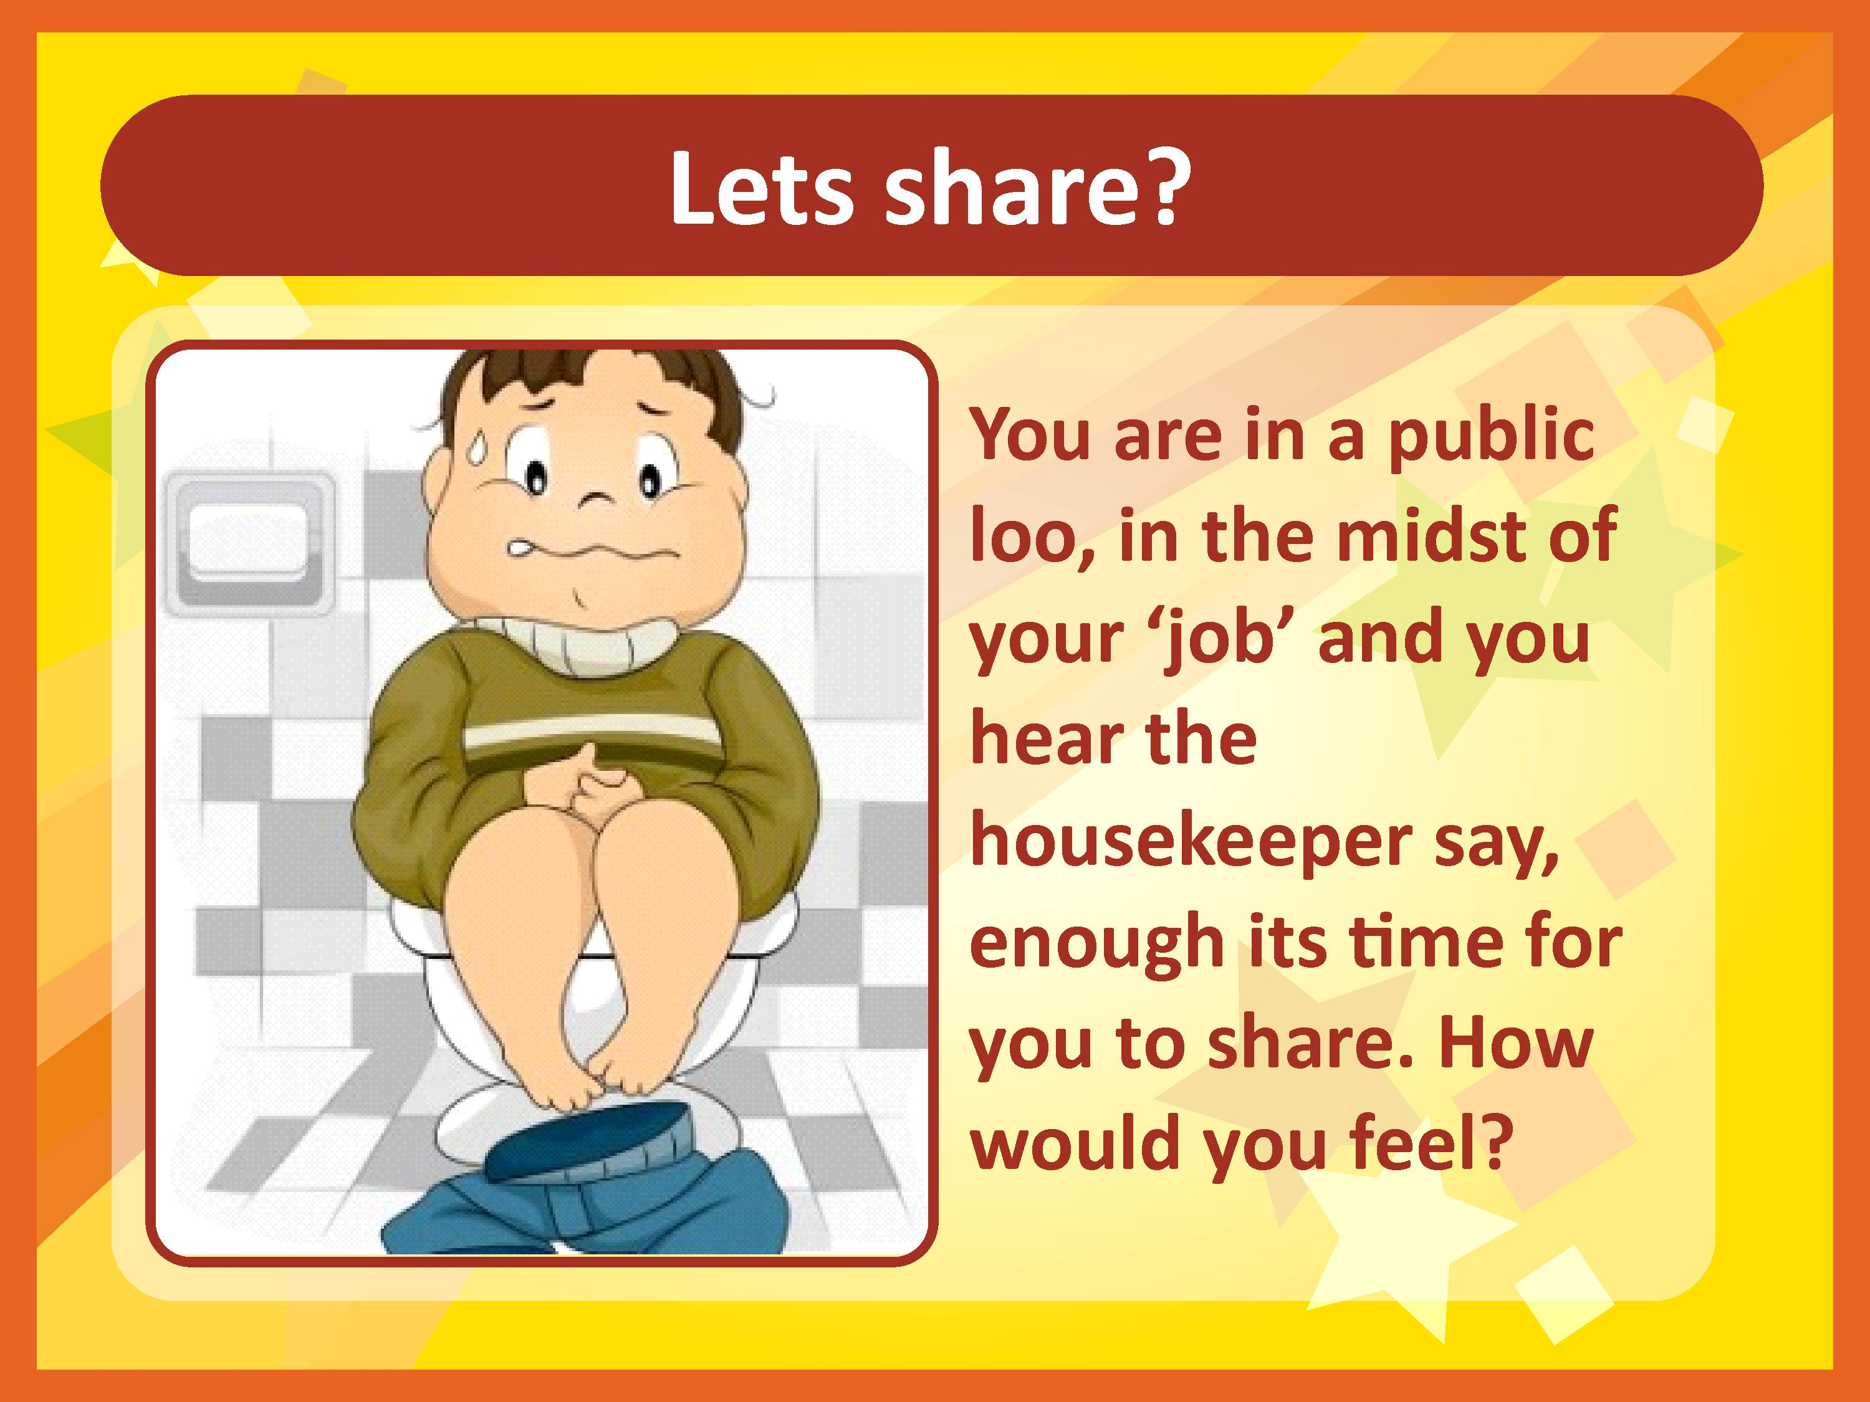

Copyright@Swati Popat Vats

Slide 14
Lets move from
Sharing to
taking turns
Copyright@Swati Popat Vats

Slide 15
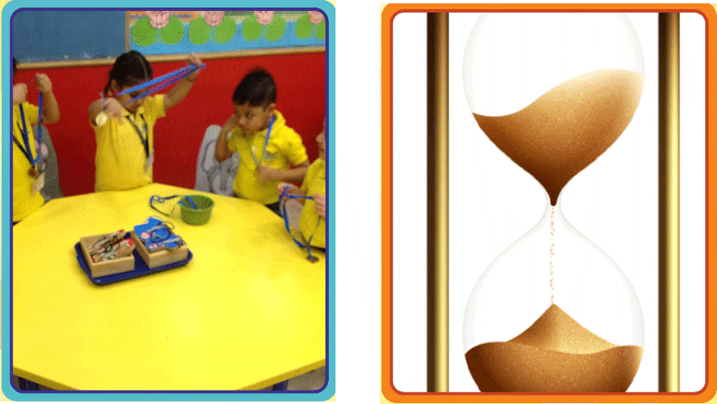
We use medals, visible and concrete time reminders and classroom agreements
Copyright@Swati Popat Vats

Slide 16
Two pillars of emotional development- Attachment (Roots) and Exploration (Wings)
Attachment comes from the desire to remain close to a caregiver and feel safe. Exploration comes from the desire to venture out and learn about the world. Children instinctively do both.
The attachment hands children form with their first early childhood teachers also predict the quality of relationship they will have with future teachers, because this first relationship becomes the model for the others.

Slide 17
One research study observed how mothers prepared their two-year-olds for a brief separation.
When mothers slipped out of the room without saying anything, their children played the least and were most likely to cry.
In contrast, when mothers told their toddlers what they were leaving and would return, or when they told their toddlers what they should do in the interim, their children played the most and cried the least.
Sneaking out might have been easier for the mothers, but it made the toddlers feel less safe. Thus, they did not explore or play as easily.

Slide 18
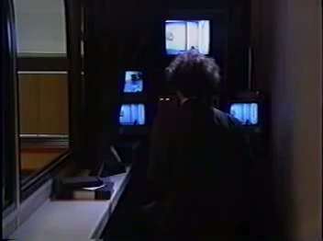
Video on strange situation
Mary Ainsworth

Slide 19
The type of attachment that young children have with their child care teachers can be observed in their behaviours.
Securely attached children:
accept comfort when they are upset.
can usually be calmed by the teacher holding them.
spontaneously hug the teacher.
easily follow her directions.
are lighthearted and playful with the teacher.

Slide 20
Insecure / avoidant attached children:
are more interested in the materials in the classroom than in the teacher or the other children.
act as if they do not hear what the teacher says or notice what he does.
avoid frequent or close contact with the teacher.
do not seek comfort from the teacher when hurt or upset, and might even move away from the teacher if she move closer to comfort them.

Slide 21
Insecure/resistant (ambivalent) attached children:
resist classroom routines such as cleaning up.
are demanding and impatient with the teacher and are not satisfied with his attempts to respond.
cry to get the teacher to do what they want her to do.
cling when the primary teacher attempts to leave the room and continue to cry after he leaves.

Slide 22
WORKING WITH AN INSECURELY ATTACHED CHILD
Children who have insecure attachments with their parents will bring that same relationship style to their interactions with you.
They will be less competent at using you, the teacher, to calm themselves or to support their efforts at self-control.
This is no fun for the child, and having an undercontrolled child is certainly no fun for you!

Slide 23
VERY SIMPLY PUT, IF YOU DO THE RIGHT THINGS AT EVERY STAGE YOU WILL HELP BRING ABOUT POSITIVE TRAITS IN THE CHILD’S EMOTIONAL DEVELOPMENT
AND IF YOU DO NOT THEN
YOU WILL BRING ABOUT NEGATIVE QUALITIES IN THE CHILD’S EMOTIONAL SET UP.

