Slide 1
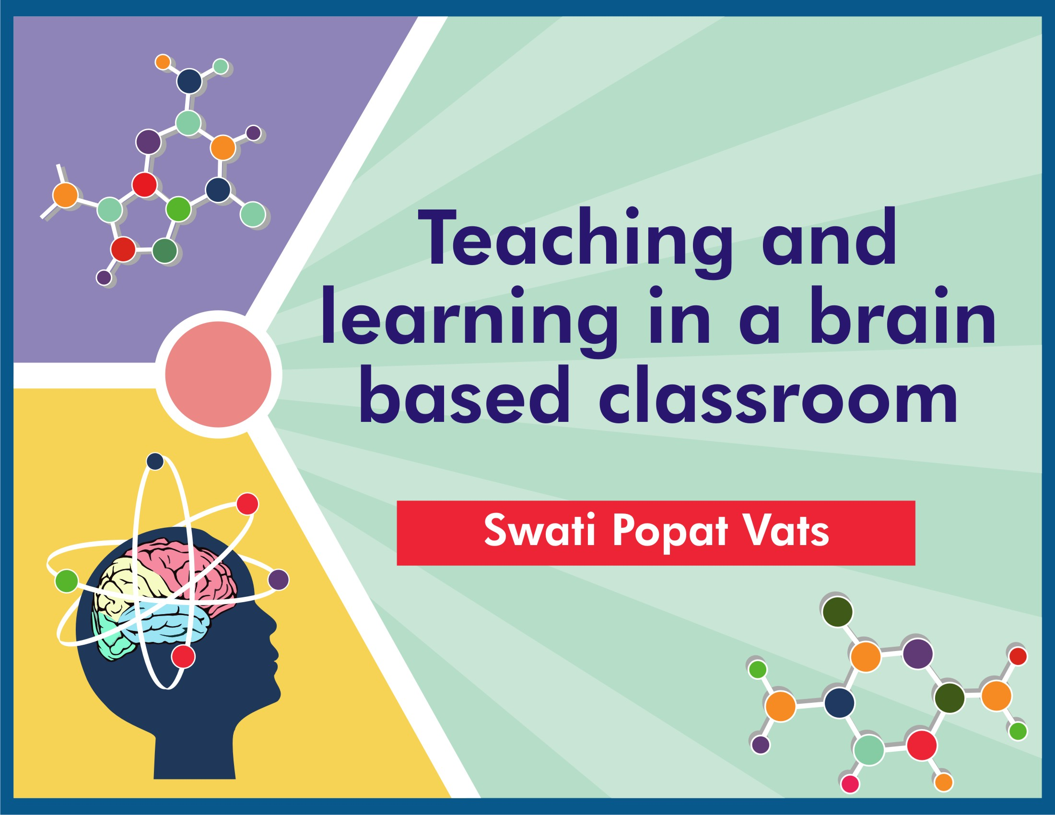

Slide 2
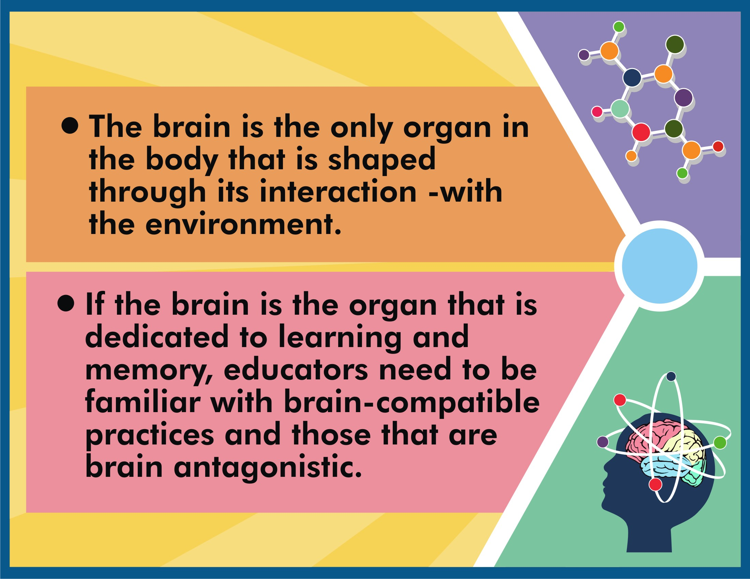

Slide 3
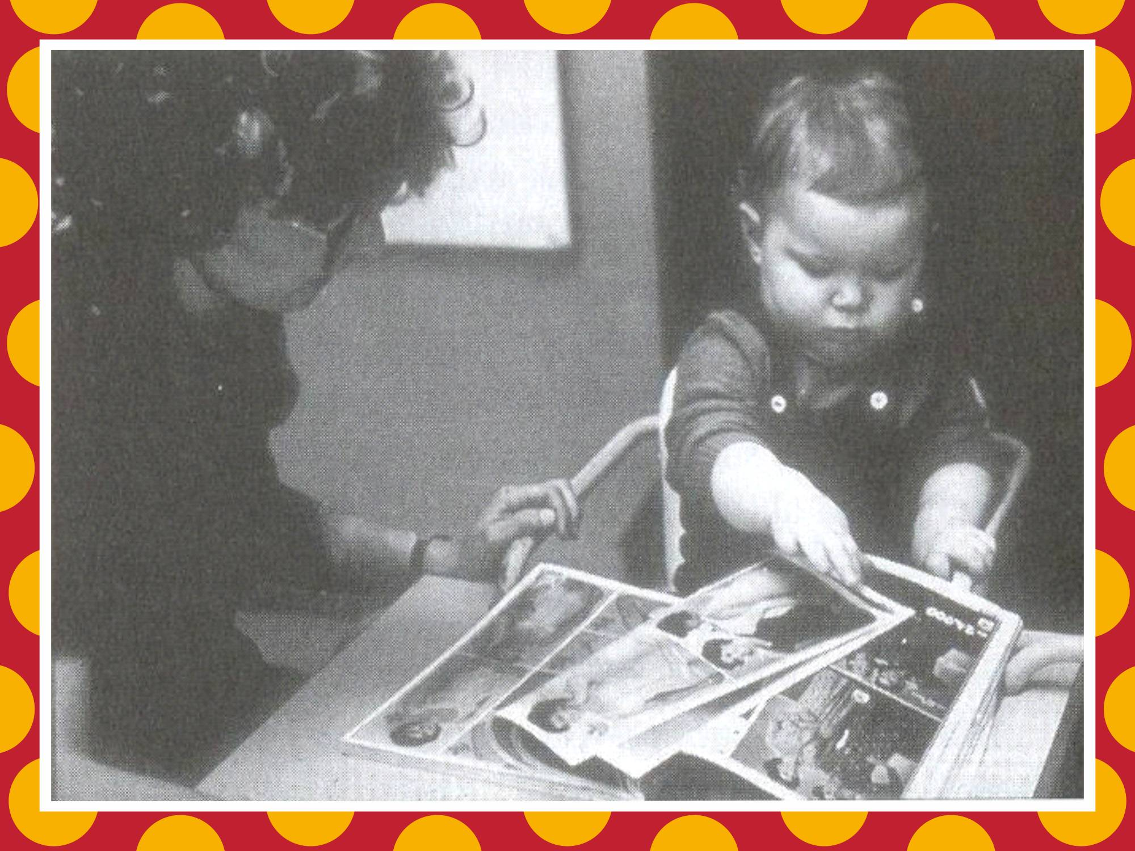

Slide 4
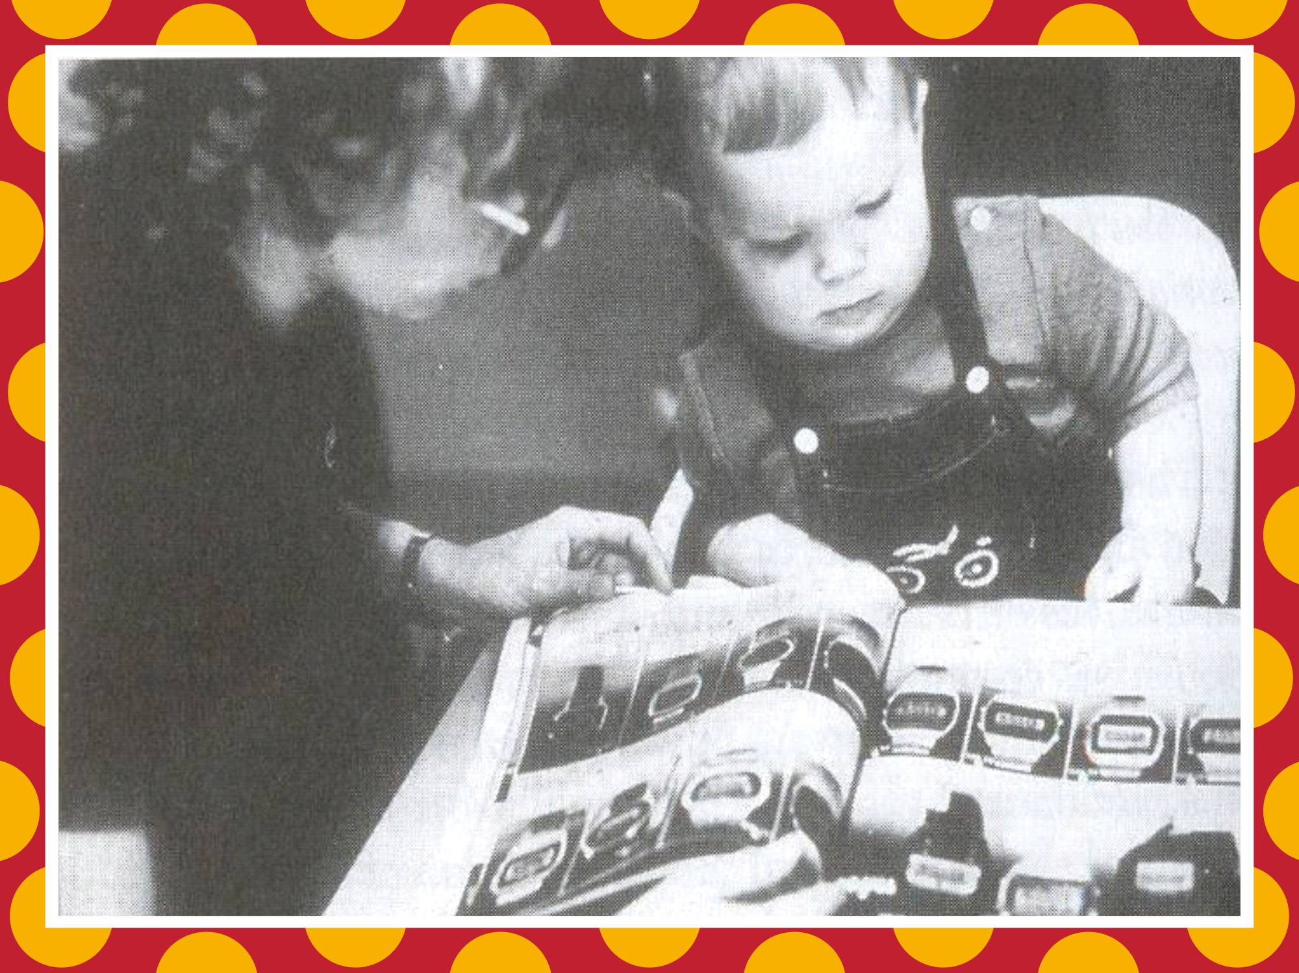

Slide 5
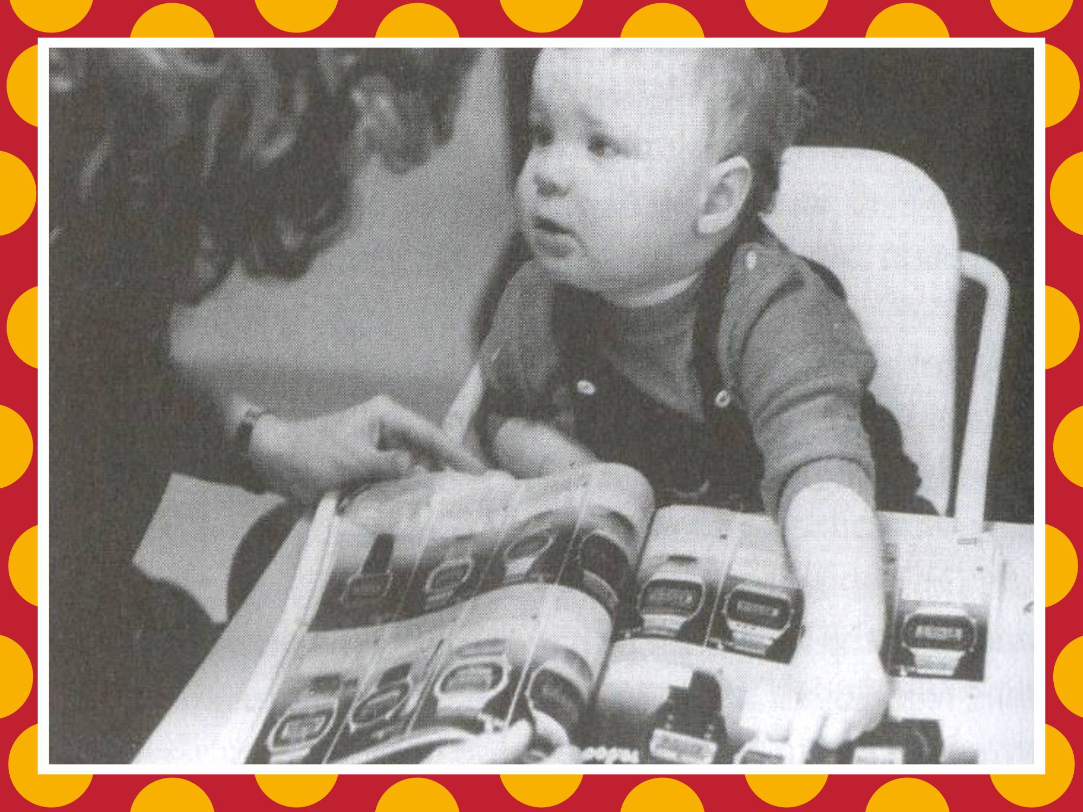

Slide 6
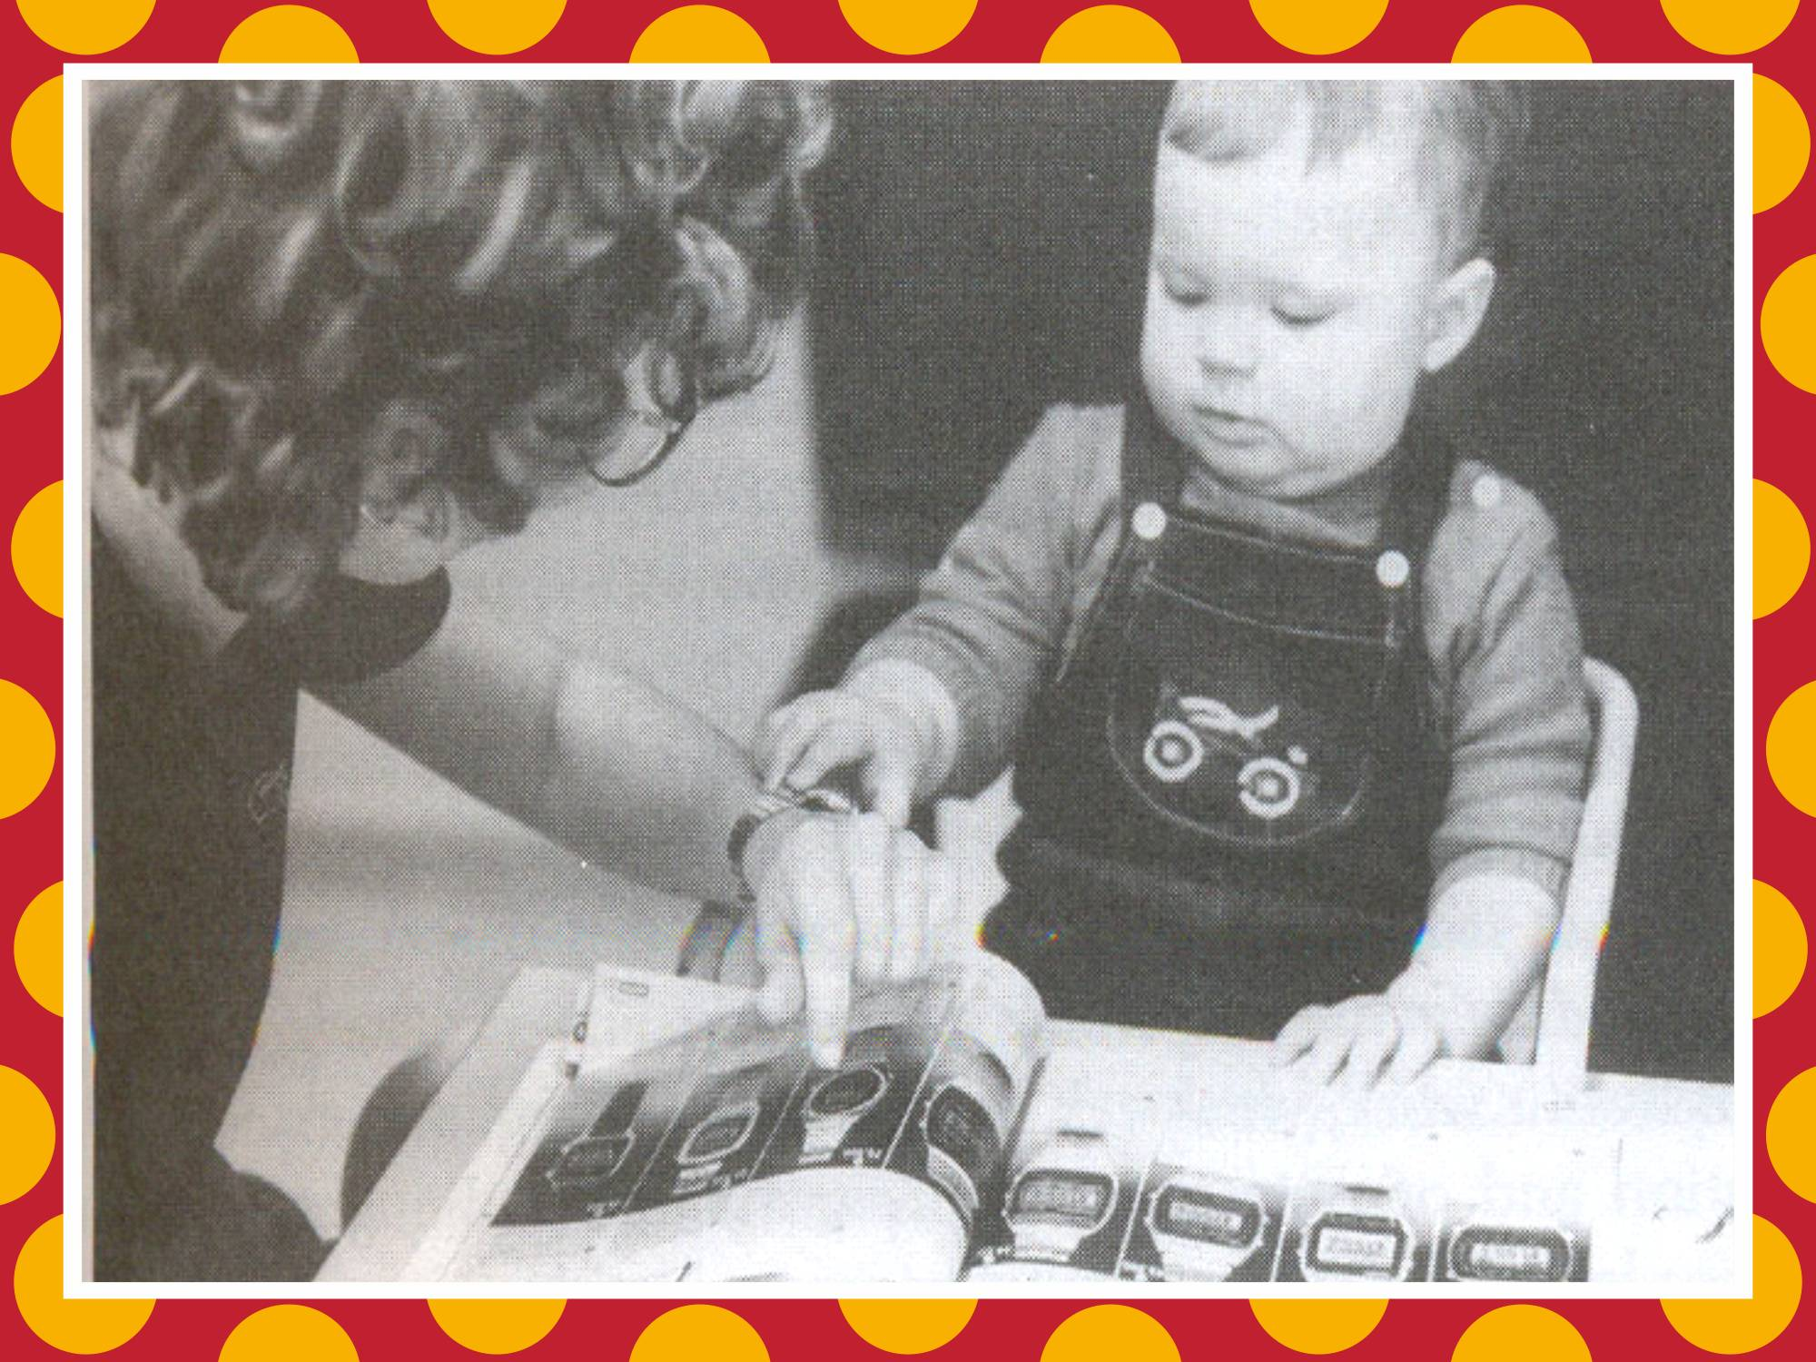

Slide 7
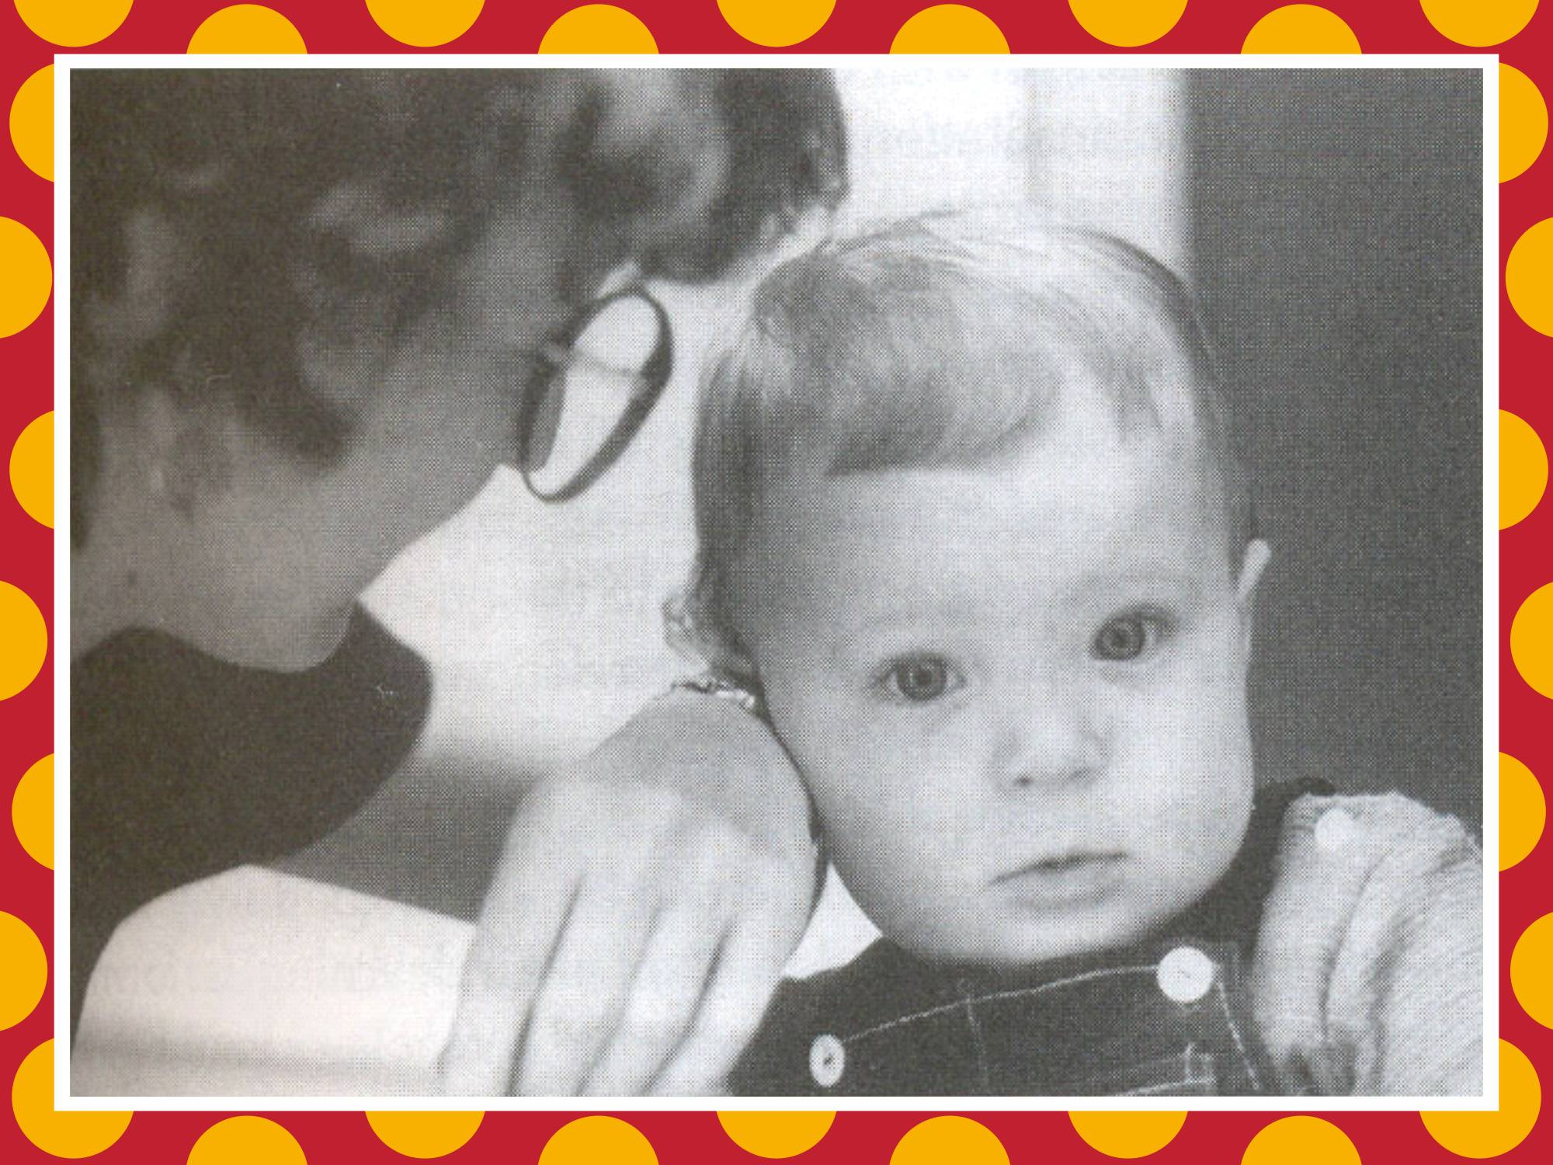

Slide 8
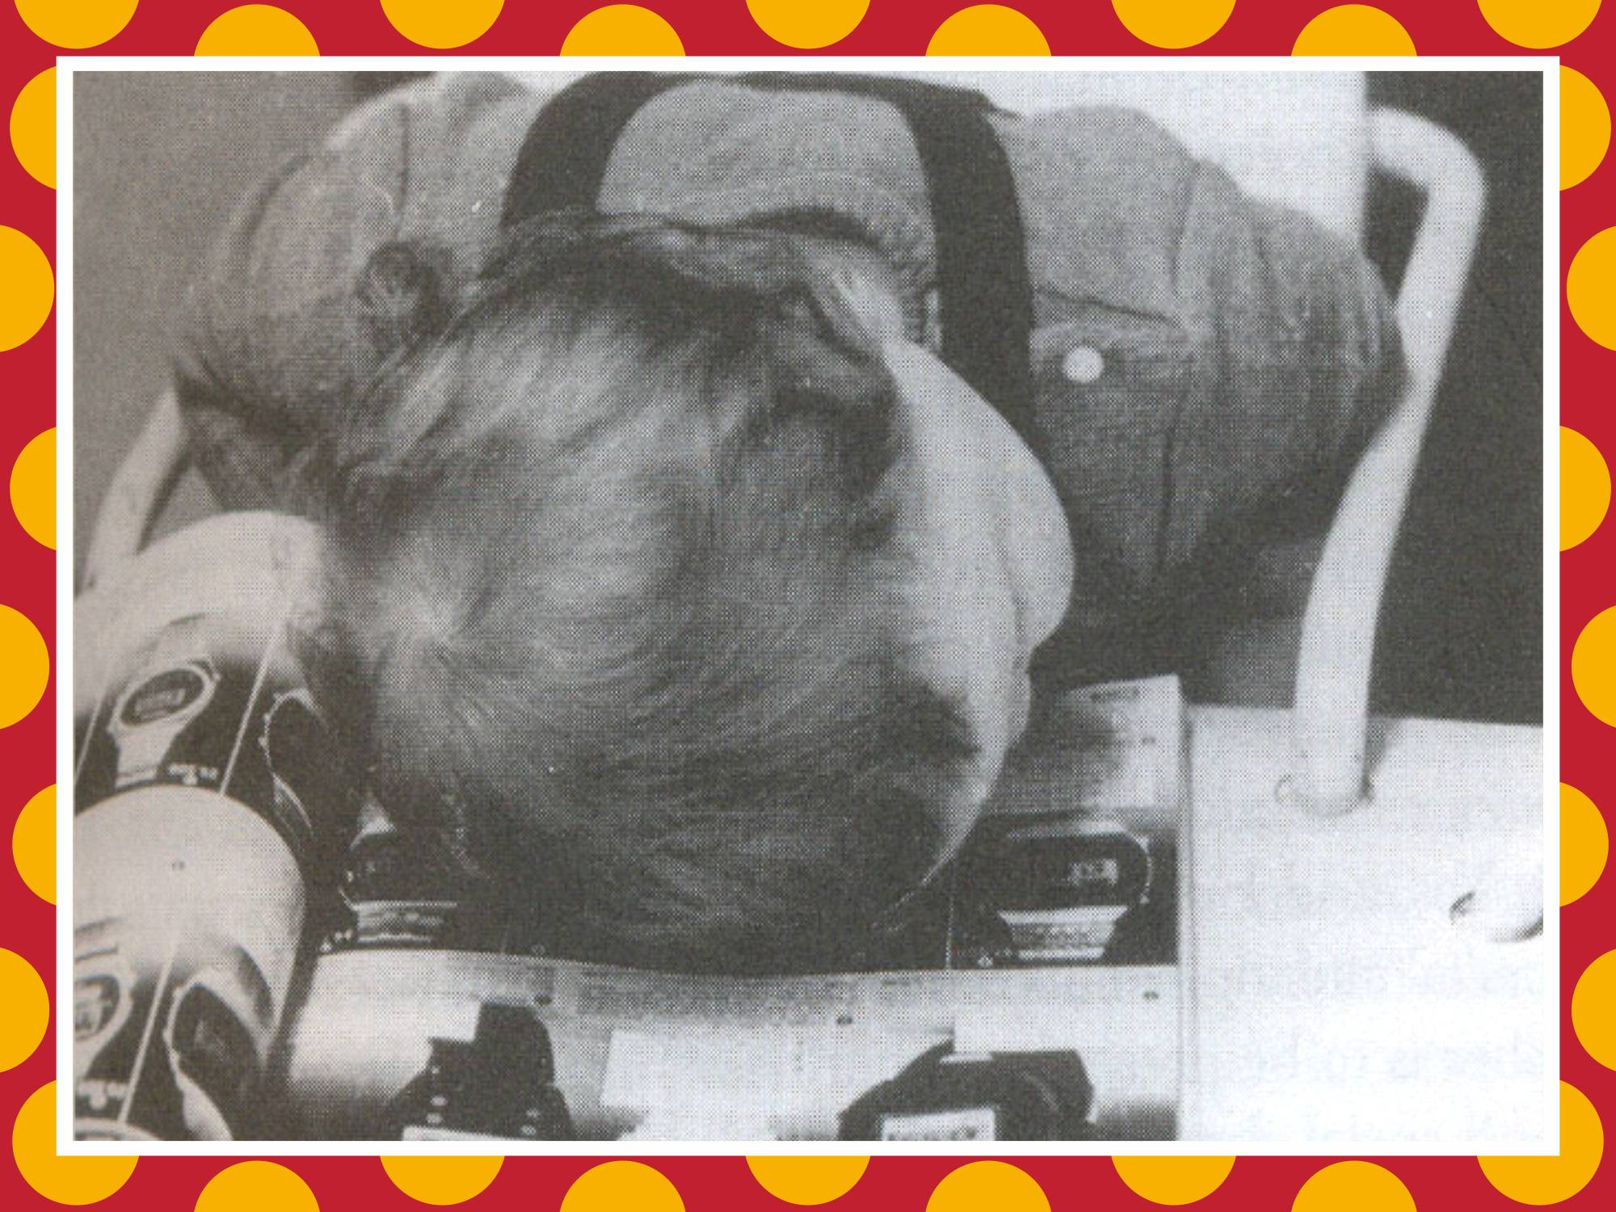

Slide 9
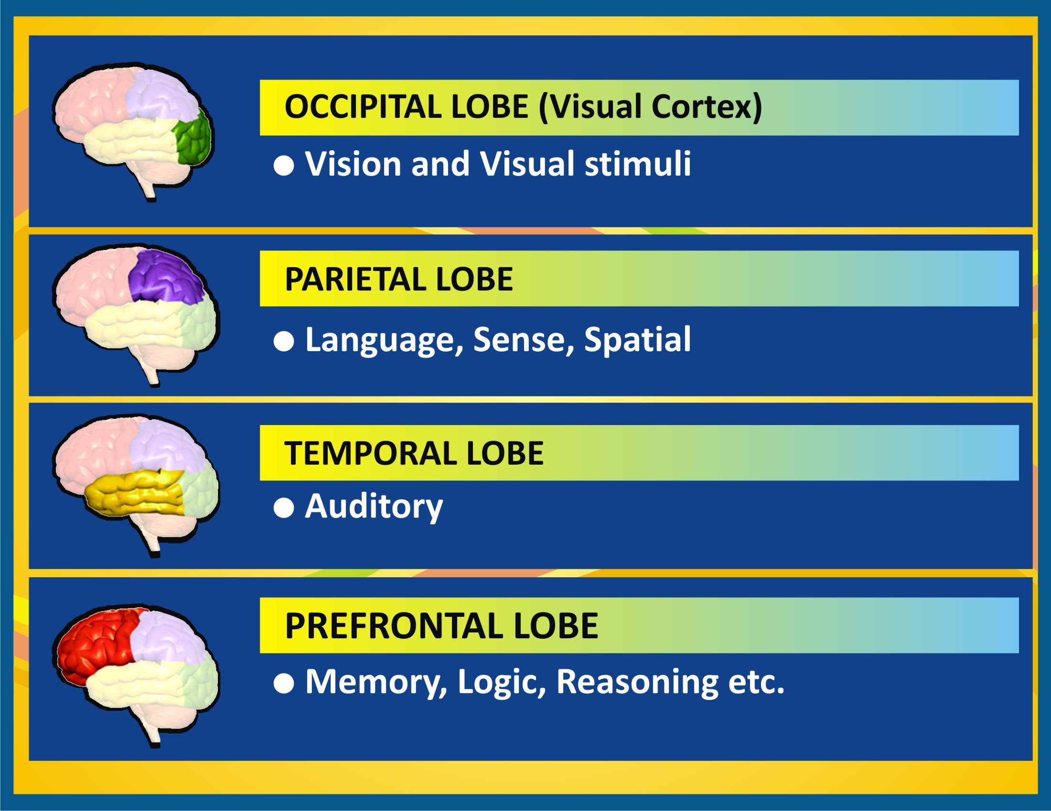

Slide 10
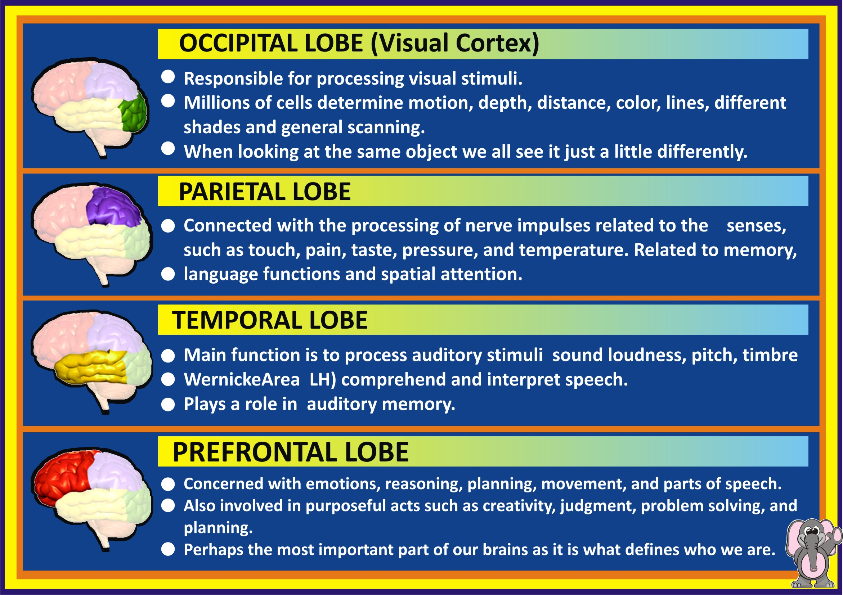

Slide 11
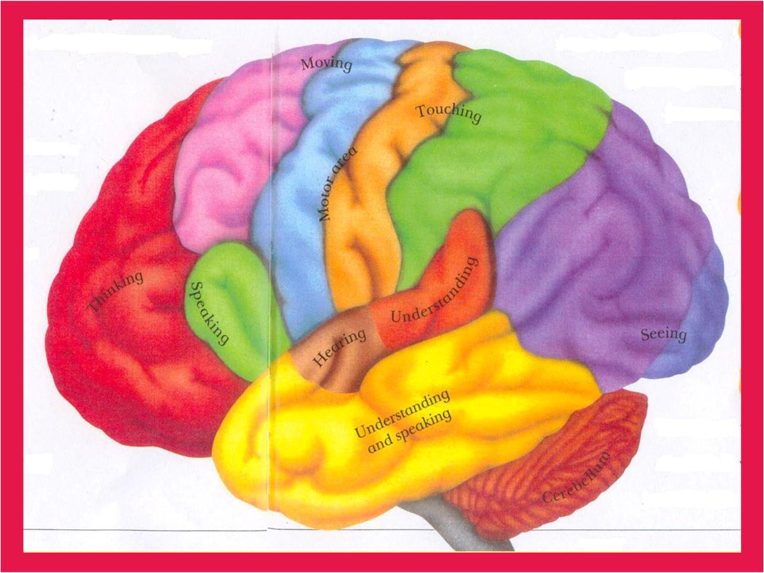

Slide 12
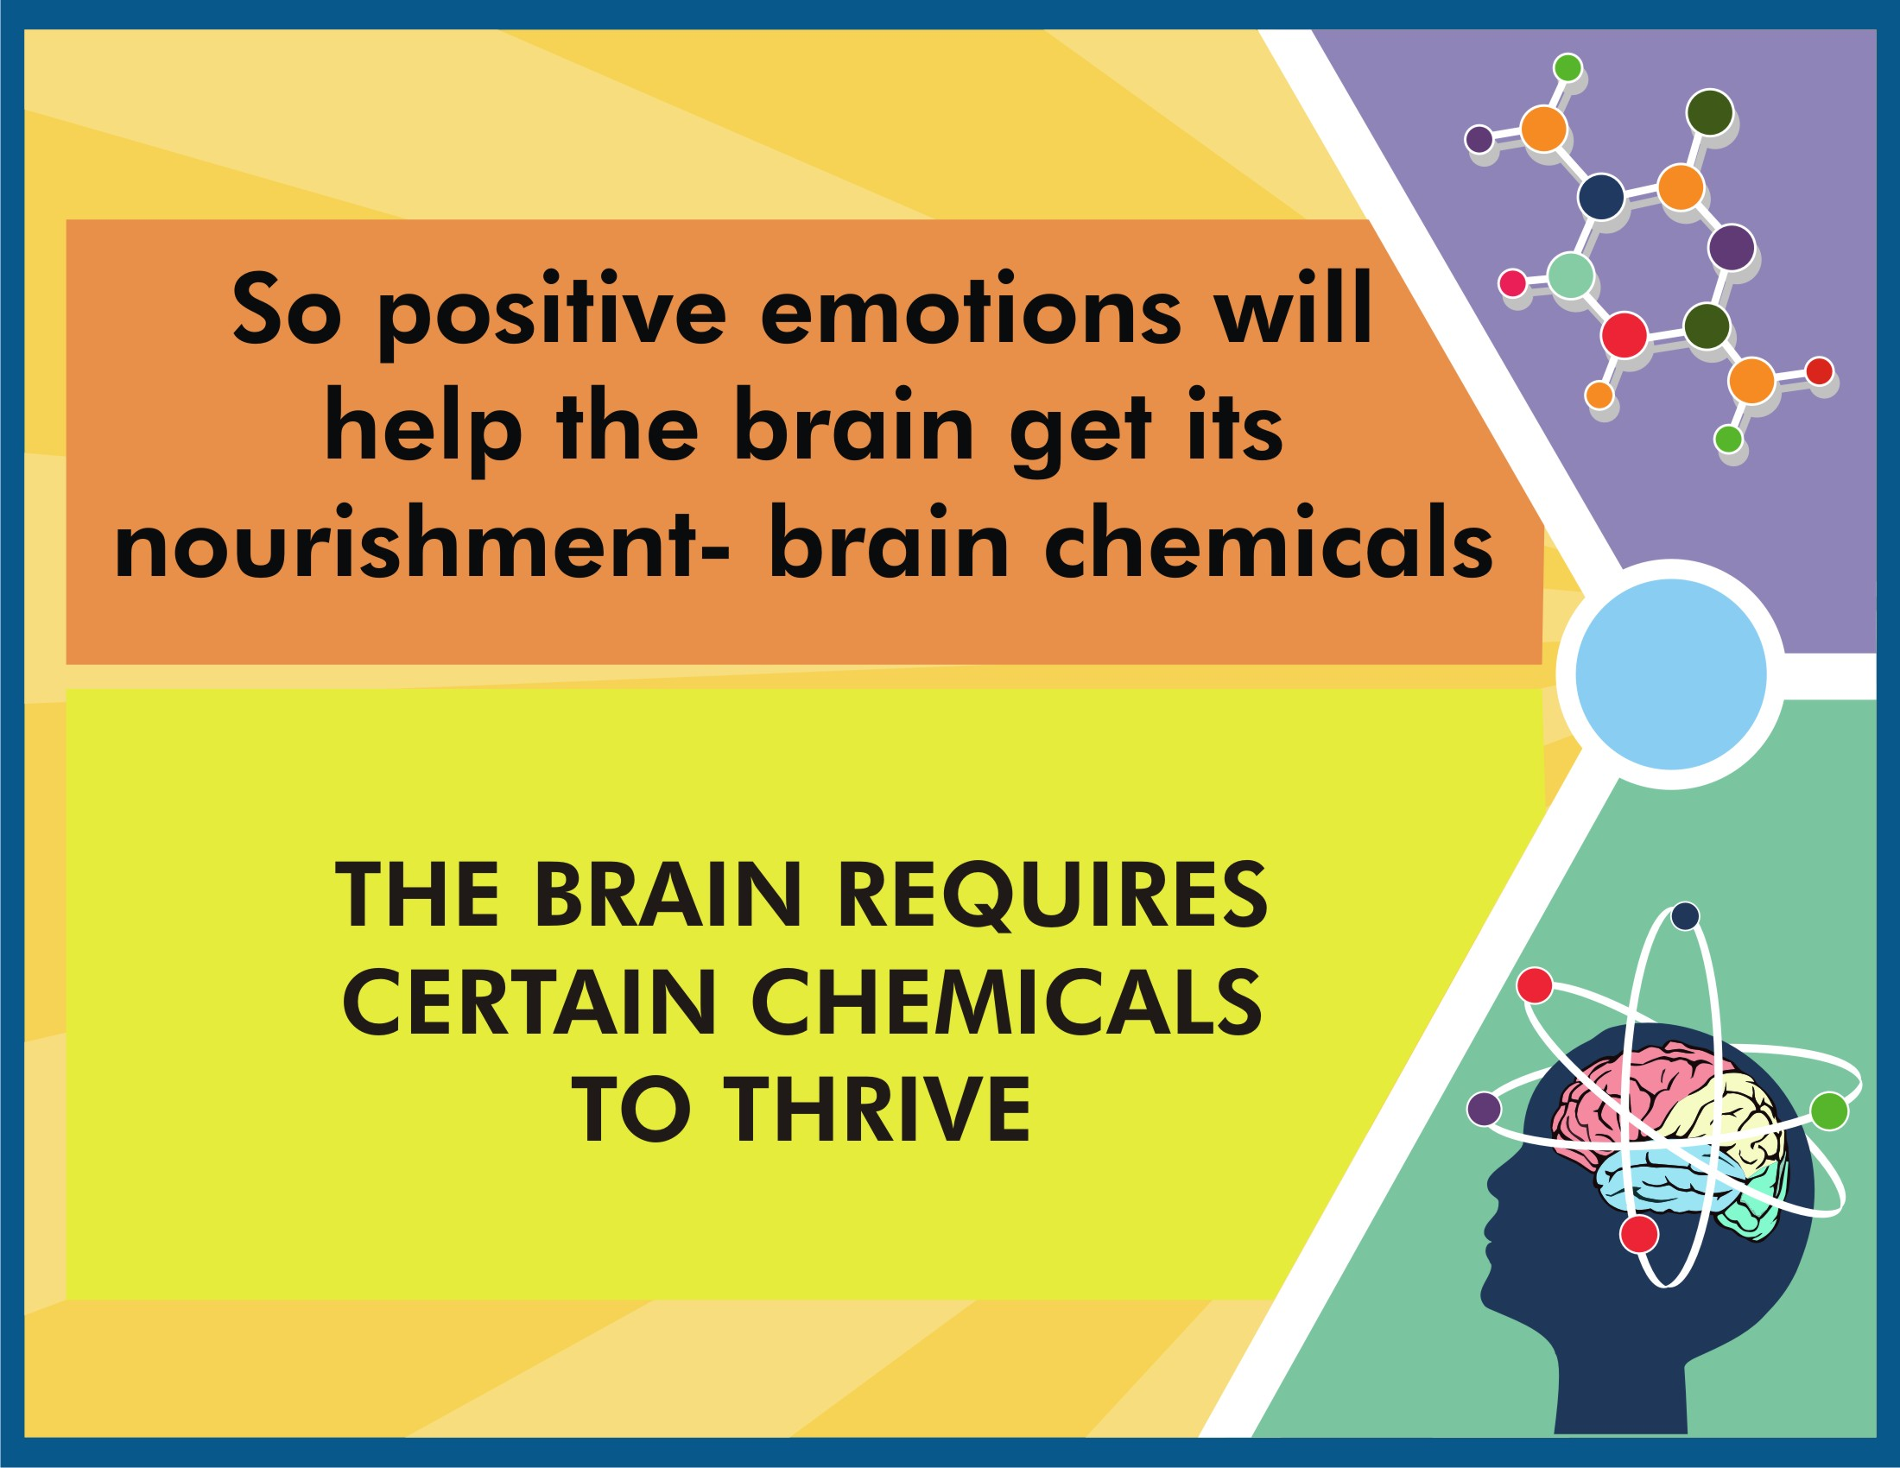

Slide 13
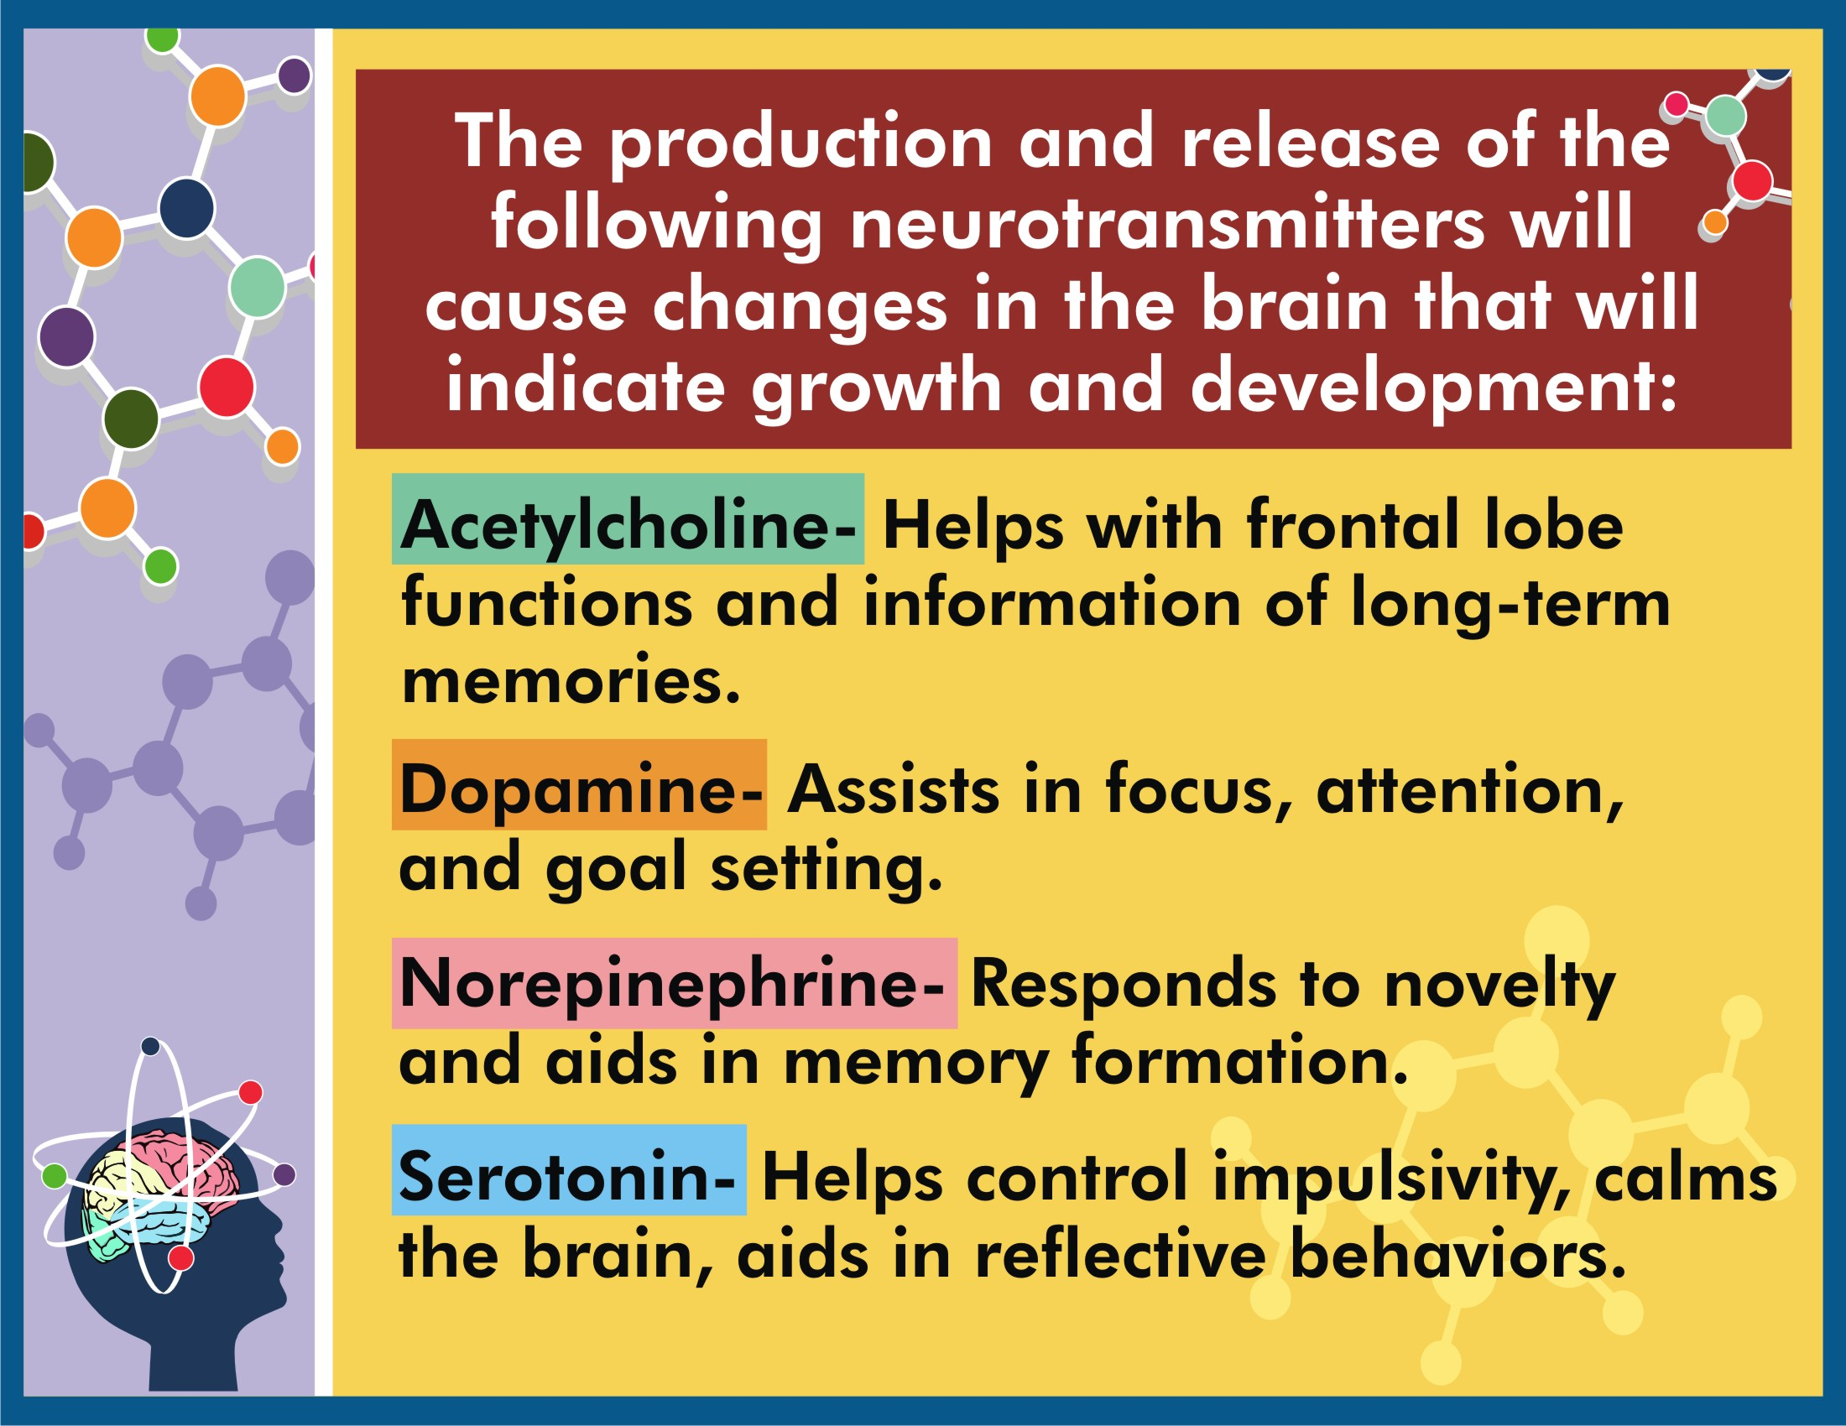

Slide 14
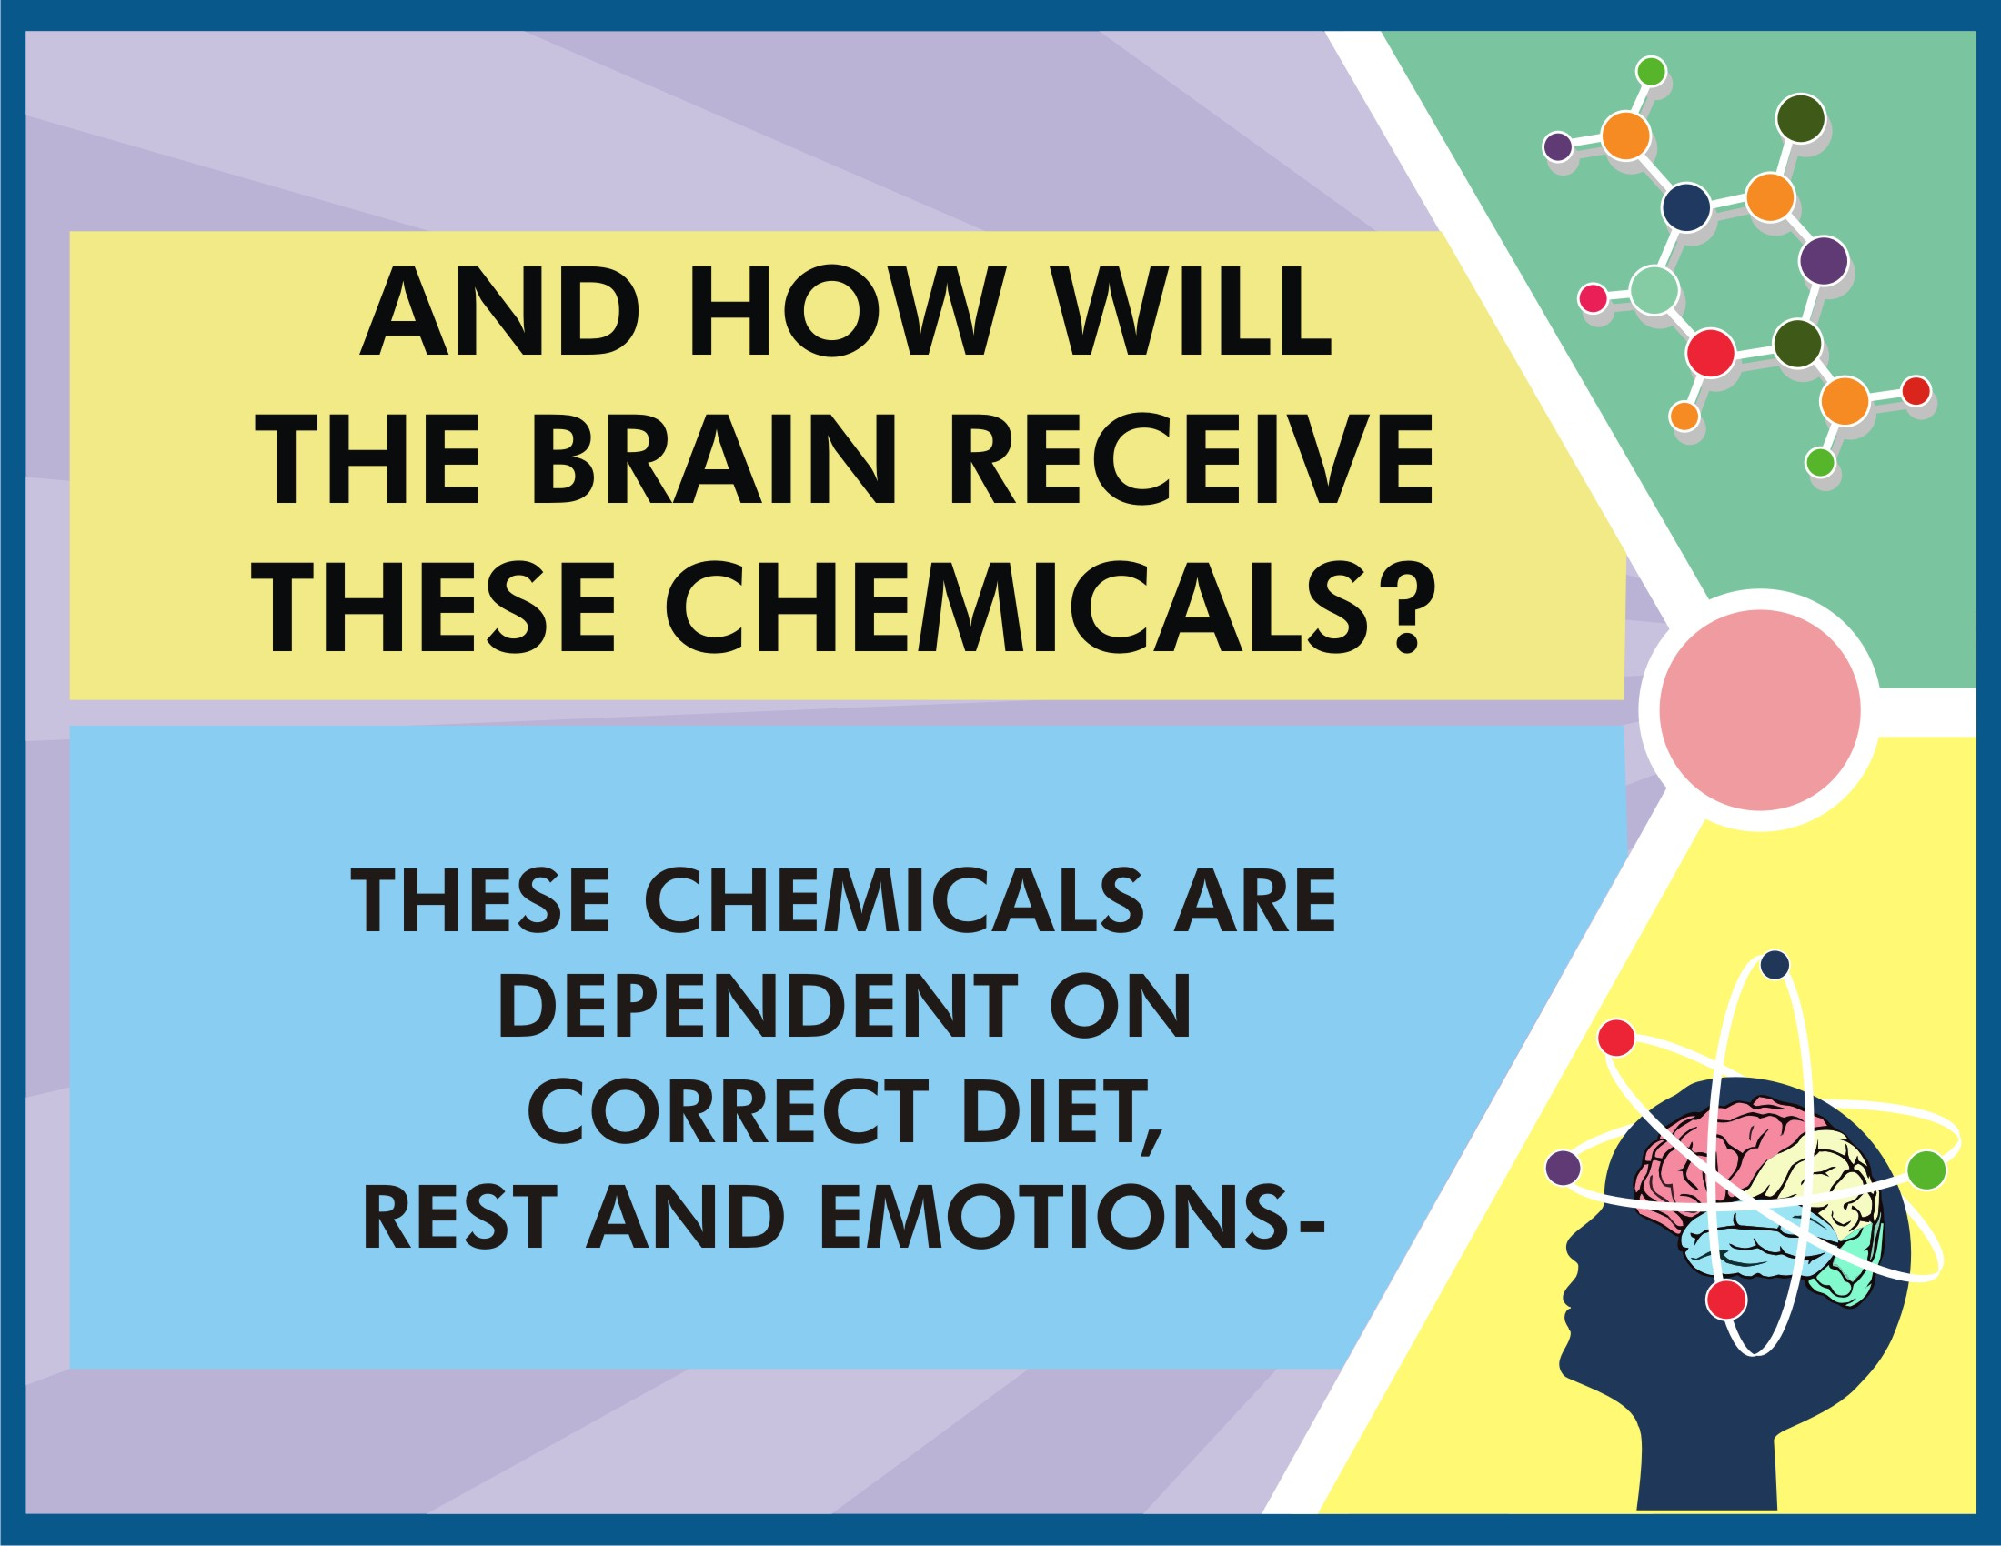

Slide 15
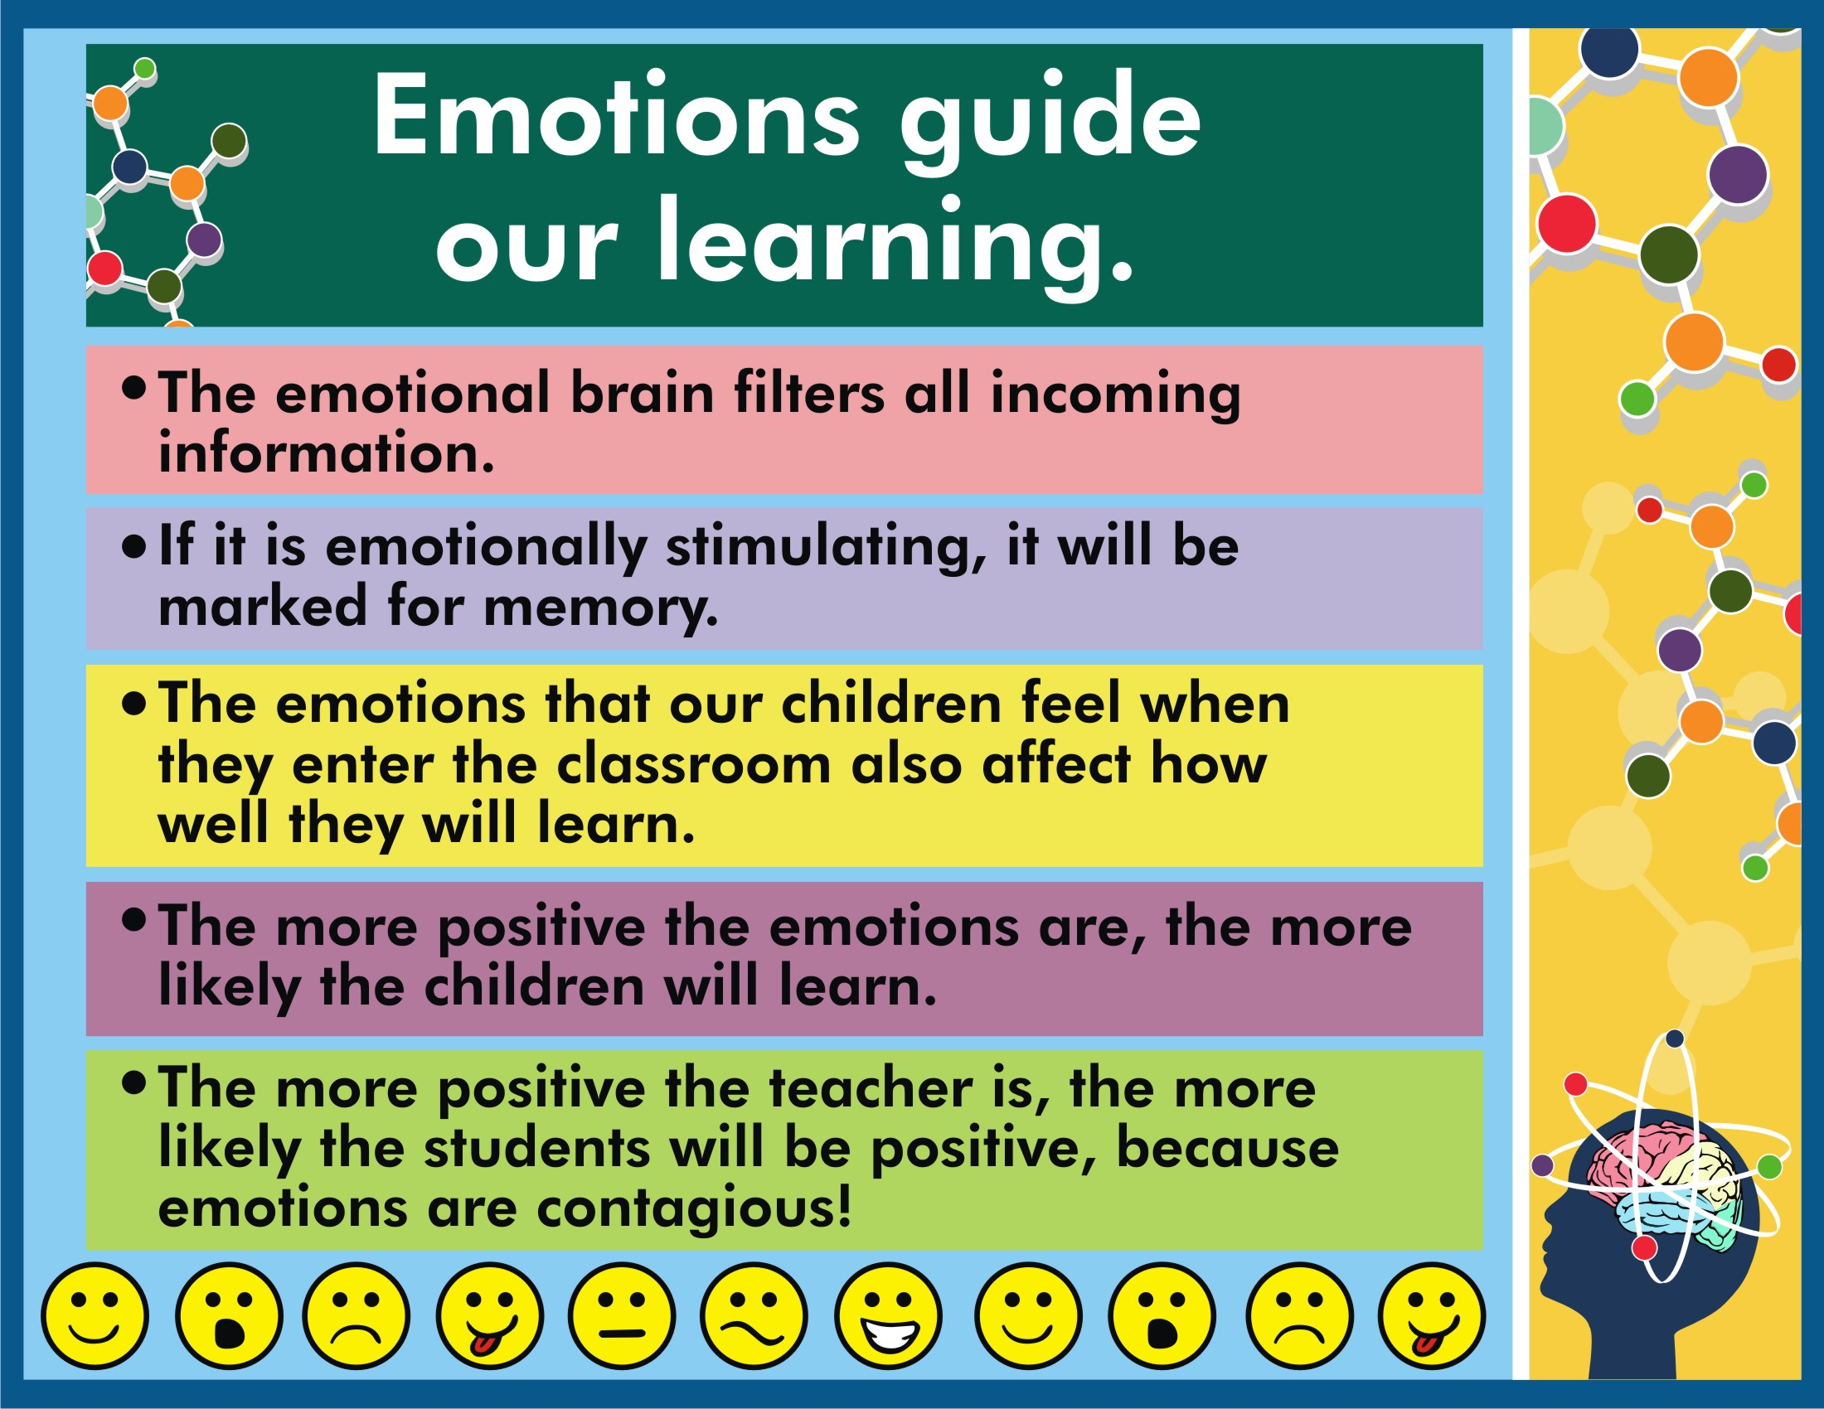

Slide 16
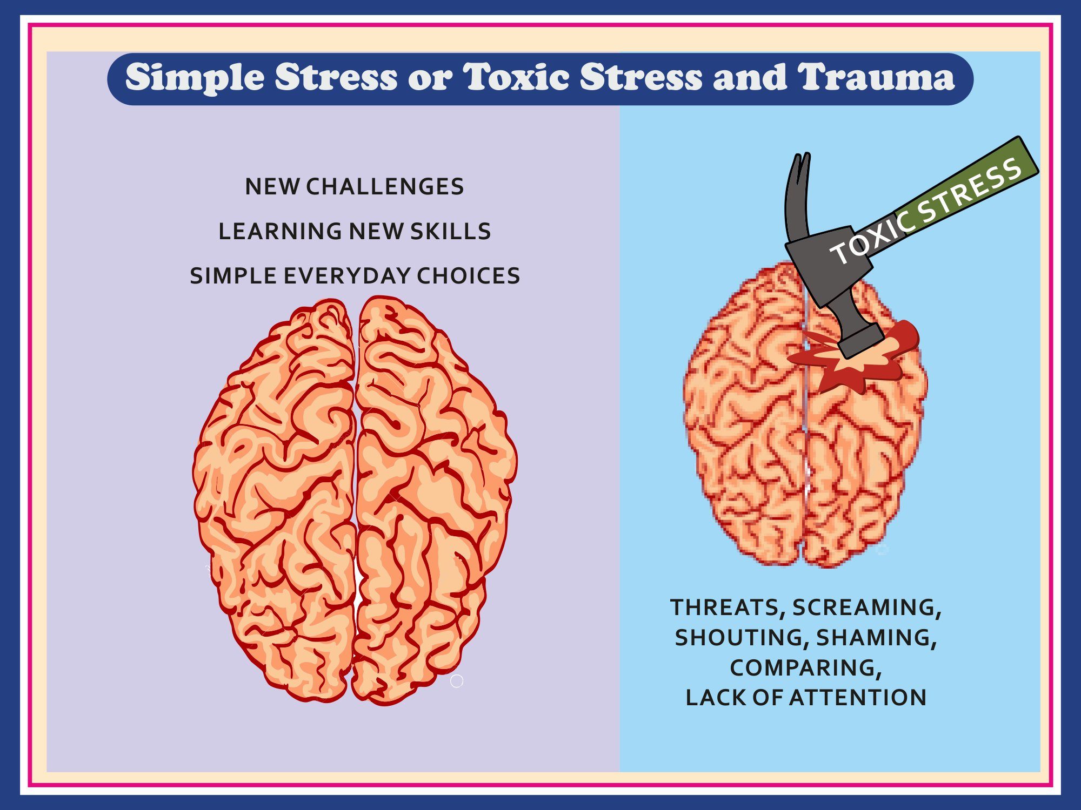
Notes:
Change heading to Simple Stress or Toxic Stress and Trauma
Make the brain better looking, remove watering can, put the headings in such a way it can be read
The brain on the right, make it smaller and wrinkly as if shrivelled and make an impact like a dent where it hits the brain, on the hammer write toxic stress and under the brain wirte- threats, screaming, shouting, shaming, comparing, lack of attention

Slide 17
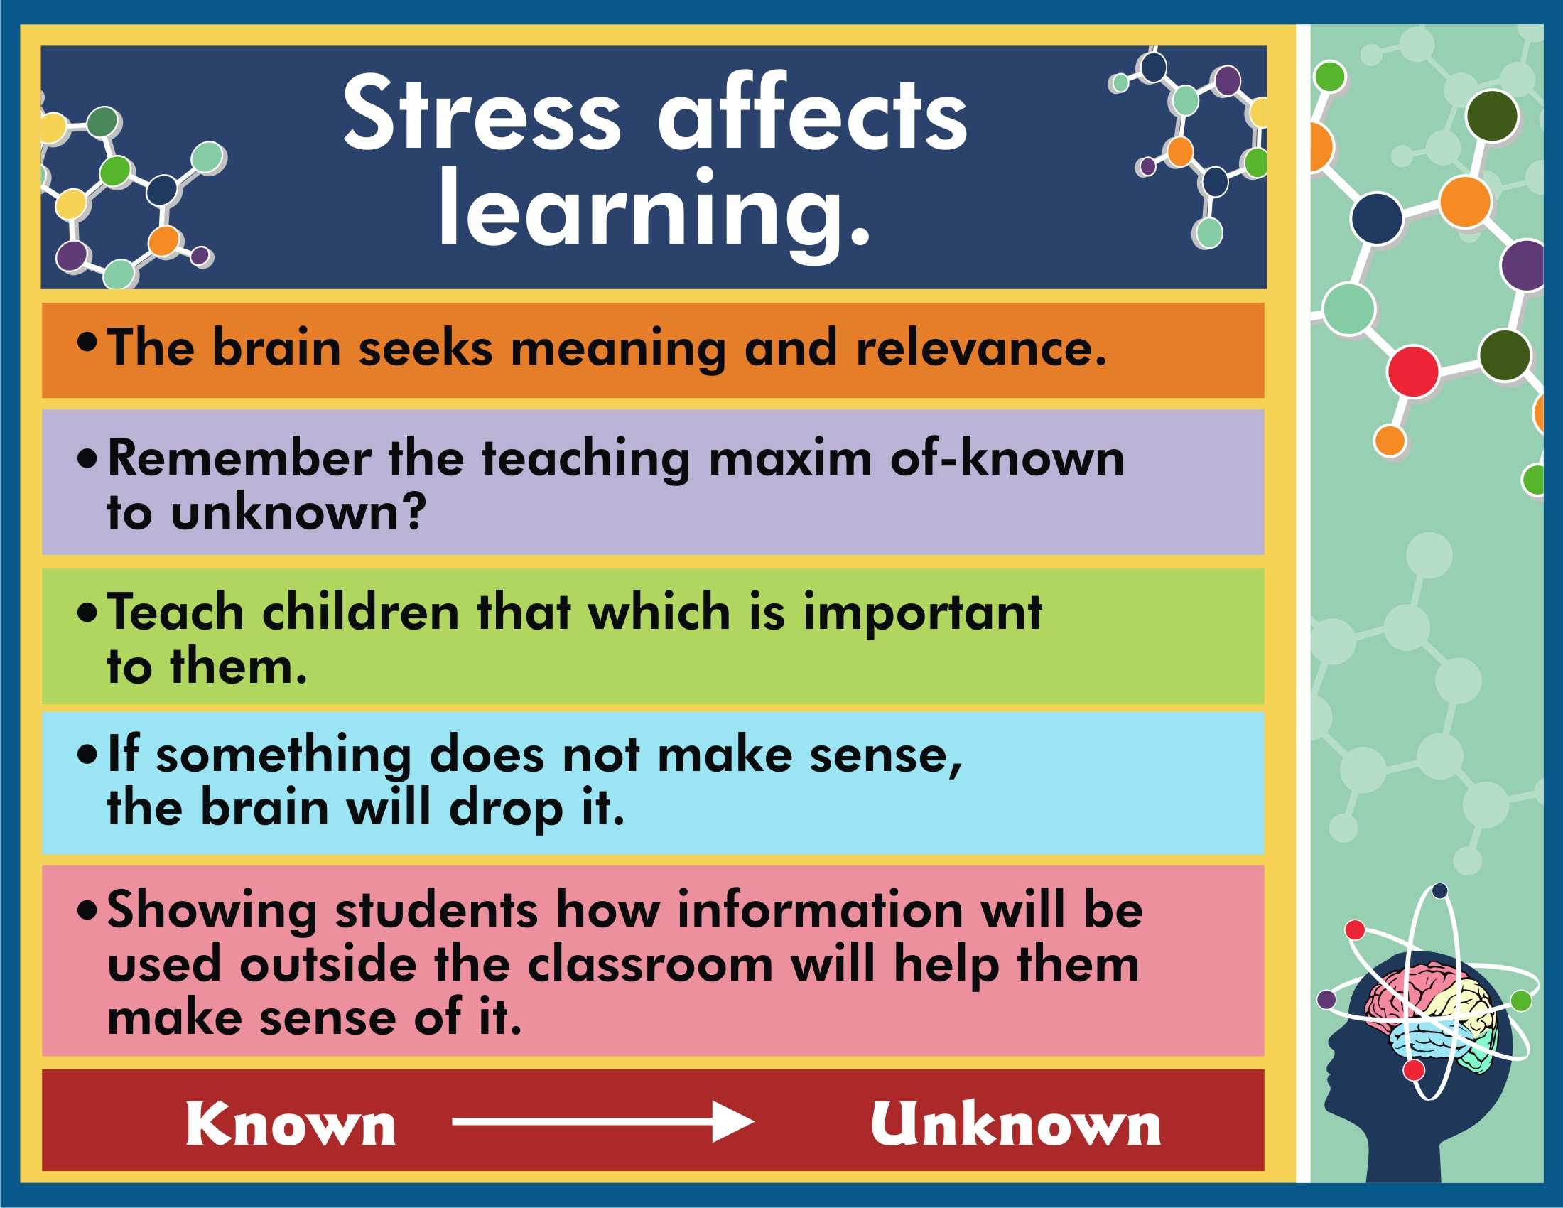

Slide 18

Why does ‘C’ make two sounds??
Sometimes the c says, “s“s“s”-“s” “s”“s”s”- “s”s”s”
Sometimes the c says, “s” “s” “s” I’ll tell you why!
If after the c you see an i,
Or an e or a y,
They all make the c say, “s” “s” “s”
You give it a try.
C is soft cent and cell, cent and cell, cent and cell,
C is soft cent and cell, and now you know why!

Slide 19
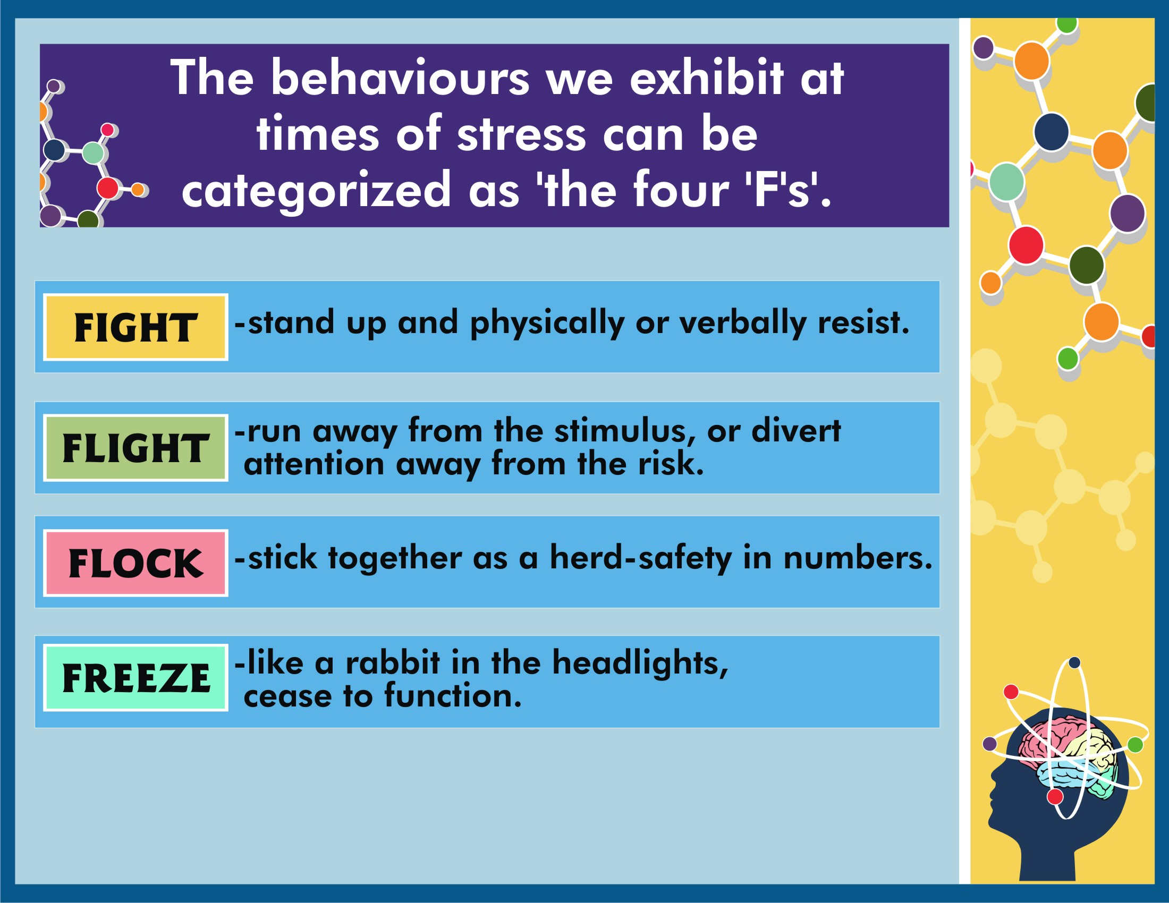

Slide 20
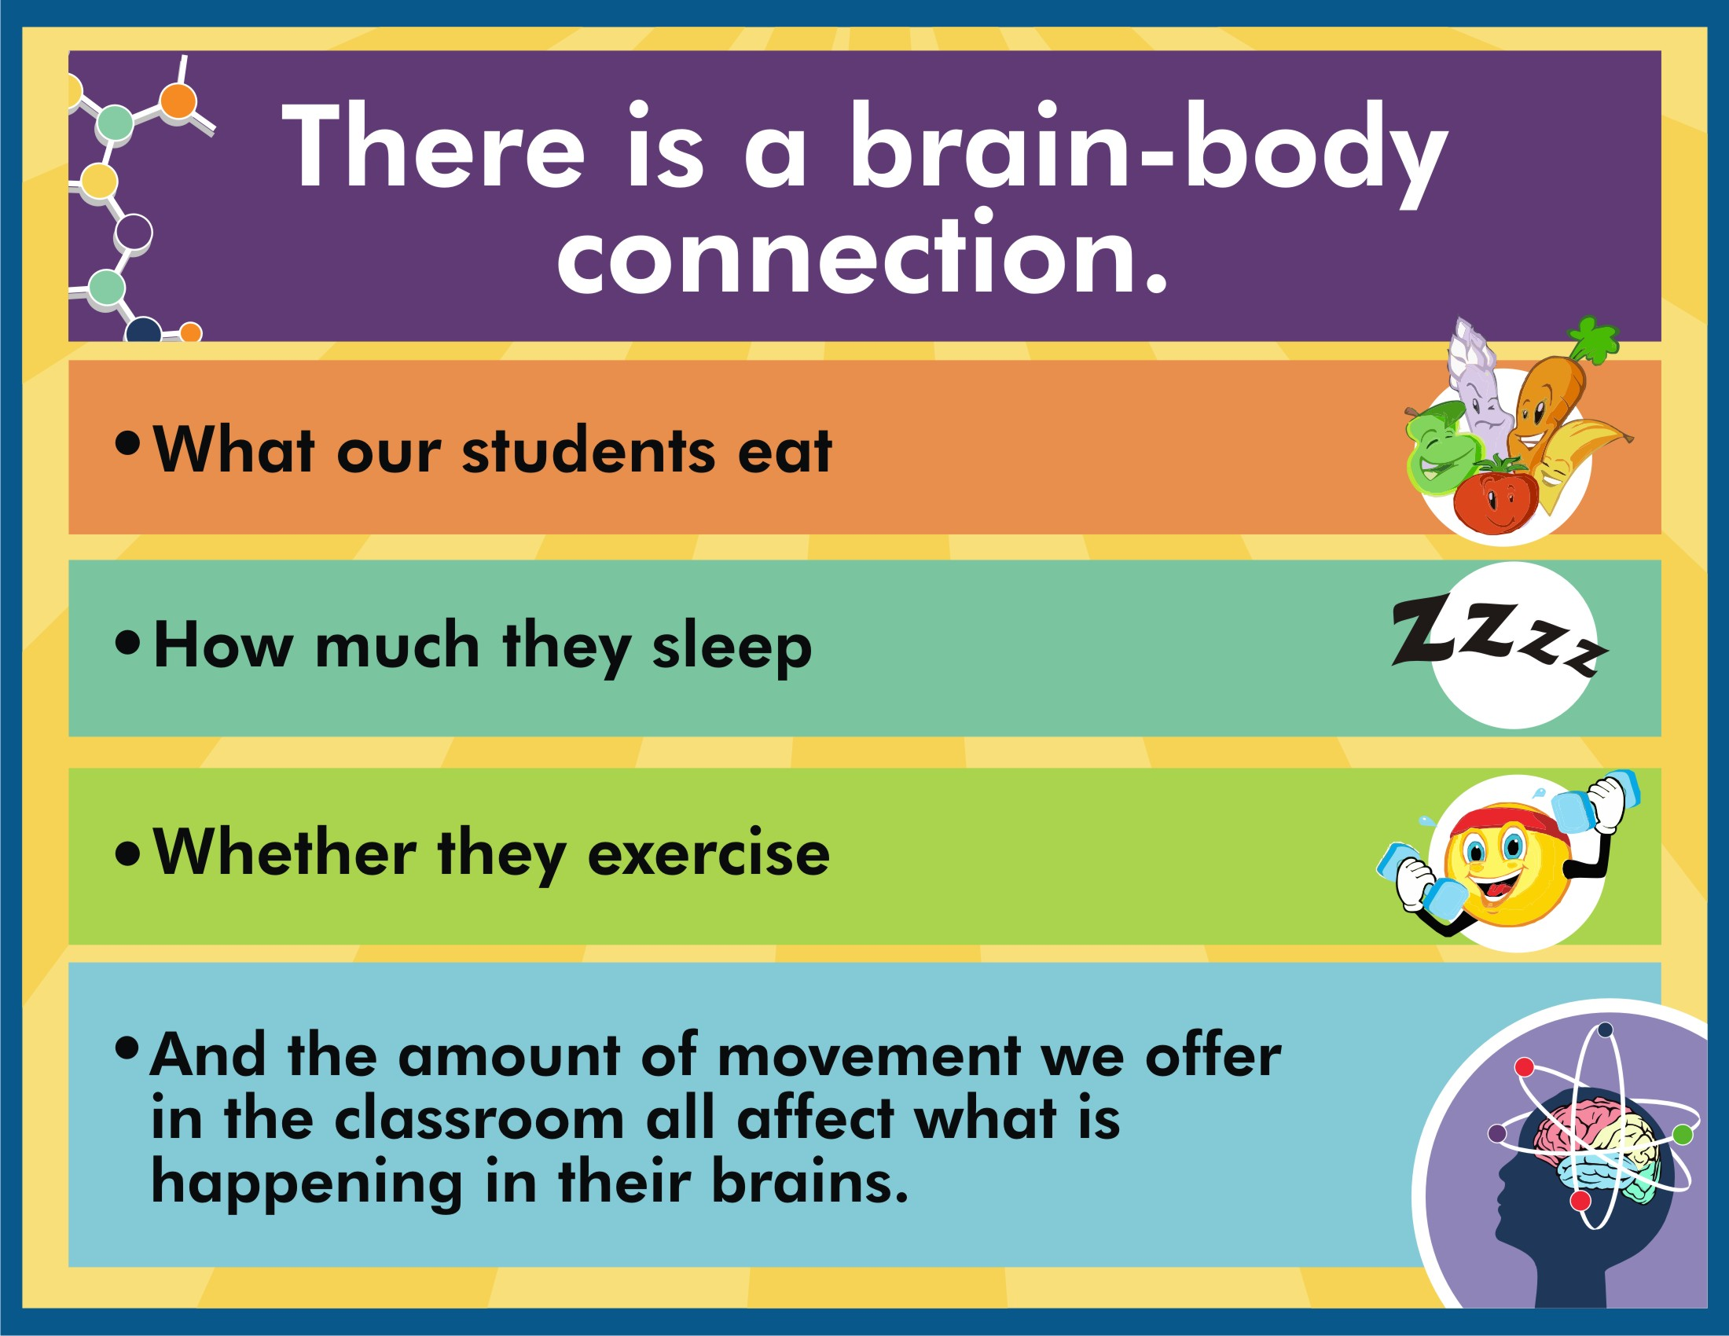

Slide 21
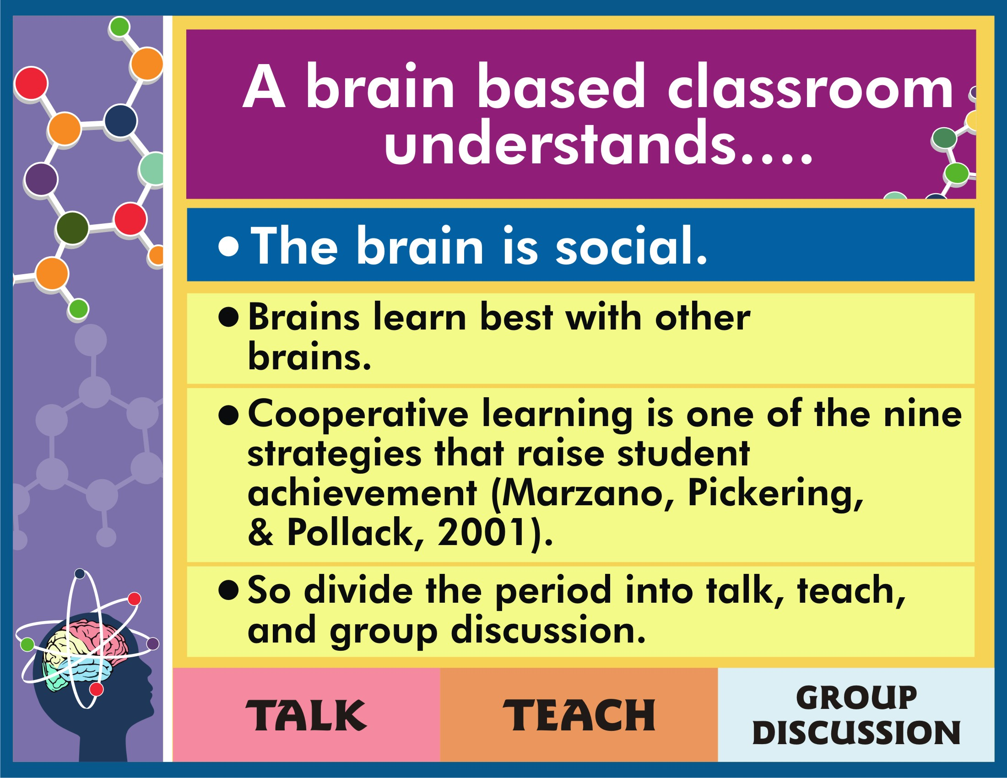

Slide 22
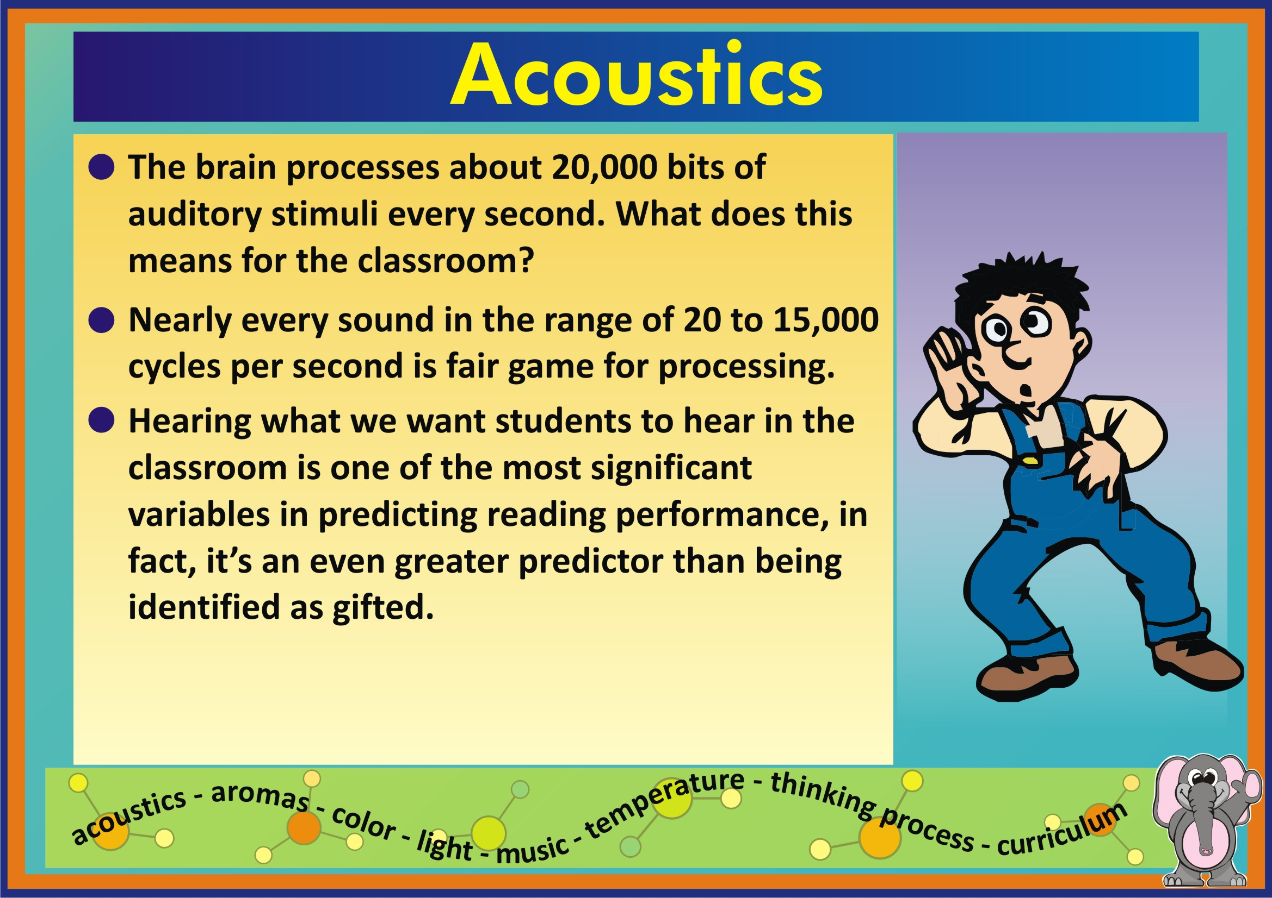

Slide 23
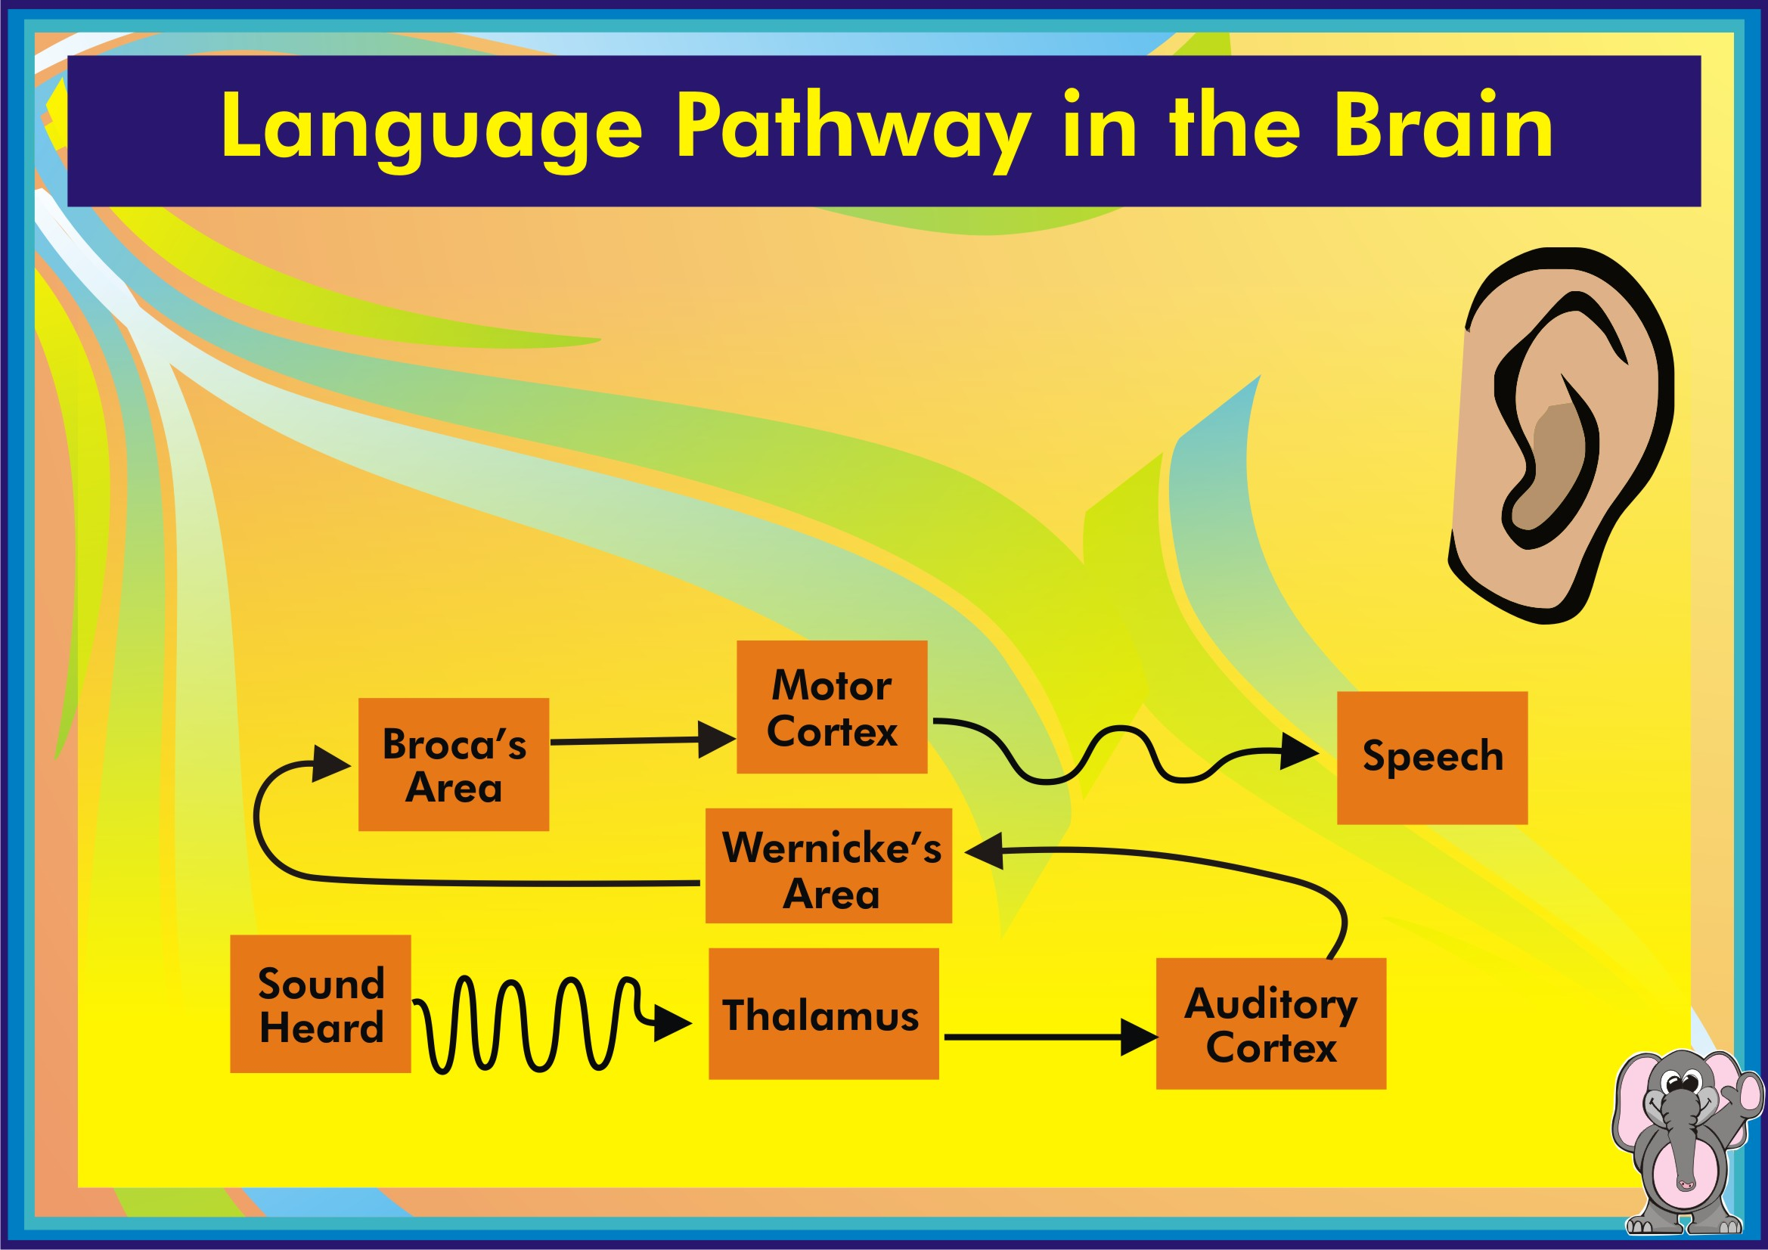

Slide 24
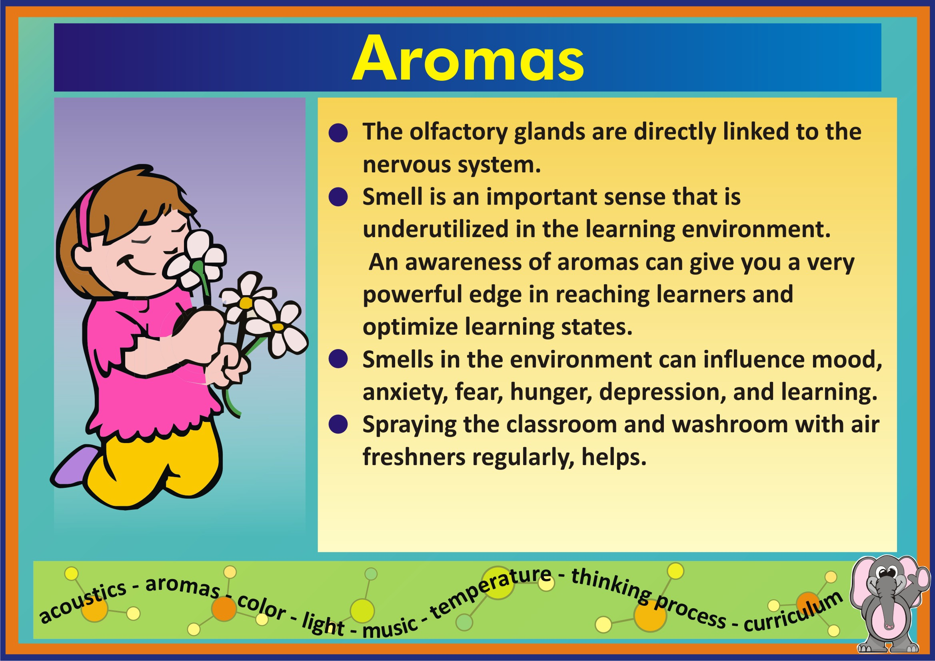

Slide 25
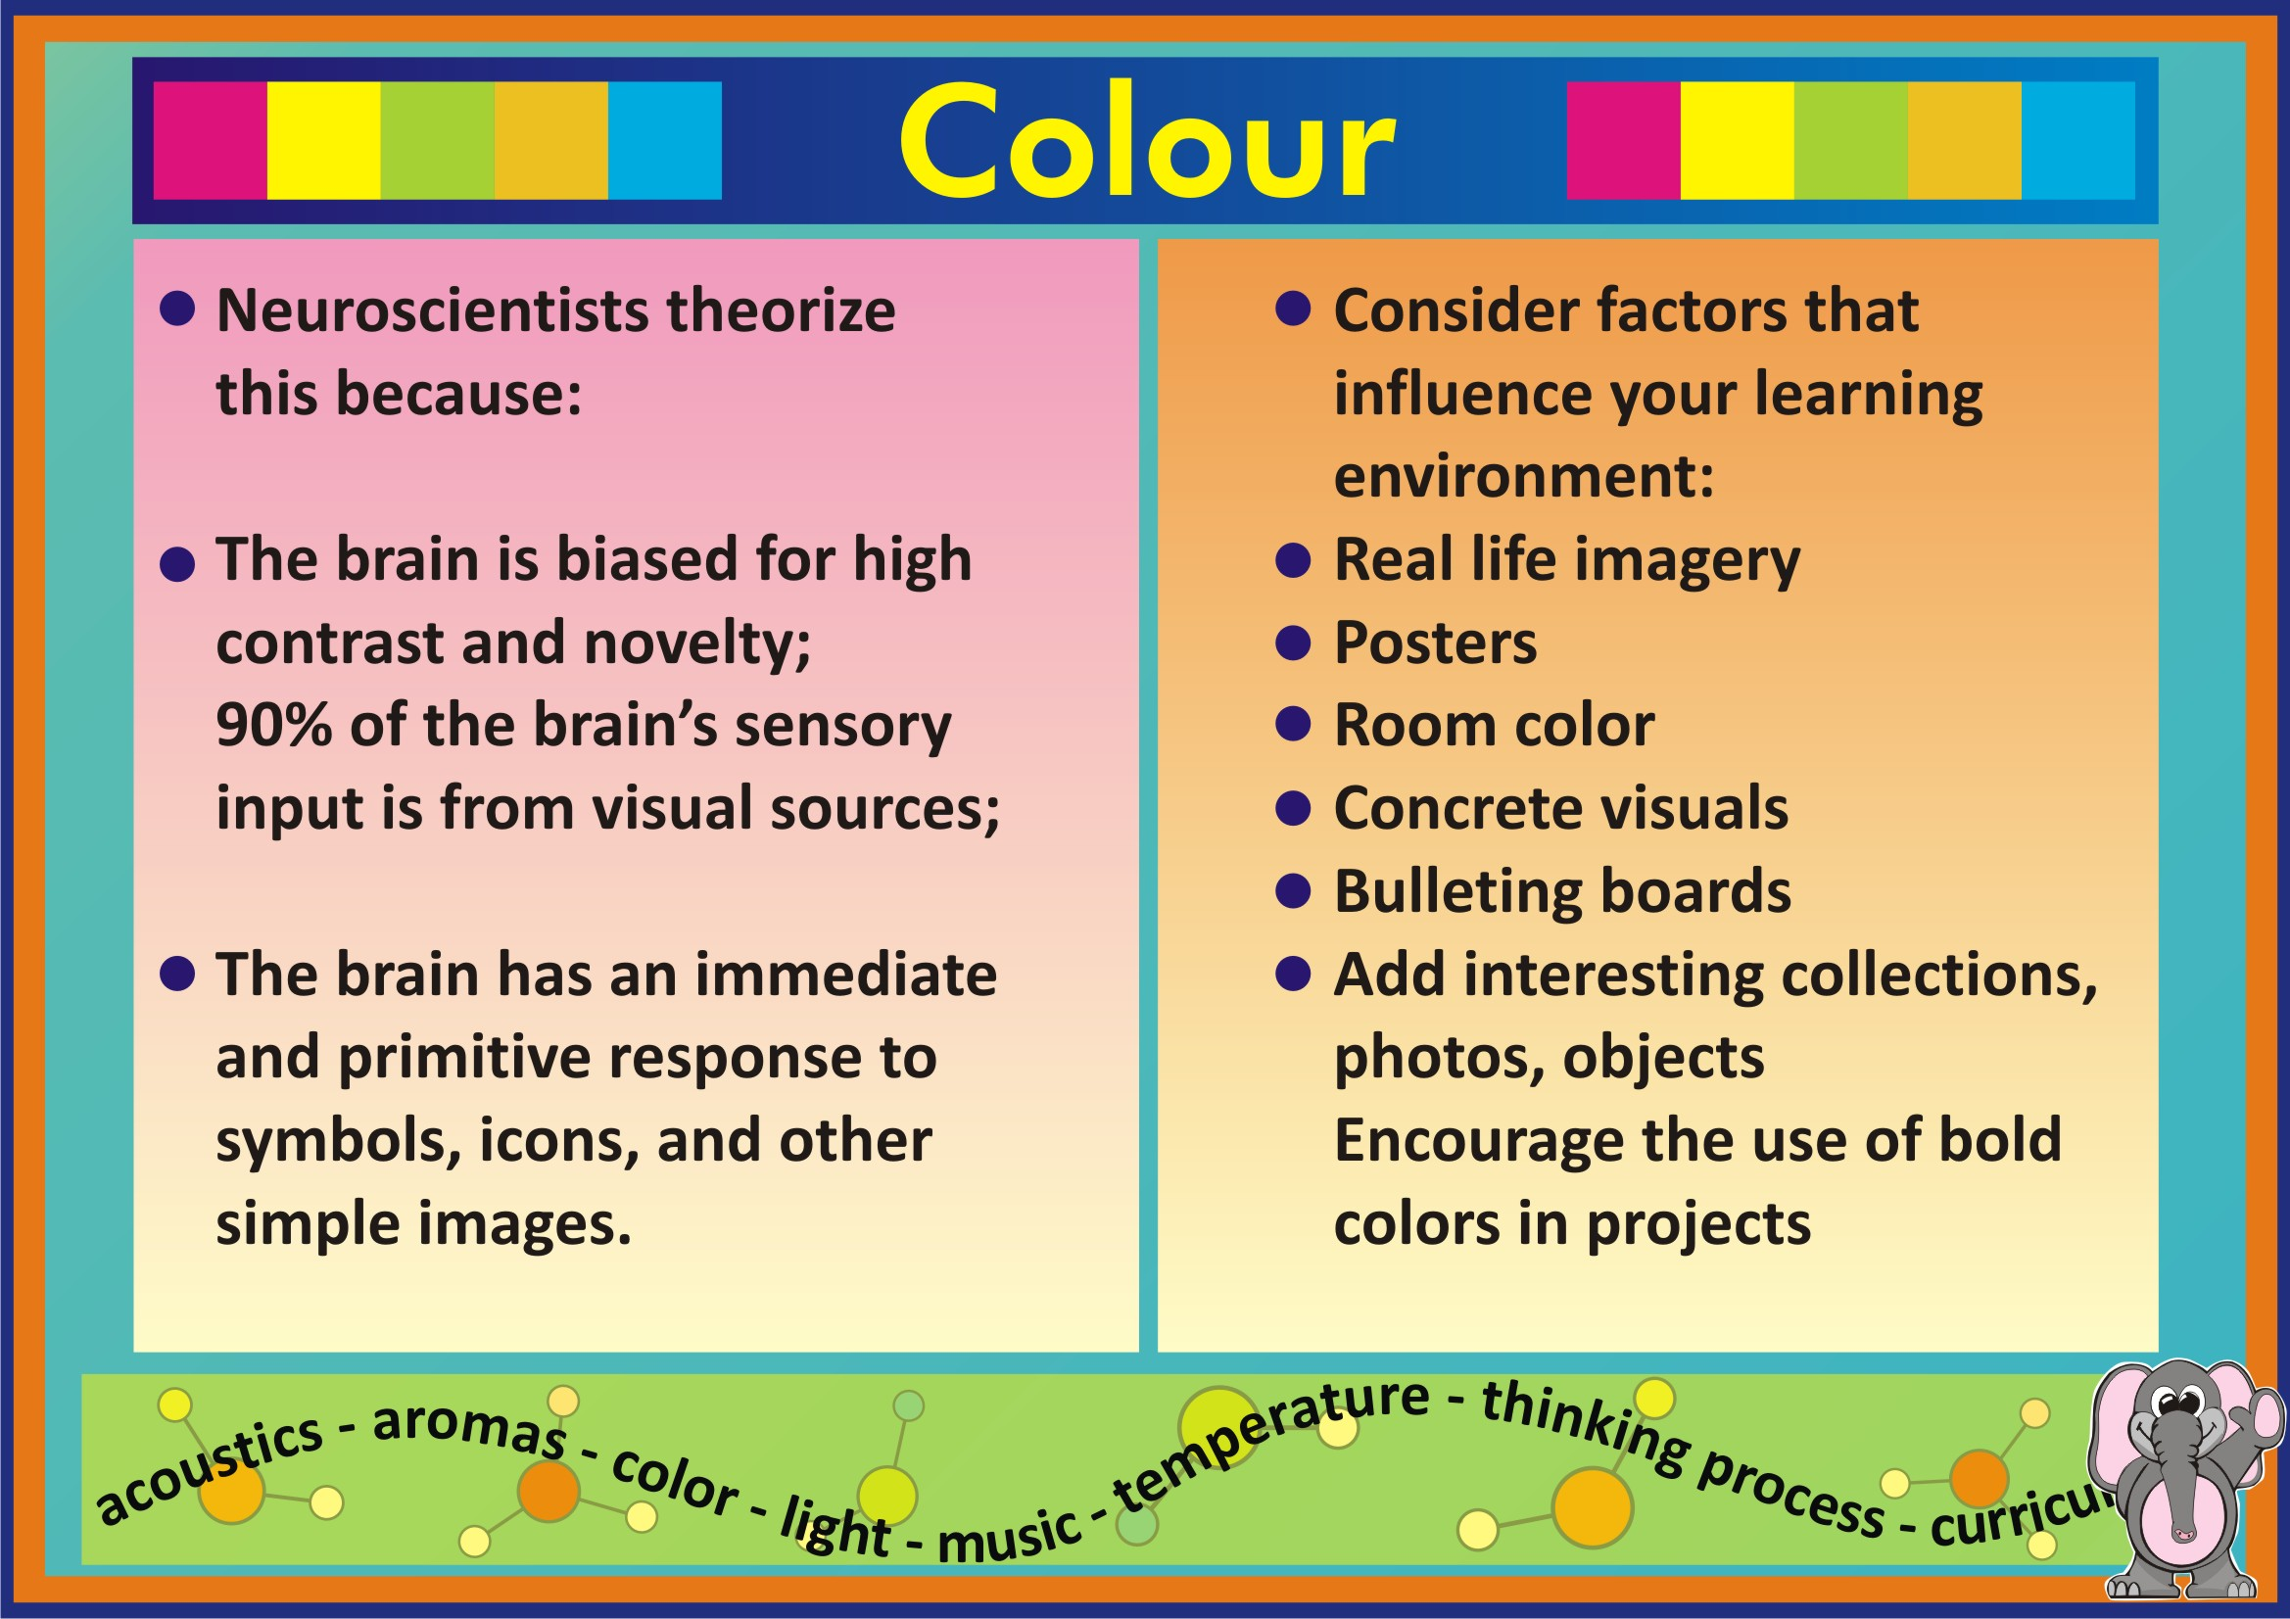

Slide 26
FUNCTIONS OF THE BRAIN
MEMORY
INTELLIGENCE
LOGIC

Slide 27
ONE OF THE MAIN FUNCTIONS OF THE BRAIN……..INTELLIGENCE
STEPS FOR INTELLIGENCE
ATTENTION
PROCESSING
MEMORY
RETENTION

Slide 28
CHILDREN NEED ACTIVITY BASED, HANDS ON, SENSORY EXPERIENCES TO BUILD THE BRAIN’S LEARNING PATHWAYS
SELF INITIATED
TRAIL AND ERROR
PROBLEM SOLVING
CAUSE AND EFFECT
ARE GOOD FOR DEVELOPING PATHWAYS

Slide 29
MULTI SENSORY
THE MORE MULTI SENSORY THE ACTIVITY, THE MORE LIKELY THE CHILD IS TO PROCESS THE LEARNING ACTIVITY.
FOR INTELLIGENCE, ATTENTION, THEN PROCESSING.
LOOKER,LISTENER, MOVER

Slide 30
HENCE THESE ACTIVITIES………
S - STORY FORM
U - UNDERSTANDING LEVEL
C - CONVERSATIONAL STYLE
C - COMPARING KNOWN WITH UNKNOWN
E - EXCITING PICTURES
S - SIMPLE AND SHORT ANSWERS
S - SHOW ANSWERS, DON’T TELL.

Slide 31
ALL PATHWAYS DO NOT GET STRENGTHENED………
TO BECOME PERMANENT, NEURAL PATHWAYS ( OR LEARNING PATHWAYS) MUST BE STRENGTHENED THROUGH REPETITION. “USE IT OR LOSE IT”
DRILL IS NOT REPETITION

Slide 32
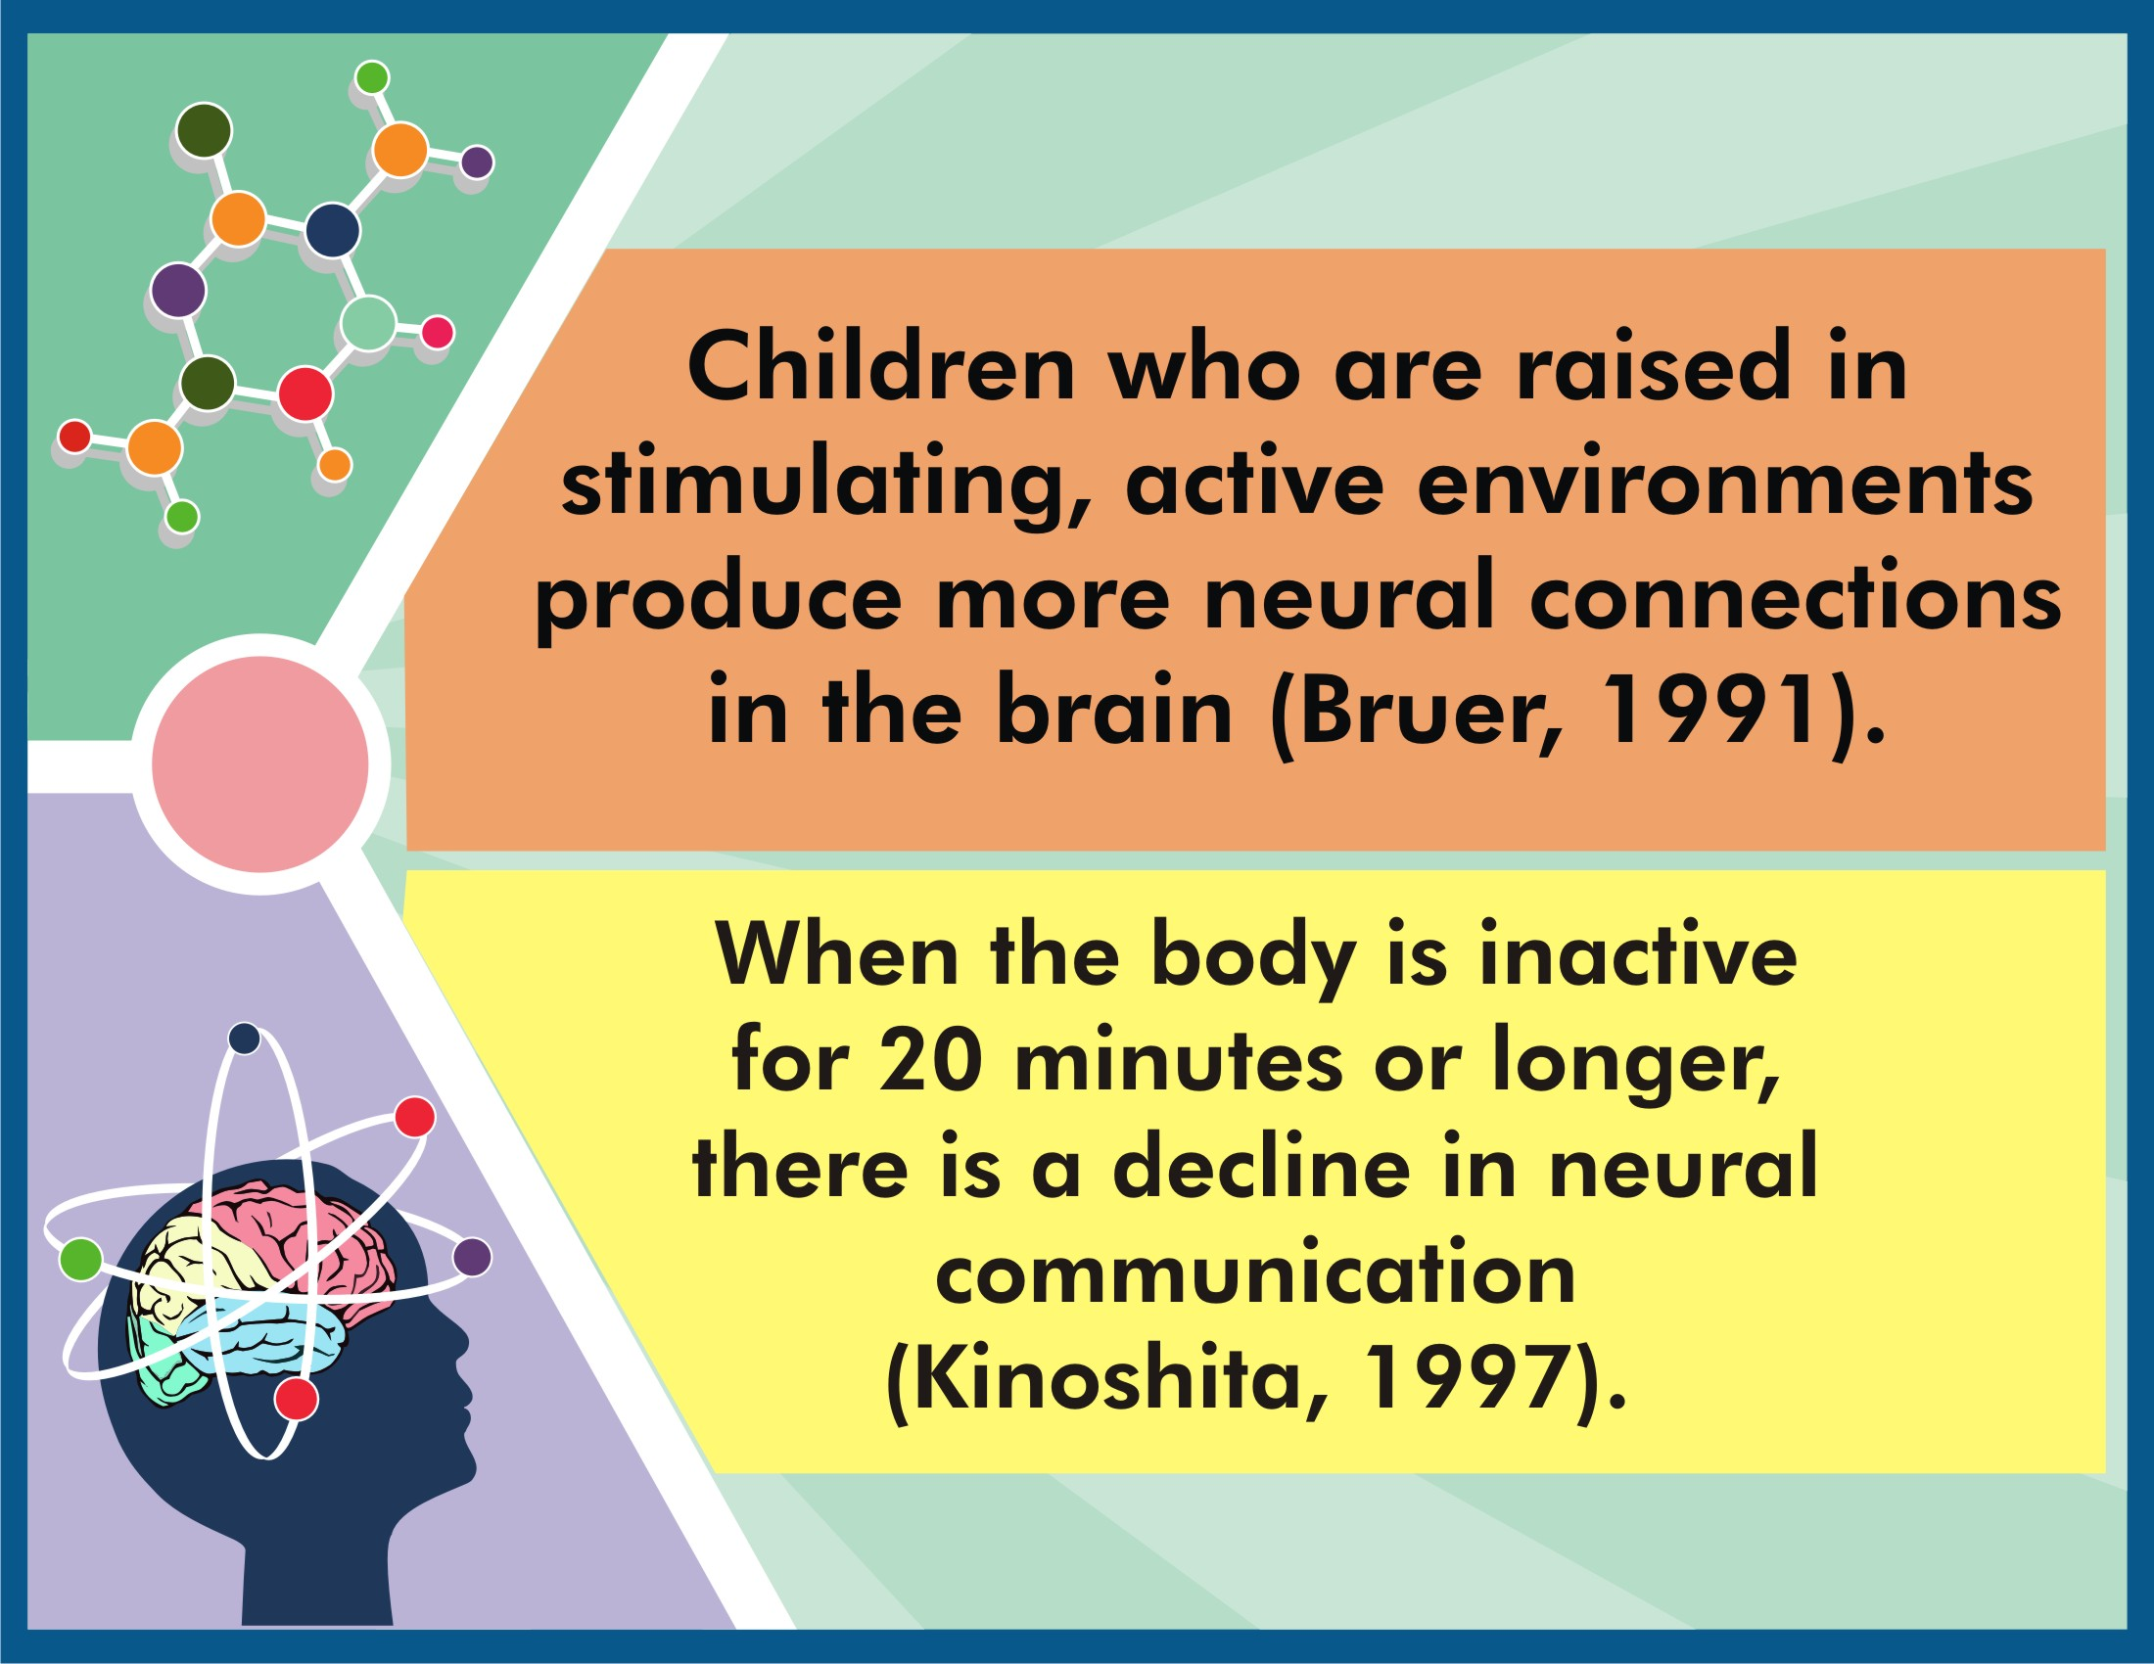

Slide 33
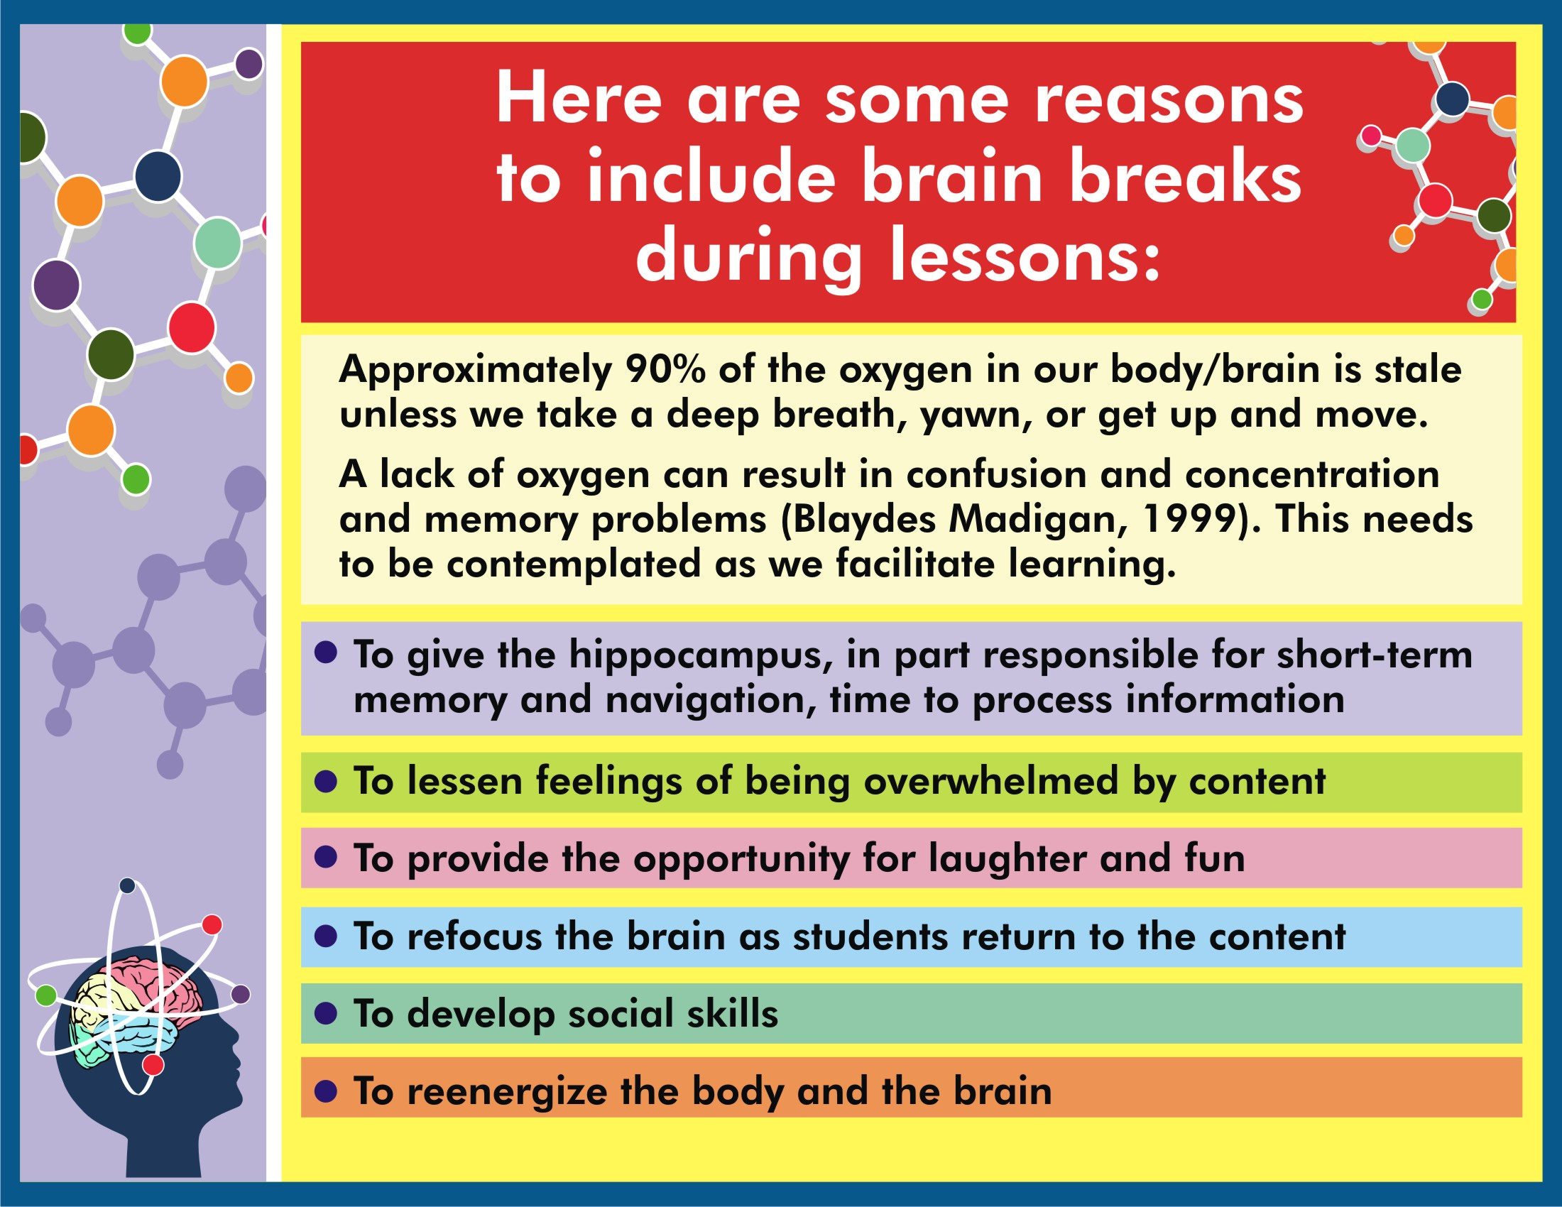

Slide 34
ADULT INVOLVEMENT AND IMPACT ON BRAIN DEVELOPMENT

Slide 35
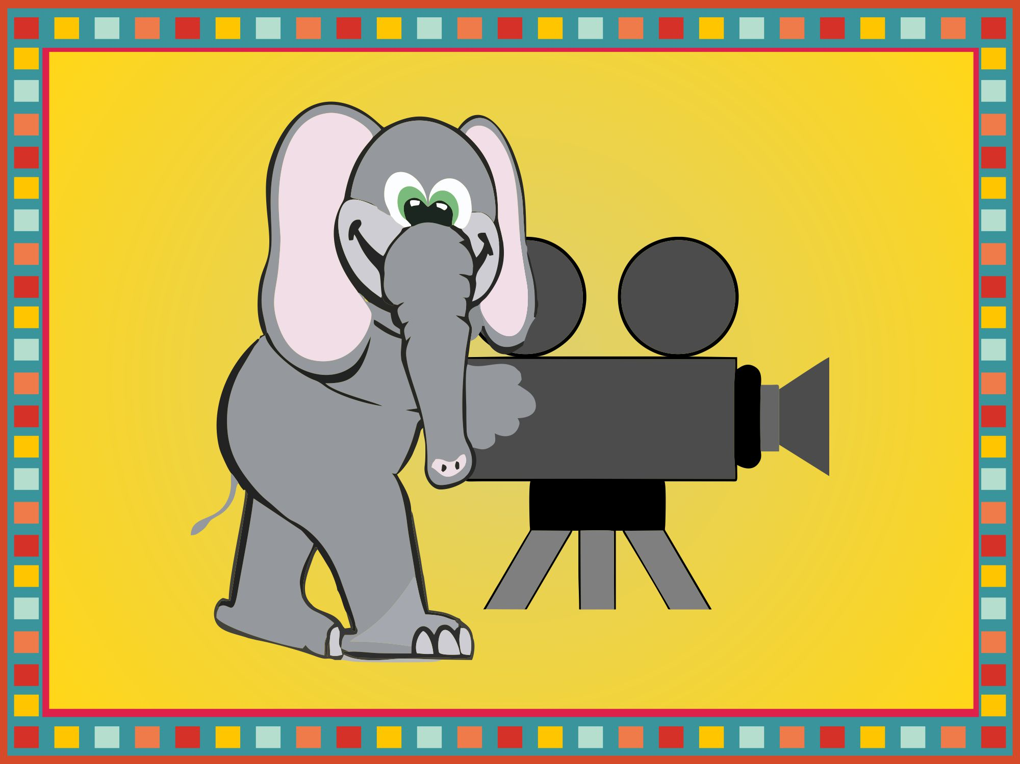

Slide 36
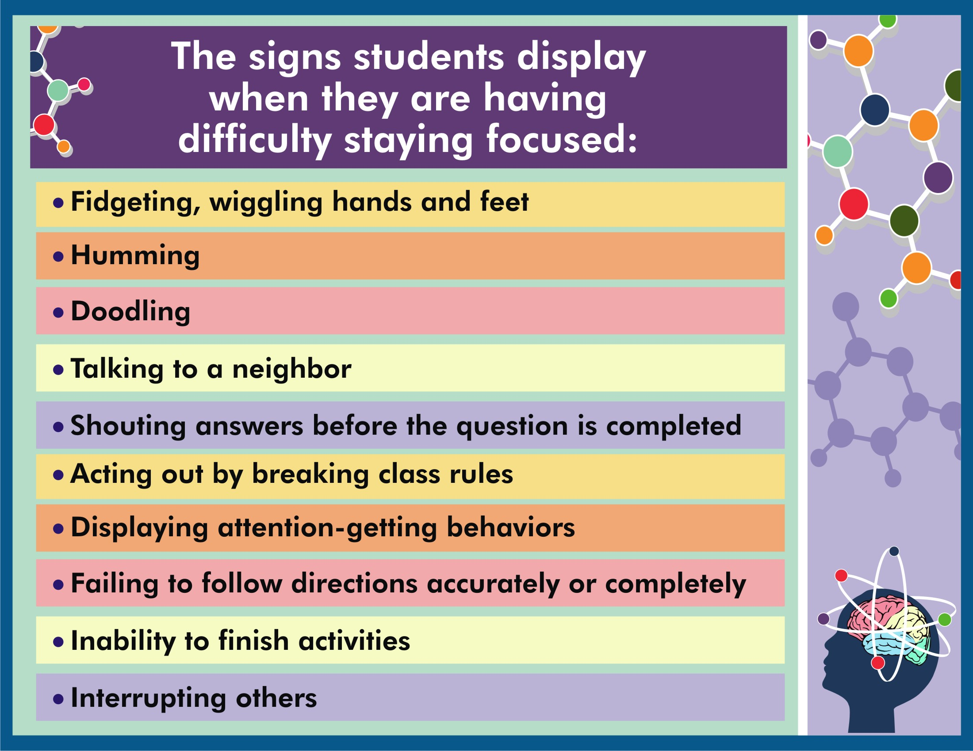

Slide 37
PRESPECTIVE TAKING
THINKING OF OTHER PEOPLE’S EMOTIONS- ALSO CALLED EMPATHY.
SELECT CORRECT SONGS AND RHYMES

Slide 39
Importance of pro-social behavior
The quality of peer relationships in early childhood predicts later success in intellectual growth, self-esteem, mental health, and school performance.

Slide 40
Child development research tells us to challenge children to use more prosocial behavior, starting with their closest friends.
This is where the learning is easiest and performance the best.
Once they can share and compromise with a friend, we can gen­tly push them toward using these skills with other children.

Slide 41
A Game That Requires Prosocial Behavior – Parachute play

Slide 42
Why We Play Simon Says
Learning Self-Regulation

Slide 43
What Is Self-Regulation, and Why Is It Important?
Self-regulation is the process of exercising control over one's actions (for example,
becoming less impulsive),
thinking processes (for example, focusing attention and planning activities),
and emotions (for example, managing frus­tration).

Slide 44
We will describe how children develop three types of self-regulation
1. Behavioral: disability to inhibit actions.
2. Cognitive: the ability to plan.
3. Emotional: the ability to regulate emotions.

Slide 45
Behavioral Self-Regulation (Impulse Control)
Young children first learn how to perform an action but only later learn how to regulate it.

Slide 46
GAMES THAT DEVELOP IMPULSE CONTROL
Traditional games:
Red Light, Green Light
Simon Says
London Bridge
Freeze Tag
Ready, Set, Go! (child must wait for “Go!”)

Slide 47
Playing Simon Says is fun, but it is also an exceptional method for teaching impulse control. Impulse control, which has been extensively-Studied-by scientists, is considered an important early predictor of later success in school and in life.

Slide 48
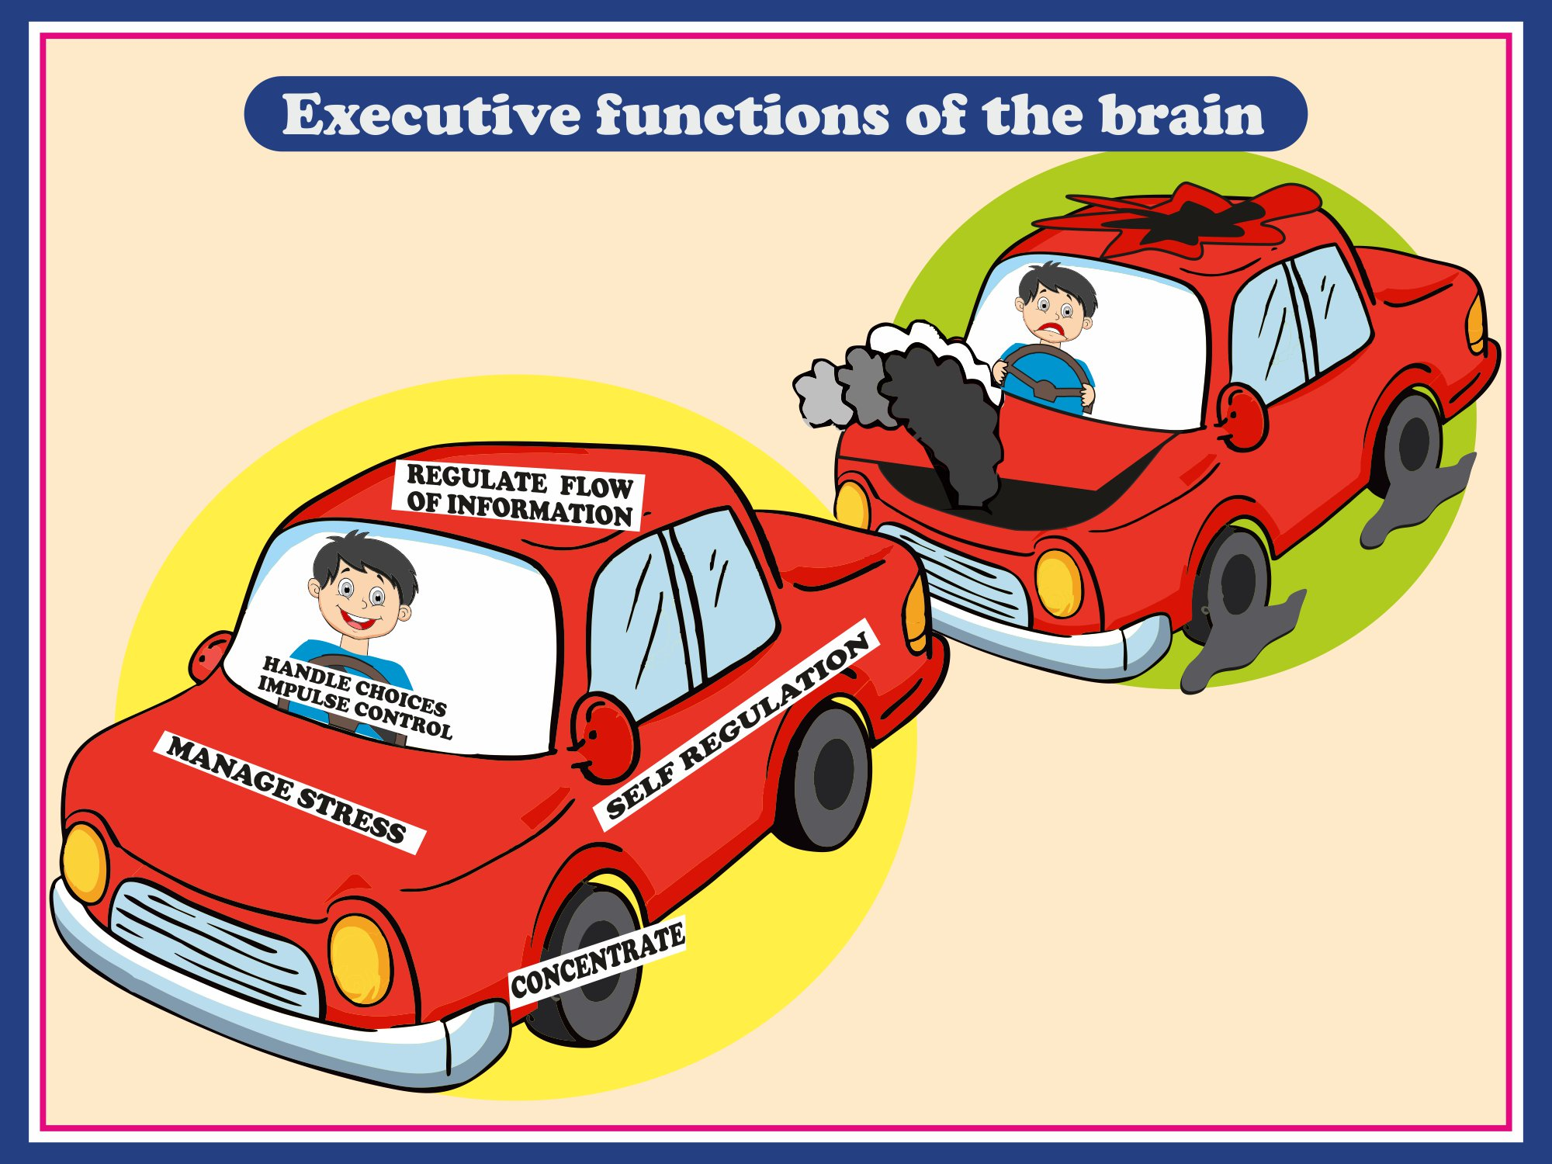
Notes:
CHANGE HEADING TO- EXECUTIVE FUNCTIONS OF THE BRAIN
ENSURE THAT HEADINGS GIVEN IN WHITE ARE READABLE, MAKE THEM BOLD

Slide 49
