Slide 1

Playing. Learning. Growing. Achieving - Goals of an Early Childhood Curriculum.
Part one-
All about play
Tewhariki- Brain Research- Froebel- Montessori
SWATI POPAT VATS

Slide 2


Slide 3
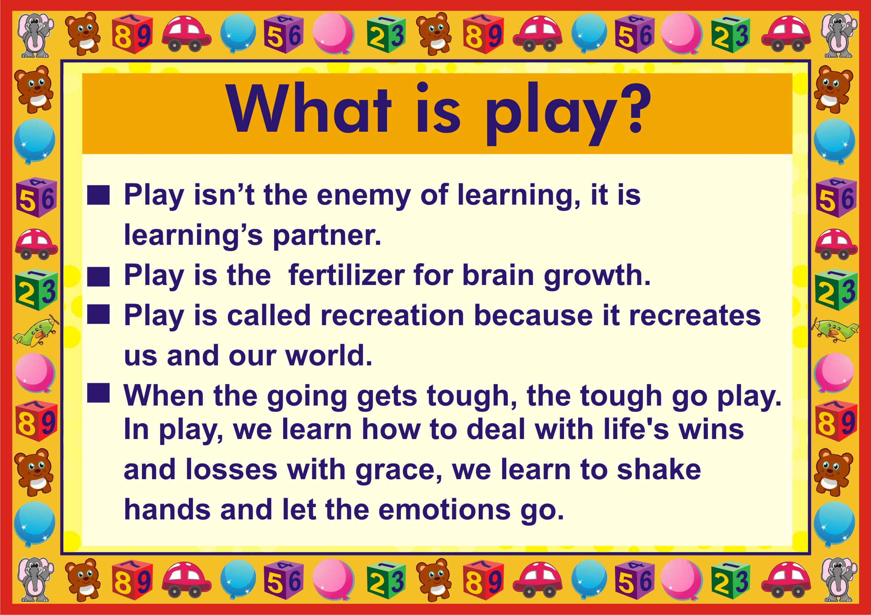

Slide 4
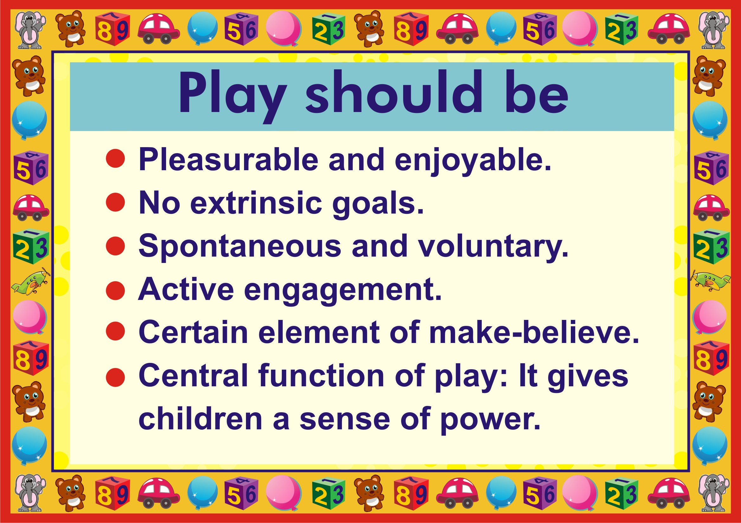

Slide 5
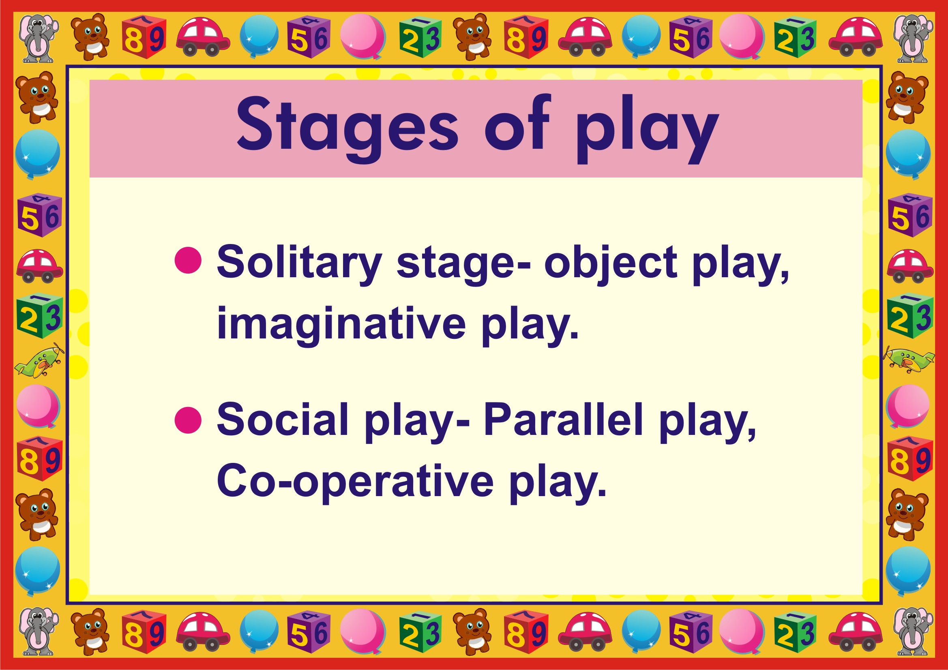

Slide 6
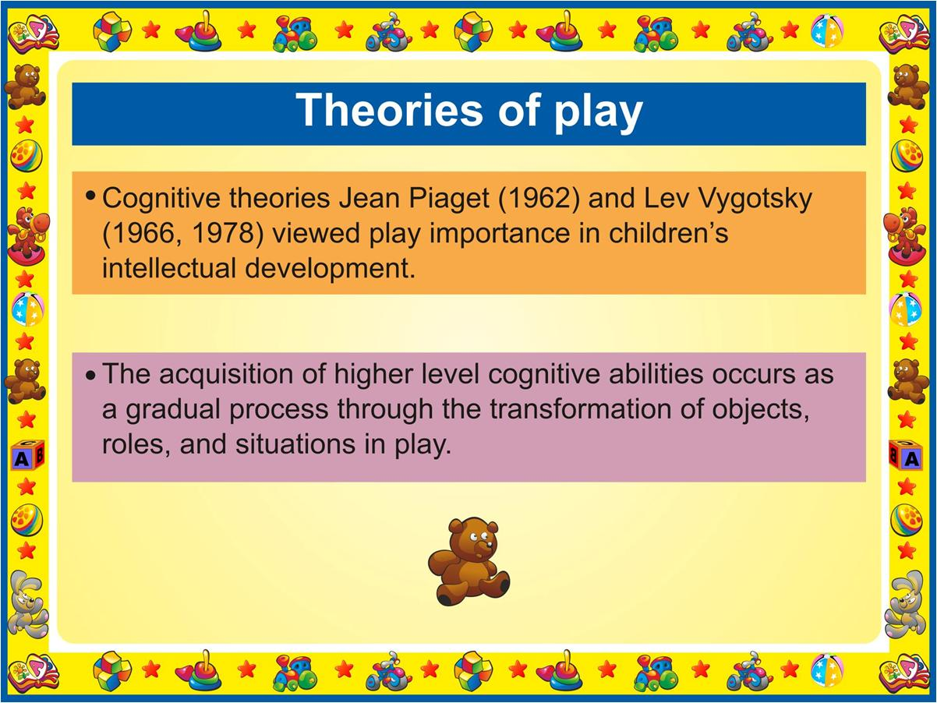

Slide 7
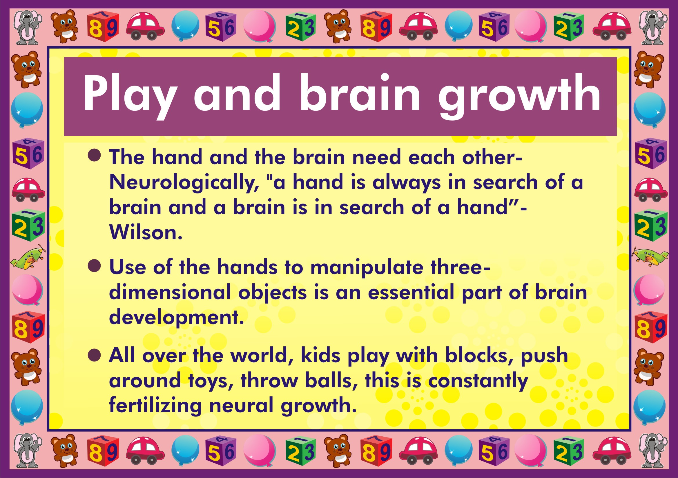

Slide 8
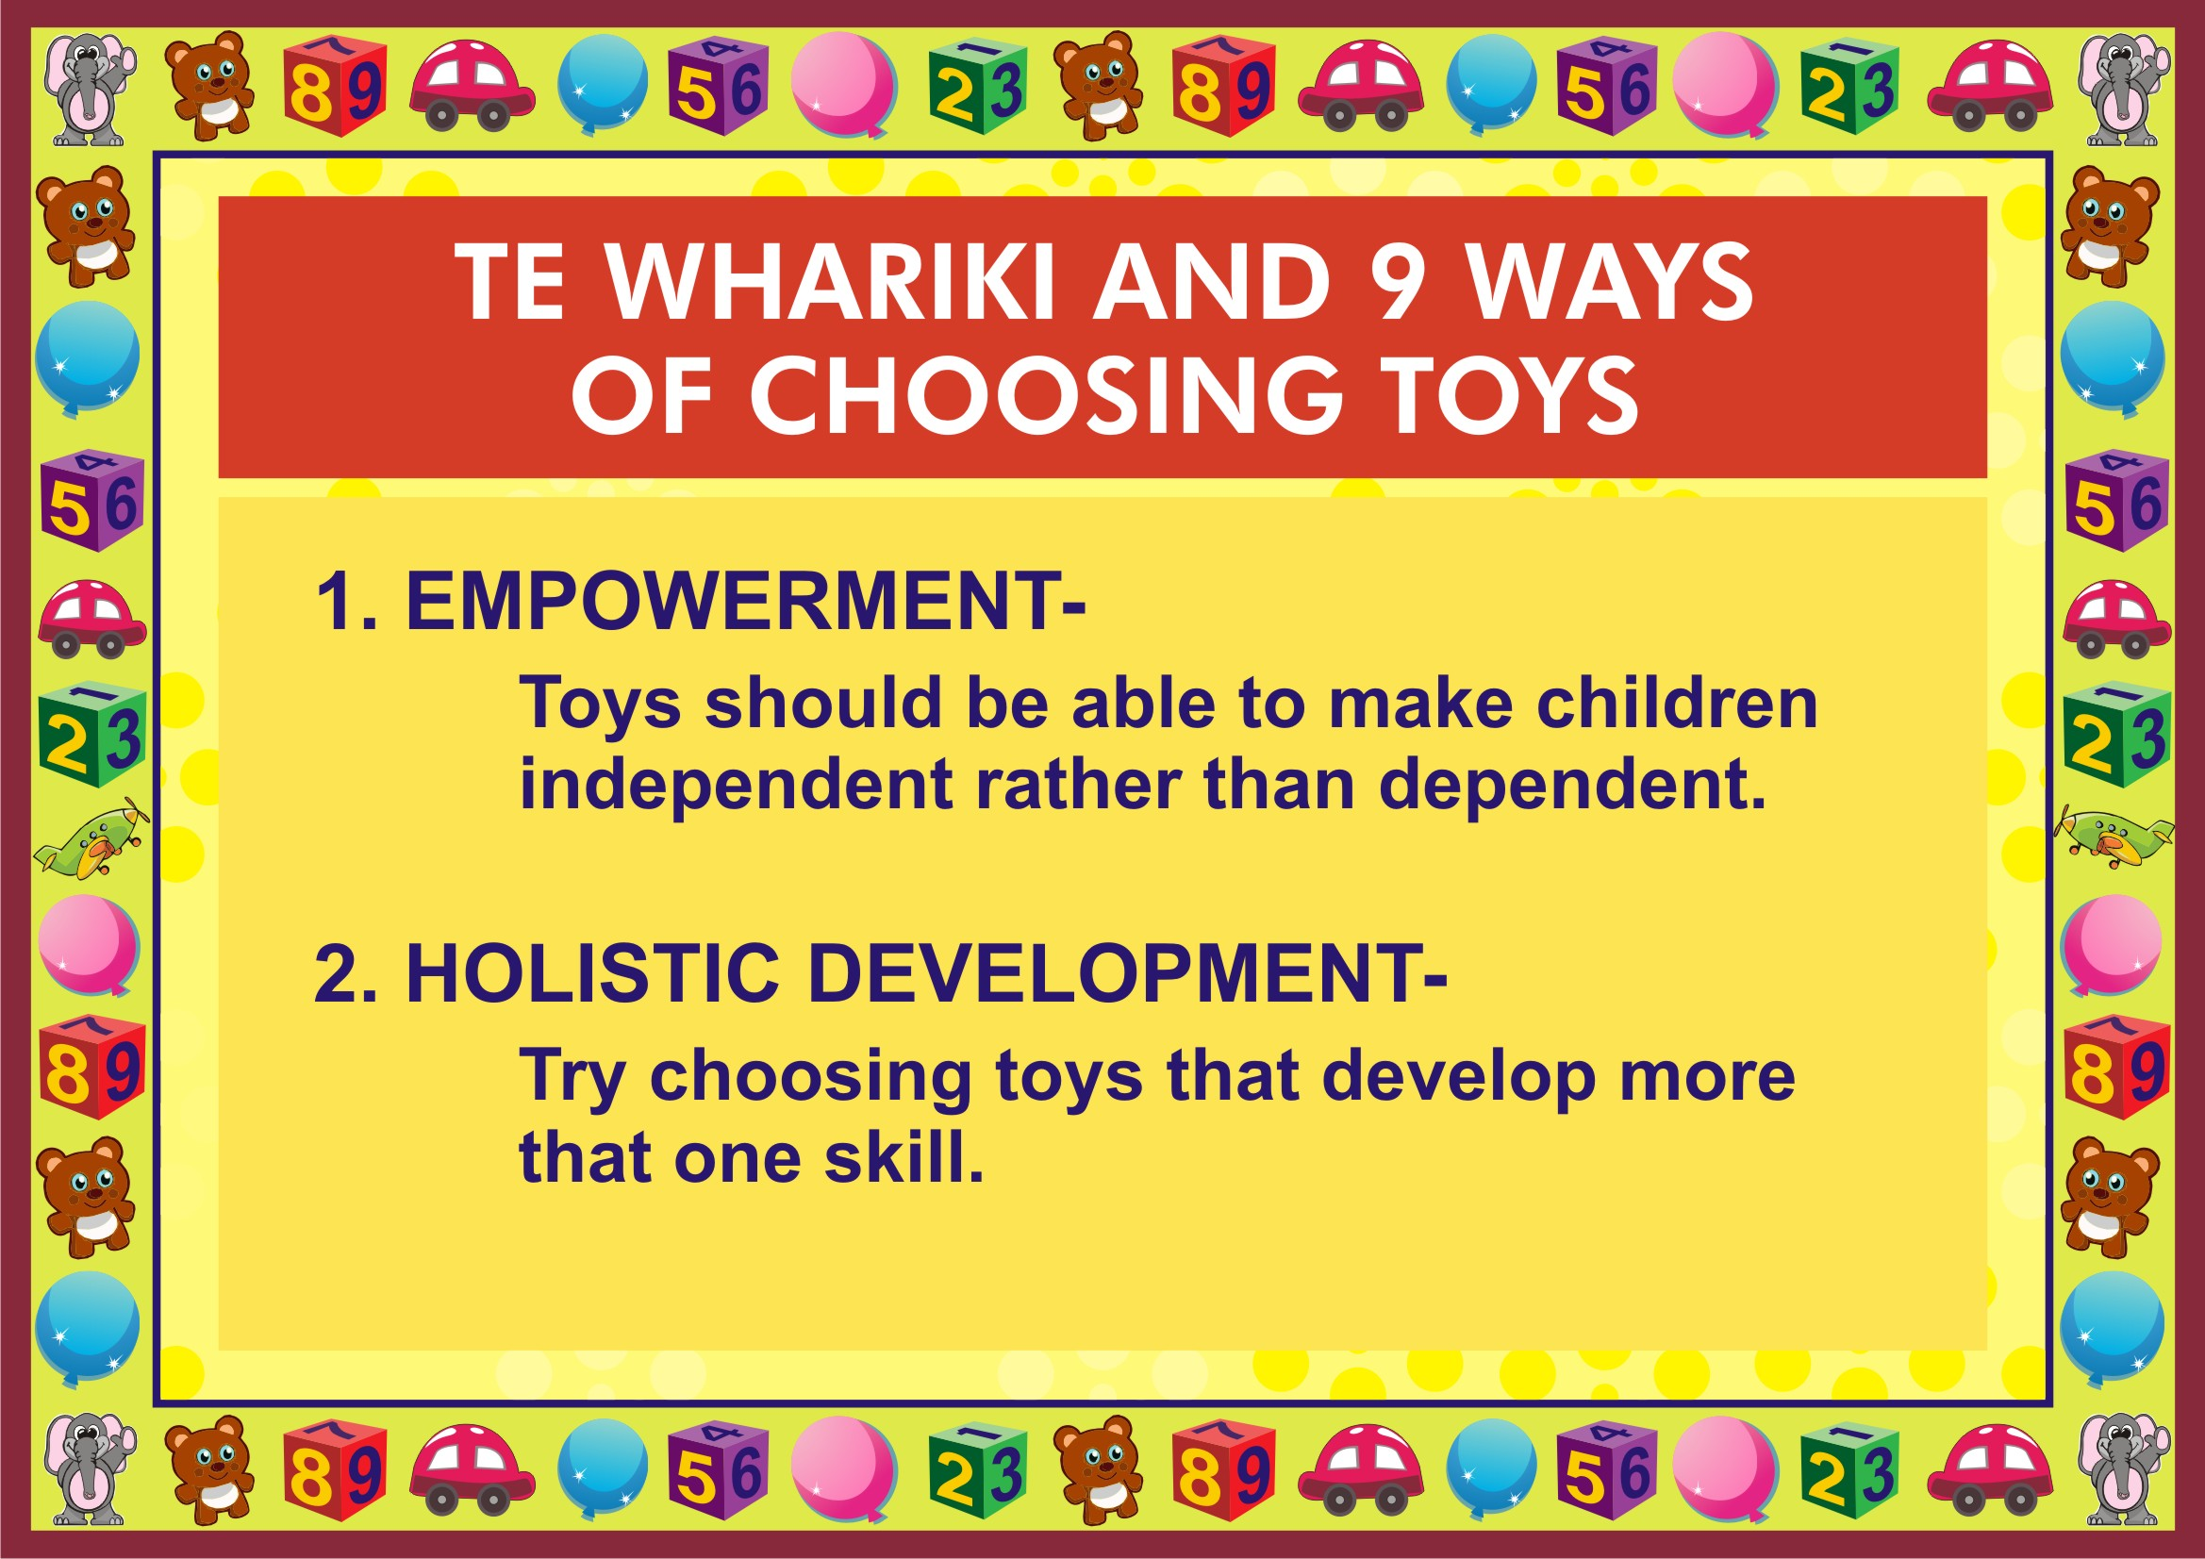

Slide 9
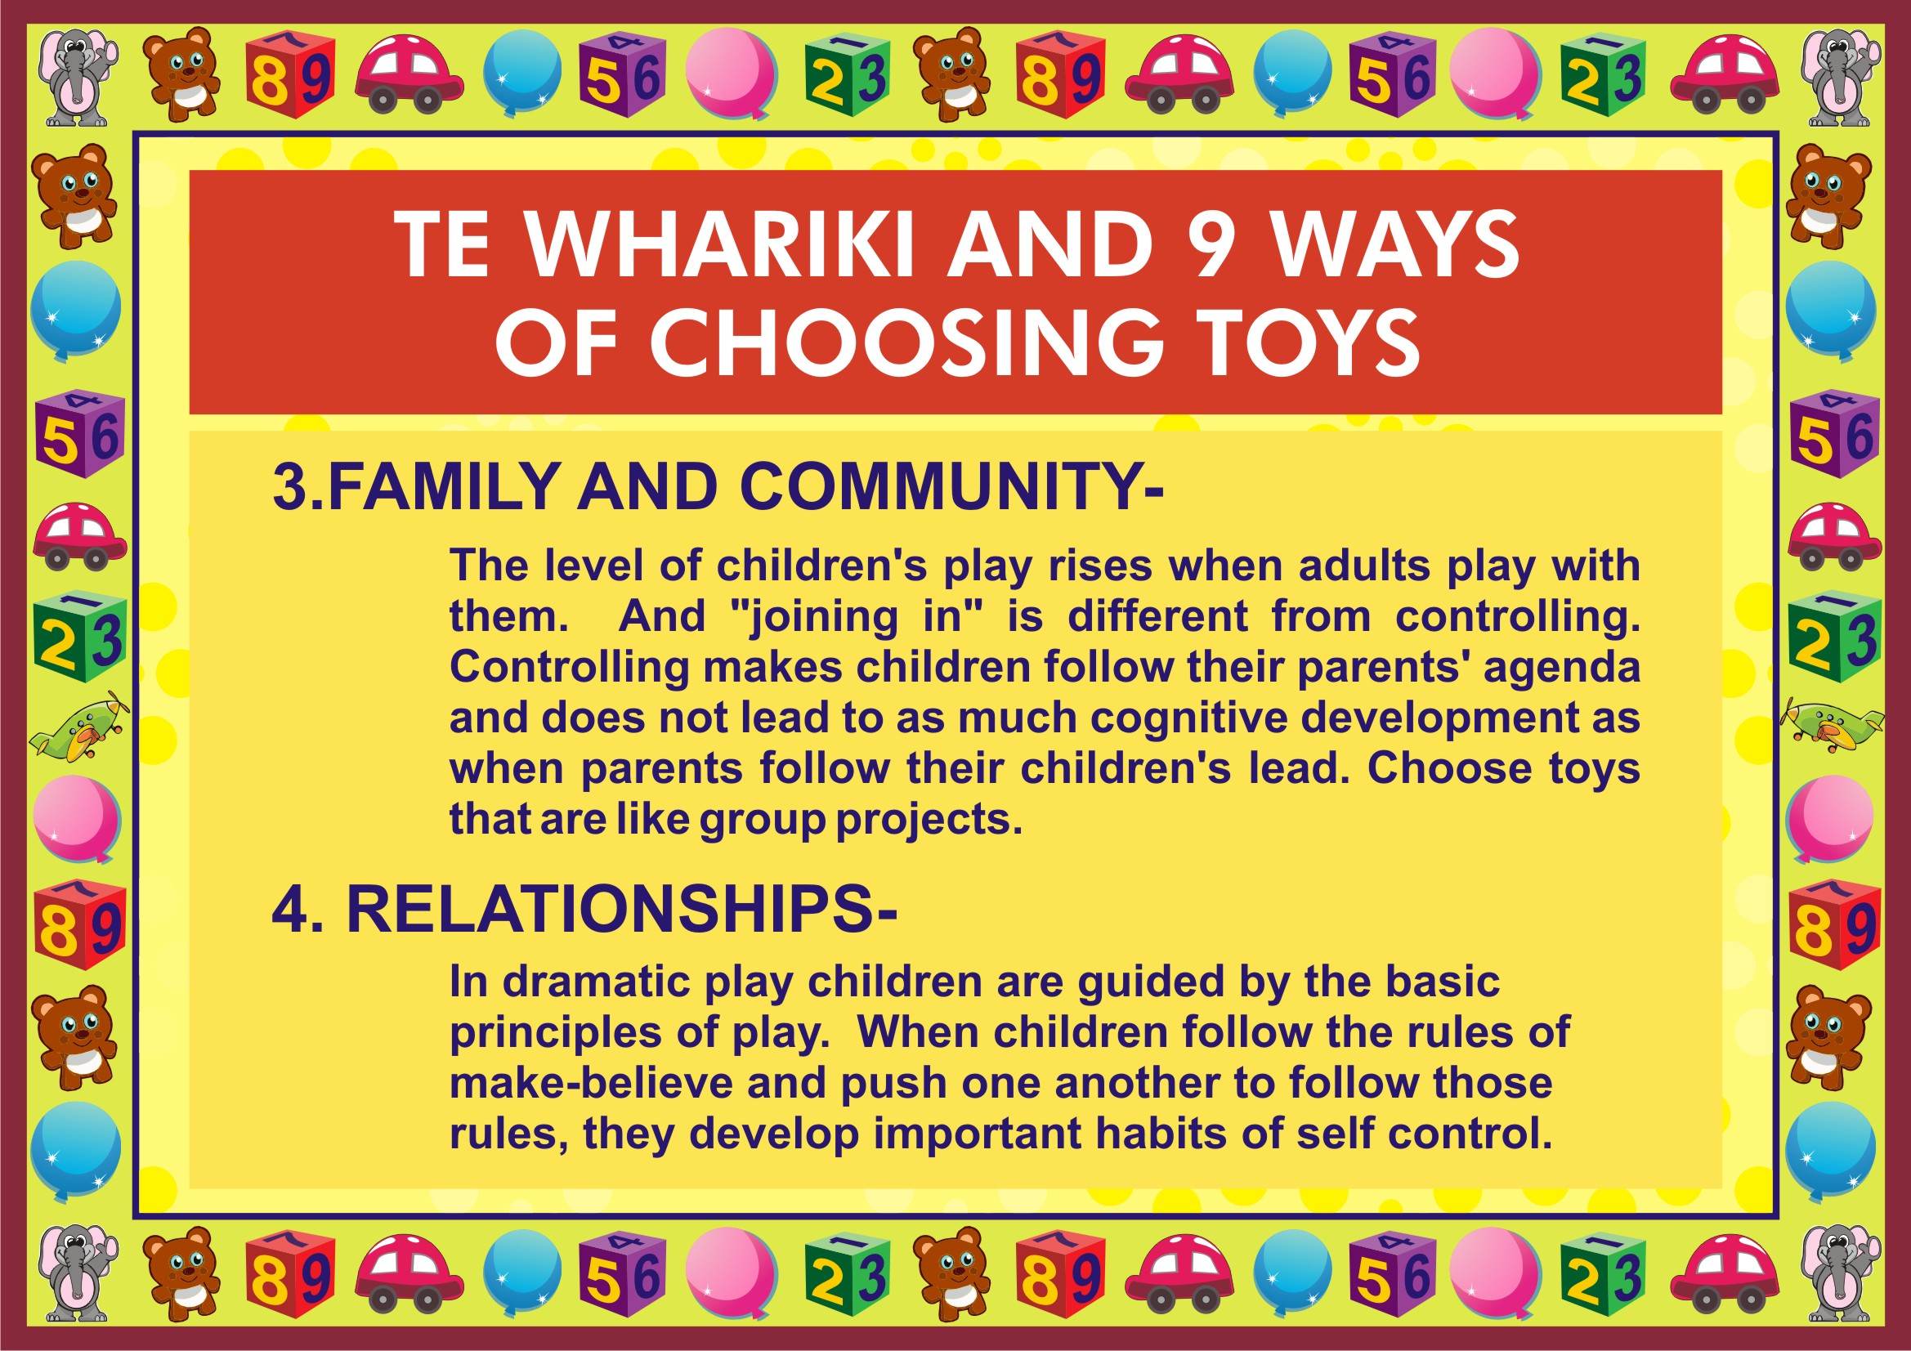

Slide 10
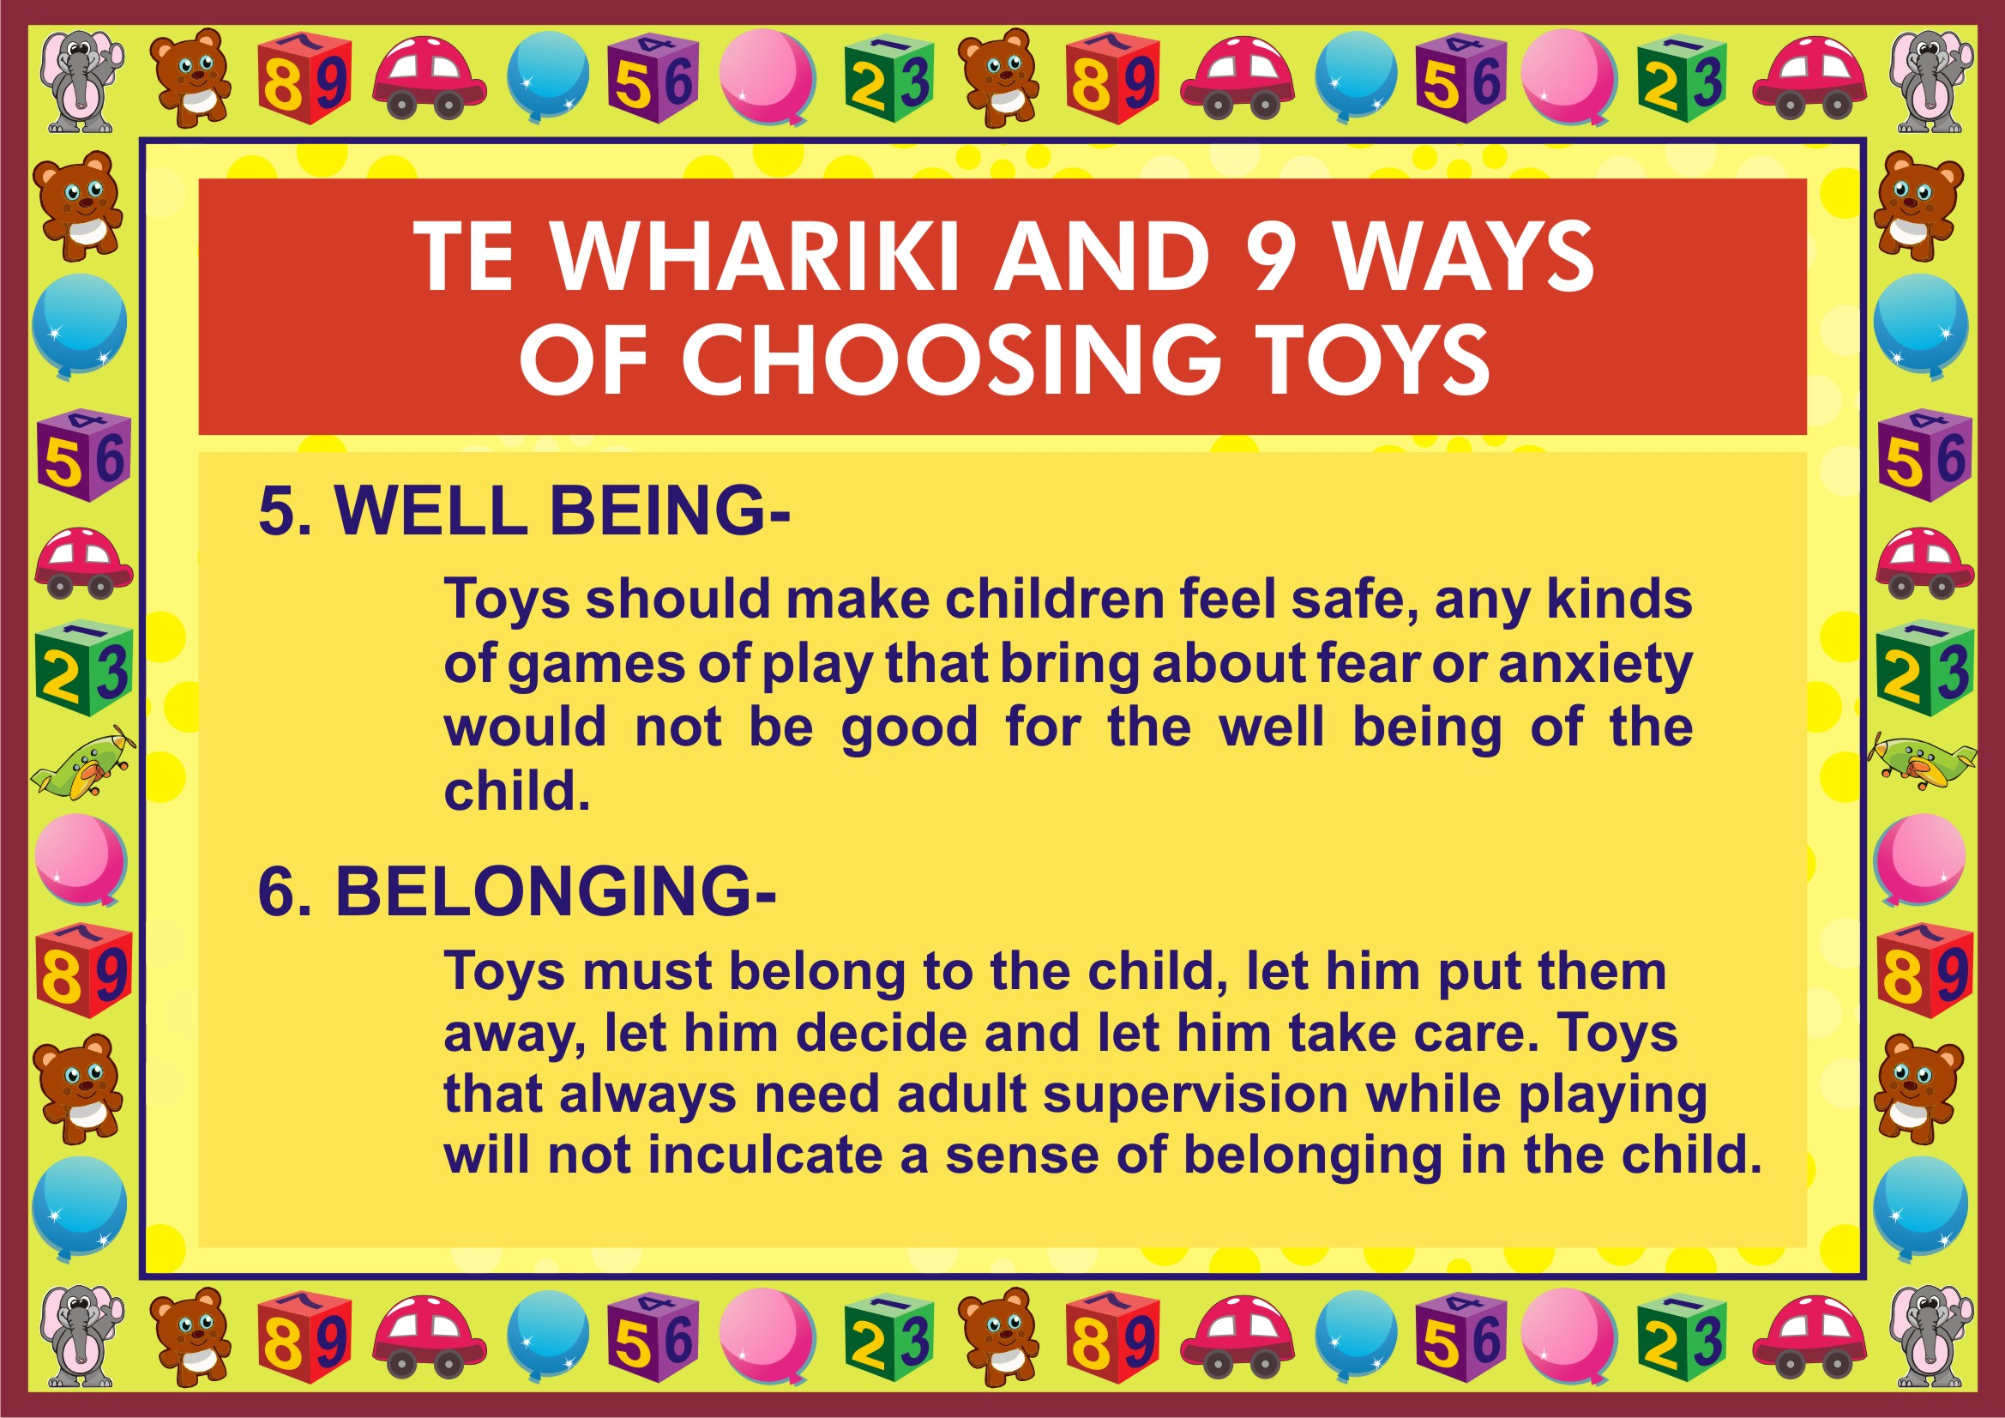

Slide 11
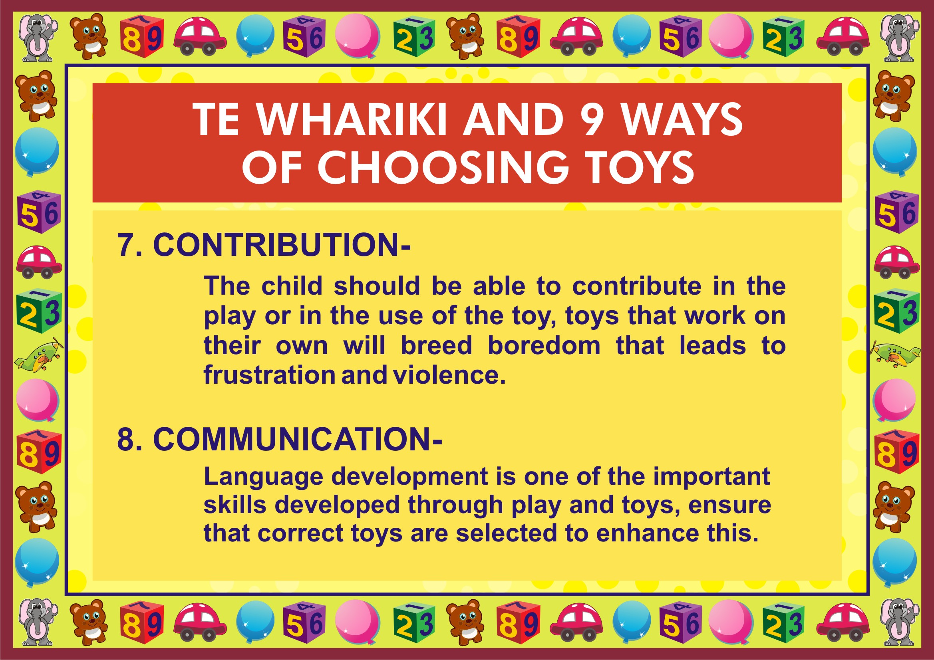

Slide 12
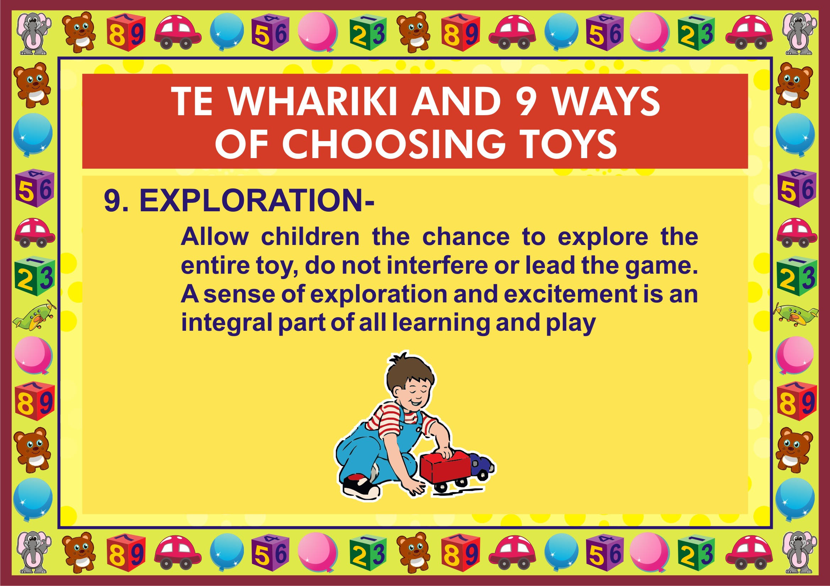

Slide 13
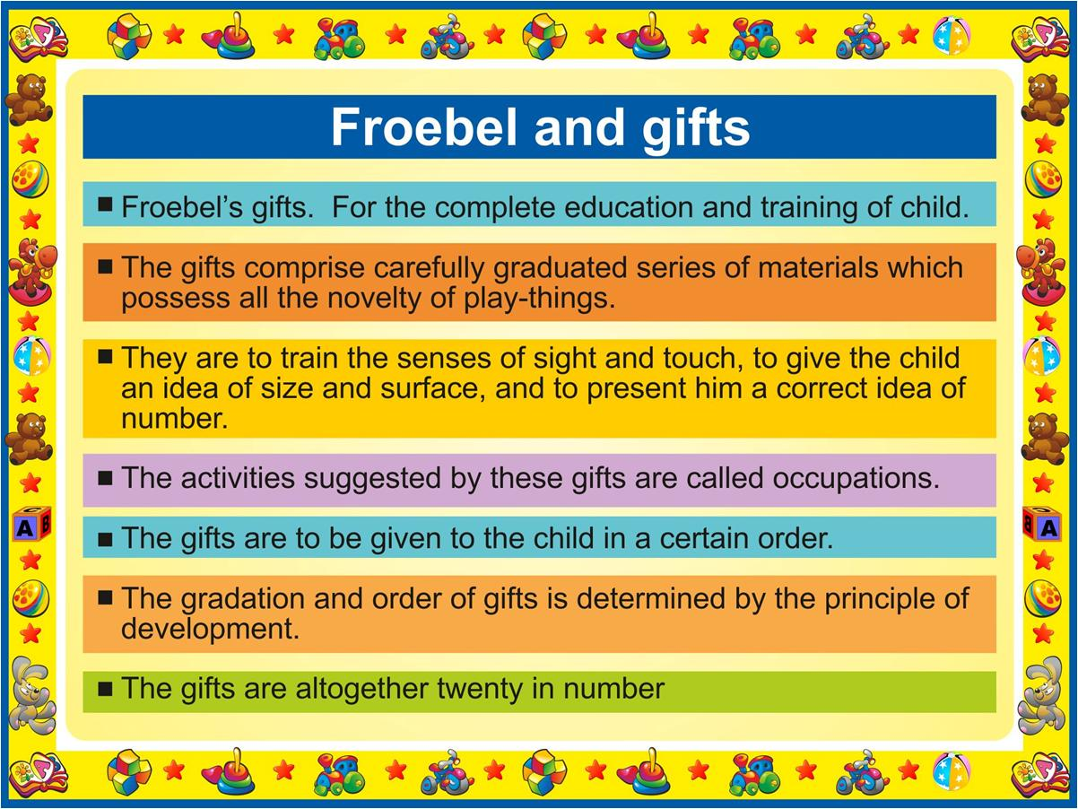

Slide 14


Slide 15
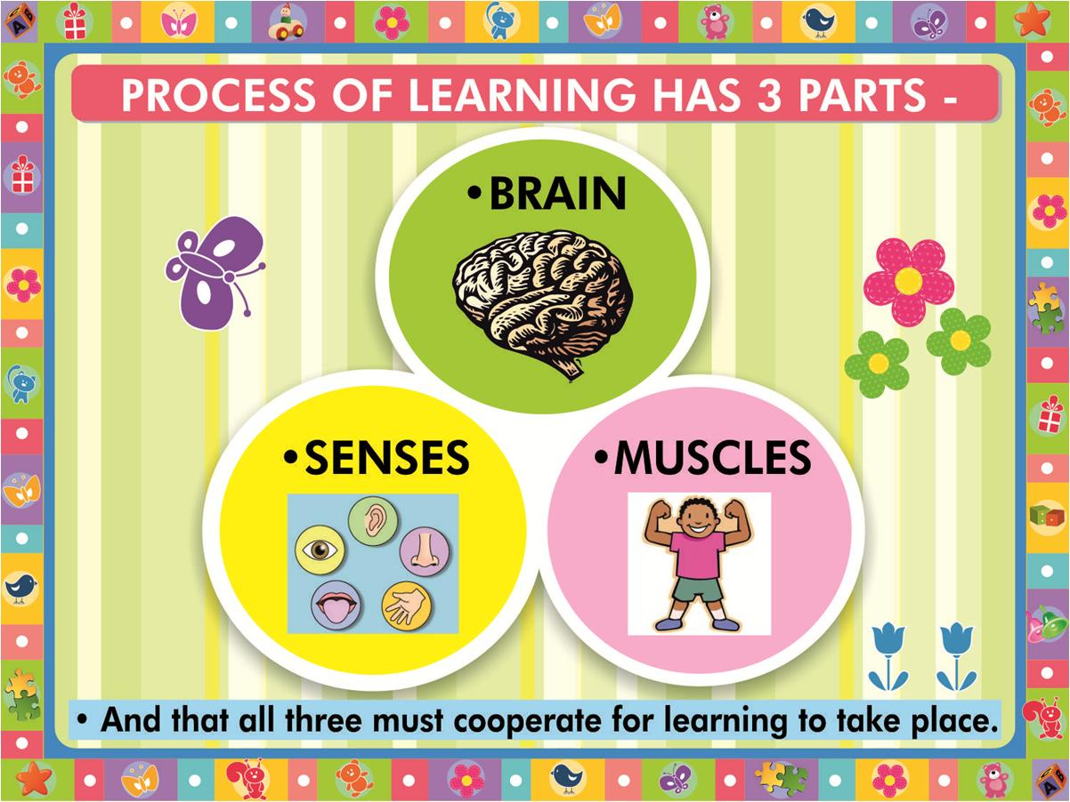

Slide 16
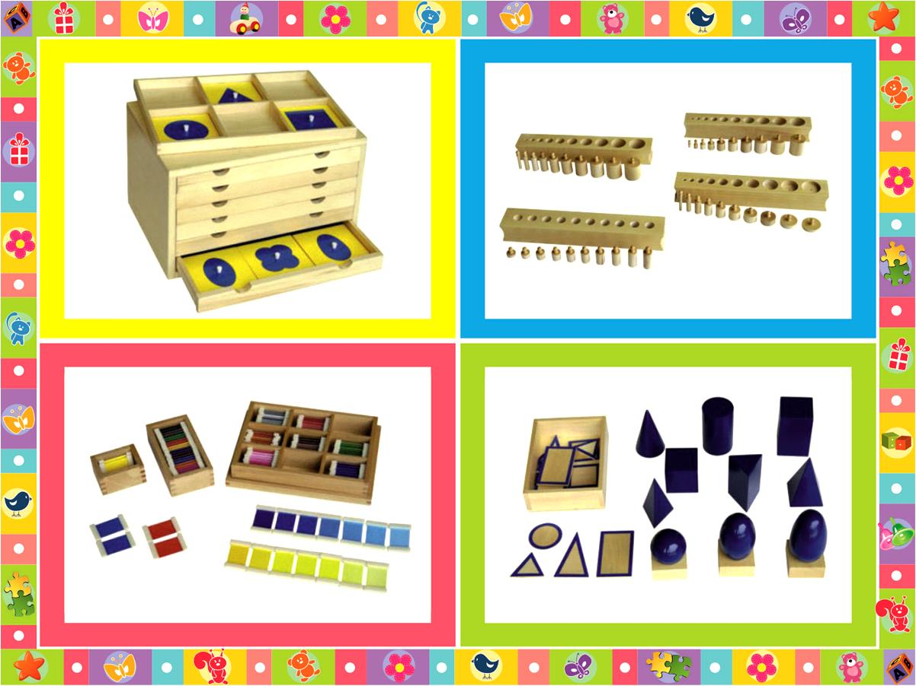

Slide 17
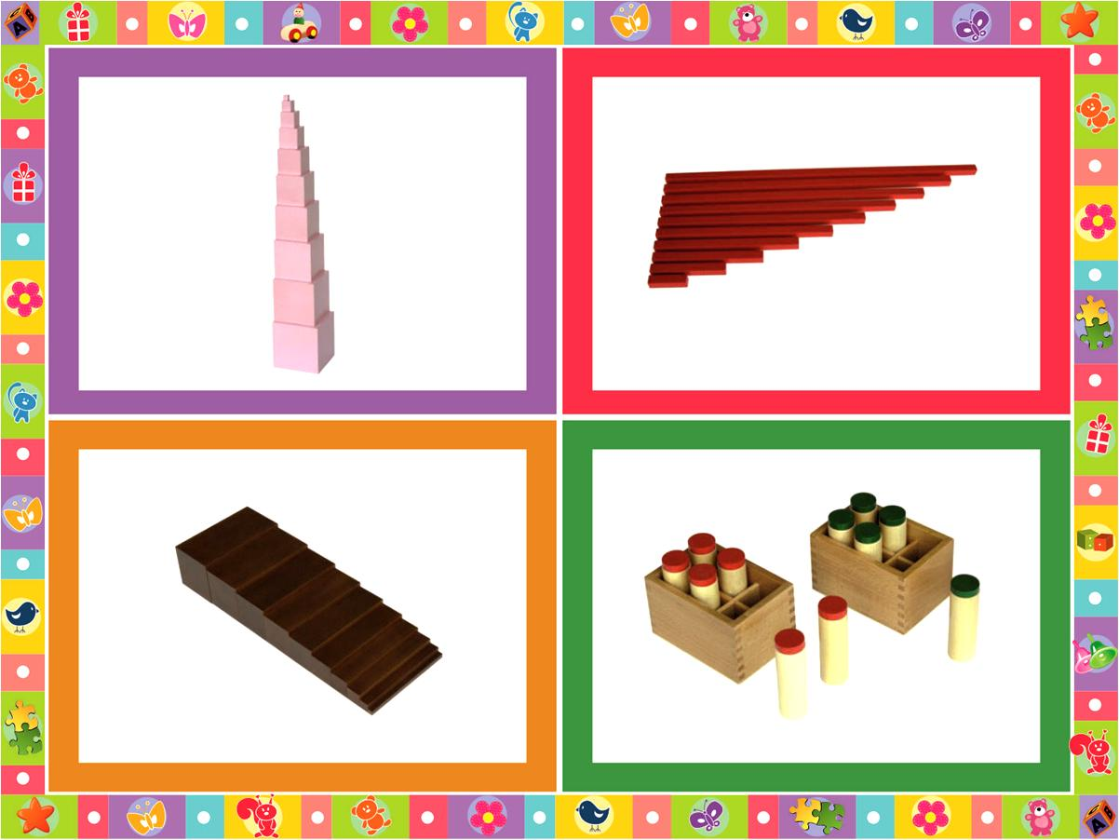

Slide 18
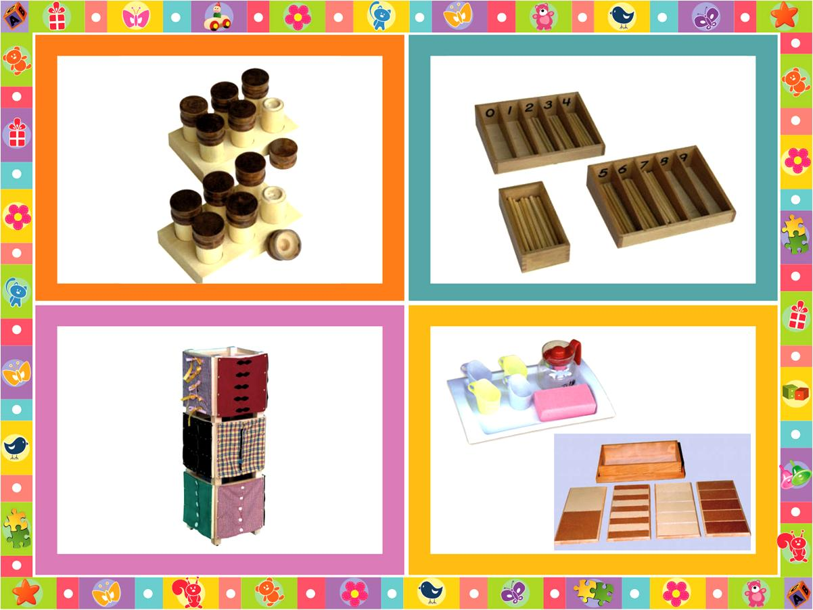

Slide 19
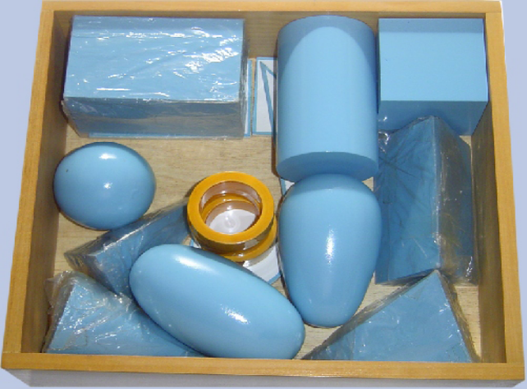
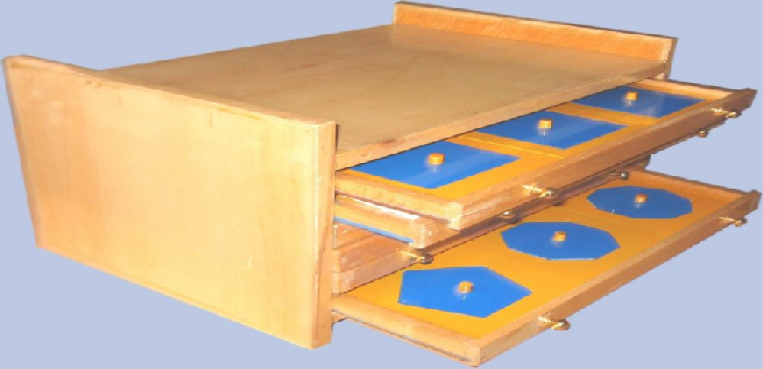
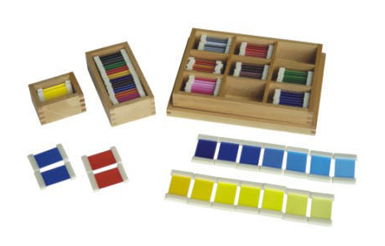
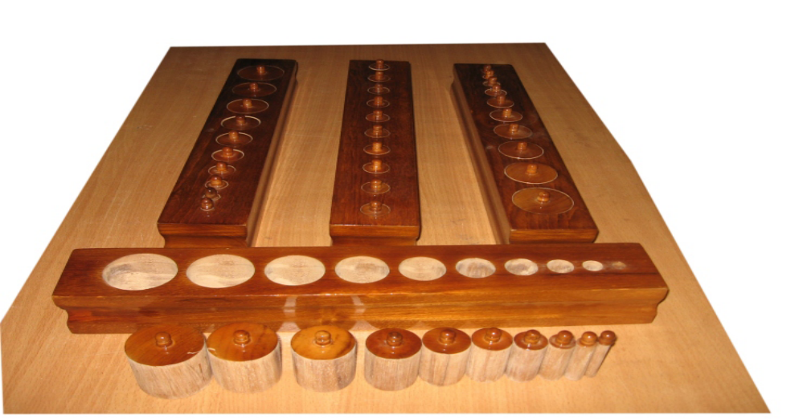

Slide 20

Playing. Learning. Growing. Achieving –
Goals of an Early Childhood Curriculum.
Part Two-
Emotional Development, Attachment and Exploration Emotional Intelligence Based on the works of
Erik Erikson, Mary Ainsworth.
SWATI POPAT VATS

Slide 21
Who is Erik Erikson?
Erik Erikson was born in Frankfurt, Germany.
He was an artist and teacher who became interested in psychology when he met Anna Freud - daughter of Sigmund Freud.
She convinced Erikson to study at the Vienna Psychoanalytic Institute,
where he specialized in child psychoanalysis.

Slide 22
His theory- the 8 ages of man.
AGE | STAGE | STRENGTH DEVELOPED
0 TO 1YRS | TRUST VS. MISTRUST | HOPE
2 TO 3 YRS | AUTONOMY VS. SHAME AND DOUBT | WILLPOWER
4 TO 5 YRS | INITIATIVE VS. GUILT | PURPOSE
6 TO 12 YRS | INDUSTRY VS. INFERIORITY | COMPETENCE
ADOLESCENSE | IDENTITY VS. ROLE CONFUSION | FIDELITY
YOUNG ADULTHOOD | INTIMACY VS. ISOLATION | LOVE
MIDDLE AGE | GENERATIVITY VS. STAGNATION | CARE
OLD | EGO INTEGRATION VS. DESPAIR | WISDOM

Slide 23
Erik Erikson –
and the preschool years.
LETS TALK ABOUT THE FIRST THREE STAGES AS THEY FALL IN THE PRESCHOOL YEARS.

Slide 24
0- 1 YRS- TRUST V/S MISTRUST
Trust has two parts, external (belief that significant adults will be present to meet the baby’s needs) and internal (belief in her own power to effect change and cope with a variety of circumstances).
A baby who successfully adapts during this first stage approaches her second year of life with a sure sense that the world is a good place to be.
She believes that others will guide and support her.
She trusts that they will lend stability and continuity of care to her life.

Slide 25
0- 1 YRS- TRUST V/S MISTRUST
She knows she has the power to engage adults (through tears, smiles, or fussing) whenever she needs their help.
This engaging of adults is part of what educators call attachment.
When children’s needs go unmet, they are unable to develop trust in themselves or the world around them.

Slide 26
0- 1 YRS- TRUST V/S MISTRUST
Erikson believed that two actions on the part of parents and teachers help babies develop this basic sense of trust:
Holding babies close and having warm physical contact with them when they are being fed
Responding right away to their distress when they cry or fuss
With consistent, responsive care, they are laying the foundation that will allow babies to grow into strong, confident toddlers ready to assert their independence.

Slide 27
2 to 3 yrs-AUTONOMY VS. SHAME AND DOUBT
This stage’s outcome determines, to a great extent,
the ratio of love and hate,
cooperation or lack of it, and
freedom of expression or tendency to suppress feelings that become part of who we are for the rest of our lives.
When a child can fully develop a strong sense of self-control without loss of self-esteem, she will feel proud and confident.
When a child experiences loss of control and excessive shame, she will tend to doubt herself.

Slide 28
2 to 3 yrs-AUTONOMY VS. SHAME AND DOUBT
Erikson believed that adults can foster independence in children of this age by :
giving children simple choices
not giving false choices
setting clear, consistent, reasonable limits
accepting children’s swings between independence and dependence, and reassuring them that both are okay.

Slide 29
4 to 5 yrs-INITIATIVE VS. GUILT
The developmental task of this stage is to acquire a sense of purpose.
At first glance, this stage seems much easier for adults that the previous two. Part of that has to do with the child’s growing cognitive and physical abilities.

Slide 30
4 to 5 yrs-INITIATIVE VS. GUILT
To support children’s development of initiative in the third stage, Erikson says that teachers can encourage children to be as independent as possible
focus on gains as children practice new skills, not on the mistakes they make along the way
set expectations that are in line with children’s individual abilities
focus curriculum on real things and on doing things

Slide 31
John Bowlby. Mary Ainsworth
Attachment theories
When a baby is born he recognises no one.
By first birthday he has his favourites.
Why? How?

Slide 32
Two pillars of emotional development- Attachment (Roots) and Exploration (Wings)
Attachment comes from the desire to remain close to a caregiver and feel safe. Exploration comes from the desire to venture out and learn about the world. Children instinctively do both.
The attachment hands children form with their first early childhood teachers also predict the quality of relationship they will have with future teachers, because this first relationship becomes the model for the others.

Slide 33
One research study by Mary Ainsworth observed how mothers prepared their two-year-olds for a brief separation.
When mothers slipped out of the room without saying anything, their children played the least and were most likely to cry.
In contrast, when mothers told their toddlers what they were leaving and would return, or when they told their toddlers what they should do in the interim, their children played the most and cried the least.
Sneaking out might have been easier for the mothers, but it made the toddlers feel less safe. Thus, they did not explore or play as easily.

Slide 34
The type of attachment that young children have with their child care teachers can be observed in their behaviours.
Securely attached children:
accept comfort when they are upset.
can usually be calmed by the teacher holding them.
spontaneously hug the teacher.
easily follow her directions.
are lighthearted and playful with the teacher.

Slide 35
Insecure / avoidant attached children:
are more interested in the materials in the classroom than in the teacher or the other children.
act as if they do not hear what the teacher says or notice what he does.
avoid frequent or close contact with the teacher.
do not seek comfort from the teacher when hurt or upset, and might even move away from the teacher if she move closer to comfort them.

Slide 36
Insecure/resistant (ambivalent) attached children:
resist classroom routines such as cleaning up.
are demanding and impatient with the teacher and are not satisfied with his attempts to respond.
cry to get the teacher to do what they want her to do.
cling when the primary teacher attempts to leave the room and continue to cry after he leaves.

Slide 37
WORKING WITH AN INSECURELY ATTACHED CHILD
Children who have insecure attachments with their parents will bring that same relationship style to their interactions with you.
They will be less competent at using you, the teacher, to calm themselves or to support their efforts at self-control.
This is no fun for the child, and having an under controlled child is certainly no fun for you!

Slide 38

Behaviour zones to look out for in
your class
The safe zone: where students feel a sense of safety, self-worth and physical and emotional security.
The learning zone: where students are challenged but at the same time supported to learn.
The anxiety zone: where students begin to experience negative stress about the learning experience, and low-level misbehaviour happens.
The stress zone: where students react in the classroom, are violent or uncontrollably abusive.

Slide 39
Using Puppets and Dolls to Teach Prosocial Skills
Dolls, puppets, stuffed animals, and play figures are wonderful tools for demonstrating social skills with young children.
You can use these props to enact a scenario that represents a frequent, troublesome behavior in the classroom or an issue that one or more children are experiencing in their lives.
Puppets and dolls help the children see the situation from a new perspective. And because everyone is calm, they allow for problem-solving discussions.

Slide 40
Why We Play Simon Says
Learning Self-Regulation
Usually the four-year-olds can go right outside to play, but today they must wait for the teachers.
Becoming impatient, they break out of line and run around the room. Nitin wants to be the first to get a swing, so he throws on his jacket and hurries to the head of the line at the door.
Then, while waiting, he turns his back to the door so be can't see the playground and sings a song to himself.

Slide 41
What Is Self-Regulation, and Why Is It Important?
Self-regulation is the process of exercising control over one's actions (for example,
becoming less impul­sive),
thinking processes (for example, focusing attention and planning activities),
and emotions (for example, managing frus­tration).

Slide 42
about 10 to 15 percent of preschool-aged children exhibit mild to moderate behavior problems, usually involving poor self-regulation.
Children with a limited ability to inhibit their impulses are more likely to be diagnosed with conduct disorder or attention-deficit / hyperactivity disorder.

Slide 43
Behavioral Self-Regulation
(Impulse Control)
The regulation of personal actions, or impulse control, includes both the ability not to do something and the ability to control the speed at which something is done.
Young children first learn how to perform an action but only later learn how to regulate it.

Slide 44
Behavioral Self-Regulation
(Impulse Control)
Until they can learn to inhibit their actions-to slow down or stop an action and but only later learn how to stop an action and give themselves the chance to think-they will be unable to choose between alternative actions.

Slide 45
At age three, most children cannot successfully play Red Light, Green Light. They can't stop them­selves from going whenever any light comes on! But by age five, most children can give different response for the red light.
Motor skills are initially learned at the speed that is easiest for the body. For example, three-year-olds cannot consistently draw lines slowly. They seem to have only one speed. But they get better at this skill each year up through at least age six.

Slide 46
GAMES THAT DEVELOP IMPULSE CONTROL
Traditional games:
Red Light, Green Light
Simon Says
London Bridge
Freeze Tag
Ready, Set, Go! (child must wait for “Go!”)

Slide 47
Playing Simon Says is fun, but it is also an exceptional method for teaching impulse control. Impulse control, which has been extensively-Studied-by scientists, is consid­ered an important early predictor of later success in school and in life.

Slide 48
Impulse Control and Compliance
It makes sense that when children are more capable of controlling their actions, they are more capable of complying with adult demands.
When we ask them to wait their turn, wait in line, or let others use the crayons, for example, we are asking for impulse control.

Slide 49
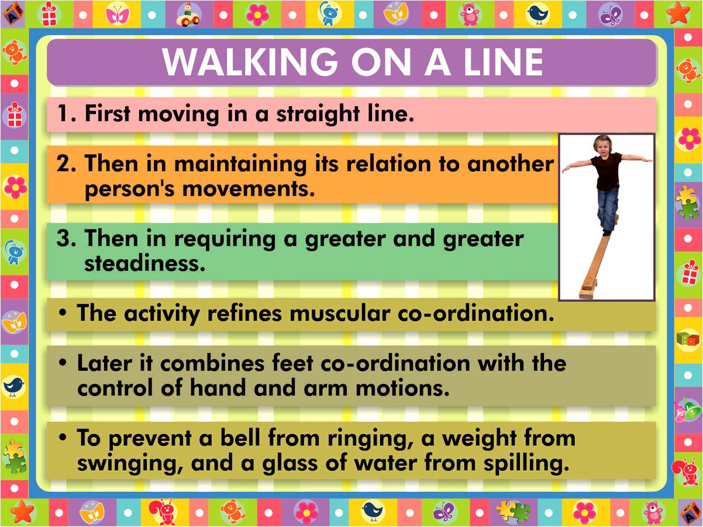

Slide 50
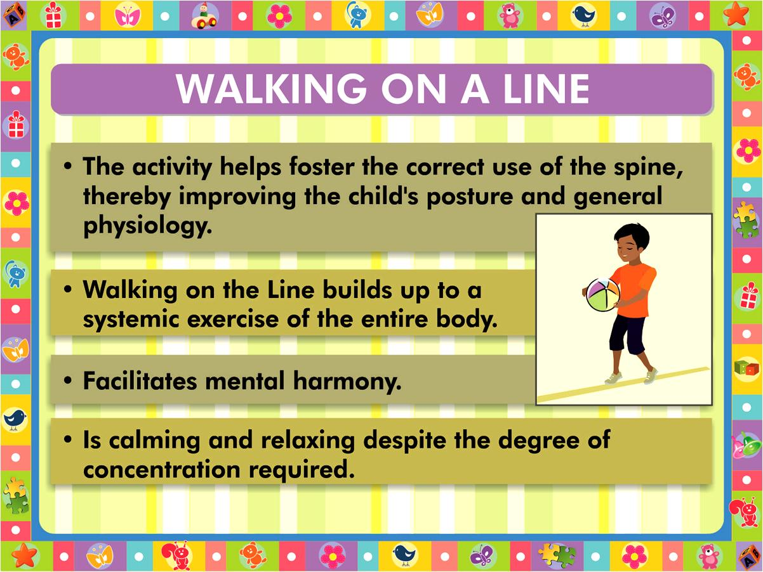

Slide 51
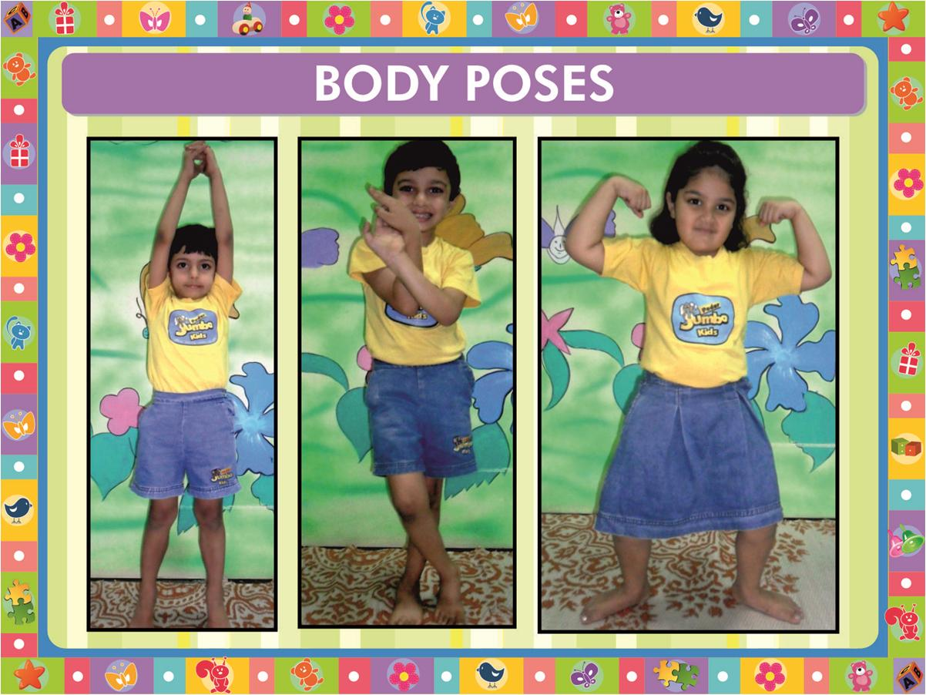

Slide 52
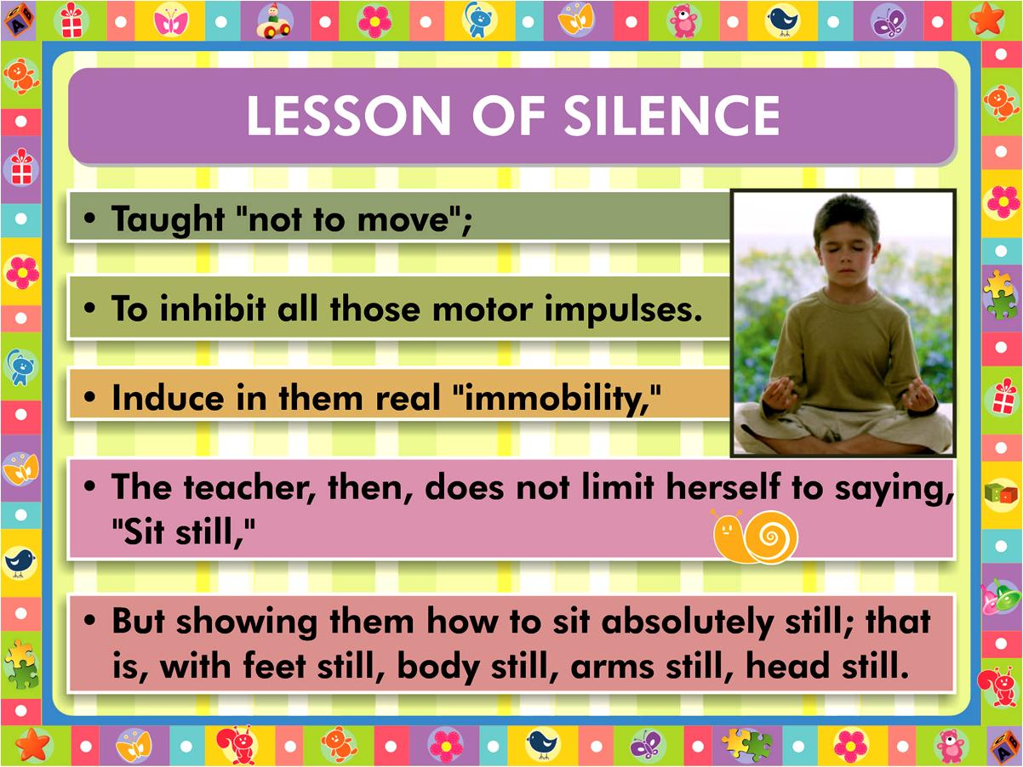

Slide 53
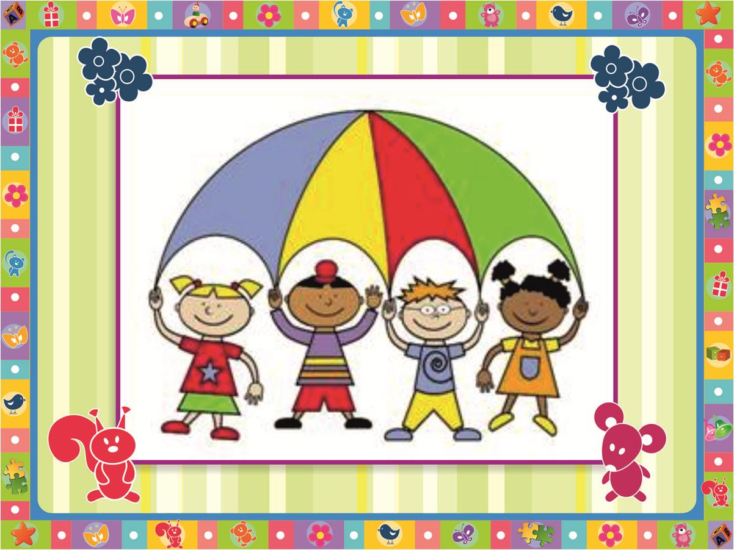

Slide 54
Playing. Learning. Growing. Achieving –
Goals of an Early Childhood Curriculum.
PART THREE-
OBSERVATION FOR ASSESSMENT
SWATI POPAT VATS

Slide 55
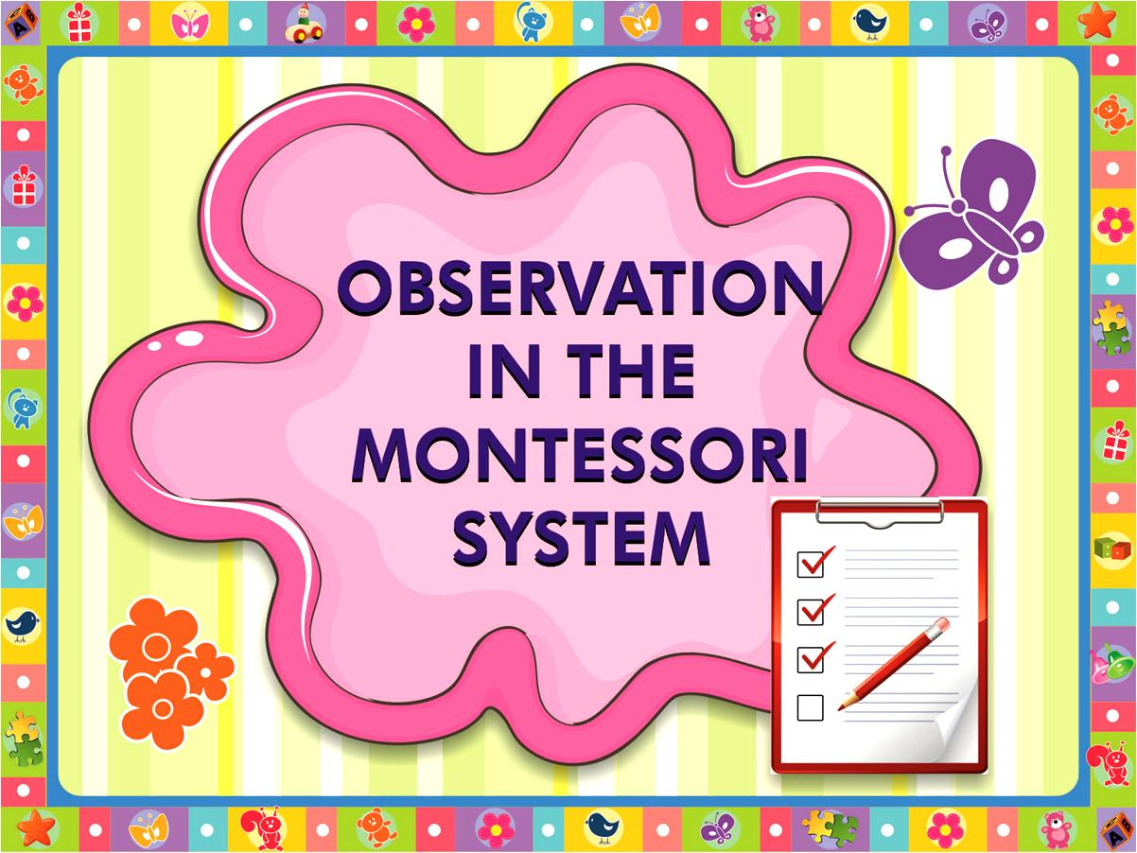

Slide 56
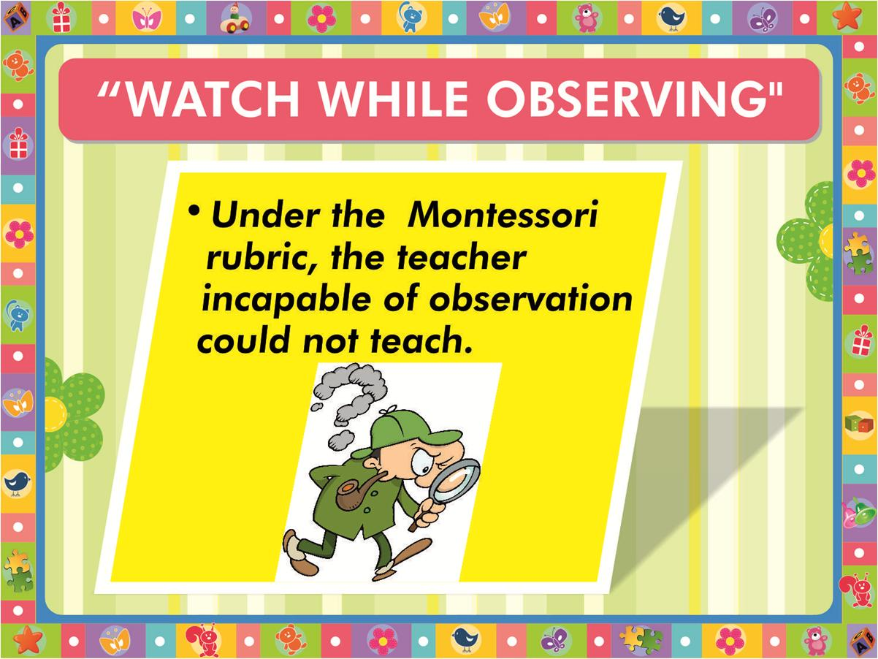

Slide 57
To observe we need to know
Knowledge of child development, and by observing what children do.
Without that knowledge we can misunderstand what they are trying to tell us and this can make life difficult for everyone.
All children develop at their own speed.
One of the main reasons we observe children, then, is to see if they are following this general pattern.

Slide 58
Why do observations?
One of the reasons identified for doing observations is to meet the needs of the children. Children are unique and to be aware of their qualities we need to:
Take an interest in what they are doing.
Listen to what they are saying.
Children may communicate their needs in a variety of individual ways. For instance, one child may scream for attention while a second bites another person to express their needs.
Take the example of biting-the observation on p.9 could help out the problem.

Slide 59
What can we see?
what children are able to do :
how they approach problems and
how they attempt to solve them:
children enjoying themselves.

Slide 60
Why do we watch children?
What can we see?
What can we learn from watching children?
How can we help the children
through watching them?
An observation is like a camera shot, camera does not lie, it may distort. We should not make judgments about a child on a single observation.
Observation can make a difference to the way the child behaves. Become inhibited or embarrassed, or may play to the audience.

Slide 61
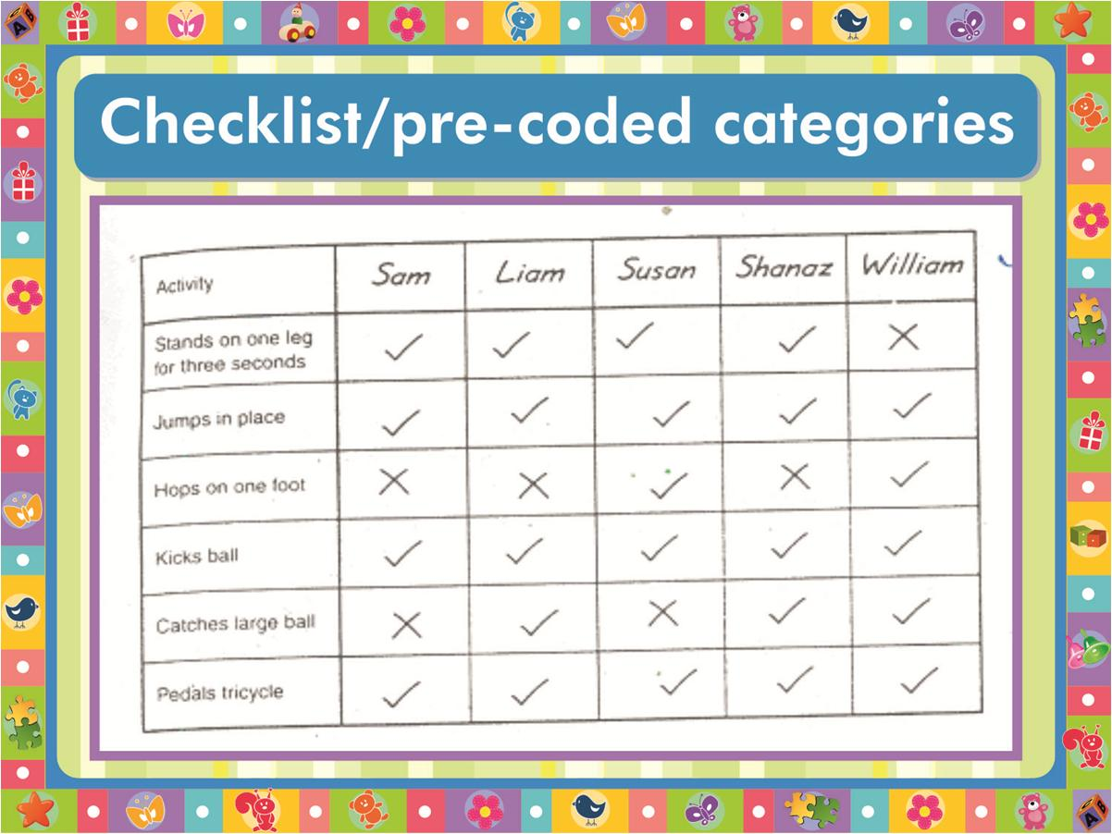

Slide 62
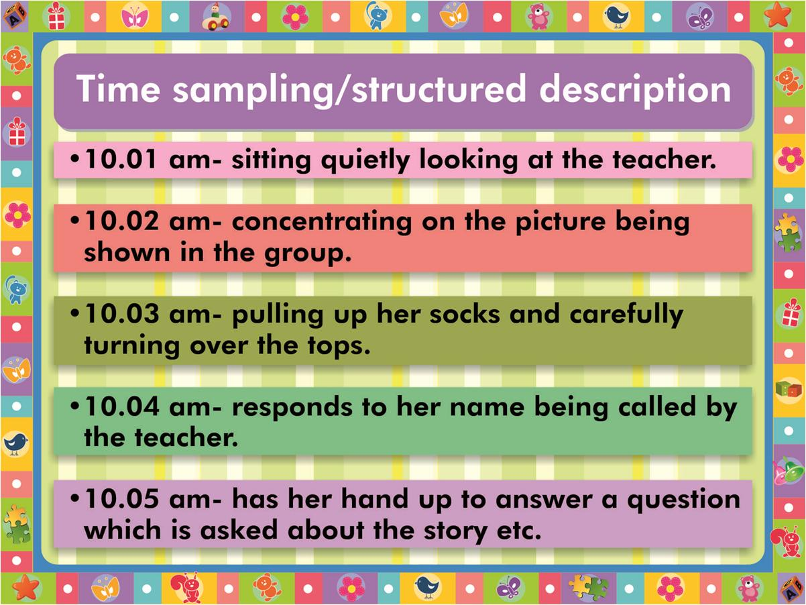

Slide 63
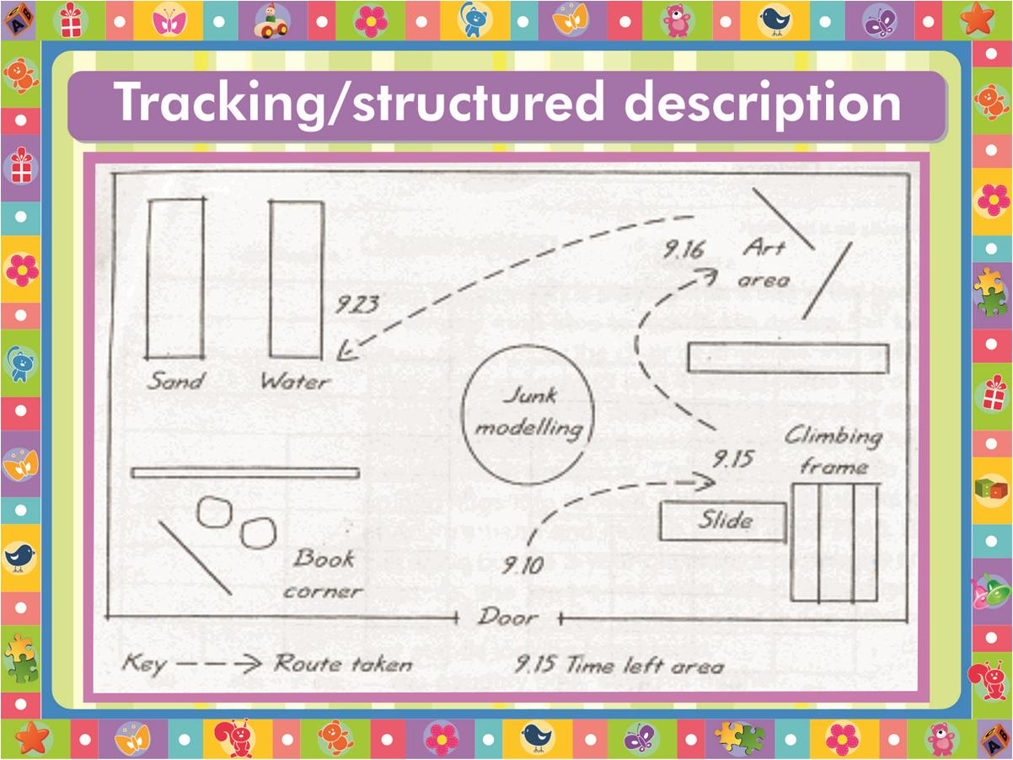

Slide 64

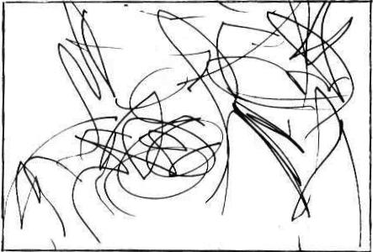
Stages of art in young children
STAGE 1 - scribbling stage- children like to pick up all kinds of writing, drawing, colouring implements and scribble with them. the medium does not matter as here they are exploring to develop their muscle control and also experimenting with what they can form.

Slide 65
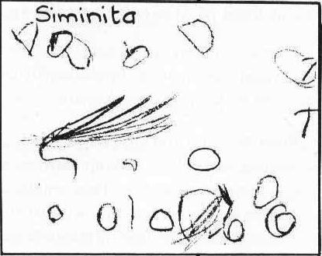
Stages of art in young children
STAGE 2 - scribbling and doodling stage, kids now have some control on their small muscles and have greater eye-hand coordination. As you observe their drawings you can see some repeat patterns emerging. At this stage kids are able to talk about their drawings, though not in too much detail but will be able to name what they have made. When they begin the drawing they have no idea what they will be drawing.

Slide 66
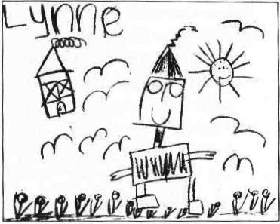
Stages of art in young children
STAGE 3 (around 4 to 6 years old) - have control on the crayons or brush and are able to represent their ideas in their drawings and paintings. At this stage another major change happens, kids now are able to think and plan what to draw and paint before they begin the drawing. Their drawings now look like representations of the real world. Size and proportion may not be correct and they may end up drawing all over the page. Simple details may be missing from their drawings like fingers or nose or ears. They are now able to talk about their drawings in details and may even give you some ‘emotions’ about the characters and settings, for e.g. He is wearing a cap because he was feeling hot, etc.

Slide 67
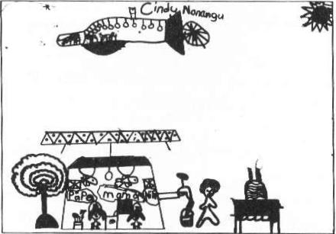
Stages of art in young children
STAGE 4 (from around 7 to 9 years of age) - they have greater eye-hand coordination. They are able to draw many different scenes and settings. They are able to bring in their understanding and observations about the environment. Their drawings and paintings have many more details, and the objects and people are almost proportionate in size.

Slide 68
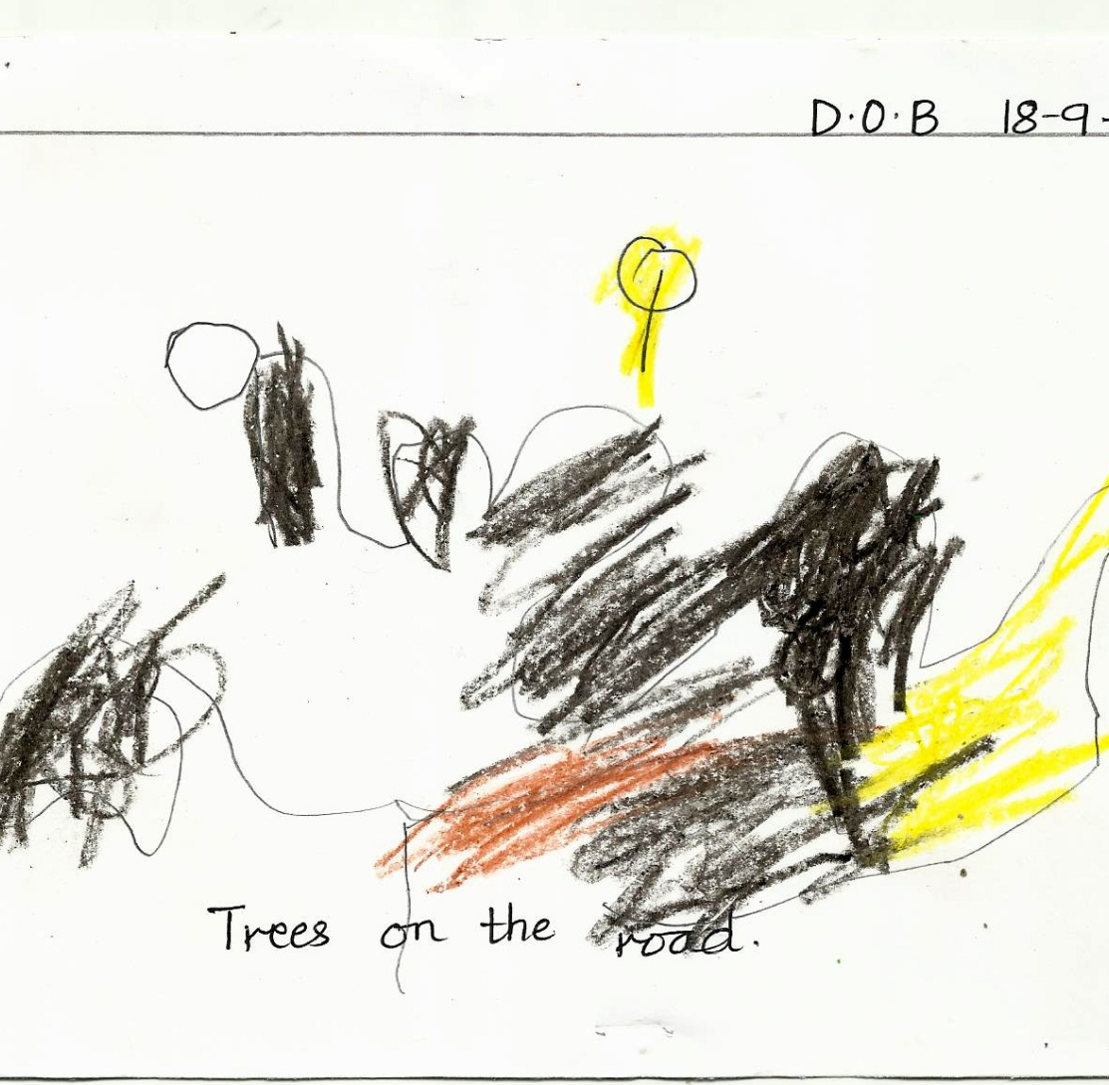
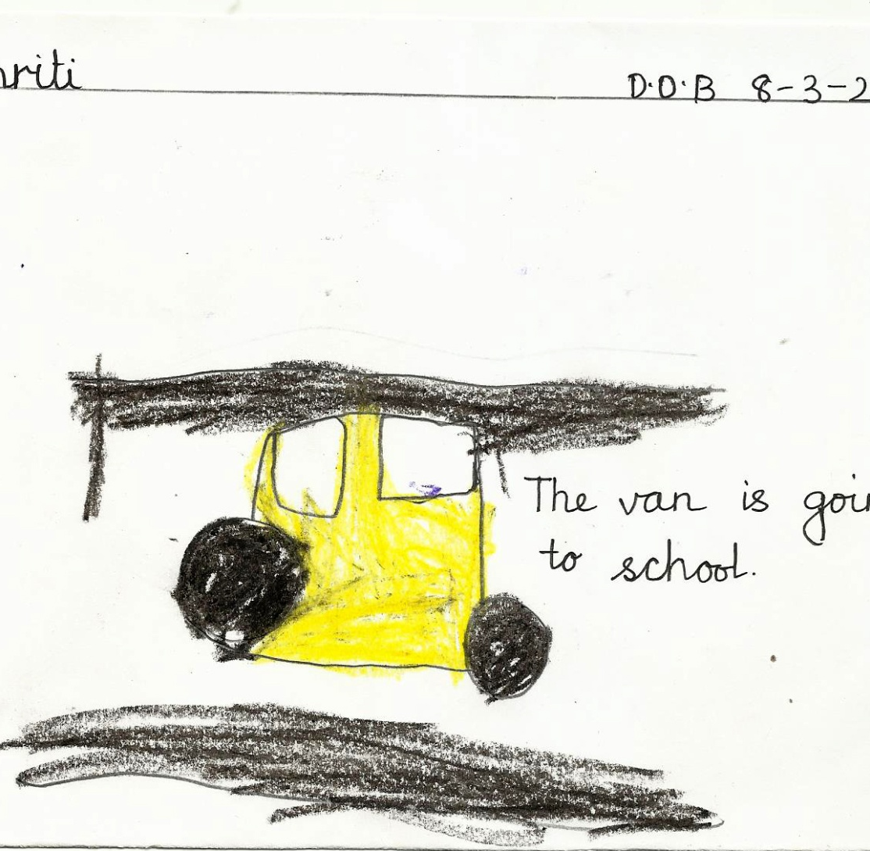
Dob- 18-9-2010
Dob- 8-3-2010

Slide 69
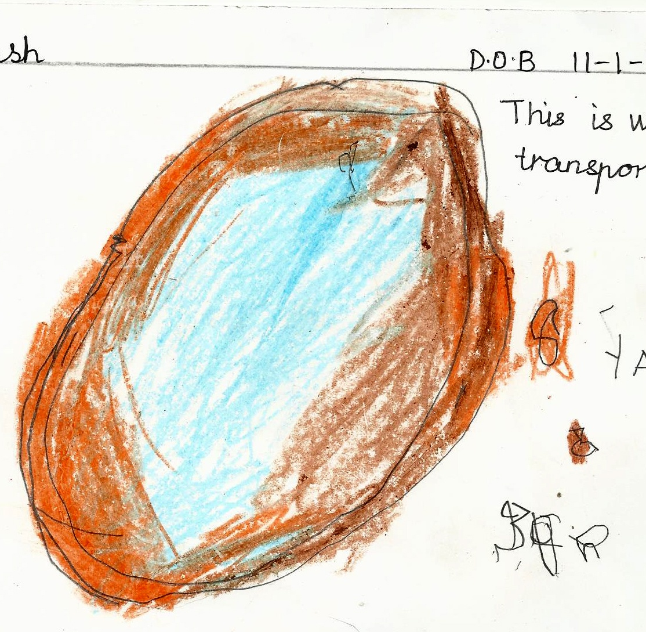
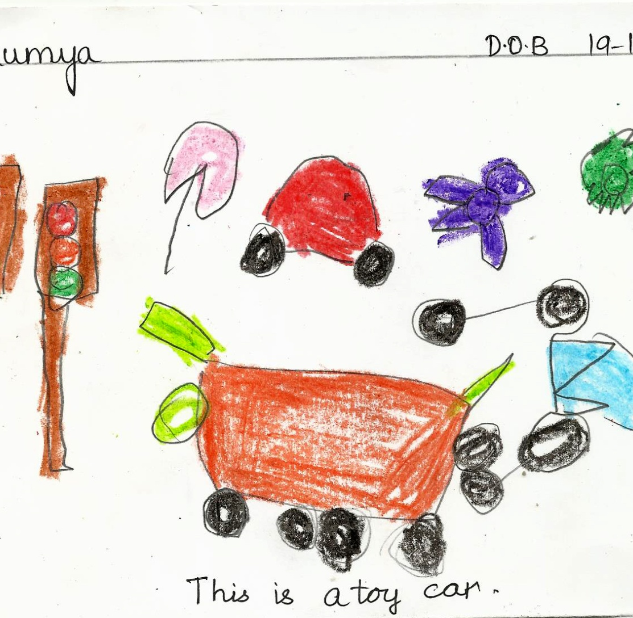
Same age?
Dob- 11-1-2010
Dob- 19-1-2010

Slide 70
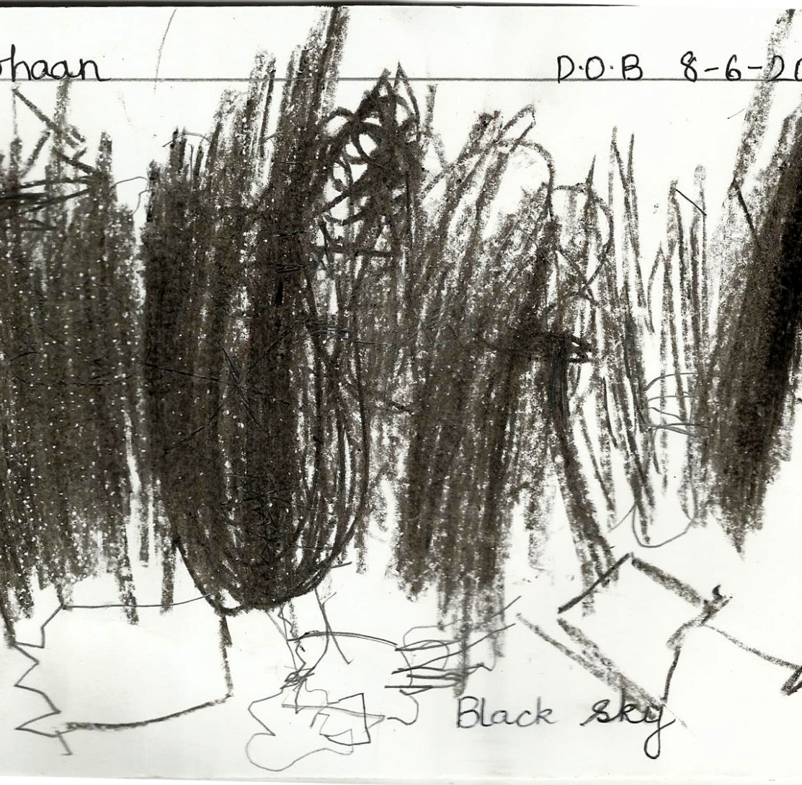
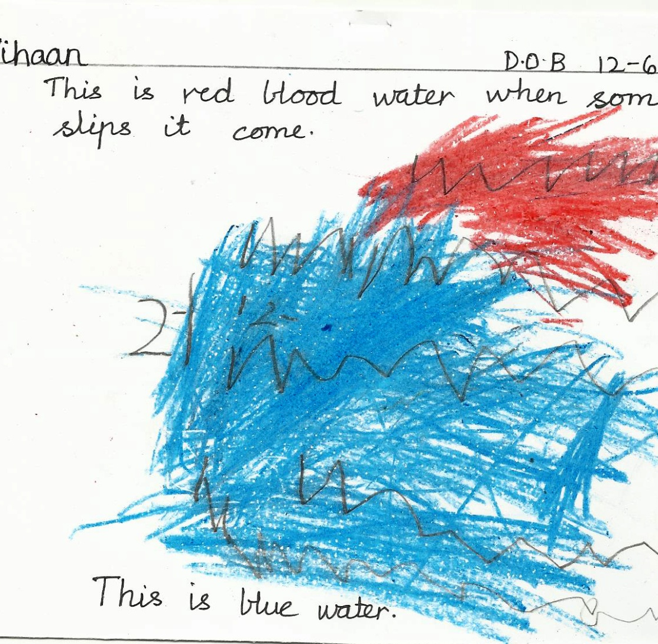
4 years and 5 months
Dob - 8-6-2010
Dob- 12-6-2010

Slide 71
Setting aims and objectives
Remember, Aims and Objectives are just the formal way of setting out your plan to discover what children are able to do. For example, your Aim could be to observe a teacher talking to a child. Your Objectives could be to discover if the child listened to what was being said and if they could understand what was being asked. This would be written as:
Aim: To observe how the child interacts with other children.
Objectives:
1. To identify the child’s ability to respond to others.
2. To identify the child’s ability to share.

Slide 72
Proceeding with aims and objectives
You will now need to decide whether you can find out these things by observing the child during the normal daily routine or whether you need to introduce a specific activity in order to achieve your objective.
Having established what you are going to do, set aside convenient time and begin to record your observations.

Slide 73
Evaluation to Conclusions and then recommendations
The value of observation is in their use, not just for a collection in a file.
We make use of the observation by evaluating it, comparing it to the expected developmental stage and then making any recommendations.
It is possible to compare the development with the other children of a similar age, but it is more usual to refer to a recognized source.

Slide 74
How often to observe..
Observations of each child should be undertaken about once every half – term, of more frequently if deemed necessary.
This information can be used in three ways:
to make a direct comparison with the child’s development a few month ago;
to make a comparison with child development ‘norms’;
to record the child’s progress in attaining the desirable outcomes for learning.
Whichever reason is decided on, it is important that the observation be promptly recorded, legible, dated, and signed.

Slide 75
Partnerships with Parents:
Ways of Sharing Information
Parents are a valuable resource when assessing a child’s development. They know a great deal about their own children.
Parents are concerned about the quality of care and education their children are receiving, but some feel it is totally the teacher’s role to ‘educate’.
Other parents like to follow their child’s progress carefully and to be involved in every aspect of their development and learning. They visit often, volunteer for a variety of tasks and attend meetings.

Slide 76
Here are a few of the many innovative ways that have been devised to make possible partnership with
all parents:
Plan a workshop on the way reading is taught in the school. This can inform parents about useful ways to help their children at home.
Encourage parents to stay and watch the children working on occasion so that they can understand the aims and objectives of the teaching.
Invite parents to contribution ideas and objects for displays linked to the area.
Involve parents in decisions about the topics and timing of open days, parent’s evenings and workshops in order to enable as many as possible to attend.

Slide 77
Professionals
Family doctor (GP)
Physiotherapist
They assess children’s motor development and skills, and provide activities and exercises that parents and carers can use to encourage better mobility and co-ordination.
Occupational Therapist
In order to advise about specialist equipment to encourage independent life skills. They assess children’s practical abilities and advise on the most appropriate activities.

Slide 78
Professionals
Speech Therapist
They assess a child’s speech, tongue and mouth movements, and understanding of language. They provide exercises and activities both to develop all aspects of children’s spoken and receptive communication skills and to encourage language development.
Clinical Psychologist
They assess children’s social and emotional development and are often involved when children are said to have ‘behavioural’ difficulties. They often work with social services in planning programmes at family centres.
Educational Psychologist
Educational psychologist are involved in the educational assessment of children with special needs. They use a battery of tests to try to establish these needs in order to prepare a statement of Special Educational Needs.

Slide 79
Professionals
Special Needs Teacher
Special needs teachers are qualified teachers with additional training and experience in working with children who have learning
Difficulties.
Special Needs Support Assistant
They often work with individual statemented children, but are also involved with groups of children who are under-achieving.

Slide 80
Playing. Learning. Growing. Achieving –
Goals of an Early Childhood Curriculum.
Part FOUR-
Towards
Reading,Writing and Number Skills in Children
SWATI POPAT VATS

Slide 81

The teaching of ‘reading’…….
Reading is the foundation for all future writing, spelling, vocabulary and intelligence development

Slide 82
The teaching of ‘reading’…….
The first step of reading is
listening skills.
Which games?

Slide 83
The teaching of ‘reading’…….
The next step for the development of reading skills is picture recognition.
Can you point to the picture of a cat?
Which game?

Slide 84
The teaching of ‘reading’…….
Then comes picture matching
Is able to match 2 pictures.
Which game?

Slide 85
The teaching of ‘reading’…….
Then comes naming a picture.
When you point to a picture, child is able to name the picture.

Slide 86
The teaching of ‘reading’…….
Then comes picture sorting, for which child must know classification skills or ability to know same and different
Put all your toys here.
Put your soft toys here and other toys in the box.
Put the teddy bears here, other soft toys in the bag and the rest of the toys in the box.

Slide 87
The teaching of ‘reading’…….
Then comes visual memory- what is missing.

Slide 88
The teaching of ‘reading’…….
So these are the foundation activities that will help me be a better reader………
Listening skills
Picture recognition
Picture matching
Naming a picture.
Picture sorting
Visual memory

Slide 89
Reading and writing……
Both reading and writing go hand in hand and if the child is weak in one the other may suffer.
But first comes reading and then comes writing
So first I should be able to read letters before I write letters
And then I should be able to read the words that I am writing.

Slide 90
Writing education
THE TEACHING OF WRITING SKILLS TO PRESCHOOLERS

Slide 91
The teaching of ‘writing’…….
Writing requires two major developments to be in place before the use of any writing implement-
Fine motor co-ordination
Eye hand co-ordination.

Slide 92
The teaching of ‘writing’…….
So activities that foster these two should be done-
Clay
Sand
Doodling
Scissoring
Parachute play
He should see people write and enjoy
Refer for more details to – ‘how to teach so kids can learn’

Slide 93
The teaching of ‘writing’…….
Understand palmer grip and pincer grip and give activities accordingly

Slide 94
The teaching of ‘writing’…….
For a child to start writing first he should be able to do the following with a crayon
His left and right preference should be in place
How to hold a crayon-pincer- three digit grip
Draw
Trace
Copy simple shapes
Be able to draw small and big
Progression from left to right
Colour within a form
Control his grip and pressure

Slide 95
The teaching of ‘writing’…….
For a child to start writing with a pencil-
His left and right preference should be in place
How to hold a pencil-pincer- three digit grip
Trace
Copy simple shapes
Be able to draw small and big
Progression from left to right
Do writing patterns
Control his grip and pressure
Is interested in writing
Has attention span

Slide 96
The teaching of ‘writing’…….
All reading readiness skills will help a child write independently-
Ability to recognize a letter
Ability to differentiate between letters
Ability to find a mistake
Ability to listen and write
Ability to write and read.

Slide 97
The teaching of ‘writing’…….
Once the child is able to copy then he can copy a letter or number
When the child is learning to write the stress should be on-
Formation,
then slant and
then size.
Refer to – ‘mr. pencil and friends’ and ‘how to teach so kids can learn’ for more details

Slide 98
Number education
A child should first be exposed to reading and writing readiness and then started on to the actual learning of numbers.

Slide 99
Learning about number….
The first aspect of mathematical development focuses on numbers as labels and for counting.
This involves working towards being able to say the number names in order, match the number to objects counted and know that you say one number for each object you count, as well as knowing that the last number you say is the number of objects in the collection.

Slide 100
The teaching of number skills…
It is important that young children truly understand foundation concepts before moving on to more abstract operations like addition and subtraction
There is a developmental sequence for teaching math.

Slide 101
The teaching of number skills…
Number skills require both oral counting and number value counting
Rote counting to 30 does not mean that a child understands the concept of 30.
So take time to develop concepts thoroughly.
Don’t rush.
Children will learn to count as counting becomes meaningful to them.

Slide 102
The teaching of number skills…
First step would be sorting and classifying
Then oral counting, can be done with finger rhymes, try to teach oral counting up to ten only, start with 1 to 5 and then 1 to 10
Sing number rhymes that teach numbers forwards first!

Slide 103
The teaching of number skills…….
Then comes patterning skills, completing a pattern etc, so he will learn about before , after etc

Slide 104
The teaching of number skills…
Then comes the concepts of big-small, few –many, one- many etc
Then he can do activities of ordering and sequencing

Slide 105
The teaching of number skills…
Then comes one to one correspondence in which his oral counting skills will be of help
This will also help him in number value, ability to count and put the same number of objects

Slide 106
The teaching of number skills…
Then comes the ability to make sets
And the ability to sort things in sets
See sets within sets

Slide 107
The teaching of number skills…
Then will be measurement- first with hand, then foot, then with a ruler and then noting down the actual measurements
Here the different types of measurement can be taught- litre, weight, time , money etc

Slide 108
The teaching of number skills…
Then comes addition

Slide 109
The teaching of number skills…
Then comes subtraction

Slide 110
The teaching of number skills…
Then comes fractions

Slide 111
The teaching of number skills…
Then graphing, multiplication and division will follow in Primary school.

Slide 112
The teaching of number skills…
In the learning of maths skills it is important to note that one stage affects the other and hence each step should be clear and understood by the child before moving on to the next step or stage.
If foundation is weak later learning of geometry and algebra will be weak.

Slide 113
The teaching of number skills…
Learning of numbers is a concept it has nothing to do with writing numbers which means if the child knows how to write numbers it does not mean he knows the number value
Writing of numbers comes under writing
Oral numbers comes under reading
Number skills means the ability to say the number and count the number and do activities with the number.

Slide 114
Reading, writing and numbers- the foundation for all future learning.
Any confusion of one with the other can lead to learning difficulties in children. For example
When children are learning to read, do not confuse them with cursive or joined hand.
First should be the foundation of reading and then writing.

