Slide 1
Top 3 areas for paradigm shift- NCF- NEP2020
Dr. Swati Popat Vats
President
Early Childhood Association
www.eca-aper.org

Slide 2
The top three areas for a paradigm shift are-
Curriculum
Assessment and parent partnership
Teacher Training

Slide 3
CURRICULUM
OUR EDUCATIONAL PIONEERS
TOY PEDAGOGY
ART AND PREWRITING SKILLS
STORY LED CURRICULUM- GIJUBHAI BADHEKA
SPIRAL CURRICULUM

Slide 4
INCLUDING our educational influencers
Mahatma Gandhi- Head- Heart- Hand
Shivaji Maharaj- Courage and conviction
Rabindranath Tagore- including nature and removing stress- Tota Kahini.
Gijubhai Badeka and Tarabai Modak- Learning with stories and creating the culture of anganwadi.
Fredrich Froebel- the kindergarten approach, the gifts and occupations
Montessori – independent learning and moulding teachers to understand how to support learning
Vygotsky- assessment model of ZPD and tools of the mind
Erik Erikson- Emotional development theory
Piaget and Bruner- Cognitive theory- how children learn and why children fail.

Slide 5
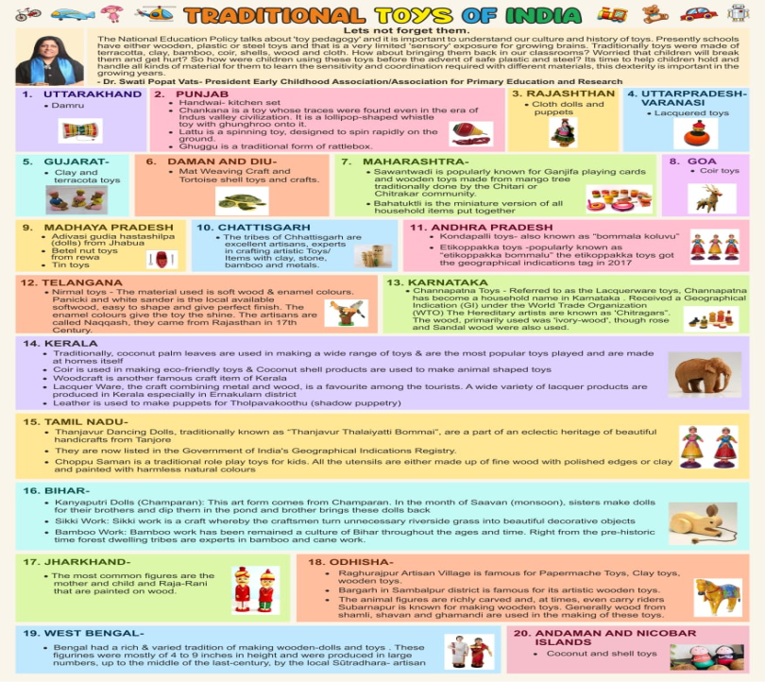

Slide 6

PREWRITING SKILLS-
The Triangle. The Circle. The Square- WARLI
Painting with Lines- Madhubani

Slide 7
PRE WRITING SKILLS-
Painting with dots
GOND
S.H.RAZA- THE BINDU

Slide 8
LEARNING THROUGH STORIES
Gijubhai Badeka pioneered learning through stories in education and in a story based curriculum there will be one core story intergral for each month.
The 6 (or 7) learning domains will be based from this core story.
Thus giving children a foundation of a story and understanding how topics and concepts are connected to what we hear, listen, read, do.
For the montly planning a web is created with the story at the center and all the 6 learning domains around it for the teachers to understand that the goal of the month is to encourage discussion and activities based on the web.

Slide 9
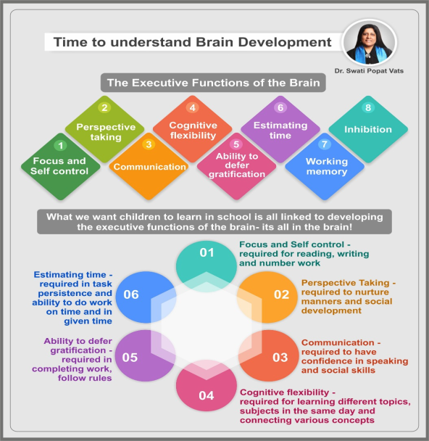
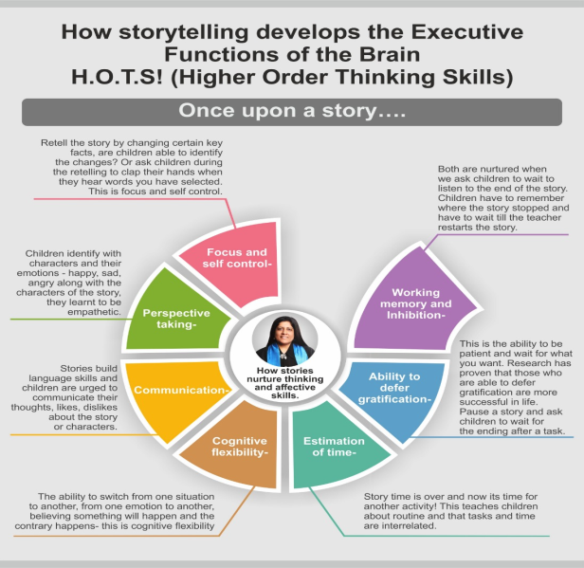
Gijubhai- Brain development and story based curriculum

Slide 10






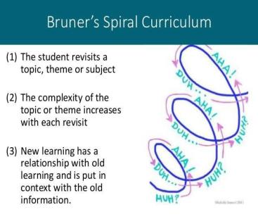

•

Slide 11
SPIRAL CURRIUCLUM
Having a story as the central theme of the month, helps make the curriculum a spiral curriculum, which means unlike the traditional concept of having one general knowledge topic or concept like animals or myself every month and then forgetting about it for the rest of the year, the spiral curriculum possible because of this will help children revisit a mix of concepts through out the year.
So myself can come 4 to 5 times a year and not just in one month.
It also helps children view the world with multiple concepts and not just with one concept.
So for example in a traditional school vehicles would be the concept of the month thus helping children focus only on vehicles but here the month would focus on vehicles, myself, colours etc as linked to the story.
Thus children will see emerging a connection in their every day life to all these concepts.

Slide 12
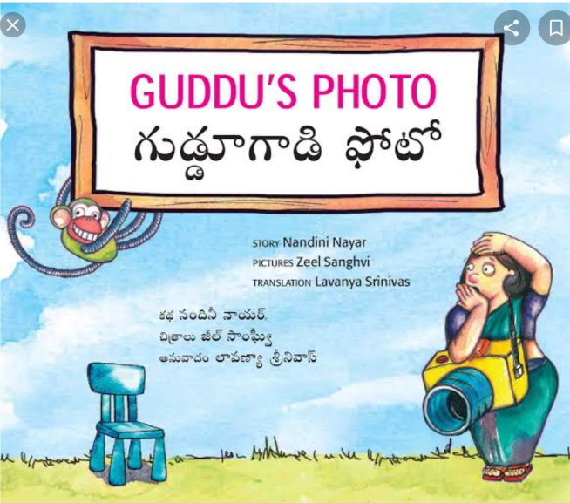

Bilingual story books

Slide 13
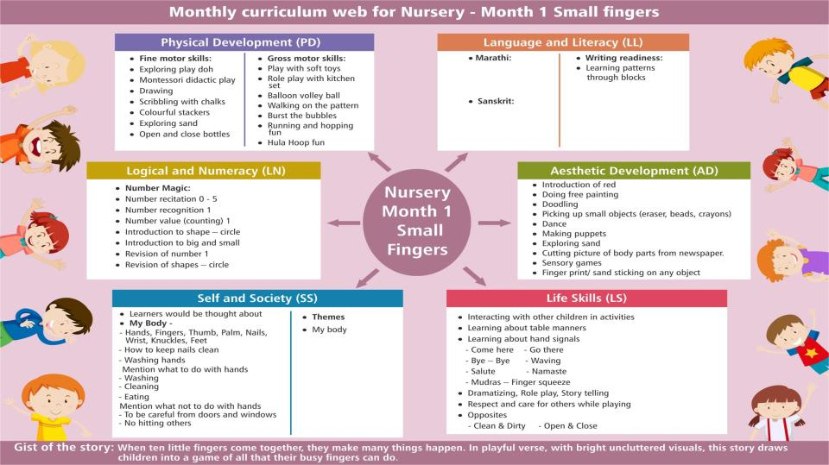

Slide 14
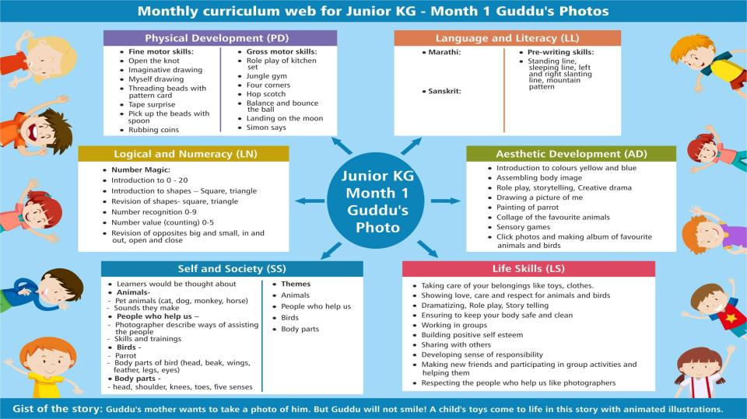

Slide 15
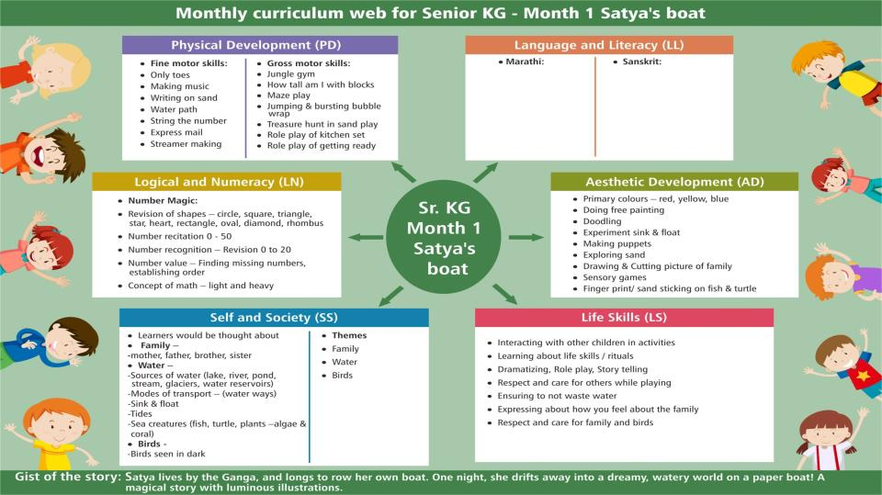

Slide 16
ASSESSMENT AND ZPD
CONTINOUS ASSESSMENT
ASSESSMENT LINKED TO DEVELOPMENT BEFORE KNOWLEDGE
PARENT PARTNERSHIP IN ASSESSMENT
ZPD AND THE LEARNING PIT

Slide 17

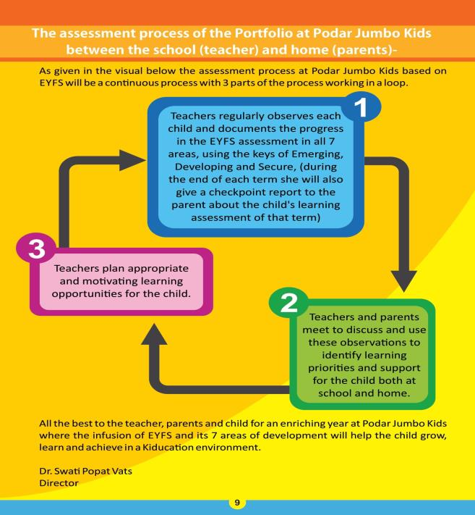

Slide 18
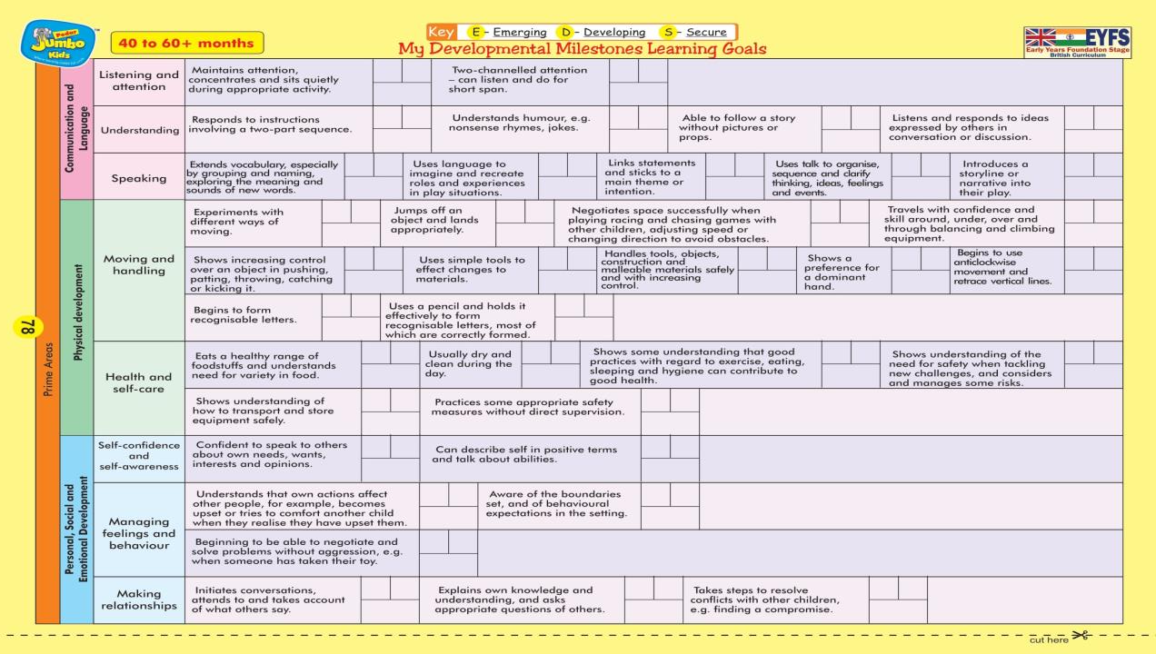

Slide 19
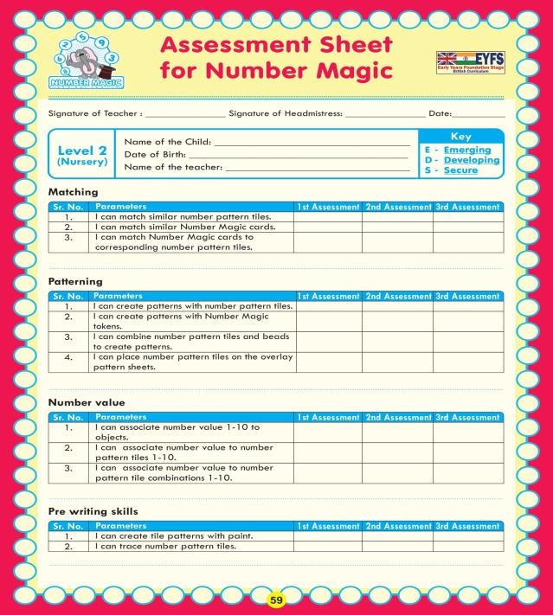
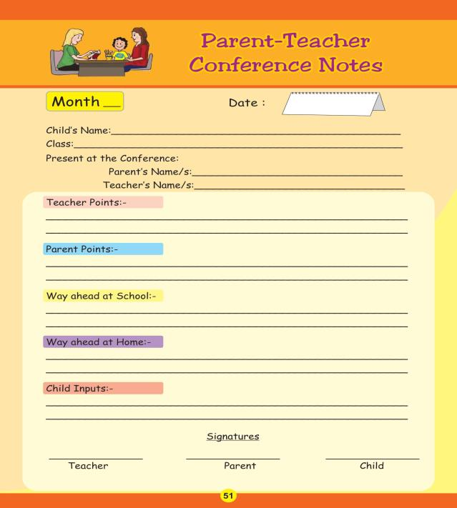

Slide 20
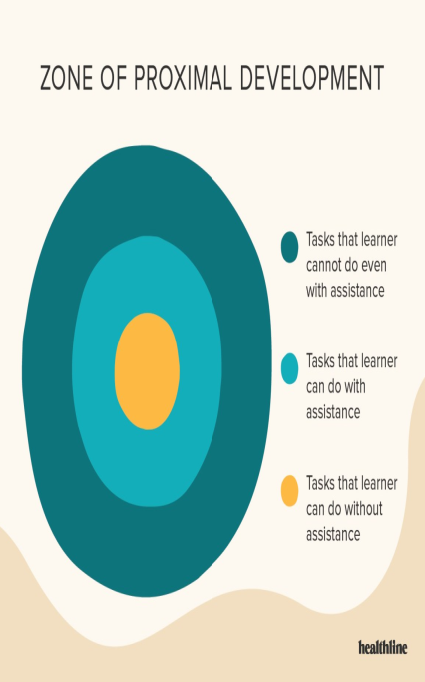
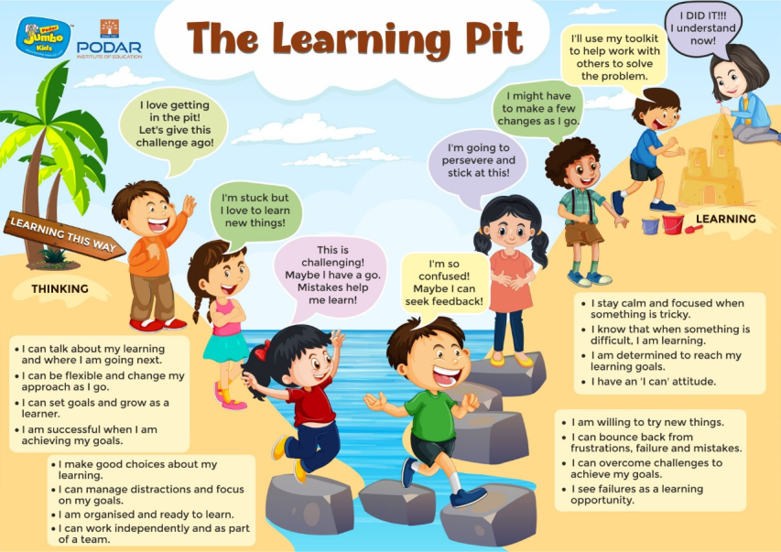

Slide 21
TEACHER TRAINING AND SKILL BUILDING
UNDERSTANDING THE ‘WHY’ OF TEACHING AND LEARNING
UNDERSTANDING BRAIN DEVELOPMENT FOR SOCIO-EMOTIONAL SKILLS
TEACHING STRATEGIES

Slide 22

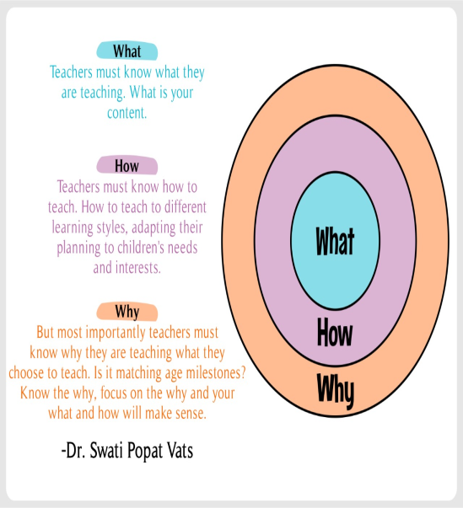

Slide 23
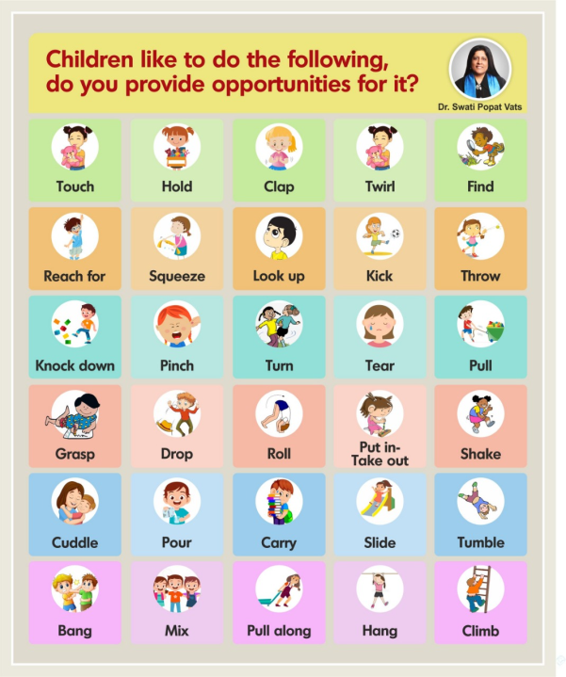
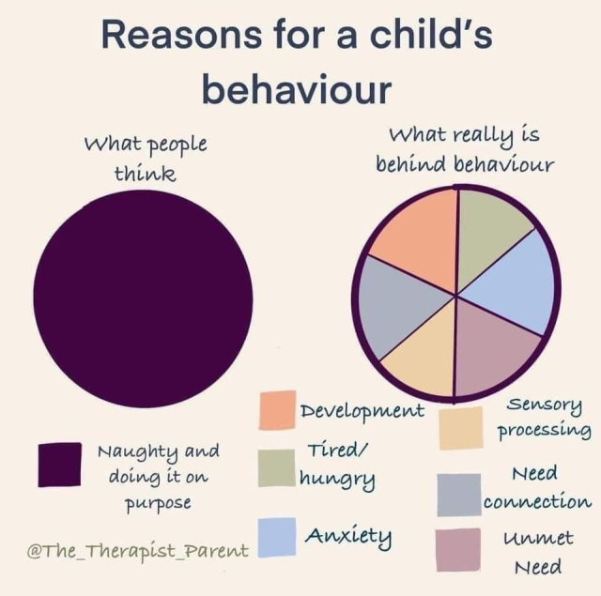

Slide 24
TEACHING STRATEGIES- NOT CHALK-TALK-CHARTS
KWL
K-W-L is an instructional reading strategy that is used to guide students through a text. Students begin by brainstorming everything they Know about a topic. This information is recorded in the K column of a K-W-L chart. Students then generate a list of questions about what they Want to Know about the topic. These questions are listed in the W column of the chart. During or after reading, students answer the questions that are in the W column. This new information that they have Learned is recorded in the L column of the K-W-L chart.
How to use the K-W-L strategy
Choose a text. This strategy works best with expository texts.
Create a K-W-L chart. The teacher should create a chart on the blackboard or on an overhead transparency. In addition, the students should have their own chart on which to record information. (Below is an example of a K-W-L chart.)
Ask students to brainstorm words, terms, or phrases they associate with a topic. The teacher and students record these associations in the K column of their charts. This is done until students run out of ideas.
K | W | L

Slide 25
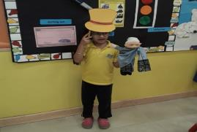
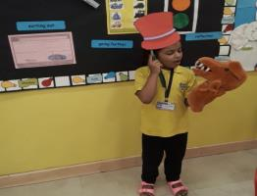
TEACHING STRATEGIES- NOT CHALK-TALK-CHARTS
Thinking hats
We have kept 3 coloured chits in a bowl and coloured hats
Take a chit and Groups will be made according to colour
Red Hat (emotion) – Find emotions in the story
Green hat (creativity)– Recreate the story
Black Hat ( Danger /problem) – Problems faced by the characters in the story.

Slide 26

THE TRIKONA
FOR ANY CURRICULUM TO BE SUCCESSFUL THE TRIKONA OF CURRICULUM-ASSESSMENT AND TEACHER TRAINING NEED TO GO HAND IN HAND.
THE BEST CURRICULUM WILL NOT BE IMPACTFUL IF THIS TRIKONA IS NOT DEVELOPED TOGETHER.
-DR. SWATI POPAT VATS
9819121384
ecapresidentindia@gmail.com

