Slide 1
Teaching Pedagogies in line with NEP 2020 and NCF 2022
Dr. Swati Popat Vats
President
Early Childhood Association
Association for Preparatory Education and Research

Slide 2
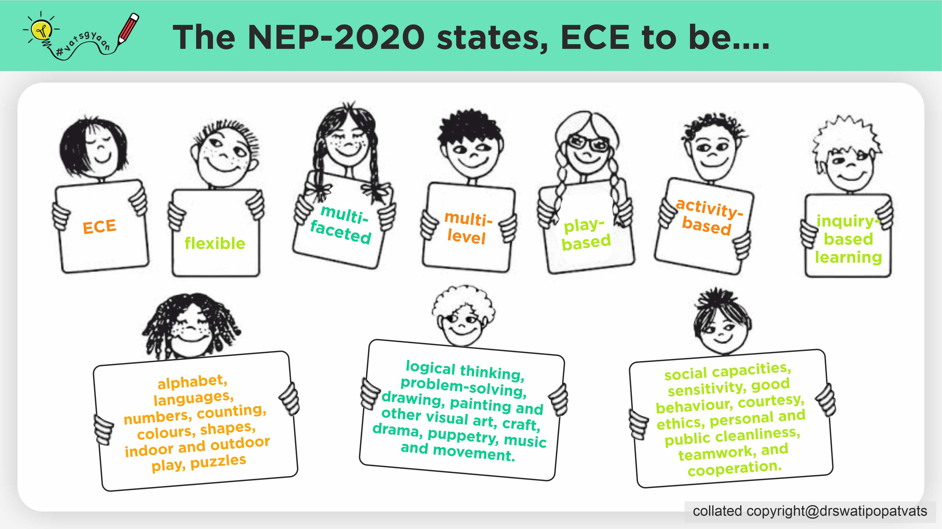

Slide 3


Slide 4


Slide 5
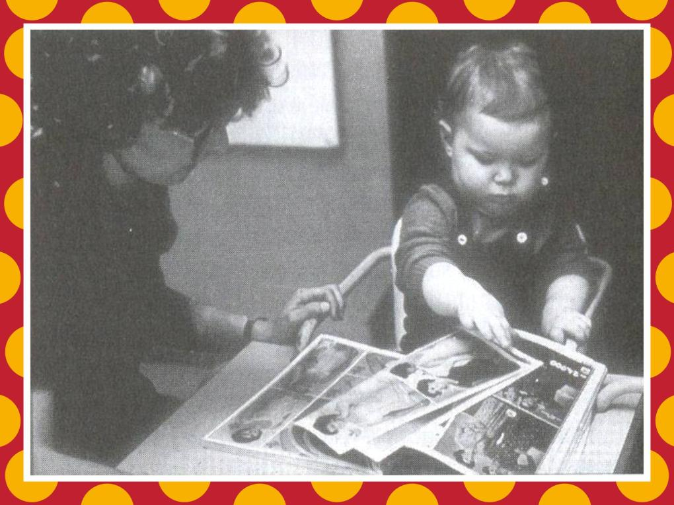
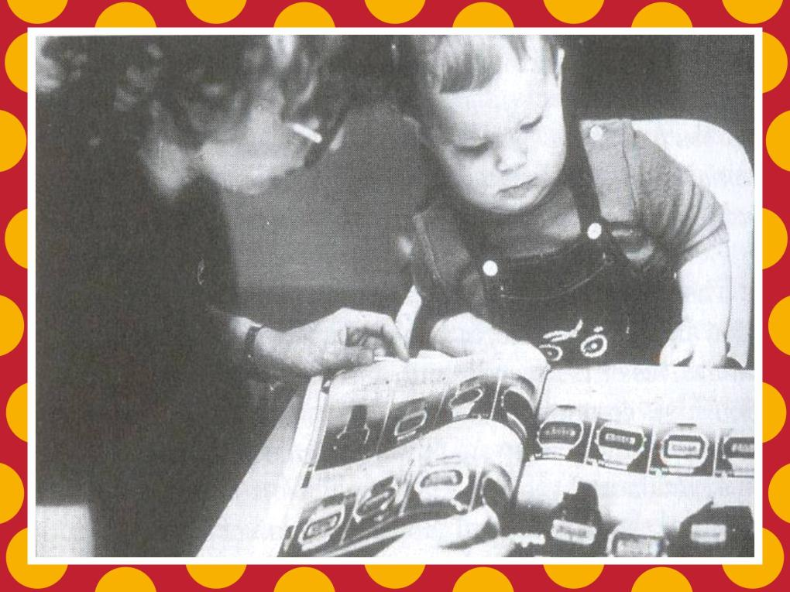
copyright@swatipopat@podar.org

Slide 6
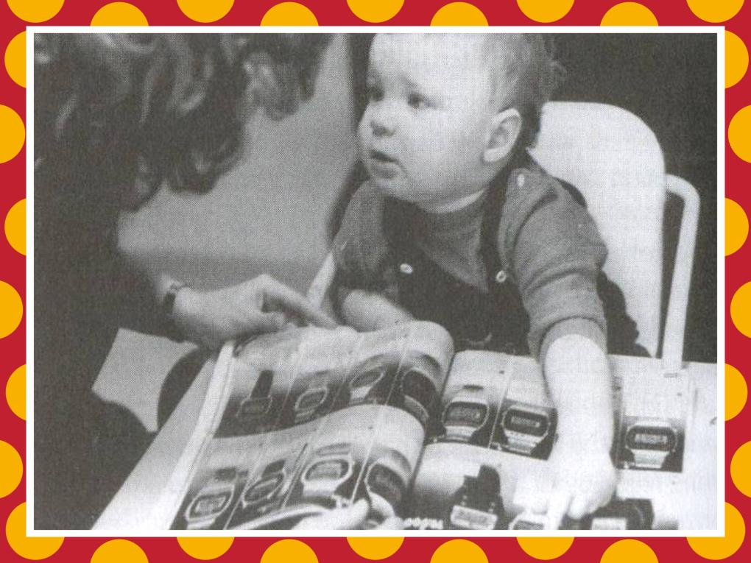
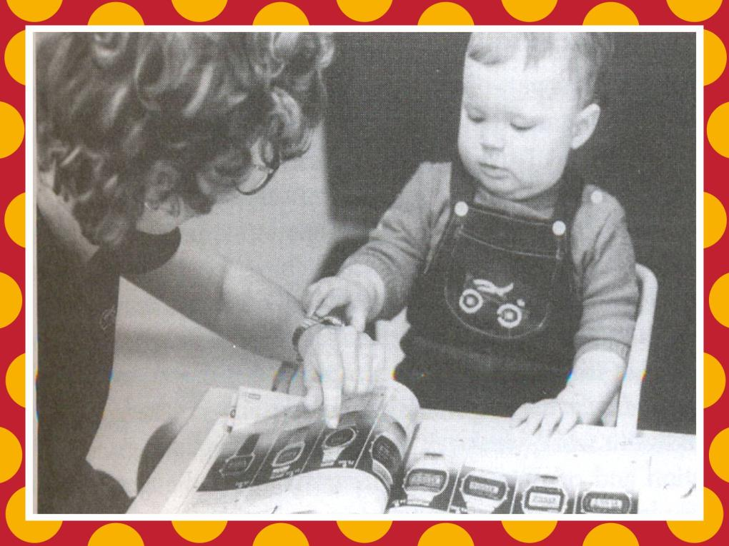
copyright@swatipopat@podar.org

Slide 7
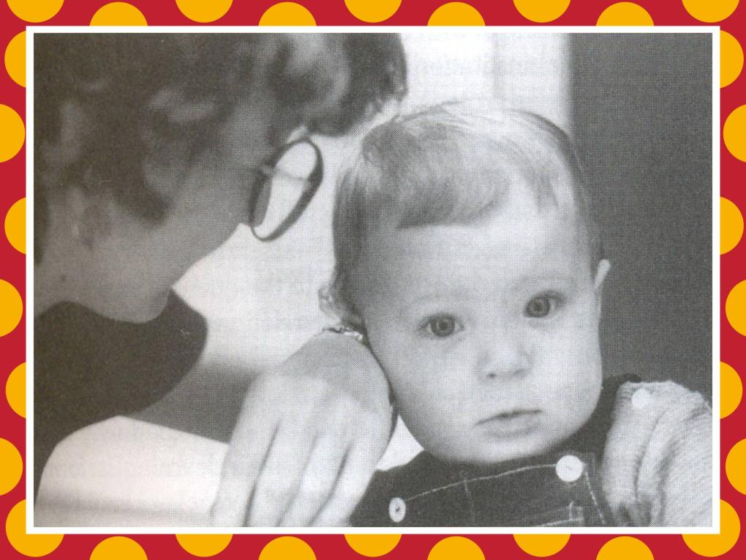
copyright@swatipopat@podar.org

Slide 8
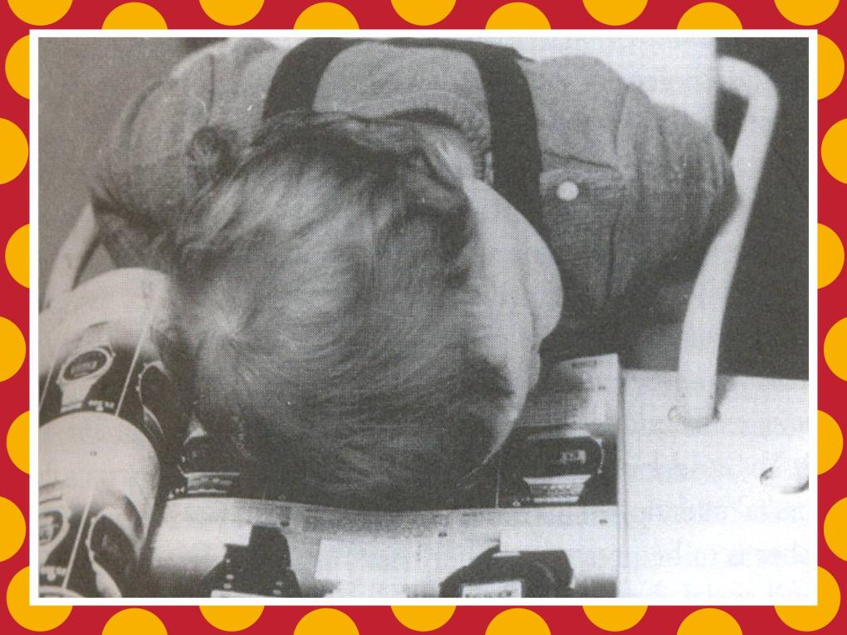
copyright@swatipopat@podar.org

Slide 10


Slide 11
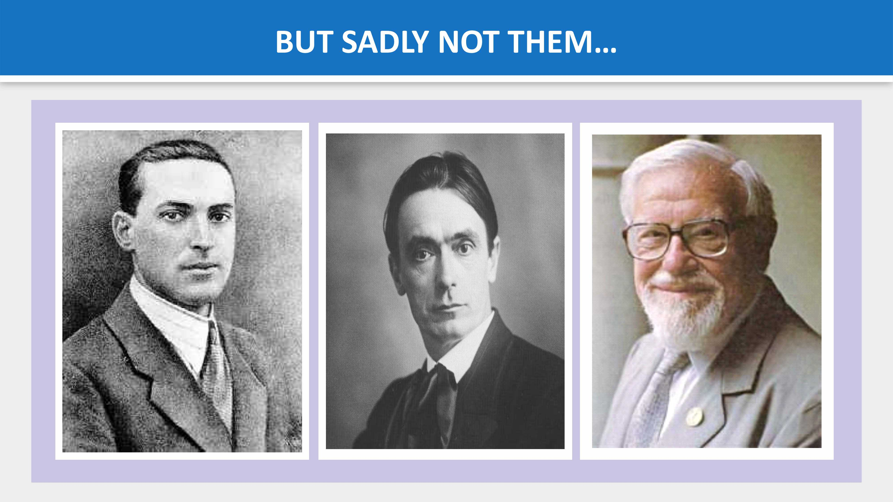

Slide 12
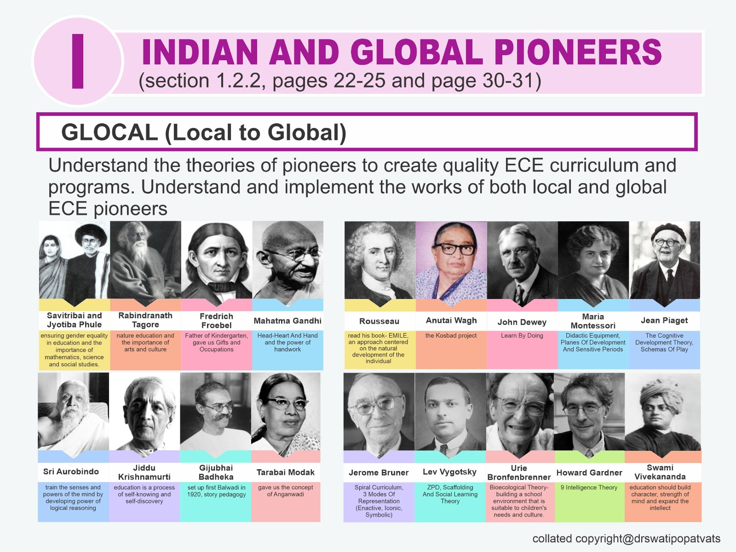

Slide 13
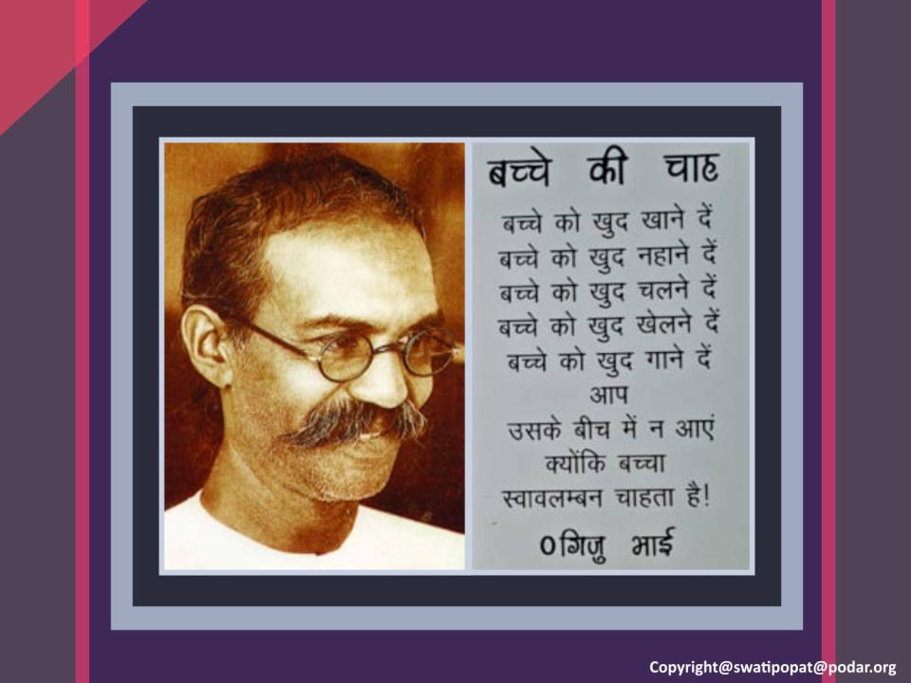

Slide 14
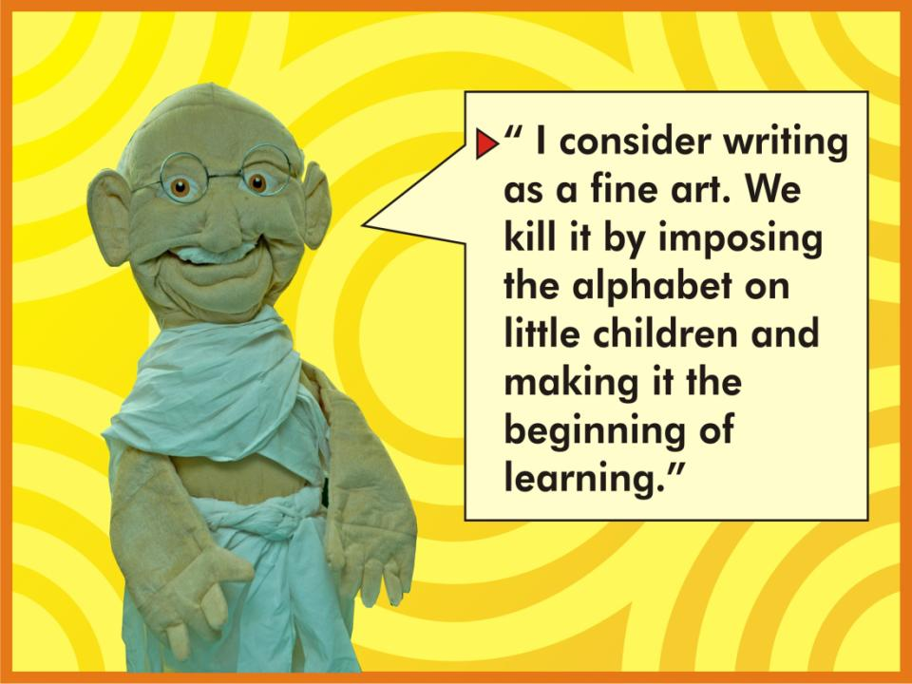
Copyright@swatipopat@podar.org

Slide 15
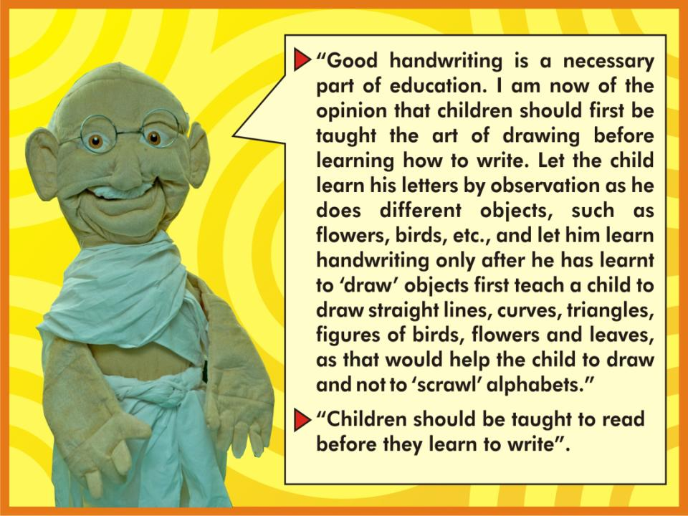
Copyright@swatipopat@podar.org

Slide 16


Slide 17
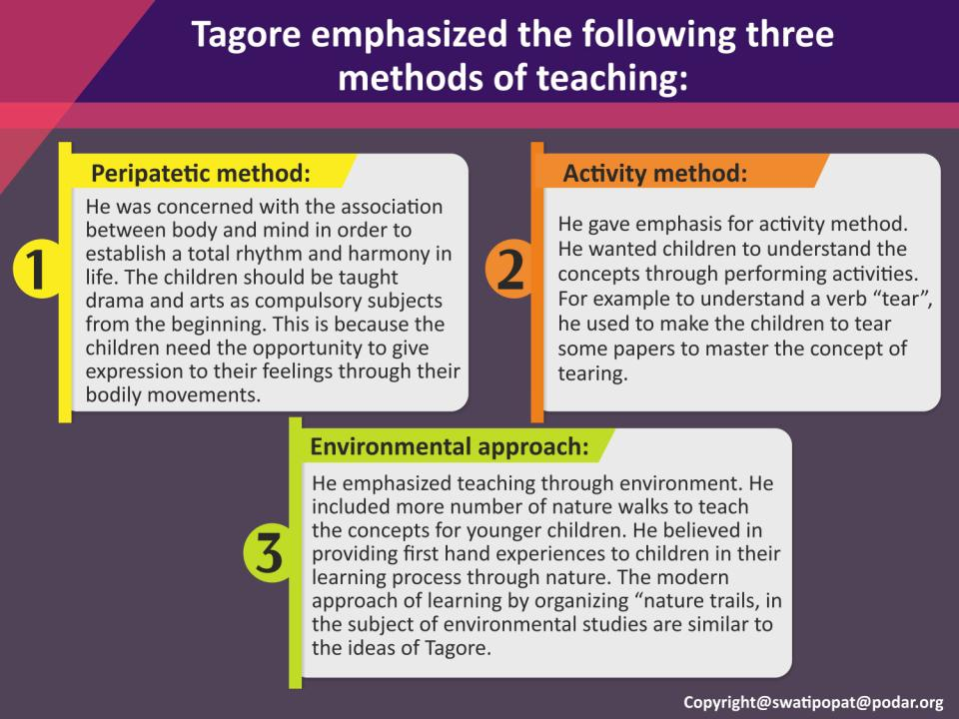

Slide 18
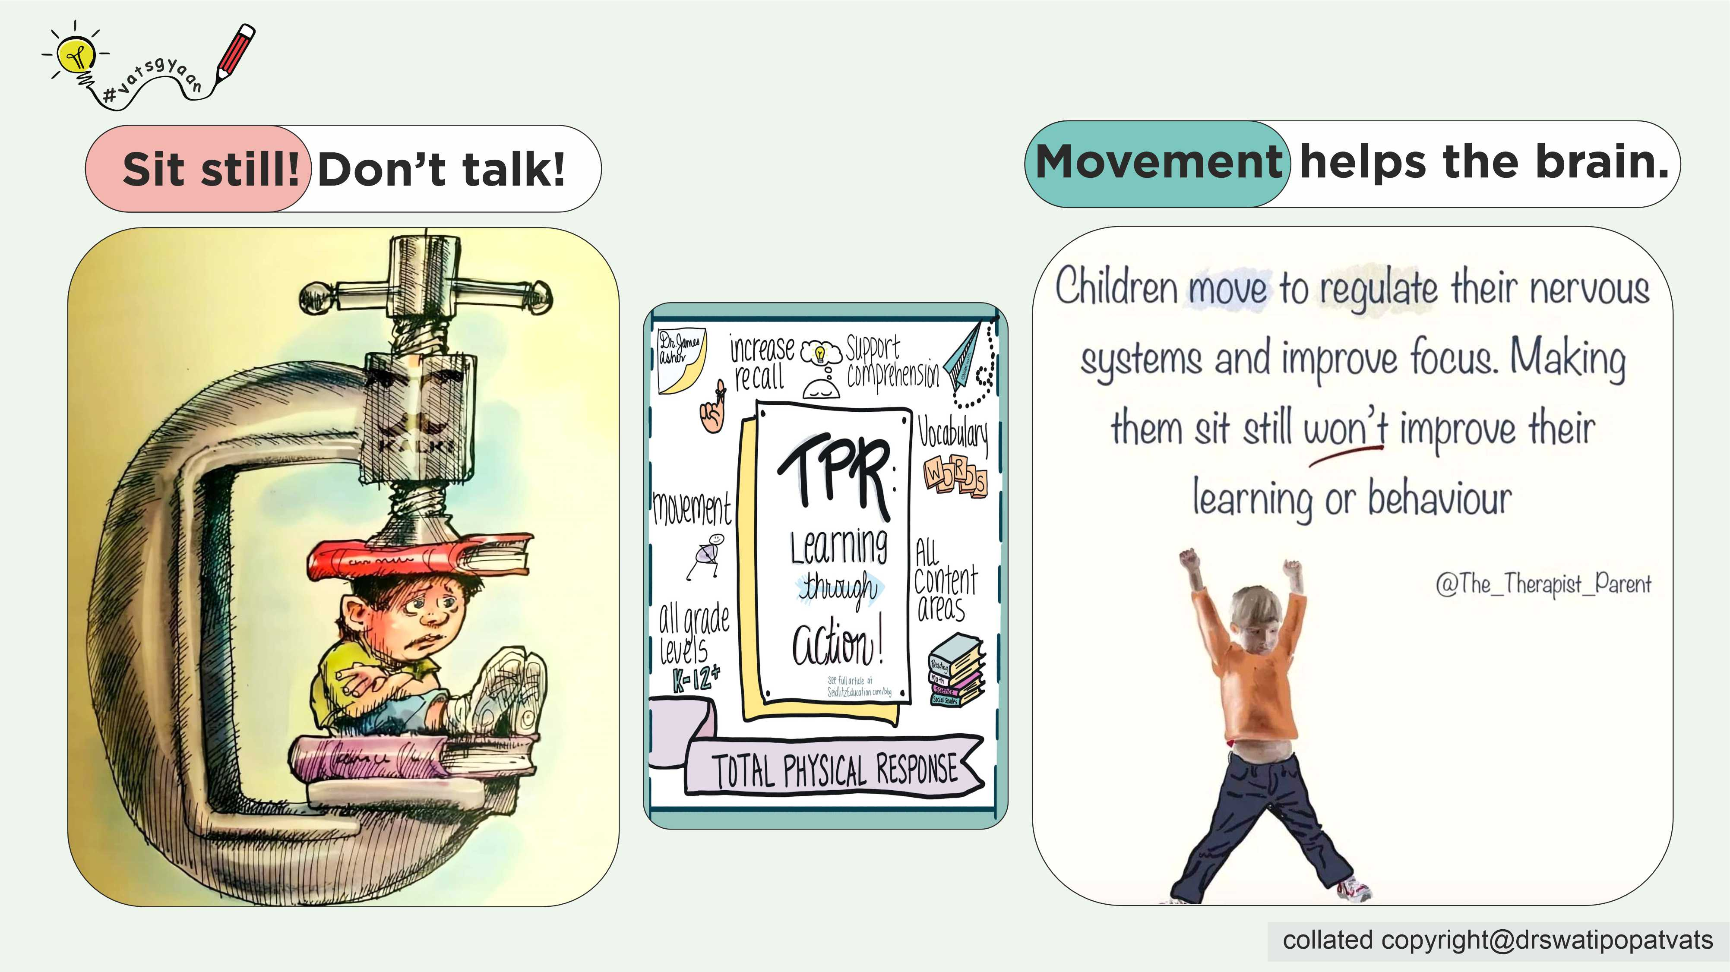

Slide 19
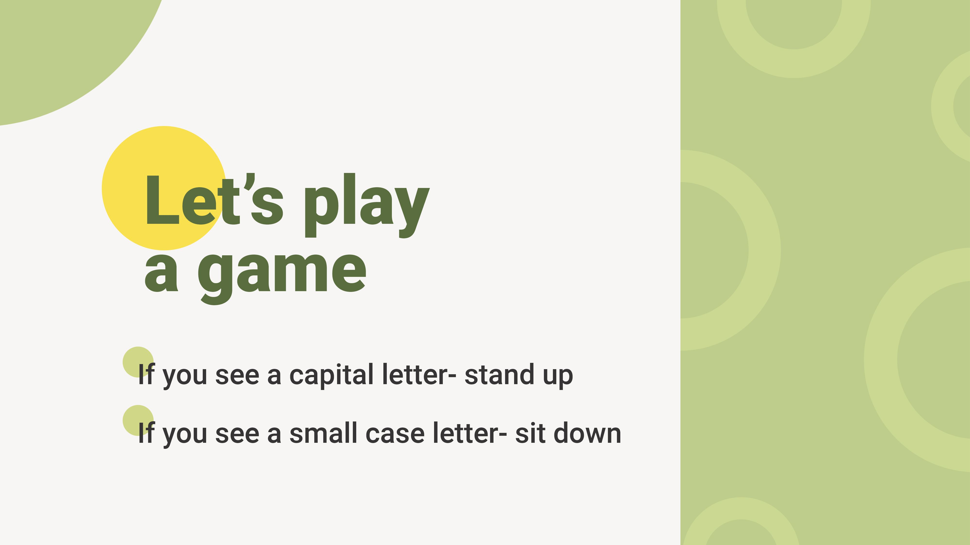

Slide 20


Slide 21


Slide 22


Slide 23
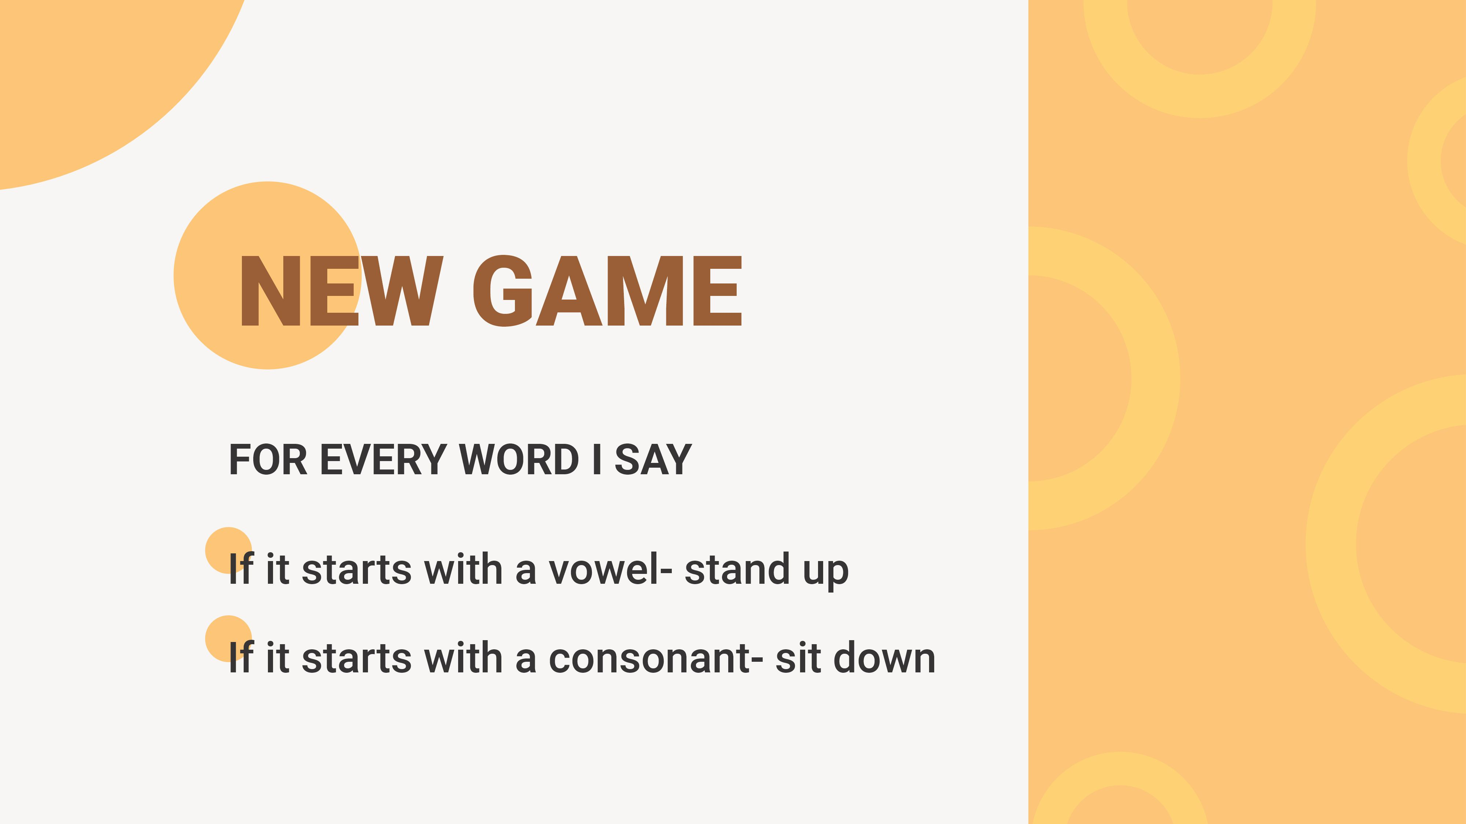

Slide 24
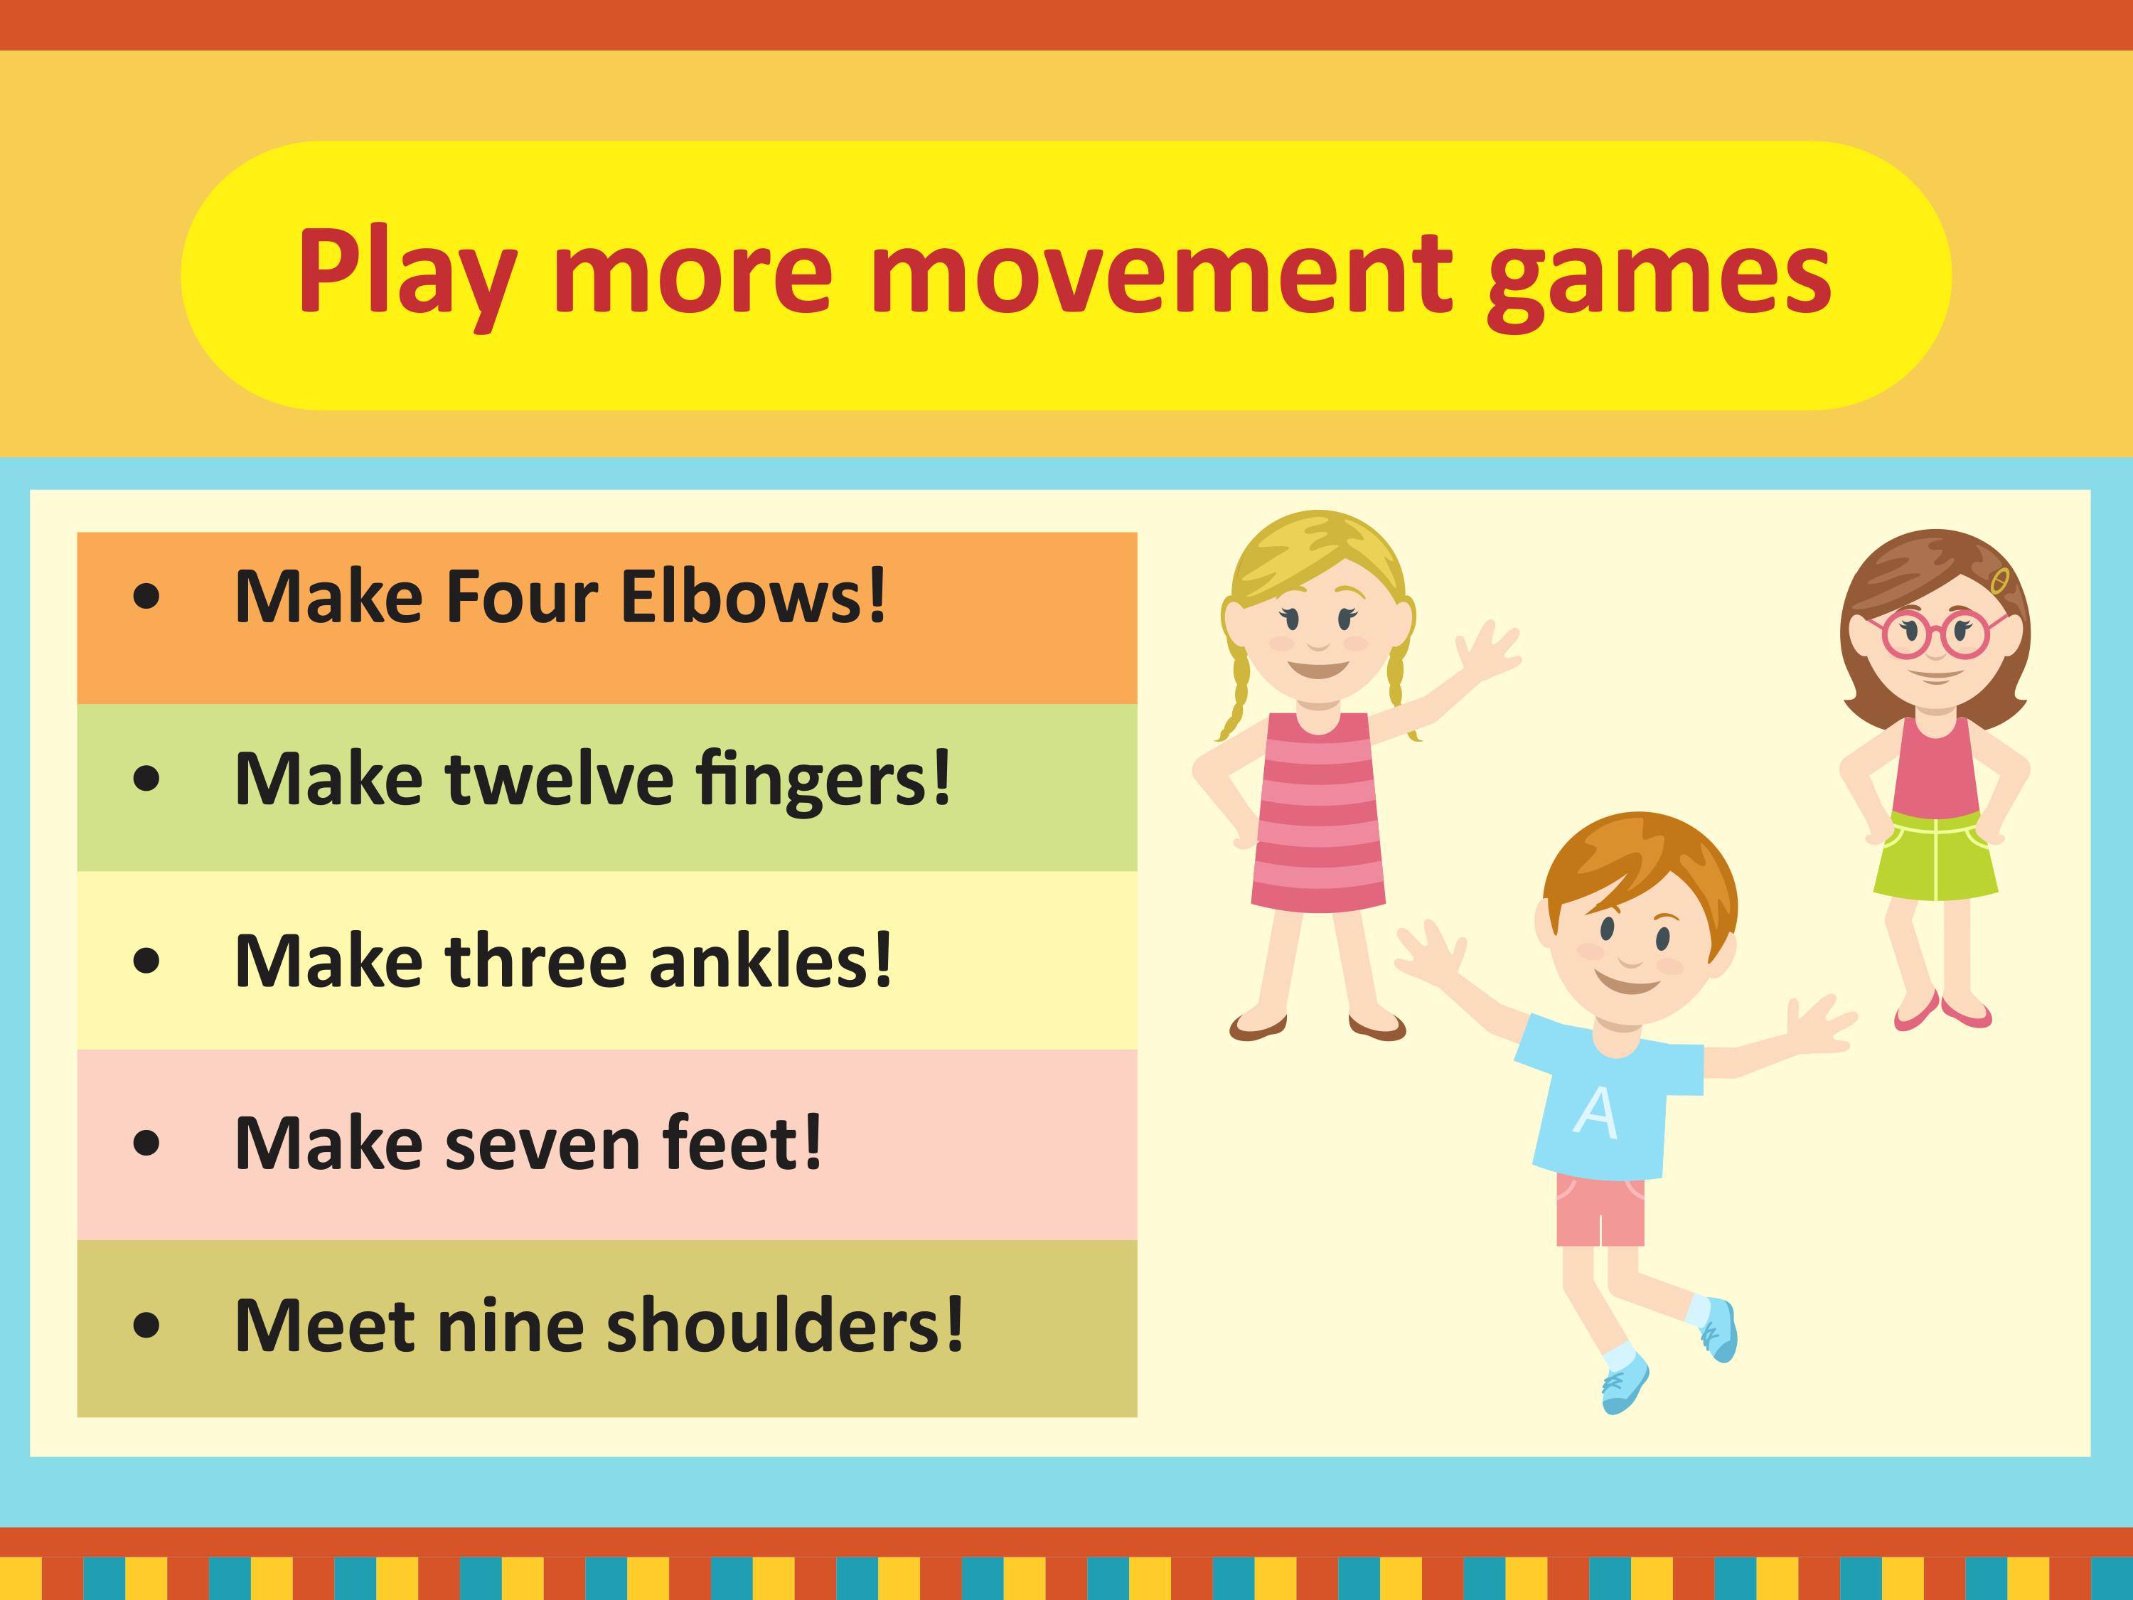
swatipopat@podar.org

Slide 25
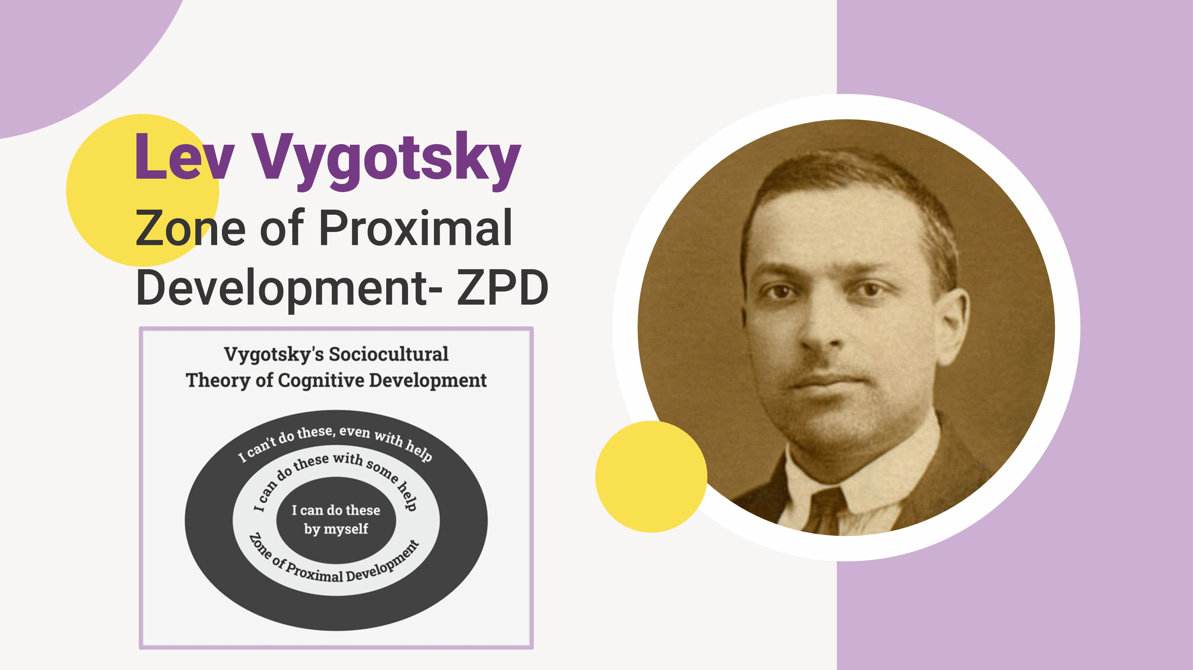

Slide 26
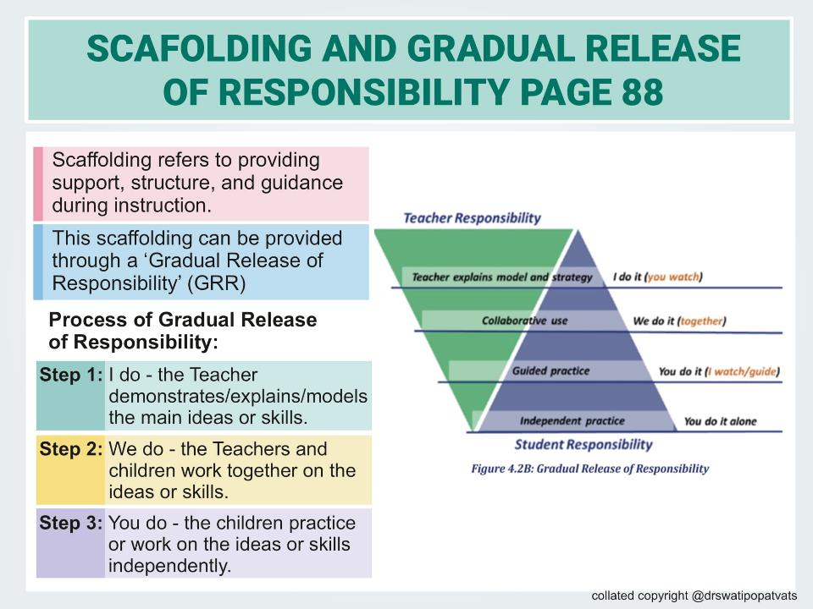

Slide 27
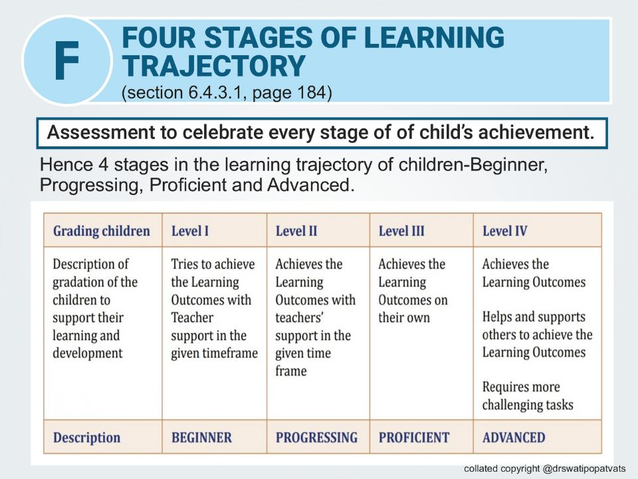

Slide 28


Lets use this with visuals
Beginner or Emerging
Progressing or Developing
Seed: Representing the initial stage of growth, where the child is just beginning to show signs of understanding or skill development.
Sprout: Symbolizing the early stages of growth, where the child is starting to demonstrate progress and development, but still requires support and nurturing.
Advanced
Proficient
Fruit-bearing Tree: Embodying the stage where the child has not only mastered the skill or concept but is also able to apply it in new and innovative ways, demonstrating a high level of understanding and expertise.
Blooming Flower: Representing the stage where the child has developed a strong foundation and is consistently demonstrating proficiency in the skill or concept.
copyright @ drswatipopatvats@gmail.com

Slide 29
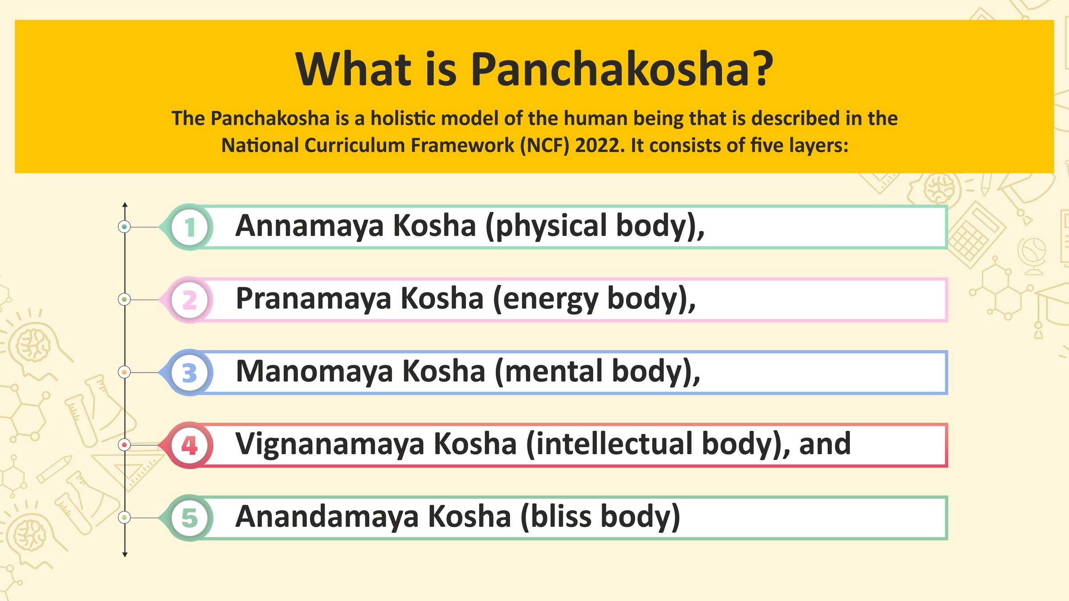
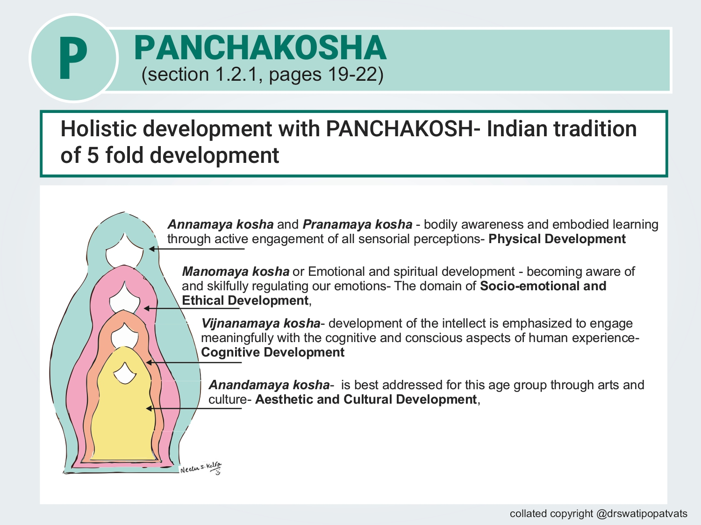

Slide 45
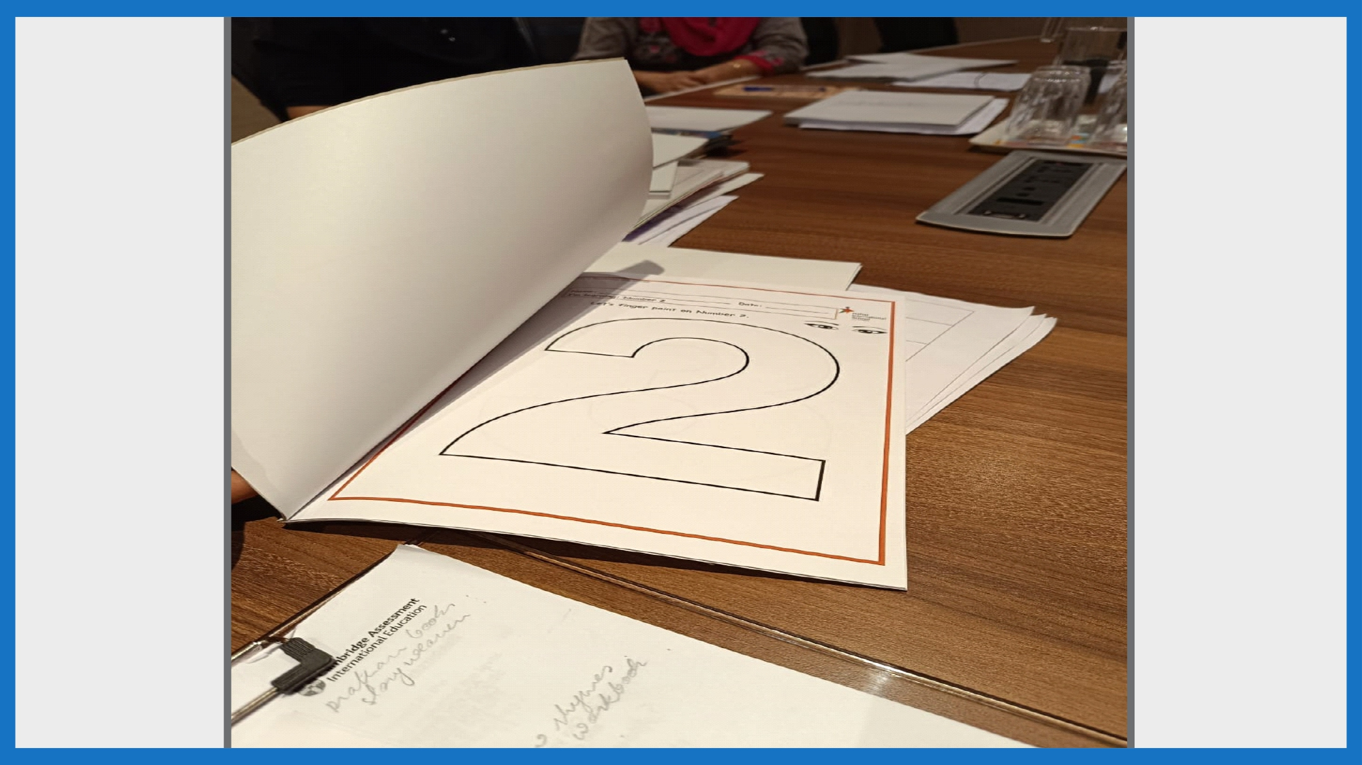

Slide 46
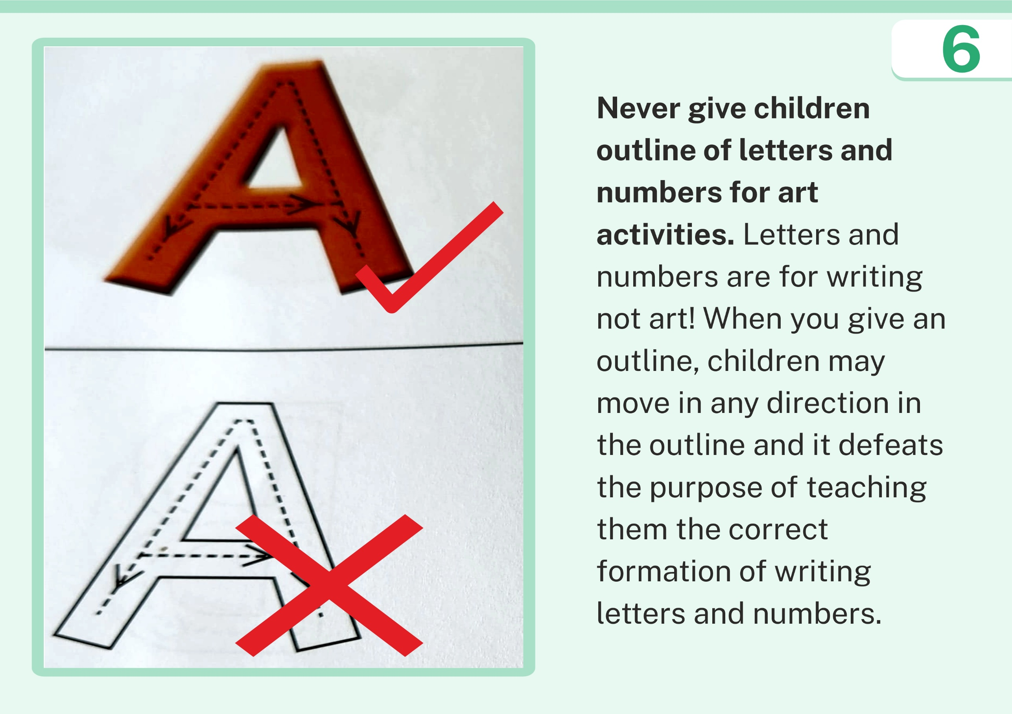

Slide 47


Slide 48
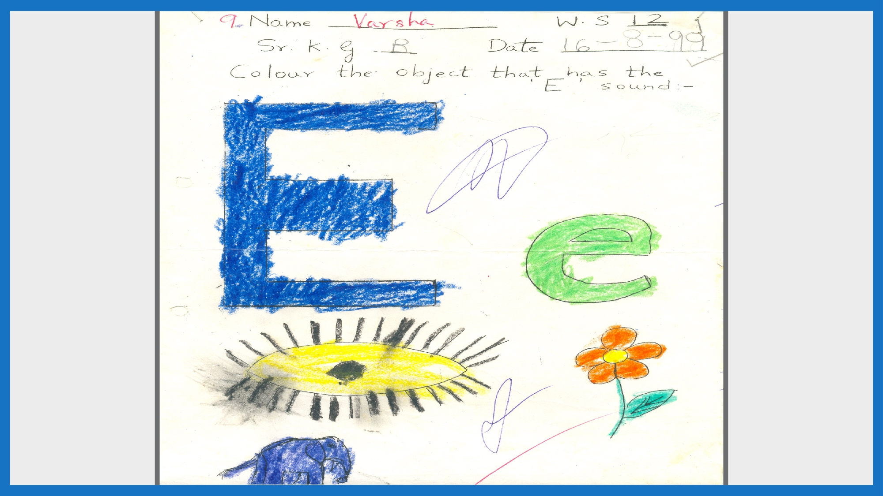

Slide 49
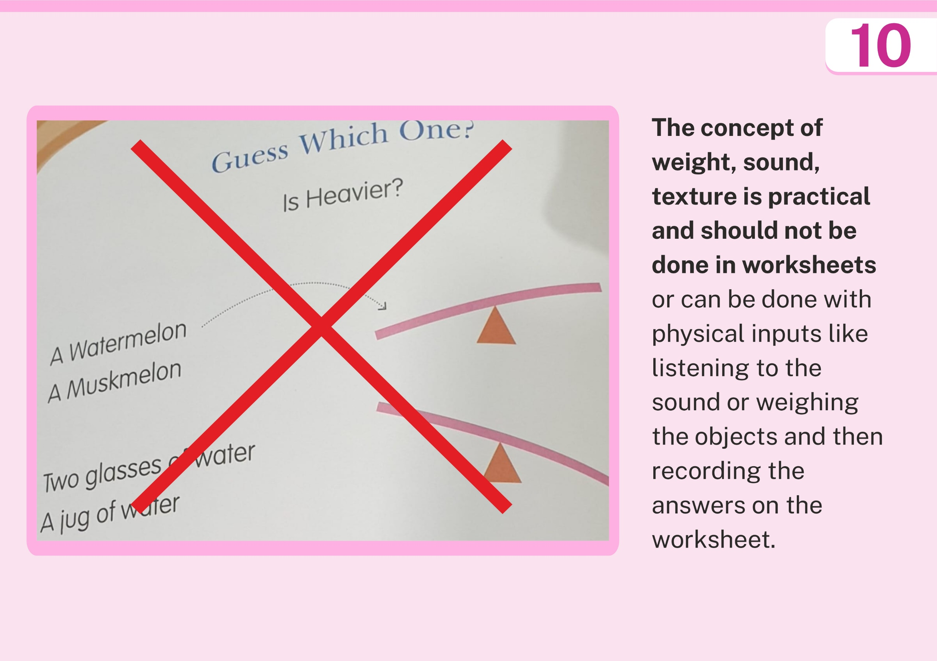

Slide 50
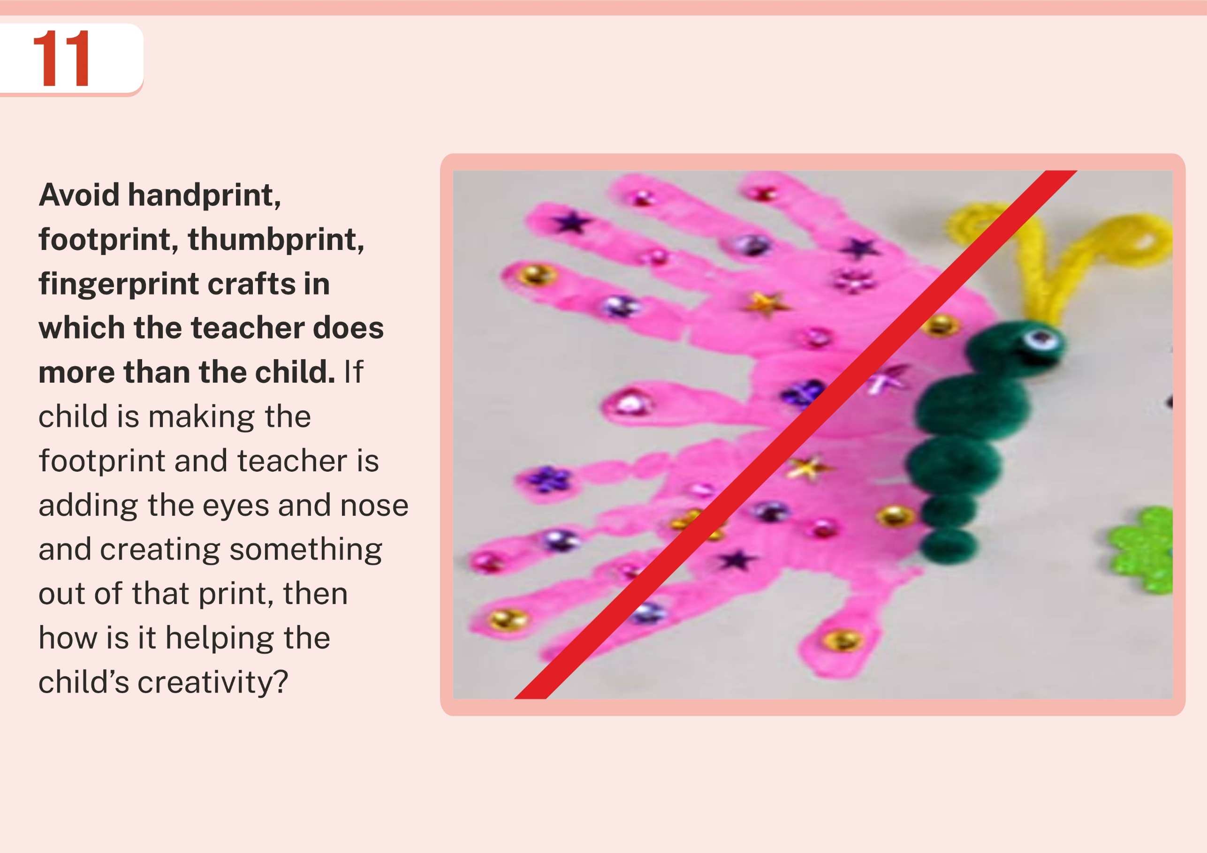

Slide 51
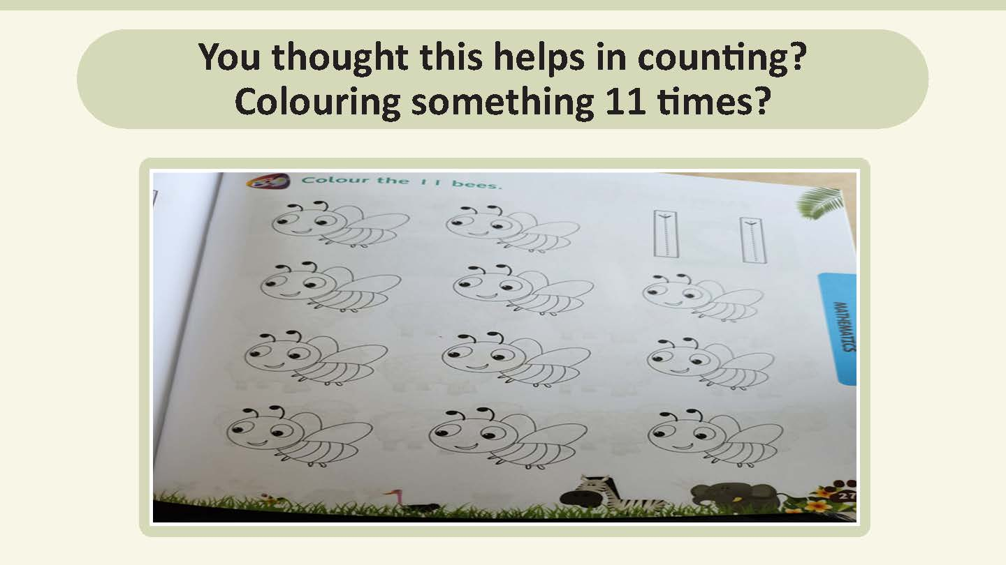

Slide 52
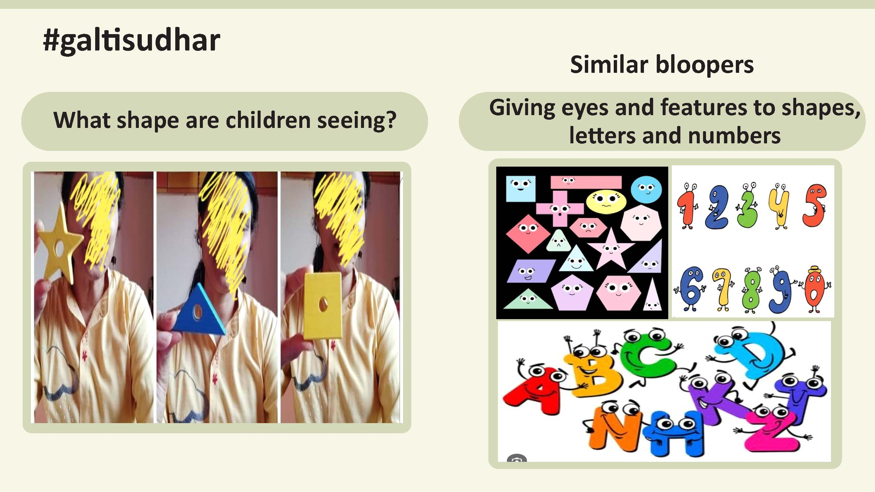

Slide 53


Slide 54

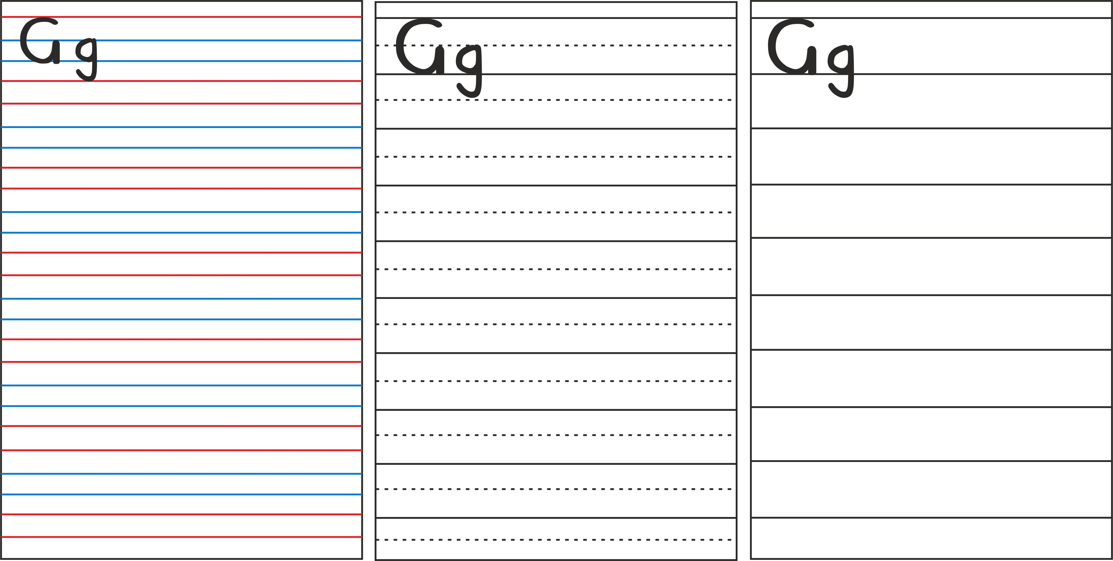
It is like a single line
There is a dotted line in the middle
All small letters are written below the dotted middle line
And all hanging letters are written till the next dotted line
This teachers children the exact size and formation of all capital and small letters
When children learn to write in the three line format, the dotted line is removed and voila your child is writing on the single line.
Simple, easy and no tears!

Slide 55
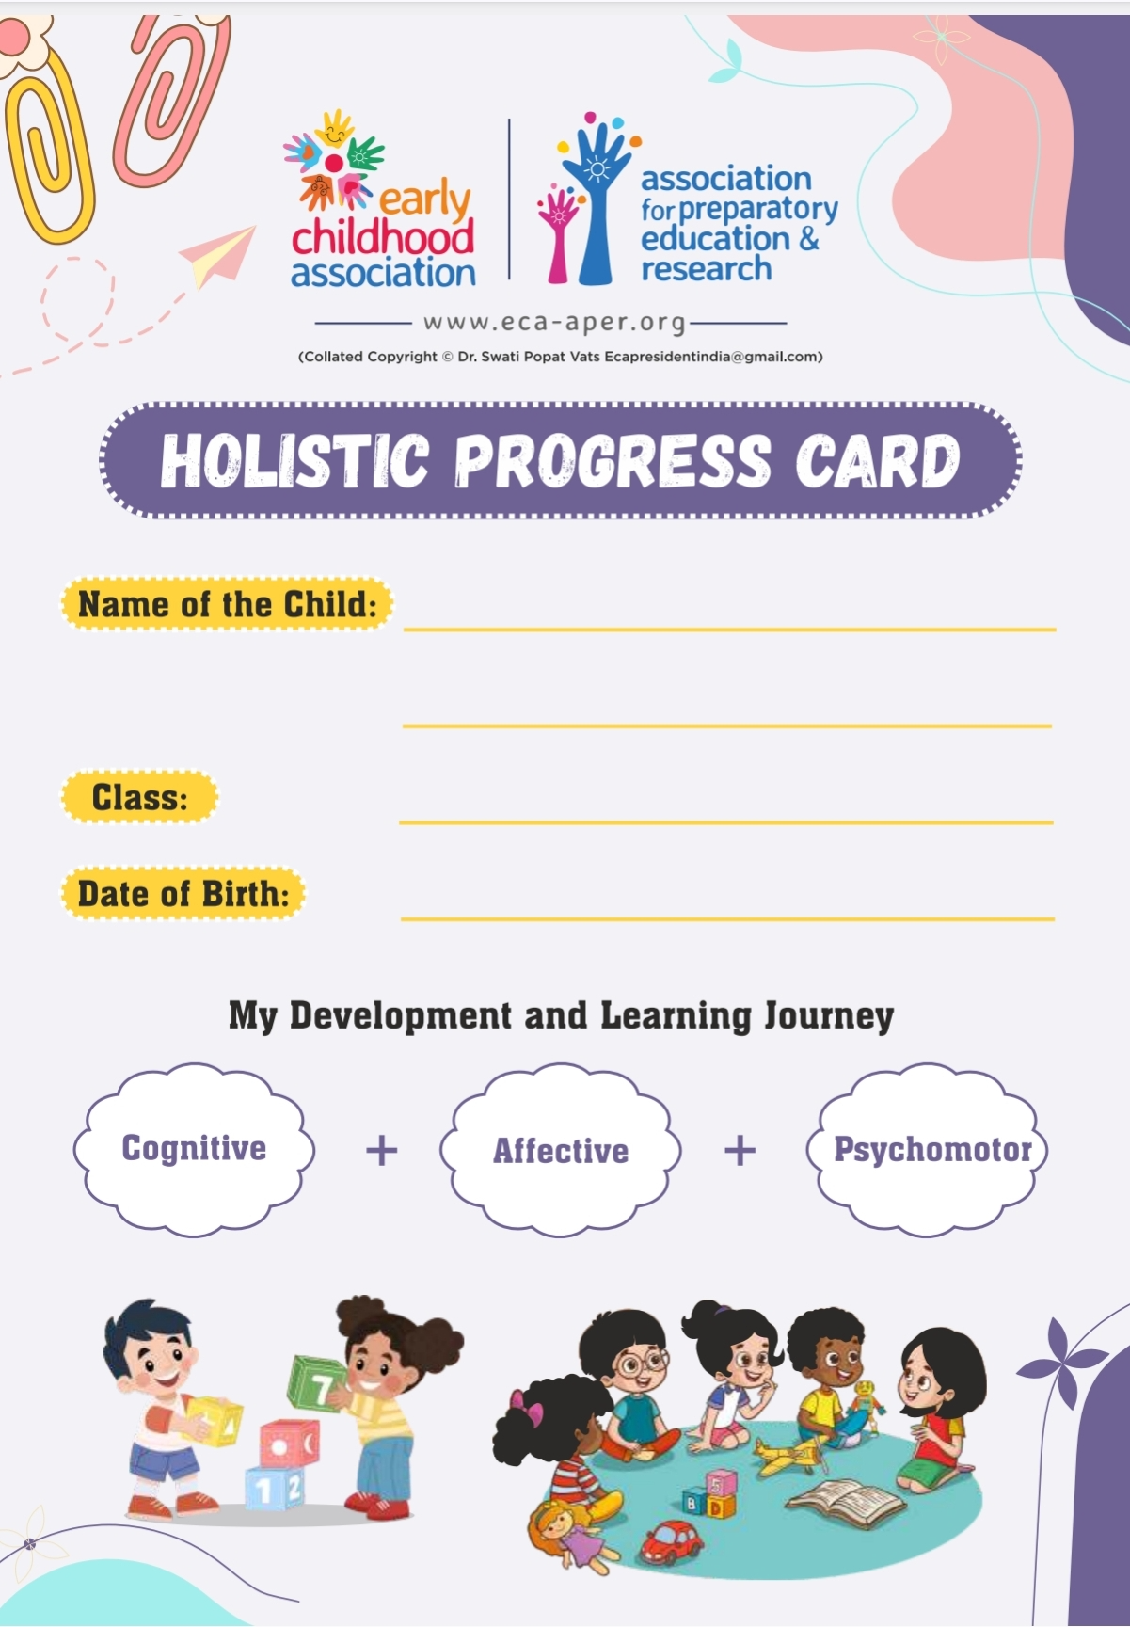

For a sample copy of HPC and video of HPC write to ecapresidentindia@gmail.com

Slide 56


