Slide 1

Global Early Childhood Education Theories and their synergy with the IB curriculum
Dr. Swati Popat Vats President
Early Childhood Association
Podar Education Network

Slide 2

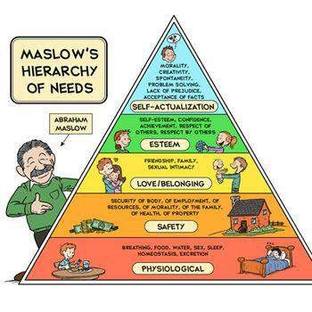

ABRAHAM MASLOW- understanding the hierarchy of needs
In the IB curriculum the unhurried agenda
and care for children sets the stage to achieve the hierarchy of
needs

Slide 3

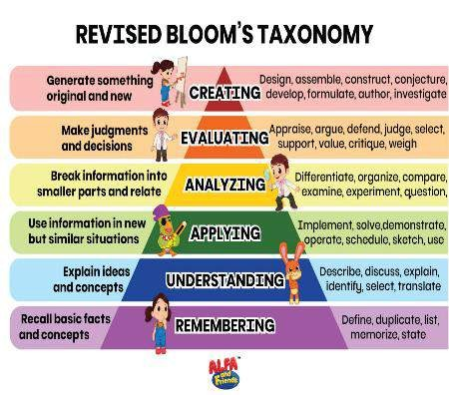

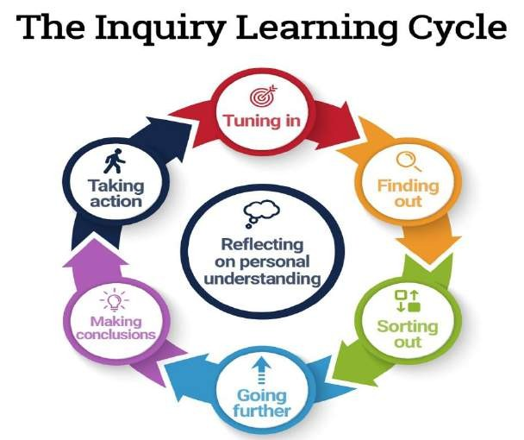
BLOOM’s TAXONOMY

Slide 4

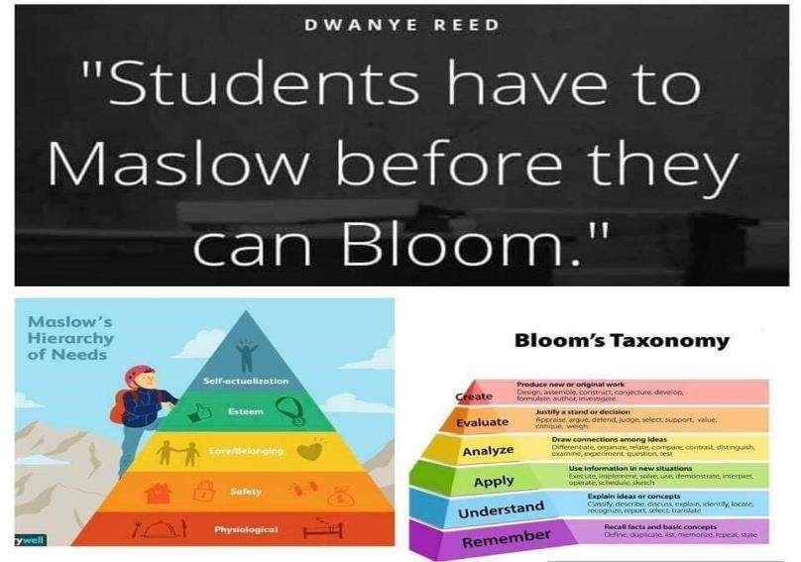


Slide 5


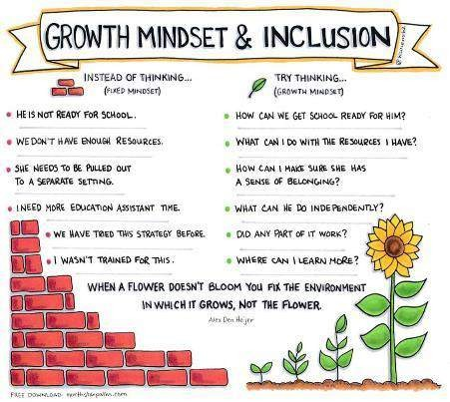
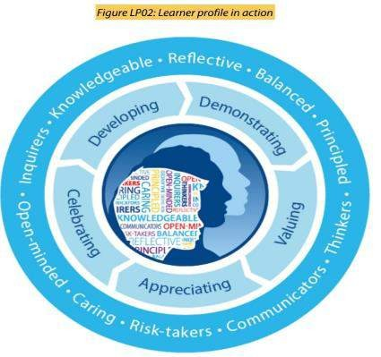
CAROL DWECK- Growth v/s Fixed Mindset

Slide 6

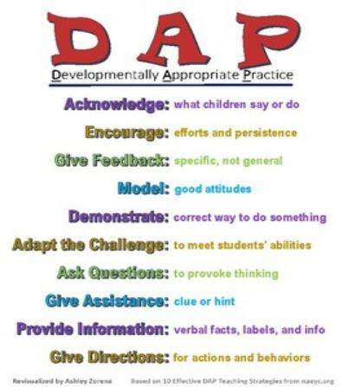

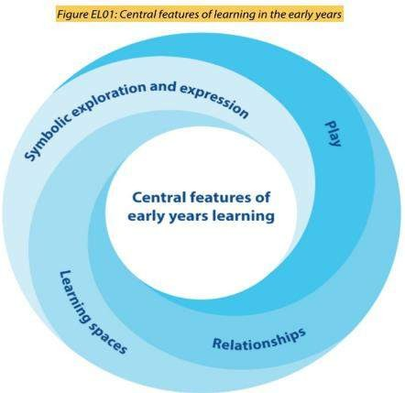
DAP- Developmentally Appropriate Practice

Slide 7


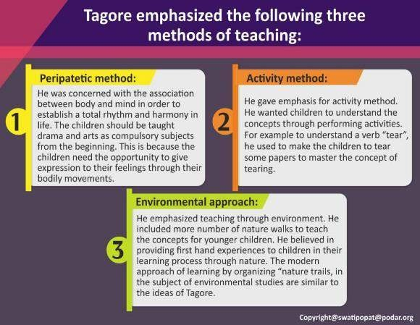






RABINDRANATH TAGORE- educational philosophy
Inquiry
Action
Nature advocacy Skills for thinking Working with others
Managing self
Communicating

Slide 8


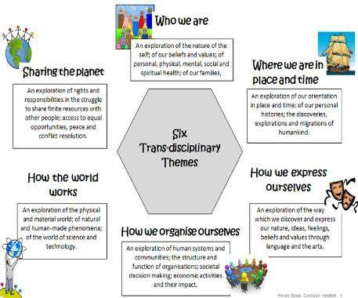
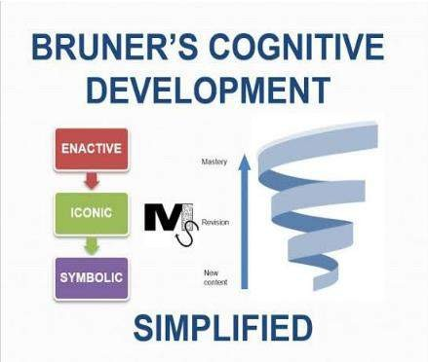
JEROME BRUNER- spiral curriculum and the CPA model

Slide 9

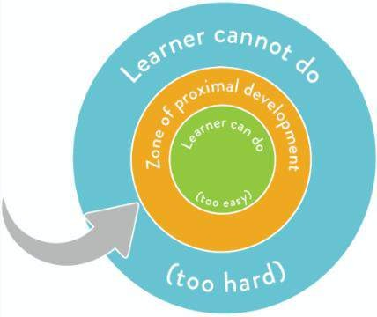

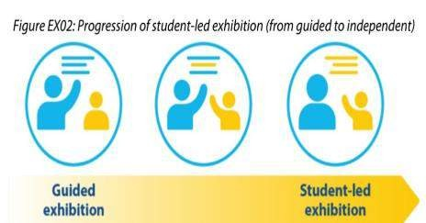
LEV VYGOTSKY-
ZONE OF PROXIMAL DEVELOPMENT

Slide 10


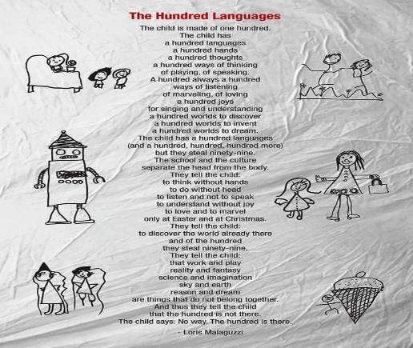

REGGIO EMILIA- 100 languages of children.

Slide 11

© International Baccalaureate Organization 2020
International Baccalaureate® | Baccalauréat International® | Bachillerato Internacional®

